Slide 1
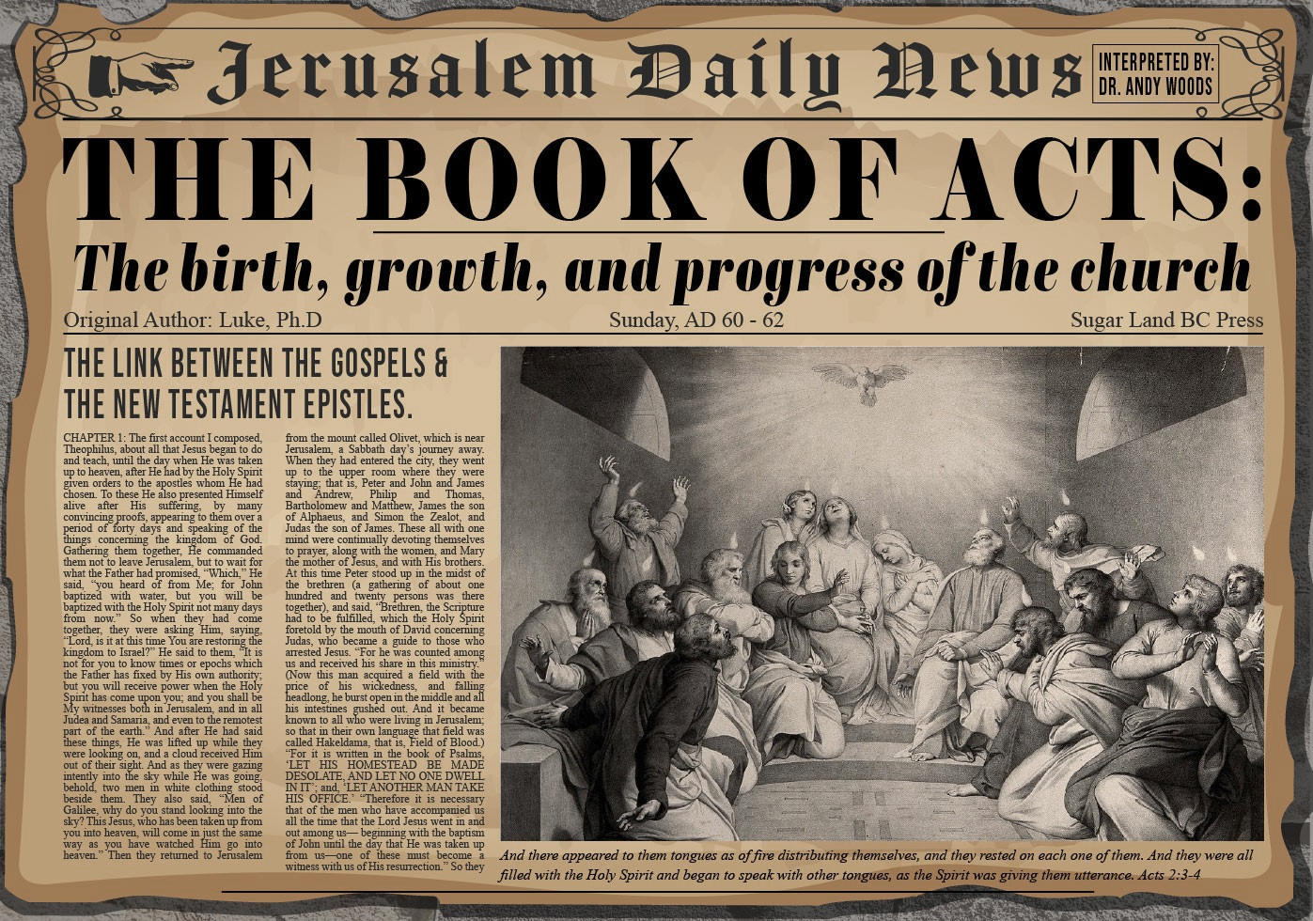
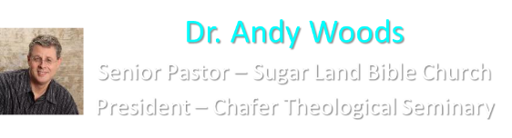

Slide 2
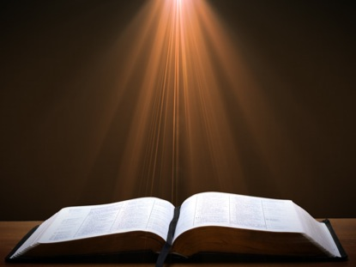
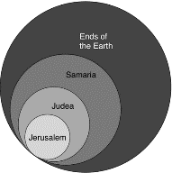
Acts 1:8
“but you will receive power when the Holy Spirit has come upon you; and you shall be My witnesses both in Jerusalem, and in all Judea and Samaria, and even to the remotest part of the earth.”

Slide 3
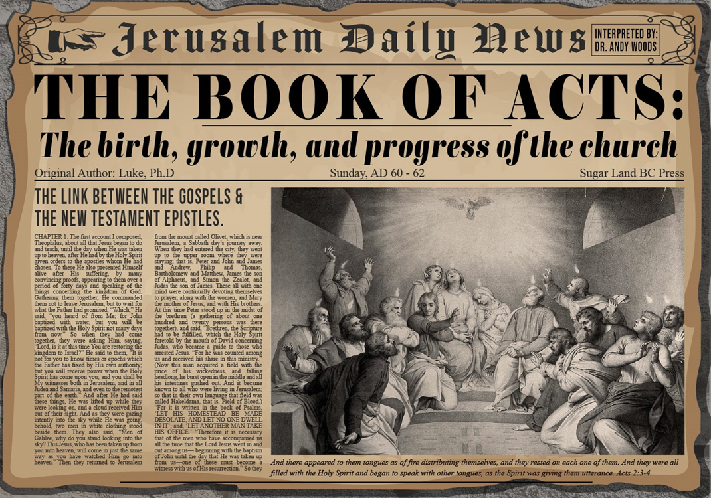
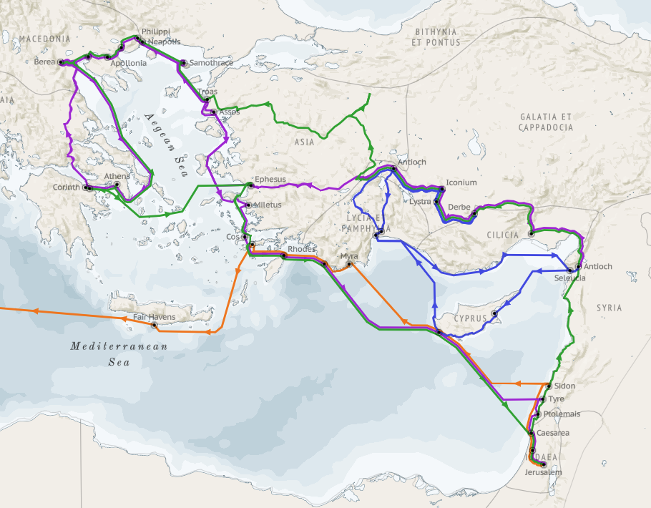
Structure (Acts 1:8)
  Jerusalem (Acts 1–7)
  Judea and Samaria (Acts 8–12)
  Remotest part of the earth (Acts 13–28)
  1st missionary journey (Acts 13–14)
  Jerusalem council (Acts 15:1-35)
  2nd missionary journey (Acts 15:36 –18:22)
  3rd missionary journey (Acts 18:23–21:17)
  Trip to Rome (Acts 21:18–28:31)

Slide 4
Acts 13‒14
1st Missionary Journey
  Paul & Barnabas’ appointment (13:1-3)
  Cyprus ministry (13:4-12)
  Pisidian Antioch ministry (13:13-52)
  Iconium ministry (14:1-7)
  Lystra ministry (14:8-20a)
  Derbe ministry (14:20b-21a)
  Return to Antioch (14:21b-28)

Slide 5
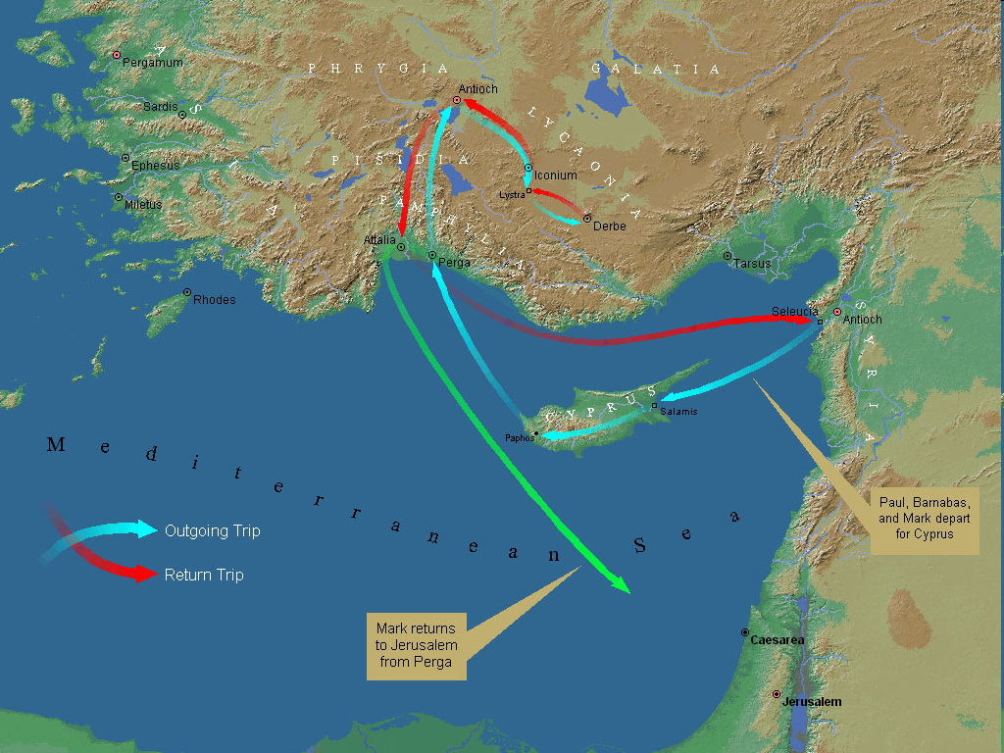
First Missionary Journey

Slide 6
III. Pisidia Antioch Ministry
Acts 13:13-52
  Journey to Pisidian Antioch (13-15)
  Paul’s message (16-41)
  Results of Paul’s message (42-52)

Slide 7
Acts 13:16-41
Paul’s Message
      Introduction (16)
      Historical background (17-22)
      Messiah (23-25)
      Gospel (26-29)
      Resurrection (30-37)
      Application to Paul’s audience (38-39)
      Warning (40-41)

Slide 8
Acts 13:17-22
Historical Background
      Exodus (17)
      Wilderness wanderings (18)
      Conquest (19)
      Judges (20)
      Saul (21)
      David (22)

Slide 9
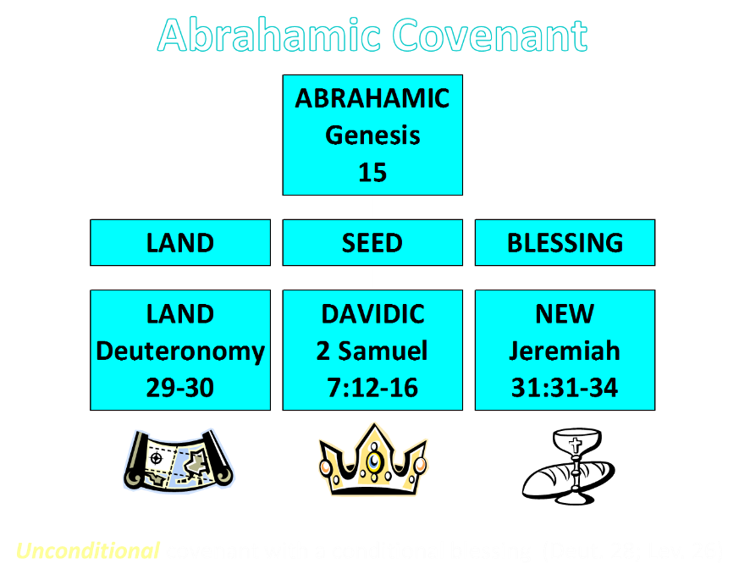

Slide 10
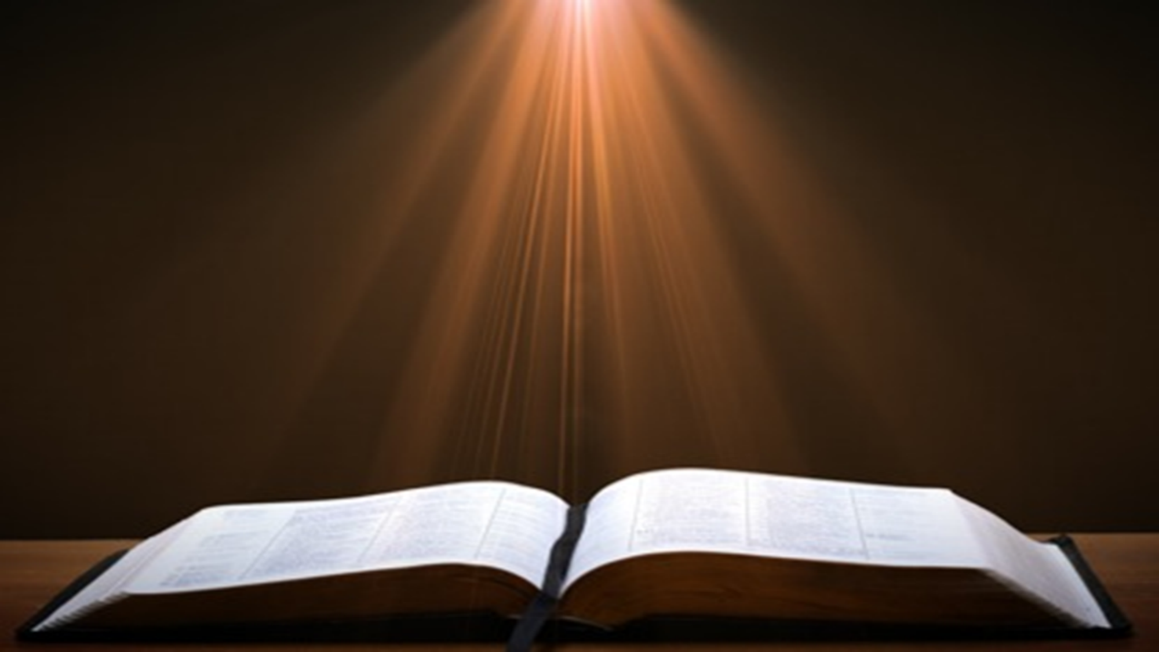
2 Samuel 7:12-16
“When your days are complete and you lie down with your fathers, I will raise up your descendant after you, who will come forth from you, and I will establish his kingdom. ¹³ He shall build a house for My name, and I will establish the throne of his kingdom forever. ¹⁴ I will be a father to him and he will be a son to Me; when he commits iniquity, I will correct him with the rod of men and the strokes of the sons of men, ¹⁵ but My lovingkindness shall not depart from him, as I took it away from Saul, whom I removed from before you. ¹⁶ Your house and your kingdom shall endure before Me forever; your throne shall be established forever.” ¹⁷ In accordance with all these words and all this vision, so Nathan spoke to David.”

Slide 11
Acts 13:16-41
Paul’s Message
      Introduction (16)
      Historical background (17-22)
      Messiah (23-25)
      Gospel (26-29)
      Resurrection (30-37)
      Application to Paul’s audience (38-39)
      Warning (40-41)

Slide 12
Acts 13:23-25
Messiah
      Davidic Covenant (23)
      John the Baptist (24-25)

Slide 13
Acts 13:23-25
Messiah
      Davidic Covenant (23)
      John the Baptist (24-25)

Slide 14
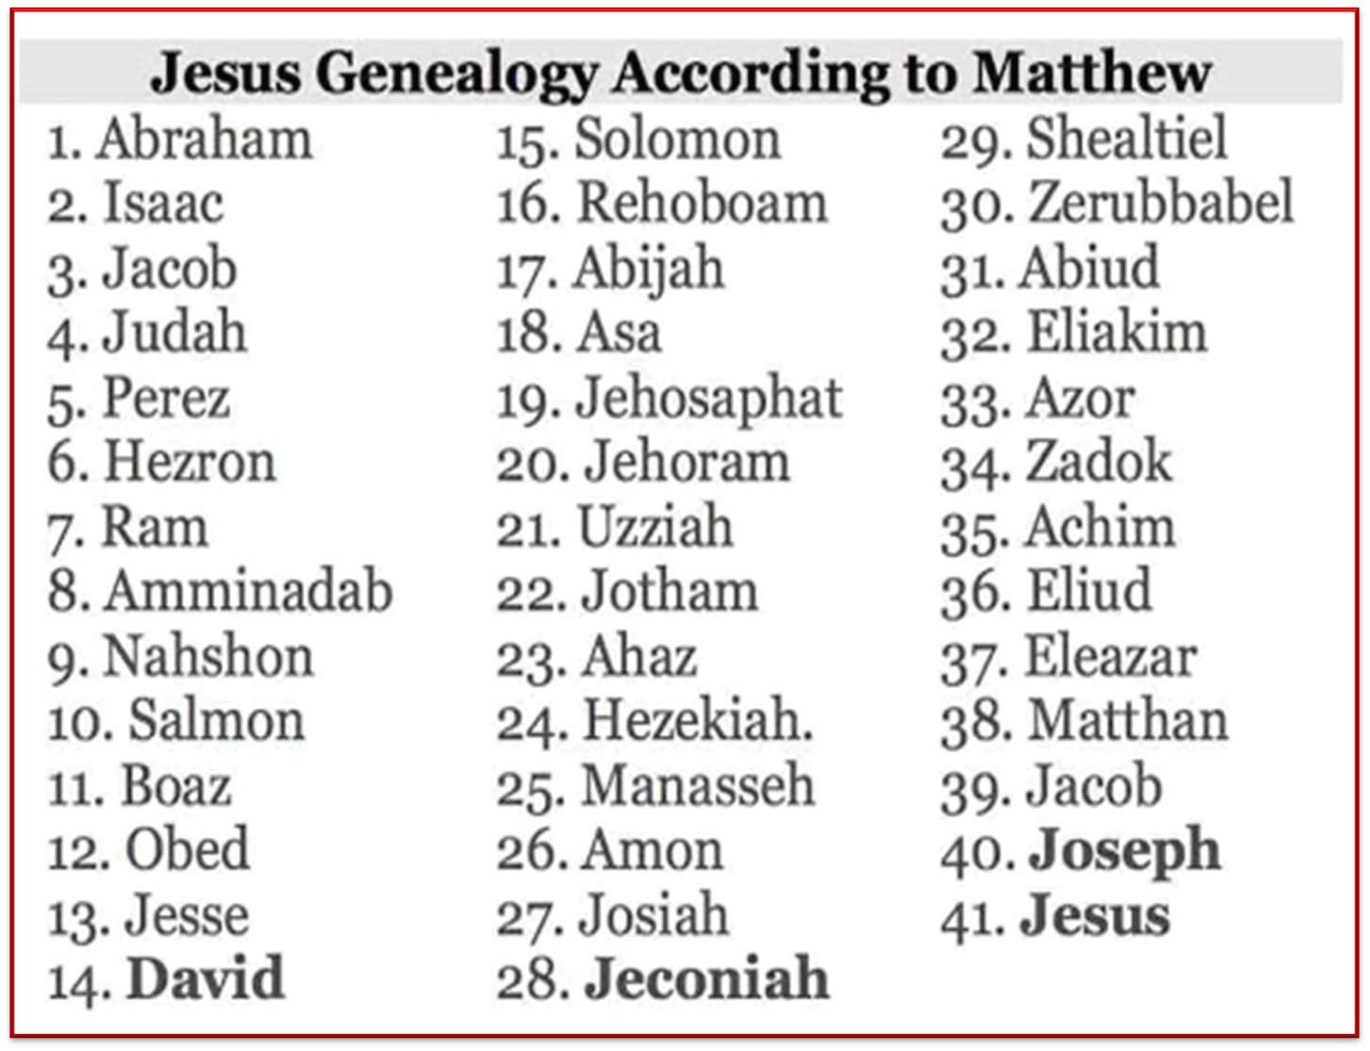

Slide 15
Acts 13:23-25
Messiah
      Davidic Covenant (23)
      John the Baptist (24-25)

Slide 16

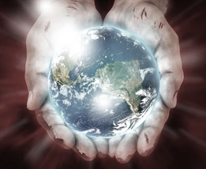
John 1:29
“The next day he saw Jesus coming to him, and said, ‘Behold, the Lamb of God who takes away the sin of the world!’”

Slide 17
Acts 13:16-41
Paul’s Message
      Introduction (16)
      Historical background (17-22)
      Messiah (23-25)
      Gospel (26-29)
      Resurrection (30-37)
      Application to Paul’s audience (38-39)
      Warning (40-41)

Slide 18

1 Corinthians 15:3-4
“³ For I handed down to you as of first importance what I also received, that Christ died for our sins according to the Scriptures, ⁴ and that He was buried, and that He was raised on the third day according to the Scriptures.”

Slide 19
Acts 13:26-29
Gospel
      Application to Paul’s audience (26)
      Death (27-28)
      Burial (29)

Slide 20
Acts 13:26-29
Gospel
      Application to Paul’s audience (26)
      Death (27-28)
      Burial (29)

Slide 21
Three Tenses of Salvation
Phase | Justification | Sanctification | Glorification
Tense | Past | Present | Future
Saved from sin’s: | Penalty | Power | Presence
Scripture | Eph 2:8-9; Titus 3:5 | Philip 2:12 | Rom 5:10

Slide 22
Acts 13:26-29
Gospel
      Application to Paul’s audience (26)
      Death (27-28)
      Burial (29)

Slide 23
Acts 13:27-28
Death
      Ignorance (27)
      Guilt (28)

Slide 24
Acts 13:27-28
Death
      Ignorance (27)
      Guilt (28)

Slide 25

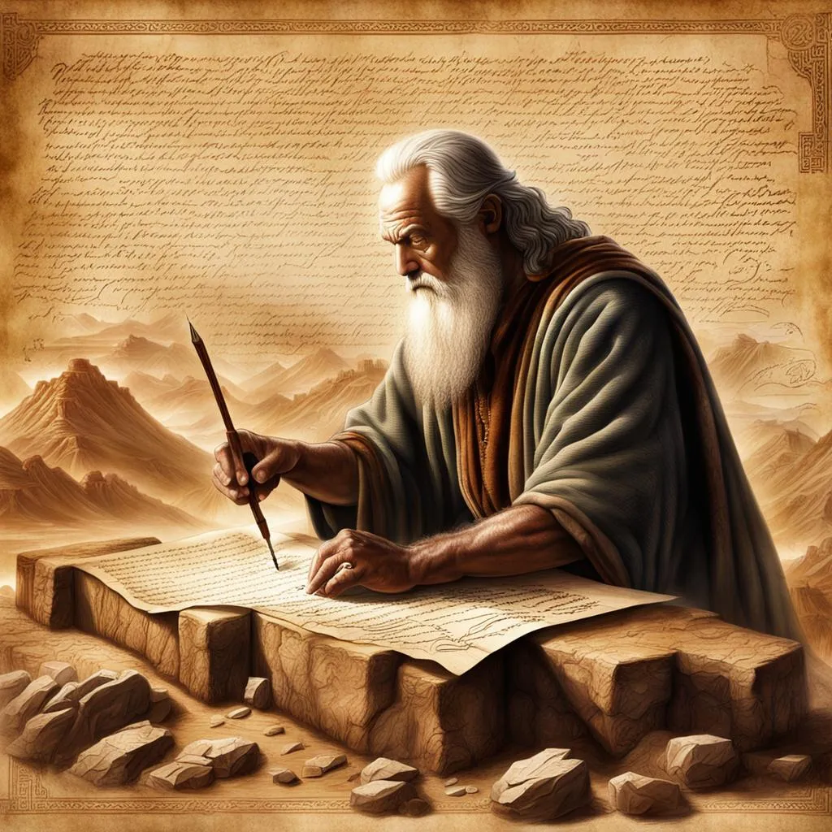
John 5:39, 46
“³⁹ You search the Scriptures because you think that in them you have eternal life; it is these that testify about Me…⁴⁶ For if you believed Moses, you would believe Me, for he wrote about Me.”

Slide 26
Luke 24:27, 44
“²⁷ Then beginning with Moses and with all the prophets, He explained to them the things concerning Himself in all the Scriptures…⁴⁴ Now He said to them, ‘These are My words which I spoke to you while I was still with you, that all things which are written about Me in the Law of Moses and the Prophets and the Psalms must be fulfilled.’”

Slide 27

Acts 17:1-3
“¹ Now when they had traveled through Amphipolis and Apollonia, they came to Thessalonica, where there was a synagogue of the Jews. ² And according to Paul’s custom, he visited them, and for three Sabbaths reasoned with them from the Scriptures, ³ explaining and giving evidence that the Christ had to suffer and rise from the dead, and saying, “This Jesus whom I am proclaiming to you is the Christ.”

Slide 28
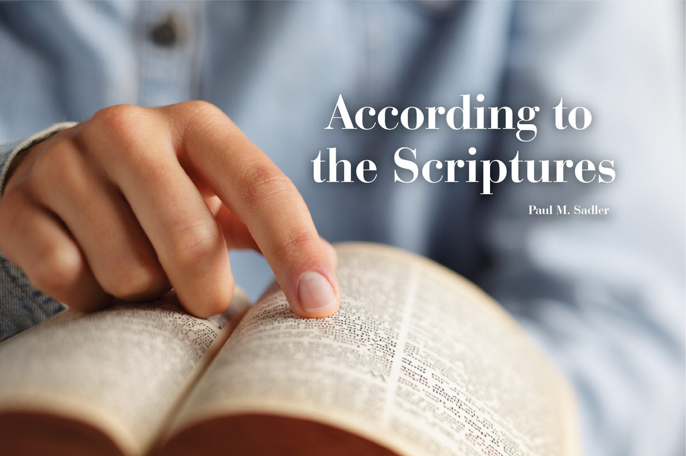
1 Corinthians 15:3-4
“³ For I handed down to you as of first importance what I also received, that Christ died for our sins according to the Scriptures, ⁴ and that He was buried, and that He was raised on the third day according to the Scriptures.”

Slide 29
Acts 13:27-28
Death
      Ignorance (27)
      Guilt (28)

Slide 30
Acts 13:26-29
Gospel
      Application to Paul’s audience (26)
      Death (27-28)
      Burial (29)

Slide 31
John 5:39, 46
“³⁹ You search the Scriptures because you think that in them you have eternal life; it is these that testify about Me…⁴⁶ For if you believed Moses, you would believe Me, for he wrote about Me.”

Slide 32
Luke 24:27, 44
“²⁷ Then beginning with Moses and with all the prophets, He explained to them the things concerning Himself in all the Scriptures…⁴⁴ Now He said to them, ‘These are My words which I spoke to you while I was still with you, that all things which are written about Me in the Law of Moses and the Prophets and the Psalms must be fulfilled.’”

Slide 33
Acts 17:1-3
“¹ Now when they had traveled through Amphipolis and Apollonia, they came to Thessalonica, where there was a synagogue of the Jews. ² And according to Paul’s custom, he visited them, and for three Sabbaths reasoned with them from the Scriptures, ³ explaining and giving evidence that the Christ had to suffer and rise from the dead, and saying, “This Jesus whom I am proclaiming to you is the Christ.”

Slide 34
1 Corinthians 15:3-4
“³ For I handed down to you as of first importance what I also received, that Christ died for our sins according to the Scriptures, ⁴ and that He was buried, and that He was raised on the third day according to the Scriptures.”

Slide 35
Acts 13:16-41
Paul’s Message
      Introduction (16)
      Historical background (17-22)
      Messiah (23-25)
      Gospel (26-29)
      Resurrection (30-37)
      Application to Paul’s audience (38-39)
      Warning (40-41)

Slide 36
Acts 13:30-37
Resurrection
    Fact of Resurrection (30-31)
    Good news of Gospel (32-33)
    Resurrection (34-35)
    Application to Jesus Christ (36-37)

Slide 37
Acts 13:30-37
Resurrection
    Fact of Resurrection (30-31)
    Good news of Gospel (32-33)
    Resurrection (34-35)
    Application to Jesus Christ (36-37)

Slide 38
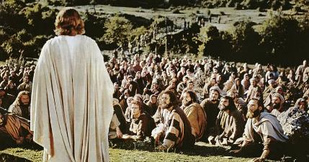
1 Corinthians 15:6-7
“⁶ After that He appeared to more than five hundred brethren at one time, most of whom remain until now, but some have fallen asleep; ⁷ then He appeared to James, then to all the apostles…”

Slide 39
Acts 13:30-37
Resurrection
    Fact of Resurrection (30-31)
    Good news of Gospel (32-33)
    Resurrection (34-35)
    Application to Jesus Christ (36-37)

Slide 40
John 5:39, 46
“³⁹ You search the Scriptures because you think that in them you have eternal life; it is these that testify about Me…⁴⁶ For if you believed Moses, you would believe Me, for he wrote about Me.”

Slide 41
Luke 24:27, 44
“²⁷ Then beginning with Moses and with all the prophets, He explained to them the things concerning Himself in all the Scriptures…⁴⁴ Now He said to them, ‘These are My words which I spoke to you while I was still with you, that all things which are written about Me in the Law of Moses and the Prophets and the Psalms must be fulfilled.’”

Slide 42
Acts 17:1-3
“¹ Now when they had traveled through Amphipolis and Apollonia, they came to Thessalonica, where there was a synagogue of the Jews. ² And according to Paul’s custom, he visited them, and for three Sabbaths reasoned with them from the Scriptures, ³ explaining and giving evidence that the Christ had to suffer and rise from the dead, and saying, “This Jesus whom I am proclaiming to you is the Christ.”

Slide 43
1 Corinthians 15:3-4
“³ For I handed down to you as of first importance what I also received, that Christ died for our sins according to the Scriptures, ⁴ and that He was buried, and that He was raised on the third day according to the Scriptures.”

Slide 44
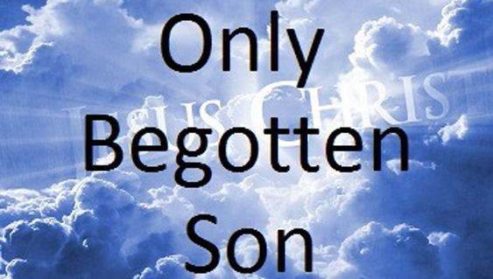
John 1:14
“And the Word became flesh, and dwelt among us, and we saw His glory, glory as of the only begotten [monogenēs] from the Father, full of grace and truth.”

Slide 45
John 3:16
“For God so loved the world, that He gave His only begotten [monogenēs] Son, that whoever believes in Him shall not perish, but have eternal life.”

Slide 46
Acts 13:30-37
Resurrection
    Fact of Resurrection (30-31)
    Good news of Gospel (32-33)
    Resurrection (34-35)
    Application to Jesus Christ (36-37)

Slide 48
2 Samuel 7:12-16
“When your days are complete and you lie down with your fathers, I will raise up your descendant after you, who will come forth from you, and I will establish his kingdom. ¹³ He shall build a house for My name, and I will establish the throne of his kingdom forever. ¹⁴ I will be a father to him and he will be a son to Me; when he commits iniquity, I will correct him with the rod of men and the strokes of the sons of men, ¹⁵ but My lovingkindness shall not depart from him, as I took it away from Saul, whom I removed from before you. ¹⁶ Your house and your kingdom shall endure before Me forever; your throne shall be established forever.” ¹⁷ In accordance with all these words and all this vision, so Nathan spoke to David.”

Slide 50
Acts 2:15-35
Refutation of the Charge of Drunkenness
      Too early (15)
      Use of Joel 2:28-32 (16-21)
      Christ’s miracles (22)
      Crucifixion (23)
      Resurrection (24)
      Use of Psalm 16:8-11 (25-29)
      Use of Psalm 132:11 (30-32)
      High priestly ministry (33)
      Use of Psalm 110:1 (34-35)

Slide 51
Acts 13:30-37
Resurrection
    Fact of Resurrection (30-31)
    Good news of Gospel (32-33)
    Resurrection (34-35)
    Application to Jesus Christ (36-37)

Slide 52
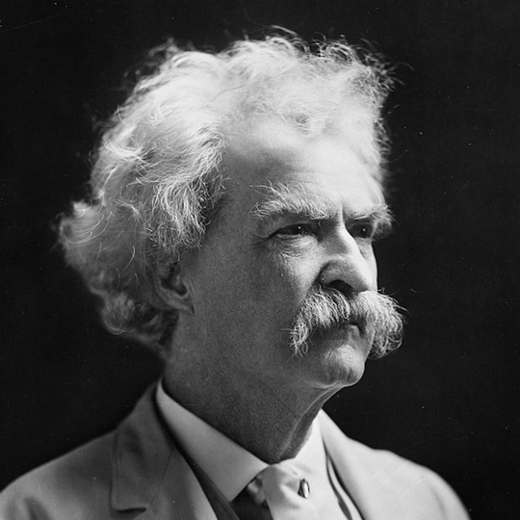
Mark Twain
Autobiography, 2:37
“A myriad of men are born; they labor and sweat and struggle for bread; they squabble and scold and fight; they scramble for little mean advantages over each other. Age creeps upon them and infirmities follow; shames and humiliations bring down their prides and their vanities. Those they love are taken from them, and the joy of life is turned to aching grief. The burden of pain, care, and misery grows heavier year by year. At length ambition is dead, pride is dead, vanity is dead; longing for release is in their place. It comes at last-the only un-poisoned gift earth ever had for them-and they vanish from a world where they were of no consequence; where they achieved nothing, where they were a mistake and a failure and a foolishness; where they left no sign that they have existed – a world that will lament them a day and forget them forever.”

Slide 53
Acts 2:15-35
Refutation of the Charge of Drunkenness
      Too early (15)
      Use of Joel 2:28-32 (16-21)
      Christ’s miracles (22)
      Crucifixion (23)
      Resurrection (24)
      Use of Psalm 16:8-11 (25-29)
      Use of Psalm 132:11 (30-32)
      High priestly ministry (33)
      Use of Psalm 110:1 (34-35)

Slide 54
From Peter to Paul
Reference | Center | Person | Place | Outreach
Acts 1–12 | Jerusalem | Peter | Jerusalem, Judea, Samaria | Jewish
Acts 13–28 | Antioch | Paul | Uttermost parts | Gentiles

Slide 55
From Peter to Paul
Peter | Paul
Heals a man lame from birth (3:1-11) | Heals a man lame from birth (14:8-18)
Heals by shadow (5:15-16) | Heals by handkerchief (19:11-12)
Success is a cause of jealousy (5:17) | Success is a cause of jealousy (13:45)
Confronts a sorcerer (8:9-24) | Confronts a sorcerer (13:6-11)
Raises Dorcas (9:36-41) | Raises Eutychus (20:9-12)
Jailed and miraculously freed (12:3-19) | Jailed and miraculously freed (16:25-34)

Slide 56
Acts 13:16-41
Paul’s Message
      Introduction (16)
      Historical background (17-22)
      Messiah (23-25)
      Gospel (26-29)
      Resurrection (30-37)
      Application to Paul’s audience (38-39)
      Warning (40-41)

Slide 57
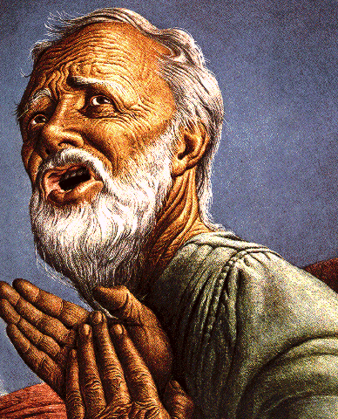
Passages Conditioning Salvation on Faith Alone (Sola Fide)
Genesis 15:6
John 3:16; 5:24; 6:28-29, 47; 16:8-9; 20:30-31
Acts 16:30-31
Romans 1:16; Ephesians 2:8-9
Hebrews 11:6

Slide 58
Belief – God’s One Condition for Justification
Gen 15:6
Then he believed in the LORD; and He reckoned it to him as righteousness.
John 3:16
For God so loved the world, that He gave His only begotten Son, that whoever believes in Him shall not perish, but have eternal life.
Acts 16:30-31
"Sirs, what must I do to be saved?" They said, "Believe in the Lord Jesus, and you will be saved..."

Slide 59
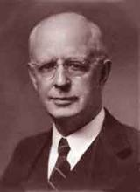
Lewis Sperry Chafer, vol. 7, Systematic Theology
(Grand Rapids, MI: Kregel Publications, 1993), 265-66.
Belief-God’s One Condition for Justification
“…because upwards of 150 passages of Scripture condition salvation upon believing only (cf. John 3:16; Acts 16:31).”

Slide 60
Acts 13:16-41
Paul’s Message
      Introduction (16)
      Historical background (17-22)
      Messiah (23-25)
      Gospel (26-29)
      Resurrection (30-37)
      Application to Paul’s audience (38-39)
      Warning (40-41)

Slide 61
Acts 13:40-41
Warning
      A.D. 70 (40)
      Application of Habakkuk 1:5 (41)

Slide 62
Acts 13:40-41
Warning
      A.D. 70 (40)
      Application of Habakkuk 1:5 (41)

Slide 63
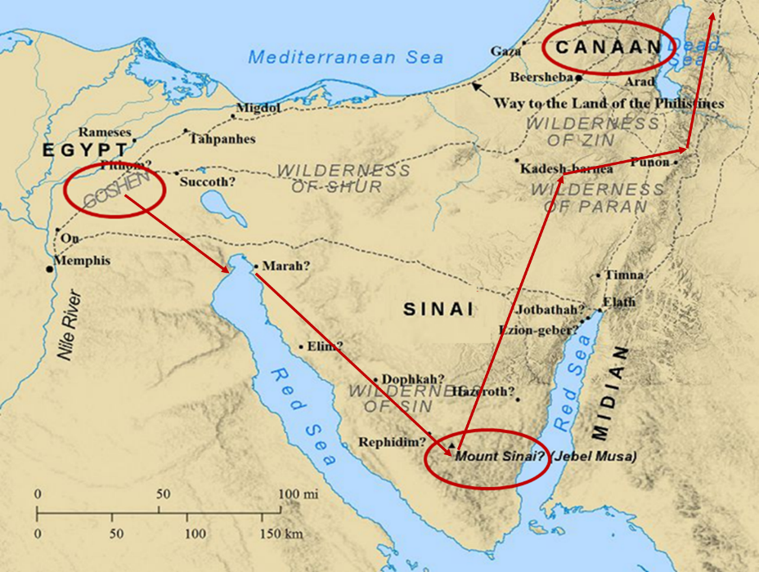

Slide 64
Six Parts of a Suzerain-Vassal Treaty in Deuteronomy
Preamble (1:1-5)
Prologue (1:6–4:40)
Covenant obligations (5–26)
Storage and reading instructions (27:2-3; 31:9, 24, 26)
Witnesses (32:1)
Blessings and curses (28)

Slide 65

Deuteronomy 28:49-50
⁴⁹ “The Lord will bring a nation against you from afar, from the end of the earth, as the eagle swoops down, a nation whose language you shall not understand, ⁵⁰ a nation of fierce countenance who will have no respect for the old, nor show favor to the young.”

Slide 66
ISRAEL'S JUDGMENTS
Division of the kingdom in 931 B.C. (1 Kgs. 12)
Assyrian judgment in 722 B.C. (2 Kgs. 17)
Babylonian captivity in 586 B.C. (2 Kgs. 25)
Rome Diaspora in A.D. 70 (Luke 19:41-44)

Slide 67
Acts 13:40-41
Warning
      A.D. 70 (40)
      Application of Habakkuk 1:5 (41)

Slide 68
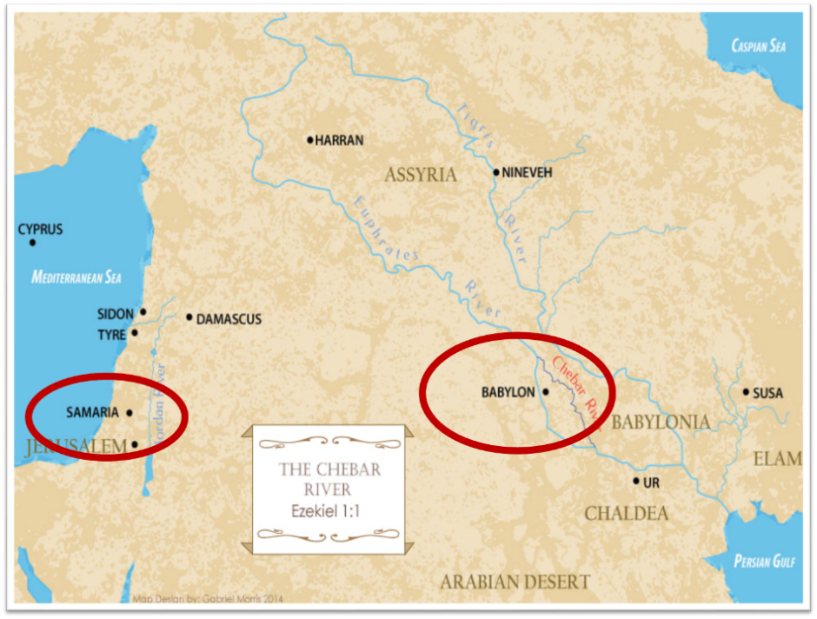

Slide 69
Conclusion

Slide 70
Acts 13:16-41
Paul’s Message
      Introduction (16)
      Historical background (17-22)
      Messiah (23-25)
      Gospel (26-29)
      Resurrection (30-37)
      Application to Paul’s audience (38-39)
      Warning (40-41)

