Slide 1
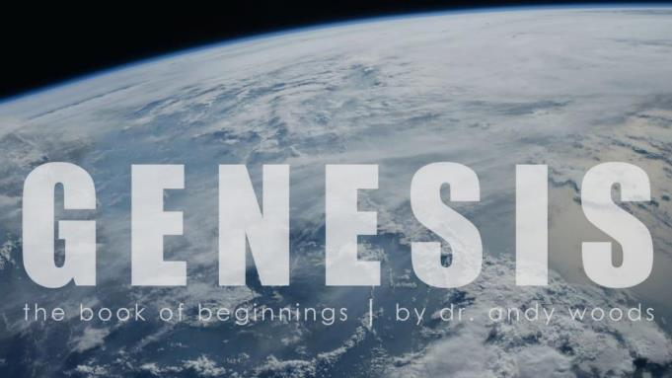
Genesis 12‒50
Israel’s Birth & Preservation

Slide 2
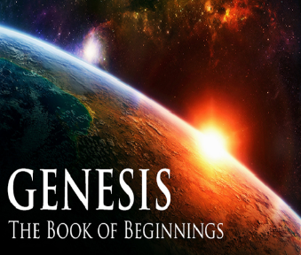
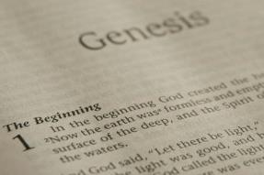
GENESIS STRUCTURE
Genesis 12-50 (four people)
Abraham (12:1–25:11)
Isaac (25:12–26:35)
Jacob (27–36)
Joseph (37–50)

Slide 3
Genesis 37‒50 Joseph
Joseph sold unto Egypt (37)
Canaan’s corruption (38)
Joseph falsely accused (39)
Joseph’s short-term predictions (40)
Joseph’s elevation (41)
Joseph’s first reunion with his brothers (42)
Joseph’s second reunion with his brothers (43‒45)
Joseph’s second reunion with his brothers (43‒45)
Sojourn to Egypt (46:1‒47:12)
Famine’s course (47:13-26)
Jacob in Egypt (47:27-31)
Jacob blesses Joseph’s sons (48)
Jacob blesses his sons (49)
Jacob’s burial & Joseph’s death (50)

Slide 4
Genesis 50:1-26 Death & Burial of Jacob & Joseph
Events following Jacob’s death (1-3)
Jacob’s burial (4-14)
Brothers’ fear & Joseph’s reassurance (15-21)
Joseph’s death (22-26)

Slide 5
III. Genesis 50:15-21 Brothers’ Fear & Joseph’s Reassurance
Brothers’ fear (15)
Brothers’ message to Joseph (16-17a)
Joseph’s response (17b)
Brothers’ submission (18)
Joseph’s comfort (19-21)

Slide 6
Genesis 50:19-21 Joseph’s Comfort
Basis (19)
God’s providence (20)
Joseph’s further comfort (21)

Slide 7
Genesis 50:19-21 Joseph’s Comfort
Basis (19)
God’s providence (20)
Joseph’s further comfort (21)

Slide 8
1 Corinthians 4:5
“ Therefore do not go on passing judgment before the time, but wait until the Lord comes who will both bring to light the things hidden in the darkness and disclose the motives of men’s hearts; and then each man’s praise will come to him from God.”

Slide 9
Genesis 50:19-21 Joseph’s Comfort
Basis (19)
God’s providence (20)
Joseph’s further comfort (21)

Slide 10
Genesis 50:20 God’s Providence
Man’s plan (20a)
God’s plan (20b)

Slide 11
Genesis 50:20 God’s Providence
Man’s plan (20a)
God’s plan (20b)

Slide 12
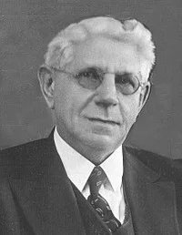
Omnicausality?
"Reformed theology stresses the sovereignty of God in virtue of which He has sovereignly determined from all eternity whatsoever will come to pass, and works His sovereign will in His entire creation, both natural and spiritual, according to His pre-determined plan.”
Louis Berkhof, Systematic Theology: With a Complete Textual Index, 4th and rev. ed. (Grand Rapids: Eerdman's, 1932; reprint, Grand Rapids: Baker, 1996), 100.

Slide 13
Calvin said: “Nor ought it to seem absurd when I say, that God not only foresaw the fall of the first man, and in him the ruin of his posterity; but also at his own pleasure arranged it.”
John Calvin
John Calvin, Institutes of the Christian Religion, Vol. 3, Chapter 23, section 7.

Slide 14
Edwin Palmer
In Edwin Palmer’s book, The Five Points of Calvinism, he states: “God is in back of everything. He decides and causes all things to happen that do happen…even sin…God ordained sin and unbelief.”
Edwin H. Palmer, The Five Points of Calvinism (Grand Rapids, MI: Baker Books, Enlarged Edition, 1980, 24th printing, 2005), pp. 25, 102.

Slide 15
R. C. Sproul Jr.
R. C. Sproul Jr. (R. C. Sproul’s Calvinist son) said that God “desired that man would fall into sin … [God] created sin.”
R.C. Sproul Jr., Almighty Over All (Grand Rapids, MI: Baker Books, 1999, Second printing, July 1999), pp. 53-54.

Slide 16
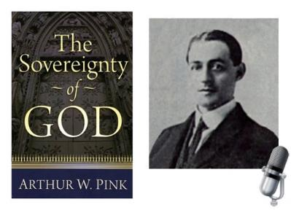
A. W. Pink
Sovereignty of God, p. 201.
“That God decreed sin should enter this world through the disobedience of our first parents was a secret hid in His own breast.”

Slide 18
James 1:13
“Let no one say when he is tempted, ‘I am being tempted by God’; for God cannot be tempted by evil, and He Himself does not tempt anyone.”

Slide 19
1 John 1:5
“This is the message we have heard from Him and announce to you, that God is Light, and in Him there is no darkness at all.”

Slide 20
Mark 7:20–23
²⁰ And He was saying, “That which proceeds out of the man, that is what defiles the man. ²¹ “For from within, out of the heart of men, proceed the evil thoughts, fornications, thefts, murders, adulteries, ²² deeds of coveting and wickedness, as well as deceit, sensuality, envy, slander, pride and foolishness. ²³ “All these evil things proceed from within and defile the man.”

Slide 21
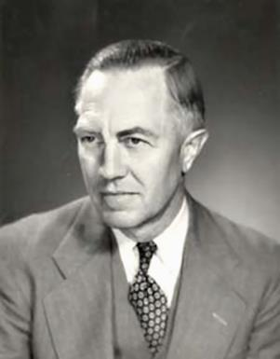
Loraine Boettner, The Reformed Doctrine of Predestination (Philipsburg, NJ: Presbyterian and Reformed, 1932), 32.
Loraine Boettner
God “…creates the very thoughts and intents of the soul.”

Slide 22
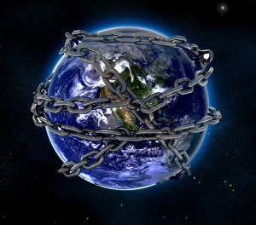

Slide 23
Romans 8:19-22
¹⁹ For the anxious longing of the creation waits eagerly for the revealing of the sons of God. ²⁰ For the creation was subjected to futility, not willingly, but because of Him who subjected it, in hope ²¹ that the creation itself also will be set free from its slavery to corruption into the freedom of the glory of the children of God. ²² For we know that the whole creation groans and suffers the pains of childbirth together until now.

Slide 24
Romans 8:28-29
²⁸ And we know that God causes all things to work together for good to those who love God, to those who are called according to His purpose. ²⁹ For those whom He foreknew [proginōskō], He also predestined to become conformed to the image of His Son, so that He would be the firstborn among many brethren.

Slide 25
Genesis 50:20 God’s Providence
Man’s plan (20a)
God’s plan (20b)

Slide 26
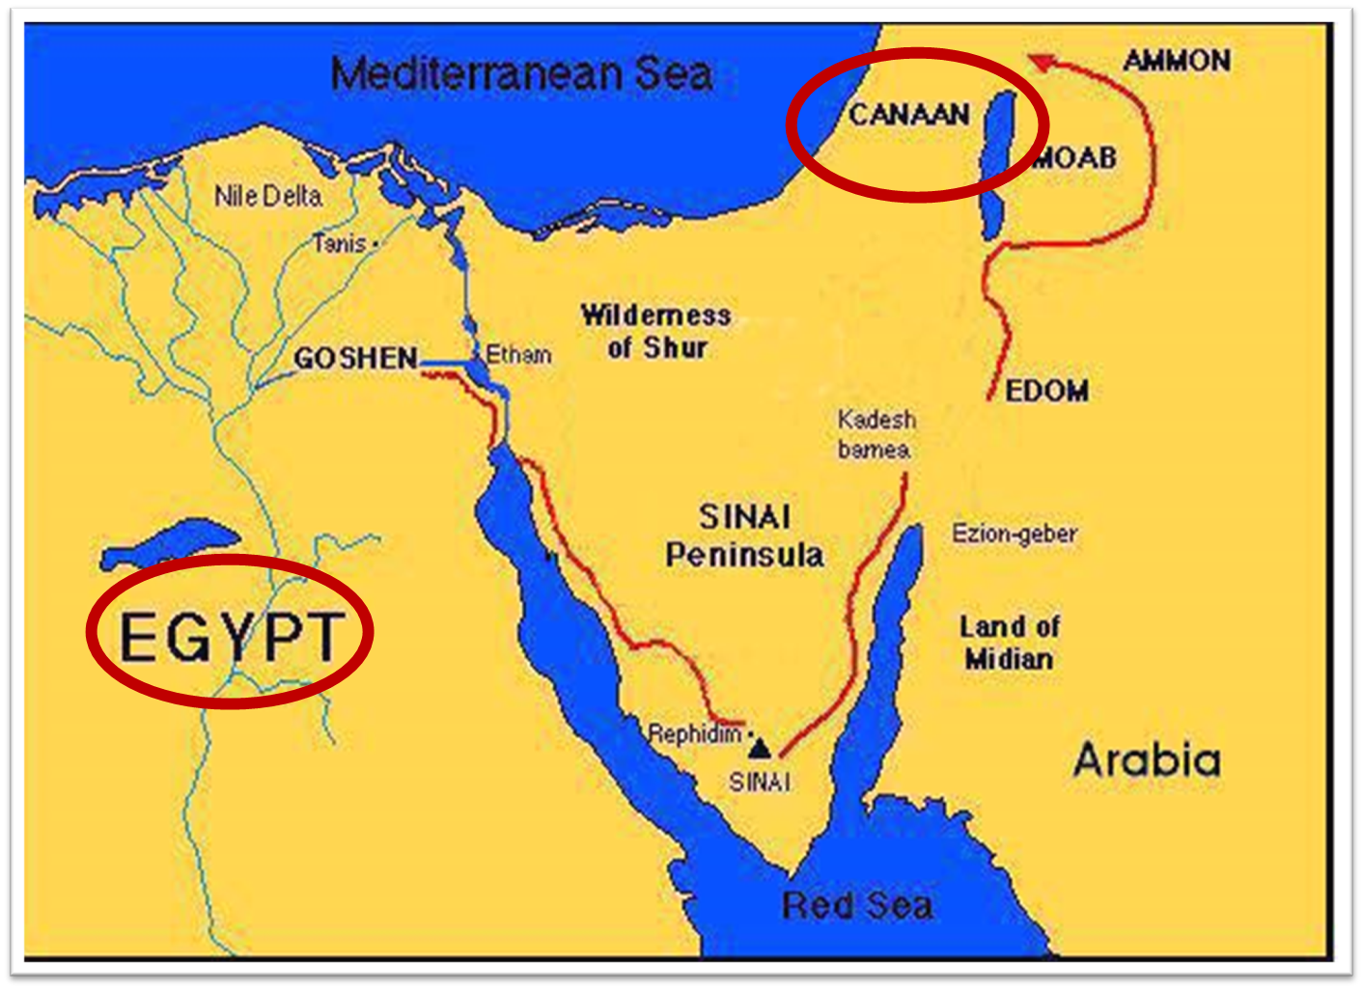

Slide 27
Three Tenses of Salvation
Phase | Justification | Sanctification | Glorification
Tense | Past | Present | Future
Saved from sin’s: | Penalty | Power | Presence
Scripture | Eph 2:8-9; Titus 3:5 | Philip 2:12 | Rom 5:10

Slide 28
Genesis 50:19-21 Joseph’s Comfort
Basis (19)
God’s providence (20)
Joseph’s further comfort (21)

Slide 29
Genesis 50:21 Joseph’s Further Comfort
Do not fear (21a)
I will provide (21b)
Joseph comforted them (21c)
Joseph spoke kindly to them (21d)

Slide 30
Genesis 50:21 Joseph’s Further Comfort
Do not fear (21a)
I will provide (21b)
Joseph comforted them (21c)
Joseph spoke kindly to them (21d)

Slide 31
Genesis 50:21 Joseph’s Further Comfort
Do not fear (21a)
I will provide (21b)
Joseph comforted them (21c)
Joseph spoke kindly to them (21d)

Slide 32
Genesis 50:21 Joseph’s Further Comfort
Do not fear (21a)
I will provide (21b)
Joseph comforted them (21c)
Joseph spoke kindly to them (21d)

Slide 33
Genesis 50:21 Joseph’s Further Comfort
Do not fear (21a)
I will provide (21b)
Joseph comforted them (21c)
Joseph spoke kindly to them (21d)

Slide 34
2 Peter 1:5-7
⁵ Now for this very reason also, applying all diligence, in your faith supply moral excellence, and in your moral excellence, knowledge, ⁶ and in your knowledge, self-control, and in your self-control, perseverance, and in your perseverance, godliness, ⁷ and in your godliness, brotherly kindness, and in your brotherly kindness, love.

Slide 35
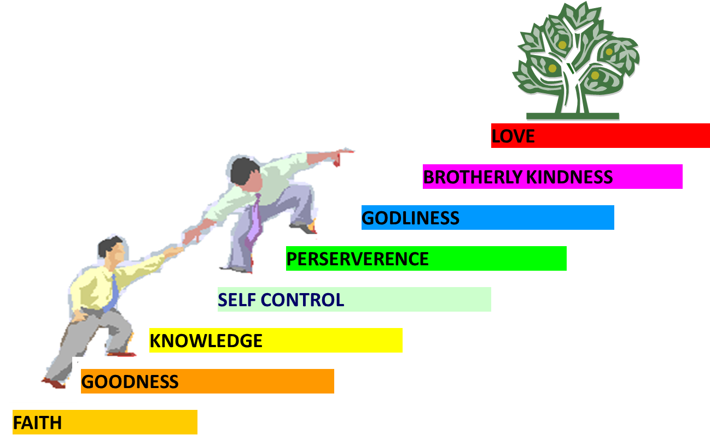
PORTRAIT OF GROWTH 1:5-7

Slide 36
Conclusion

Slide 37
Genesis 50:19-21 Joseph’s Comfort
Basis (19)
God’s providence (20)
Joseph’s further comfort (21)

Slide 38
Genesis 50:1-26 Death & Burial of Jacob & Joseph
Events following Jacob’s death (1-3)
Jacob’s burial (4-14)
Brothers’ fear & Joseph’s reassurance (15-21)
Joseph’s death (22-26)

Slide 39
²⁴ The Lord bless you, and keep you; ²⁵ The Lord make His face shine on you, And be gracious to you; ²⁶ The Lord lift up His countenance on you, And give you peace.
Numbers 6:24–26 (NASB95)

