Slide 2
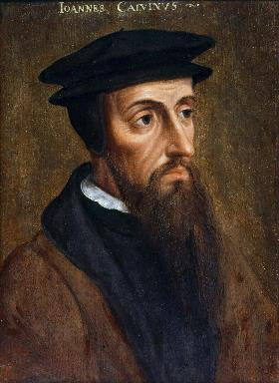
Neo-Calvinism vs. The Bible
Calvinism’s Mixed Blessing
Why Critique Calvinism?
The Source of Calvin’s Theology
Calvin’s Manner of Life
TULIP Through the Grid of Scripture
Conclusion

Slide 3
V. Running TULIP Through the Grid of Scripture
Total Depravity
Unconditional Election
Limited Atonement
Irresistible Grace
Perseverance of the Saints

Slide 4
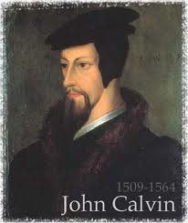
Irresistible Grace
Calvinistic definition
Calvinistic arguments
Man can resist God’s grace
Man can resist God by disbelieving
John 6:44?

Slide 5
Irresistible Grace
Calvinistic definition
Calvinistic arguments
Man can resist God’s grace
Man can resist God by disbelieving
John 6:44?

Slide 6
Irresistible Grace = Regeneration Precedes Faith & Faith is a Gift
“I” stands for “Irresistible Grace.” Faith is something “God irresistibly bestowed upon the elect without their having believed anything…By such reasoning, man…can’t even hear the gospel—much less respond to the pleadings of Christ.”
Bob Kirkland, Calvinism: None Dare Call It Heresy; Spotlight on the Life and Teachings of John Calvin (Eureka, MT: Lighthouse Trails, 2018), 34.

Slide 7
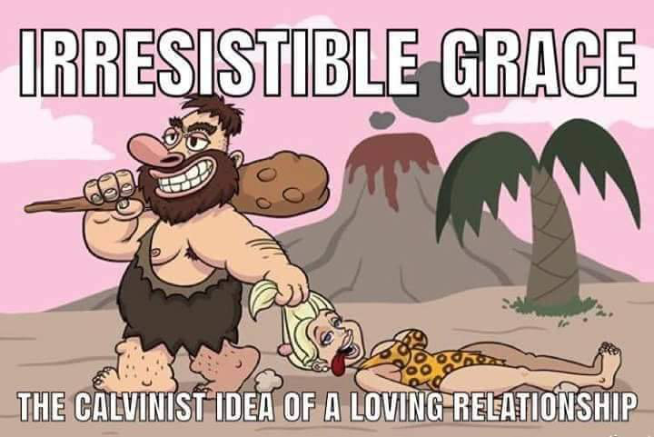

Slide 8
Westminster Confession X, i
“All those whom God hath predestinated unto life, and those only, he is pleased, in his appointed and accepted time, effectually to call, by his Word and Spirit, out of that state of sin and death, in which they are by nature, to grace and salvation, by Jesus Christ; enlightening their minds spiritually and savingly to understand the things of God, taking away their heart of stone, and giving unto them a heart of flesh; renewing their wills, and, by his almighty power, determining them to that which is good, and effectually drawing them to Jesus Christ: yet so, as they come most freely, being made willing by his grace.”
Notes:
Error of reductionism – oversimplification of a complex subject

Slide 9
David N. Steele & Curtis C. Thomas
The “efficacious call of the Spirit or irresistible grace” is “the special inward call of the Spirit [that] never fails to result in the conversion of those to whom it is made. This special call is not made to all sinners what is issued to the elect only.”
David N. Steele, Curtis C. Thomas, and S. Lance Quinn, The Five Points of Calvinism, 2nd ed. (Phillipsburg, NJ: Presbyterian and Reformed Publishing, 1963), 52-53.

Slide 10
Ephesians 2:1-5
¹ “And you were dead in your trespasses and sins, ² in which you formerly walked according to the course of this world, according to the prince of the power of the air, of the spirit that is now working in the sons of disobedience. ³ Among them we too all formerly lived in the lusts of our flesh, indulging the desires of the flesh and of the mind, and were by nature children of wrath, even as the rest. ⁴ But God, being rich in mercy, because of His great love with which He loved us, ⁵ even when we were dead in our transgressions, made us alive together with Christ (by grace you have been saved)”

Slide 11
R.C. Sproul
R.C. Sproul, Chosen by God (Wheaton, IL: Tyndale House, 1986), 68.
“No human being can possibly come to Christ unless something happens that makes it possible for him to come. That necessary condition Jesus declares is that ‘it has been granted to him by the Father.’ Jesus is saying here that the ability to come to Him is a gift from God. Man does not have the ability in and of himself to come to Christ. God must do something first.”

Slide 12
Andrew T. Lincoln
Andrew T. Lincoln, The Gospel according to Saint John, Black‘s New Testament Commentaries (Peabody, MA: Hendrickson, 2005), 230.
“God takes the initiative and enables them [the murmuring Jews] to believe.”

Slide 13
John H. Gerstner
John H. Gerstner, Wrongly Dividing the Word of Truth: A Critique of Dispensationalism (Brentwood, TN: Wolgemuth and Hyatt, Publishers, Inc., 1991), 124.
Gerstner argues that if John 3:16 “is supposed to teach that God so loved everyone in the world that He gave His only son to provide them an opportunity to be saved by faith...such love on God’s part...would be a refinement of cruelty…Offering a gift of life to a spiritual corpse, a brilliant sunset to a blind man, and a reward to a legless cripple if only he will come and get it, are horrible mockeries.”

Slide 14
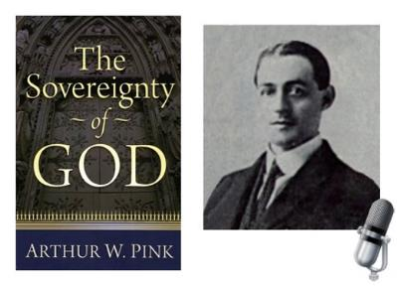
A. W. Pink
Sovereignty of God, p. 57, 113, 120.
“Personally, we have no more to do with our spiritual birth than we had with our natural birth…[Man is] utterly incapable of willing anything…the sinner, of himself, cannot repent and believe.”

Slide 15
David N. Steele & Curtis C. Thomas
“Because of the fall, man is an unable of himself to savingly believe the gospel. The sinner is dead, blind, and deaf to the things of God; his heart is deceitful and desperately corrupt. His will is not free, it is in bondage to his evil nature, therefore, he will not – indeed he cannot – choose good over evil in the spiritual realm. Consequently, it takes much more than the Spirit’s assistance to bring a sinner to Christ – it takes regeneration by which He makes the sinner alive and gives him a new nature. Faith is not something man contributes to salvation, but is itself a part of God‘s gift of salvation – it is God’s gift to the sinner, not the sinner’s gift to God.”
David N. Steele, Curtis C. Thomas, and S. Lance Quinn, The Five Points of Calvinism, 2nd ed. (Phillipsburg, NJ: Presbyterian and Reformed Publishing, 1963), 5-6.

Slide 16
John 16:7-11
“⁷ But I tell you the truth, it is to your advantage that I go away; for if I do not go away, the Helper will not come to you; but if I go, I will send Him to you. ⁸ And He, when He comes, will convict the world concerning sin and righteousness and judgment; ⁹ concerning sin, because they do not believe in Me; ¹⁰ and concerning righteousness, because I go to the Father and you no longer see Me; ¹¹ and concerning judgment, because the ruler of this world has been judged.”

Slide 17
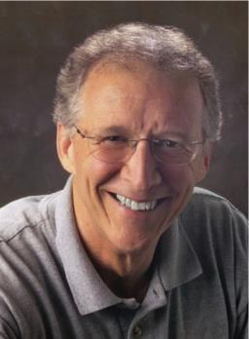
John Piper
John Piper and Pastoral Staff, TULIP: What We Believe about the Five Points of Calvinism: Position Paper of the Pastoral Staff (Desiring God Ministries, 1997), 10.
“If our doctrine of total depravity is true, there can be no salvation without the reality of irresistible grace. If we are dead in our sins, totally unable to submit to God, then we will never believe in Christ unless God overcomes our rebellion.”

Slide 18
John Piper
John Piper and Pastoral Staff, TULIP: What We Believe about the Five Points of Calvinism: Position Paper of the Pastoral Staff (Desiring God Ministries, 1997), 10.
“Since men are blinded to the words of Christ, a miracle is needed for them to come to see and believe…Those who are called have their eyes opened by the sovereign creative power of God so that they no longer see the cross as foolishness but as the power and the wisdom of God. The effectual call is the miracle of having our blindness removed. This is irresistible grace.”

Slide 19
Irresistible Grace
Calvinistic definition
Calvinistic arguments
Man can resist God’s grace
Man can resist God by disbelieving
John 6:44?

Slide 20
Calvinistic Arguments
Faith is a gift
Regeneration precedes faith
Lost man cannot seek God (Rom. 3:11)

Slide 21
Calvinistic Arguments
Faith is a gift
Regeneration precedes faith
Lost man cannot seek God (Rom. 3:11)

Slide 22
Faith is a Gift?
Calvinist Examples
Faith is a work?
Calvinist Proof texts
Miscellaneous problems

Slide 23
Faith is a Gift?
Calvinist Examples
Faith is a work?
Calvinist Proof texts
Miscellaneous problems

Slide 24
A. W. Pink
Sovereignty of God, p. 57
“Faith is a spiritual grace, the fruit of the spiritual nature, and because the unregenerate are spiritually dead – ‘dead in trespasses and sins’ – then it follows that faith from them is impossible, for a dead man cannot believe anything.”

Slide 25
Tom Wells
“Faith is God‘s gift. In no degree could a natural man produce faith. It is utterly beyond him. Let us adore the God who gives it.”
Tom Wells, Faith: The Gift of God (Carlisle, PA: Banner of Truth Trust, 1983), 55.

Slide 26
Tom Wells
Wells compares spiritual deadness to “an old dry [Christmas] tree with ―no fruit or ornaments of his own [his faith]. Then God comes along and hangs the bright jewel of faith on him. . . . There is no real connection between what he is and this gift of faith from God.”
Tom Wells, Faith: The Gift of God (Carlisle, PA: Banner of Truth Trust, 1983), 56–57

Slide 27
James K. Bridges
“Faith for salvation is a gift from the Saviour. . . . The entirety of our salvation depends on God’s gift of faith.”
James K. Bridges, “The Gift of Faith,” in Conference on the Holy Spirit, ed. Gwen Jones (Springfield, MO: Gospel, 1983), 225.

Slide 28
Lorraine Boettner
“The elect of God are chosen by Him to be His children, in order that they might be made to believe, not because He foresaw that they would believe.”
Lorraine Boettner, The Reformed Doctrine of Predestination (Phillipsburg, NJ: Presbyterian and Reformed Publishing Company, 1932, 14th printing), page 101, citing Augustine.

Slide 29
Calvin said: “Had he [Paul] said men are not willing to be wise, that indeed would have been true, but he states further that they are not able. Hence we infer, that faith is not in one‘s own power, but is divinely conferred.”
John Calvin
John Calvin, Commentary on the Epistles of Paul the Apostle to the Corinthians, trans. William Pringle [Edinburgh: Calvin Translation Society, n.d.; re- print, Grand Rapids: Baker, 2003], 116–17.

Slide 30
David N. Steele & Curtis C. Thomas
“Because of the fall, man is an unable of himself to savingly believe the gospel. The sinner is dead, blind, and deaf to the things of God; his heart is deceitful and desperately corrupt. His will is not free, it is in bondage to his evil nature, therefore, he will not – indeed he cannot – choose good over evil in the spiritual realm. Consequently, it takes much more than the Spirit’s assistance to bring a sinner to Christ – it takes regeneration by which He makes the sinner alive and gives him a new nature. Faith is not something man contributes to salvation, but is itself a part of God‘s gift of salvation – it is God’s gift to the sinner, not the sinner’s gift to God.”
David N. Steele, Curtis C. Thomas, and S. Lance Quinn, The Five Points of Calvinism, 2nd ed. (Phillipsburg, NJ: Presbyterian and Reformed Publishing, 1963), 5-6.

Slide 31
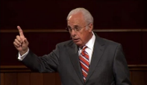
John MacArthur
The Gospel According to Jesus, p. 172-73
“…Genuine faith…is granted by God…Faith is a supernatural gift of God… It seems that what Paul had in mind [in Ephesians 2:8-9] was the entire process of grace, faith, and salvation as the gift of God…Faith is not something that is conjured up by the human will but is a sovereignly granted gift of God. (cf. Philippians 1:29)…The faith that God begets includes both the volition and the ability to comply with His will (cf. Philippians 2:13).”

Slide 32
John MacArthur
The Gospel According to Jesus, p. 69
“Either way, the meaning is inescapable: Faith is God’s gracious gift. Jesus explicitly affirmed this truth: ‘No one can come to Me, unless it has been granted him from the Father’ (John 6:65). Faith is also spoken of as a divine gift in Acts 3:16 (‘The faith which comes through Him has given him this perfect health in the presence of you all’), Philippians 1:29 (‘To you it has been granted for Christ’s sake, not only to believe in Him, but also to suffer for His sake’), and 2 Peter 1:1 (‘Simon Peter, a bond-servant and apostle of Jesus Christ, to those who have received a faith of the same kind as ours’).”

Slide 34
Faith is a Gift?
Calvinist Examples
Faith is a work?
Calvinist Proof texts
Miscellaneous problems

Slide 35
John MacArthur
The Gospel According to Jesus, p. 33
“Faith and works are not incompatible. There is a sense in which Jesus calls even the act of believing a work (John 6:29)—not merely a human work, but a gracious work of God in us. He brings us to faith, then enables and empowers us to believe unto obedience (cf. Romans 16:26).”

Slide 36
Sam Storms
“..even if what he or she does is simply to repent and believe the gospel, God’s grace is seriously, albeit unwittingly, compromised.”
Sam Storms, Chosen for Life: The Case for Divine Election (Wheaton, IL: Crossway Books, a ministry of Good News Publishers, revised and expanded edition, 2007), p. 77.

Slide 37
James White
White argues that because the Bible says Christ saves sinners, we can’t change it to say that he “saves synergistically with the assistance of the sinner himself.”
James R. White, The Potter’s Freedom (Amityville, NY: Calvary Press Publishing, 2000), 247.

Slide 38
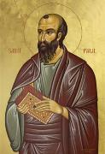
Romans 4:4-5
⁴ “Now to the one who works, his wage is not credited as a favor, but as what is due. ⁵ But to the one who does not work, but believes in Him who justifies the ungodly, his faith is credited as righteousness.”

Slide 39
Ephesians 2:8-10
“⁸ For by grace you have been saved through faith; and that not of yourselves, it is the gift of God; ⁹ not as a result of works, so that no one may boast. ¹⁰ For we are His workmanship, created in Christ Jesus for good works, which God prepared beforehand so that we would walk in them.”

Slide 40
Alfred J. Martin
“Faith is never presented in the Scripture as a meritorious act, but only as a channel of salvation.”
Alfred J. Martin, “The Sovereignty of Grace as Seen in Romans 8:28–30,” Bibliotheca Sacra 99 (October–December 1942): 460.

Slide 41
René A. Lopez
“Scripture never considers faith a work. Instead faith is always juxtaposed to works, as Paul stated in Romans 4:3–5. Human faith is but a passive response that receives God‘s free gift of eternal life. Who would accuse a beggar of working by holding out his hand to receive a dollar bill? No one!”
Rene A. Lopez, “Is Faith a Gift From God or a Human Exercise?,” Bibliotheca Sacra 164 (July–September 2007): 266.

Slide 42
Faith is a Gift?
Calvinist Examples
Faith is a work?
Calvinist Proof texts
Miscellaneous problems

Slide 43
Calvinist Proof-Texts
John 6:27-29 John 6:44-45 Acts 3:16 Acts 11:18 Acts 16:14 |  | (f) 1 Cor. 12:9 (g) Rom. 12:3 (h) Eph. 2:8-9 (i) Philip. 1:29 (j) 2 Pet. 1:1

Slide 44
Calvinist Proof-Texts
John 6:27-29 John 6:44-45 Acts 3:16 Acts 11:18 Acts 16:14 |  | (f) 1 Cor. 12:9 (g) Rom. 12:3 (h) Eph. 2:8-9 (i) Philip. 1:29 (j) 2 Pet. 1:1

Slide 45
John 6:27-29
“²⁷ Do not work for the food which perishes, but for the food which endures to eternal life, which the Son of Man will give to you, for on Him the Father, God, has set His seal.” ²⁸ Therefore they said to Him, “What shall we do, so that we may work the works of God?” ²⁹ Jesus answered and said to them, “This is the work of God, that you believe in Him whom He has sent.”

Slide 46
John 6:27-29
“²⁷ Do not work for the food which perishes, but for the food which endures to eternal life, which the Son of Man will give to you, for on Him the Father, God, has set His seal.” ²⁸ Therefore they said to Him, “What shall we do, so that we may work the works of God?” ²⁹ Jesus answered and said to them, “This is the work of God, that you believe in Him whom He has sent.”

Slide 47
John 6:27-29
“²⁷ Do not work for the food which perishes, but for the food which endures to eternal life, which the Son of Man will give to you, for on Him the Father, God, has set His seal.” ²⁸ Therefore they said to Him, “What shall we do, so that we may work the works of God?” ²⁹ Jesus answered and said to them, “This is the work of God, that you believe in Him whom He has sent.”

Slide 48
John 6:27-29
“²⁷ Do not work for the food which perishes, but for the food which endures to eternal life, which the Son of Man will give to you, for on Him the Father, God, has set His seal.” ²⁸ Therefore they said to Him, “What shall we do, so that we may work the works of God?” ²⁹ Jesus answered and said to them, “This is the work of God, that you believe in Him whom He has sent.”

Slide 49
John 6:27-29
“²⁷ Do not work for the food which perishes, but for the food which endures to eternal life, which the Son of Man will give to you, for on Him the Father, God, has set His seal.” ²⁸ Therefore they said to Him, “What shall we do, so that we may work the works of God?” ²⁹ Jesus answered and said to them, “This is the work of God, that you believe in Him whom He has sent.”

Slide 50
John 6:27-29
“²⁷ Do not work for the food which perishes, but for the food which endures to eternal life, which the Son of Man will give to you, for on Him the Father, God, has set His seal.” ²⁸ Therefore they said to Him, “What shall we do, so that we may work the works of God?” ²⁹ Jesus answered and said to them, “This is the work of God, that you believe in Him whom He has sent.”

Slide 51
Calvinist Proof-Texts
John 6:27-29 John 6:44-45 Acts 3:16 Acts 11:18 Acts 16:14 |  | (f) 1 Cor. 12:9 (g) Rom. 12:3 (h) Eph. 2:8-9 (i) Philip. 1:29 (j) 2 Pet. 1:1

Slide 52
John 6:44-45
“⁴⁴ No one can come to Me unless the Father who sent Me draws him; and I will raise him up on the last day. ⁴⁵ It is written in the prophets, ‘And they shall all be taught of God.’ Everyone who has heard and learned from the Father, comes to Me.”

Slide 53
John 6:44-45
“⁴⁴ No one can come to Me unless the Father who sent Me draws him; and I will raise him up on the last day. ⁴⁵ It is written in the prophets, ‘And they shall all be taught of God.’ Everyone who has heard and learned from the Father, comes to Me.”

Slide 54
John 6:44-45
“⁴⁴ No one can come to Me unless the Father who sent Me draws him; and I will raise him up on the last day. ⁴⁵ It is written in the prophets, ‘And they shall all be taught of God.’ Everyone who has heard and learned from the Father, comes to Me.”

Slide 55
John 6:44-45
“⁴⁴ No one can come to Me unless the Father who sent Me draws him; and I will raise him up on the last day. ⁴⁵ It is written in the prophets, ‘And they shall all be taught of God.’ Everyone who has heard and learned from the Father, comes to Me.”

Slide 56
Calvinist Proof-Texts
John 6:27-29 John 6:44-45 Acts 3:16 Acts 11:18 Acts 16:14 |  | (f) 1 Cor. 12:9 (g) Rom. 12:3 (h) Eph. 2:8-9 (i) Philip. 1:29 (j) 2 Pet. 1:1

Slide 57
Acts 3:16
“And on the basis of faith in His name, it is the name of Jesus which has strengthened this man whom you see and know; and the faith which comes through Him has given him this perfect health in the presence of you all.”

Slide 58
Acts 3:16
“And on the basis of faith in His name, it is the name of Jesus which has strengthened this man whom you see and know; and the faith which comes through Him has given him this perfect health in the presence of you all.”

Slide 59
John MacArthur
The Gospel According to Jesus, p. 69
“Either way, the meaning is inescapable: Faith is God’s gracious gift. Jesus explicitly affirmed this truth: ‘No one can come to Me, unless it has been granted him from the Father’ (John 6:65). Faith is also spoken of as a divine gift in Acts 3:16 (‘The faith which comes through Him has given him this perfect health in the presence of you all’), Philippians 1:29 (‘To you it has been granted for Christ’s sake, not only to believe in Him, but also to suffer for His sake’), and 2 Peter 1:1 (‘Simon Peter, a bond-servant and apostle of Jesus Christ, to those who have received a faith of the same kind as ours’).”

Slide 60
René A. Lopez
“MacArthur says that the phrase ‘faith which comes through Him’ means that faith is a divine gift. However, in the first part of this verse faith is the means by which the healing took place, and ‘in His name’ stresses the object (God) of that faith. The latter half of the passage is repetitious in order to rule out anything magical about the source of the healing. The man‘s faith in Peter‘s words resulted in healing through Jesus. ‘Such faith was possible through Jesus: the proclamation of his power made it possible for people to believe.’ Therefore, nothing in Acts 3:16 supports the gift-of-faith view.”
“Is Faith a Gift From God or a Human Exercise?,” Bibliotheca Sacra 164 (July–September 2007): 268-69.

Slide 61
Acts 3:16
“And on the basis of faith in His name, it is the name of Jesus which has strengthened this man whom you see and know; and the faith which comes through Him has given him this perfect health in the presence of you all.”

Slide 62
Acts 3:16
“And on the basis of faith in His name, it is the name of Jesus which has strengthened this man whom you see and know; and the faith which comes through Him has given him this perfect health in the presence of you all.”

Slide 63
Acts 3:6, 12
“⁶ But Peter said, “I do not possess silver and gold, but what I do have I give to you: In the name of Jesus Christ the Nazarene—walk!”…¹² But when Peter saw this, he replied to the people, ‘Men of Israel, why are you amazed at this, or why do you gaze at us, as if by our own power or piety we had made him walk?’”

Slide 64
Calvinist Proof-Texts
John 6:27-29 John 6:44-45 Acts 3:16 Acts 11:18 Acts 16:14 |  | (f) 1 Cor. 12:9 (g) Rom. 12:3 (h) Eph. 2:8-9 (i) Philip. 1:29 (j) 2 Pet. 1:1

Slide 65
Acts 11:18
“When they heard this, they quieted down and glorified God, saying, ‘Well then, God has granted to the Gentiles also the repentance that leads to life.’”

Slide 66
John 16:7-11
“⁷ But I tell you the truth, it is to your advantage that I go away; for if I do not go away, the Helper will not come to you; but if I go, I will send Him to you. ⁸ And He, when He comes, will convict the world concerning sin and righteousness and judgment; ⁹ concerning sin, because they do not believe in Me; ¹⁰ and concerning righteousness, because I go to the Father and you no longer see Me; ¹¹ and concerning judgment, because the ruler of this world has been judged.”

Slide 67
Calvinist Proof-Texts
John 6:27-29 John 6:44-45 Acts 3:16 Acts 11:18 Acts 16:14 |  | (f) 1 Cor. 12:9 (g) Rom. 12:3 (h) Eph. 2:8-9 (i) Philip. 1:29 (j) 2 Pet. 1:1

Slide 68
Acts 16:14
“A woman named Lydia, from the city of Thyatira, a seller of purple fabrics, a worshiper of God, was listening; and the Lord opened her heart to respond to the things spoken by Paul.”

Slide 69
John 16:7-11
“⁷ But I tell you the truth, it is to your advantage that I go away; for if I do not go away, the Helper will not come to you; but if I go, I will send Him to you. ⁸ And He, when He comes, will convict the world concerning sin and righteousness and judgment; ⁹ concerning sin, because they do not believe in Me; ¹⁰ and concerning righteousness, because I go to the Father and you no longer see Me; ¹¹ and concerning judgment, because the ruler of this world has been judged.”

Slide 70
René A. Lopez
“The Greek…(‘opened’) refers to ‘opening of the eyes to make understanding possible and enable perception.’ Many of the New Testament occurrences of…(‘heart’) refer to the mind, as it does here; God opened Lydia’s ‘eyes of the heart,’ as if removing a mental veil (2 Cor. 4:3–4), so that she would understand and respond. God enabled her to understand Paul’s message so that she could believe and be saved. But opening her heart (or understanding) is not the same as giving her faith. Acts 16 does not say God gave her faith. Instead He enabled her to understand so that she could exercise faith…Paul wrote in Romans 3:11, ‘There is none who understands, there is none who seeks for God.’ However, God was drawing (cf. John 6:44–45) Lydia to Himself before Paul arrived. Nevertheless giving a person the ability to understand differs from giving him or her faith to believe. God enlightened (a type of drawing) Lydia so that she could believe, but it was still her faith, not God’s gift of faith.”
“Is Faith a Gift From God or a Human Exercise?,” Bibliotheca Sacra 164 (July–September 2007): 264 and n. 20.

Slide 71
Calvinist Proof-Texts
John 6:27-29 John 6:44-45 Acts 3:16 Acts 11:18 Acts 16:14 |  | (f) 1 Cor. 12:9 (g) Rom. 12:3 (h) Eph. 2:8-9 (i) Philip. 1:29 (j) 2 Pet. 1:1

Slide 72
1 Corinthians 12:9
“to another faith by the same Spirit, and to another gifts of healing by the one Spirit.”

Slide 73
Calvinist Proof-Texts
John 6:27-29 John 6:44-45 Acts 3:16 Acts 11:18 Acts 16:14 |  | (f) 1 Cor. 12:9 (g) Rom. 12:3 (h) Eph. 2:8-9 (i) Philip. 1:29 (j) 2 Pet. 1:1

Slide 74
Romans 12:3
“For through the grace given to me I say to everyone among you not to think more highly of himself than he ought to think; but to think so as to have sound judgment, as God has allotted to each a measure of faith.”

Slide 75
Calvinist Proof-Texts
John 6:27-29 John 6:44-45 Acts 3:16 Acts 11:18 Acts 16:14 |  | (f) 1 Cor. 12:9 (g) Rom. 12:3 (h) Eph. 2:8-9 (i) Philip. 1:29 (j) 2 Pet. 1:1

Slide 76
Ephesians 2:8-10
“⁸ For by grace you have been saved through faith; and that not of yourselves, it is the gift of God; ⁹ not as a result of works, so that no one may boast. ¹⁰ For we are His workmanship, created in Christ Jesus for good works, which God prepared beforehand so that we would walk in them.”

Slide 77
Gordon H. Clark
“A dead man cannot…exercise faith in Jesus Christ. Faith is an activity of spiritual life, and without the life there can be no activity. Furthermore, faith… does not come by any independent decision. The Scripture is explicit, plain, and unmistakable: ‘for by grace are you saved through faith, and that is not of yourselves, it is the gift of God’ (Ephesians 2:8). Look at the words again, ‘it is the gift of God.’ If God does not give a man faith no amount of willpower and decision can manufacture it for him.”
Gordon H. Clark, Predestination (Phillipsburg, NJ: Presbyterian and Reformed Publishing, 1987), 102.

Slide 78
Ephesians 2:8-9
“⁸ For by grace you have been saved through faith [pistis, feminine noun]; and that [touto, neuter demonstrative pronoun] not of yourselves, it is the gift [dōron, neuter noun] of God; ⁹ not as a result of works, so that no one may boast. ”

Slide 79
Harold Hoehner
“The real problem is with the demonstrative pronoun τοῦτο, ‘this.’ Barth states, “The neuter pronoun ‘this’ may refer to…the noun ‘faith.’” Some commentators think that it refers to πίστεως, the nearest preceding noun. A serious objection to this is that the feminine noun does not match the neuter gender of the pronoun…Furthermore, to refer back to any one of these words seems to be redundant.”
Harold W. Hoehner, Ephesians: An Exegetical Commentary (Grand Rapids: Baker, 2002), 342-43.

Slide 80
Harold Hoehner
“Rather than any particular word it is best to conclude that τοῦτο refers back to the preceding section. This is common and there are numerous illustrations of such in Ephesians. For example, in 1:15 τοῦτο refers back to the contents of 1:3–14, in 3:1 it refers back to 2:11–22, and in 3:14 it refers back to 3:1–13. Therefore, in the present context, τοῦτο refers back to 2:4–8a and more specifically 2:8a, the concept of salvation by grace through faith.”
Harold W. Hoehner, Ephesians: An Exegetical Commentary (Grand Rapids: Baker, 2002), 342-43.

Slide 81
Ephesians 2:8-10
“⁸ For by grace you have been saved through faith; and that not of yourselves, it is the gift of God; ⁹ not as a result of works, so that no one may boast. ¹⁰ For we are His workmanship, created in Christ Jesus for good works, which God prepared beforehand so that we would walk in them.”

Slide 82
What “Gift” and “Not by Works” Do Refer To
“Gift” (dōron) never refers to “faith” (pistis) but…
Everlasting life (John 4:10)
Eternal life (Rom. 6:23)
Holy Spirit (Acts 2:38; 8:20; 10:45; 11:17)
Justification (Rom. 5:15, 17)
Jesus Christ (2 Cor. 9:15)
George Zeller, “What Is The Gift of God? A Study of Ephesians 2:8-9,” online: http://www.middletownbiblechurch.org/reformed/godgift.htm, accessed 04 November 2019.

Slide 83
Ephesians 2:8-10
“⁸ For by grace you have been saved through faith; and that not of yourselves, it is the gift of God; ⁹ not as a result of works, so that no one may boast. ¹⁰ For we are His workmanship, created in Christ Jesus for good works, which God prepared beforehand so that we would walk in them.”

Slide 84
What “Gift” and “Not by Works” Do Refer To
“Not by works” never refers to “faith” (pistis) but…
Justification (Rom. 3:20, 27, 28; 4:2, 6; Gal. 2:16)
Election (Rom. 9:11; 11:6)
Righteousness (Rom. 9:32)
Salvation (Titus 3:5; 2 Tim. 1:9)
Calling (2 Tim. 1:9)
George Zeller, “What Is The Gift of God? A Study of Ephesians 2:8-9,” online: http://www.middletownbiblechurch.org/reformed/godgift.htm, accessed 04 November 2019.

Slide 85
Harold Hoehner
“The genitive could be possessive, ‘God’s gift,’ or more likely a genitive of origin, ‘gift from God.’ In the present passage, the gift of God does not refer to ‘faith’ but rather it refers to whole concept of salvation. The contrast is stark not only in the words themselves but also in their position in the sentence. The words καὶ τοῦτο οὐκ ἐξ ὑμῶν, θεοῦ τὸ δῶρον are literally ‘and this is not of yourselves, of God is the gift.’ In conclusion, the ‘gift’ is that which is outside of ourselves and is to be received. Therefore, the gift of salvation has its origin in God, its basis is grace, and it is received by means of faith.”
Harold W. Hoehner, Ephesians: An Exegetical Commentary (Grand Rapids: Baker, 2002), 343-44.

Slide 86
Calvinist Proof-Texts
John 6:27-29 John 6:44-45 Acts 3:16 Acts 11:18 Acts 16:14 |  | (f) 1 Cor. 12:9 (g) Rom. 12:3 (h) Eph. 2:8-9 (i) Philip. 1:29 (j) 2 Pet. 1:1

Slide 87
Philippians 1:29
“For to you it has been granted for Christ’s sake, not only to believe in Him, but also to suffer for His sake.”

Slide 88
René A. Lopez
“However, the gift of faith is not the topic of the verse. In fact the word ‘granted’ (…‘give graciously’) should be understood here as conveying a privilege. It is a graciously granted privilege that God allows a person to believe in Christ and to suffer for Him. Since ‘to believe’ and ‘to suffer’ are parallel, it follows that if faith is a gift then so is suffering. But the Bible nowhere speaks of suffering as a divine gift. Furthermore, ‘it is not God who suffers but man. Likewise, it is not God who believes but man. Both believing and suffering are actions of people.’”
“Is Faith a Gift From God or a Human Exercise?,” Bibliotheca Sacra 164 (July–September 2007): 269-70.

Slide 89
John 16:7-11
“⁷ But I tell you the truth, it is to your advantage that I go away; for if I do not go away, the Helper will not come to you; but if I go, I will send Him to you. ⁸ And He, when He comes, will convict the world concerning sin and righteousness and judgment; ⁹ concerning sin, because they do not believe in Me; ¹⁰ and concerning righteousness, because I go to the Father and you no longer see Me; ¹¹ and concerning judgment, because the ruler of this world has been judged.”

Slide 90
Philippians 1:29
“For to you it has been granted for Christ’s sake, not only to believe in Him, but also to suffer for His sake.”

Slide 91
Calvinist Proof-Texts
John 6:27-29 John 6:44-45 Acts 3:16 Acts 11:18 Acts 16:14 |  | (f) 1 Cor. 12:9 (g) Rom. 12:3 (h) Eph. 2:8-9 (i) Philip. 1:29 (j) 2 Pet. 1:1

Slide 92
2 Peter 1:1
“Simon Peter, a bond-servant and apostle of Jesus Christ,
To those who have received a faith of the same kind as ours, by the righteousness of our God and Savior, Jesus Christ.”

Slide 93
Faith is a Gift?
Calvinist Examples
Faith is a work?
Calvinist Proof texts
Miscellaneous problems

Slide 94
iv. Miscellaneous Problems
Degree of faith mentioned? (Matt. 8:5-13)
Responsibility to believe?
Responsibility for not believing (John 3:18; 5:40)
Confuses the instrument with the agent
Reverses the subject (man)‒object (God) relationship
Romans 10:17
Confuses how the Gospel is shared
A lively corpse indeed?
Roman Catholic roots

Slide 95
iv. Miscellaneous Problems
Degree of faith mentioned? (Matt. 8:5-13)
Responsibility to believe?
Responsibility for not believing (John 3:18; 5:40)
Confuses the instrument with the agent
Reverses the subject (man)‒object (God) relationship
Romans 10:17
Confuses how the Gospel is shared
A lively corpse indeed?
Roman Catholic roots

Slide 96
René A. Lopez
“A Roman centurion is another example of a person who exercised faith (Matt. 8:5–13). Marveling at his faith, Jesus said, ‘Truly I say to you, I have not found such great faith with anyone in Israel’ (v. 10). Jesus’ reference to the centurion’s ‘great faith’ makes sense only if that faith came from the centurion and not God. For why would Christ emphasize the centurion‘s degree of faith if it came from God?”
“Is Faith a Gift From God or a Human Exercise?,” Bibliotheca Sacra 164 (July–September 2007): 264.

Slide 97
Luke 22:32
“but I have prayed for you, that your faith may not fail; and you, when once you have turned again, strengthen your brothers.”

Slide 98
iv. Miscellaneous Problems
Degree of faith mentioned? (Matt. 8:5-13)
Responsibility to believe?
Responsibility for not believing (John 3:18; 5:40)
Confuses the instrument with the agent
Reverses the subject (man)‒object (God) relationship
Romans 10:17
Confuses how the Gospel is shared
A lively corpse indeed?
Roman Catholic roots

Slide 99
The Responsibility to Believe
John 1:12-13 John 3:16 John 3:36 John 5:24 John 6:47 |  | Acts 16:31 Rom. 3:21-22 Rom. 3:25-26 Rom. 4:3-6 Eph. 2:8

Slide 100
iv. Miscellaneous Problems
Degree of faith mentioned? (Matt. 8:5-13)
Responsibility to believe?
Responsibility for not believing (John 3:18; 5:40)
Confuses the instrument with the agent
Reverses the subject (man)‒object (God) relationship
Romans 10:17
Confuses how the Gospel is shared
A lively corpse indeed?
Roman Catholic roots

Slide 101
Dr. Robert R. Congdon
Oops! I Thought I Was a Four - Pt Calvinist (Greer, SC: Congdon Ministries International, 2014), 51.
“Furthermore, why would God admonish and warn unbelievers for being spiritually blind and deaf if it were not in their power to respond?…Is this not a mockery? It would be like chiding a legless man for being unable to walk.”

Slide 102
iv. Miscellaneous Problems
Degree of faith mentioned? (Matt. 8:5-13)
Responsibility to believe?
Responsibility for not believing (John 3:18; 5:40)
Confuses the instrument with the agent
Reverses the subject (man)‒object (God) relationship
Romans 10:17
Confuses how the Gospel is shared
A lively corpse indeed?
Roman Catholic roots

Slide 103
Charlie Bing
“When faith is called a dynamic (the same as calling it a power), it is confused with the Holy Spirit. The Spirit is the agent of salvation and the Power that effects a changed life. Faith is the instrument of salvation which, when exercised as a response to God‘s grace, secures the Spirit’s salvation.”
Charles C. Bing, “Lordship Salvation: A Biblical Evaluation and Response” (Th.D. diss., Dallas Theological Seminary, 1991), 53.

Slide 104
iv. Miscellaneous Problems
Degree of faith mentioned? (Matt. 8:5-13)
Responsibility to believe?
Responsibility for not believing (John 3:18; 5:40)
Confuses the instrument with the agent
Reverses the subject (man)‒object (God) relationship
Romans 10:17
Confuses how the Gospel is shared
A lively corpse indeed?
Roman Catholic roots

Slide 105
Carmen Bryant
“It is not God who believes but man, even though a work of God may have occurred previously to enable man to believe. It is man who performs the action. Linguistically, man is the subject, God the object. Saying that faith is a ’gift of God‘ reverses the subject-object relationship.”
Carmen J. Bryant, “Salvific Faith: Gift from God or Action of Man? A Linguistic Approach” (Th.M. thesis, Western Conservative Baptist Seminary, 1992), 51-53.

Slide 106
iv. Miscellaneous Problems
Degree of faith mentioned? (Matt. 8:5-13)
Responsibility to believe?
Responsibility for not believing (John 3:18; 5:40)
Confuses the instrument with the agent
Reverses the subject (man)‒object (God) relationship
Romans 10:17
Confuses how the Gospel is shared
A lively corpse indeed?
Roman Catholic roots

Slide 107
Romans 10:17
“So faith comes from hearing, and hearing by the word of Christ.”

Slide 108
iv. Miscellaneous Problems
Degree of faith mentioned? (Matt. 8:5-13)
Responsibility to believe?
Responsibility for not believing (John 3:18; 5:40)
Confuses the instrument with the agent
Reverses the subject (man)‒object (God) relationship
Romans 10:17
Confuses how the Gospel is shared
A lively corpse indeed?
Roman Catholic roots

Slide 109
Passages Conditioning Salvation on Faith Alone (Sola Fide)
Genesis 15:6
John 3:16; 5:24; 6:28-29, 47; 16:8-9; 20:30-31
Acts 16:30-31
Romans 1:16; Ephesians 2:8-9
Hebrews 11:6

Slide 110
Belief – God’s One Condition for Justification
Gen 15:6
Then he believed in the LORD; and He reckoned it to him as righteousness.
John 3:16
For God so loved the world, that He gave His only begotten Son, that whoever believes in Him shall not perish, but have eternal life.
Acts 16:30-31
"Sirs, what must I do to be saved?" They said, "Believe in the Lord Jesus, and you will be saved..."

Slide 111
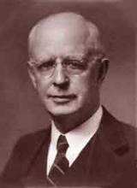
Lewis Sperry Chafer, vol. 7, Systematic Theology^{b} (Grand Rapids, MI: Kregel Publications, 1993), 265-66.
Belief-God’s One Condition for Justification
“…because upwards of 150 passages of Scripture condition salvation upon believing only (cf. John 3:16; Acts 16:31).

Slide 112
John MacArthur, Jr.
Tape GC 90-21 on Lordship salvation, last part of tape, comments made during the closing invitation.
“If faith is a gift of God, THEN HOW DO I GET IT? Do I do nothing and hope that God will sovereignly bestow it upon me? Or, do I cry out to God and pray that He will give me the gift of saving faith? Dr. MacArthur apparently holds to this second option. At the end of one of his messages he gave a salvation appeal and said the following: "Faith is a gift from God...it is permanent...the faith that God gives begets obedience...God gave it to you and He sustains it...May God grant you a true saving faith, a permanent gift that begins in humility and brokenness over sin and ends up in obedience unto righteousness. That's true faith and it's a gift that only God can give, and if you desire it pray and ask that He would grant it to you.”

Slide 113
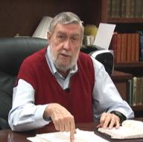
Jay Adams
Competent to Counsel, 70.
“But counselors, as Christians, are obligated to present the claims of Christ. They must present the good news that Christ Jesus died on the cross in the place of His own, that He bore the guilt and suffered the penalty for their sins. He died that all whom the Father had given to Him might come unto Him and have life everlasting. As a reformed Christian, the writer believes that counselors must not tell any unsaved counselee that Christ died for him, FOR THEY CANNOT SAY THAT. No man knows except Christ Himself who are His elect for whom He died." [emphasis mine]

Slide 114
iv. Miscellaneous Problems
Degree of faith mentioned? (Matt. 8:5-13)
Responsibility to believe?
Responsibility for not believing (John 3:18; 5:40)
Confuses the instrument with the agent
Reverses the subject (man)‒object (God) relationship
Romans 10:17
Confuses how the Gospel is shared
A lively corpse indeed?
Roman Catholic roots

Slide 115
John MacArthur, Jr.
Tape GC 90-21 on Lordship salvation, last part of tape, comments made during the closing invitation.
“If faith is a gift of God, THEN HOW DO I GET IT? Do I do nothing and hope that God will sovereignly bestow it upon me? Or, do I cry out to God and pray that He will give me the gift of saving faith? Dr. MacArthur apparently holds to this second option. At the end of one of his messages he gave a salvation appeal and said the following: "Faith is a gift from God...it is permanent...the faith that God gives begets obedience...God gave it to you and He sustains it...May God grant you a true saving faith, a permanent gift that begins in humility and brokenness over sin and ends up in obedience unto righteousness. That's true faith and it's a gift that only God can give, and if you desire it pray and ask that He would grant it to you.”

Slide 116
Roy L. Aldrich
“Thus an unscriptural doctrine of total depravity leads to an unscriptural and inconsistent plan of salvation. Doubtless the sinner is ‘dead in trespasses and sins’ (Eph. 2:1b). If this means that regeneration must precede faith, then it must also mean that regeneration must precede all three of the pious duties Shedd outlines for the lost [as seen in the following sentence]. A doctrine of total depravity that excludes the possibility of faith must also exclude the possibilities of ‘hearing the word,’ ‘giving serious application to divine truth,’ and ‘praying for the Holy Spirit for conviction and regeneration.’ The extreme Calvinist deals with a rather lively spiritual corpse after all. If the corpse has enough vitality to read the Word, and heed the message, and pray for conviction, perhaps it can also believe.”
Roy L. Aldrich, “The Gift of God,” Bibliotheca Sacra 122 (July–September 1965): 249.

Slide 117
iv. Miscellaneous Problems
Degree of faith mentioned? (Matt. 8:5-13)
Responsibility to believe?
Responsibility for not believing (John 3:18; 5:40)
Confuses the instrument with the agent
Reverses the subject (man)‒object (God) relationship
Romans 10:17
Confuses how the Gospel is shared
A lively corpse indeed?
Roman Catholic roots

Slide 118
Gary L. Nebeker
“the concept of infused faith for salvation bears a marked resemblance to the sacramentalism of the Roman Catholic Church. That is to say, faith becomes a transmitted and efficacious element which God gives to men for salvation.”
Gary L. Nebeker, “Is Faith a Gift of God? Ephesians 2:8 Reconsidered,” Grace Evangelical Society News, July 1989, 1.

Slide 119
Dave Hunt
“Most of those today, including evangelical leaders who hold Calvin in great esteem, are not aware that they have been captivated by the writings of a devout Roman Catholic, newly converted to Luther’s Protestantism, who had broken with Rome only a year before. Oddly, Calvin kept himself on the payroll of the Roman Catholic Church for nearly a year after he claimed to have been miraculously delivered from the ‘deep slough’ of ‘obstinate addiction to the superstitions of the papacy.’”
Dave Hunt, What Love Is This? Calvinism's Misrepresentation of God, 4th ed. (Bend, OR: Berean Call, 2013), 42.

Slide 120
Calvinistic Arguments
Faith is a gift
Regeneration precedes faith
Lost man cannot seek God (Rom. 3:11)

Slide 121
Regeneration Precedes Faith?
Definition
Calvinistic examples
Calvinist Proof texts
Biblical order
Ordo-Salutis
An eschatological parallel
Why believe?

Slide 122
Regeneration Precedes Faith?
Definition
Calvinistic examples
Calvinist Proof texts
Biblical order
Ordo-Salutis
An eschatological parallel
Why believe?

Slide 123
Regeneration
Definition – impartation of divine life
Palingenesia (Titus 3:5)
Needed because of spiritual death – Gen. 2:16-17; Eph. 2:1
New birth – John 3:5
Accomplished through exposure to God’s Word (Jas. 1:18; 1 Pet. 1:23; Rom. 10:17; 2 Tim. 3:15)
If you are born once you will die twice; if you are born twice you will die once

Slide 124
Regeneration Precedes Faith?
Definition
Calvinistic examples
Calvinist Proof texts
Biblical order
Ordo-Salutis
An eschatological parallel
Why believe?

Slide 125
David N. Steele & Curtis C. Thomas
“Thus, the once dead sinner is drawn to Christ by the inward, supernatural call of the Spirit, who through regeneration makes him alive and creates faith and repentance within him.”
David N. Steele, Curtis C. Thomas, and S. Lance Quinn, The Five Points of Calvinism, 2nd ed. (Phillipsburg, NJ: Presbyterian and Reformed Publishing, 1963), 53.

Slide 126
John MacArthur
“Furthermore, because of human depravity, there is nothing in a fallen, reprobate sinner that desires God or is capable of responding in faith...From the viewpoint of reason, regeneration logically must initiate faith and repentance.”
John F. MacArthur, Faith Works: The Gospel According to the Apostles (Dallas, TX: Word, 1993), 62 & n. 8.

Slide 127
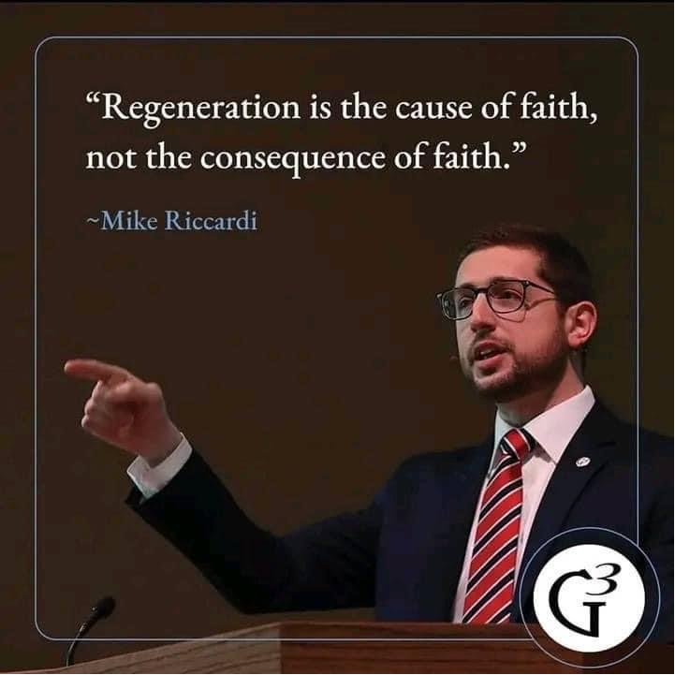

Slide 128
Tom Wells
“I am afraid we have come to think of faith and the new birth in just the opposite way. . . . If a man must repent and have faith in order to be born again—if he must make some such decision about it—then he is the cause, in part at least, of his own birth. No, the Biblical view is quite the opposite. Put simply, it is this. A man must be born again in order to exercise faith.”
Tom Wells, Faith: The Gift of God (Carlisle, PA: Banner of Truth Trust, 1983), 58.

Slide 130
R.C. Sproul
Sproul explains that according to the “Reformed view of predestination before a person can choose Christ he must be born again.”
R. C. Sproul, Chosen by God (Carol Stream, IL: Tyndale House Publishers, Inc., 1986), 72.

Slide 131
James White
White writes, “The Reformed assertion is that man cannot understand and embrace the gospel nor respond in faith and repentance toward Christ without God first freeing him from sin and giving him spiritual life (regeneration).”
James R. White, The Potter’s Freedom (Amityville, NY: Calvary Press Publishing, 2000), 101.

Slide 132
James White
White writes, “‘Irresistible grace’ is a reference to God’s sovereign regeneration of His elect: any other use of this phrase is in error.”
James R. White, The Potter’s Freedom (Amityville, NY: Calvary Press Publishing, 2000), 137.

Slide 133
J. I. Packer
“Without [regeneration] there is no faith in the redeemer, and therefore no benefit from His death…we are impotent to turn to Christ in repentance and faith; part of the effect of regeneration, however, is that faith dawns in our hearts.”
J. I. Packer, Great Grace (Ann Arbor, MI: Vine Books, 1997), 67.

Slide 134
David N. Steele & Curtis C. Thomas
“Because of the fall, man is an unable of himself to savingly believe the gospel. The sinner is dead, blind, and deaf to the things of God; his heart is deceitful and desperately corrupt. His will is not free, it is in bondage to his evil nature, therefore, he will not – indeed he cannot – choose good over evil in the spiritual realm. Consequently, it takes much more than the Spirit’s assistance to bring a sinner to Christ – it takes regeneration by which He makes the sinner alive and gives him a new nature. Faith is not something man contributes to salvation, but is itself a part of God‘s gift of salvation – it is God’s gift to the sinner, not the sinner’s gift to God.”
David N. Steele, Curtis C. Thomas, and S. Lance Quinn, The Five Points of Calvinism, 2nd ed. (Phillipsburg, NJ: Presbyterian and Reformed Publishing, 1963), 5-6.

Slide 135
Regeneration Precedes Faith?
Definition
Calvinistic examples
Calvinist Proof texts
Biblical order
Ordo-Salutis
An eschatological parallel
Why believe?

Slide 136
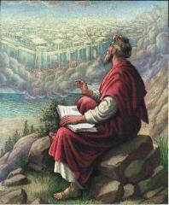
John 1:13
“who were born, not of blood nor of the will of the flesh nor of the will of man, but of God.”

Slide 137
John 1:12-13
“But as many as received Him, to them He gave the right to become children of God, even to those who believe in His name, ¹³ who were born, not of blood nor of the will of the flesh nor of the will of man, but of God.”

Slide 138
Ezekiel 36:24-28
“For I will take you from the nations, gather you from all the lands and bring you into your own land. ²⁵ Then I will sprinkle clean water on you, and you will be clean; I will cleanse you from all your filthiness and from all your idols. ²⁶ Moreover, I will give you a new heart and put a new spirit within you; and I will remove the heart of stone from your flesh and give you a heart of flesh. ²⁷ I will put My Spirit within you and cause you to walk in My statutes, and you will be careful to observe My ordinances. ²⁸ You will live in the land that I gave to your forefathers; so you will be My people, and I will be your God.”

Slide 139
Matthew 23:37-39
“Jerusalem, Jerusalem, who kills the prophets and stones those who are sent to her! How often I wanted to gather your children together, the way a hen gathers her chicks under her wings, and you were unwilling. ³⁸ Behold, your house is being left to you desolate! ³⁹ For I say to you, from now on you will not see Me until you say, ‘Blessed is He who comes in the name of the Lord!’”

Slide 140
Regeneration Precedes Faith?
Definition
Calvinistic examples
Calvinist Proof texts
Biblical order
Ordo-Salutis
An eschatological parallel
Why believe?

Slide 141
Belief – God’s One Condition for Justification
Gen 15:6
Then he believed in the LORD; and He reckoned it to him as righteousness.
John 3:16
For God so loved the world, that He gave His only begotten Son, that whoever believes in Him shall not perish, but have eternal life.
Acts 16:30-31
"Sirs, what must I do to be saved?" They said, "Believe in the Lord Jesus, and you will be saved..."

Slide 142
John 3:16
“For God so loved the world, that He gave His only begotten Son, that whoever believes in Him shall not perish, but have eternal life.”

Slide 143
John 5:24
“Truly, truly, I say to you, he who hears My word, and believes Him who sent Me, has eternal life, and does not come into judgment, but has passed out of death into life.”

Slide 144
John 6:40
“For this is the will of My Father, that everyone who beholds the Son and believes in Him will have eternal life, and I Myself will raise him up on the last day.”

Slide 145
John 6:47
“Truly, truly, I say to you, he who believes has eternal life.”

Slide 146
John 20:30-31
“Therefore many other signs Jesus also performed in the presence of the disciples, which are not written in this book; but these have been written so that you may believe that Jesus is the Christ, the Son of God; and that believing you may have life in His name.”

Slide 147
Regeneration Precedes Faith?
Definition
Calvinistic examples
Calvinist Proof texts
Biblical order
Ordo-Salutis
An eschatological parallel
Why believe?

Slide 148
John 16:7-11
“⁷ But I tell you the truth, it is to your advantage that I go away; for if I do not go away, the Helper will not come to you; but if I go, I will send Him to you. ⁸ And He, when He comes, will convict the world concerning sin (hamartia, singular noun) and righteousness and judgment; ⁹ concerning sin, because they do not believe in Me; ¹⁰ and concerning righteousness, because I go to the Father and you no longer see Me; ¹¹ and concerning judgment, because the ruler of this world has been judged.”

Slide 149
Divine Drawing vs. Divine Coercion
“We see then that while it is the Holy Spirit’s work to draw men to the Savior, it is incumbent on each individual to respond of his own free will prior to conversion.”
Bob Kirkland, Calvinism: None Dare Call It Heresy; Spotlight on the Life and Teachings of John Calvin (Eureka, MT: Lighthouse Trails, 2018), 40.

Slide 150
René A. Lopez
“In His convicting work the Holy Spirit draws sinners to Himself and waits for their simple response of faith. God then imparts eternal life to them the moment they believe. As Paul and Silas told the Philippian jailer, ‘Believe on the Lord Jesus Christ, and you will be saved‖ (Acts 16:31).’”
“Is Faith a Gift From God or a Human Exercise?,” Bibliotheca Sacra 164 (July–September 2007): 276.

Slide 151
Regeneration Precedes Faith?
Definition
Calvinistic examples
Calvinist Proof texts
Biblical order
Ordo-Salutis
An eschatological parallel
Why believe?

Slide 152
Matthew 19:28
“And Jesus said to them, ’Truly I say to you, that you who have followed Me, in the regeneration [palingenesia] when the Son of Man will sit on His glorious throne, you also shall sit upon twelve thrones, judging the twelve tribes of Israel.’”

Slide 153
Regeneration Precedes Faith?
Definition
Calvinistic examples
Calvinist Proof texts
Biblical order
Ordo-Salutis
An eschatological parallel
Why believe?

Slide 154
Charles Ryrie
“In the Reformed statement of the ordo salutis, regeneration precedes faith, for, it is argued, a sinner must be given new life in order to be able to believe. While this is admittedly stated only as a logical order, it is not wise to insist even on that; for it may as well be argued that if a sinner has new life through regeneration, why does he need to believe?”
Charles C. Ryrie, Basic Theology (Wheaton, IL: Victor, 1986; reprint, Chicago: Moody, 1999), 326.

Slide 155
Does Regeneration Precede Faith?
"If I am to preach the faith in Christ to a man who is regenerated, then the man, being regenerated, is saved already, and it is an unnecessary and ridiculous thing for me to preach Christ to him, and bid him to believe in order to be saved when he is saved already, being regenerate. Am I only to preach faith to those who have it? Absurd, indeed! Is not this waiting till the man is cured and then bringing him the medicine? This is preaching Christ to the righteous and not to sinners."
[Spurgeon - Sermon entitled, The Warrant of Faith].

Slide 156
Calvinistic Arguments
Faith is a gift
Regeneration precedes faith
Lost man cannot seek God (Rom. 3:11)

Slide 157
Romans 3:11
“There is none who understands, There is none who seeks for God.”

Slide 158
2 Corinthians 4:4
“in whose case the god of this world has blinded the minds of the unbelieving so that they might not see the light of the gospel of the glory of Christ, who is the image of God.”

Slide 159
Lost Man Cannot Seek God?
No biblical verse indicates that lost man cannot believe when convicted
Lost man is held accountable for not believing (Matt. 23:37; John 3:18; 4:48; 5:40)
Lost man can believe (John 1:12; 20:31; 1 Cor. 1:21; 1 John 5:10)

Slide 160
Lost Man Cannot Seek God?
No biblical verse indicates that lost man cannot believe when convicted
Lost man is held accountable for not believing (Matt. 23:37; John 3:18; 4:48; 5:40)
Lost man can believe (John 1:12; 20:31; 1 Cor. 1:21; 1 John 5:10)

Slide 161
John 16:7-11
“⁷ But I tell you the truth, it is to your advantage that I go away; for if I do not go away, the Helper will not come to you; but if I go, I will send Him to you. ⁸ And He, when He comes, will convict the world concerning sin (hamartia, singular noun) and righteousness and judgment; ⁹ concerning sin, because they do not believe in Me; ¹⁰ and concerning righteousness, because I go to the Father and you no longer see Me; ¹¹ and concerning judgment, because the ruler of this world has been judged.”

Slide 162
2 Timothy 3:15
“and that from childhood you have known the sacred writings which are able to give you the wisdom that leads to salvation through faith which is in Christ Jesus.”

Slide 163
2 Timothy 3:16-17
“All Scripture is inspired by God [theopneustos] and profitable for teaching, for reproof, for correction, for training in righteousness; so that the man of God may be adequate, equipped for every good work.”

Slide 164
Isaiah 55:10-11
¹⁰ “For as the rain and the snow come down from heaven, And do not return there without watering the earth And making it bear and sprout, And furnishing seed to the sower and bread to the eater; ¹¹ So will My word be which goes forth from My mouth; It will not return to Me empty, Without accomplishing what I desire, And without succeeding in the matter for which I sent it.”

Slide 165
Romans 10:17
“So faith comes from hearing, and hearing by the word of Christ.”

Slide 166
Romans 1:16
“For I am not ashamed of the gospel, for it is the power of God for salvation to everyone who believes, to the Jew first and also to the Greek.”

Slide 167
Psalm 19:1-4
“¹ The heavens are telling of the glory of God; And their expanse is declaring the work of His hands. ² Day to day pours forth speech, And night to night reveals knowledge. ³ There is no speech, nor are there words; Their voice is not heard. ⁴ Their line has gone out through all the earth, And their utterances to the end of the world. In them He has placed a tent for the sun.”

Slide 168
Romans 1:18-20
“¹⁸ For the wrath of God is revealed from heaven against all ungodliness and unrighteousness of men who suppress the truth in unrighteousness, ¹⁹ because that which is known about God is evident within them; for God made it evident to them. ²⁰ For since the creation of the world His invisible attributes, His eternal power and divine nature, have been clearly seen, being understood through what has been made, so that they are without excuse.”

Slide 169
Romans 2:14–16
¹⁴ “For when Gentiles who do not have the Law do instinctively the things of the Law, these, not having the Law, are a law to themselves, ¹⁵ in that they show the work of the Law written in their hearts, their conscience bearing witness and their thoughts alternately accusing or else defending them, ¹⁶ on the day when, according to my gospel, God will judge the secrets of men through Christ Jesus.”

Slide 170
Dr. Robert R. Congdon
Oops! I Thought I Was a Four - Pt Calvinist (Greer, SC: Congdon Ministries International, 2014), 48.
“While I do agree that salvation comes through the workings of the Holy Spirit and the Word of God, I disagree with the idea that God must first predispose some to believe and receive it, for the Word of God and the Holy Spirit are sufficient in and of themselves in bringing about the new birth. Instead of forcing individuals to be saved through the irresistible prompting of the Holy Spirit, God uses His Word and the convicting work of the Holy Spirit to confirm its truth in order to bring individuals to the point of decision. It is certainly God’s grace that offers it, but at this point they are free to accept or reject salvation.”

Slide 171
Dr. Robert R. Congdon
Oops! I Thought I Was a Four - Pt Calvinist (Greer, SC: Congdon Ministries International, 2014), 69-70.
“…their [Calvinism’s] definition of total depravity negates the sufficiency of the power of the Word of God and the Holy Spirit to give life...”

Slide 172
Lost Man Cannot Seek God?
No biblical verse indicates that lost man cannot believe when convicted
Lost man is held accountable for not believing (Matt. 23:37; John 3:18; 4:48; 5:40)
Lost man can believe (John 1:12; 20:31; 1 Cor. 1:21; 1 John 5:10)

Slide 173
Matthew 23:37-39
“Jerusalem, Jerusalem, who kills the prophets and stones those who are sent to her! How often I wanted to gather your children together, the way a hen gathers her chicks under her wings, and you were unwilling. ³⁸ Behold, your house is being left to you desolate! ³⁹ For I say to you, from now on you will not see Me until you say, ‘Blessed is He who comes in the name of the Lord!’”

Slide 174
Lost Man Cannot Seek God?
No biblical verse indicates that lost man cannot believe when convicted
Lost man is held accountable for not believing (Matt. 23:37; John 3:18; 4:48; 5:40)
Lost man can believe (John 1:12; 20:31; 1 Cor. 1:21; 1 John 5:10)

Slide 175
John 1:12-13
“But as many as received Him, to them He gave the right to become children of God, even to those who believe in His name, ¹³ who were born, not of blood nor of the will of the flesh nor of the will of man, but of God.”

Slide 176
John 20:30-31
“Therefore many other signs Jesus also performed in the presence of the disciples, which are not written in this book; but these have been written so that you may believe that Jesus is the Christ, the Son of God; and that believing you may have life in His name.”

Slide 177
Lewis Sperry Chafer, vol. 7, Systematic Theology^{b} (Grand Rapids, MI: Kregel Publications, 1993), 265-66.
Belief-God’s One Condition for Justification
“…because upwards of 150 passages of Scripture condition salvation upon believing only (cf. John 3:16; Acts 16:31).

Slide 178
Irresistible Grace
Calvinistic definition
Calvinistic arguments
Man can resist God’s grace
Man can resist God by disbelieving
John 6:44?

Slide 179
Man Can Resist God’s Grace
Gen. 6:3 (1 Pet. 3:20; 2 Pet. 2:5)
Prov. 1:24-25; 29:1
Matt. 23:37
John 12:32 (Rev. 20:11-15)
Acts 7:51
Heb. 12:25

Slide 180
Man Can Resist God’s Grace
Gen. 6:3 (1 Pet. 3:20; 2 Pet. 2:5)
Prov. 1:24-25; 29:1
Matt. 23:37
John 12:32 (Rev. 20:11-15)
Acts 7:51
Heb. 12:25

Slide 181
Genesis 6:1-4
“¹ Now it came about, when men began to multiply on the face of the land, and daughters were born to them, ² that the sons of God saw that the daughters of men were beautiful; and they took wives for themselves, whomever they chose. ³ Then the Lord said, ‘My Spirit shall not strive with man forever, because he also is flesh; nevertheless his days shall be one hundred and twenty years.’ ⁴ The Nephilim were on the earth in those days, and also afterward, when the sons of God came in to the daughters of men, and they bore children to them. Those were the mighty men who were of old, men of renown.”

Slide 182
Dr. Henry M. Morris
The Genesis Record, 144
“The ancient quibble about ‘Cain’s wife’ is thus seen to be quite trivial. Long before Cain died, there was a large population in the earth. By the time of the Deluge, 1,656 years after Creation by the Ussher chronology, even using the above conservative assumptions, the world population would have been at least seven billion people!”

Slide 183
Man Can Resist God’s Grace
Gen. 6:3 (1 Pet. 3:20; 2 Pet. 2:5)
Prov. 1:24-25; 29:1
Matt. 23:37
John 12:32 (Rev. 20:11-15)
Acts 7:51
Heb. 12:25

Slide 184
Matthew 23:37-39
“Jerusalem, Jerusalem, who kills the prophets and stones those who are sent to her! How often I wanted to gather your children together, the way a hen gathers her chicks under her wings, and you were unwilling. ³⁸ Behold, your house is being left to you desolate! ³⁹ For I say to you, from now on you will not see Me until you say, ‘Blessed is He who comes in the name of the Lord!’”

Slide 185
Man Can Resist God’s Grace
Gen. 6:3 (1 Pet. 3:20; 2 Pet. 2:5)
Prov. 1:24-25; 29:1
Matt. 23:37
John 12:32 (Rev. 20:11-15)
Acts 7:51
Heb. 12:25

Slide 186
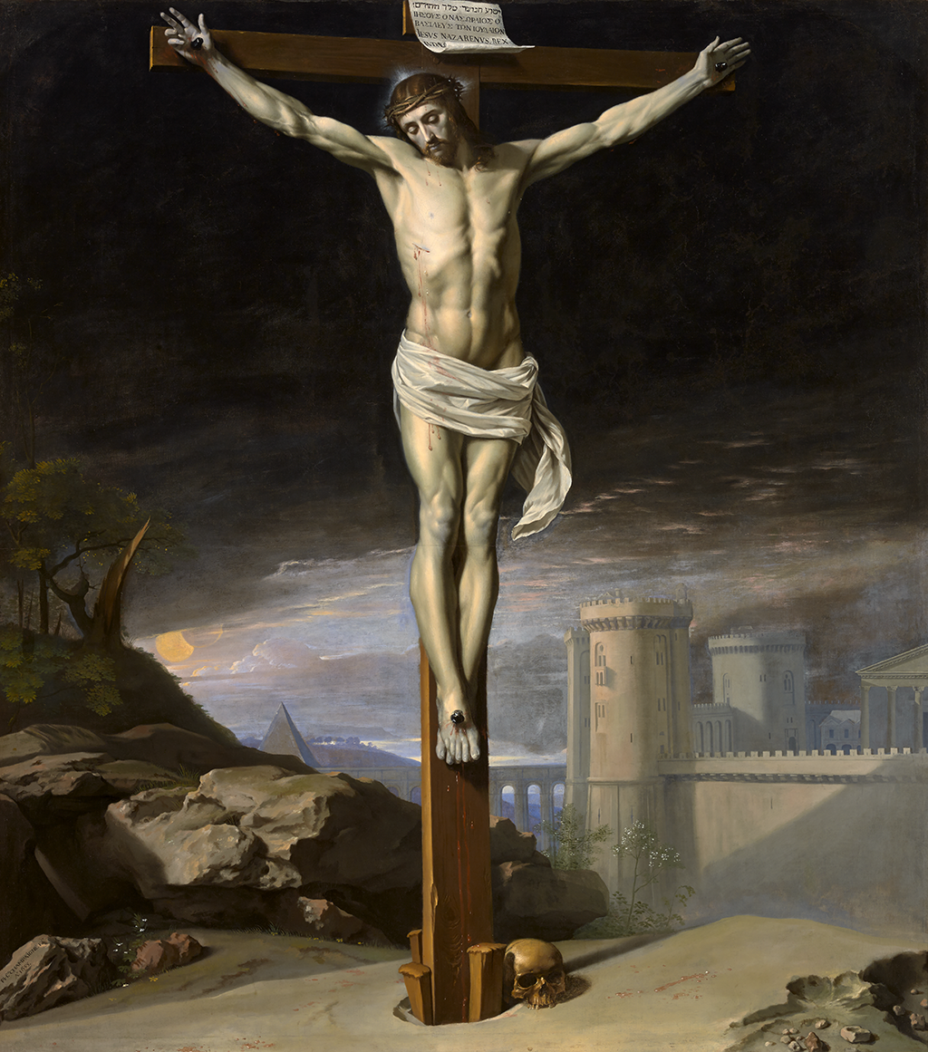
John 12:32
“And I, if I am lifted up from the earth, will draw (helkyō) all men to Myself.”

Slide 187
Man Can Resist God’s Grace
Gen. 6:3 (1 Pet. 3:20; 2 Pet. 2:5)
Prov. 1:24-25; 29:1
Matt. 23:37
John 12:32 (Rev. 20:11-15)
Acts 7:51
Heb. 12:25

Slide 188
Irresistible Grace
Calvinistic definition
Calvinistic arguments
Man can resist God’s grace
Man can resist God by disbelieving
John 6:44?

Slide 189
Man Can Resist God By Disbelieving
John 10:25
John 12:37
Acts 9:26; Acts 17:5; 19:9; 28:4
2 Thess. 2:12

Slide 190
Irresistible Grace
Calvinistic definition
Calvinistic arguments
Man can resist God’s grace
Man can resist God by disbelieving
John 6:44?

Slide 191
John 6:44
“No one can come to Me unless the Father who sent Me draws (helkyō) him; and I will raise him up on the last day.”

Slide 192
John 6:44?
Verb helkyō can mean “drag” (Acts 21:30; Jas. 2:6)
What does it mean in John’s Gospel?
John 12:32, 37-40
John 18:10; 21:6, 11 (inanimate objects)
Verb helkyō can mean “attract” or “draw” rather than coerce

Slide 193
John 6:44?
Verb helkyō can mean “drag” (Acts 21:30; Jas. 2:6)
What does it mean in John’s Gospel?
John 12:32, 37-40
John 18:10; 21:6, 11 (inanimate objects)
Verb helkyō can mean “attract” or “draw” rather than coerce

Slide 194
John 6:44?
Verb helkyō can mean “drag” (Acts 21:30; Jas. 2:6)
What does it mean in John’s Gospel?
John 12:32, 37-40
John 18:10; 21:6, 11 (inanimate objects)
Verb helkyō can mean “attract” or “draw” rather than coerce

Slide 195
John 6:44?
Verb helkyō can mean “drag” (Acts 21:30; Jas. 2:6)
What does it mean in John’s Gospel?
John 12:32, 37-40
John 18:10; 21:6, 11 (inanimate objects)
Verb helkyō can mean “attract” or “draw” rather than coerce

Slide 196
John 12:32
“And I, if I am lifted up from the earth, will draw (helkyō) all men to Myself.”

Slide 197
John 6:44?
Verb helkyō can mean “drag” (Acts 21:30; Jas. 2:6)
What does it mean in John’s Gospel?
John 12:32, 37-40
John 18:10; 21:6, 11 (inanimate objects)
Verb helkyō can mean “attract” or “draw” rather than coerce

Slide 198
John 6:44?
Verb helkyō can mean “drag” (Acts 21:30; Jas. 2:6)
What does it mean in John’s Gospel?
John 12:32, 37-40
John 18:10; 21:6, 11 (inanimate objects)
Verb helkyō can mean “attract” or “draw” rather than coerce

Slide 199
Frederick L. Godet
“helkyō, to draw, does not necessarily denote an effectual drawing. This word may refer only to the preaching of the cross throughout the whole world and the action of the Holy Spirit which accompanies it. This heavenly drawing is not irresistible.”
Frederick L. Godet, Commentary on the Gospel of John, trans. Timothy Dwight [n.p.: Funk & Wagnalls, 1893; reprint, Grand Rapids: Zondervan, n.d.], 228.

Slide 200
John 6:40, 44
“For this is the will of My Father, that everyone who beholds the Son and believes in Him will have eternal life, and I Myself will raise him up on the last day…No one can come to Me unless the Father who sent Me draws (helkyō) him; and I will raise him up on the last day.”

Slide 201
V. Running TULIP Through the Grid of Scripture
Total Depravity
Unconditional Election
Limited Atonement
Irresistible Grace
Perseverance of the Saints

