Slide 1
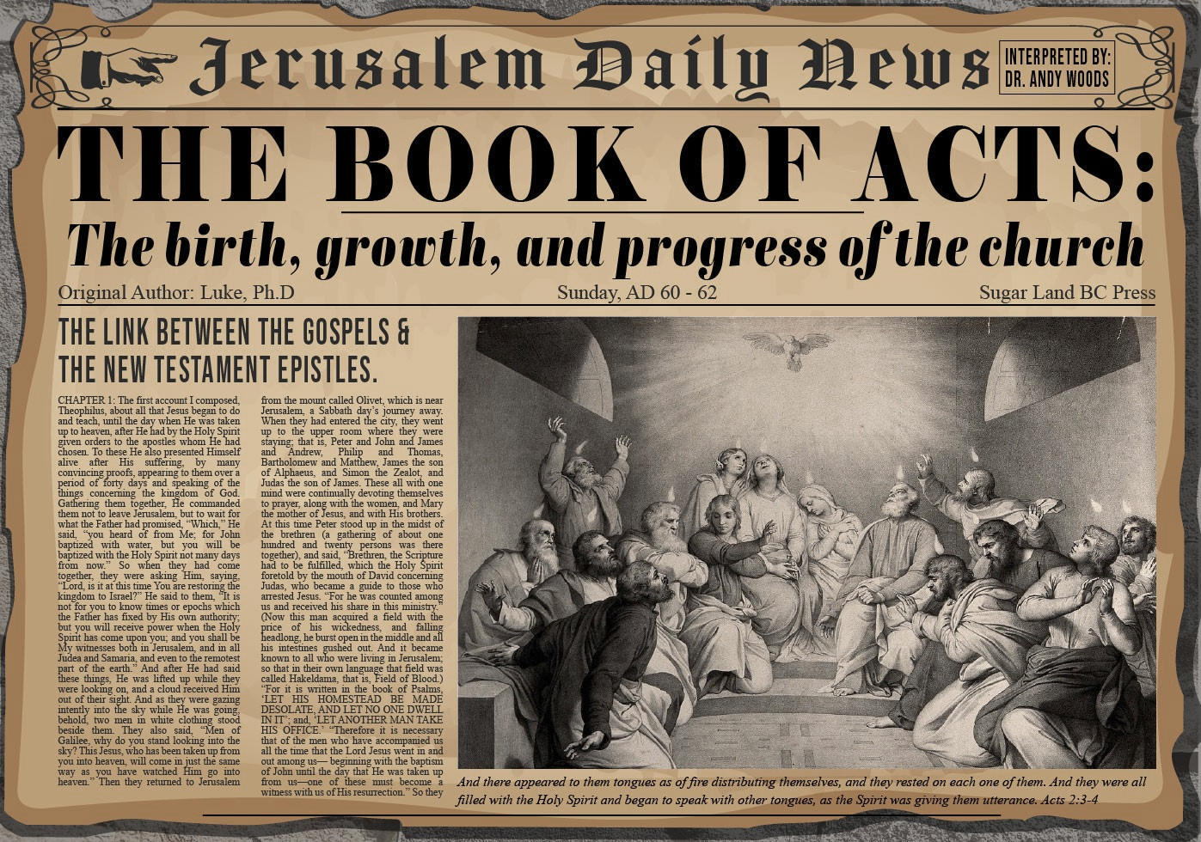


Slide 2

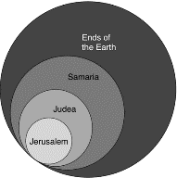
Acts 1:8
“but you will receive power when the Holy Spirit has come upon you; and you shall be My witnesses both in Jerusalem, and in all Judea and Samaria, and even to the remotest part of the earth.”

Slide 3
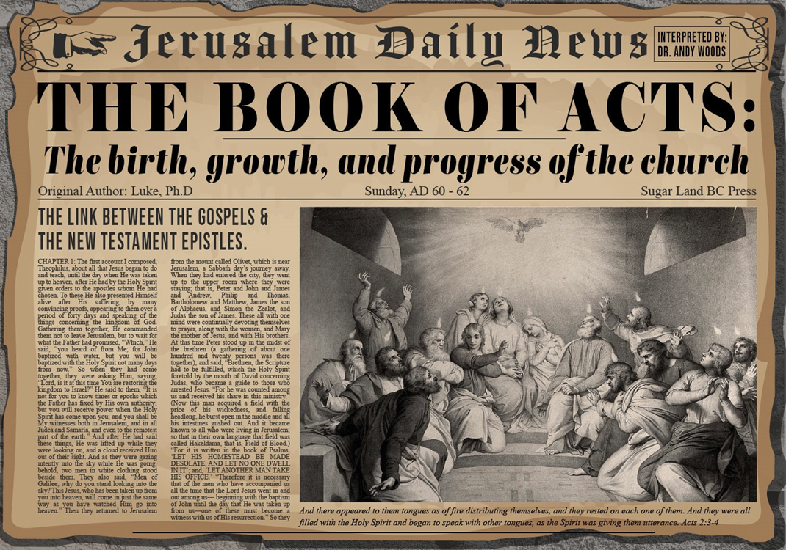
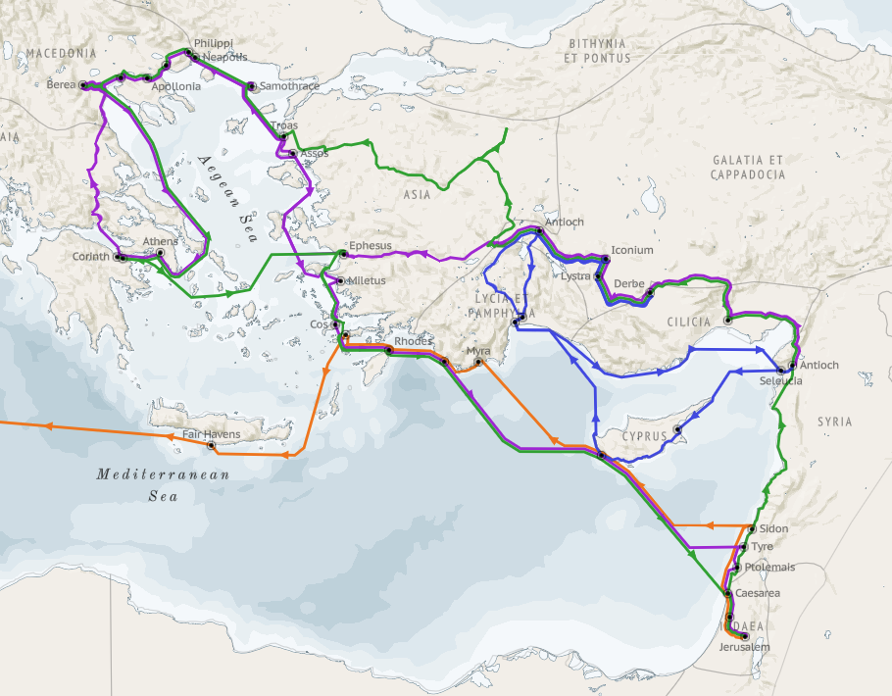
Structure (Acts 1:8)
  Jerusalem (Acts 1–7)
  Judea and Samaria (Acts 8–12)
  Remotest part of the earth (Acts 13–28)
  1st missionary journey (Acts 13–14)
  Jerusalem council (Acts 15:1-35)
  2nd missionary journey (Acts 15:36 –18:22)
  3rd missionary journey (Acts 18:23–21:17)
  Trip to Rome (Acts 21:18–28:31)

Slide 4
Acts 13‒14
1st Missionary Journey
  Paul & Barnabas’ appointment (13:1-3)
  Cyprus ministry (13:4-12)
  Pisidian Antioch ministry (13:13-52)
  Iconium ministry (14:1-7)
  Lystra ministry (14:8-20a)
  Derbe ministry (14:20b-21a)
  Return to Antioch (14:21b-28)

Slide 5
III. Pisidia Antioch Ministry
Acts 13:13-52
  Journey to Pisidian Antioch (13-15)
  Paul’s message (16-41)
  Results of Paul’s message (42-52)

Slide 6
III. Pisidia Antioch Ministry
Acts 13:13-52
  Journey to Pisidian Antioch (13-15)
  Paul’s message (16-41)
  Results of Paul’s message (42-52)

Slide 7
Acts 13:13-15
Pisidian Antioch Ministry
      Cyprus to Perga journey (13a)
      John Mark’s departure (13b)
      Journey to Pisidian Antioch via Perga (14a)
      Occasion for Paul’s message (14b-15)

Slide 8
Acts 13:13-15
Pisidian Antioch Ministry
      Cyprus to Perga journey (13a)
      John Mark’s departure (13b)
      Journey to Pisidian Antioch via Perga (14a)
      Occasion for Paul’s message (14b-15)

Slide 9

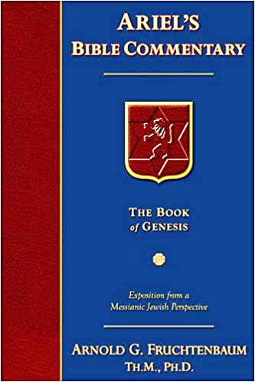
Dr. Arnold G. Fruchtenbaum
The Book of Acts, 286-87
“Verse 9a gives an explanation of Saul’s name: But Saul, who is also called Paul. Some claim that after being saved, Saul changed his name to Paul, but that is not true. Jews of the Diaspora who were Roman citizens, such as Saul, always had a Jewish name and a Gentile name. Now that he was operating in the Roman world ministering among Gentiles, Saul’s Latin name began to be used. Hence, from this point on, Luke called him ‘Saul’ only in reference to his past, such as in Acts 22:7 and 26:14. Paul now took the lead, and only in rare exceptions would his name appear after Barnabas’. The exceptions include Acts 14:14; 15:12 , and 25.”

Slide 10
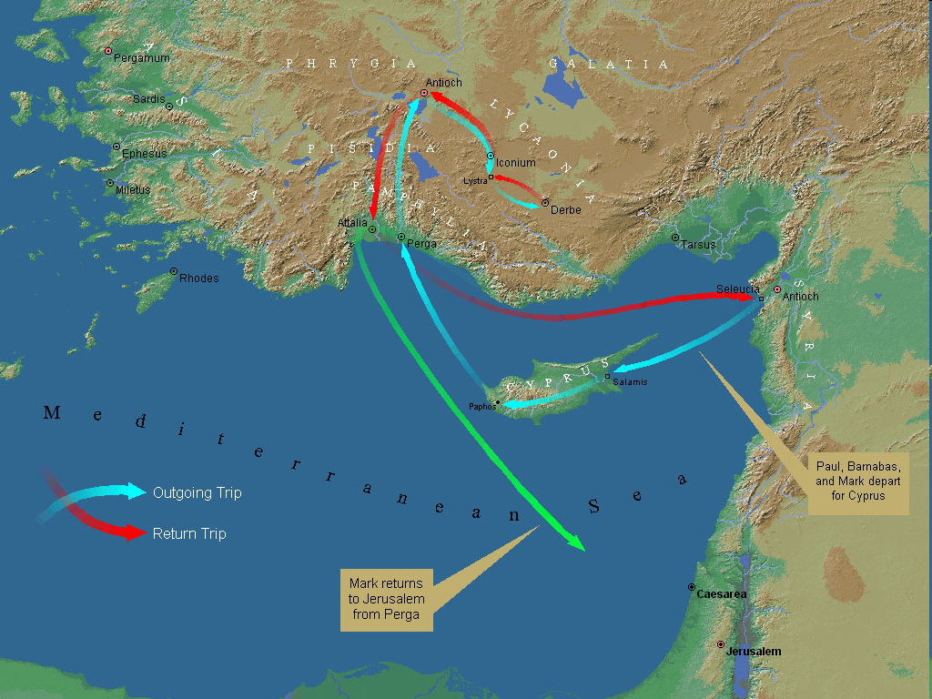
First Missionary Journey

Slide 11
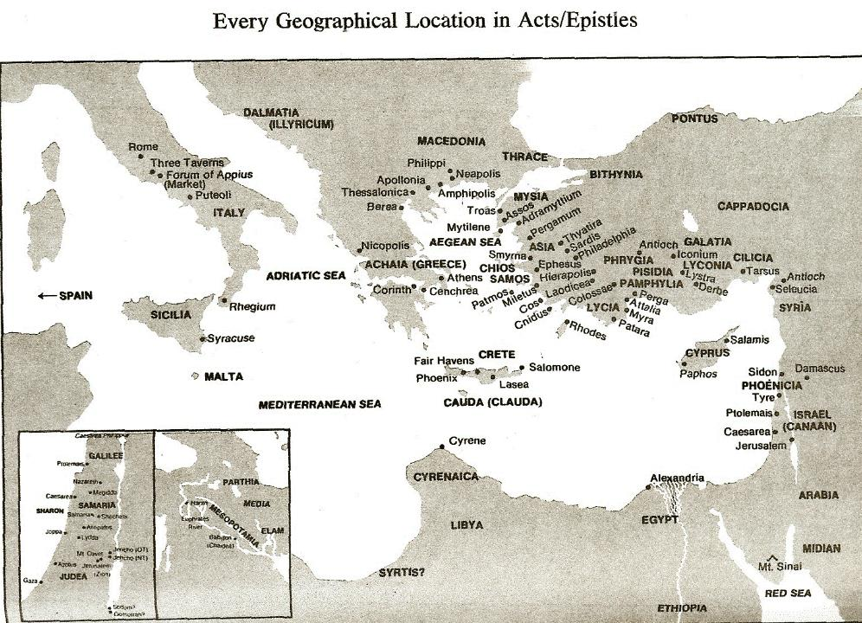

Slide 12
Acts 13:13-15
Pisidian Antioch Ministry
      Cyprus to Perga journey (13a)
      John Mark’s departure (13b)
      Journey to Pisidian Antioch via Perga (14a)
      Occasion for Paul’s message (14b-15)

Slide 13
First Missionary Journey

Slide 14
Dr. Stanley Toussaint
Toussaint, S. D. (1985). Acts. In J. F. Walvoord & R. B. Zuck (Eds.), The Bible Knowledge Commentary: An Exposition of the Scriptures (Vol. 2, pp. 388–389). Victor Books.
“So Paul and his companions sailed to Perga in Pamphylia. But John (i.e., John Mark) left them and returned to Jerusalem. What caused Mark to desert is open to speculation: (1) Perhaps he was disillusioned with the change in leadership. After all, Barnabas, the original leader, was John Mark’s cousin. (2) The new emphasis on Gentiles may have been too much of an adjustment for a Palestinian Jew like Mark. (3) Possibly he was afraid of the dangerous road over the Taurus Mountains to Antioch which Paul was determined to travel. “(4) There is some evidence Paul became quite ill in Perga, possibly with malaria, as the city of …

Slide 15
Dr. Stanley Toussaint
Toussaint, S. D. (1985). Acts. In J. F. Walvoord & R. B. Zuck (Eds.), The Bible Knowledge Commentary: An Exposition of the Scriptures (Vol. 2, pp. 388–389). Victor Books.
...Perga was subject to malarial infections. Furthermore, Paul preached to the people of Galatia “because of an illness” (Gal. 4:13). The missionary party may have gone inland to higher ground to avoid the ravages of malaria and Mark in discouragement over this may have returned home. (5) Some think Mark was homesick. His mother may have been a widow (Acts 12:12); perhaps Mark became lonesome for her and home. Whatever the reason, Paul considered it a defection and a fault (cf. 15:38).”

Slide 16
Acts 13:13-15
Pisidian Antioch Ministry
      Cyprus to Perga journey (13a)
      John Mark’s departure (13b)
      Journey to Pisidian Antioch via Perga (14a)
      Occasion for Paul’s message (14b-15)

Slide 17
First Missionary Journey

Slide 19
First Missionary Journey

Slide 21
Acts 13:13-15
Pisidian Antioch Ministry
      Cyprus to Perga journey (13a)
      John Mark’s departure (13b)
      Journey to Pisidian Antioch via Perga (14a)
      Occasion for Paul’s message (14b-15)

Slide 22
Acts 13:14b-15
Occasion for Paul’s Message
      Synagogue’s location (14b)
      Synagogue’s invitation (15)

Slide 23
Acts 13:14b-15
Occasion for Paul’s Message
      Synagogue’s location (14b)
      Synagogue’s invitation (15)

Slide 24
Acts 13:14b-15
Occasion for Paul’s Message
      Synagogue’s location (14b)
      Synagogue’s invitation (15)

Slide 25

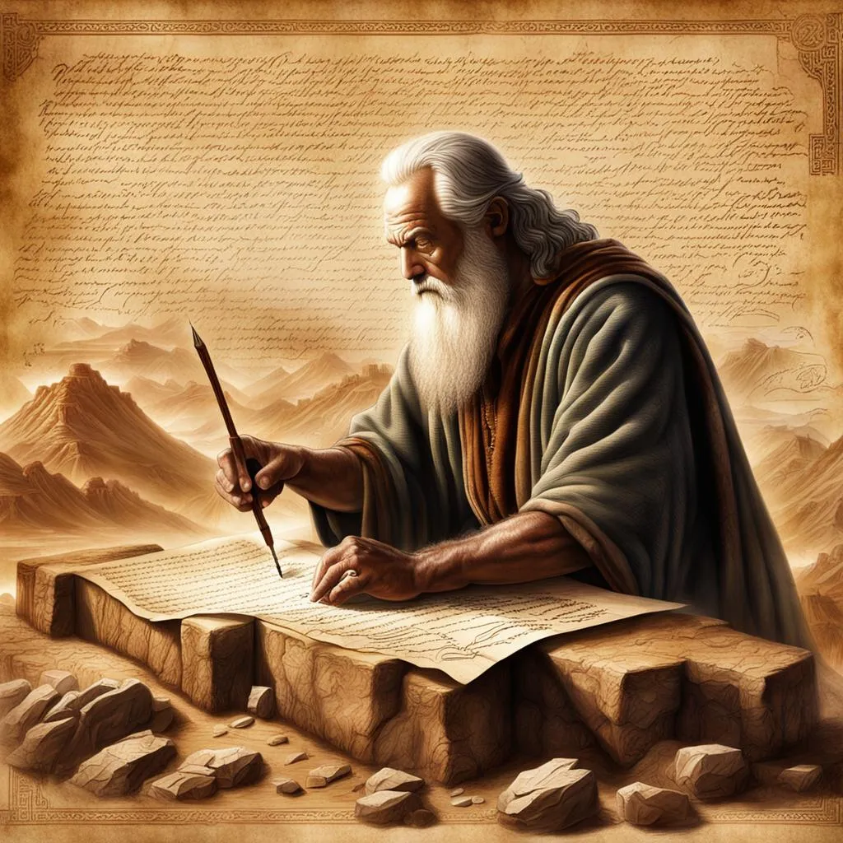
John 5:39, 46
“³⁹ You search the Scriptures because you think that in them you have eternal life; it is these that testify about Me…⁴⁶ For if you believed Moses, you would believe Me, for he wrote about Me.”

Slide 26
Luke 24:27, 44
“²⁷ Then beginning with Moses and with all the prophets, He explained to them the things concerning Himself in all the Scriptures…⁴⁴ Now He said to them, ‘These are My words which I spoke to you while I was still with you, that all things which are written about Me in the Law of Moses and the Prophets and the Psalms must be fulfilled.’”

Slide 27

Acts 17:1-3
“¹ Now when they had traveled through Amphipolis and Apollonia, they came to Thessalonica, where there was a synagogue of the Jews. ² And according to Paul’s custom, he visited them, and for three Sabbaths reasoned with them from the Scriptures, ³ explaining and giving evidence that the Christ had to suffer and rise from the dead, and saying, “This Jesus whom I am proclaiming to you is the Christ.”

Slide 28

1 Corinthians 15:3-4
“³ For I handed down to you as of first importance what I also received, that Christ died for our sins according to the Scriptures, ⁴ and that He was buried, and that He was raised on the third day according to the Scriptures.”

Slide 29
III. Pisidia Antioch Ministry
Acts 13:13-52
  Journey to Pisidian Antioch (13-15)
  Paul’s message (16-41)
  Results of Paul’s message (42-52)

Slide 30
Acts 13:16-41
Paul’s Message
      Introduction (16)
      Historical background (17-22)
      Messiah (23-25)
      Gospel (26-29)
      Resurrection (30-37)
      Application to Paul’s audience (38-39)
      Warning (40-41)

Slide 31
Acts 13:16-41
Paul’s Message
      Introduction (16)
      Historical background (17-22)
      Messiah (23-25)
      Gospel (26-29)
      Resurrection (30-37)
      Application to Paul’s audience (38-39)
      Warning (40-41)

Slide 32
Acts 13:16-41
Paul’s Message
      Introduction (16)
      Historical background (17-22)
      Messiah (23-25)
      Gospel (26-29)
      Resurrection (30-37)
      Application to Paul’s audience (38-39)
      Warning (40-41)

Slide 33
Acts 13:17-22
Historical Background
      Exodus (17)
      Wilderness wanderings (18)
      Conquest (19)
      Judges (20)
      Saul (21)
      David (22)

Slide 34
Acts 13:17-22
Historical Background
      Exodus (17)
      Wilderness wanderings (18)
      Conquest (19)
      Judges (20)
      Saul (21)
      David (22)

Slide 35
The Plagues of Egypt
NO. | DESCRIPTION | SCRIPTURE | Egyptian Deity
1. | Water to Blood | Exod. 7:14-25 | Hapi, Khnum
2. | Frogs | Exod. 8:1-15 | Heqt
3. | Gnats | Exod. 8:16-19 | Set
4. | Flies | Exod. 8:20-32 | Uatchit
5. | Disease on Cattle | Exod. 9:1-7 | Hathor, Apis
6. | Boils | Exod. 9:8-12 | Sekhmet, Serapis
7. | Hail | Exod. 9:13-35 | Seth, Nut
8. | Locusts | Exod. 10:1-20 | Seth, Nut, Osiris
9. | Darkness | Exod. 10:21-29 | Re, Horus, Atum
10. | Death of the First Born | Exod. 12:29-36 | Min, Osiris, Heqt, Isis

Slide 36
Acts 13:17-22
Historical Background
      Exodus (17)
      Wilderness wanderings (18)
      Conquest (19)
      Judges (20)
      Saul (21)
      David (22)

Slide 37
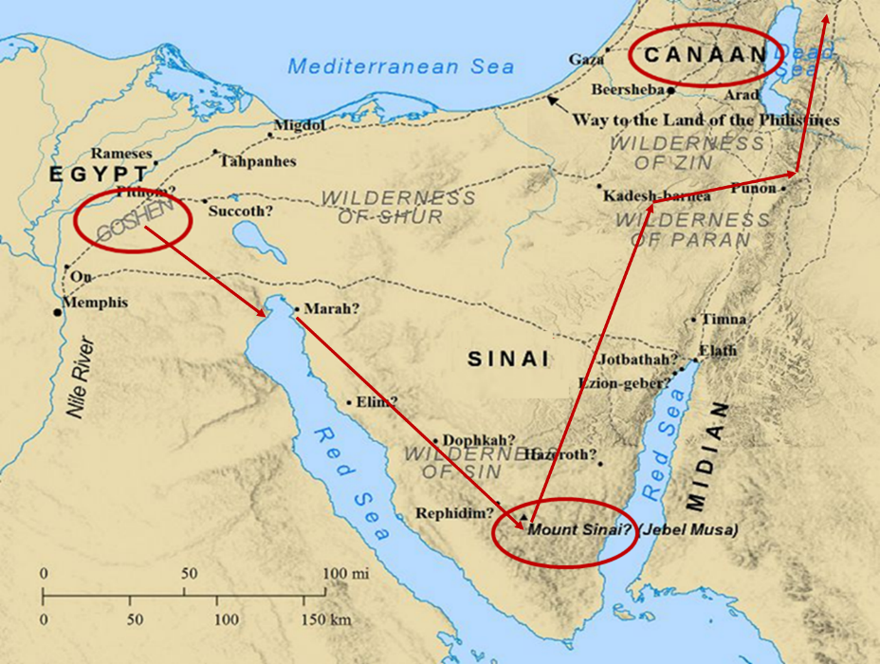

Slide 38
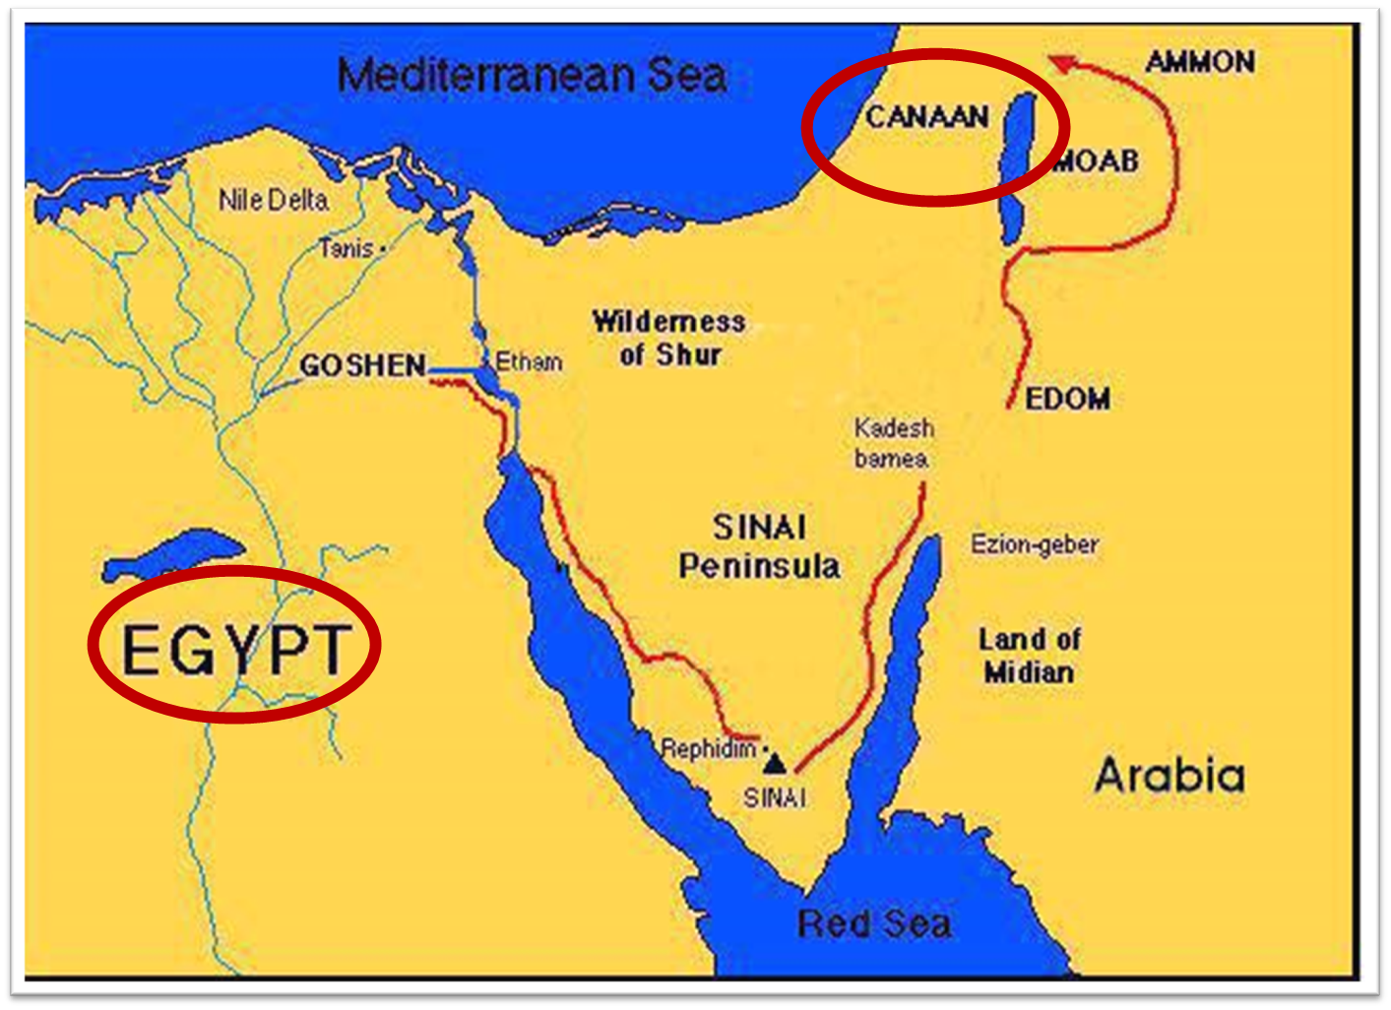

Slide 39
Acts 13:17-22
Historical Background
      Exodus (17)
      Wilderness wanderings (18)
      Conquest (19)
      Judges (20)
      Saul (21)
      David (22)

Slide 40
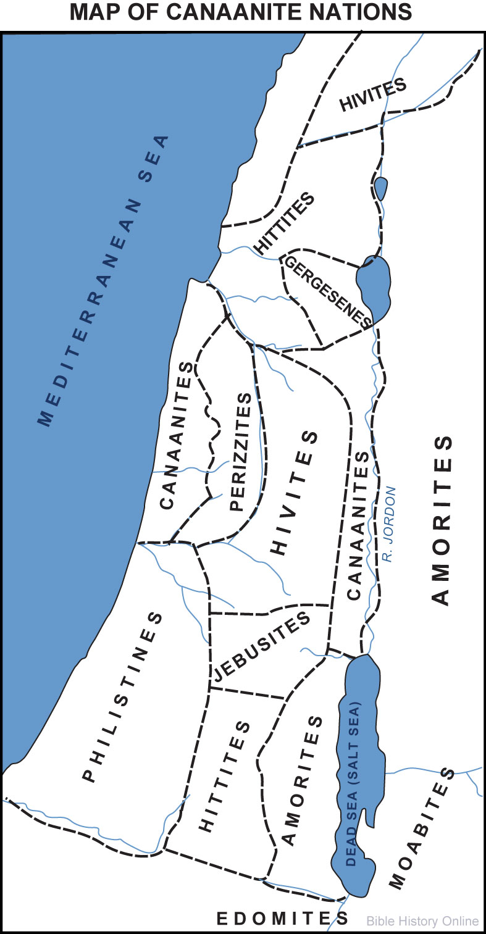

Slide 41
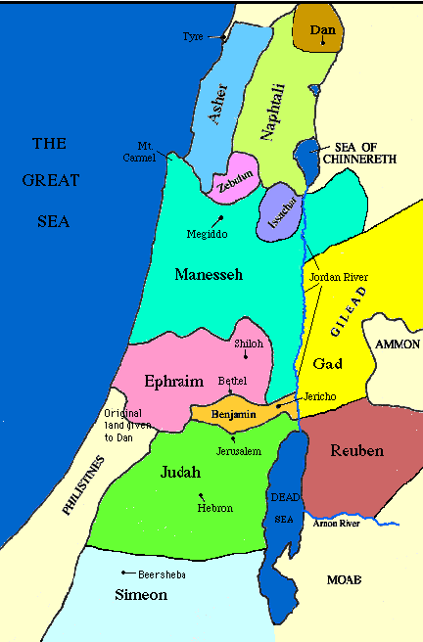

Slide 42
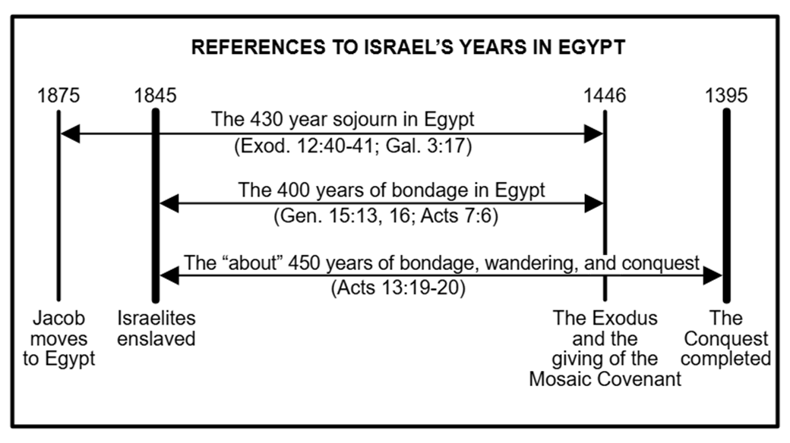

Slide 43
Acts 13:17-22
Historical Background
      Exodus (17)
      Wilderness wanderings (18)
      Conquest (19)
      Judges (20)
      Saul (21)
      David (22)

Slide 44
Acts 13:17-22
Historical Background
      Exodus (17)
      Wilderness wanderings (18)
      Conquest (19)
      Judges (20)
      Saul (21)
      David (22)

Slide 45
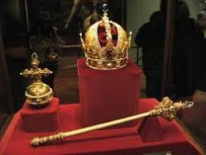
Genesis 49:10
“The scepter shall not depart from Judah, Nor the ruler’s staff from between his feet, Until Shiloh comes, And to him shall be the obedience of the peoples.”

Slide 46
Acts 13:17-22
Historical Background
      Exodus (17)
      Wilderness wanderings (18)
      Conquest (19)
      Judges (20)
      Saul (21)
      David (22)

Slide 47
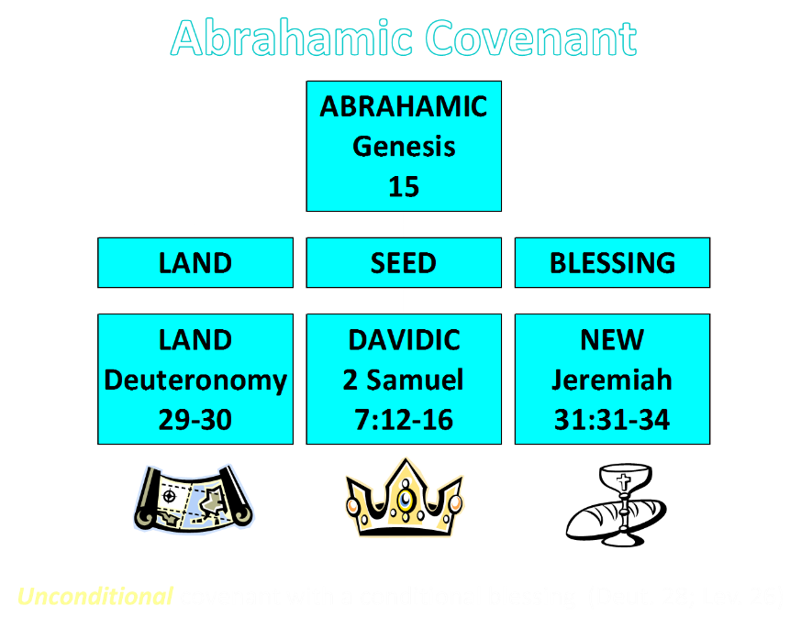

Slide 48

2 Samuel 7:12-16
“When your days are complete and you lie down with your fathers, I will raise up your descendant after you, who will come forth from you, and I will establish his kingdom. ¹³ He shall build a house for My name, and I will establish the throne of his kingdom forever. ¹⁴ I will be a father to him and he will be a son to Me; when he commits iniquity, I will correct him with the rod of men and the strokes of the sons of men, ¹⁵ but My lovingkindness shall not depart from him, as I took it away from Saul, whom I removed from before you. ¹⁶ Your house and your kingdom shall endure before Me forever; your throne shall be established forever.” ¹⁷ In accordance with all these words and all this vision, so Nathan spoke to David.”

Slide 49
Acts 13:16-41
Paul’s Message
      Introduction (16)
      Historical background (17-22)
      Messiah (23-25)
      Gospel (26-29)
      Resurrection (30-37)
      Application to Paul’s audience (38-39)
      Warning (40-41)

Slide 50
Acts 13:23-25
Messiah
      Davidic Covenant (23)
      John the Baptist (24-25)

Slide 51
Acts 13:23-25
Messiah
      Davidic Covenant (23)
      John the Baptist (24-25)

Slide 52
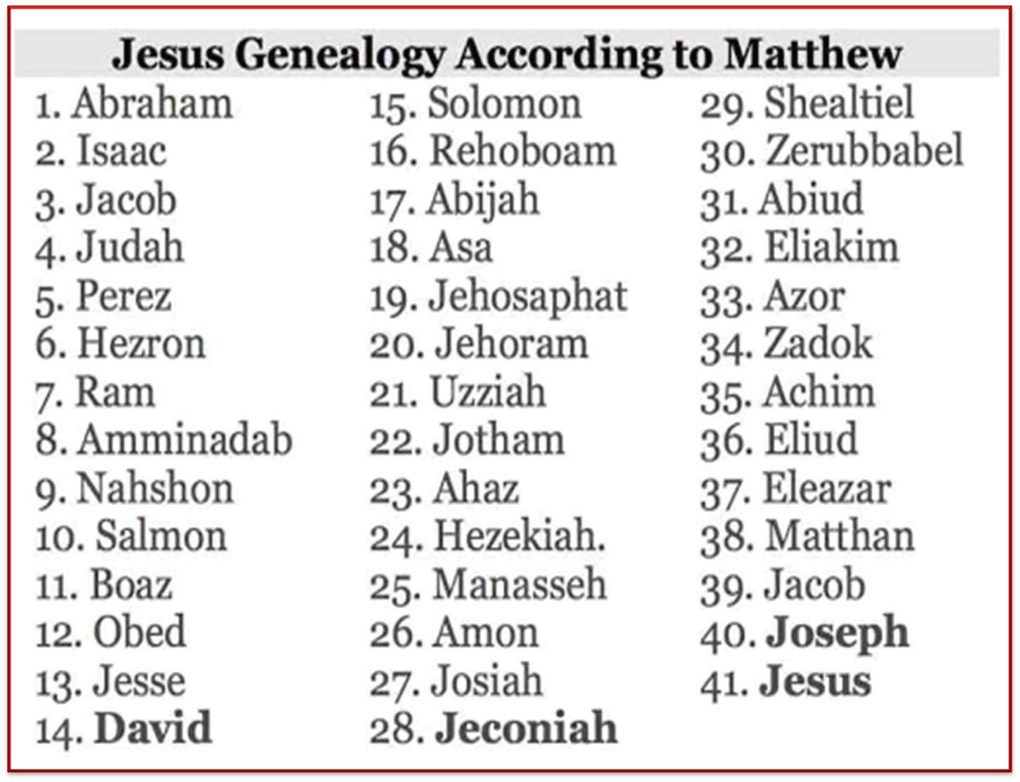

Slide 53
Acts 13:23-25
Messiah
      Davidic Covenant (23)
      John the Baptist (24-25)

Slide 54


John 1:29
“The next day he saw Jesus coming to him, and said, ‘Behold, the Lamb of God who takes away the sin of the world!’”

Slide 55
Acts 13:16-41
Paul’s Message
      Introduction (16)
      Historical background (17-22)
      Messiah (23-25)
      Gospel (26-29)
      Resurrection (30-37)
      Application to Paul’s audience (38-39)
      Warning (40-41)

Slide 56
1 Corinthians 15:3-4
“³ For I handed down to you as of first importance what I also received, that Christ died for our sins according to the Scriptures, ⁴ and that He was buried, and that He was raised on the third day according to the Scriptures.”

Slide 57
Acts 13:26-29
Gospel
      Application to Paul’s audience (26)
      Death (27-28)
      Burial (29)

Slide 58
Acts 13:26-29
Gospel
      Application to Paul’s audience (26)
      Death (27-28)
      Burial (29)

Slide 59
Three Tenses of Salvation
Phase | Justification | Sanctification | Glorification
Tense | Past | Present | Future
Saved from sin’s: | Penalty | Power | Presence
Scripture | Eph 2:8-9; Titus 3:5 | Philip 2:12 | Rom 5:10

Slide 60
Acts 13:26-29
Gospel
      Application to Paul’s audience (26)
      Death (27-28)
      Burial (29)

Slide 61
Acts 13:27-28
Death
      Ignorance (27)
      Guilt (28)

Slide 62
Acts 13:27-28
Death
      Ignorance (27)
      Guilt (28)

Slide 63
John 5:39, 46
“³⁹ You search the Scriptures because you think that in them you have eternal life; it is these that testify about Me…⁴⁶ For if you believed Moses, you would believe Me, for he wrote about Me.”

Slide 64
Luke 24:27, 44
“²⁷ Then beginning with Moses and with all the prophets, He explained to them the things concerning Himself in all the Scriptures…⁴⁴ Now He said to them, ‘These are My words which I spoke to you while I was still with you, that all things which are written about Me in the Law of Moses and the Prophets and the Psalms must be fulfilled.’”

Slide 65
Acts 17:1-3
“¹ Now when they had traveled through Amphipolis and Apollonia, they came to Thessalonica, where there was a synagogue of the Jews. ² And according to Paul’s custom, he visited them, and for three Sabbaths reasoned with them from the Scriptures, ³ explaining and giving evidence that the Christ had to suffer and rise from the dead, and saying, “This Jesus whom I am proclaiming to you is the Christ.”

Slide 66
1 Corinthians 15:3-4
“³ For I handed down to you as of first importance what I also received, that Christ died for our sins according to the Scriptures, ⁴ and that He was buried, and that He was raised on the third day according to the Scriptures.”

Slide 67
Acts 13:27-28
Death
      Ignorance (27)
      Guilt (28)

Slide 68
Acts 13:26-29
Gospel
      Application to Paul’s audience (26)
      Death (27-28)
      Burial (29)

Slide 69
John 5:39, 46
“³⁹ You search the Scriptures because you think that in them you have eternal life; it is these that testify about Me…⁴⁶ For if you believed Moses, you would believe Me, for he wrote about Me.”

Slide 70
Luke 24:27, 44
“²⁷ Then beginning with Moses and with all the prophets, He explained to them the things concerning Himself in all the Scriptures…⁴⁴ Now He said to them, ‘These are My words which I spoke to you while I was still with you, that all things which are written about Me in the Law of Moses and the Prophets and the Psalms must be fulfilled.’”

Slide 71
Acts 17:1-3
“¹ Now when they had traveled through Amphipolis and Apollonia, they came to Thessalonica, where there was a synagogue of the Jews. ² And according to Paul’s custom, he visited them, and for three Sabbaths reasoned with them from the Scriptures, ³ explaining and giving evidence that the Christ had to suffer and rise from the dead, and saying, “This Jesus whom I am proclaiming to you is the Christ.”

Slide 72
1 Corinthians 15:3-4
“³ For I handed down to you as of first importance what I also received, that Christ died for our sins according to the Scriptures, ⁴ and that He was buried, and that He was raised on the third day according to the Scriptures.”

Slide 73
Acts 13:16-41
Paul’s Message
      Introduction (16)
      Historical background (17-22)
      Messiah (23-25)
      Gospel (26-29)
      Resurrection (30-37)
      Application to Paul’s audience (38-39)
      Warning (40-41)

Slide 74
Acts 13:30-37
Resurrection
    Fact of Resurrection (30-31)
    Good news of Gospel (32-33)
    Resurrection (34-35)
    Application to Jesus Christ (36-37)

Slide 75
Acts 13:30-37
Resurrection
    Fact of Resurrection (30-31)
    Good news of Gospel (32-33)
    Resurrection (34-35)
    Application to Jesus Christ (36-37)

Slide 76
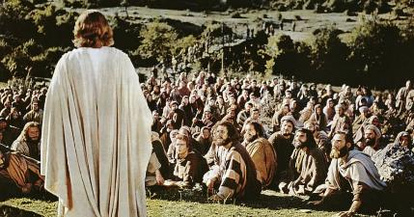
1 Corinthians 15:6-7
“⁶ After that He appeared to more than five hundred brethren at one time, most of whom remain until now, but some have fallen asleep; ⁷ then He appeared to James, then to all the apostles…”

Slide 77
Acts 13:30-37
Resurrection
    Fact of Resurrection (30-31)
    Good news of Gospel (32-33)
    Resurrection (34-35)
    Application to Jesus Christ (36-37)

Slide 78
John 5:39, 46
“³⁹ You search the Scriptures because you think that in them you have eternal life; it is these that testify about Me…⁴⁶ For if you believed Moses, you would believe Me, for he wrote about Me.”

Slide 79
Luke 24:27, 44
“²⁷ Then beginning with Moses and with all the prophets, He explained to them the things concerning Himself in all the Scriptures…⁴⁴ Now He said to them, ‘These are My words which I spoke to you while I was still with you, that all things which are written about Me in the Law of Moses and the Prophets and the Psalms must be fulfilled.’”

Slide 80
Acts 17:1-3
“¹ Now when they had traveled through Amphipolis and Apollonia, they came to Thessalonica, where there was a synagogue of the Jews. ² And according to Paul’s custom, he visited them, and for three Sabbaths reasoned with them from the Scriptures, ³ explaining and giving evidence that the Christ had to suffer and rise from the dead, and saying, “This Jesus whom I am proclaiming to you is the Christ.”

Slide 81
1 Corinthians 15:3-4
“³ For I handed down to you as of first importance what I also received, that Christ died for our sins according to the Scriptures, ⁴ and that He was buried, and that He was raised on the third day according to the Scriptures.”

Slide 82

John 1:14
“And the Word became flesh, and dwelt among us, and we saw His glory, glory as of the only begotten [monogenēs] from the Father, full of grace and truth.”

Slide 83
John 3:16
“For God so loved the world, that He gave His only begotten [monogenēs] Son, that whoever believes in Him shall not perish, but have eternal life.”

Slide 84
Acts 13:30-37
Resurrection
    Fact of Resurrection (30-31)
    Good news of Gospel (32-33)
    Resurrection (34-35)
    Application to Jesus Christ (36-37)

Slide 85
Acts 2:15-35
Refutation of the Charge of Drunkenness
      Too early (15)
      Use of Joel 2:28-32 (16-21)
      Christ’s miracles (22)
      Crucifixion (23)
      Resurrection (24)
      Use of Psalm 16:8-11 (25-29)
      Use of Psalm 132:11 (30-32)
      High priestly ministry (33)
      Use of Psalm 110:1 (34-35)

Slide 86
Acts 13:30-37
Resurrection
    Fact of Resurrection (30-31)
    Good news of Gospel (32-33)
    Resurrection (34-35)
    Application to Jesus Christ (36-37)

Slide 87
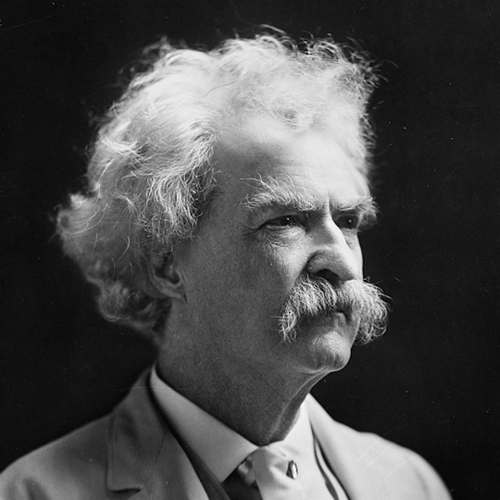
Mark Twain
Autobiography, 2:37
“A myriad of men are born; they labor and sweat and struggle for bread; they squabble and scold and fight; they scramble for little mean advantages over each other. Age creeps upon them and infirmities follow; shames and humiliations bring down their prides and their vanities. Those they love are taken from them, and the joy of life is turned to aching grief. The burden of pain, care, and misery grows heavier year by year. At length ambition is dead, pride is dead, vanity is dead; longing for release is in their place. It comes at last-the only un-poisoned gift earth ever had for them-and they vanish from a world where they were of no consequence; where they achieved nothing, where they were a mistake and a failure and a foolishness; where they left no sign that they have existed – a world that will lament them a day and forget them forever.”

Slide 88
Acts 2:15-35
Refutation of the Charge of Drunkenness
      Too early (15)
      Use of Joel 2:28-32 (16-21)
      Christ’s miracles (22)
      Crucifixion (23)
      Resurrection (24)
      Use of Psalm 16:8-11 (25-29)
      Use of Psalm 132:11 (30-32)
      High priestly ministry (33)
      Use of Psalm 110:1 (34-35)

Slide 89
From Peter to Paul
Reference | Center | Person | Place | Outreach
Acts 1–12 | Jerusalem | Peter | Jerusalem, Judea, Samaria | Jewish
Acts 13–28 | Antioch | Paul | Uttermost parts | Gentiles

Slide 90
From Peter to Paul
Peter | Paul
Heals a man lame from birth (3:1-11) | Heals a man lame from birth (14:8-18)
Heals by shadow (5:15-16) | Heals by handkerchief (19:11-12)
Success is a cause of jealousy (5:17) | Success is a cause of jealousy (13:45)
Confronts a sorcerer (8:9-24) | Confronts a sorcerer (13:6-11)
Raises Dorcas (9:36-41) | Raises Eutychus (20:9-12)
Jailed and miraculously freed (12:3-19) | Jailed and miraculously freed (16:25-34)

Slide 91
Acts 13:16-41
Paul’s Message
      Introduction (16)
      Historical background (17-22)
      Messiah (23-25)
      Gospel (26-29)
      Resurrection (30-37)
      Application to Paul’s audience (38-39)
      Warning (40-41)

Slide 92
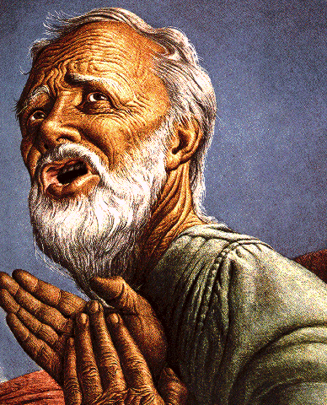
Passages Conditioning Salvation on Faith Alone (Sola Fide)
Genesis 15:6
John 3:16; 5:24; 6:28-29, 47; 16:8-9; 20:30-31
Acts 16:30-31
Romans 1:16; Ephesians 2:8-9
Hebrews 11:6

Slide 93
Belief – God’s One Condition for Justification
Gen 15:6
Then he believed in the LORD; and He reckoned it to him as righteousness.
John 3:16
For God so loved the world, that He gave His only begotten Son, that whoever believes in Him shall not perish, but have eternal life.
Acts 16:30-31
"Sirs, what must I do to be saved?" They said, "Believe in the Lord Jesus, and you will be saved..."

Slide 94
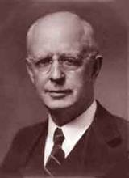
Lewis Sperry Chafer, vol. 7, Systematic Theology
(Grand Rapids, MI: Kregel Publications, 1993), 265-66.
Belief-God’s One Condition for Justification
“…because upwards of 150 passages of Scripture condition salvation upon believing only (cf. John 3:16; Acts 16:31).”

Slide 95
Acts 13:16-41
Paul’s Message
      Introduction (16)
      Historical background (17-22)
      Messiah (23-25)
      Gospel (26-29)
      Resurrection (30-37)
      Application to Paul’s audience (38-39)
      Warning (40-41)

Slide 96
Acts 13:40-41
Warning
      A.D. 70 (40)
      Application of Habakkuk 1:5 (41)

Slide 97
Acts 13:40-41
Warning
      A.D. 70 (40)
      Application of Habakkuk 1:5 (41)

Slide 99
Six Parts of a Suzerain-Vassal Treaty in Deuteronomy
Preamble (1:1-5)
Prologue (1:6–4:40)
Covenant obligations (5–26)
Storage and reading instructions (27:2-3; 31:9, 24, 26)
Witnesses (32:1)
Blessings and curses (28)

Slide 100

Deuteronomy 28:49-50
⁴⁹ “The Lord will bring a nation against you from afar, from the end of the earth, as the eagle swoops down, a nation whose language you shall not understand, ⁵⁰ a nation of fierce countenance who will have no respect for the old, nor show favor to the young.”

Slide 101
ISRAEL'S JUDGMENTS
Division of the kingdom in 931 B.C. (1 Kgs. 12)
Assyrian judgment in 722 B.C. (2 Kgs. 17)
Babylonian captivity in 586 B.C. (2 Kgs. 25)
Rome Diaspora in A.D. 70 (Luke 19:41-44)

Slide 102
Acts 13:40-41
Warning
      A.D. 70 (40)
      Application of Habakkuk 1:5 (41)

Slide 103
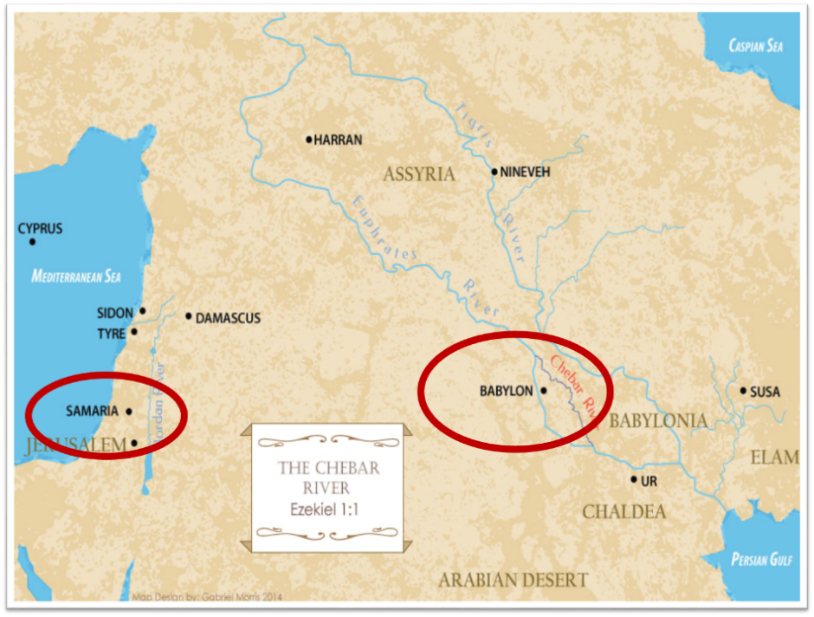

Slide 104
III. Pisidia Antioch Ministry
Acts 13:13-52
  Journey to Pisidian Antioch (13-15)
  Paul’s message (16-41)
  Results of Paul’s message (42-52)

Slide 105
Acts 13:42-53
Results of Paul’s Message
      Immediate results (42-43)
      Subsequent results (44-49)
      Results for the Apostles (50-52)

Slide 106
Acts 13:42-53
Results of Paul’s Message
      Immediate results (42-43)
      Subsequent results (44-49)
      Results for the Apostles (50-52)

Slide 107
Acts 13:42-43
Immediate Results
      Synagogue’s invitation (42)
      Many followers (43)

Slide 108
Acts 13:42-43
Immediate Results
      Synagogue’s invitation (42)
      Many followers (43)

Slide 109
Acts 13:42-43
Immediate Results
      Synagogue’s invitation (42)
      Many followers (43)

Slide 110


Galatians 3:3
“Are you so foolish? Having begun by the Spirit, are you now being perfected by the flesh?”

Slide 111
Three Tenses of Salvation
Phase | Justification | Sanctification | Glorification
Tense | Past | Present | Future
Saved from sin’s: | Penalty | Power | Presence
Scripture | Eph 2:8-9; Titus 3:5 | Philip 2:12 | Rom 5:10

Slide 112
Acts 13:42-53
Results of Paul’s Message
      Immediate results (42-43)
      Subsequent results (44-49)
      Results for the Apostles (50-52)

Slide 113
Acts 13:44-49
Subsequent Results
      Citizens (44)
      Unbelieving religious leaders (45)
      Apostles’ decision (46-47)
      Results of the Apostles’ decision (48-49)

Slide 114
Acts 13:44-49
Subsequent Results
      Citizens (44)
      Unbelieving religious leaders (45)
      Apostles’ decision (46-47)
      Results of the Apostles’ decision (48-49)

Slide 115
Acts 13:44-49
Subsequent Results
      Citizens (44)
      Unbelieving religious leaders (45)
      Apostles’ decision (46-47)
      Results of the Apostles’ decision (48-49)

Slide 116
From Peter to Paul
Reference | Center | Person | Place | Outreach
Acts 1–12 | Jerusalem | Peter | Jerusalem, Judea, Samaria | Jewish
Acts 13–28 | Antioch | Paul | Uttermost parts | Gentiles

Slide 117
From Peter to Paul
Peter | Paul
Heals a man lame from birth (3:1-11) | Heals a man lame from birth (14:8-18)
Heals by shadow (5:15-16) | Heals by handkerchief (19:11-12)
Success is a cause of jealousy (5:17) | Success is a cause of jealousy (13:45)
Confronts a sorcerer (8:9-24) | Confronts a sorcerer (13:6-11)
Raises Dorcas (9:36-41) | Raises Eutychus (20:9-12)
Jailed and miraculously freed (12:3-19) | Jailed and miraculously freed (16:25-34)

Slide 118
Acts 13:44-49
Subsequent Results
      Citizens (44)
      Unbelieving religious leaders (45)
      Apostles’ decision (46-47)
      Results of the Apostles’ decision (48-49)

Slide 119
Dr. Arnold G. Fruchtenbaum
The Book of Acts, 301
“Chapter 13 shows the pattern of evangelizing activity. The apostles proclaimed the gospel to the Jews first, and when that proclamation was rejected, only then did they turn to the Gentiles. This is not a once-and-for-all turning to the Gentiles in general, as some seem to think. As the book of Acts continues and as the apostles entered the next city, they again went to the Jews first. So, the turning away from the Jews in Antioch Pisidia was only a local, regional situation. The Jewish people there rejected the gospel, so Paul and Barnabas turned to the Gentiles. In a new locality, they would once again adopt the same procedure of going to the Jews first, because that mandate was never rescinded.”

Slide 120
Acts 1:8
“but you will receive power when the Holy Spirit has come upon you; and you shall be My witnesses both in Jerusalem, and in all Judea and Samaria, and even to the remotest part of the earth.”

Slide 121
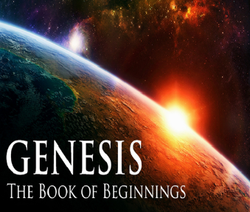
8 New Promises
Genesis 12:1-3
    Land (Gen. 12:1b)
    Great nation (Gen. 12:2a)
    Personal blessing (Gen. 12:2b)
    Great name (Gen. 12:2c)
    Blessing to others (Gen. 12:2d)
    Blessing to blessers (Gen. 12:3a)
    Cursing to cursers (Gen. 12:3b)
    Blessing to the world (Gen. 12:3c)

Slide 122

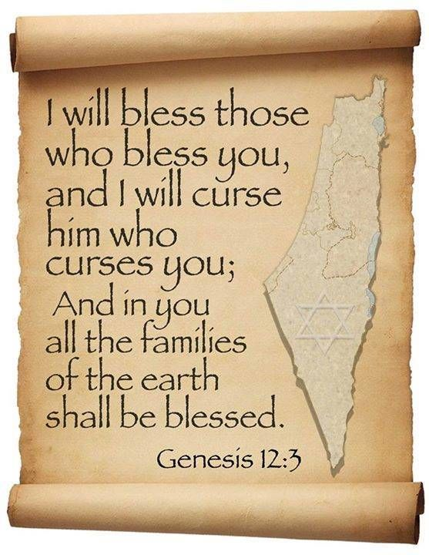
Genesis 12:3
“And I will bless those who bless you, And the one who curses you I will curse. And in you all the families of the earth will be blessed.”

Slide 123
Acts 13:44-49
Subsequent Results
      Citizens (44)
      Unbelieving religious leaders (45)
      Apostles’ decision (46-47)
      Results of the Apostles’ decision (48-49)

Slide 124
Acts 13:48-49
Results of the Apostles’ Decision
      Salvation to the Gentiles (48)
      Spread of the Gospel (49)

Slide 125
Acts 13:48-49
Results of the Apostles’ Decision
      Salvation to the Gentiles (48)
      Spread of the Gospel (49)

Slide 126

Acts 13:48
“When the Gentiles heard this, they began rejoicing and glorifying the word of the Lord; and as many as had been appointed [tassō] to eternal life believed.”

Slide 127
Dr. Arnold G. Fruchtenbaum
The Book of Acts, 300
“Verses 48-49 record that the decision to turn to the Gentiles produced two results. The first result was the salvation of the Gentiles (v. 48). Luke wrote: As many as were ordained to eternal life believed. According to The Bible Knowledge Commentary, the Greek term for ‘ordained,’ tetagmenoi, “comes from the verb tassó, a military word meaning ‘to arrange’ or ‘to assign.’ Luke used it here to show that God’s elective decree included Gentiles.” Those who were appointed to eternal life believed. This is a clear statement of God’s sovereignty and the doctrine of election and predestination: Those whom God ordained to eternal life were the ones who believed; those who believed were the ones who were appointed to believe; only those who were appointed believed. As a result, many of the Gentiles were saved.

Slide 128
Laurence M. Vance
“Every Calvinist, no matter what else he believes, uses this verse [Acts 13:48] to prove Unconditional Election. Every Calvinist claims that on the basis of this verse, every person who has ever been saved (Old or New Testament) or ever will be saved (Church age or Tribulation or Millennium) was ‘ordained to life’ before the foundation of the world by a sovereign, eternal decree.”
Laurence M. Vance, The Other Side of Calvinism, rev. ed. (Pensacola, FL: Vance Publications, 1999); citing Calvin, Institutes, 345..

Slide 129

Acts 13:48?
One verse cannot be used to undo hundreds of others (1 Tim. 2:4; 2 Pet. 3:9)
Sometimes the Greek word for “appointed”(NASB) or “ordained” (KJV) is translated “wanted” (LB) or “disposed” (REB) in other English translations
Tassō is used (rather than proorizō), which never refers to predestination unto Salvation in any of its other New Testament uses (Matt. 28:16; Luke 7:38; Acts 15:2; 22:10; 28:23; Rom. 13:1; 1 Cor. 16:15)

Slide 130
Acts 13:48?
One verse cannot be used to undo hundreds of others (1 Tim. 2:4; 2 Pet. 3:9)
Sometimes the Greek word for “appointed”(NASB) or “ordained” (KJV) is translated “wanted” (LB) or “disposed” (REB) in other English translations
Tassō is used (rather than proorizō), which never refers to predestination unto Salvation in any of its other New Testament uses (Matt. 28:16; Luke 7:38; Acts 15:2; 22:10; 28:23; Rom. 13:1; 1 Cor. 16:15)

Slide 131

1 Timothy 2:3-4
“³ This is good and acceptable in the sight of God our Savior, ⁴ who desires all men to be saved and to come to the knowledge of the truth.”

Slide 132
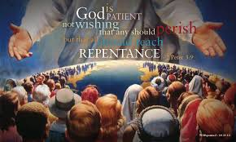
2 Peter 3:9
“The Lord is not slow about His promise, as some count slowness, but is patient toward you, not wishing for any to perish but for all to come to repentance.”

Slide 133
Acts 13:48?
One verse cannot be used to undo hundreds of others (1 Tim. 2:4; 2 Pet. 3:9)
Sometimes the Greek word for “appointed”(NASB) or “ordained” (KJV) is translated “wanted” (LB) or “disposed” (REB) in other English translations
Tassō is used (rather than proorizō), which never refers to predestination unto Salvation in any of its other New Testament uses (Matt. 28:16; Luke 7:38; Acts 15:2; 22:10; 28:23; Rom. 13:1; 1 Cor. 16:15)

Slide 134
Acts 13:48?
The corrupted, Roman Catholic Latin Vulgate mistranslates tassō as “preordained.”
The context of the book of Acts pertains to the predisposition of the Gentiles (rather than the Jews) toward the Gospel (Acts 13:44-47; 28:26-28)
There is no textual or exegetical evidence that the divine appointing (tassō) caused the believing (pisteuō).

Slide 135
Acts 13:48?
The corrupted, Roman Catholic Latin Vulgate mistranslates tassō as “preordained.”
The context of the book of Acts pertains to the predisposition of the Gentiles (rather than the Jews) toward the Gospel (Acts 13:44-47; 28:26-28)
There is no textual or exegetical evidence that the divine appointing (tassō) caused the believing (pisteuō).

Slide 136
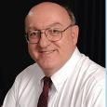
Dennis Rokser
“[It is incorrect to say that]…the Greek verb for ‘believe’ (episteusan) is the result of the perfect passive participle ‘appointed’ (tetagmenoi). Grammatically, all that the aorist tense verb of ‘believe’ shows when it is combined with the periphrastic construction of ‘had been appointed’ is that the appointing on God's part preceded the believing on man's part. NOTE: the grammar does not prove that one is the result of the other! In order to show that the act of believing was the result of or caused by God's prior appointing, there would need to be a causal conjunction in the Greek text after ‘believed’ (episteusan), so that the verse would say: ‘and believed [episteusan], because [hoti, hina, hos, hoste] they had been appointed to life eternal.’”
Personal email correspondence from Dennis Rokser

Slide 137
Dennis Rokser
“The conjunctions hoti, hina, hos, hoste are all used at times in Greek (most often hoti) to show purpose, result, or cause. But Acts 13:48 contains none of these! Calvinists assume that God foreordains certain people (those unconditionally elected to eternal salvation) to receive the gift of faith. If that were the case, then this verse should say ‘and as many as were appointed to believe received life eternal.’”
Personal email correspondence from Dennis Rokser

Slide 138
Acts 13:48
“When the Gentiles heard this, they began rejoicing and glorifying the word of the Lord; and as many as had been appointed [tassō] to eternal life believed.”

Slide 139
Dennis Rokser
“There are no verses in the Bible that say we were preordained to believe. Acts 13:48 simply doesn't say WHY the Galatians were appointed to eternal life. However, since the context of the passage involves human responsibility (v. 46), and it is consistent with Scripture elsewhere, we should interpret v. 48 to mean that God's ordaining must have factored in their faith which He foresaw.”
Personal email correspondence from Dennis Rokser

Slide 140
Acts 13:48?
Contrary too many English translations, the word order of Acts 13:48 in the Greek text places the verb “believed” before the Greek verb pre-ordained “appointed.”
In Acts 13:48, “believed” is in the active voice.

Slide 141
Acts 13:48?
Contrary too many English translations, the word order of Acts 13:48 in the Greek text places the verb “believed” before the Greek verb pre-ordained “appointed.”
In Acts 13:48, “believed” is in the active voice.

Slide 142
Acts 13:48
“When the Gentiles heard this, they began rejoicing and glorifying the word of the Lord; and as many as had been appointed [tassō] to eternal life believed.”
Acts 13:48 (NA26)
⁴⁸ Ἀκούοντα δὲ τὰ ἔθνη ἔχαιρον καὶ ἐδόξαζον τὸν λόγον τοῦ κυρίου καὶ ἐπίστευσαν ὅσοι ἦσαν τεταγμένοι εἰς ζωὴν αἰώνιον·

Slide 143
Ron Merryman
“The verb “believed” (aorist tense, active voice, indicative mode) stands first in word order in the Greek text, thus it is emphasized. The statement literally is, ‘And they believed, as many as were ordained unto eternal life’ (a perfect tense periphrastic in Greek). They did not believe because they were ordained unto eternal life.”
Ron Merryman, “Election & Acts 13:48,” Grace Family Journal, September-October 2000.

Slide 144
Acts 13:48?
Contrary too many English translations, the word order of Acts 13:48 in the Greek text places the verb “believed” before the Greek verb pre-ordained “appointed.”
In Acts 13:48, “believed” is in the active voice.

Slide 145
Ron Merryman
“Simply, they believed; that is, they actively (active voice) expressed positive volition toward the Gospel…‘Believed’ or ‘believe’ is consistently active in voice in its over 100 uses in the N.T. relative to trust in Christ and Him alone. That means the person who believes is actively, not passively, trusting in the Gospel. They are exercising their faith, not someone else's and not a faith given to them… Contrasted to the ones that believed in the context are those that did not. We are told that ‘they spake against the things that were spoken by Paul, contradicting and blaspheming’ (v.45). Again, the verbal voice is active. . . .
Ron Merryman, “Election & Acts 13:48,” Grace Family Journal, September-October 2000.

Slide 146
Ron Merryman
“…They were actively expressing their negative volition to the Gospel, so that Paul follows their blasphemies with the statement ‘... you put it (the word of God expressed in the Gospel he had just spoken) from you and you judge yourselves unworthy of eternal life’ (v. 46). These verbs also are active voice. They could not blame their negativeness on Satan or any other. Paul did not say that God declared these unbelieving Jews unworthy of eternal life: he says that they declared themselves unworthy of it!”
Ron Merryman, “Election & Acts 13:48,” Grace Family Journal, September-October 2000.

Slide 147
Romans 8:29–30
²⁹ For those whom He foreknew [proginōskō], He also predestined to become conformed to the image of His Son, so that He would be the firstborn among many brethren; ³⁰ and these whom He predestined, He also called; and these whom He called, He also justified; and these whom He justified, He also glorified.

Slide 148
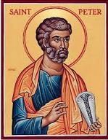
2 Peter 3:17
“You therefore, beloved, knowing this beforehand [proginōskō], be on your guard so that you are not carried away by the error of unprincipled men and fall from your own steadfastness.”

Slide 149
Acts 13:48-49
Results of the Apostles’ Decision
      Salvation to the Gentiles (48)
      Spread of the Gospel (49)

Slide 150
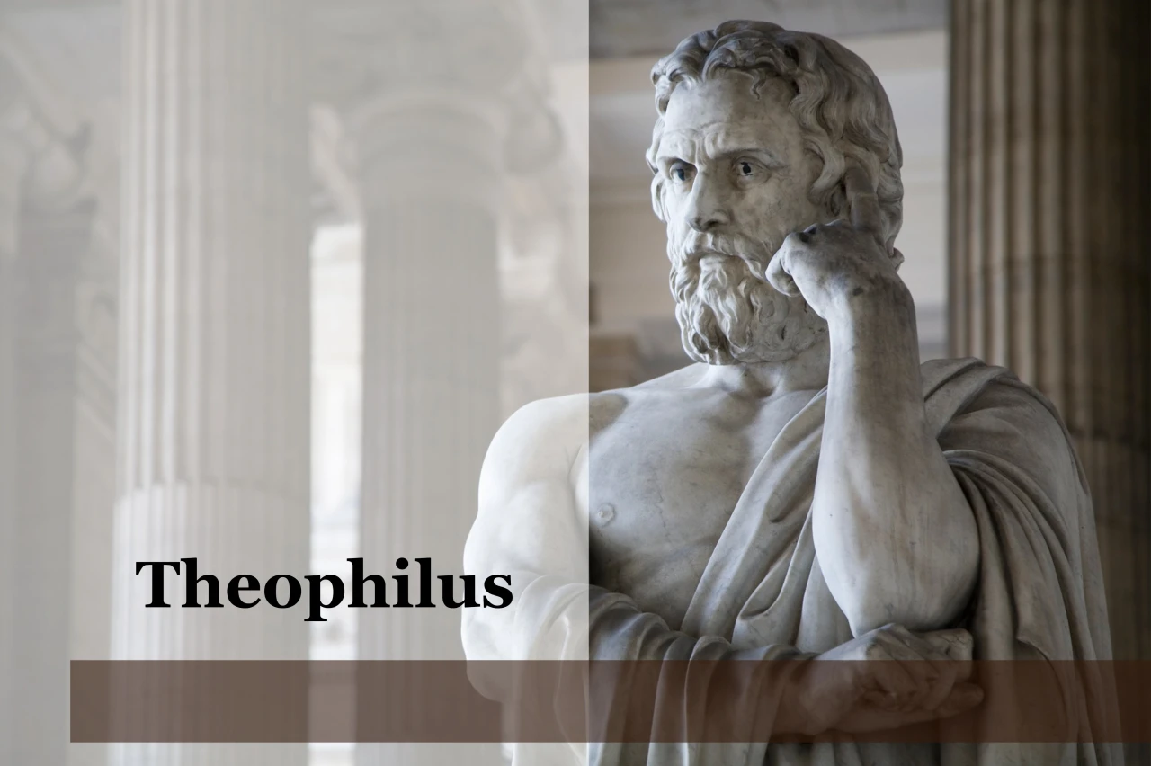
Purpose
  To present Theophilus with an orderly account of the birth and growth of the church so as to affirm him in what he has believed.

Slide 151

Message
  Birth and growth of the church numerically, geographically, ethnically.
  Components
  Numerically (progress reports)
  Geographically (From Jerusalem to Rome)
  Ethnically (From Judaism to Gentile domination)

Slide 152
Progress Reports
  Clearest: Acts 2:47; 6:7; 9:31; 12:24; 16:5; 19:20; 28:30-31
  Less clear: Acts 1:13, 15; 2:41, 47; 4:4, 31; 5:14, 42; 8:25, 40; 11:21; 13:49; 17:6

Slide 153
Dr. Arnold G. Fruchtenbaum
The Book of Acts, 300
“In verse 49, the second result was the advancement of the gospel. The Greek word for ‘was spread,’ diephereto, means ‘to carry in different directions.’ The strategic location of Antioch of Pisidia would help the spread of the gospel throughout all the region. The ministry grew in spite of determined opposition.”

Slide 154
Acts 13:42-53
Results of Paul’s Message
      Immediate results (42-43)
      Subsequent results (44-49)
      Results for the Apostles (50-52)

Slide 155
Acts 13:50-52
Results for the Apostles
      Jewish opposition to the Gospel (50)
      Apostles’ response (51)
      Impact on the Pisidian Antioch Church (52)

Slide 156
Acts 13:50-52
Results for the Apostles
      Jewish opposition to the Gospel (50)
      Apostles’ response (51)
      Impact on the Pisidian Antioch Church (52)

Slide 157
Acts 13:50-52
Results for the Apostles
      Jewish opposition to the Gospel (50)
      Apostles’ response (51)
      Impact on the Pisidian Antioch Church (52)

Slide 158

Biblical Basis for Separation?
2 Thess. 3:6, 14
1 Cor. 5:11
2 Cor. 6:14-18
Rom. 16:17
Eph. 5:11
Titus 3:9-11
2 John 9-11

Slide 159

2 John 7-11
“⁷ For many deceivers have gone out into the world, those who do not acknowledge Jesus Christ as coming in the flesh. This is the deceiver and the antichrist. ⁸ Watch yourselves, that you do not lose what we have accomplished, but that you may receive a full reward. ⁹ Anyone who goes too far and does not abide in the teaching of Christ, does not have God; the one who abides in the teaching, he has both the Father and the Son. ¹⁰ If anyone comes to you and does not bring this teaching, do not receive him into your house, and do not give him a greeting; ¹¹ for the one who gives him a greeting participates in his evil deeds.”

Slide 160

What to Separate From?
False doctrine – 1 Tim. 4:16; Titus 1:9
Divisive persons – Rom. 16:17; Titus 3:9-11
Immorality – 1 Cor. 5:9-11; Eph. 5:11
General disobedience to Scripture –2 Thess. 3:6, 14

Slide 161
Dr. Arnold G. Fruchtenbaum
The Book of Acts, 301
“The apostolic response is given in verse 51: But they shook off the dust of their feet against them. This action was a visible, physical, symbolic measure marking a complete break of fellowship and renunciation with a person or community. It was also what Yeshua had commanded His disciples to do (Mt. 10:14; Mk. 6:11; Lk. 9:5). The procedure was to take the sandals off the feet, and the dust was shaken toward the group or place being renounced as a symbolic token. Then the apostles went to Iconium, the next city to be evangelized.”

Slide 162
First Missionary Journey

Slide 163
Acts 13:50-52
Results for the Apostles
      Jewish opposition to the Gospel (50)
      Apostles’ response (51)
      Impact on the Pisidian Antioch Church (52)

Slide 164
c) Acts 13:52
Impact on the Pisidian Antioch Church
      Joy (52a)
      Holy Spirit (52b)

Slide 165
c) Acts 13:52
Impact on the Pisidian Antioch Church
      Joy (52a)
      Holy Spirit (52b)

Slide 166
c) Acts 13:52
Impact on the Pisidian Antioch Church
      Joy (52a)
      Holy Spirit (52b)

Slide 167

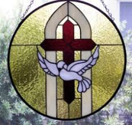
John 14:16-17
¹⁶ I will ask the Father, and He will give you another Helper, that He may be with you forever; ¹⁷ that is the Spirit of truth, whom the world cannot receive, because it does not see Him or know Him, but you know Him because He abides with you and will be in you.

Slide 168
Acts 13‒14
1st Missionary Journey
  Paul & Barnabas’ appointment (13:1-3)
  Cyprus ministry (13:4-12)
  Pisidian Antioch ministry (13:13-52)
  Iconium ministry (14:1-7)
  Lystra ministry (14:8-20a)
  Derbe ministry (14:20b-21a)
  Return to Antioch (14:21b-28)

Slide 169
Acts 13‒14
1st Missionary Journey
  Paul & Barnabas’ appointment (13:1-3)
  Cyprus ministry (13:4-12)
  Pisidian Antioch ministry (13:13-52)
  Iconium ministry (14:1-7)
  Lystra ministry (14:8-20a)
  Derbe ministry (14:20b-21a)
  Return to Antioch (14:21b-28)

Slide 170
Acts 13‒14
1st Missionary Journey
  Paul & Barnabas’ appointment (13:1-3)
  Cyprus ministry (13:4-12)
  Pisidian Antioch ministry (13:13-52)
  Iconium ministry (14:1-7)
  Lystra ministry (14:8-20a)
  Derbe ministry (14:20b-21a)
  Return to Antioch (14:21b-28)

Slide 171
Acts 13‒14
1st Missionary Journey
  Paul & Barnabas’ appointment (13:1-3)
  Cyprus ministry (13:4-12)
  Pisidian Antioch ministry (13:13-52)
  Iconium ministry (14:1-7)
  Lystra ministry (14:8-20a)
  Derbe ministry (14:20b-21a)
  Return to Antioch (14:21b-28)

Slide 172
Conclusion

Slide 173
Acts 13‒14
1st Missionary Journey
  Paul & Barnabas’ appointment (13:1-3)
  Cyprus ministry (13:4-12)
  Pisidian Antioch ministry (13:13-52)
  Iconium ministry (14:1-7)
  Lystra ministry (14:8-20a)
  Derbe ministry (14:20b-21a)
  Return to Antioch (14:21b-28)

