Slide 1
Victory in christ
A world-conquering faith
Jonathan Smith

Slide 2
1 John 5:4-5
“For whatever is born of God overcomes (nikaō) the world; and this the victory (nikē) that has overcome (nikaō) the world – our faith. Who is the one who overcomes (nikaō) the world, but he who believes that Jesus is the Son of God?”
Notes:
I. The word overcome in the Greek is nikaō, which means to conquer, or to carry off the victory, and it is the verb tense of the root word nikē which means victory.

Slide 3
Overcoming this World?
Who is an overcomer of this world?
What does it mean to be a victor and overcomer of this world?
How should this shift our perspective?
Notes:
The word victory, the phrase victorious living, and victory have been used by many preachers
Some use it to promote self-help principles, like positive thinking for success in life
Some use it to promote a victory that must be obtained through our own perseverance in good works
Is the understanding of victory just a mindset in order to achieve success akin to the law of attraction? Is it to achieve specific results that result in temporal successes?
How was Paul able to state in Phil 1:21, “For to me, to live is Christ and to die is gain”?
The more we understand what it means to be victorious in Christ and overcomers, the more we can align ourselves with the way God exhorts us to live our lives
As the days seem to get darker and more chaotic by the day, how paramount is it to understand where the true and ultimate victory lies, and that is with Christ and the Body of Christ
I am going to be speaking on who is an overcomer of this world, what it means to be an overcomer of this world in victory, how this understanding should shift our perspective on our current circumstances and relationship to this present world.
Before we dive into the passage, I want to give a brief overview of 1 John for context.

Slide 4
1 John – Introductory Matters
Background
Writing to a group of believers in Asia
False teachings gaining prevalence
Early forms of Gnosticism
Docetism
Cerinthianism

Slide 5
1 John – Introductory Matters
Purpose of Writing
Abide in Christ
Proper beliefs (orthodoxy)
Proper practice (orthopraxy)
= Proper fellowship
Test of Fellowship – Not test of salvation

Slide 6
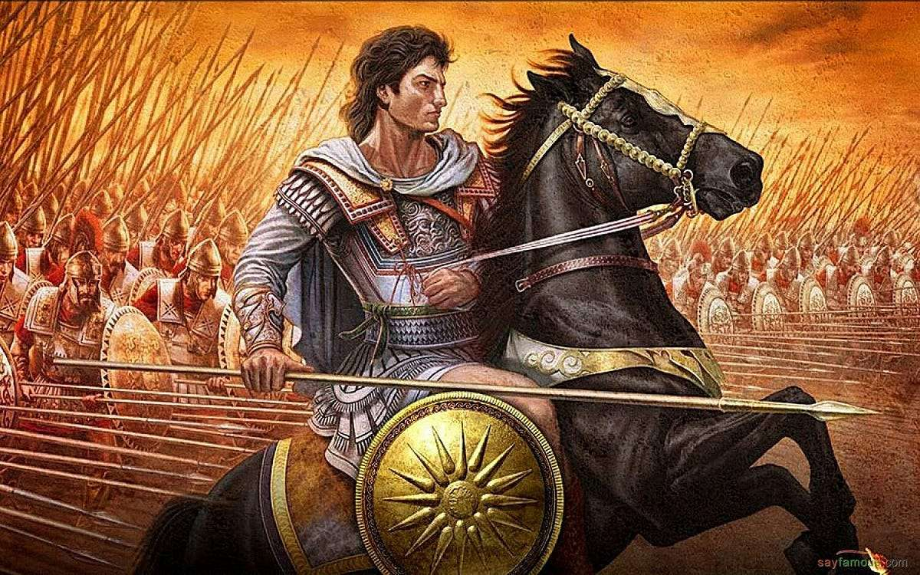
Who is an overcomer of the World?
Natural mind’s answer?
Biblical Answer?

Slide 7
Who is an overcomer of the World?
Natural mind’s answer?
Biblical Answer?

Slide 8
Who is an overcomer of the World?
Natural mind’s answer?
Biblical Answer?

Slide 9
Who is an overcomer of the world?
1 John 5:4-5
“For whatever is born of God overcomes the world; and this the victory that has overcome the world – our faith. Who is the one who overcomes the world, but he who believes that Jesus is the Son of God?”

Slide 10
Who is the one that is born of God?
Whatever is born of God = Overcomes of the World
The one who believes that Jesus is God = Overcomes the World
Whatever Born of God = The one who believes that Jesus is God

Slide 11
What it Means to be Born of God
First birth – In Adam
Second Birth – In Jesus

Slide 12
What it Means to be Born of God
First birth – In Adam
Second Birth – In Jesus

Slide 13
First Birth – In Adam
Psalm 51:5
“Behold, I was brought forth in iniquity, and in sin my mother conceived me.”

Slide 14
First Birth – In Adam
Ephesians 2:1-3
“And you were dead in your trespasses and sins, in which you formerly walked according to the course of this world, according to the prince of the power of the air, of the spirit that is now working in the sons of disobedience. Among them we too all formerly lived in the lusts of our flesh, indulging the desires of the flesh and of the mind, and were by nature children of wrath, even as the rest.”

Slide 15
What it Means to be Born of God
First birth – In Adam
Second Birth – In Jesus

Slide 16
What it Means to be Born of God
First birth – In Adam
Second Birth – In Jesus

Slide 17
Second Birth – In Jesus
John 3:3
“Truly, truly, I say to you, unless one is born again he cannot see the kingdom of God.”

Slide 18
Second Birth – In Jesus
John 1:12-13
“But as many as received Him, to them He gave the right to become children of God, even to those who believe in His name, who were born, not of blood nor of the will of the flesh nor of the will of man, but of God.”

Slide 19
Second Birth – In Jesus
1 Peter 1:3
“Blessed be the God and Father of our Lord Jesus Christ, who according to His great mercy has caused us to be born again to a living hope through the resurrection of Jesus Christ from the dead…”

Slide 20
Second Birth – In Jesus
1 Peter 1:23
“…for you have been born again not of seed which is perishable but imperishable, that is, through the living and enduring word of God.”

Slide 21
Who is an overcomer of the World?
Natural mind’s answer?
Biblical Answer?
The one who experiences the second birth (birth in Jesus)

Slide 22
What does it mean to be a victor in Christ and an overcomer of this world?
John is speaking of a singular event
Being born of God is a singular event
Whatever is born of God overcomes the world
The object of the victory is our faith
Our faith is evidence that we have overcome the world

Slide 23
Who is an Overcomer of the World?
1 John 5:4-5
“For whatever is born of God overcomes the world; and this the victory that has overcome the world – our faith. Who is the one who overcomes the world, but he who believes that Jesus is the Son of God?”

Slide 24
What Does it Mean to be a Victor in Christ and an Overcomer of this World?
John is speaking of a singular event
Being born of God is a singular event
Whatever is born of God overcomes the world
The object of the victory is our faith
Our faith is evidence that we have overcome the world

Slide 25
What Does it Mean to be a Victor in Christ and an Overcomer of this World?
John is speaking of a singular event
Being born of God is a singular event
Whatever is born of God overcomes the world
The object of the victory is our faith
Our faith is evidence that we have overcome the world

Slide 26
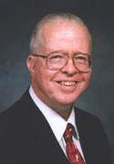
Zane Hodges
The Bible Knowledge Commentary, 901
“…the principle of victory resides in everyone born of God. Every such person has already overcome the world. His faith in Christ, by which he was regenerated, constitutes a victory over the world system which is satanically blinded to the gospel.”

Slide 27
Faith is Evidence We’ve Overcome the World
1 John 4:1-4
“Beloved, do not believe every spirit, but test the spirits to see whether they are from God, because many false prophets have gone out into the world. By this you know the Spirit of God: every spirit that confesses that Jesus Christ has come in the flesh is from God; and every spirit that does not confess Jesus is not from God; this is the spirit of the antichrist, of which you have heard that it is coming, and now it is already in the world. You are from God, little children, and have overcome them; because greater is He who is in you than he who is in the world.”

Slide 28
Satan is Blinding the World
2 Corinthians 4:3-4
“And even if our gospel is veiled, it is veiled to those who are perishing, in whose case the god of this world has blinded the minds of the unbelieving so that they might not see the light of the gospel of the glory of Christ, who is the image of God.”

Slide 29
Satan is Blinding the World
Ephesians 2:1-2
“And you were dead in your trespasses and sins, in which you formerly walked according to the course of this world, according to the prince of the power of the air, of the spirit that is now working in the sons of disobedience.”

Slide 30
Faith is Evidence We’ve Overcome the World
All religions that do not point to Jesus come from the same source – Satan.
Unbelievers are under spiritual warfare for their souls
Believers have become victorious at the moment of faith

Slide 31
All False Religions come from Satan
Matthew 7:13-14
“Enter through the narrow gate; for the gate is wide and the way is broad that leads to destruction, and there are many who enter through it. For the gate is small and the way is narrow that leads to life, and there are few who find it.”

Slide 32
Jesus is the Only Way
John 14:6
“Jesus said to him, ‘I am the way, the truth, and the life; no one comes to the Father but through Me.’”

Slide 33
Faith is Evidence We’ve Overcome the World
All religions that do not point to Jesus come from the same source – Satan.
Unbelievers are under spiritual warfare for their souls
Believers have become victorious at the moment of faith

Slide 34
Faith is Evidence We’ve Overcome the World
All religions that do not point to Jesus come from the same source – Satan.
Unbelievers are under spiritual warfare for their souls
Believers have become victorious at the moment of faith

Slide 35
Victory over Death and Judgement
Regeneration
Future Resurrection

Slide 36
Victory over Death and Judgement
Regeneration
Future Resurrection

Slide 37
Steven W. Waterhouse
Not By Bread Alone, 239
“Regeneration is the supernatural, instantaneous, and direct act of God whereby He imparts eternal life to all that trust in Christ.”

Slide 38
Regeneration
John 5:24
“Truly, truly, I say to you, he who hears My word, and believes Him who sent Me, has eternal life, and does not come into judgement, but has passed out of death into life.”

Slide 39
Victory over Death and Judgement
Regeneration
Future Resurrection

Slide 40
Future Resurrection
1 Corinthians 15:50-57
“Now I say this, brethren, that flesh and blood cannot inherit the kingdom of God; nor does the perishable inherit the imperishable. Behold, I tell you a mystery; we will not all sleep, but we will all be changed, in a moment in the twinkling of an eye, at the last trumpet; for the trumpet will sound, and the dead will be raised imperishable, and we will be changed. For this imperishable must put on the imperishable…

Slide 41
Future Resurrection
1 Corinthians 15:50-57
...and this mortal must put on immortality. But when this perishable will have put on the imperishable, and this mortal will have put on immortality, then will come about the saying that is written, ‘Death is swallowed up in victory. O death, where is your victory? O death, where is your sting?’ The sting of death is sin, and the power of sin is the law; but thanks be to God, who gives us the victory through our Lord Jesus Christ.”

Slide 42
Shift in Perspective
This world is passing away
Do not conform to this world
Focus on the eternal and not the temporal

Slide 43
Shift in Perspective
This world is passing away
Do not conform to this world
Focus on the eternal and not the temporal

Slide 44
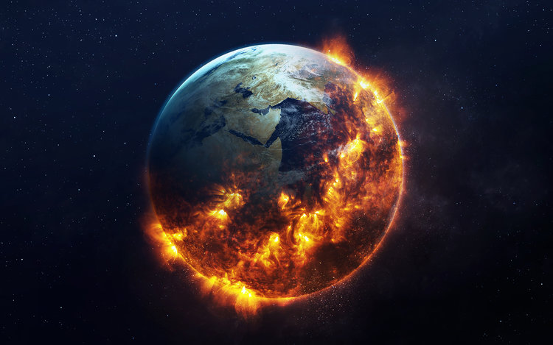
This World is Passing Away
1 John 2:15-17
“Do not love the world nor the things in the world. If anyone loves the world, the love of the Father is not in him. For all that is in the world, the lust of the flesh and the lust of the eyes and the boastful pride of life, is not from the Father, but is from the world. The world is passing away, and also its lust; the one who does the will of God lives forever.”

Slide 45
This World is Passing Away
Lust of the flesh
Lust of the eyes
Boastful pride of life

Slide 46
This World is Passing Away
Lust of the flesh
Lust of the eyes
Boastful pride of life

Slide 47
This World is Passing Away
Lust of the flesh
Lust of the eyes
Boastful pride of life

Slide 48
Shift in Perspective
This world is passing away
Do not conform to this world
Focus on the eternal and not the temporal

Slide 49
Do not Conform to this World
Renew your mind
Do not love this world
We are not of this world
Instead, we are ambassadors for Christ

Slide 50
Do not Conform to this World
Romans 12:1-2
“Therefore I urge you, brethren, by the mercies of God, to present your bodies a living and holy sacrifice, acceptable to God, which is your spiritual service of worship. And do not be conformed to this world, but be transformed by the renewing of your mind, so that you may prove what the will of God is, that which is good and acceptable and perfect.”

Slide 51
Do not Conform to this World
Renew your mind
Do not love this world
We are not of this world
Instead, we are ambassadors for Christ

Slide 52
Do not Love this World
1 John 2:15-16
“Do not love the world nor the things in the world. If anyone loves the world, the love of the Father is not in him. For all that is in the world, the lust of the flesh and the lust of the eyes and the boastful pride of life, is not from the Father, but is from the world.”

Slide 53
Do not Love this World
James 4:4
“You adulteresses, do you not know that friendship with the world is hostility toward God? Therefore whoever wishes to be a friend of the world makes himself an enemy of God.”

Slide 54
Do not Conform to this World
Renew your mind
Do not love this world
We are not of this world
Instead, we are ambassadors for Christ

Slide 55
We are not of This World
John 15:18-19
“If the world hates you, you know that it has hated Me before it hated you. If you were of the world, the world would love its own; but because you are not of the world, but I chose you out of the world, because of this the world hates you.”

Slide 56
We are not of This World
John 17:14-18
“I have given them Your word; and the world has hated them, because they are not of the world, even as I am not of the world. I do not ask You to take them out of the world, but to keep them from the evil one. They are not of the world, even as I am not of the world. Sanctify them in the truth; Your word is truth. As You sent Me into the world, I also have sent them into the world.”

Slide 57
Ambassadors for Christ
2 Corinthians 5:20
“Therefore, we are ambassadors for Christ, as though God were making an appeal through us; we beg you on behalf of Christ, be reconciled to God.”

Slide 58
Shift in Perspective
This world is passing away
Do not conform to this world
Focus on the eternal and not the temporal

Slide 59
Focus on the Eternal and not the Temporal
2 Corinthians 4:16-18
“Therefore we do not lose heart, but though our outer man is decaying, yet our inner man is being renewed day by day. For momentary, light affliction is producing for us an eternal weight of glory far beyond all comparison, while we look not at the things which are seen, but at the things which are not seen; for the things which are seen are temporal, but the things which are not seen are eternal.”

Slide 60
Focus on the Eternal and not the Temporal
Romans 8:18
“For I consider that the sufferings of this present time are not worthy to be compared with the glory that is to be revealed to us.”

Slide 61
Shift in Perspective
This world is passing away
Do not conform to this world
Focus on the eternal and not the temporal

Slide 62
The Victorious Life
When does the victory happen?
“Final salvation?”
Why bear good fruit?

Slide 63
The Victorious Life
When does the victory happen?
“Final salvation?”
Why bear good fruit?

Slide 64
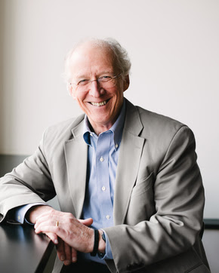
John Piper
“Does God Really Save Us by Faith Alone?”
“These works of faith, and this obedience of faith, these fruits of the Spirit that come by faith, are necessary for our final salvation. No holiness, no heaven. So, we should not speak of getting to heaven by faith alone the same way we are justified by faith alone.”
John Piper, Does God Really Save Us by Faith Alone?, https://www.desiringgod.org/articles/does-god-really-save-us-by-faith-alone

Slide 65
Faith is Evidence of Victory, not Works
1 John 5:4-5
“For whatever is born of God overcomes the world; and this the victory that has overcome the world – our faith. Who is the one who overcomes the world, but he who believes that Jesus is the Son of God?”

Slide 66
The Victorious Life
When does the victory happen?
“Final salvation?”
Why bear good fruit?

Slide 67
Conclusion
The Believer is a Victor and Overcomer of the World
The Believer has Overcome:
Satanic blinding, death and future judgement
How should this shift our perspective?
Non-conformity to this world
Focus on the eternal rather than the temporal

