Slide 2
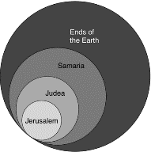
Acts 1:8
“but you will receive power when the Holy Spirit has come upon you; and you shall be My witnesses both in Jerusalem, and in all Judea and Samaria, and even to the remotest part of the earth.”

Slide 3
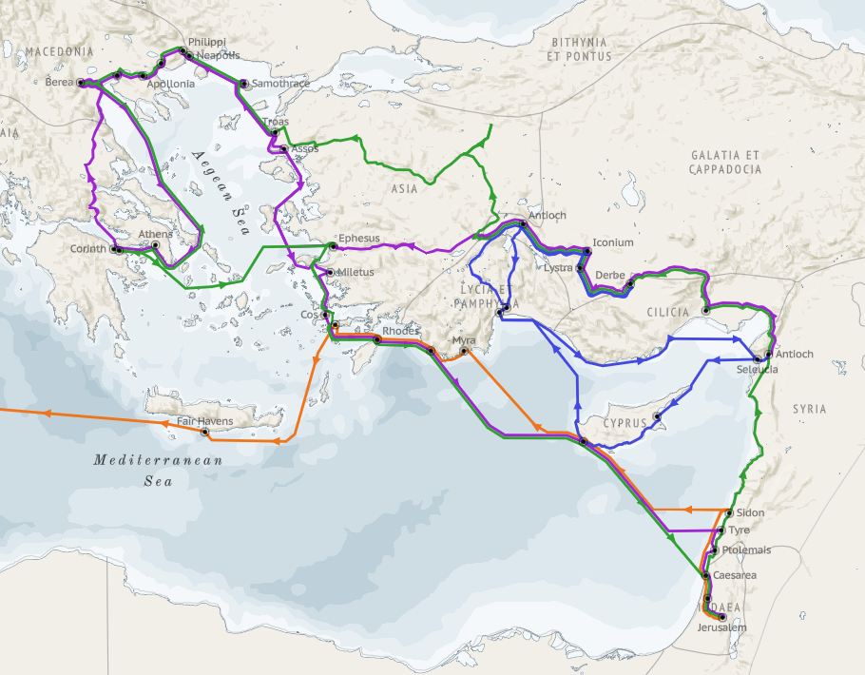
Structure (Acts 1:8)
Jerusalem (Acts 1–7)
Judea and Samaria (Acts 8–12)
Remotest part of the earth (Acts 13–28)
1st missionary journey (Acts 13–14)
Jerusalem council (Acts 15:1-35)
2nd missionary journey (Acts 15:36 –18:22)
3rd missionary journey (Acts 18:23–21:17)
Trip to Rome (Acts 21:18–28:31)

Slide 4
Acts 13‒14 1st Missionary Journey
Paul & Barnabas’ appointment (13:1-3)
Cyprus ministry (13:4-12)
Pisidian Antioch ministry (13:13-52)
Iconium ministry (14:1-7)
Lystra ministry (14:8-20a)
Derbe ministry (14:20b-21a)
Return to Antioch (14:21b-28)

Slide 5
Acts 13:1 Plurality of Elders
Prophets (1a)
Teachers (1b)

Slide 6
Acts 13:1b Teachers
Manaen
Saul

Slide 7
Acts 13‒14 1st Missionary Journey
Paul & Barnabas’ appointment (13:1-3)
Cyprus ministry (13:4-12)
Pisidian Antioch ministry (13:13-52)
Iconium ministry (14:1-7)
Lystra ministry (14:8-20a)
Derbe ministry (14:20b-21a)
Return to Antioch (14:21b-28)

Slide 8
II. Cyprus Ministry Acts 13:4-12
Holy Spirit’s call (4a)
From Seleucia to Cyprus (4b)
Salamis ministry (5)
Paphos ministry (6-12)

Slide 9
II. Cyprus Ministry Acts 13:4-12
Holy Spirit’s call (4a)
From Seleucia to Cyprus (4b)
Salamis ministry (5)
Paphos ministry (6-12)

Slide 10
II. Cyprus Ministry Acts 13:4-12
Holy Spirit’s call (4a)
From Seleucia to Cyprus (4b)
Salamis ministry (5)
Paphos ministry (6-12)

Slide 11
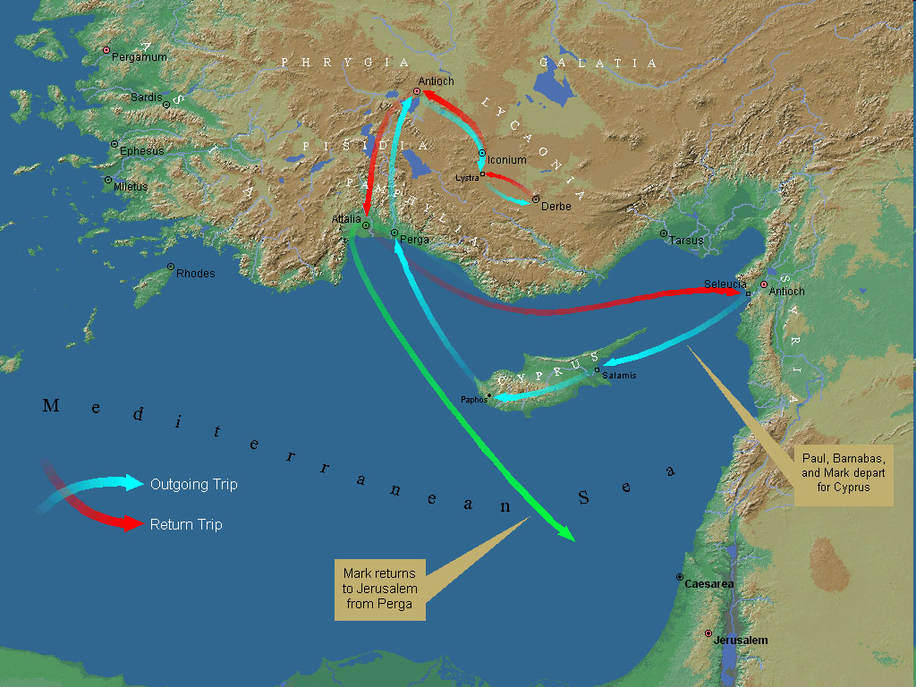
First Missionary Journey

Slide 12
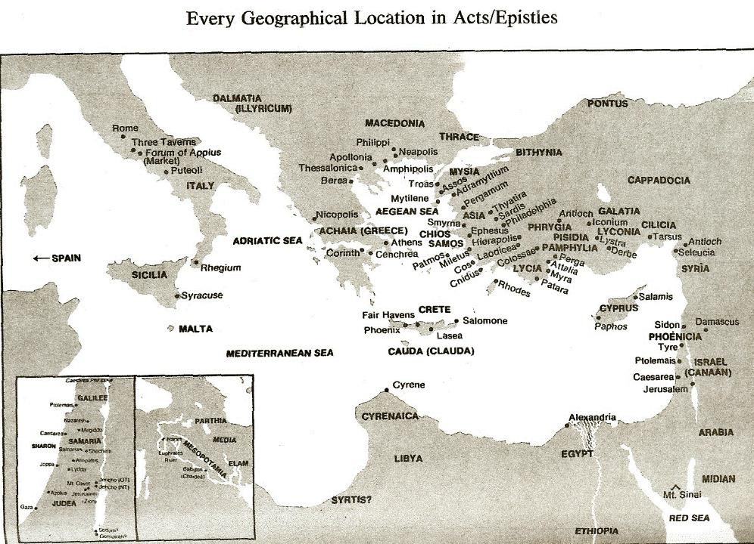

Slide 13
II. Cyprus Ministry Acts 13:4-12
Holy Spirit’s call (4a)
From Seleucia to Cyprus (4b)
Salamis ministry (5)
Paphos ministry (6-12)

Slide 14
First Missionary Journey

Slide 16
Dr. Arnold G. Fruchtenbaum
The Book of Acts, 285
“The ‘John’ mentioned in verse 5 is the same as John Mark of Acts 12:25. He traveled with Barnabas and Saul as their attendant. The Greek word for ‘attendant,’ hypēretēn, means ‘under rower’ and describes someone who is subordinate to another. John Mark was a helper, a servant to the apostles. As mentioned in the previous chapter, he was a cousin of Barnabas (Col. 4:10) from Jerusalem (Acts 12:12).”

Slide 17
First Missionary Journey

Slide 18
II. Cyprus Ministry Acts 13:4-12
Holy Spirit’s call (4a)
From Seleucia to Cyprus (4b)
Salamis ministry (5)
Paphos ministry (6-12)

Slide 19
Acts 13:6-12 Paphos Ministry
Elymas Bar Jesus’ opposition (6-11)
Proconsul’s conversion (12)

Slide 20
Acts 13:6-12 Paphos Ministry
Elymas Bar Jesus’ opposition (6-11)
Proconsul’s conversion (12)

Slide 21
Acts 13:6-11 Elymas Bar Jesus’ Opposition
Description (6)
Proconsul’s spiritual hunger (7)
Opposition (8)
Paul (9)
Condemnation (10)
Judgment (11)

Slide 22
Acts 13:6-11 Elymas Bar Jesus’ Opposition
Description (6)
Proconsul’s spiritual hunger (7)
Opposition (8)
Paul (9)
Condemnation (10)
Judgment (11)

Slide 23
First Missionary Journey

Slide 25
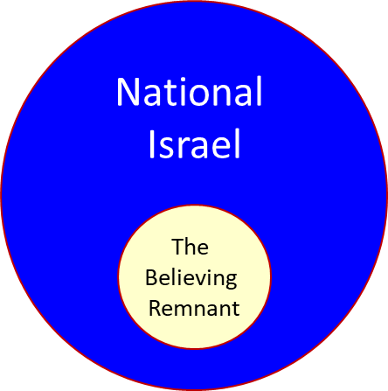

Slide 26
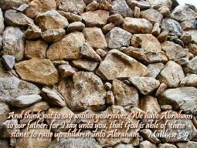
Matthew 3:9
“and do not suppose that you can say to yourselves, ‘We have Abraham for our father’; for I say to you that from these stones God is able to raise up children to Abraham.”

Slide 27
Romans 2:28-29
“²⁸ For he is not a Jew who is one outwardly, nor is circumcision that which is outward in the flesh. ²⁹ But he is a Jew who is one inwardly; and circumcision is that which is of the heart, by the Spirit, not by the letter; and his praise is not from men, but from God.”

Slide 28
Romans 9:6
“But it is not as though the word of God has failed. For they are not all Israel who are descended from Israel.”

Slide 30
Revelation 2:9
“I know your tribulation and your poverty (but you are rich), and the blasphemy by those who say they are Jews and are not, but are a synagogue of Satan.”

Slide 32
Revelation 3:9
“Behold, I will cause those of the synagogue of Satan, who say that they are Jews and are not, but lie—I will make them come and bow down at your feet, and make them know that I have loved you.”

Slide 33
Zechariah 13:8-9
⁸“It will come about in all the land,” Declares the Lord, “That two parts in it will be cut off and perish; But the third will be left in it. ⁹“And I will bring the third part through the fire, Refine them as silver is refined, And test them as gold is tested. They will call on My name, And I will answer them; I will say, ‘They are My people,’ And they will say, ‘The Lord is my God.’ ”

Slide 34
Ezekiel 20:33-38
³³ “As I live,” declares the Lord God, “surely with a mighty hand and with an outstretched arm and with wrath poured out, I shall be king over you. ³⁴ I will bring you out from the peoples and gather you from the lands where you are scattered, with a mighty hand and with an outstretched arm and with wrath poured out; ³⁵ and I will bring you into the wilderness of the peoples, and there I will enter into judgment with you face to face. ³⁶ As I entered into . . .

Slide 35
Ezekiel 20:33-38
. . . judgment with your fathers in the in the wilderness of the land of Egypt, so I will enter into judgment with you,” declares the Lord God. ³⁷ “I will make you pass under the rod, and I will bring you into the bond of the covenant; ³⁸ and I will purge from you the rebels and those who transgress against Me; I will bring them out of the land where they sojourn, but they will not enter the land of Israel. Thus you will know that I am the Lord.

Slide 36
Acts 13:6-11 Elymas Bar Jesus’ Opposition
Description (6)
Proconsul’s spiritual hunger (7)
Opposition (8)
Paul (9)
Condemnation (10)
Judgment (11)

Slide 37
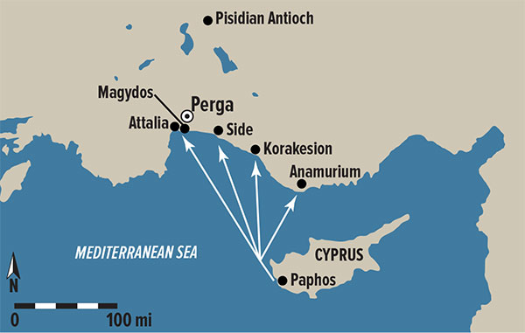
Dr. Arnold G. Fruchtenbaum
The Book of Acts, 286
“In 1877, his name was found in an inscription discovered in Soloi on the northern coast of Cyprus, which reads ‘Under Paulus the proconsul.’ This inscription dates to the year A.D. 53 or 54.”

Slide 38
Acts 17:26-27
²⁶ and He made from one man every nation of mankind to live on all the face of the earth, having determined their appointed times and the boundaries of their habitation, ²⁷ that they would seek God, if perhaps they might grope for Him and find Him, though He is not far from each one of us (Italics added)

Slide 39
Acts 13:6-11 Elymas Bar Jesus’ Opposition
Description (6)
Proconsul’s spiritual hunger (7)
Opposition (8)
Paul (9)
Condemnation (10)
Judgment (11)

Slide 40
Acts 13:6-11 Elymas Bar Jesus’ Opposition
Description (6)
Proconsul’s spiritual hunger (7)
Opposition (8)
Paul (9)
Condemnation (10)
Judgment (11)

Slide 41
Acts 13:9 Paul
Name’s explanation (9a)
Paul’s power (9b)

Slide 42
Acts 13:9 Paul
Name’s explanation (9a)
Paul’s power (9b)

Slide 43
Dr. Arnold G. Fruchtenbaum
The Book of Acts, 286-87
“Verse 9a gives an explanation of Saul’s name: But Saul, who is also called Paul. Some claim that after being saved, Saul changed his name to Paul, but that is not true. Jews of the Diaspora who were Roman citizens, such as Saul, always had a Jewish name and a Gentile name. Now that he was operating in the Roman world ministering among Gentiles, Saul’s Latin name began to be used. Hence, from this point on, Luke called him ‘Saul’ only in reference to his past, such as in Acts 22:7 and 26:14. Paul now took the lead, and only in rare exceptions would his name appear after Barnabas’. The exceptions include Acts 14:14; 15:12 , and 25.”

Slide 44
Acts 13:9 Paul
Name’s explanation (9a)
Paul’s power (9b)

Slide 45
Acts 13:6-11 Elymas Bar Jesus’ Opposition
Description (6)
Proconsul’s spiritual hunger (7)
Opposition (8)
Paul (9)
Condemnation (10)
Judgment (11)

Slide 46
Acts 13:10 Condemnation
Guile (10a)
Full of villany (10b)
Son of the Devil (10c)
Enemy of righteousness (10d)

Slide 47
Acts 13:10 Condemnation
Guile (10a)
Full of villany (10b)
Son of the Devil (10c)
Enemy of righteousness (10d)

Slide 48
Acts 13:10 Condemnation
Guile (10a)
Full of villany (10b)
Son of the Devil (10c)
Enemy of righteousness (10d)

Slide 49
Acts 13:10 Condemnation
Guile (10a)
Full of villany (10b)
Son of the Devil (10c)
Enemy of righteousness (10d)

Slide 50
Acts 13:10 Condemnation
Guile (10a)
Full of villany (10b)
Son of the Devil (10c)
Enemy of righteousness (10d)

Slide 51
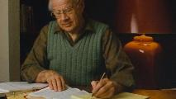
J. Dwight Pentecost Pentecost, J. D. (1997). Your Adversary, the Devil (p. 69). Kregel.
“We find another example in the experience of Paul. The Apostle was sent to propagate the Gospel of the grace of God throughout the Gentile world. When Paul started on his first missionary journey he went into Paphos. “… they found a certain sorcerer, a false prophet, a Jew, whose name was Bar-jesus, which was with the deputy of the country, Sergius Paulus, a prudent man; who called for Barnabas and Saul, and desired to hear the Word of God. But Elymas, the sorcerer, withstood them, seeking to turn away the deputy from the faith” (Acts 13:6–8). Now, what happened? Paul came to a man whose heart was hungry and crying out for a knowledge of God. He introduced this man to the Gospel of the grace of God. But Satan had his minister, who professed to be a minister of righteousness, there to tell this burdened sinner that this was not truth, that it was a lie.”

Slide 52
The First Interfaith Dialogue
2 CORINTHIANS 11:3
“But I fear, lest somehow, as the serpent deceived Eve by his craftiness, so your minds may be corrupted by from the simplicity that is in Christ.” (Italics mine)
GENESIS 3:1
“Now the serpent was more crafty than any beast of the field which the Lord God had made. And he said to the woman, ‘Indeed, has God said, ‘You shall not eat from any tree of the garden’?”

Slide 53
Acts 13:6-11 Elymas Bar Jesus’ Opposition
Description (6)
Proconsul’s spiritual hunger (7)
Opposition (8)
Paul (9)
Condemnation (10)
Judgment (11)

Slide 54
The Plagues of Egypt
NO. | DESCRIPTION | SCRIPTURE | Egyptian Deity
1. | Water to Blood | Exod. 7:14-25 | Hapi, Khnum
2. | Frogs | Exod. 8:1-15 | Heqt
3. | Gnats | Exod. 8:16-19 | Set
4. | Flies | Exod. 8:20-32 | Uatchit
5. | Disease on Cattle | Exod. 9:1-7 | Hathor, Apis
6. | Boils | Exod. 9:8-12 | Sekhmet, Serapis
7. | Hail | Exod. 9:13-35 | Seth, Nut
8. | Locusts | Exod. 10:1-20 | Seth, Nut, Osiris
9. | Darkness | Exod. 10:21-29 | Re, Horus, Atum
10. | Death of the First Born | Exod. 12:29-36 | Min, Osiris, Heqt, Isis

Slide 56
Acts 13:6-12 Paphos Ministry
Elymas Bar Jesus’ opposition (6-11)
Proconsul’s conversion (12)

Slide 57
Passages Conditioning Salvation on Faith Alone (Sola Fide)
Genesis 15:6
John 3:16; 5:24; 6:28-29, 47; 16:8-9; 20:30-31
Acts 16:30-31
Romans 1:16; Ephesians 2:8-9
Hebrews 11:6

Slide 58
Belief – God’s One Condition for Justification
Gen 15:6
Then he believed in the LORD; and He reckoned it to him as righteousness.
John 3:16
For God so loved the world, that He gave His only begotten Son, that whoever believes in Him shall not perish, but have eternal life.
Acts 16:30-31
"Sirs, what must I do to be saved?" They said, "Believe in the Lord Jesus, and you will be saved..."

Slide 59
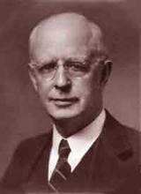
Lewis Sperry Chafer, vol. 7, Systematic Theology (Grand Rapids, MI: Kregel Publications, 1993), 265-66.
Belief-God’s One Condition for Justification
“…because upwards of 150 passages of Scripture condition salvation upon believing only (cf. John 3:16; Acts 16:31).”

Slide 60
Acts 13‒14 1st Missionary Journey
Paul & Barnabas’ appointment (13:1-3)
Cyprus ministry (13:4-12)
Pisidian Antioch ministry (13:13-52)
Iconium ministry (14:1-7)
Lystra ministry (14:8-20a)
Derbe ministry (14:20b-21a)
Return to Antioch (14:21b-28)

Slide 61
Acts 13‒14 1st Missionary Journey
Paul & Barnabas’ appointment (13:1-3)
Cyprus ministry (13:4-12)
Pisidian Antioch ministry (13:13-52)
Iconium ministry (14:1-7)
Lystra ministry (14:8-20a)
Derbe ministry (14:20b-21a)
Return to Antioch (14:21b-28)

Slide 62
Acts 13‒14 1st Missionary Journey
Paul & Barnabas’ appointment (13:1-3)
Cyprus ministry (13:4-12)
Pisidian Antioch ministry (13:13-52)
Iconium ministry (14:1-7)
Lystra ministry (14:8-20a)
Derbe ministry (14:20b-21a)
Return to Antioch (14:21b-28)

Slide 63
Acts 13‒14 1st Missionary Journey
Paul & Barnabas’ appointment (13:1-3)
Cyprus ministry (13:4-12)
Pisidian Antioch ministry (13:13-52)
Iconium ministry (14:1-7)
Lystra ministry (14:8-20a)
Derbe ministry (14:20b-21a)
Return to Antioch (14:21b-28)

Slide 64
Acts 13‒14 1st Missionary Journey
Paul & Barnabas’ appointment (13:1-3)
Cyprus ministry (13:4-12)
Pisidian Antioch ministry (13:13-52)
Iconium ministry (14:1-7)
Lystra ministry (14:8-20a)
Derbe ministry (14:20b-21a)
Return to Antioch (14:21b-28)

Slide 65
Conclusion

Slide 66
Acts 13‒14 1st Missionary Journey
Paul & Barnabas’ appointment (13:1-3)
Cyprus ministry (13:4-12)
Pisidian Antioch ministry (13:13-52)
Iconium ministry (14:1-7)
Lystra ministry (14:8-20a)
Derbe ministry (14:20b-21a)
Return to Antioch (14:21b-28)

