Slide 1
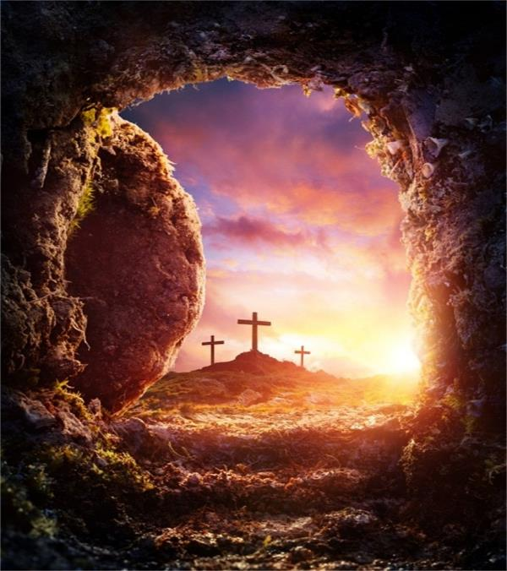
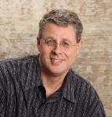
Jesus: One of a Kind
Dr. Andy Woods
Senior Pastor – Sugar Land Bible Church
President – Chafer Theological Seminary

Slide 2


John 1:14
“And the Word became flesh, and dwelt among us, and we saw His glory, glory as of the only begotten [monogenēs] from the Father, full of grace and truth.”

Slide 3
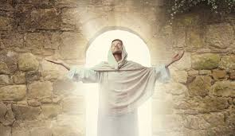
The Uniqueness of Jesus Christ
A man of verifiable history
A man of fulfilled prophecy
A man of predictive prophecy
A man of unimpeachable morality
A man of profound teaching
A man of authentic miracles
A man of bodily resurrection

Slide 4
The Uniqueness of Jesus Christ
A man of verifiable history
A man of fulfilled prophecy
A man of predictive prophecy
A man of unimpeachable morality
A man of profound teaching
A man of authentic miracles
A man of bodily resurrection

Slide 5
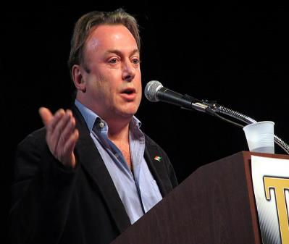
Christopher Hitchens
(AD 1949‒2011)
“Jesus of Nazareth is not a figure in history…There is no reason at all to believe that the so-called Jesus of Nazareth ever existed.”
https://www.youtube.com/watch?v=zBxvLmRsKiw

Slide 6
What Happened to Christ’s Disciples?
Disciple | Place | Martyrdom
James the Son of Alpheus | Jerusalem | Clubbed to death
Simon the Zealot | Jerusalem | Martyred
James the Son of Zebedee | Judea (Acts 12:2) | Executed
Thaddeus | Mesopotamia | Beaten to death
Peter | Babylon, Rome | Crucified upside down
Matthew | Parthia (Tehran) | Beheaded
Notes:
109 prophecies…
Peter Stoner – SCIENCE SPEAKS, An Evaluation of Certain Christian Evidences
To fulfill just 8 prophecies =1 X 10 to the twenty-eighth power!
Can we visualize this with an illustration? Suppose we took an atheistic professor, blindfolded him and covered the state of Texas two feet deep with silver dollars. Then we put a check on one of those silver dollars and mixed them up. The odds of one person fulfilling just these eight prophecies would be the same as this atheistic professor selecting the silver dollar upon which we have placed a check, in his first try.
https://www.bereanpublishers.com/the-odds-of-eight-messianic-prophecies-coming-true/

Slide 7
What Happened to Christ’s Disciples?
Disciple | Place | Martyrdom
John | Asia Minor, Patmos, Ephesus | Fried in boiling oil
Philip | E. Turkey | Tortured & crucified
Thomas | India | Speared
Bartholomew | India | Flayed & crucified
Andrew | Ukraine, Russia, Greece | Hanged
Notes:
109 prophecies…
Peter Stoner – SCIENCE SPEAKS, An Evaluation of Certain Christian Evidences
To fulfill just 8 prophecies =1 X 10 to the twenty-eighth power!
Can we visualize this with an illustration? Suppose we took an atheistic professor, blindfolded him and covered the state of Texas two feet deep with silver dollars. Then we put a check on one of those silver dollars and mixed them up. The odds of one person fulfilling just these eight prophecies would be the same as this atheistic professor selecting the silver dollar upon which we have placed a check, in his first try.
https://www.bereanpublishers.com/the-odds-of-eight-messianic-prophecies-coming-true/

Slide 8
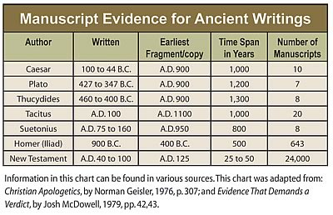

Slide 9
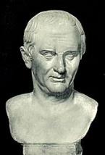
Cornelius Tacitus
(AD 55‒120)
Annals XV, 44
“Consequently, to get rid of the report, Nero fastened the guilt and inflicted the most exquisite tortures on a class hated for their abominations, called Christians by the populace. Christus, from whom the name had its origin, suffered the extreme penalty during the reign of Tiberius at the hands of one of our procurators, Pontius Pilatus, and a most mischievous superstition, thus checked for the moment, again broke out not only in Judea, the first source of the evil, but even in Rome, where all things hideous and shameful from every part of the world find their centre and become popular.”

Slide 10
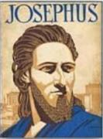
Josephus
Antiquities 18.3.3
“About this time there lived Jesus, a wise man, if indeed one ought to call him a man. For he was one who performed surprising deeds and was a teacher of such people as accept the truth gladly. He won over many Jews and many of the Greeks. He was the Christ. And when, upon the accusation of the principal men among us, Pilate had condemned him to a cross, those who had first come to love him did not cease. He appeared to them spending a third day restored to life, for the prophets of God had foretold these things and a thousand other marvels about him. And the tribe of the Christians, so called after him, has still to this day not disappeared.”

Slide 11
Secular Historians Mentioning Christ
Secular Historian | Date
Tacitus | AD 55‒120
Lucian | AD Second Century
Suetonius | AD 69‒122
Pliny the Younger | AD 112
Thallus | AD 52
Mar Bar Serapion | AD 70
Josephus | AD 78

Slide 12
The Uniqueness of Jesus Christ
A man of verifiable history
A man of fulfilled prophecy
A man of predictive prophecy
A man of unimpeachable morality
A man of profound teaching
A man of authentic miracles
A man of bodily resurrection

Slide 13
John 5:39, 46
“³⁹ You search the Scriptures because you think that in them you have eternal life; it is these that testify about Me…⁴⁶ For if you believed Moses, you would believe Me, for he wrote about Me.”

Slide 14
Luke 24:27, 44
“²⁷ Then beginning with Moses and with all the prophets, He explained to them the things concerning Himself in all the Scriptures…⁴⁴ Now He said to them, ‘These are My words which I spoke to you while I was still with you, that all things which are written about Me in the Law of Moses and the Prophets and the Psalms must be fulfilled.’”

Slide 15

Acts 17:1-3
“¹ Now when they had traveled through Amphipolis and Apollonia, they came to Thessalonica, where there was a synagogue of the Jews. ² And according to Paul’s custom, he visited them, and for three Sabbaths reasoned with them from the Scriptures, ³ explaining and giving evidence that the Christ had to suffer and rise from the dead, and saying, “This Jesus whom I am proclaiming to you is the Christ.”

Slide 16

1 Corinthians 15:3-4
“³ For I handed down to you as of first importance what I also received, that Christ died for our sins according to the Scriptures, ⁴ and that He was buried, and that He was raised on the third day according to the Scriptures.”

Slide 17
Josephus
Antiquities 18.3.3
“About this time there lived Jesus, a wise man, if indeed one ought to call him a man. For he was one who performed surprising deeds and was a teacher of such people as accept the truth gladly. He won over many Jews and many of the Greeks. He was the Christ. And when, upon the accusation of the principal men among us, Pilate had condemned him to a cross, those who had first come to love him did not cease. He appeared to them spending a third day restored to life, for the prophets of God had foretold these things and a thousand other marvels about him. And the tribe of the Christians, so called after him, has still to this day not disappeared.”

Slide 18
OT Prophecies About Christ
Prophecy | Scripture | Years in Advance
Manner of Birth | Isaiah 7:14 | 700 years
Place of Birth | Micah 5:2 | 700 years
Nationality | Numbers 24:17 | 1400 years
Tribe | Genesis 49:10 | 1800 years
Time of and Response to His Messiahship | Dan. 9:25-26 | 600 years

Slide 19
OT Prophecies About Christ
Prophecy | Scripture | Years in Advance
Crucified Between Thieves | Isaiah 53:9 | 700 years
Pierced | Isaiah 53:5 | 700 years
No Broken Bones | Psalm 22:17 | 1000 years
Gamble for His Clothing | Psalm 22:18 | 1000 years
Buried in Rich Man’s Tomb | Isaiah 53:9 | 700 years
Notes:
109 prophecies…
Peter Stoner – SCIENCE SPEAKS, An Evaluation of Certain Christian Evidences
To fulfill just 8 prophecies =1 X 10 to the twenty-eighth power!
Can we visualize this with an illustration? Suppose we took an atheistic professor, blindfolded him and covered the state of Texas two feet deep with silver dollars. Then we put a check on one of those silver dollars and mixed them up. The odds of one person fulfilling just these eight prophecies would be the same as this atheistic professor selecting the silver dollar upon which we have placed a check, in his first try.
https://www.bereanpublishers.com/the-odds-of-eight-messianic-prophecies-coming-true/

Slide 20
The Uniqueness of Jesus Christ
A man of verifiable history
A man of fulfilled prophecy
A man of predictive prophecy
A man of unimpeachable morality
A man of profound teaching
A man of authentic miracles
A man of bodily resurrection

Slide 21
John 13:19; 14:29
“¹⁹ From now on I am telling you before it comes to pass, so that when it does occur, you may believe that I am He… ^{14:29} Now I have told you before it happens, so that when it happens, you may believe.”

Slide 22
Christ’s Short-Term Predictions
Prophecy | Scripture
Betrayal by a Friend | John 13:21
Three-fold Denial by Peter | Matthew 26:34, 75
Manner of His Own Death | Matthew 20:18-19
Manner of Disciples’ Deaths | John 21:18-22
AD 70 Events | Luke 19:41-44

Slide 23
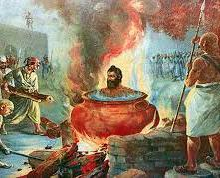
Tertullian
Prescription Against Heretics, 36
“…where the Apostle John was first plunged, unhurt, into boiling oil, and thence remitted to his island-exile!”

Slide 24
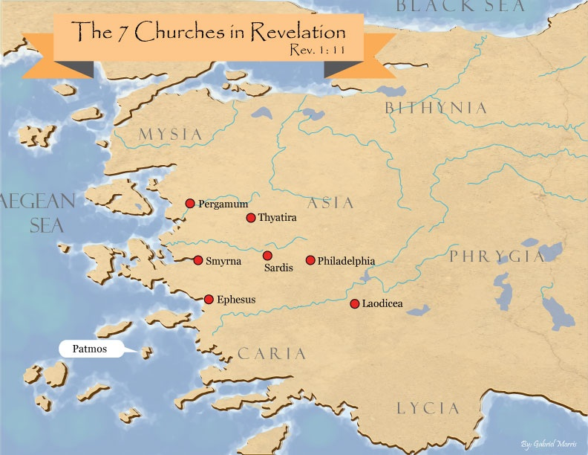
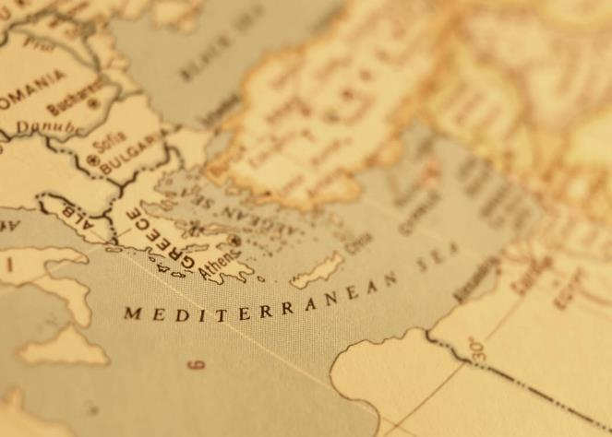

Slide 25
Christ’s Short-Term Predictions
Prophecy | Scripture
Betrayal by a Friend | John 13:21
Three-fold Denial by Peter | Matthew 26:34, 75
Manner of His Own Death | Matthew 20:18-19
Manner of Disciples’ Deaths | John 21:18-22
AD 70 Events | Luke 19:41-44

Slide 26
Luke 19:41-44
^{41 “}When He approached Jerusalem, He saw the city and wept over it, ⁴² saying, “If you had known in this day, even you, the things which make for peace! But now they have been hidden from your eyes. ⁴³ For the days will come upon you when your enemies will throw up a barricade against you, and surround you and hem you in on . . .

Slide 27
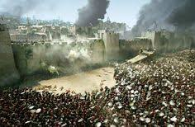
Luke 19:41-44
. . . every side, ⁴⁴ and they will level you to the ground and your children within you, and they will not leave in you one stone upon another, because you did not recognize the time of your visitation.”

Slide 28
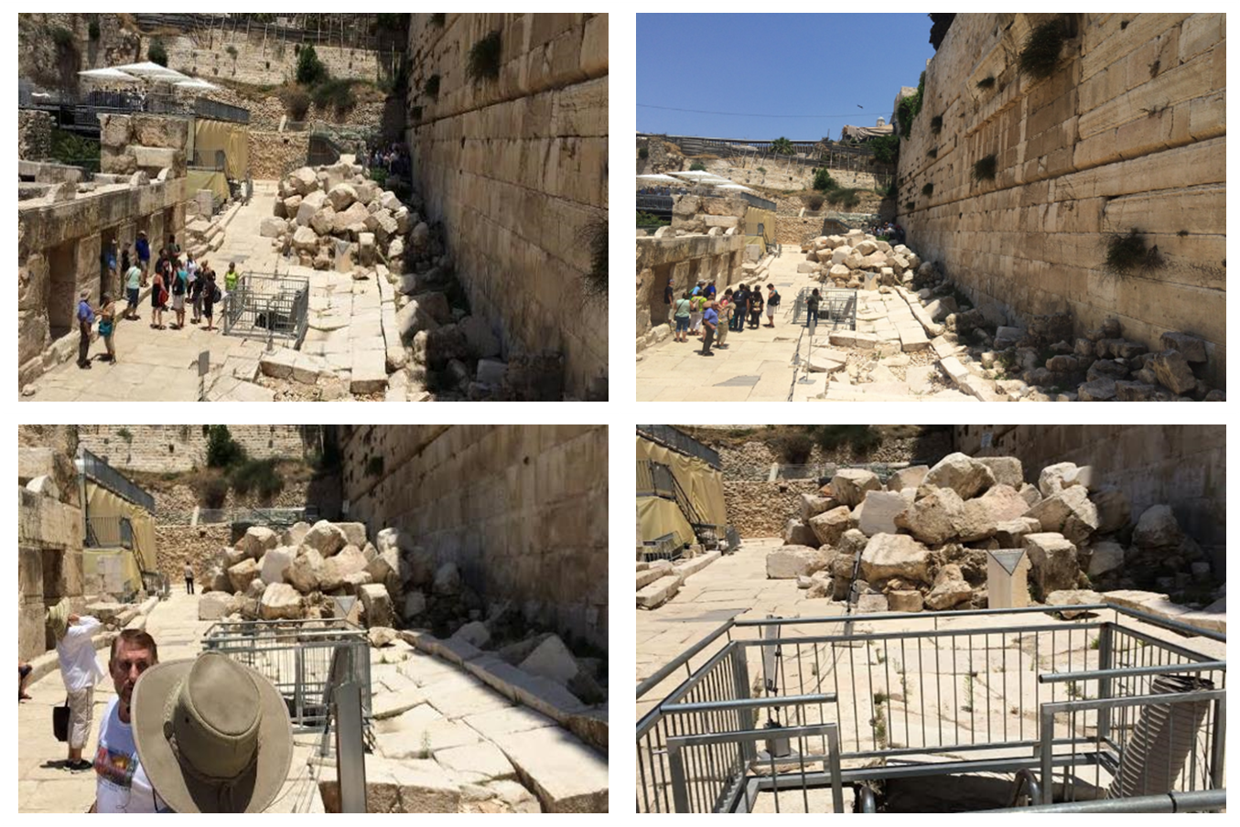

Slide 29
MATT 24 / REV 6 PARALLELS
Prediction | Birth pangs (Matt 24) | Seal judgments (Rev 6)
False Christ | 24:5 | 6:2
War | 24:6 | 6:3-4
Famine | 24:7 | 6:5-6
Death | 24:6-7 | 6:7-8
Martyrs | 24:9-13 | 6:9-11
Earthquakes | 24:7 | 6:12-17
Evangelism | 24:14 | 7:1-9

Slide 30
The Uniqueness of Jesus Christ
A man of verifiable history
A man of fulfilled prophecy
A man of predictive prophecy
A man of unimpeachable morality
A man of profound teaching
A man of authentic miracles
A man of bodily resurrection

Slide 31
Cornelius Tacitus
(AD 55‒120)
Annals XV, 44
“Consequently, to get rid of the report, Nero fastened the guilt and inflicted the most exquisite tortures on a class hated for their abominations, called Christians by the populace. Christus, from whom the name had its origin, suffered the extreme penalty during the reign of Tiberius at the hands of one of our procurators, Pontius Pilatus, and a most mischievous superstition, thus checked for the moment, again broke out not only in Judea, the first source of the evil, but even in Rome, where all things hideous and shameful from every part of the world find their centre and become popular.”

Slide 32
Josephus
Antiquities 18.3.3
“About this time there lived Jesus, a wise man, if indeed one ought to call him a man. For he was one who performed surprising deeds and was a teacher of such people as accept the truth gladly. He won over many Jews and many of the Greeks. He was the Christ. And when, upon the accusation of the principal men among us, Pilate had condemned him to a cross, those who had first come to love him did not cease. He appeared to them spending a third day restored to life, for the prophets of God had foretold these things and a thousand other marvels about him. And the tribe of the Christians, so called after him, has still to this day not disappeared.”

Slide 33
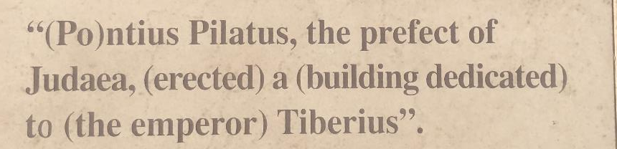
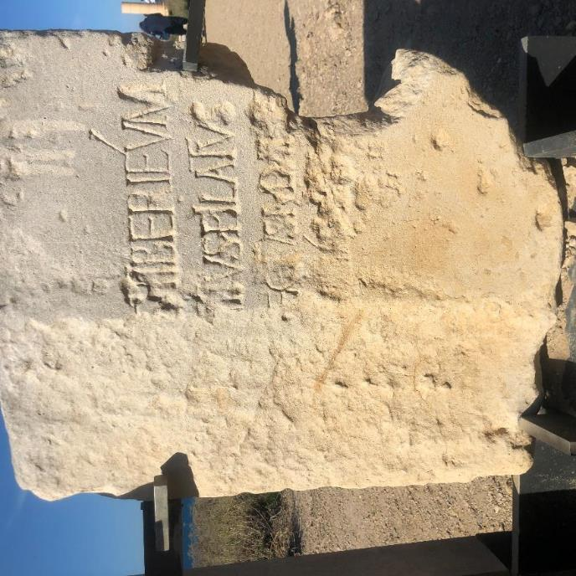


Slide 34
The Uniqueness of Jesus Christ
A man of verifiable history
A man of fulfilled prophecy
A man of predictive prophecy
A man of unimpeachable morality
A man of profound teaching
A man of authentic miracles
A man of bodily resurrection

Slide 35
The Incomparable Christ
Anonymous
“He never wrote a book, and yet all the libraries of the country could not hold the books that have been written about Him. He never wrote a song, and yet He has furnished the theme for more songs than all the song writers combined. He never founded a college, but all the schools put together cannot boast of having as many students. He never marshaled an army, nor drafted a soldier, nor fired a gun; and yet no leader ever had more volunteers who have, under His orders, made more rebels stack arms and surrender without a shot fired. He never practiced psychiatry, and yet He healed more broken hearts than all the doctors far and near.”

Slide 36
Matthew 5:21-22
“²¹ “You have heard that the ancients were told, ‘You shall not commit murder’ and ‘Whoever commits murder shall be liable to the court.’ ²² But I say to you that everyone who is angry with his brother shall be guilty before the court; and whoever says to his brother, ‘You good-for-nothing,’ shall be guilty before the supreme court; and whoever says, ‘You fool,’ shall be guilty enough to go into the fiery hell.”

Slide 37
Matthew 5:27-28
“²⁷ You have heard that it was said, ‘You shall not commit adultery’; ²⁸ but I say to you that everyone who looks at a woman with lust for her has already committed adultery with her in his heart.”

Slide 38
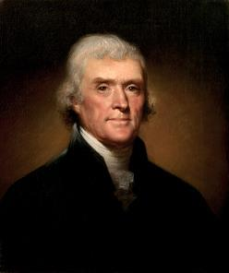
Thomas Jefferson
"My views ... are the result of a life of inquiry and reflection, and very different from the anti-Christian system imputed to me by those who know nothing of my opinions. To the corruptions of Christianity, I am, indeed, opposed; but not to the genuine precepts of Jesus Himself. I am a Christian in the only sense in which He wished any one to be; sincerely attached to his doctrines in preference to all others...His system of morals...if filled up in the style and spirit of the rich fragments He left us, would be the most perfect and sublime that has ever been taught by man...His moral doctrines...were more pure and . . .
On April 21, 1803, Jefferson wrote to Dr. Benjamin Rush, also a signer of the Declaration

Slide 39
Thomas Jefferson
...perfect than those of the most correct of the philosophers...gathering all into one family under the bonds of love, charity, peace, common wants and common aids. A development of this head will evince the peculiar superiority of the system of Jesus over all others. The precepts of philosophy, and of the Hebrew code, laid hold of actions only. He pushed his scrutinies into the heart of man; erected his tribunal in the region of his thoughts, and purified the waters at the fountain head.”
On April 21, 1803, Jefferson wrote to Dr. Benjamin Rush, also a signer of the Declaration

Slide 40
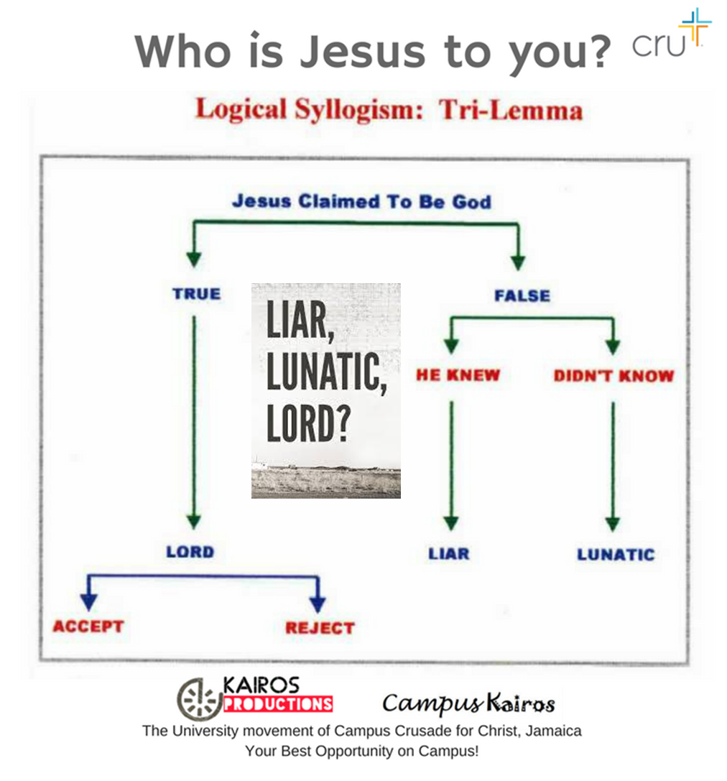

Slide 41
The Uniqueness of Jesus Christ
A man of verifiable history
A man of fulfilled prophecy
A man of predictive prophecy
A man of unimpeachable morality
A man of profound teaching
A man of authentic miracles
A man of bodily resurrection

Slide 42
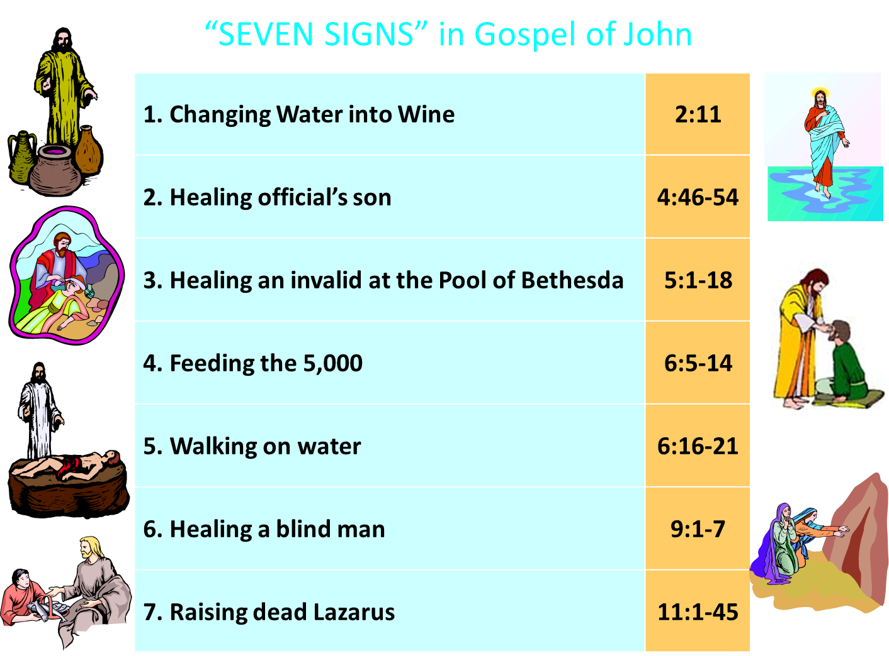
John 3:2
“this man came to Jesus by night and said to Him, “Rabbi, we know that You have come from God as a teacher; for no one can do these signs that You do unless God is with him.”

Slide 43
Matthew 11:2-6
“² Now when John, while imprisoned, heard of the works of Christ, he sent word by his disciples ³ and said to Him, ‘Are You the Expected One, or shall we look for someone else?’ ⁴ Jesus answered and said to them, ’Go and report to John what you hear and see: ⁵ the blind receive sight and the lame walk, the lepers are cleansed and the deaf hear the dead are raised up, and the poor have the . . .

Slide 44
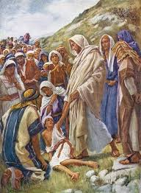
Matthew 11:2-6
. . . gospel preached to them. ⁶ And blessed is he who does not take offense at Me.’”

Slide 45
Acts 2:22
“Men of Israel, listen to these words: Jesus the Nazarene, a man attested to you by God with miracles and wonders and signs which God performed through Him in your midst, just as you yourselves know.”

Slide 46
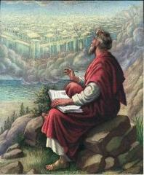
John 20:30-31
“Therefore many other signs Jesus also performed in the presence of the disciples, which are not written in this book; but these have been written so that you may believe that Jesus is the Christ, the Son of God; and that believing you may have life in His name.”

Slide 47
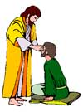
“SEVEN SIGNS” in Gospel of John
1. Changing Water into Wine | 2:11
2. Healing official’s son | 4:46-54
3. Healing an invalid at the Pool of Bethesda | 5:1-18
4. Feeding the 5,000 | 6:5-14
5. Walking on water | 6:16-21
6. Healing a blind man | 9:1-7
7. Raising dead Lazarus | 11:1-45

Slide 48
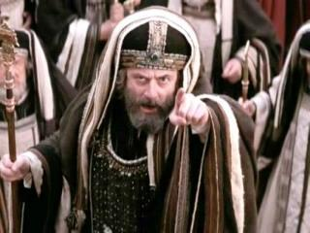
Matthew 12:24
“But when the Pharisees heard this, they said, ‘This man casts out demons only by Beelzebul the ruler of the demons.’”

Slide 49
Josephus
Antiquities 18.3.3
“About this time there lived Jesus, a wise man, if indeed one ought to call him a man. For he was one who performed surprising deeds and was a teacher of such people as accept the truth gladly. He won over many Jews and many of the Greeks. He was the Christ. And when, upon the accusation of the principal men among us, Pilate had condemned him to a cross, those who had first come to love him did not cease. He appeared to them spending a third day restored to life, for the prophets of God had foretold these things and a thousand other marvels about him. And the tribe of the Christians, so called after him, has still to this day not disappeared.”

Slide 50
The Uniqueness of Jesus Christ
A man of verifiable history
A man of fulfilled prophecy
A man of predictive prophecy
A man of unimpeachable morality
A man of profound teaching
A man of authentic miracles
A man of bodily resurrection

Slide 51
Josephus
Antiquities 18.3.3
“About this time there lived Jesus, a wise man, if indeed one ought to call him a man. For he was one who performed surprising deeds and was a teacher of such people as accept the truth gladly. He won over many Jews and many of the Greeks. He was the Christ. And when, upon the accusation of the principal men among us, Pilate had condemned him to a cross, those who had first come to love him did not cease. He appeared to them spending a third day restored to life, for the prophets of God had foretold these things and a thousand other marvels about him. And the tribe of the Christians, so called after him, has still to this day not disappeared.”

Slide 52
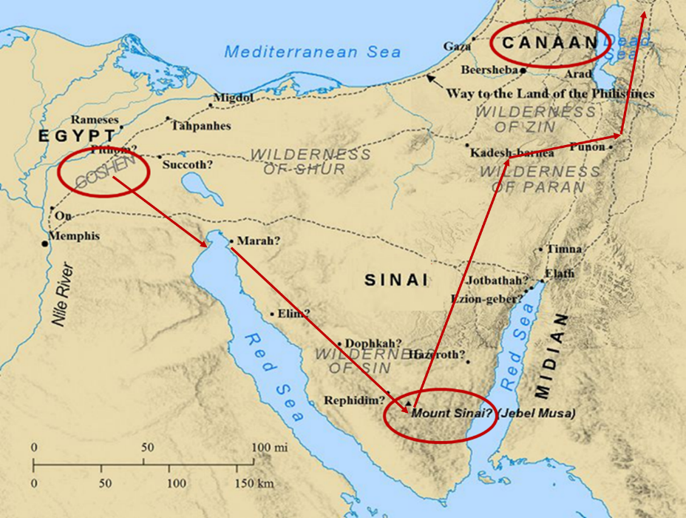

Slide 53
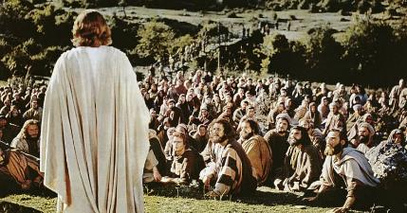
1 Corinthians 15:6-7
“⁶ After that He appeared to more than five hundred brethren at one time, most of whom remain until now, but some have fallen asleep; ⁷ then He appeared to James, then to all the apostles…”

Slide 54
Naturalistic Theories
Swoon theory
Theft theory
Hallucination theory
Wrong tomb theory

Slide 55
Naturalistic Theories
Swoon theory
Theft theory
Hallucination theory
Wrong tomb theory

Slide 56
Naturalistic Theories
Swoon theory
Theft theory
Hallucination theory
Wrong tomb theory

Slide 57

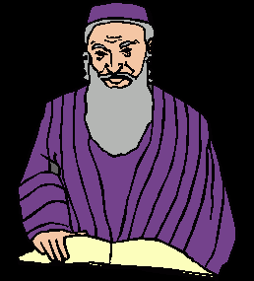
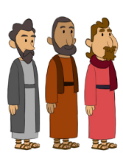
2. Theft Theories
Rome
Jews
Disciples

Slide 58
2. Theft Theories
Rome
Jews
Disciples

Slide 59
2. Theft Theories
Rome
Jews
Disciples

Slide 60
2. Theft Theories
Rome
Jews
Disciples

Slide 61
Naturalistic Theories
Swoon theory
Theft theory
Hallucination theory
Wrong tomb theory

Slide 62
Naturalistic Theories
Swoon theory
Theft theory
Hallucination theory
Wrong tomb theory

Slide 63
How Does Jesus Compare?
Deity | Tomb Status
Confucius | Occupied
Buddha | Occupied
Mohammed | Occupied
Jesus | ***EMPTY***
G.B. Hardy, Countdown

Slide 64
Conclusion

Slide 65
The Uniqueness of Jesus Christ
A man of verifiable history
A man of fulfilled prophecy
A man of predictive prophecy
A man of unimpeachable morality
A man of profound teaching
A man of authentic miracles
A man of bodily resurrection

Slide 66
Seven “I AM” statements in John
1. I am the Bread of Life | 6:35
2. I am the Light of the world | 8:12
3. I am the Gate for the sheep | 10:7; cf. v.9
4. I am the Good Shepherd | 10:11,14
5. I am the Resurrection and the Life | 11:25
6. I am the Way and the Truth and the Life | 14:6
7. I am the true Vine | 15:1; cf. v.5

Slide 67
John 11:25-27
“²⁵ Jesus said to her, ‘I am the resurrection and the life; he who believes in Me will live even if he dies, ²⁶ and everyone who lives and believes in Me will never die. Do you believe this?’ ²⁷ She said to Him, ‘Yes, Lord; I have believed that You are the Christ, the Son of God, even He who comes into the world.’”

Slide 68
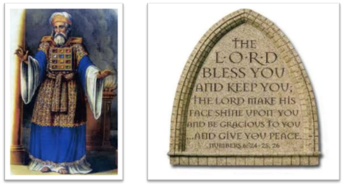
“The Lord bless you and keep you; the Lord make his face shine on you and be gracious to you; the Lord turn his face toward you and give you peace.” (NIV)

