Slide 1
WHY WE SHOULD PRAISE THE LORD
Psalm 145:1-21
Jim McGowan, Th.D. Sugar Land Bible Church 04-16-2025
Special thanks to Duluth Bible Church for access to their insights and resources.

Slide 2
PSALM 145
Session Outline
INTRODUCTION
WHAT WE NEED TO KNOW ABOUT PSALM 145
WHY WE SHOULD PRAISE THE LORD
PSALM 145 – VERSE BY VERSE
CONCLUDING COMMENTS

Slide 3
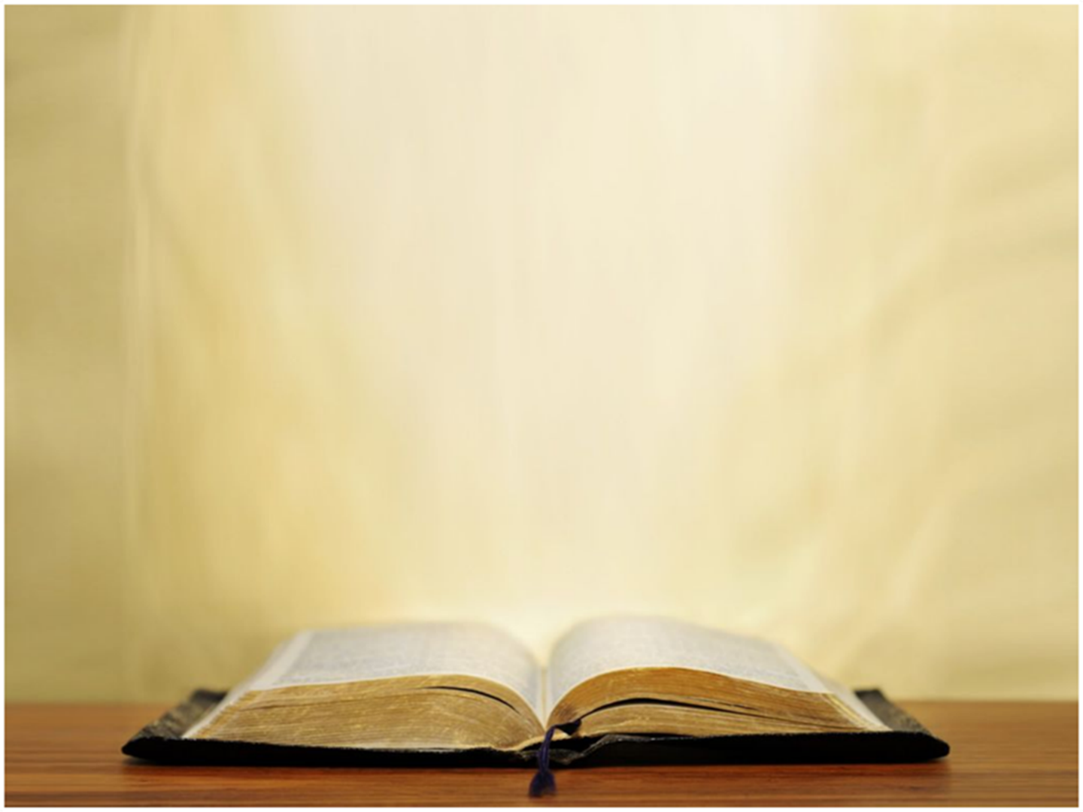
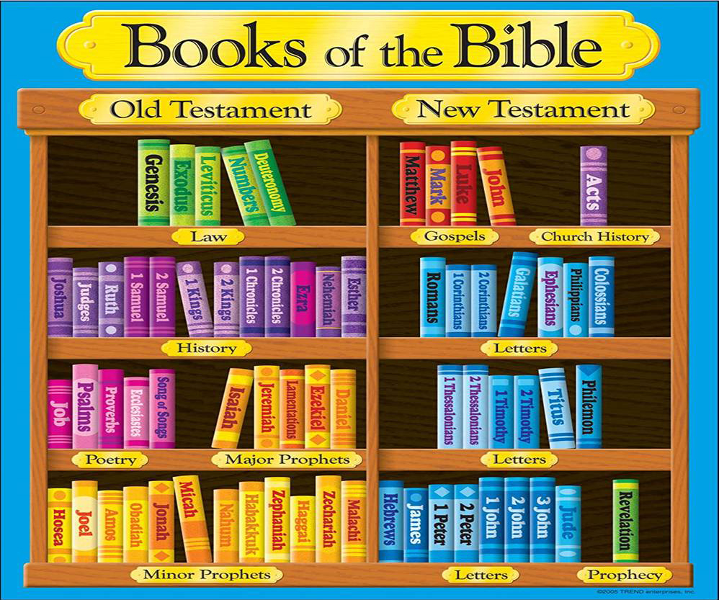
2 Timothy 3:16-17 (NKJV)
¹⁶ All Scripture is given by inspiration of God, and is profitable for doctrine, for reproof, for correction, for instruction in righteousness, ¹⁷ that the man of God may be complete, thoroughly equipped for every good work.

Slide 4
PSALM 145
Session Outline
INTRODUCTION
WHAT WE NEED TO KNOW ABOUT PSALM 145
WHY WE SHOULD PRAISE THE LORD
PSALM 145 – VERSE BY VERSE
CONCLUDING COMMENTS

Slide 5
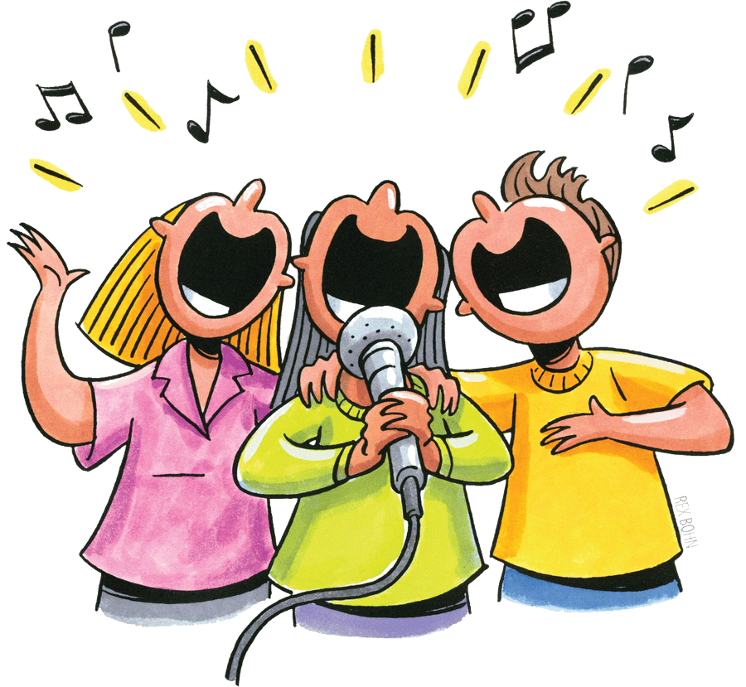
PSALM 145 - WHAT WE NEED TO KNOW
PSALM 145 is:
an acrostic psalm

Slide 6
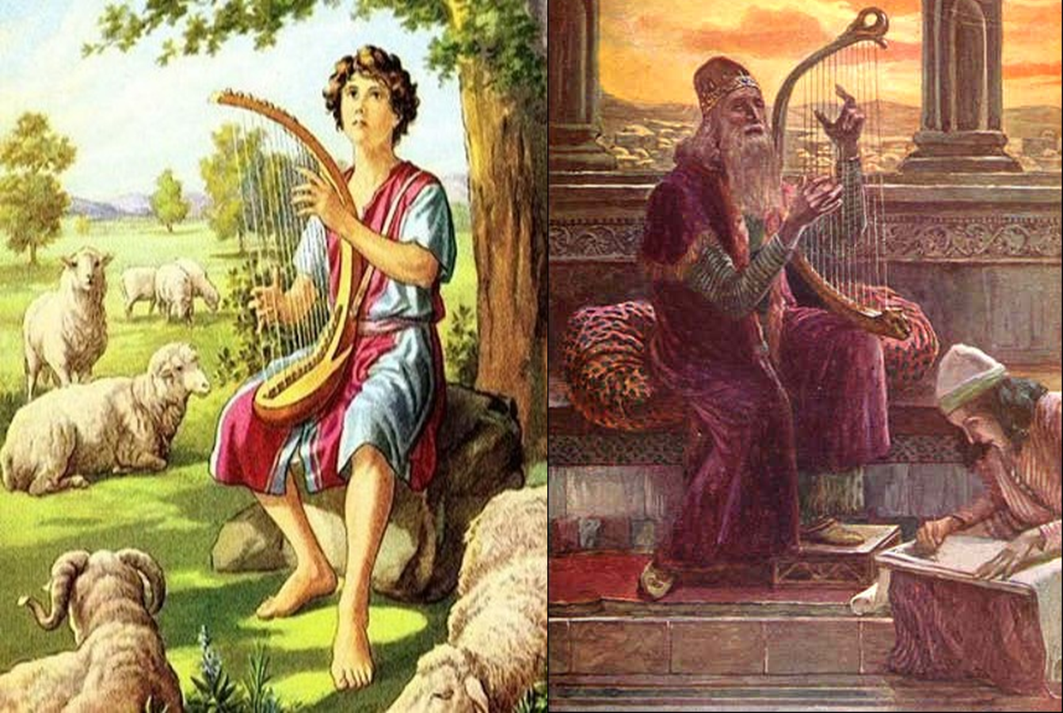
PSALM 145 - WHAT WE NEED TO KNOW
PSALM 145 is:
a psalm of David

Slide 7
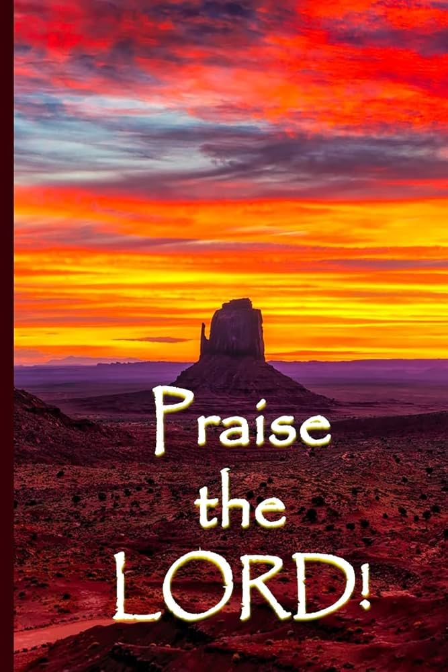
PSALM 145 - WHAT WE NEED TO KNOW
PSALM 145 is:
a pure praise Psalm

Slide 8
PSALM 145 - WHAT WE NEED TO KNOW
PSALM 145 is:
the exquisite Psalm
the magnificent ode of praise

Slide 9
PSALM 145 - WHAT WE NEED TO KNOW
PSALM 145 is:
the crown jewel of praise

Slide 10
PSALM 145
Session Outline
INTRODUCTION
WHAT WE NEED TO KNOW ABOUT PSALM 145
WHY WE SHOULD PRAISE THE LORD
PSALM 145 – VERSE BY VERSE
CONCLUDING COMMENTS

Slide 11
PSALM 145 - WHY WE SHOULD PRAISE THE LORD
We should praise the Lord:
because of His greatness! (vv. 1-3)

Slide 12
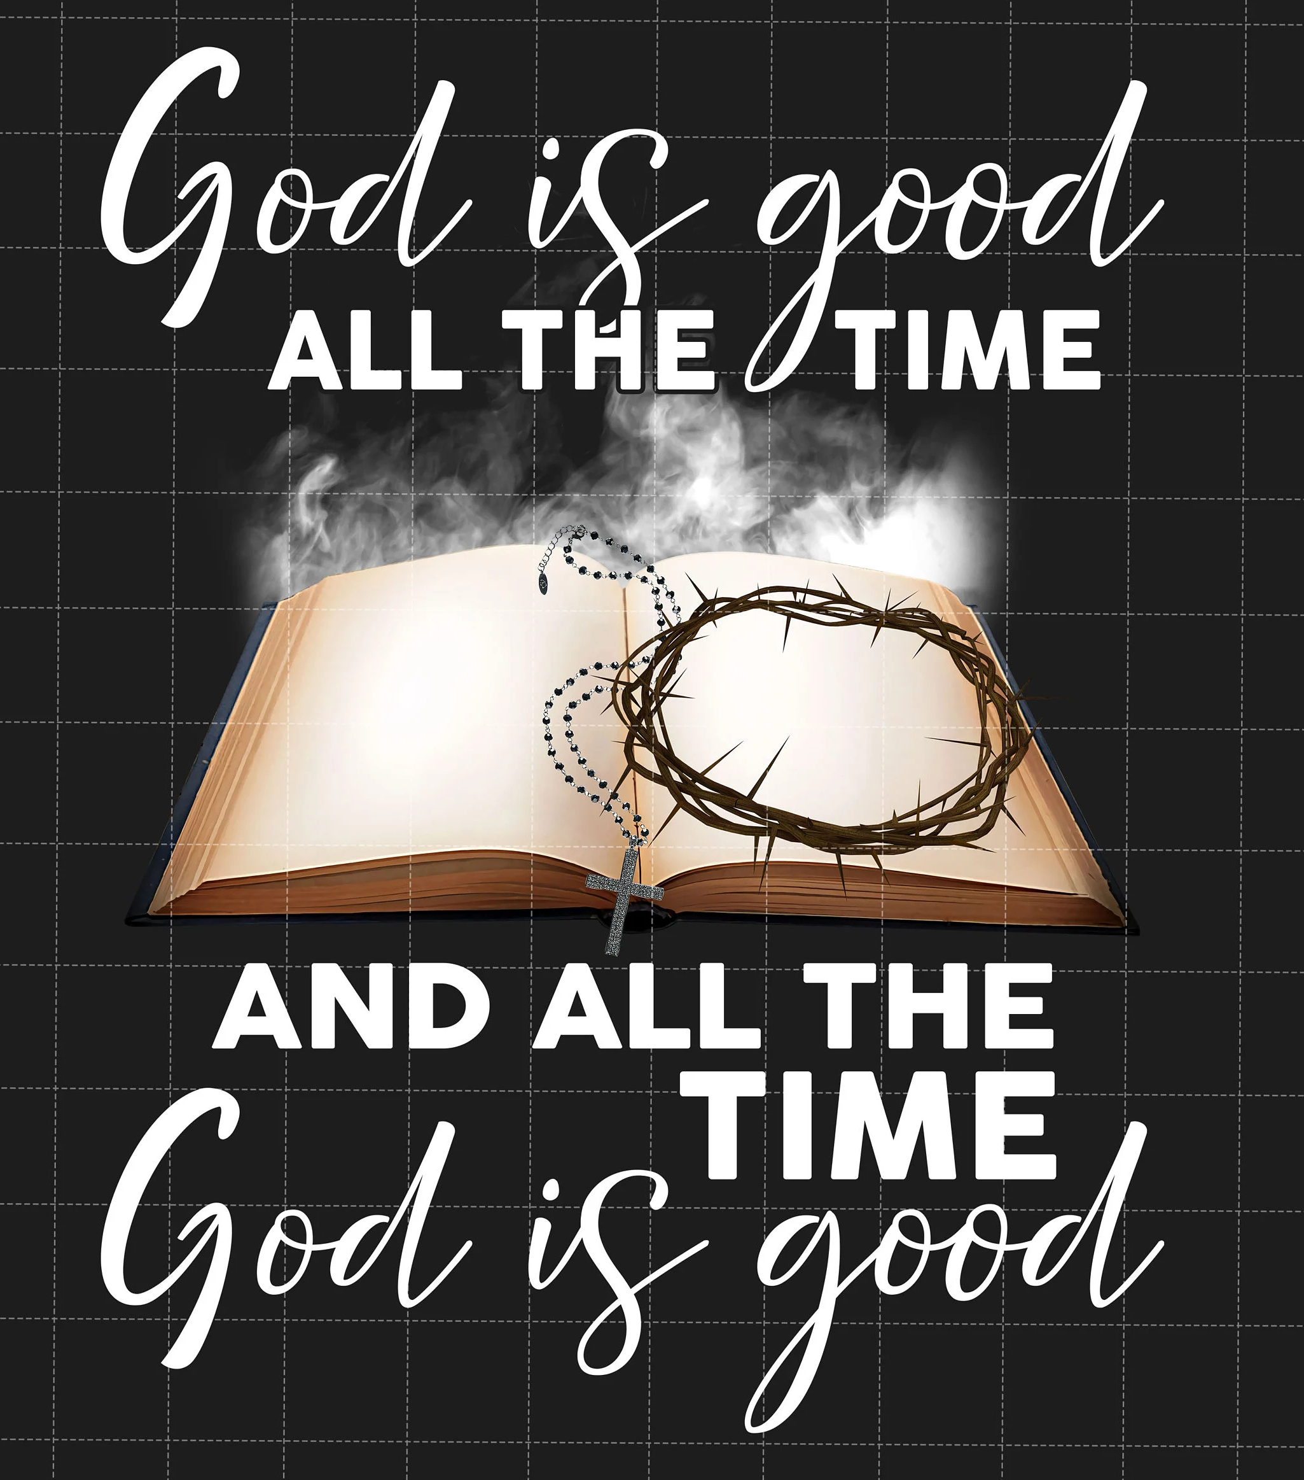
PSALM 145 - WHY WE SHOULD PRAISE THE LORD
We should praise the Lord:
because of His unceasing goodness! (vv. 4-10)

Slide 13
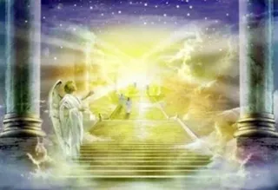
PSALM 145 - WHY WE SHOULD PRAISE THE LORD
We should praise the Lord:
because of His universal government! (vv. 11-13)

Slide 14
PSALM 145 - WHY WE SHOULD PRAISE THE LORD
We should praise the Lord:
because of His undeserved grace! (vv. 14-11)

Slide 15
PSALM 145
Session Outline
INTRODUCTION
WHAT WE NEED TO KNOW ABOUT PSALM 145
WHY WE SHOULD PRAISE THE LORD
PSALM 145 – VERSE BY VERSE
CONCLUDING COMMENTS

Slide 16
Psalm 145:1–21 (NKJV)
A Psalm of Praise, of David.
¹ I will extol You, my God, O King; And I will bless Your name forever and ever. ² Every day I will bless You, And I will praise Your name forever and ever. ³ Great is the Lord, and greatly to be praised; And His greatness is unsearchable.

Slide 17
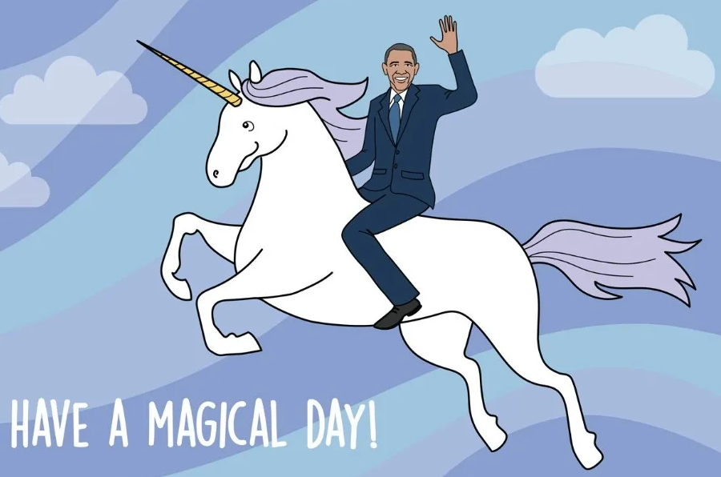
A. WE SHOULD PTL BECAUSE OF HIS GREATNESS! (VV. 1-3)
The expression of worship to God includes extolling, blessing, and praising, God.

Slide 18
Galatians 6:14 (NKJV)
“But God forbid that I should boast (KJV glory) except in the cross of our Lord Jesus Christ, by whom the world was crucified to me and I to it.”

Slide 19
A. WE SHOULD PTL BECAUSE OF HIS GREATNESS! (VV. 1-3)
in v. 4, we are told that we should ‘declare’ truth about the Lord;
in v. 5, that we should ‘meditate’ upon his character;
in v. 6, that we should ‘speak’ or ‘declare’ things about him;
in v.7, that we should ‘utter’ or ‘sing’ truth about him and to him;
in v. 12, that we should ‘make known’ his character and his goodness to others around us;
in v. 18 that we should ‘call upon Him’;
in v. 19, that we should ‘fear him’; and
in v. 20, that we should ‘love him’.

Slide 20
A. WE SHOULD PTL BECAUSE OF HIS GREATNESS! (VV. 1-3)
Why should our worship be daily and eternal?

Slide 21
Psalm 145:1–21 (NKJV)
A Psalm of Praise, of David.
¹ I will extol You, my God, O King; And I will bless Your name forever and ever. ² Every day I will bless You, And I will praise Your name forever and ever. ³ Great is the Lord, and greatly to be praised; And His greatness is unsearchable.

Slide 22
Psalm 145:1–21 (NKJV)
A Psalm of Praise, of David.
¹ I will extol You, my God, O King; And I will bless Your name forever and ever. ² Every day I will bless You, And I will praise Your name forever and ever. ³ Great is the Lord, and greatly to be praised; And His greatness is unsearchable.
Ephesians 3:8 (NKJV)
⁸ To me, who am less than the least of all the saints, this grace was given, that I should preach among the Gentiles the unsearchable riches of Christ,

Slide 23
A. WE SHOULD PTL BECAUSE OF HIS GREATNESS! (VV. 1-3)
The cause for genuine worship is God’s GREATNESS (v. 3)

Slide 24
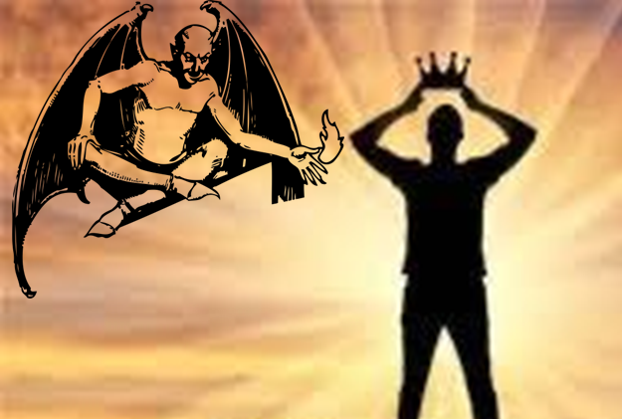
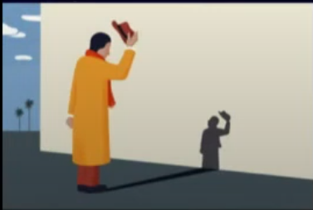
A. WE SHOULD PTL BECAUSE OF HIS GREATNESS! (VV. 1-3)
What hinders or enhances praise to God?

Slide 25
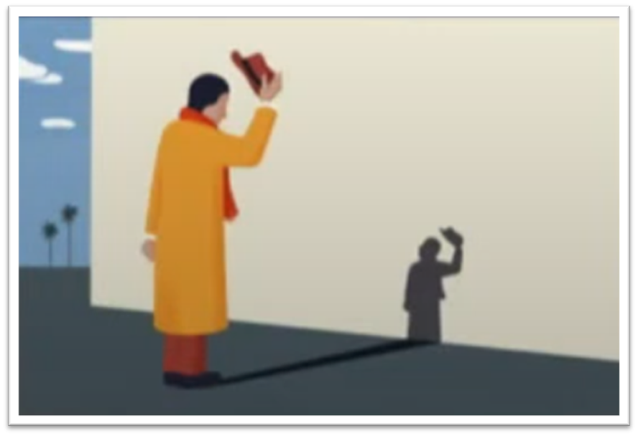
Psalm 34:1–2
¹ I will bless the Lord at all times; His praise shall continually be in my mouth. ² My soul will make its boast in the LORD; The humble will hear it and rejoice.

Slide 26
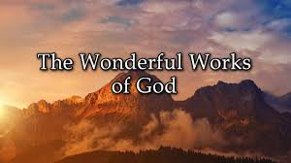
Psalm 145:1–21 (NKJV)
A Psalm of Praise, of David.
⁴ One generation shall praise Your works to another, And shall declare Your mighty acts. ⁵ I will meditate on the glorious splendor of Your majesty, And on Your wondrous works. ⁶ Men shall speak of the might of Your awesome acts, And I will declare Your greatness.

Slide 27
B. WE SHOULD PTL BECAUSE OF HIS UNCEASING GOODNESS (VV. 4-10)
In terms of God’s character, He is worthy to be praised because of His WORKS! (vv. 4-6)

Slide 28
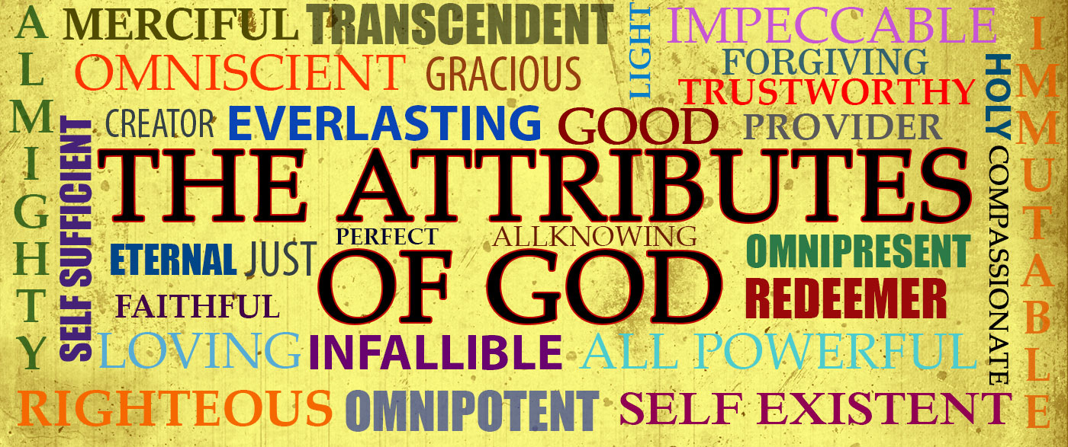
Psalm 145:1–21 (NKJV)
A Psalm of Praise, of David.
⁷ They (men) shall utter the memory of Your great goodness, And shall sing of Your righteousness. ⁸ The Lord is gracious and full of compassion, Slow to anger and great in mercy. ⁹ The Lord is good to all (cf. Luke 6:35), And His tender mercies are over all His works.

Slide 29
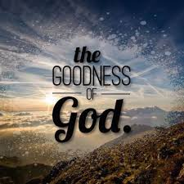
B. WE SHOULD PTL BECAUSE OF HIS UNCEASING GOODNESS (VV. 4-10)
In terms of God’s character, He is worthy to be praised because of His great GOODNESS! (vv. 7, 9)

Slide 30
Psalm 145:1–21 (NKJV)
A Psalm of Praise, of David.
⁷ They shall utter the memory of Your great goodness, And shall sing of Your righteousness. ⁸ The Lord is gracious and full of compassion, Slow to anger and great in mercy. ⁹ The Lord is good to all, And His tender mercies are over all His works.

Slide 31
B. WE SHOULD PTL BECAUSE OF HIS UNCEASING GOODNESS (VV. 4-10)
In terms of God’s character, He is worthy to be praised because of His great RIGHTOUSNESS! (vv. 7)

Slide 32
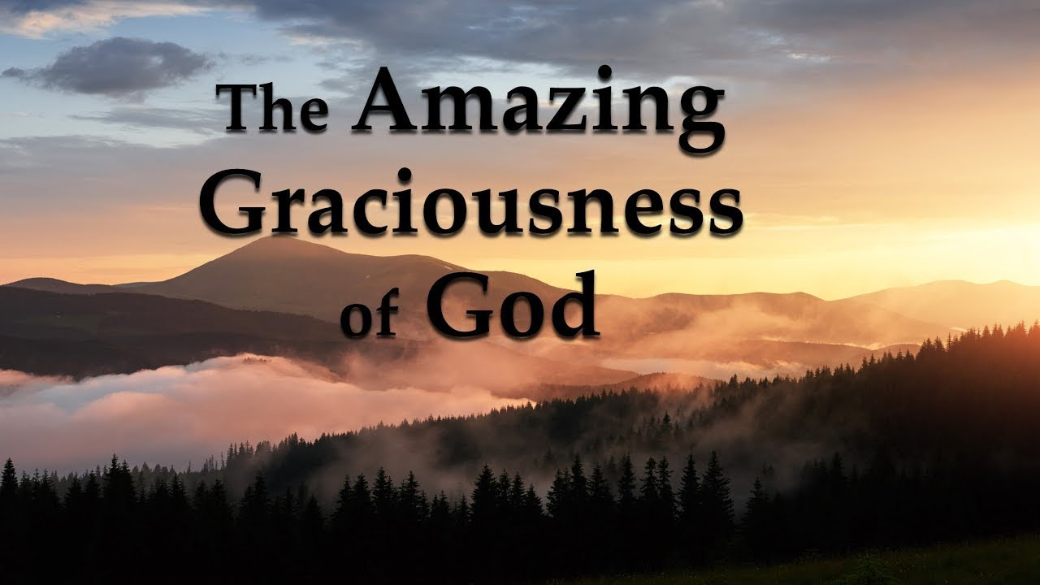
Psalm 145:1–21 (NKJV)
A Psalm of Praise, of David.
⁷ They shall utter the memory of Your great goodness, And shall sing of Your righteousness. ⁸ The Lord is gracious and full of compassion, Slow to anger and great in mercy. ⁹ The Lord is good to all, And His tender mercies are over all His works.

Slide 33
B. WE SHOULD PTL BECAUSE OF HIS UNCEASING GOODNESS (VV. 4-10)
In terms of God’s character, He is worthy to be praised because of His great GRACIOUSNESS of God! (v. 8)

Slide 34
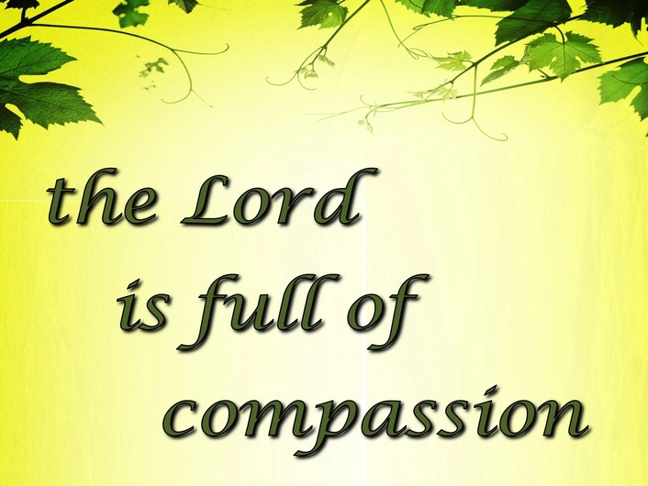
Psalm 145:1–21 (NKJV)
A Psalm of Praise, of David.
⁷ They shall utter the memory of Your great goodness, And shall sing of Your righteousness. ⁸ The Lord is gracious and full of compassion, Slow to anger and great in mercy. ⁹ The Lord is good to all, And His tender mercies are over all His works.

Slide 35
B. WE SHOULD PTL BECAUSE OF HIS UNCEASING GOODNESS (VV. 4-10)
In terms of God’s character, He is worthy to be praised because He is FULL OF COMPASSION! (v. 8)

Slide 36
Psalm 145:1–21 (NKJV)
A Psalm of Praise, of David.
⁷ They shall utter the memory of Your great goodness, And shall sing of Your righteousness. ⁸ The Lord is gracious and full of compassion, Slow to anger and great in mercy. ⁹ The Lord is good to all, And His tender mercies are over all His works.

Slide 37
B. WE SHOULD PTL BECAUSE OF HIS UNCEASING GOODNESS (VV. 4-10)
In terms of God’s character, He is worthy to be praised because of His great FOREBEARANCE of God! (v. 8)

Slide 38
Psalm 145:1–21 (NKJV)
A Psalm of Praise, of David.
⁷ They shall utter the memory of Your great goodness, And shall sing of Your righteousness. ⁸ The Lord is gracious and full of compassion, Slow to anger and great in mercy. ⁹ The Lord is good to all, And His tender mercies are over all His works.

Slide 39
B. WE SHOULD PTL BECAUSE OF HIS UNCEASING GOODNESS (VV. 4-10)
In terms of God’s character, He is worthy to be praised because of His great MERCY of God! (v. 8)

Slide 40
Psalm 145:1–21 (NKJV)
A Psalm of Praise, of David.
⁴ One generation shall praise Your works to another, And shall declare Your mighty acts. ⁵ I will meditate on the glorious splendor of Your majesty, And on Your wondrous works. ⁶ Men shall speak of the might of Your awesome acts, And I will declare Your greatness. ⁷ They shall utter the memory of Your great goodness, And shall sing of Your righteousness. ⁸ The Lord is gracious and full of compassion, Slow to anger and great in mercy. ⁹ The Lord is good to all, And His tender mercies are over all His works. ¹⁰ All Your works shall praise You, O Lord, And Your saints shall bless You.

Slide 41
SO, WHY SHOULD WE PRAISE THE LORD?
We should praise the Lord:
because of His greatness! (vv. 1-3)
because of His unceasing goodness! (vv. 4-10), and…

Slide 42
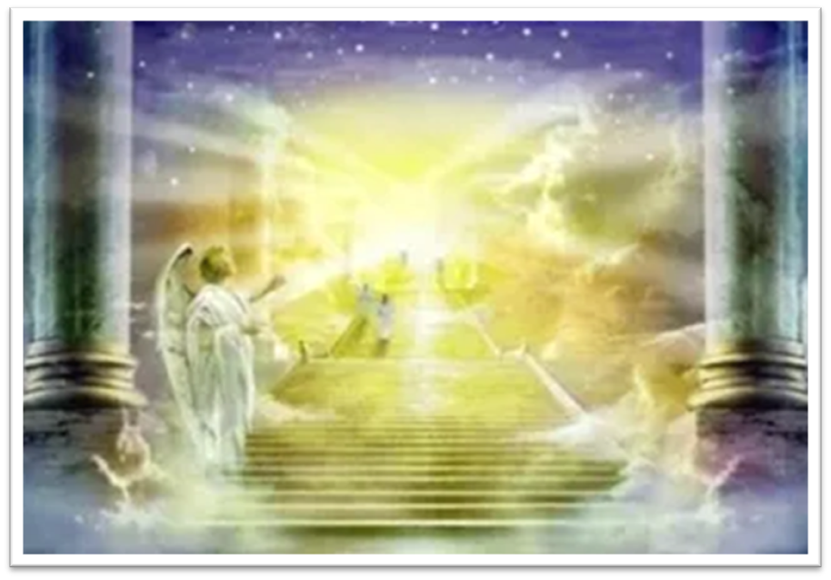
Psalm 145:1–21 (NKJV)
A Psalm of Praise, of David.
¹¹ They shall speak of the glory of Your kingdom, And talk of Your power, ¹² To make known to the sons of men His mighty acts, And the glorious majesty of His kingdom. ¹³ Your kingdom is an everlasting kingdom, And Your dominion endures throughout all generations.

Slide 43
C. WE SHOULD PTL BECAUSE OF HIS UNIVERSAL GOVERNMENT
(VV. 11-13)
As members of Christ’s Body, the Church, we are also within the sphere of God’s UNIVERSAL KINGDOM.

Slide 44
C. WE SHOULD PTL BECAUSE OF HIS UNIVERSAL GOVERNMENT
(VV. 11-13)
The word of God distinguishes between God’s UNIVERSAL KINGDOM (cf. Ps. 103:19; Dan. 4:17) and his MEDIATORIAL or PHYSICAL KINGDOM (cf. Matt. 6:10; 2 Tim. 4:1; Heb. 12:28).

Slide 45
THE UNIVERSAL KINGDOM OF GOD
God’s rule over, management of, and building of, His creation as King, Administrator, Builder
Psalm 47; 57:11; Jeremiah 23:24; Ephesians 1:10; Hebrews 3:4
Alpha
Omega
Seal Opener
Seated in the heavenlies, and our life on earth
The Messiah, King of Israel, King of kings and Lord of lords over the Gentiles
Creator
The Angel of the Lord
Lamb, Word made flesh
7 year Tribulation
Abraham
Moses
David
Adam
Millennial Kingdom
Noah
Church: Grace
Israel: Mosaic Law
Kingdom Law
Gentiles
World, Flesh, Devil
Flesh

Slide 46
ALVA MCCLAIN
(Alva McClain, The Greatness of the Kingdom).
McClain defines the MEDIATORIAL KINGDOM as:
the rule of God through a divinely chosen representative who not only speaks and acts for God but also represents the people before God;
a rule which has special reference to the earth; and
having as its mediatorial ruler one who is always a member of the human race”

Slide 47
C. WE SHOULD PTL BECAUSE OF HIS UNIVERSAL GOVERNMENT
(VV. 11-13)
Biblically speaking, Israel as a theocracy had King-Representatives for God like David, who also oversaw a mediatorial kingdom in the past.

Slide 48
C. WE SHOULD PTL BECAUSE OF HIS UNIVERSAL GOVERNMENT
(VV. 11-13)
How should we respond to these truths?
We should trust the Lord and meditate on these truths!

Slide 49
Psalm 145:1–21 (NKJV)
A Psalm of Praise, of David.
¹⁴ The Lord upholds all who fall, And raises up all who are bowed down. ¹⁵ The eyes of all look expectantly to You, And You give them their food in due season. ¹⁶ You open Your hand And satisfy the desire of every living thing. ¹⁷ The Lord is righteous in all His ways, Gracious in all His works.

Slide 50
D. WE SHOULD PTL BECAUSE OF HIS UNDESERVED GRACE!
(VV. 14-17)
We see God’s graciousness reflected specifically in His PROVIDENTIAL CARE for his creation.

Slide 51
Psalm 145:1–21 (NKJV)
A Psalm of Praise, of David.
¹⁸ The Lord is near to all who call upon Him, To all who call upon Him in truth. ¹⁹ He will fulfill the desire of those who fear Him; He also will hear their cry and save them. ²⁰ The Lord preserves all who love Him, But all the wicked He will destroy. ²¹ My mouth shall speak the praise of the Lord, And all flesh shall bless His holy name Forever and ever.

Slide 52
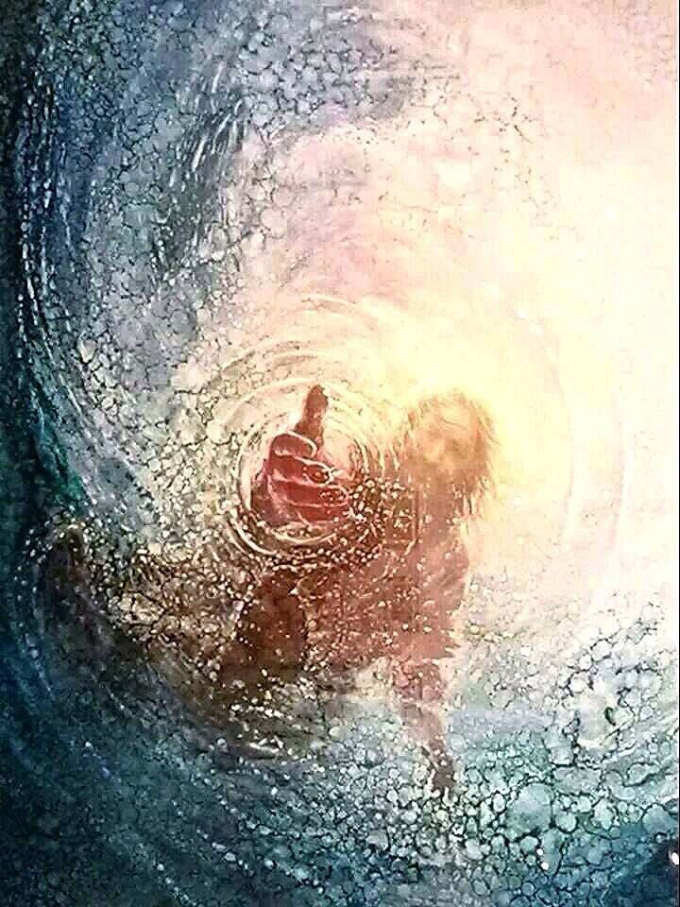
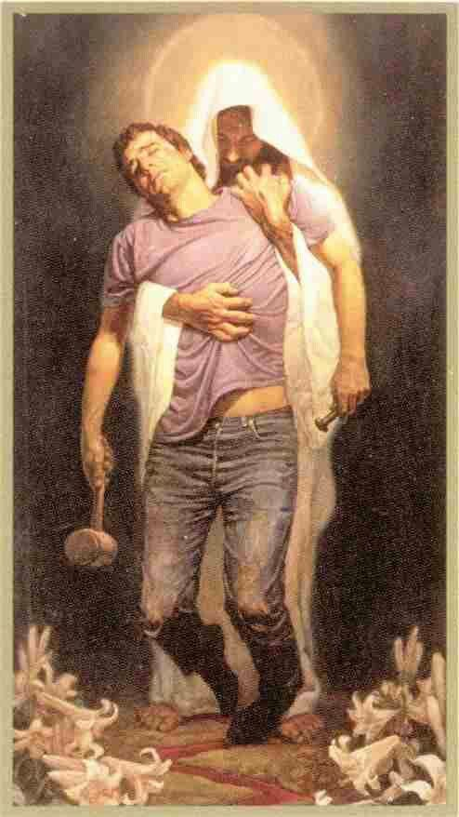
D. WE SHOULD PTL BECAUSE OF HIS UNDESERVED GRACE!
(VV. 18-20)
God’s grace is also seen by His DELIVERING and PRESERVING us (vv.18-20).

Slide 53
1 John 1:9 (NKJV)
If we confess our sins, He is faithful and just to forgive us our sins and to cleanse us from all unrighteousness. (cf. Ps. 32:5; Jam. 4:3)
Proverbs 28:13 (NKJV)
He who covers his sins will not prosper, But whoever confesses and forsakes them will have mercy.
Psalm 66:18 (NKJV)
If I regard iniquity in my heart, The Lord will not hear.

Slide 54
Psalm 145:1–21 (NKJV)
A Psalm of Praise, of David.
¹⁸ The Lord is near to all who call upon Him, To all who call upon Him in truth. ¹⁹ He will fulfill the desire of those who fear Him; He also will hear their cry and save them. ²⁰ The Lord preserves all who love Him, But all the wicked He will destroy. ²¹ My mouth shall speak the praise of the Lord, And all flesh shall bless His holy name Forever and ever.

Slide 55
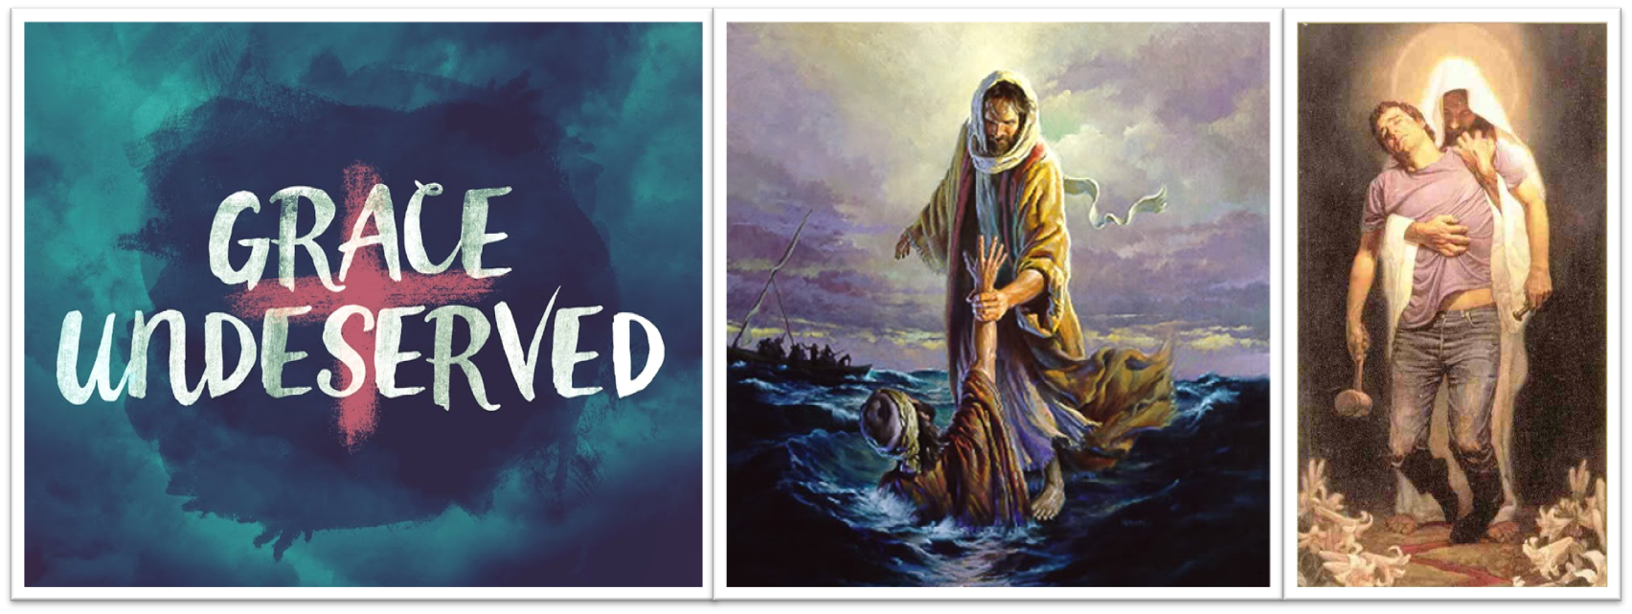
D. WE SHOULD PTL BECAUSE OF HIS UNDESERVED GRACE!
(VV. 18-20)
Do we deserve any of this? Absolutely not! It's all by GRACE!

Slide 56
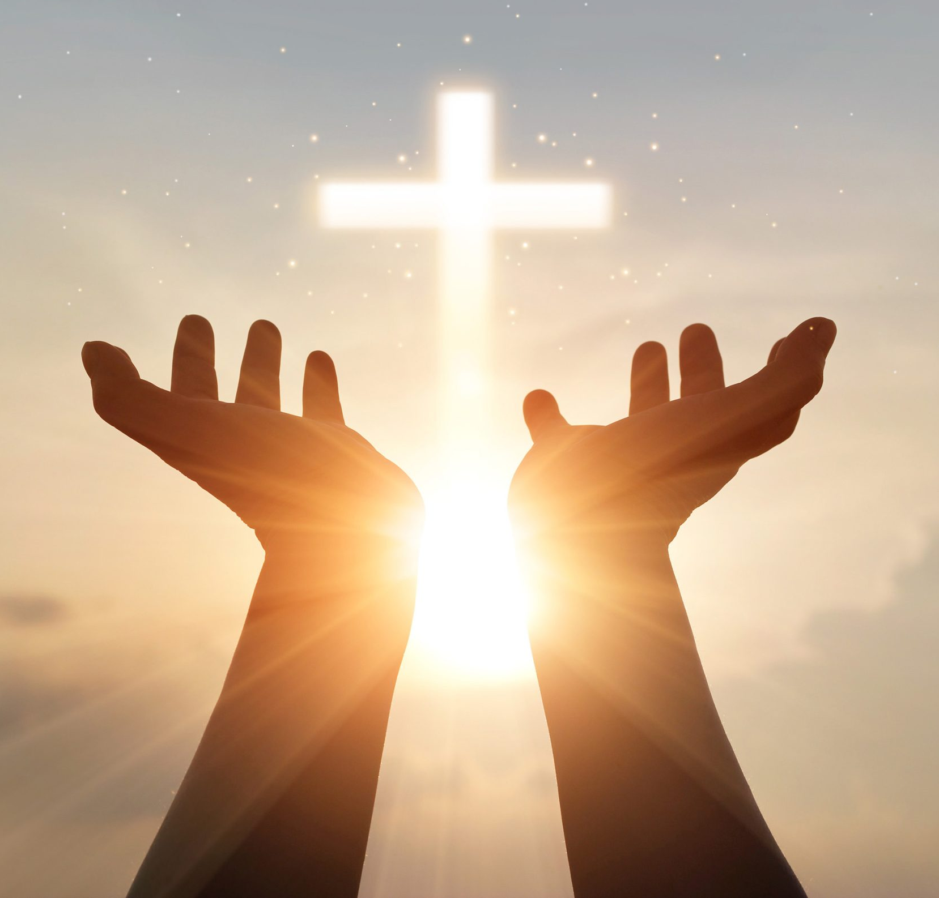
Psalm 145:1–21 (NKJV)
A Psalm of Praise, of David.
¹⁸ The Lord is near to all who call upon Him, To all who call upon Him in truth. ¹⁹ He will fulfill the desire of those who fear Him; He also will hear their cry and save them. ²⁰ The Lord preserves all who love Him, But all the wicked He will destroy. ²¹ My mouth shall speak the praise of the Lord, And all flesh shall bless His holy name Forever and ever.

Slide 57
PSALM 145
Session Outline
INTRODUCTION
WHAT WE NEED TO KNOW ABOUT PSALM 145
WHY WE SHOULD PRAISE THE LORD
PSALM 145 – VERSE BY VERSE
CONCLUDING COMMENTS

Slide 58
*GREATNESS, *UNCEASING GOODNESS, *UNIVERSAL
GOVERNMENT, & *UNDESERVED GRACE!
How should we respond to these truths?
We should…

Slide 59
WHY WE SHOULD PRAISE THE LORD
Psalm 145:1-21
Jim McGowan, Th.D. Sugar Land Bible Church 04-16-2025
Special thanks to Duluth Bible Church for access to their insights and resources.

