Slide 1
Genesis 12‒50
Israel’s Birth & Preservation

Slide 2
GENESIS STRUCTURE
Genesis 12-50 (four people)
Abraham (12:1–25:11)
Isaac (25:12–26:35)
Jacob (27–36)
Joseph (37–50)

Slide 3
Genesis 37‒50 Joseph
Joseph sold unto Egypt (37)
Canaan’s corruption (38)
Joseph falsely accused (39)
Joseph’s short-term predictions (40)
Joseph’s elevation (41)
Joseph’s first reunion with his brothers (42)
Joseph’s second reunion with his brothers (43‒45)
Joseph’s second reunion with his brothers (43‒45)
Sojourn to Egypt (46:1‒47:12)
Famine’s course (47:13-26)
Jacob in Egypt (47:27-31)
Jacob blesses Joseph’s sons (48)
Jacob blesses his sons (49)
Jacob’s burial & Joseph’s death (50)

Slide 4
Genesis 50:1-26 Death & Burial of Jacob & Joseph
Events following Jacob’s death (1-3)
Jacob’s burial (4-14)
Brothers’ fear & Joseph’s reassurance (15-21)
Joseph’s death (22-26)

Slide 5
II. Genesis 50:4-14 Jacob’s Burial
Joseph’s request (4-5)
Request granted (6)
Funeral procession (7-9)
Arrival (10-11)
Jacob’s burial (12-13)
Return to Egypt (14)

Slide 6
Genesis 50:12-13 Jacob’s Burial
Jacob’s sons’ obedience (12)
Obedience’s content (13)

Slide 7
Genesis 50:12-13 Jacob’s Burial
Jacob’s sons’ obedience (12)
Obedience’s content (13)

Slide 9
Genesis 50:12-13 Jacob’s Burial
Jacob’s sons’ obedience (12)
Obedience’s content (13)

Slide 10
Genesis 12‒25 Abraham’s Early Journeys
Unconditional promises (Gen. 12:1-3) From Haran to Canaan (Gen. 12:4-5) In Canaan (Gen. 12:6-9) In Egypt (Gen. 12:10-20) Abram and Lot Separate (Gen. 13:1-13) Reaffirmation of Abram’s promises (Gen. 13:14-18) Abram Rescues Lot (14:1-24) Abrahamic Covenant (15:1-21) Hagar & Ishmael (16:1-16) Circumcision (Gen. 17:1-27) | Sodom & Gomorrah (Gen. 18‒19) Abraham & Abimelech (Gen. 20) Isaac’s birth (Gen. 21:1-7) Ishmael’s expulsion (21:8-21) Abraham & Abimelech’s covenant (21:22-34) Abraham sacrifices Isaac (22) Sarah’s death (23) Isaac’s marriage (24) Abraham & Keturah (25:1-6) Abraham’s death (25:7-11)

Slide 11
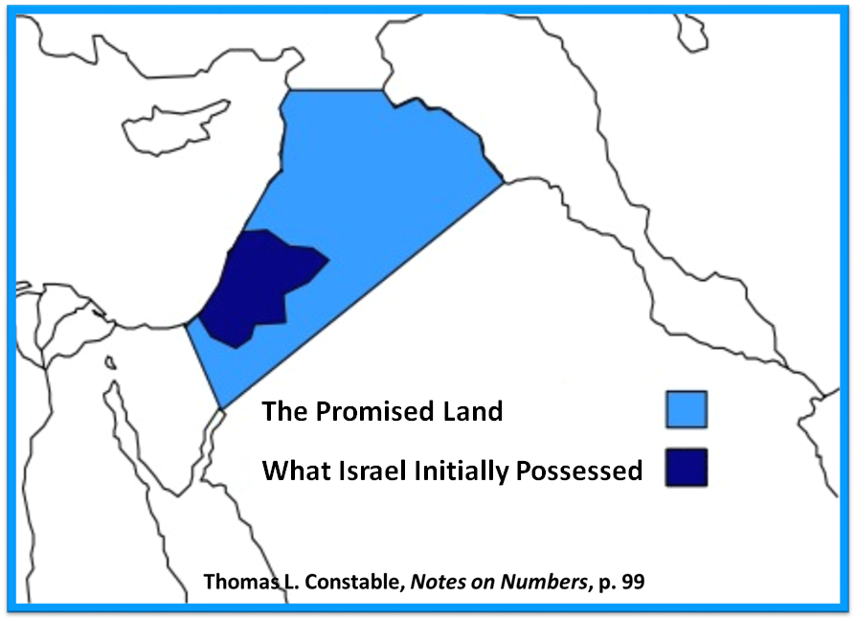

Slide 12
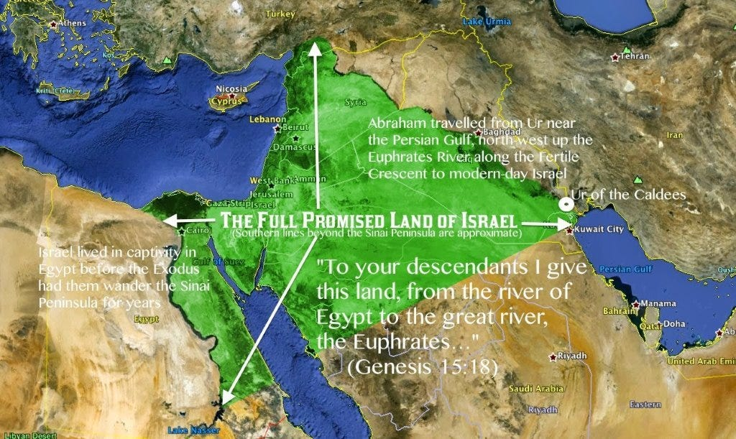

Slide 14
II. Genesis 50:4-14 Jacob’s Burial
Joseph’s request (4-5)
Request granted (6)
Funeral procession (7-9)
Arrival (10-11)
Jacob’s burial (12-13)
Return to Egypt (14)

Slide 15
Genesis 50:14 Return to Egypt
Timing (14a)
Group (14b)

Slide 16
Genesis 50:14 Return to Egypt
Timing (14a)
Group (14b)

Slide 17
Genesis 50:14 Return to Egypt
Timing (14a)
Group (14b)

Slide 19
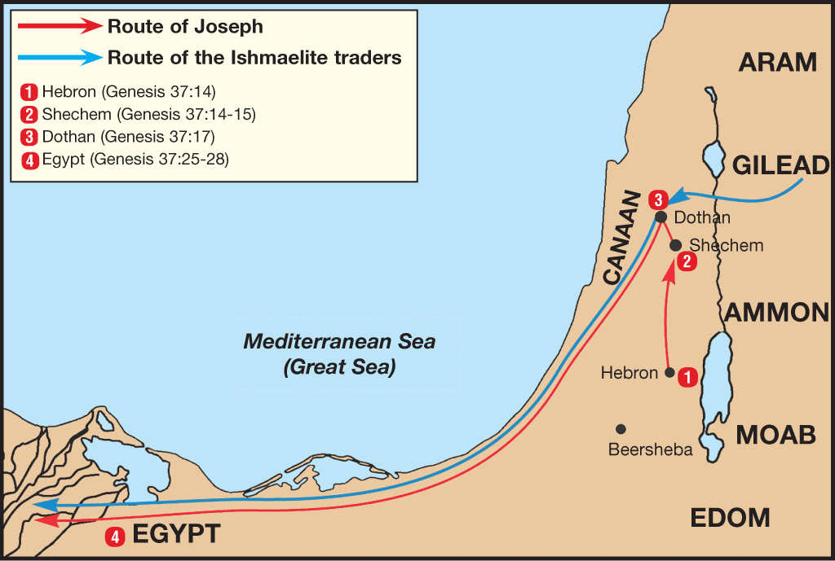

Slide 20
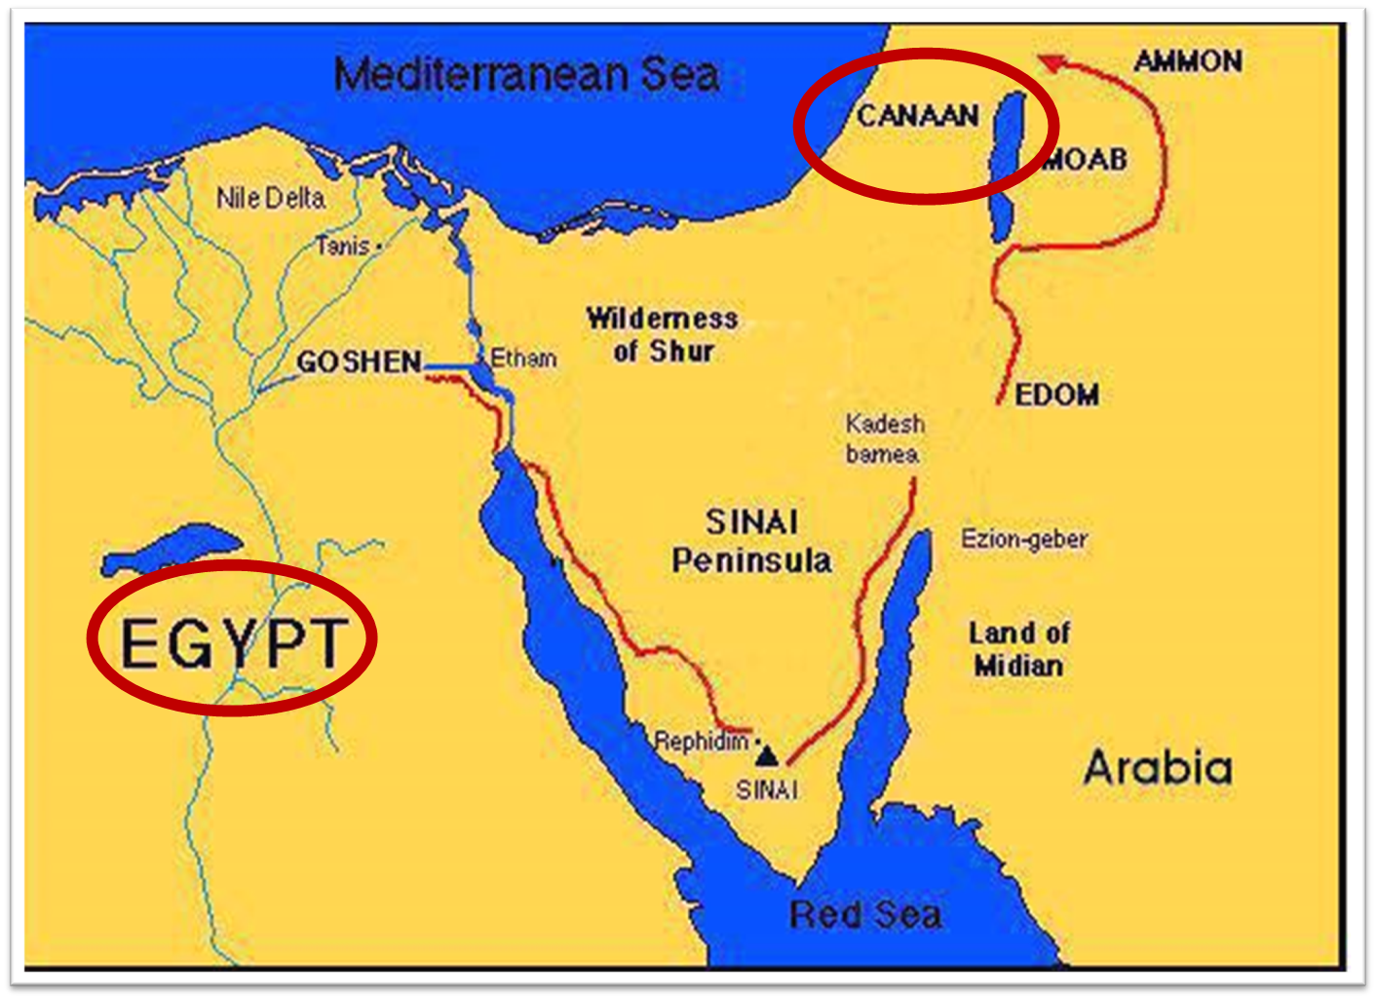

Slide 21
Genesis 50:1-26 Death & Burial of Jacob & Joseph
Events following Jacob’s death (1-3)
Jacob’s burial (4-14)
Brothers’ fear & Joseph’s reassurance (15-21)
Joseph’s death (22-26)

Slide 22
III. Genesis 50:15-21 Brothers’ Fear & Joseph’s Reassurance
Brothers’ fear (15)
Brothers’ message to Joseph (16-17a)
Joseph’s response (17b)
Brothers’ submission (18)
Joseph’s comfort (19-21)

Slide 23
III. Genesis 50:15-21 Brothers’ Fear & Joseph’s Reassurance
Brothers’ fear (15)
Brothers’ message to Joseph (16-17a)
Joseph’s response (17b)
Brothers’ submission (18)
Joseph’s comfort (19-21)

Slide 24
Genesis 50:15 Brothers’ Fear
Timing (15a)
Fear stated (15b)

Slide 25
Genesis 50:15 Brothers’ Fear
Timing (15a)
Fear stated (15b)

Slide 26
Genesis 50:15 Brothers’ Fear
Timing (15a)
Fear stated (15b)

Slide 27
III. Genesis 50:15-21 Brothers’ Fear & Joseph’s Reassurance
Brothers’ fear (15)
Brothers’ message to Joseph (16-17a)
Joseph’s response (17b)
Brothers’ submission (18)
Joseph’s comfort (19-21)

Slide 28
Genesis 50:16-17a Brothers’ Message to Joseph
Made up command (16)
Command stated (17a)

Slide 29
Genesis 50:16-17a Brothers’ Message to Joseph
Made up command (16)
Command stated (17a)

Slide 30
Genesis 50:16-17a Brothers’ Message to Joseph
Made up command (16)
Command stated (17a)

Slide 31
III. Genesis 50:15-21 Brothers’ Fear & Joseph’s Reassurance
Brothers’ fear (15)
Brothers’ message to Joseph (16-17a)
Joseph’s response (17b)
Brothers’ submission (18)
Joseph’s comfort (19-21)

Slide 32
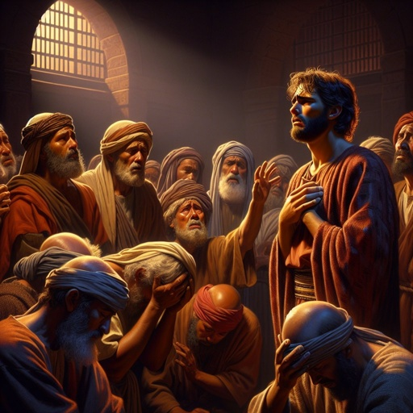
Dr. Arnold G. Fruchtenbaum
The Book of Genesis, 659
“Joseph’s response is in 50:17b: And Joseph wept when they spoke unto him; that they would even think that he would want take any vengeance upon them, causes him to weep over such a misjudgment.”

Slide 33
Luke 19:41-44
^{41 “}When He approached Jerusalem, He saw the city and wept over it, ⁴² saying, “If you had known in this day, even you, the things which make for peace! But now they have been hidden from your eyes. ⁴³ For the days will come upon you when your enemies will throw up a barricade against you, and surround you and hem you in on . . .

Slide 34
III. Genesis 50:15-21 Brothers’ Fear & Joseph’s Reassurance
Brothers’ fear (15)
Brothers’ message to Joseph (16-17a)
Joseph’s response (17b)
Brothers’ submission (18)
Joseph’s comfort (19-21)

Slide 35
Genesis 50:18 Brothers’ Submission
Homage (18a)
Declaration (18b)

Slide 36
Genesis 50:18 Brothers’ Submission
Homage (18a)
Declaration (18b)

Slide 37
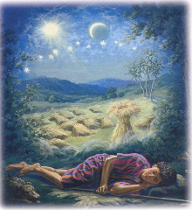
Genesis 37:9
Now he had still another dream, and related it to his brothers, and said, “Lo, I have had still another dream; and behold, the sun and the moon and eleven stars were bowing down to me.”

Slide 38
Genesis 37:10
He related it to his father and to his brothers; and his father rebuked him and said to him, “What is this dream that you have had? Shall I and your mother and your brothers actually come to bow ourselves down before you to the ground?”

Slide 39
Sun = Jacob
Moon = Leah
11 Stars = Joseph’s brothers
12th Star = Joseph
12 Stars = Israel’s twelve tribes

Slide 40
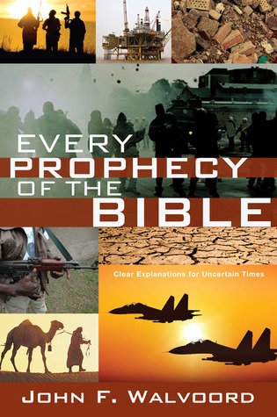

Slide 41
Genesis 50:18 Brothers’ Submission
Homage (18a)
Declaration (18b)

Slide 43
III. Genesis 50:15-21 Brothers’ Fear & Joseph’s Reassurance
Brothers’ fear (15)
Brothers’ message to Joseph (16-17a)
Joseph’s response (17b)
Brothers’ submission (18)
Joseph’s comfort (19-21)

Slide 44
Genesis 50:19-21 Joseph’s Comfort
Basis (19)
God’s providence (20)
Joseph’s further comfort (21)

Slide 45
Genesis 50:19-21 Joseph’s Comfort
Basis (19)
God’s providence (20)
Joseph’s further comfort (21)

Slide 46
Genesis 50:19-21 Joseph’s Comfort
Basis (19)
God’s providence (20)
Joseph’s further comfort (21)

Slide 47
Genesis 50:20 God’s Providence
Man’s plan (20a)
God’s plan (20b)

Slide 48
Genesis 50:20 God’s Providence
Man’s plan (20a)
God’s plan (20b)

Slide 49
Calvin said: “Nor ought it to seem absurd when I say, that God not only foresaw the fall of the first man, and in him the ruin of his posterity; but also at his own pleasure arranged it.”
John Calvin
John Calvin, Institutes of the Christian Religion, Vol. 3, Chapter 23, section 7.

Slide 50
Edwin Palmer
In Edwin Palmer’s book, The Five Points of Calvinism, he states: “God is in back of everything. He decides and causes all things to happen that do happen…even sin…God ordained sin and unbelief.”
Edwin H. Palmer, The Five Points of Calvinism (Grand Rapids, MI: Baker Books, Enlarged Edition, 1980, 24th printing, 2005), pp. 25, 102.

Slide 51
R. C. Sproul Jr.
R. C. Sproul Jr. (R. C. Sproul’s Calvinist son) said that God “desired that man would fall into sin … [God] created sin.”
R.C. Sproul Jr., Almighty Over All (Grand Rapids, MI: Baker Books, 1999, Second printing, July 1999), pp. 53-54.

Slide 52
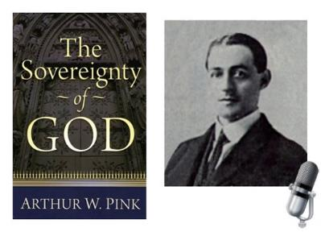
A. W. Pink
Sovereignty of God, p. 201.
“That God decreed sin should enter this world through the disobedience of our first parents was a secret hid in His own breast.”

Slide 54
Mark 7:20–23
²⁰ And He was saying, “That which proceeds out of the man, that is what defiles the man. ²¹ “For from within, out of the heart of men, proceed the evil thoughts, fornications, thefts, murders, adulteries, ²² deeds of coveting and wickedness, as well as deceit, sensuality, envy, slander, pride and foolishness. ²³ “All these evil things proceed from within and defile the man.”

Slide 55
Romans 8:19-22
¹⁹ For the anxious longing of the creation waits eagerly for the revealing of the sons of God. ²⁰ For the creation was subjected to futility, not willingly, but because of Him who subjected it, in hope ²¹ that the creation itself also will be set free from its slavery to corruption into the freedom of the glory of the children of God. ²² For we know that the whole creation groans and suffers the pains of childbirth together until now.

Slide 56
Romans 8:28-29
²⁸ And we know that God causes all things to work together for good to those who love God, to those who are called according to His purpose. ²⁹ For those whom He foreknew [proginōskō], He also predestined to become conformed to the image of His Son, so that He would be the firstborn among many brethren.

Slide 57
Genesis 50:20 God’s Providence
Man’s plan (20a)
God’s plan (20b)

Slide 58
Three Tenses of Salvation
Phase | Justification | Sanctification | Glorification
Tense | Past | Present | Future
Saved from sin’s: | Penalty | Power | Presence
Scripture | Eph 2:8-9; Titus 3:5 | Philip 2:12 | Rom 5:10

Slide 59
Genesis 50:19-21 Joseph’s Comfort
Basis (19)
God’s providence (20)
Joseph’s further comfort (21)

Slide 60
2 Peter 1:5-7
⁵ Now for this very reason also, applying all diligence, in your faith supply moral excellence, and in your moral excellence, knowledge, ⁶ and in your knowledge, self-control, and in your self-control, perseverance, and in your perseverance, godliness, ⁷ and in your godliness, brotherly kindness, and in your brotherly kindness, love.

Slide 61
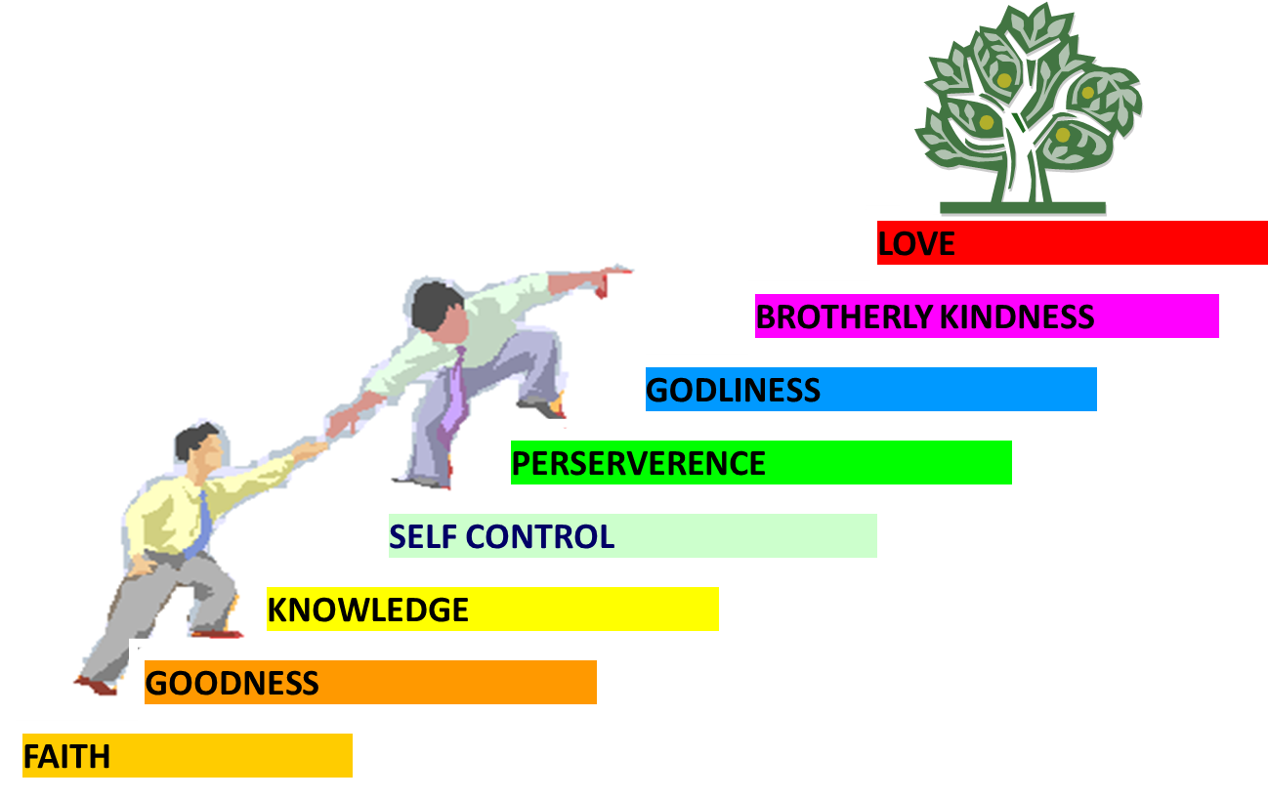
PORTRAIT OF GROWTH 1:5-7

Slide 62
Conclusion

Slide 63
Genesis 50:1-26 Death & Burial of Jacob & Joseph
Events following Jacob’s death (1-3)
Jacob’s burial (4-14)
Brothers’ fear & Joseph’s reassurance (15-21)
Joseph’s death (22-26)

Slide 64
²⁴ The Lord bless you, and keep you; ²⁵ The Lord make His face shine on you, And be gracious to you; ²⁶ The Lord lift up His countenance on you, And give you peace.
Numbers 6:24–26 (NASB95)

