Slide 2
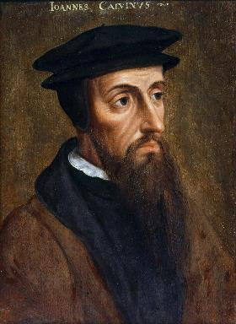
Neo-Calvinism vs. The Bible
Calvinism’s Mixed Blessing
Why Critique Calvinism?
The Source of Calvin’s Theology
Calvin’s Manner of Life
TULIP Through the Grid of Scripture
Conclusion

Slide 3
V. Running TULIP Through the Grid of Scripture
Total Depravity
Unconditional Election
Limited Atonement
Irresistible Grace
Perseverance of the Saints

Slide 4
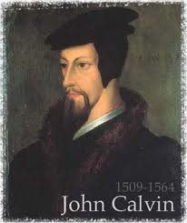
Limited Atonement
Calvinistic definition
Examples
Problems with the Calvinistic definition

Slide 5
Limited Atonement = Jesus Did Not Die for the Entire World
“L” stands for “Limited Atonement.” Christ’s atonement on the Cross was not for everyone but rather just for the “elect.”
Bob Kirkland, Calvinism: None Dare Call It Heresy; Spotlight on the Life and Teachings of John Calvin (Eureka, MT: Lighthouse Trails, 2018), 34.

Slide 6
Limited Atonement
Calvinistic definition
Examples
Problems with the Calvinistic definition

Slide 7
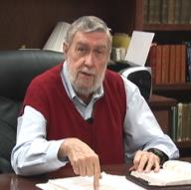
Jay Adams
Competent to Counsel, 70.
“But counselors, as Christians, are obligated to present the claims of Christ. They must present the good news that Christ Jesus died on the cross in the place of His own, that He bore the guilt and suffered the penalty for their sins. He died that all whom the Father had given to Him might come unto Him and have life everlasting. As a reformed Christian, the writer believes that counselors must not tell any unsaved counselee that Christ died for him, FOR THEY CANNOT SAY THAT. No man knows except Christ Himself who are His elect for whom He died." [emphasis mine]

Slide 8
John 1:29
“The next day he saw Jesus coming to him, and said, ‘Behold, the Lamb of God who takes away the sin of the world!’”

Slide 9
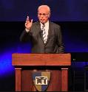
John F. MacArthur,
John F. MacArthur, Jr., ed. (1997). The MacArthur Study Bible (electronic ed., p. 1576). Word Pub.
“sin of the world. See note on v. 9; cf. 3:16; 6:33, 51. In this context ‘world’ has the connotation of humanity in general, not specifically every person.”

Slide 10
Limited Atonement
Calvinistic definition
Examples
Problems with the Calvinistic definition

Slide 11
Problems with the Calvinistic Definition
Attack on God’s character (Num. 14:18; Ps. 103:8)
Limited atonement proof texts lack exclusivity (Matt. 20:28; John 10:15; Acts 20:28; Eph. 5:25)
Abundance of unlimited atonement passages
What Jesus never said

Slide 12
1 John 4:8
“The one who does not love does not know God, for God is love.”

Slide 13
Problems with the Calvinistic Definition
Attack on God’s character (Num. 14:18; Ps. 103:8)
Limited atonement proof texts lack exclusivity (Matt. 20:28; John 10:15; Acts 20:28; Eph. 5:25)
Abundance of unlimited atonement passages
What Jesus never said

Slide 14
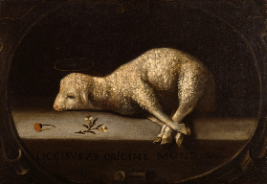
Extent of the Atonement
Limited
Five point Calvinism – TULIP
Biblical support
Matt 20:28
John 10:15
Acts 20:28
Eph. 5:25

Slide 15
Problems with the Calvinistic Definition
Attack on God’s character (Num. 14:18; Ps. 103:8)
Limited atonement proof texts lack exclusivity (Matt. 20:28; John 10:15; Acts 20:28; Eph. 5:25)
Abundance of unlimited atonement passages
What Jesus never said

Slide 16
Extent of the Atonement
Unlimited
Biblical support
John 1:29; 3:16-17; 4:42; 6:51; 12:32, 47
Acts 17:30
2 Cor 5:19
1 Tim. 2:4, 6; 4:10
Titus 2:11
Heb. 2:9
2 Pet. 2:1
1 John 2:2; 4:14

Slide 17
John 1:29
“The next day he saw Jesus coming to him, and said, ‘Behold, the Lamb of God who takes away the sin of the world!’”

Slide 18
Extent of the Atonement
Unlimited
Biblical support
John 1:29; 3:16-17; 4:42; 6:51; 12:32, 47
Acts 17:30
2 Cor 5:19
1 Tim. 2:4, 6; 4:10
Titus 2:11
Heb. 2:9
2 Pet. 2:1
1 John 2:2; 4:14

Slide 19
John 3:16
“For God so loved the world, that He gave His only begotten Son, that whoever believes in Him shall not perish, but have eternal life.”

Slide 20
Extent of the Atonement
Unlimited
Biblical support
John 1:29; 3:16-17; 4:42; 6:51; 12:32, 47
Acts 17:30
2 Cor 5:19
1 Tim. 2:4, 6; 4:10
Titus 2:11
Heb. 2:9
2 Pet. 2:1
1 John 2:2; 4:14

Slide 21
Acts 17:30-31
“³⁰ Therefore having overlooked the times of ignorance, God is now declaring to men that all people everywhere should repent [metanoeō], ³¹ because He has fixed a day in which He will judge the world in righteousness through a Man whom He has appointed, having furnished proof to all men by raising Him from the dead.”

Slide 22
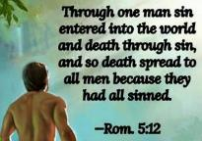
Romans 5:12
“Therefore, just as through one man sin entered into the world, and death through sin, and so death spread to all men, because all sinned—.”

Slide 23
Extent of the Atonement
Unlimited
Biblical support
John 1:29; 3:16-17; 4:42; 6:51; 12:32, 47
Acts 17:30
2 Cor 5:19
1 Tim. 2:4, 6; 4:10
Titus 2:11
Heb. 2:9
2 Pet. 2:1
1 John 2:2; 4:14

Slide 24
1 Timothy 2:3-4
“³ This is good and acceptable in the sight of God our Savior, ⁴ who desires all men to be saved and to come to the knowledge of the truth.”

Slide 25
Extent of the Atonement
Unlimited
Biblical support
John 1:29; 3:16-17; 4:42; 6:51; 12:32, 47
Acts 17:30
2 Cor 5:19
1 Tim. 2:4, 6; 4:10
Titus 2:11
Heb. 2:9
2 Pet. 2:1
1 John 2:2; 4:14

Slide 26
Hebrews 2:9
But we do see Him who was made for a little while lower than the angels, namely, Jesus, because of the suffering of death crowned with glory and honor, so that by the grace of God He might taste death for everyone.

Slide 27
Extent of the Atonement
Unlimited
Biblical support
John 1:29; 3:16-17; 4:42; 6:51; 12:32, 47
Acts 17:30
2 Cor 5:19
1 Tim. 2:4, 6; 4:10
Titus 2:11
Heb. 2:9
2 Pet. 2:1
1 John 2:2; 4:14

Slide 28
BELIEVER OR UNBELIEVER?
BELIEVER | UNBELIEVER
Purchased (1) | Dogs/pigs (22)
Knowledge of Christ (20) | Overcome (20)
Believers can sin (1:8-10) | Other unbelievers (4-6)
Example of Lot (7-8) | Last state worse than the first (20)
Examples of Balaam (15-16) | Darkness reserved (17)

Slide 29
Extent of the Atonement
Unlimited
Biblical support
John 1:29; 3:16-17; 4:42; 6:51; 12:32, 47
Acts 17:30
2 Cor 5:19
1 Tim. 2:4, 6; 4:10
Titus 2:11
Heb. 2:9
2 Pet. 2:1
1 John 2:2; 4:14

Slide 30
Problems with the Calvinistic Definition
Attack on God’s character (Num. 14:18; Ps. 103:8)
Limited atonement proof texts lack exclusivity (Matt. 20:28; John 10:15; Acts 20:28; Eph. 5:25)
Abundance of unlimited atonement passages
What Jesus never said

Slide 31
What Jesus Never Said…
“Jesus never preached saying, ‘I am going to die for some of you, and the rest of you only came into the world so my Father could be glorified in sending you to Hell.’”
Bob Kirkland, Calvinism: None Dare Call It Heresy; Spotlight on the Life and Teachings of John Calvin (Eureka, MT: Lighthouse Trails, 2018), 67.

Slide 32
V. Running TULIP Through the Grid of Scripture
Total Depravity
Unconditional Election
Limited Atonement
Irresistible Grace
Perseverance of the Saints

