Slide 1
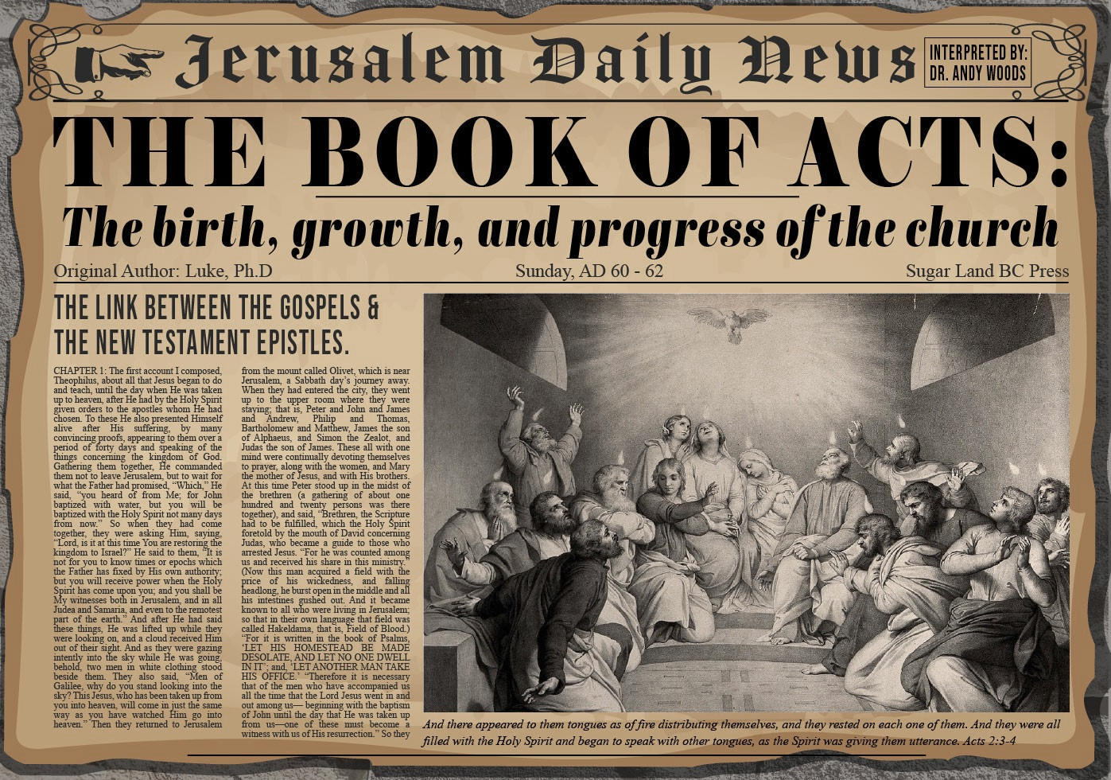


Slide 2

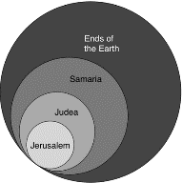
Acts 1:8
“but you will receive power when the Holy Spirit has come upon you; and you shall be My witnesses both in Jerusalem, and in all Judea and Samaria, and even to the remotest part of the earth.”

Slide 3
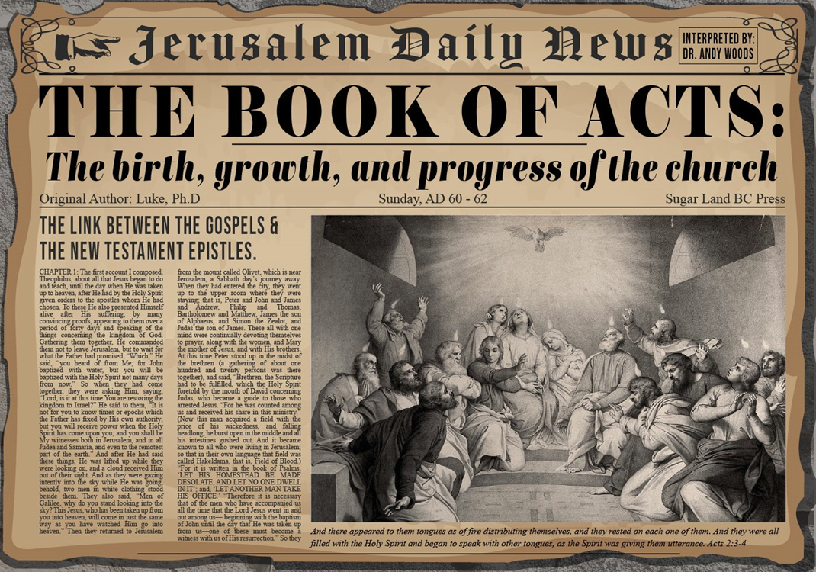
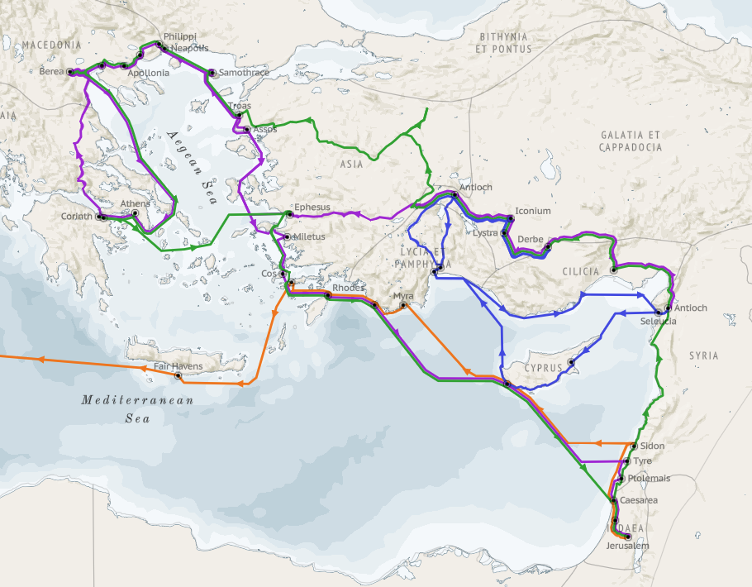
Structure (Acts 1:8)
  Jerusalem (Acts 1–7)
  Judea and Samaria (Acts 8–12)
  Remotest part of the earth (Acts 13–28)
  1st missionary journey (Acts 13–14)
  Jerusalem council (Acts 15:1-35)
  2nd missionary journey (Acts 15:36 –18:22)
  3rd missionary journey (Acts 18:23–21:17)
  Trip to Rome (Acts 21:18–28:31)

Slide 4
Acts 13‒14
1st Missionary Journey
  Paul & Barnabas’ appointment (13:1-3)
  Cyprus ministry (13:4-12)
  Pisidian Antioch ministry (13:13-52)
  Iconium ministry (14:1-7)
  Lystra ministry (14:8-20a)
  Derbe ministry (14:20b-21a)
  Return to Antioch (14:21b-28)

Slide 5
Acts 13‒14
1st Missionary Journey
  Paul & Barnabas’ appointment (13:1-3)
  Cyprus ministry (13:4-12)
  Pisidian Antioch ministry (13:13-52)
  Iconium ministry (14:1-7)
  Lystra ministry (14:8-20a)
  Derbe ministry (14:20b-21a)
  Return to Antioch (14:21b-28)

Slide 6
I. Paul & Barnabas’ Appointment
Acts 13:1-3
  Plurality of elders (1)
  Holy Spirit’s call (2-3)

Slide 7
I. Paul & Barnabas’ Appointment
Acts 13:1-3
  Plurality of elders (1)
  Holy Spirit’s call (2-3)

Slide 8

Local Church Government
Episcopalian / bishop rule – Acts 15:2, 6
Congregational rule – Acts 6:1-7
Presbyterian / elder rule – Acts 20:28; 1 Tim 5:17; 4:14

Slide 9
Acts 13:1
Plurality of Elders
      Prophets (1a)
      Teachers (1b)

Slide 10
Acts 13:1
Plurality of Elders
      Prophets (1a)
      Teachers (1b)

Slide 11
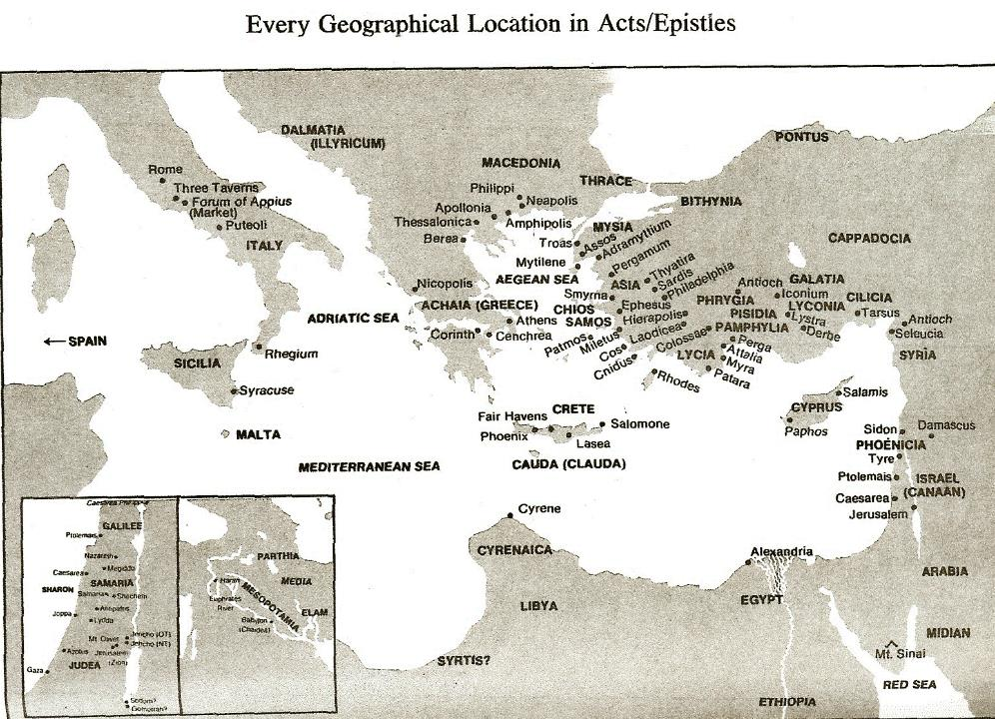

Slide 12

A.T. Robertson
Word Pictures (Acts 13:1)
“In the church that was there (κατα την οὐσαν ἐκκλησιαν [kata tēn ousan ekklēsian]). Possibly distributed throughout the church (note ‘in the church’ 11:26). Now a strong organization there. Luke here begins the second part of Acts with Antioch as the centre of operations, no longer Jerusalem. Paul is now the central figure instead of Peter. Jerusalem had hesitated too long to carry out the command of Jesus to take the gospel to the whole world. That glory will now belong to Antioch. Prophets and teachers (προφηται και διδασκαλοι [prophētai kai didaskaloi]). All prophets were teachers, but not all teachers were prophets who were fore-speakers of God, sometimes fore-speakers like Agabus in 11:28. The double use of τε [te] here makes three prophets (Barnabas, Symeon, Lucius) and two teachers (Manaen and Saul). Barnabas heads the list (11:22) and Saul comes last.”

Slide 13

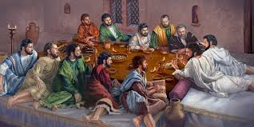
Ephesians 2:20
“having been built on the foundation of the apostles and prophets, Christ Jesus Himself being the corner stone.”

Slide 14
Acts 13:1a
Prophets
      Barnabas
      Symeon
      Lucius

Slide 15
Acts 13:1a
Prophets
      Barnabas
      Symeon
      Lucius

Slide 16
Acts 13:1a
Prophets
      Barnabas
      Symeon
      Lucius

Slide 18
Acts 13:1a
Prophets
      Barnabas
      Symeon
      Lucius

Slide 20
Acts 13:1
Plurality of Elders
      Prophets (1a)
      Teachers (1b)

Slide 21
Acts 13:1b
Teachers
      Manaen
      Saul

Slide 22
Acts 13:1b
Teachers
      Manaen
      Saul

Slide 23
Acts 13:1b
Teachers
      Manaen
      Saul

Slide 24
I. Paul & Barnabas’ Appointment
Acts 13:1-3
  Plurality of elders (1)
  Holy Spirit’s call (2-3)

Slide 25
Acts 13:2-3
Holy Spirit’s Call
      Circumstances (2)
      Church’s obedience (3)

Slide 26
Acts 13:2-3
Holy Spirit’s Call
      Circumstances (2)
      Church’s obedience (3)

Slide 27
Acts 13:2
Circumstances
      Ministry to the Lord (2a)
      Holy Spirit speaks (2b)

Slide 28
Acts 13:2
Circumstances
      Ministry to the Lord (2a)
      Holy Spirit speaks (2b)

Slide 29

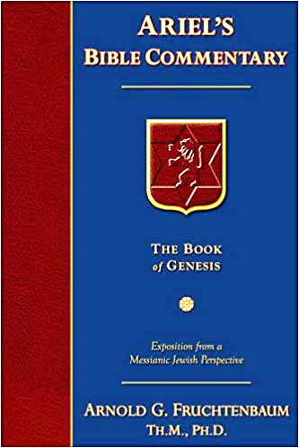
Dr. Arnold G. Fruchtenbaum
The Book of Acts, 283
“Verses 2-3 deal with the call of the Holy Spirit, with verse 2 introducing the circumstances: as they ministered to the Lord. The Greek word for ‘ministered,’ leitourgountōn, was used in the Septuagint of priests as they functioned in the Tabernacle. In the New Testament, it appears in only two other places. In Romans 15:27, it was used of aid for Jewish believers in poverty; this kind of charity was considered a way of ministering to the Lord. In Hebrews 10:11, it is mentioned in the context of the Levitical priesthood. The way the leaders ministered to the Lord in Acts 13:2 was by spending time in prayer and intercession.”

Slide 30
Acts 13:2
Circumstances
      Ministry to the Lord (2a)
      Holy Spirit speaks (2b)

Slide 31


1 Timothy 4:1
“But the Spirit explicitly says that in later times some will fall away from the faith, paying attention to deceitful spirits and doctrines of demons.”

Slide 32
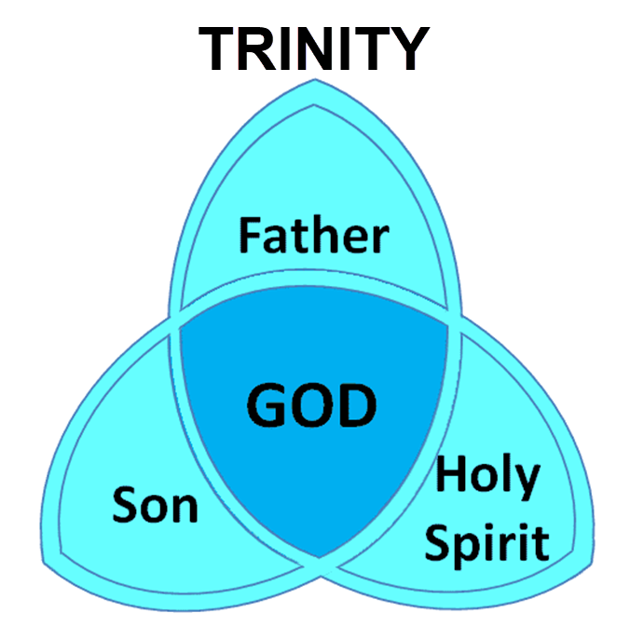

Slide 33
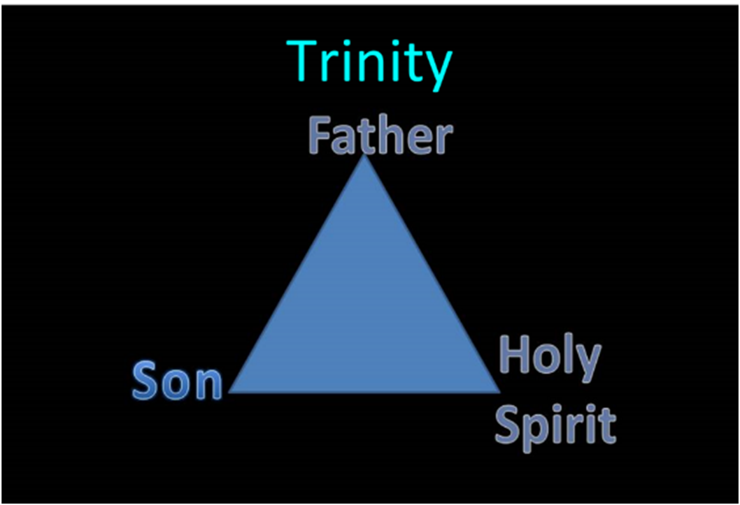

Slide 34
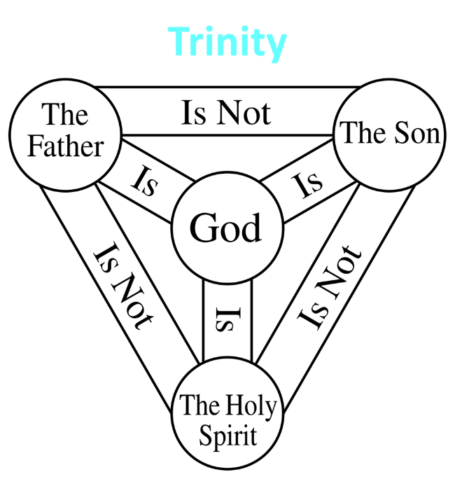

Slide 35
Dr. Arnold G. Fruchtenbaum
The Book of Acts, 283
“At this point, the order of names is Barnabas and Saul, because Barnabas had preeminence (Acts 11:30; 12:25 ; 13:2 , 7; 14:14 ; 15:12 , 25). However, after the first missionary journey, Saul took over the leadership, and in most cases, the order is Saul and Barnabas (Acts 13:43 , 46, 50; 15:2, 22, 35).”

Slide 36
Acts 13:2-3
Holy Spirit’s Call
      Circumstances (2)
      Church’s obedience (3)

Slide 37
Acts 13:3
Church’s Obedience
      Confirmation (3a)
      Appointment (3b)
      Sending (3c)

Slide 38
Acts 13:3
Church’s Obedience
      Confirmation (3a)
      Appointment (3b)
      Sending (3c)

Slide 39
Acts 13:3
Church’s Obedience
      Confirmation (3a)
      Appointment (3b)
      Sending (3c)

Slide 40
Acts 13:3
Church’s Obedience
      Confirmation (3a)
      Appointment (3b)
      Sending (3c)

Slide 41
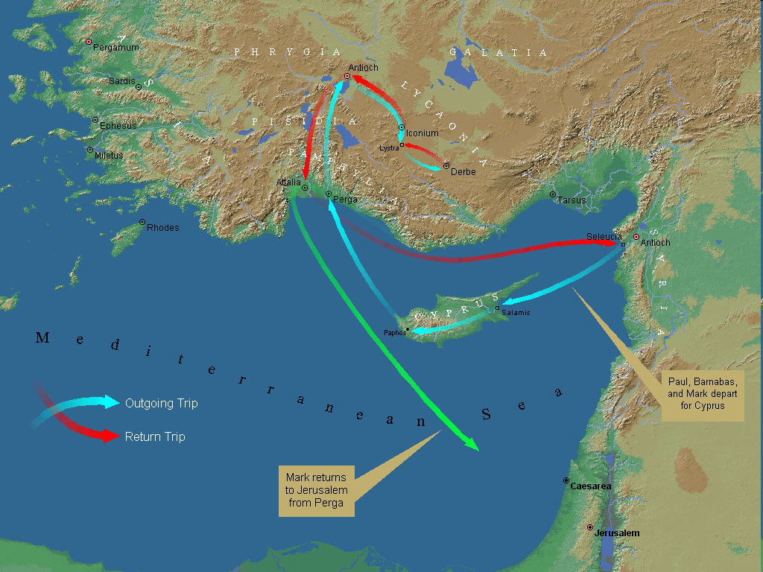
First Missionary Journey

Slide 42
Acts 13‒14
1st Missionary Journey
  Paul & Barnabas’ appointment (13:1-3)
  Cyprus ministry (13:4-12)
  Pisidian Antioch ministry (13:13-52)
  Iconium ministry (14:1-7)
  Lystra ministry (14:8-20a)
  Derbe ministry (14:20b-21a)
  Return to Antioch (14:21b-28)

Slide 43
II. Cyprus Ministry
Acts 13:4-12
  Holy Spirit’s call (4a)
  From Seleucia to Cyprus (4b)
  Salamis ministry (5)
  Paphos ministry (6-12)

Slide 44
II. Cyprus Ministry
Acts 13:4-12
  Holy Spirit’s call (4a)
  From Seleucia to Cyprus (4b)
  Salamis ministry (5)
  Paphos ministry (6-12)

Slide 45
II. Cyprus Ministry
Acts 13:4-12
  Holy Spirit’s call (4a)
  From Seleucia to Cyprus (4b)
  Salamis ministry (5)
  Paphos ministry (6-12)

Slide 46
First Missionary Journey

Slide 48
II. Cyprus Ministry
Acts 13:4-12
  Holy Spirit’s call (4a)
  From Seleucia to Cyprus (4b)
  Salamis ministry (5)
  Paphos ministry (6-12)

Slide 49
First Missionary Journey

Slide 51
Dr. Arnold G. Fruchtenbaum
The Book of Acts, 285
“The ‘John’ mentioned in verse 5 is the same as John Mark of Acts 12:25. He traveled with Barnabas and Saul as their attendant. The Greek word for ‘attendant,’ hypēretēn, means ‘under rower’ and describes someone who is subordinate to another. John Mark was a helper, a servant to the apostles. As mentioned in the previous chapter, he was a cousin of Barnabas (Col. 4:10) from Jerusalem (Acts 12:12).”

Slide 52
II. Cyprus Ministry
Acts 13:4-12
  Holy Spirit’s call (4a)
  From Seleucia to Cyprus (4b)
  Salamis ministry (5)
  Paphos ministry (6-12)

Slide 53
Acts 13:6-12
Paphos Ministry
      Elymas Bar Jesus’ opposition (6-11)
      Proconsul’s conversion (12)

Slide 54
Acts 13:6-12
Paphos Ministry
      Elymas Bar Jesus’ opposition (6-11)
      Proconsul’s conversion (12)

Slide 55
Acts 13:6-11
Elymas Bar Jesus’ Opposition
      Description (6)
      Proconsul’s spiritual hunger (7)
      Opposition (8)
      Paul (9)
      Condemnation (10)
      Judgment (11)

Slide 56
Acts 13:6-11
Elymas Bar Jesus’ Opposition
      Description (6)
      Proconsul’s spiritual hunger (7)
      Opposition (8)
      Paul (9)
      Condemnation (10)
      Judgment (11)

Slide 57
First Missionary Journey

Slide 59
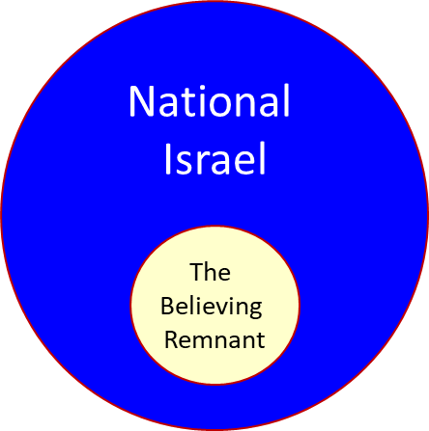

Slide 60

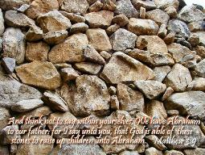
Matthew 3:9
“and do not suppose that you can say to yourselves, ‘We have Abraham for our father’; for I say to you that from these stones God is able to raise up children to Abraham.”

Slide 61

Romans 2:28-29
“²⁸ For he is not a Jew who is one outwardly, nor is circumcision that which is outward in the flesh. ²⁹ But he is a Jew who is one inwardly; and circumcision is that which is of the heart, by the Spirit, not by the letter; and his praise is not from men, but from God.”

Slide 62
Romans 9:6
“But it is not as though the word of God has failed. For they are not all Israel who are descended from Israel.”

Slide 63
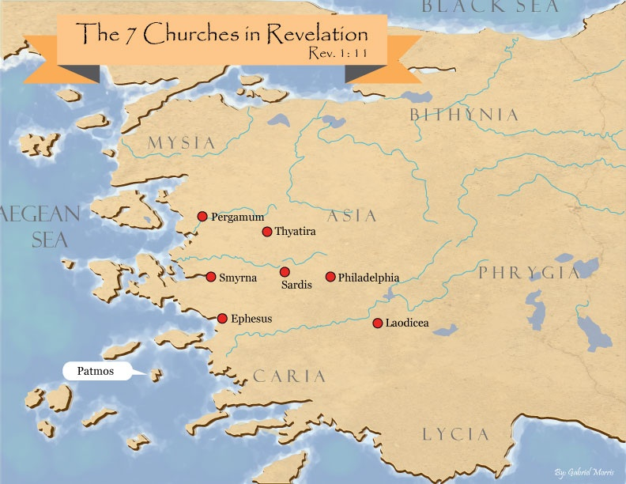
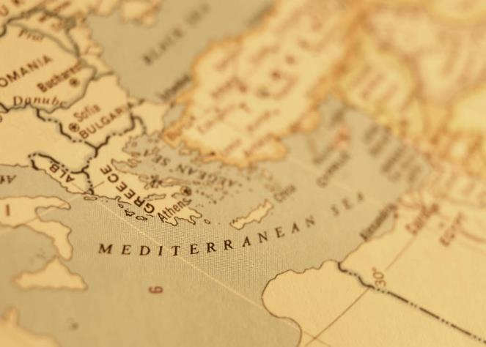

Slide 64

Revelation 2:9
“I know your tribulation and your poverty (but you are rich), and the blasphemy by those who say they are Jews and are not, but are a synagogue of Satan.”

Slide 66
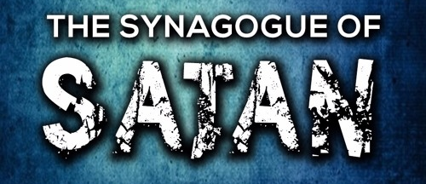
Revelation 3:9
“Behold, I will cause those of the synagogue of Satan, who say that they are Jews and are not, but lie—I will make them come and bow down at your feet, and make them know that I have loved you.”

Slide 67
Acts 13:6-11
Elymas Bar Jesus’ Opposition
      Description (6)
      Proconsul’s spiritual hunger (7)
      Opposition (8)
      Paul (9)
      Condemnation (10)
      Judgment (11)

Slide 68
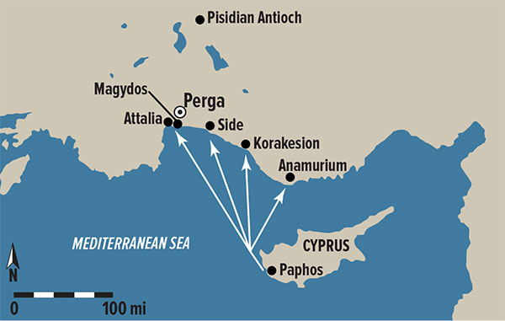
Dr. Arnold G. Fruchtenbaum
The Book of Acts, 286
“In 1877, his name was found in an inscription discovered in Soloi on the northern coast of Cyprus, which reads ‘Under Paulus the proconsul.’ This inscription dates to the year A.D. 53 or 54.”

Slide 69

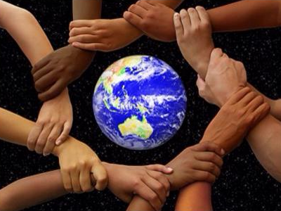
Acts 17:26-27
²⁶ and He made from one man every nation of mankind to live on all the face of the earth, having determined their appointed times and the boundaries of their habitation, ²⁷ that they would seek God, if perhaps they might grope for Him and find Him, though He is not far from each one of us (Italics added)

Slide 70
Acts 13:6-11
Elymas Bar Jesus’ Opposition
      Description (6)
      Proconsul’s spiritual hunger (7)
      Opposition (8)
      Paul (9)
      Condemnation (10)
      Judgment (11)

Slide 71
Acts 13:6-11
Elymas Bar Jesus’ Opposition
      Description (6)
      Proconsul’s spiritual hunger (7)
      Opposition (8)
      Paul (9)
      Condemnation (10)
      Judgment (11)

Slide 72
Acts 13:9
Paul
      Name’s explanation (9a)
      Paul’s power (9b)

Slide 73
Acts 13:9
Paul
      Name’s explanation (9a)
      Paul’s power (9b)

Slide 74
Dr. Arnold G. Fruchtenbaum
The Book of Acts, 286-87
“Verse 9a gives an explanation of Saul’s name: But Saul, who is also called Paul. Some claim that after being saved, Saul changed his name to Paul, but that is not true. Jews of the Diaspora who were Roman citizens, such as Saul, always had a Jewish name and a Gentile name. Now that he was operating in the Roman world ministering among Gentiles, Saul’s Latin name began to be used. Hence, from this point on, Luke called him ‘Saul’ only in reference to his past, such as in Acts 22:7 and 26:14. Paul now took the lead, and only in rare exceptions would his name appear after Barnabas’. The exceptions include Acts 14:14; 15:12 , and 25.”

Slide 75
Acts 13:9
Paul
      Name’s explanation (9a)
      Paul’s power (9b)

Slide 76
Acts 13:6-11
Elymas Bar Jesus’ Opposition
      Description (6)
      Proconsul’s spiritual hunger (7)
      Opposition (8)
      Paul (9)
      Condemnation (10)
      Judgment (11)

Slide 77
Acts 13:10
Condemnation
      Guile (10a)
      Full of villany (10b)
      Son of the Devil (10c)
      Enemy of righteousness (10d)

Slide 78
Acts 13:10
Condemnation
      Guile (10a)
      Full of villany (10b)
      Son of the Devil (10c)
      Enemy of righteousness (10d)

Slide 79
Acts 13:10
Condemnation
      Guile (10a)
      Full of villany (10b)
      Son of the Devil (10c)
      Enemy of righteousness (10d)

Slide 80
Acts 13:10
Condemnation
      Guile (10a)
      Full of villany (10b)
      Son of the Devil (10c)
      Enemy of righteousness (10d)

Slide 81
Acts 13:10
Condemnation
      Guile (10a)
      Full of villany (10b)
      Son of the Devil (10c)
      Enemy of righteousness (10d)

Slide 82
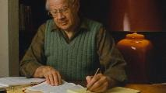
J. Dwight Pentecost
Pentecost, J. D. (1997). Your Adversary, the Devil (p. 69). Kregel.
“We find another example in the experience of Paul. The Apostle was sent to propagate the Gospel of the grace of God throughout the Gentile world. When Paul started on his first missionary journey he went into Paphos. “… they found a certain sorcerer, a false prophet, a Jew, whose name was Bar-jesus, which was with the deputy of the country, Sergius Paulus, a prudent man; who called for Barnabas and Saul, and desired to hear the Word of God. But Elymas, the sorcerer, withstood them, seeking to turn away the deputy from the faith” (Acts 13:6–8). Now, what happened? Paul came to a man whose heart was hungry and crying out for a knowledge of God. He introduced this man to the Gospel of the grace of God. But Satan had his minister, who professed to be a minister of righteousness, there to tell this burdened sinner that this was not truth, that it was a lie.”

Slide 83

The First Interfaith Dialogue
2 CORINTHIANS 11:3
“But I fear, lest somehow, as the serpent deceived Eve by his craftiness, so your minds may be corrupted by from the simplicity that is in Christ.” (Italics mine)
GENESIS 3:1
“Now the serpent was more crafty than any beast of the field which the Lord God had made. And he said to the woman, ‘Indeed, has God said, ‘You shall not eat from any tree of the garden’?”

Slide 84
Acts 13:6-11
Elymas Bar Jesus’ Opposition
      Description (6)
      Proconsul’s spiritual hunger (7)
      Opposition (8)
      Paul (9)
      Condemnation (10)
      Judgment (11)

Slide 85
The Plagues of Egypt
NO. | DESCRIPTION | SCRIPTURE | Egyptian Deity
1. | Water to Blood | Exod. 7:14-25 | Hapi, Khnum
2. | Frogs | Exod. 8:1-15 | Heqt
3. | Gnats | Exod. 8:16-19 | Set
4. | Flies | Exod. 8:20-32 | Uatchit
5. | Disease on Cattle | Exod. 9:1-7 | Hathor, Apis
6. | Boils | Exod. 9:8-12 | Sekhmet, Serapis
7. | Hail | Exod. 9:13-35 | Seth, Nut
8. | Locusts | Exod. 10:1-20 | Seth, Nut, Osiris
9. | Darkness | Exod. 10:21-29 | Re, Horus, Atum
10. | Death of the First Born | Exod. 12:29-36 | Min, Osiris, Heqt, Isis

Slide 86
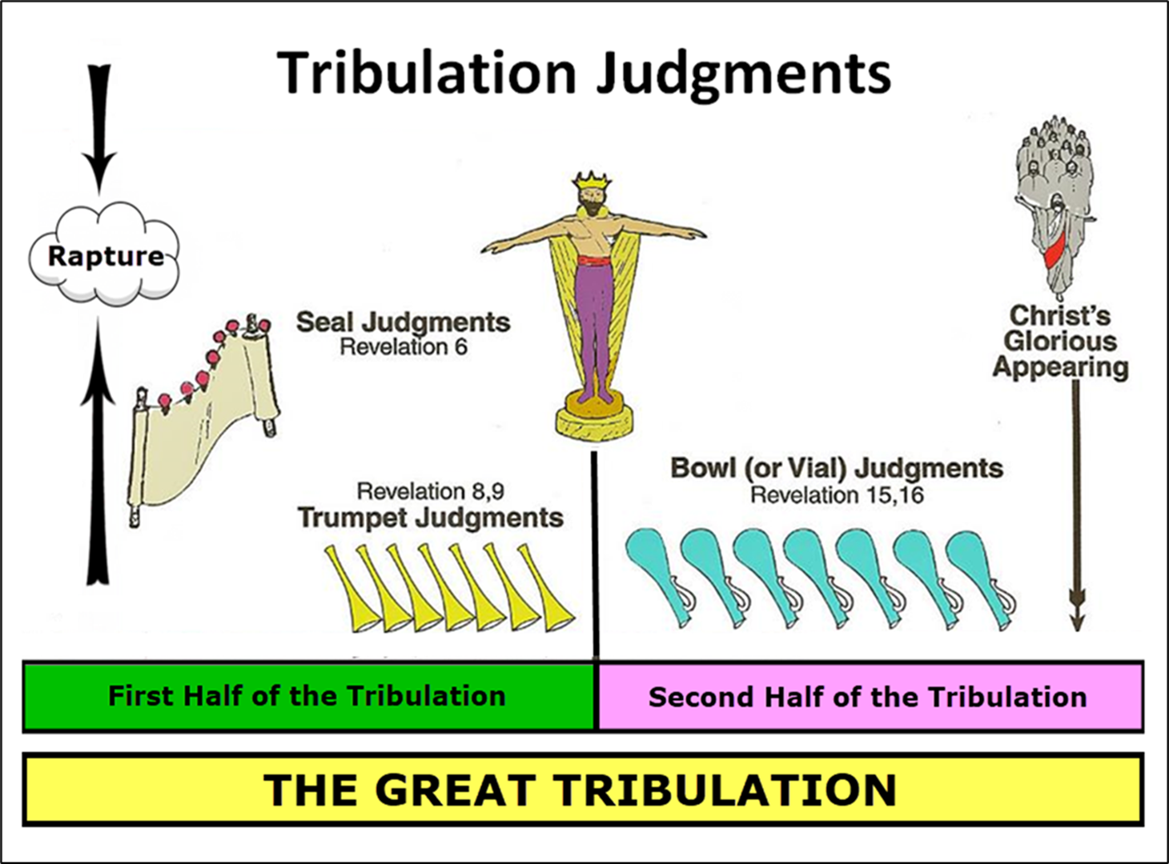

Slide 87
Acts 13:6-12
Paphos Ministry
      Elymas Bar Jesus’ opposition (6-11)
      Proconsul’s conversion (12)

Slide 88
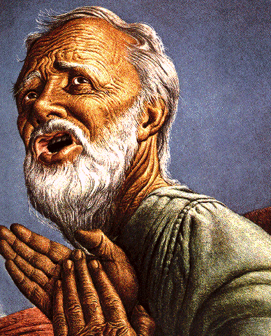
Passage Conditioning Salvation on Faith Alone (Sola Fide)
Genesis 15:6
John 3:16; 5:24; 6:28-29, 47; 16:8-9; 20:30-31
Acts 16:30-31
Romans 1:16; Ephesians 2:8-9
Hebrews 11:6

Slide 89
Belief – God’s One Condition for Justification
Gen 15:6
Then he believed in the LORD; and He reckoned it to him as righteousness.
John 3:16
For God so loved the world, that He gave His only begotten Son, that whoever believes in Him shall not perish, but have eternal life.
Acts 16:30-31
"Sirs, what must I do to be saved?" They said, "Believe in the Lord Jesus, and you will be saved..."

Slide 90
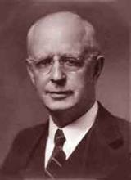
Lewis Sperry Chafer, vol. 7, Systematic Theology
(Grand Rapids, MI: Kregel Publications, 1993), 265-66.
Belief-God’s One Condition for Justification
“…because upwards of 150 passages of Scripture condition salvation upon believing only (cf. John 3:16; Acts 16:31).”

Slide 91
Acts 13‒14
1st Missionary Journey
  Paul & Barnabas’ appointment (13:1-3)
  Cyprus ministry (13:4-12)
  Pisidian Antioch ministry (13:13-52)
  Iconium ministry (14:1-7)
  Lystra ministry (14:8-20a)
  Derbe ministry (14:20b-21a)
  Return to Antioch (14:21b-28)

Slide 92
Acts 13‒14
1st Missionary Journey
  Paul & Barnabas’ appointment (13:1-3)
  Cyprus ministry (13:4-12)
  Pisidian Antioch ministry (13:13-52)
  Iconium ministry (14:1-7)
  Lystra ministry (14:8-20a)
  Derbe ministry (14:20b-21a)
  Return to Antioch (14:21b-28)

Slide 93
Acts 13‒14
1st Missionary Journey
  Paul & Barnabas’ appointment (13:1-3)
  Cyprus ministry (13:4-12)
  Pisidian Antioch ministry (13:13-52)
  Iconium ministry (14:1-7)
  Lystra ministry (14:8-20a)
  Derbe ministry (14:20b-21a)
  Return to Antioch (14:21b-28)

Slide 94
Acts 13‒14
1st Missionary Journey
  Paul & Barnabas’ appointment (13:1-3)
  Cyprus ministry (13:4-12)
  Pisidian Antioch ministry (13:13-52)
  Iconium ministry (14:1-7)
  Lystra ministry (14:8-20a)
  Derbe ministry (14:20b-21a)
  Return to Antioch (14:21b-28)

Slide 95
Acts 13‒14
1st Missionary Journey
  Paul & Barnabas’ appointment (13:1-3)
  Cyprus ministry (13:4-12)
  Pisidian Antioch ministry (13:13-52)
  Iconium ministry (14:1-7)
  Lystra ministry (14:8-20a)
  Derbe ministry (14:20b-21a)
  Return to Antioch (14:21b-28)

Slide 96
Conclusion

Slide 97
Acts 13‒14
1st Missionary Journey
  Paul & Barnabas’ appointment (13:1-3)
  Cyprus ministry (13:4-12)
  Pisidian Antioch ministry (13:13-52)
  Iconium ministry (14:1-7)
  Lystra ministry (14:8-20a)
  Derbe ministry (14:20b-21a)
  Return to Antioch (14:21b-28)

