Slide 1
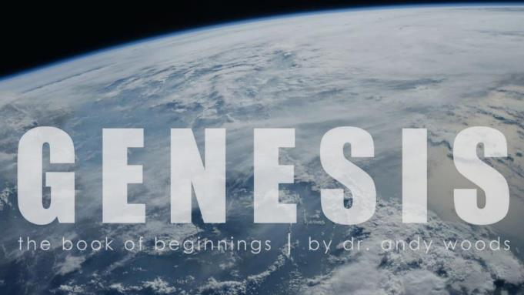
Genesis 12‒50
Israel’s Birth & Preservation

Slide 2
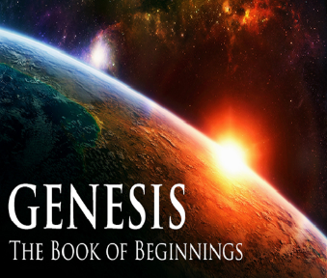
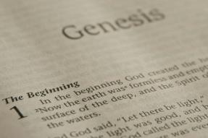
GENESIS STRUCTURE
Genesis 12-50 (four people)
Abraham (12:1–25:11)
Isaac (25:12–26:35)
Jacob (27–36)
Joseph (37–50)

Slide 3
Genesis 37‒50 Joseph
Joseph sold unto Egypt (37)
Canaan’s corruption (38)
Joseph falsely accused (39)
Joseph’s short-term predictions (40)
Joseph’s elevation (41)
Joseph’s first reunion with his brothers (42)
Joseph’s second reunion with his brothers (43‒45)
Joseph’s second reunion with his brothers (43‒45)
Sojourn to Egypt (46:1‒47:12)
Famine’s course (47:13-26)
Jacob in Egypt (47:27-31)
Jacob blesses Joseph’s sons (48)
Jacob blesses his sons (49)
Jacob’s burial & Joseph’s death (50)

Slide 4
Genesis 50:1-26 Death & Burial of Jacob & Joseph
Events following Jacob’s death (1-3)
Jacob’s burial (4-14)
Brothers’ fear & Joseph’s reassurance (15-21)
Joseph’s death (22-26)

Slide 5
II. Genesis 50:4-14 Jacob’s Burial
Joseph’s request (4-5)
Request granted (6)
Funeral procession (7-9)
Arrival (10-11)
Jacob’s burial (12-13)
Return to Egypt (14)

Slide 6
II. Genesis 50:4-14 Jacob’s Burial
Joseph’s request (4-5)
Request granted (6)
Funeral procession (7-9)
Arrival (10-11)
Jacob’s burial (12-13)
Return to Egypt (14)

Slide 7
Genesis 50:4-5 Joseph’s Request
Timing (4a)
Joseph approaches Pharaoh (4b)
Basis (4c)
Request (4d)
Oath (5a)
Promise to return (5b)

Slide 8
Genesis 50:4-5 Joseph’s Request
Timing (4a)
Joseph approaches Pharaoh (4b)
Basis (4c)
Request (4d)
Oath (5a)
Promise to return (5b)

Slide 9
Genesis 50:4-5 Joseph’s Request
Timing (4a)
Joseph approaches Pharaoh (4b)
Basis (4c)
Request (4d)
Oath (5a)
Promise to return (5b)

Slide 10
Genesis 50:4-5 Joseph’s Request
Timing (4a)
Joseph approaches Pharaoh (4b)
Basis (4c)
Request (4d)
Oath (5a)
Promise to return (5b)

Slide 11
Genesis 50:4-5 Joseph’s Request
Timing (4a)
Joseph approaches Pharaoh (4b)
Basis (4c)
Request (4d)
Oath (5a)
Promise to return (5b)

Slide 12
Genesis 50:4-5 Joseph’s Request
Timing (4a)
Joseph approaches Pharaoh (4b)
Basis (4c)
Request (4d)
Oath (5a)
Promise to return (5b)

Slide 13
Genesis 12‒25 Abraham’s Early Journeys
Unconditional promises (Gen. 12:1-3) From Haran to Canaan (Gen. 12:4-5) In Canaan (Gen. 12:6-9) In Egypt (Gen. 12:10-20) Abram and Lot Separate (Gen. 13:1-13) Reaffirmation of Abram’s promises (Gen. 13:14-18) Abram Rescues Lot (14:1-24) Abrahamic Covenant (15:1-21) Hagar & Ishmael (16:1-16) Circumcision (Gen. 17:1-27) | Sodom & Gomorrah (Gen. 18‒19) Abraham & Abimelech (Gen. 20) Isaac’s birth (Gen. 21:1-7) Ishmael’s expulsion (21:8-21) Abraham & Abimelech’s covenant (21:22-34) Abraham sacrifices Isaac (22) Sarah’s death (23) Isaac’s marriage (24) Abraham & Keturah (25:1-6) Abraham’s death (25:7-11)

Slide 14
Genesis 50:4-5 Joseph’s Request
Timing (4a)
Joseph approaches Pharaoh (4b)
Basis (4c)
Request (4d)
Oath (5a)
Promise to return (5b)

Slide 16
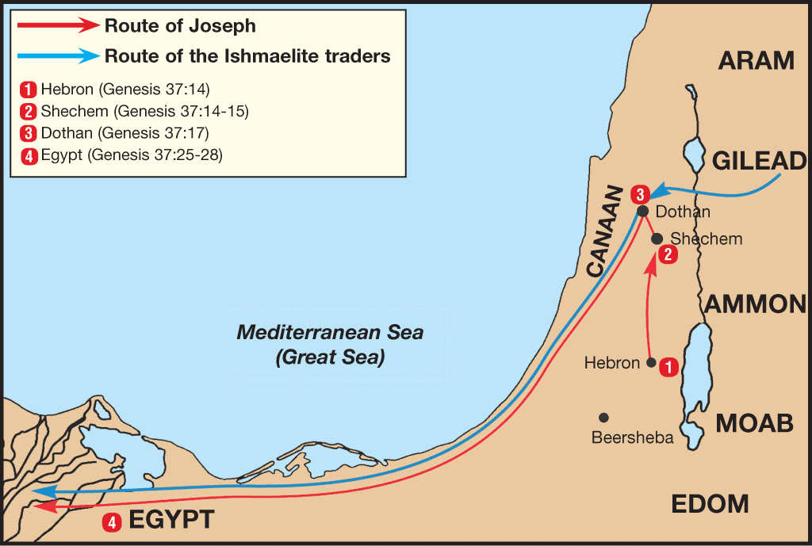

Slide 17
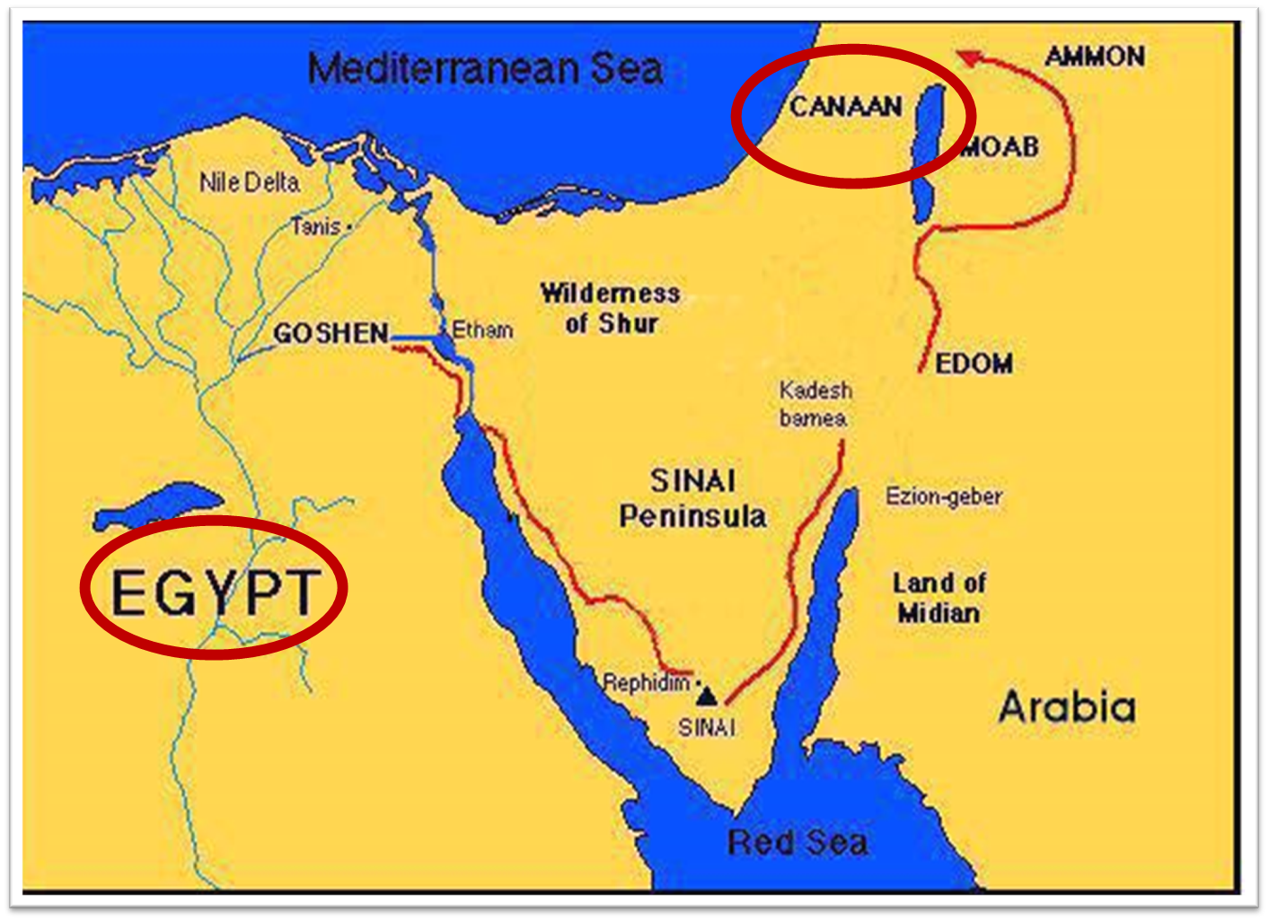

Slide 18
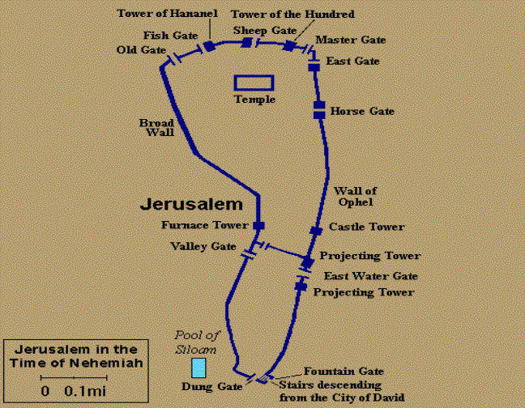
Gates of Nehemiah

Slide 19
II. Genesis 50:4-14 Jacob’s Burial
Joseph’s request (4-5)
Request granted (6)
Funeral procession (7-9)
Arrival (10-11)
Jacob’s burial (12-13)
Return to Egypt (14)

Slide 20
II. Genesis 50:4-14 Jacob’s Burial
Joseph’s request (4-5)
Request granted (6)
Funeral procession (7-9)
Arrival (10-11)
Jacob’s burial (12-13)
Return to Egypt (14)

Slide 21
Genesis 50:7-9 Funeral Procession
Joseph (7a)
House of Egypt (7b)
House of Jacob (8)
Pharaoh’s bodyguard (9)

Slide 22
Genesis 50:7-9 Funeral Procession
Joseph (7a)
House of Egypt (7b)
House of Jacob (8)
Pharaoh’s bodyguard (9)

Slide 23
Genesis 50:7-9 Funeral Procession
Joseph (7a)
House of Egypt (7b)
House of Jacob (8)
Pharaoh’s bodyguard (9)

Slide 24
Genesis 50:7-9 Funeral Procession
Joseph (7a)
House of Egypt (7b)
House of Jacob (8)
Pharaoh’s bodyguard (9)

Slide 26
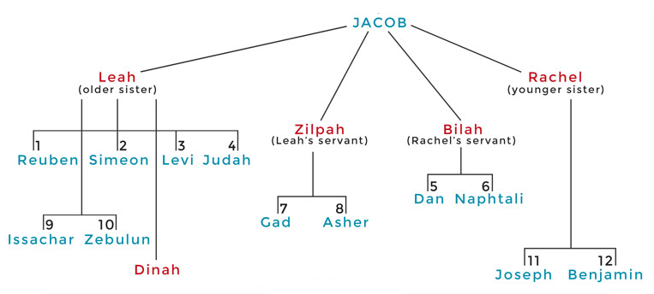

Slide 27
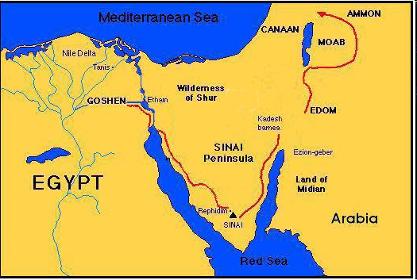

Slide 28
Genesis 15:16
“Then in the fourth generation they will return here, for the wrongdoing of the Amorite is not yet complete.”

Slide 29
Genesis 50:7-9 Funeral Procession
Joseph (7a)
House of Egypt (7b)
House of Jacob (8)
Pharaoh’s bodyguard (9)

Slide 30
II. Genesis 50:4-14 Jacob’s Burial
Joseph’s request (4-5)
Request granted (6)
Funeral procession (7-9)
Arrival (10-11)
Jacob’s burial (12-13)
Return to Egypt (14)

Slide 31
Genesis 50:10-11 Arrival
Place (10)
Change of name (11)

Slide 32
Genesis 50:10-11 Arrival
Place (10)
Change of name (11)

Slide 36
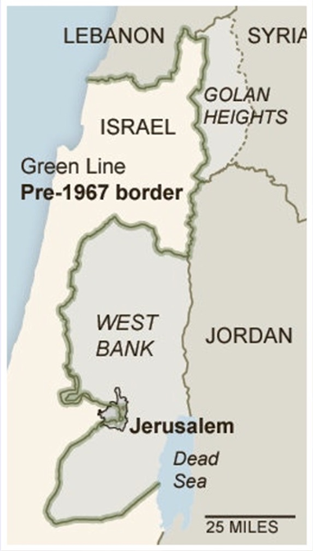

Slide 37
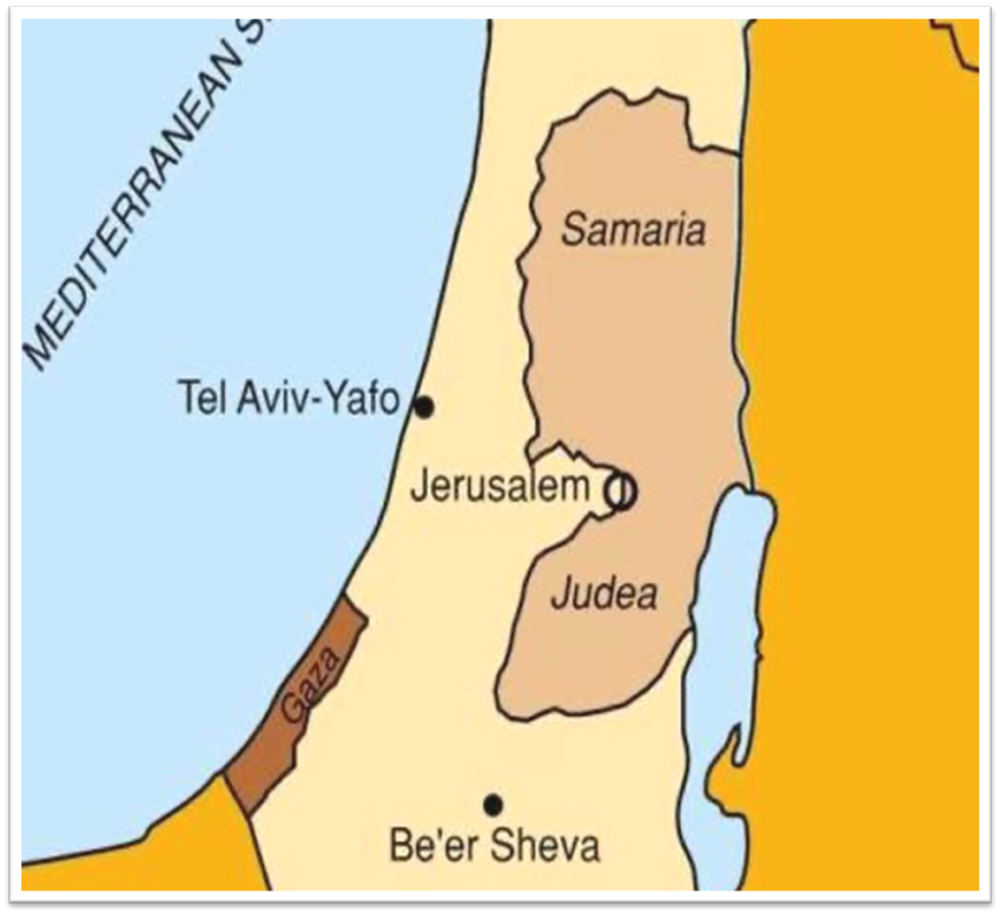

Slide 38
1 Thessalonians 4:13-18
¹³ But we do not want you to be uninformed, brethren, about those who are asleep, so that you will not grieve as do the rest who have no hope. ¹⁴ For if we believe that Jesus died and rose again, even so God will bring with Him those who have fallen asleep in Jesus. ¹⁵ For this we say to you by the word of the Lord, that we who are alive and remain until the coming of the Lord, will not precede. . .

Slide 39
Shaping and Populating (Gen 1:1)
Day 1: | Light | Day 4: | Luminaries
Day 2: | Water, sky | Day 5: | Sea animals, birds
Day 3: | Land, vegetation | Day 6: | Land animals, man

Slide 40
Genesis 50:10-11 Arrival
Place (10)
Change of name (11)

Slide 41
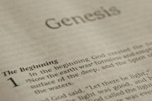
Beginning Themes
Universe Life Man Marriage Evil Clothing | Religion Salvation Language Government Nations Israel
Morris, Genesis Record, 18-20

Slide 42
II. Genesis 50:4-14 Jacob’s Burial
Joseph’s request (4-5)
Request granted (6)
Funeral procession (7-9)
Arrival (10-11)
Jacob’s burial (12-13)
Return to Egypt (14)

Slide 43
Genesis 50:12-13 Jacob’s Burial
Jacob’s sons’ obedience (12)
Obedience’s content (13)

Slide 44
Genesis 50:12-13 Jacob’s Burial
Jacob’s sons’ obedience (12)
Obedience’s content (13)

Slide 45
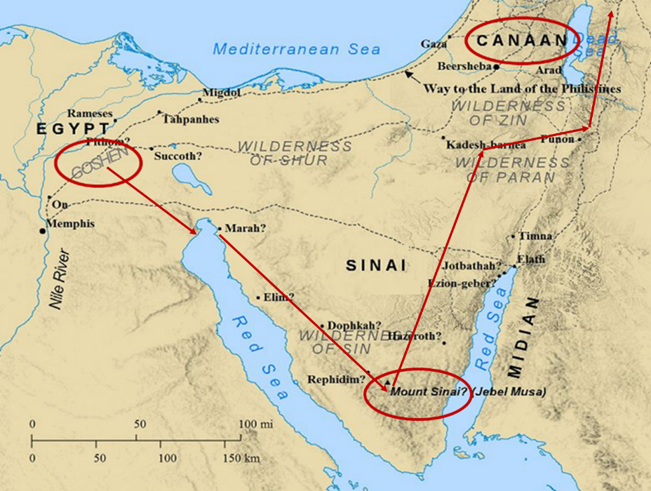

Slide 46
Genesis 50:12-13 Jacob’s Burial
Jacob’s sons’ obedience (12)
Obedience’s content (13)

Slide 47
Genesis 12‒25 Abraham’s Early Journeys
Unconditional promises (Gen. 12:1-3) From Haran to Canaan (Gen. 12:4-5) In Canaan (Gen. 12:6-9) In Egypt (Gen. 12:10-20) Abram and Lot Separate (Gen. 13:1-13) Reaffirmation of Abram’s promises (Gen. 13:14-18) Abram Rescues Lot (14:1-24) Abrahamic Covenant (15:1-21) Hagar & Ishmael (16:1-16) Circumcision (Gen. 17:1-27) | Sodom & Gomorrah (Gen. 18‒19) Abraham & Abimelech (Gen. 20) Isaac’s birth (Gen. 21:1-7) Ishmael’s expulsion (21:8-21) Abraham & Abimelech’s covenant (21:22-34) Abraham sacrifices Isaac (22) Sarah’s death (23) Isaac’s marriage (24) Abraham & Keturah (25:1-6) Abraham’s death (25:7-11)

Slide 48
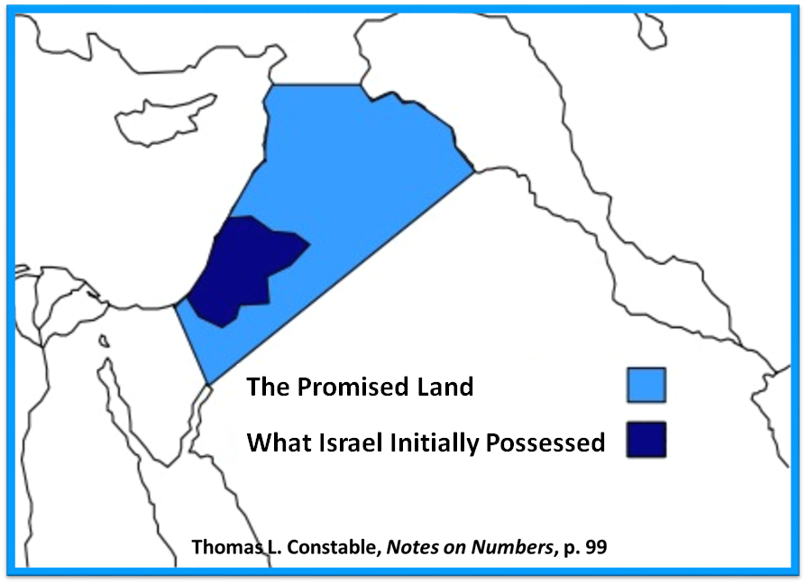

Slide 49
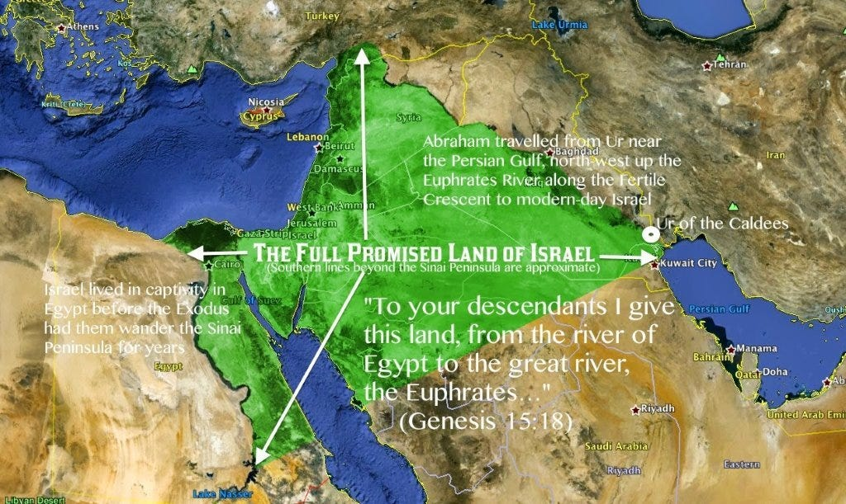

Slide 51
II. Genesis 50:4-14 Jacob’s Burial
Joseph’s request (4-5)
Request granted (6)
Funeral procession (7-9)
Arrival (10-11)
Jacob’s burial (12-13)
Return to Egypt (14)

Slide 52
Genesis 50:14 Return to Egypt
Timing (14a)
Group (14b)

Slide 53
Genesis 50:14 Return to Egypt
Timing (14a)
Group (14b)

Slide 54
Genesis 50:14 Return to Egypt
Timing (14a)
Group (14b)

Slide 58
Conclusion

Slide 59
Genesis 50:1-26 Death & Burial of Jacob & Joseph
Events following Jacob’s death (1-3)
Jacob’s burial (4-14)
Brothers’ fear & Joseph’s reassurance (15-21)
Joseph’s death (22-26)

Slide 60
²⁴ The Lord bless you, and keep you; ²⁵ The Lord make His face shine on you, And be gracious to you; ²⁶ The Lord lift up His countenance on you, And give you peace.
Numbers 6:24–26 (NASB95)

