Slide 2
Acts 12:1-25 4th Persecution of Jerusalem Church
James’ Death (12:1-2)
Peter’s imprisonment (12:3-5)
Peter’s Deliverance (12:6-17)
Results of Peter’s Escape (12:18-25)

Slide 3
IV. Results of Peter’s Escape Acts 12:18-25
On Herod (18-23)
On the Church (24-25)

Slide 4
Acts 12:18-23 On Herod
Soldiers’ reaction (18)
Herod’s reaction (19)
Herod’s death (20-23)

Slide 5
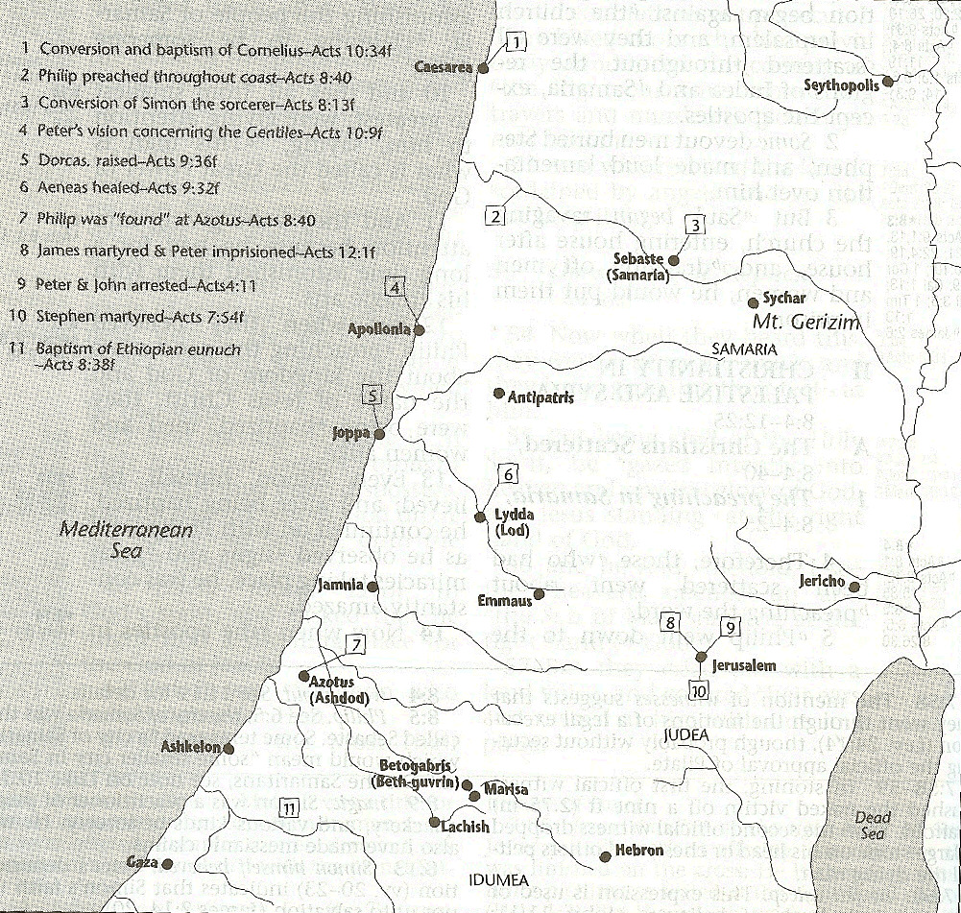

Slide 6
Acts 12:18-23 On Herod
Soldiers’ reaction (18)
Herod’s reaction (19)
Herod’s death (20-23)

Slide 7
Acts 12:20-23 Herod’s Death
Herod’s displeasure with Tyre & Sidon (20)
Herod’s speech at the Festival (21)
Response of the people (22)
Judgment upon Herod (23)

Slide 8
Acts 12:20-23 Herod’s Death
Herod’s displeasure with Tyre & Sidon (20)
Herod’s speech at the Festival (21)
Response of the people (22)
Judgment upon Herod (23)

Slide 9
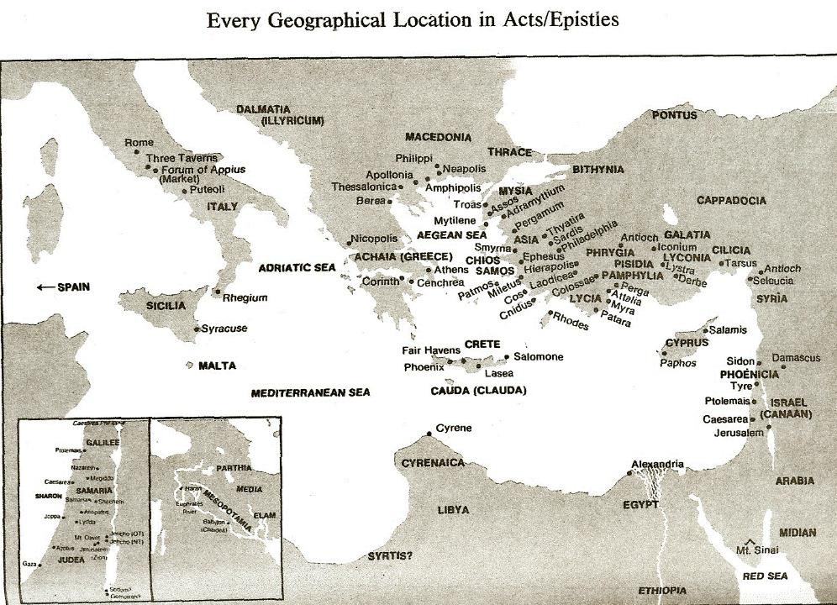

Slide 10
Acts 12:20-23 Herod’s Death
Herod’s displeasure with Tyre & Sidon (20)
Herod’s speech at the Festival (21)
Response of the people (22)
Judgment upon Herod (23)

Slide 11
Acts 12:20-23 Herod’s Death
Herod’s displeasure with Tyre & Sidon (20)
Herod’s speech at the Festival (21)
Response of the people (22)
Judgment upon Herod (23)

Slide 12
Acts 12:20-23 Herod’s Death
Herod’s displeasure with Tyre & Sidon (20)
Herod’s speech at the Festival (21)
Response of the people (22)
Judgment upon Herod (23)

Slide 13
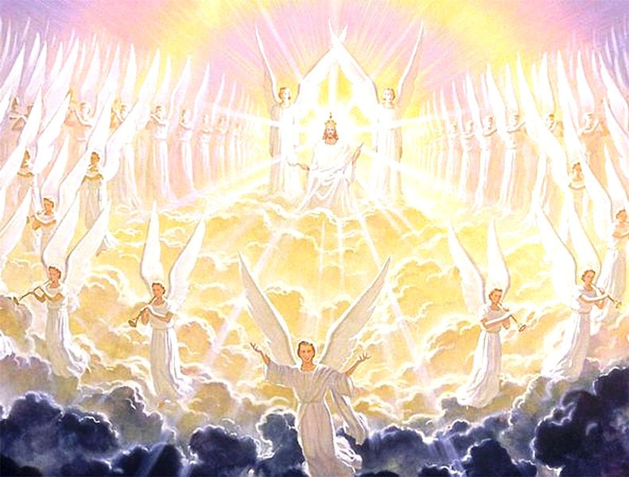
Activities of the Angels PAST
Witnessed creation (Job 38:7)
Brought judgment (Gen 19:22; Acts 12:22-23)
Accompanied the Law (Gal 3:19)
Announced births of John and Christ (Luke 1:11-13, 26-27)
Strengthened Christ (Matt 4:11)
Announced resurrection (Matt 28:1-7)
Observed Ascension (Acts 1:11)
Brought messages (Luke 1:13)

Slide 14
Activities of the Angels FUTURE
Rapture (1 Thess. 4:16)
Judged by humans (1 Cor 6:3)
Tribulation judgments (Rev 8:2; 16:1)
Return of Christ (Matt 24:31; 25:31)
Bind Satan (Rev 20:1-2)

Slide 16
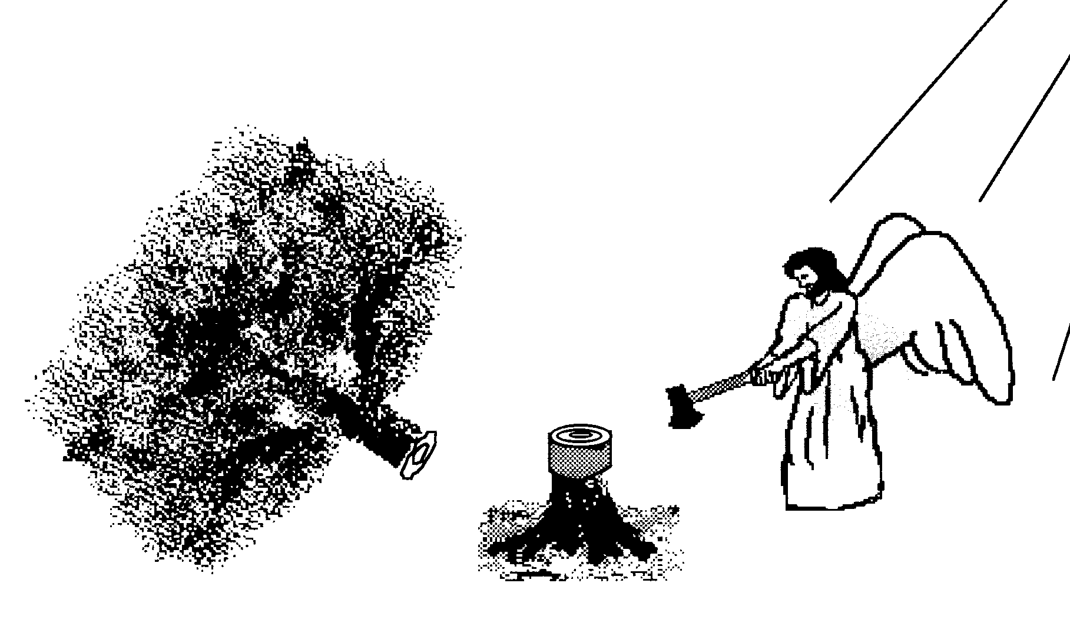
Scripture and Pride
Prov 16:18
Isa 14:12-15; Ezek 28:12-17
1 Tim 3:6
Acts 12:21-23
2 Cor 12:7
1 Pet 5:5

Slide 17
Hall of the Humbled (Prov. 16:18; 1 Peter 5:5)
Satan (Isa. 14:12-15; Ezek. 28:12-17; 1 Tim. 3:6)
Uzziah (2 Chron. 26:16)
Herod (Acts 12:20-23)
Paul (2 Cor. 12:1-10)

Slide 18
Dr. Arnold G. Fruchtenbaum
The Book of Acts, 278-79
“As a result, Agrippa was eaten of worms. The Greek expression is genomenos skōlēkobrōtos and literally means ‘becoming worm-eaten.’ Robertson notes: ‘The word skóléx was used of intestinal worms and Herodotus . . . describes Pheretima, Queen of Cyrene, as having swarms of worms which ate her flesh while still alive.’ In other words, Agrippa died of acute intestinal problems. This was not an uncommon way for someone to die in ancient times. Josephus described the death as occurring five days after the painful stomach condition started, stating ‘that the rotting of his flesh produced worms, an item in harmony with the narrative of Luke.’”

Slide 19
IV. Results of Peter’s Escape Acts 12:18-25
On Herod (18-23)
On the Church (24-25)

Slide 20
Acts 12:24-25 On the Church
Progress report (24)
Paul & Barnabas return to Antioch (25)

Slide 21
Acts 12:24-25 On the Church
Progress report (24)
Paul & Barnabas return to Antioch (25)

Slide 22
Purpose
To present Theophilus with an orderly account of the birth and growth of the church so as to affirm him in what he has believed.

Slide 23
Message
Birth and growth of the church numerically, geographically, ethnically.
Components
Numerically (progress reports)
Geographically (From Jerusalem to Rome)
Ethnically (From Judaism to Gentile domination)

Slide 24
Progress Reports
Clearest: Acts 2:47; 6:7; 9:31; 12:24; 16:5; 19:20; 28:30-31
Less clear: Acts 1:13, 15; 2:41, 47; 4:4, 31; 5:14, 42; 8:25, 40; 11:21; 13:49; 17:6

Slide 25
Acts 12:24-25 On the Church
Progress report (24)
Paul & Barnabas return to Antioch (25)

Slide 27
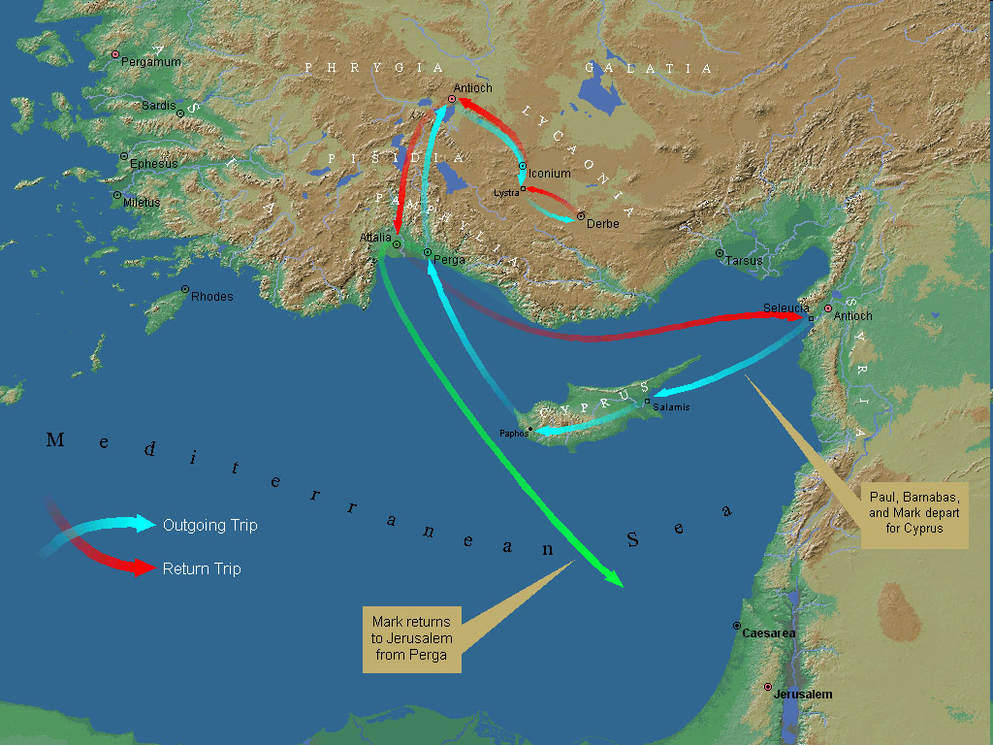
First Missionary Journey

Slide 28
Conclusion

Slide 29
Acts 12:1-25 4th Persecution of Jerusalem Church
James’ Death (12:1-2)
Peter’s Imprisonment (12:3-5)
Peter’s Deliverance (12:6-17)
Results of Peter’s Escape (12:18-25)

