Slide 1
Genesis 12‒50
Israel’s Birth & Preservation

Slide 2
GENESIS STRUCTURE
Genesis 12-50 (four people)
Abraham (12:1–25:11)
Isaac (25:12–26:35)
Jacob (27–36)
Joseph (37–50)

Slide 3
Genesis 37‒50 Joseph
Joseph sold unto Egypt (37)
Canaan’s corruption (38)
Joseph falsely accused (39)
Joseph’s short-term predictions (40)
Joseph’s elevation (41)
Joseph’s first reunion with his brothers (42)
Joseph’s second reunion with his brothers (43‒45)
Joseph’s second reunion with his brothers (43‒45)
Sojourn to Egypt (46:1‒47:12)
Famine’s course (47:13-26)
Jacob in Egypt (47:27-31)
Jacob blesses Joseph’s sons (48)
Jacob blesses his sons (49)
Jacob’s burial & Joseph’s death (50)

Slide 4
Genesis 50:1-26 Death & Burial of Jacob & Joseph
Events following Jacob’s death (1-3)
Jacob’s burial (4-14)
Brothers’ fear & Joseph’s reassurance (15-21)
Joseph’s death (22-26)

Slide 5
Genesis 50:1-26 Death & Burial of Jacob & Joseph
Events following Jacob’s death (1-3)
Jacob’s burial (4-14)
Brothers’ fear & Joseph’s reassurance (15-21)
Joseph’s death (22-26)

Slide 6
I. Genesis 50:1-3 Events Following Jacob’s Death
Weeping (1)
Embalming (2-3)

Slide 7
I. Genesis 50:1-3 Events Following Jacob’s Death
Weeping (1)
Embalming (2-3)

Slide 8
1 Thessalonians 4:13-18
^{13 “}But we do not want you to be uninformed, brethren, about those who are asleep, so that you will not grieve as do the rest who have no hope. ¹⁴ For if we believe that Jesus died and rose again, even so God will bring with Him those who have fallen asleep in Jesus. ¹⁵ For this we say to you by the word of the Lord, that we who are alive and remain until the coming of the Lord, will not precede. . .

Slide 9
I. Genesis 50:1-3 Events Following Jacob’s Death
Weeping (1)
Embalming (2-3)

Slide 10
Genesis 50:2-3 Embalming
Command (2)
Days of embalming (3)

Slide 11
Genesis 50:2-3 Embalming
Command (2)
Days of embalming (3)

Slide 12
Dr. Arnold G. Fruchtenbaum
The Book of Genesis, 654-55
“Sixth, later, the four entrails of the liver, the lungs, the stomach, and the intestines were put in four jars and each was dedicated to the four genies of the underworld. It was because of this particular magical, mystical art that was practiced that Joseph probably chose to use physicians rather than professional embalmers.”

Slide 14
Occult Works
NAME | DEFINITION | SCRIPTURE
Divination | Fortune telling | Deut 18:10; Acts 16:16
Spiritism | Contacting the dead | Deut 18:11
Magic | Performance of miraculous powers | Deut 18:11
Pharamkeia | Illicit drug use | Rev 9:20-21; 18:2, 23

Slide 15
Bible Verses Against Necromancy
Lev. 19:31
Deut. 18:9-14
1 Sam. 28:7-8
2 Kgs. 21:6
1 Chron. 10:13
Isa. 8:19-20

Slide 16
1 Timothy 4:1
“But the Spirit explicitly says that in later times some will fall away from the faith, paying attention to deceitful spirits and doctrines of demons.”

Slide 17
Steve Berger
Steve Berger & Sarah Berger, Have Heart: Bridging the Gulf Between Heaven and Earth (Franklin, TN: Grace Chapel, 2010).
“And then one night, Josiah [their son] showed up in a dream” (p. 69)
“Josiah came into the sanctuary…It wasn’t like he just appeared there. It was a sense of him coming into the aisle, and he got down on one knee and bent into my ear…Then, as quickly as he came, he left. It wasn’t that he disappeared; rather, it was a sense of him leaving the sanctuary…. He had a sense of speed about him, not that he was hurried, but as if life on earth was much slower than in Heaven—it’s a different place, a different plane. I stood up and went over to my wife and told her, ‘Josiah was just here.’” p. 99-100.

Slide 18
Steve Berger
Steve Berger & Sarah Berger, Have Heart: Bridging the Gulf Between Heaven and Earth (Franklin, TN: Grace Chapel, 2010).
“God granted Josiah permission to make an appearance…it demonstrates his continued presence in not only our lives but in the lives of his friends as well” (p. 100; italics added).
“Yes, the residents of Heaven are personally present, they are aware, and they are near!” p. 100-101.
“We want all of us to continue to have relationship with Siah right up until the day that we are face-to-face in Heaven with him” (p. 103).

Slide 19
Steve Berger
Steve Berger & Sarah Berger, Have Heart: Bridging the Gulf Between Heaven and Earth (Franklin, TN: Grace Chapel, 2010).
“The cloud of witnesses [of ‘Christian loved ones in Heaven’] is personal, and we believe it is part of their work in the spiritual realm to cheer on their loved ones still on earth…” (p. 107; italics added).
“Our loved ones may show up in dreams or visits or other ways (who can limit God’s imagination?), but the fact is that we’re connected….There is a thin veil, and we’re connected to them, forever, in Christ” (p. 110)
“You don’t father or mother a child for nineteen years and then hear God say, ‘Oh, now you can’t talk to him. You no longer have a relationship with him until you see him face to face in Heaven….’ We still talk to Josiah, and it’s going to be so great when we’re together again” (p. 125).

Slide 20
2 Samuel 12:22-23
²² “While the child was still alive, I fasted and wept; for I said, ‘Who knows, the Lord may be gracious to me, that the child may live.’ ²³ But now he has died; why should I fast? Can I bring him back again? I will go to him, but he will not return to me.”

Slide 21
Luke 16:24-26
“²⁴ And he cried out and said, ‘Father Abraham, have mercy on me, and send Lazarus so that he may dip the tip of his finger in water and cool off my tongue, for I am in agony in this flame.’ ²⁵ But Abraham said, ‘Child, remember that during your life you received your good things, and likewise Lazarus bad things; but now he is being comforted here, and you are in agony. ²⁶ And besides all this, between us and you there is a great chasm fixed, so that those who wish to come over from here to you will not be able, and that none may cross over from there to us.’”

Slide 22
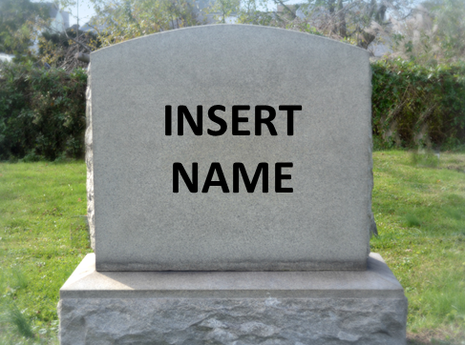
Hebrews 9:27
And inasmuch as it is appointed for men to die once and after this comes judgment.

Slide 23
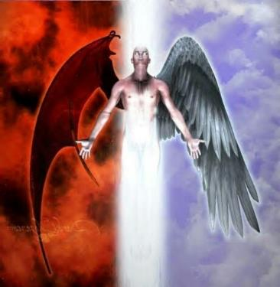
2 Corinthians 11:14
“No wonder, for even Satan disguises himself as an angel of light.”

Slide 24
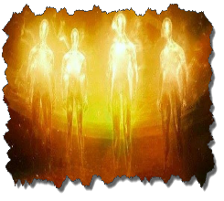
Dangerous Influences on our Children & Youth Dr. Christine J. Tan (May 21, 2017)
Sue Bohlin (PROBE.org) – on Harry Potter
https://www.probe.org/harry-potter/
Sue Bohlin (PROBE.org) – on Twilight
https://www.probe.org/the-darkness-of-twilight
Matt Slick (CARM) – on Pokemon
https://carm.org/what-is-pokemon
Patrick Zukeran (EvidenceAndAnswers.org) – on Worldview of Star Wars
http://evidenceandanswers.org/article/worldvie w-star-wars/

Slide 25
Dangerous Influences on our Children & Youth Dr. Christine J. Tan (May 21, 2017)
Sue Bohlin (PROBE.org) – on Harry Potter
https://www.probe.org/harry-potter/
Sue Bohlin (PROBE.org) – on Twilight
https://www.probe.org/the-darkness-of-twilight
Matt Slick (CARM) – on Pokemon
https://carm.org/what-is-pokemon
Patrick Zukeran (EvidenceAndAnswers.org) – on Worldview of Star Wars
http://evidenceandanswers.org/article/worldvie w-star-wars/

Slide 26
Harry Potter
“A Roman Catholic school in Tennessee has banished JK Rowling's universally popular series of Harry Potter novels from its library shelves after its pastor took exception to their portrayal of magic, warning the spells and curses the author describes are real and ‘risk conjuring evil spirits’ when read…‘These books present magic as both good and evil, which is not true, but in fact a clever deception. The curses and spells used in the books are actual curses and spells; which when read by a human being risk conjuring evil spirits into the presence of the person reading the text,’ the Reverend Reehill wrote, apparently in all seriousness.
Joe Sommerlad, Harry Potter books removed from school library because they contain 'real' curses and spells, “Independent,” online: https://www.independent.co.uk/news/world/americas/harry-potter-banned-school-library-nashville-tennessee-exorcist-a9087676. htmlwww.soniclight.com, September 1, 2019; accessed 13 December 219, p. 1.

Slide 27
Dangerous Influences on our Children & Youth Dr. Christine J. Tan (May 21, 2017)
Sue Bohlin (PROBE.org) – on Harry Potter
https://www.probe.org/harry-potter/
Sue Bohlin (PROBE.org) – on Twilight
https://www.probe.org/the-darkness-of-twilight
Matt Slick (CARM) – on Pokemon
https://carm.org/what-is-pokemon
Patrick Zukeran (EvidenceAndAnswers.org) – on Worldview of Star Wars
http://evidenceandanswers.org/article/worldvie w-star-wars/

Slide 28
Dangerous Influences on our Children & Youth Dr. Christine J. Tan (May 21, 2017)
Kerby Anderson (PROBE.org) – on High Tech Witchcraft
https://www.probe.org/high-tech-witchcraft/
Patrick Zukeran (EvidenceAndAnswers.org) – on the Occult
http://evidenceandanswers.org/article/the-world-of-the-occult/
Michael Gleghorn (PROBE.org) – on Yoga and Christianity
https://www.probe.org/yoga-and-christianity-are-they-compatible/
Michael Gleghorn (PROBE.org) – OK for Christian to do yoga?
https://www.probe.org/is-it-ok-for-a-christian-to-practice-yoga/

Slide 29
Dangerous Influences on our Children & Youth Dr. Christine J. Tan (May 21, 2017)
Patrick Zukeran (EvidenceAndAnswers.org) – on Yoga
http://evidenceandanswers.org/podcast/episode-280-yoga-great-exercise-or-dangerous-worship/
Michael Gleghorn (PROBE.org) – on Hypnosis
https://www.probe.org/is-hypnosis-ok-or-a-problem/
Oropeza (Christian Research Institute) – on some Martial Arts
http://www.equip.org/articles/should-a-christian-practice-the-martial-arts/

Slide 30
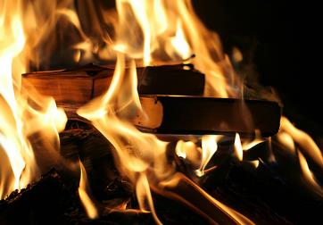
Acts 19:19
“And many of those who practiced magic brought their books together and began burning them in the sight of everyone; and they counted up the price of them and found it fifty thousand pieces of silver.”

Slide 31
Charles Ryrie
The Ryrie Study Bible
“19:19 Magic. Magical spells written on scrolls. Fifty thousand pieces of silver. If the silver drachma is meant, the value would have been the equivalent of about 138 years’ pay for a rural worker.”

Slide 32
Genesis 50:2-3 Embalming
Command (2)
Days of embalming (3)

Slide 33
Genesis 50:3 Days of Embalming
Egyptian embalming (3a)
Egyptian weeping (3b)

Slide 34
Genesis 50:3 Days of Embalming
Egyptian embalming (3a)
Egyptian weeping (3b)

Slide 35
Genesis 50:3 Days of Embalming
Egyptian embalming (3a)
Egyptian weeping (3b)

Slide 36
Shaping and Populating (Gen 1:1)
Day 1: | Light | Day 4: | Luminaries
Day 2: | Water, sky | Day 5: | Sea animals, birds
Day 3: | Land, vegetation | Day 6: | Land animals, man

Slide 37
Genesis 50:1-26 Death & Burial of Jacob & Joseph
Events following Jacob’s death (1-3)
Jacob’s burial (4-14)
Brothers’ fear & Joseph’s reassurance (15-21)
Joseph’s death (22-26)

Slide 38
II. Genesis 50:4-14 Jacob’s Burial
Joseph’s request (4-5)
Request granted (6)
Funeral procession (7-9)
Arrival (10-11)
Jacob’s burial (12-13)
Return to Egypt (14)

Slide 39
II. Genesis 50:4-14 Jacob’s Burial
Joseph’s request (4-5)
Request granted (6)
Funeral procession (7-9)
Arrival (10-11)
Jacob’s burial (12-13)
Return to Egypt (14)

Slide 40
Genesis 50:4-5 Joseph’s Request
Timing (4a)
Joseph approaches Pharaoh (4b)
Basis (4c)
Request (4d)
Oath (5a)
Promise to return (5b)

Slide 41
Genesis 50:4-5 Joseph’s Request
Timing (4a)
Joseph approaches Pharaoh (4b)
Basis (4c)
Request (4d)
Oath (5a)
Promise to return (5b)

Slide 42
Genesis 50:4-5 Joseph’s Request
Timing (4a)
Joseph approaches Pharaoh (4b)
Basis (4c)
Request (4d)
Oath (5a)
Promise to return (5b)

Slide 43
Genesis 50:4-5 Joseph’s Request
Timing (4a)
Joseph approaches Pharaoh (4b)
Basis (4c)
Request (4d)
Oath (5a)
Promise to return (5b)

Slide 44
Genesis 50:4-5 Joseph’s Request
Timing (4a)
Joseph approaches Pharaoh (4b)
Basis (4c)
Request (4d)
Oath (5a)
Promise to return (5b)

Slide 45
Genesis 50:4-5 Joseph’s Request
Timing (4a)
Joseph approaches Pharaoh (4b)
Basis (4c)
Request (4d)
Oath (5a)
Promise to return (5b)

Slide 46
Genesis 12‒25 Abraham’s Early Journeys
Unconditional promises (Gen. 12:1-3) From Haran to Canaan (Gen. 12:4-5) In Canaan (Gen. 12:6-9) In Egypt (Gen. 12:10-20) Abram and Lot Separate (Gen. 13:1-13) Reaffirmation of Abram’s promises (Gen. 13:14-18) Abram Rescues Lot (14:1-24) Abrahamic Covenant (15:1-21) Hagar & Ishmael (16:1-16) Circumcision (Gen. 17:1-27) | Sodom & Gomorrah (Gen. 18‒19) Abraham & Abimelech (Gen. 20) Isaac’s birth (Gen. 21:1-7) Ishmael’s expulsion (21:8-21) Abraham & Abimelech’s covenant (21:22-34) Abraham sacrifices Isaac (22) Sarah’s death (23) Isaac’s marriage (24) Abraham & Keturah (25:1-6) Abraham’s death (25:7-11)

Slide 47
Genesis 50:4-5 Joseph’s Request
Timing (4a)
Joseph approaches Pharaoh (4b)
Basis (4c)
Request (4d)
Oath (5a)
Promise to return (5b)

Slide 49
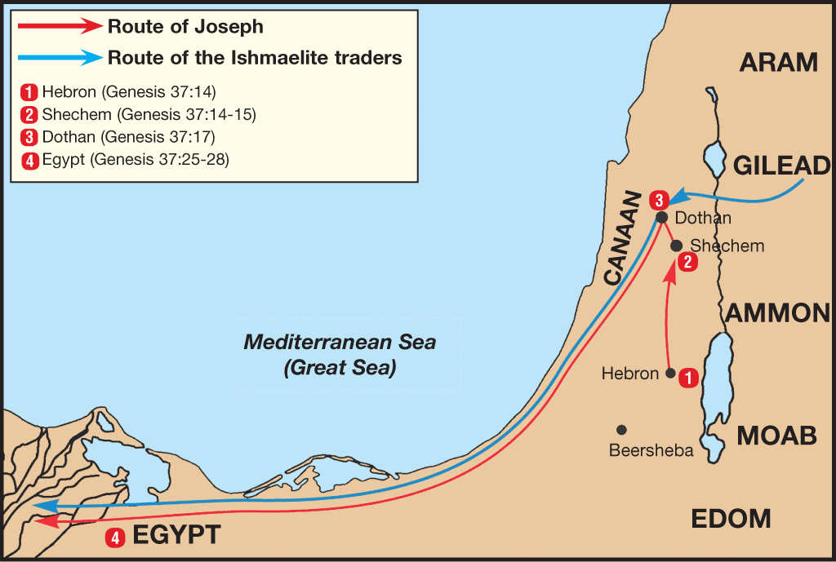

Slide 50
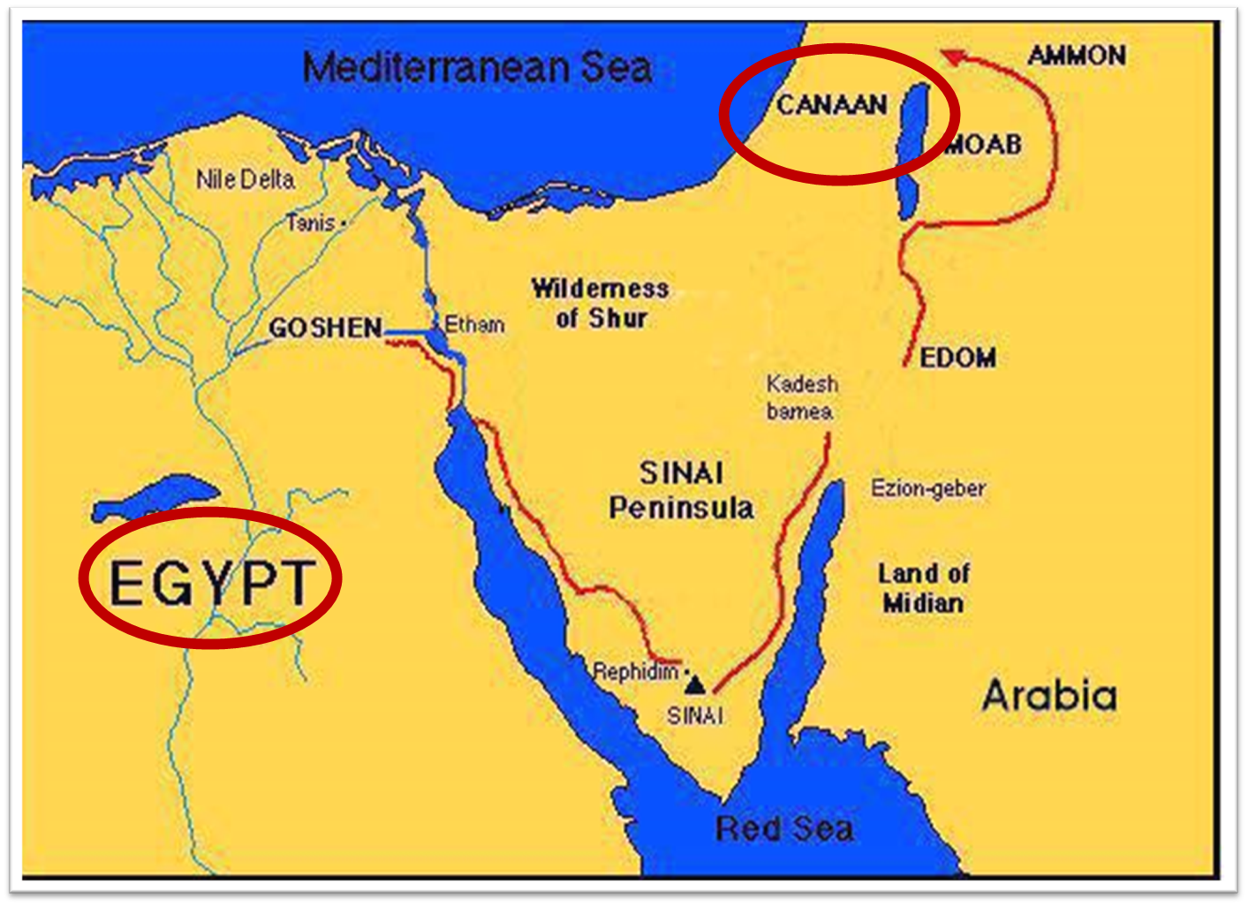

Slide 51
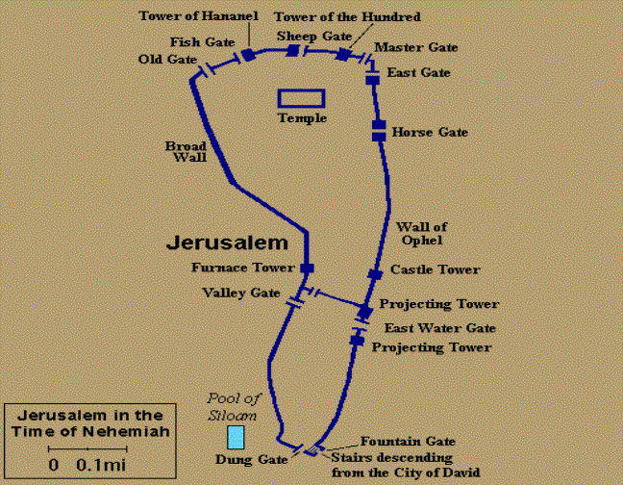
Gates of Nehemiah

Slide 52
II. Genesis 50:4-14 Jacob’s Burial
Joseph’s request (4-5)
Request granted (6)
Funeral procession (7-9)
Arrival (10-11)
Jacob’s burial (12-13)
Return to Egypt (14)

Slide 53
II. Genesis 50:4-14 Jacob’s Burial
Joseph’s request (4-5)
Request granted (6)
Funeral procession (7-9)
Arrival (10-11)
Jacob’s burial (12-13)
Return to Egypt (14)

Slide 54
Genesis 50:7-9 Funeral Procession
Joseph (7a)
House of Egypt (7b)
House of Jacob (8)
Pharaoh’s bodyguard (9)

Slide 55
Genesis 50:7-9 Funeral Procession
Joseph (7a)
House of Egypt (7b)
House of Jacob (8)
Pharaoh’s bodyguard (9)

Slide 56
Genesis 50:7-9 Funeral Procession
Joseph (7a)
House of Egypt (7b)
House of Jacob (8)
Pharaoh’s bodyguard (9)

Slide 57
Genesis 50:7-9 Funeral Procession
Joseph (7a)
House of Egypt (7b)
House of Jacob (8)
Pharaoh’s bodyguard (9)

Slide 59
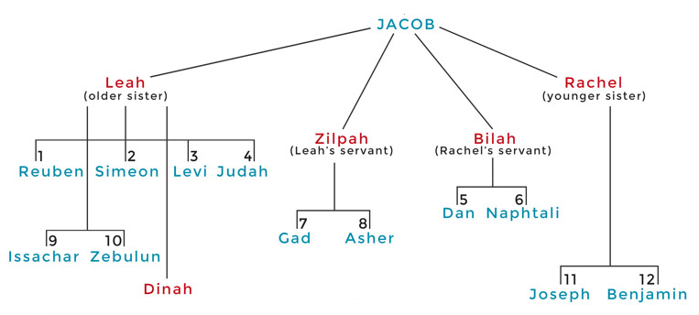

Slide 61
Genesis 15:16
“Then in the fourth generation they will return here, for the wrongdoing of the Amorite is not yet complete.”

Slide 62
Genesis 50:7-9 Funeral Procession
Joseph (7a)
House of Egypt (7b)
House of Jacob (8)
Pharaoh’s bodyguard (9)

Slide 63
II. Genesis 50:4-14 Jacob’s Burial
Joseph’s request (4-5)
Request granted (6)
Funeral procession (7-9)
Arrival (10-11)
Jacob’s burial (12-13)
Return to Egypt (14)

Slide 64
Genesis 50:10-11 Arrival
Place (10)
Change of name (11)

Slide 65
Genesis 50:10-11 Arrival
Place (10)
Change of name (11)

Slide 69
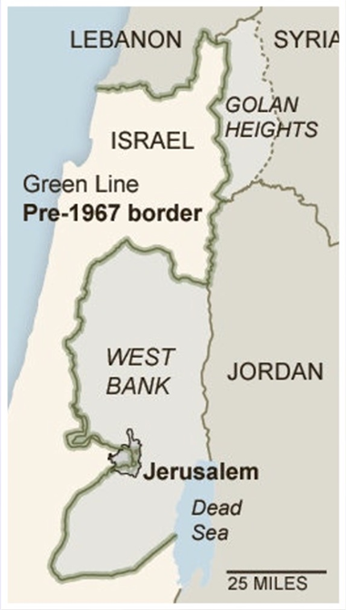

Slide 70
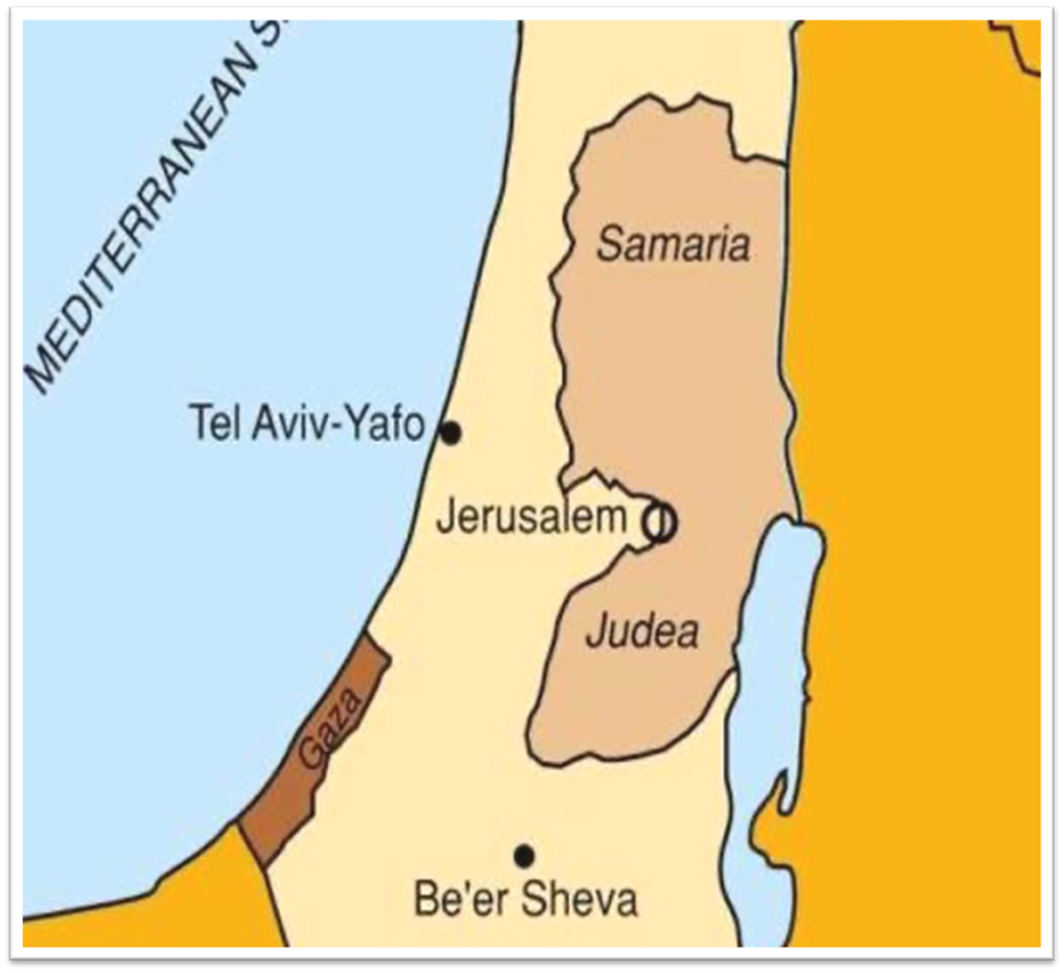

Slide 71
1 Thessalonians 4:13-18
^{13 “}But we do not want you to be uninformed, brethren, about those who are asleep, so that you will not grieve as do the rest who have no hope. ¹⁴ For if we believe that Jesus died and rose again, even so God will bring with Him those who have fallen asleep in Jesus. ¹⁵ For this we say to you by the word of the Lord, that we who are alive and remain until the coming of the Lord, will not precede. . .

Slide 72
Shaping and Populating (Gen 1:1)
Day 1: | Light | Day 4: | Luminaries
Day 2: | Water, sky | Day 5: | Sea animals, birds
Day 3: | Land, vegetation | Day 6: | Land animals, man

Slide 73
Genesis 50:10-11 Arrival
Place (10)
Change of name (11)

Slide 74
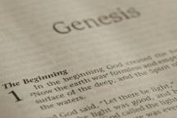
Beginning Themes
Universe Life Man Marriage Evil Clothing | Religion Salvation Language Government Nations Israel
Morris, Genesis Record, 18-20

Slide 75
II. Genesis 50:4-14 Jacob’s Burial
Joseph’s request (4-5)
Request granted (6)
Funeral procession (7-9)
Arrival (10-11)
Jacob’s burial (12-13)
Return to Egypt (14)

Slide 76
Genesis 50:12-13 Jacob’s Burial
Jacob’s sons’ obedience (12)
Obedience’s content (13)

Slide 77
Genesis 50:12-13 Jacob’s Burial
Jacob’s sons’ obedience (12)
Obedience’s content (13)

Slide 79
Genesis 50:12-13 Jacob’s Burial
Jacob’s sons’ obedience (12)
Obedience’s content (13)

Slide 80
Genesis 12‒25 Abraham’s Early Journeys
Unconditional promises (Gen. 12:1-3) From Haran to Canaan (Gen. 12:4-5) In Canaan (Gen. 12:6-9) In Egypt (Gen. 12:10-20) Abram and Lot Separate (Gen. 13:1-13) Reaffirmation of Abram’s promises (Gen. 13:14-18) Abram Rescues Lot (14:1-24) Abrahamic Covenant (15:1-21) Hagar & Ishmael (16:1-16) Circumcision (Gen. 17:1-27) | Sodom & Gomorrah (Gen. 18‒19) Abraham & Abimelech (Gen. 20) Isaac’s birth (Gen. 21:1-7) Ishmael’s expulsion (21:8-21) Abraham & Abimelech’s covenant (21:22-34) Abraham sacrifices Isaac (22) Sarah’s death (23) Isaac’s marriage (24) Abraham & Keturah (25:1-6) Abraham’s death (25:7-11)

Slide 81
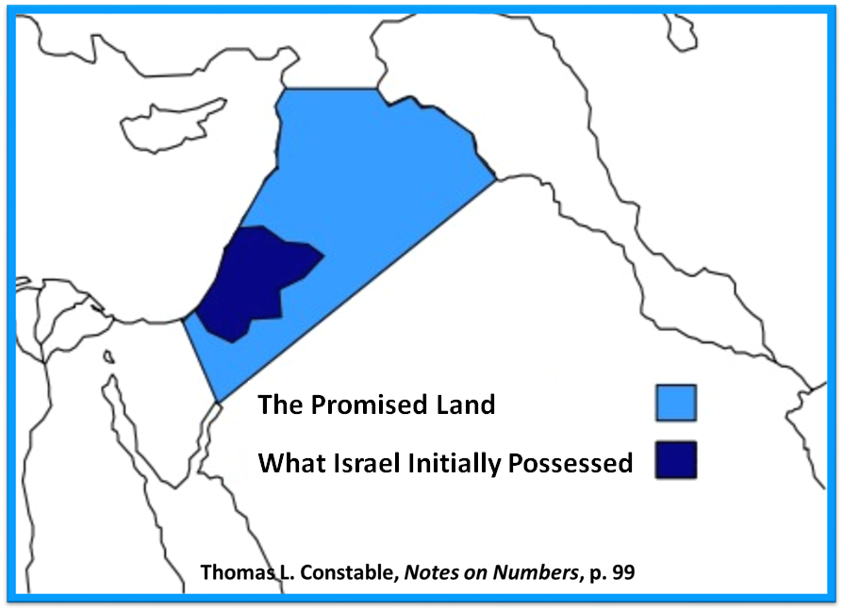

Slide 82
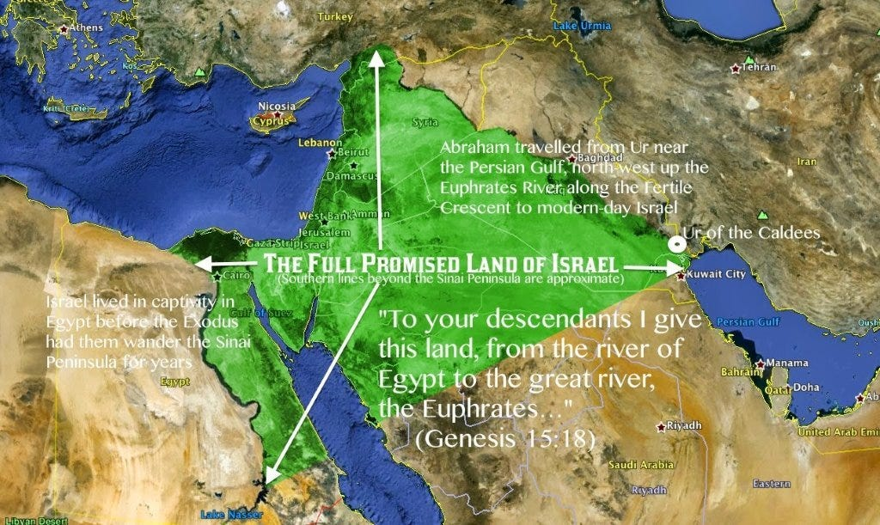

Slide 84
II. Genesis 50:4-14 Jacob’s Burial
Joseph’s request (4-5)
Request granted (6)
Funeral procession (7-9)
Arrival (10-11)
Jacob’s burial (12-13)
Return to Egypt (14)

Slide 85
Genesis 50:14 Return to Egypt
Timing (14a)
Group (14b)

Slide 86
Genesis 50:14 Return to Egypt
Timing (14a)
Group (14b)

Slide 87
Genesis 50:14 Return to Egypt
Timing (14a)
Group (14b)

Slide 91
Genesis 50:1-26 Death & Burial of Jacob & Joseph
Events following Jacob’s death (1-3)
Jacob’s burial (4-14)
Brothers’ fear & Joseph’s reassurance (15-21)
Joseph’s death (22-26)

Slide 92
III. Genesis 50:15-21 Brothers’ Fear & Joseph’s Reassurance
Brothers’ fear (15)
Brothers’ message to Joseph (16-17a)
Joseph’s response (17b)
Brothers’ submission (18)
Joseph’s comfort (19-21)

Slide 93
III. Genesis 50:15-21 Brothers’ Fear & Joseph’s Reassurance
Brothers’ fear (15)
Brothers’ message to Joseph (16-17a)
Joseph’s response (17b)
Brothers’ submission (18)
Joseph’s comfort (19-21)

Slide 94
Genesis 50:15 Brothers’ Fear
Timing (15a)
Fear stated (15b)

Slide 95
Genesis 50:15 Brothers’ Fear
Timing (15a)
Fear stated (15b)

Slide 96
Genesis 50:15 Brothers’ Fear
Timing (15a)
Fear stated (15b)

Slide 97
III. Genesis 50:15-21 Brothers’ Fear & Joseph’s Reassurance
Brothers’ fear (15)
Brothers’ message to Joseph (16-17a)
Joseph’s response (17b)
Brothers’ submission (18)
Joseph’s comfort (19-21)

Slide 98
Genesis 50:16-17a Brothers’ Message to Joseph
Made up command (16)
Command stated (17a)

Slide 99
Genesis 50:16-17a Brothers’ Message to Joseph
Made up command (16)
Command stated (17a)

Slide 100
Genesis 50:16-17a Brothers’ Message to Joseph
Made up command (16)
Command stated (17a)

Slide 101
III. Genesis 50:15-21 Brothers’ Fear & Joseph’s Reassurance
Brothers’ fear (15)
Brothers’ message to Joseph (16-17a)
Joseph’s response (17b)
Brothers’ submission (18)
Joseph’s comfort (19-21)

Slide 102
Luke 19:41-44
^{41 “}When He approached Jerusalem, He saw the city and wept over it, ⁴² saying, “If you had known in this day, even you, the things which make for peace! But now they have been hidden from your eyes. ⁴³ For the days will come upon you when your enemies will throw up a barricade against you, and surround you and hem you in on . . .

Slide 103
III. Genesis 50:15-21 Brothers’ Fear & Joseph’s Reassurance
Brothers’ fear (15)
Brothers’ message to Joseph (16-17a)
Joseph’s response (17b)
Brothers’ submission (18)
Joseph’s comfort (19-21)

Slide 104
Genesis 50:18 Brothers’ Submission
Homage (18a)
Declaration (18b)

Slide 105
Genesis 50:18 Brothers’ Submission
Homage (18a)
Declaration (18b)

Slide 106
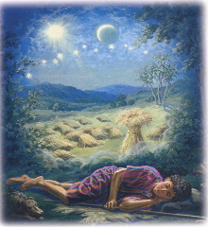
Genesis 37:9
Now he had still another dream, and related it to his brothers, and said, “Lo, I have had still another dream; and behold, the sun and the moon and eleven stars were bowing down to me.”

Slide 107
Genesis 37:10
He related it to his father and to his brothers; and his father rebuked him and said to him, “What is this dream that you have had? Shall I and your mother and your brothers actually come to bow ourselves down before you to the ground?”

Slide 108
Sun = Jacob
Moon = Leah
11 Stars = Joseph’s brothers
12th Star = Joseph
12 Stars = Israel’s twelve tribes

Slide 109
Genesis 50:18 Brothers’ Submission
Homage (18a)
Declaration (18b)

Slide 111
III. Genesis 50:15-21 Brothers’ Fear & Joseph’s Reassurance
Brothers’ fear (15)
Brothers’ message to Joseph (16-17a)
Joseph’s response (17b)
Brothers’ submission (18)
Joseph’s comfort (19-21)

Slide 112
Genesis 50:19-21 Joseph’s Comfort
Basis (19)
God’s providence (20)
Joseph’s further comfort (21)

Slide 113
Genesis 50:19-21 Joseph’s Comfort
Basis (19)
God’s providence (20)
Joseph’s further comfort (21)

Slide 114
Genesis 50:19-21 Joseph’s Comfort
Basis (19)
God’s providence (20)
Joseph’s further comfort (21)

Slide 115
Genesis 50:20 God’s Providence
Man’s plan (20a)
God’s plan (20b)

Slide 116
Genesis 50:20 God’s Providence
Man’s plan (20a)
God’s plan (20b)

Slide 117
Mark 7:20–23
²⁰ And He was saying, “That which proceeds out of the man, that is what defiles the man. ²¹ “For from within, out of the heart of men, proceed the evil thoughts, fornications, thefts, murders, adulteries, ²² deeds of coveting and wickedness, as well as deceit, sensuality, envy, slander, pride and foolishness. ²³ “All these evil things proceed from within and defile the man.”

Slide 118
Romans 8:19-22
¹⁹ For the anxious longing of the creation waits eagerly for the revealing of the sons of God. ²⁰ For the creation was subjected to futility, not willingly, but because of Him who subjected it, in hope ²¹ that the creation itself also will be set free from its slavery to corruption into the freedom of the glory of the children of God. ²² For we know that the whole creation groans and suffers the pains of childbirth together until now.

Slide 119
Genesis 50:20 God’s Providence
Man’s plan (20a)
God’s plan (20b)

Slide 120
Three Tenses of Salvation
Phase | Justification | Sanctification | Glorification
Tense | Past | Present | Future
Saved from sin’s: | Penalty | Power | Presence
Scripture | Eph 2:8-9; Titus 3:5 | Philip 2:12 | Rom 5:10

Slide 121
Genesis 50:19-21 Joseph’s Comfort
Basis (19)
God’s providence (20)
Joseph’s further comfort (21)

Slide 122
2 Peter 1:5-7
⁵ Now for this very reason also, applying all diligence, in your faith supply moral excellence, and in your moral excellence, knowledge, ⁶ and in your knowledge, self-control, and in your self-control, perseverance, and in your perseverance, godliness, ⁷ and in your godliness, brotherly kindness, and in your brotherly kindness, love.

Slide 123
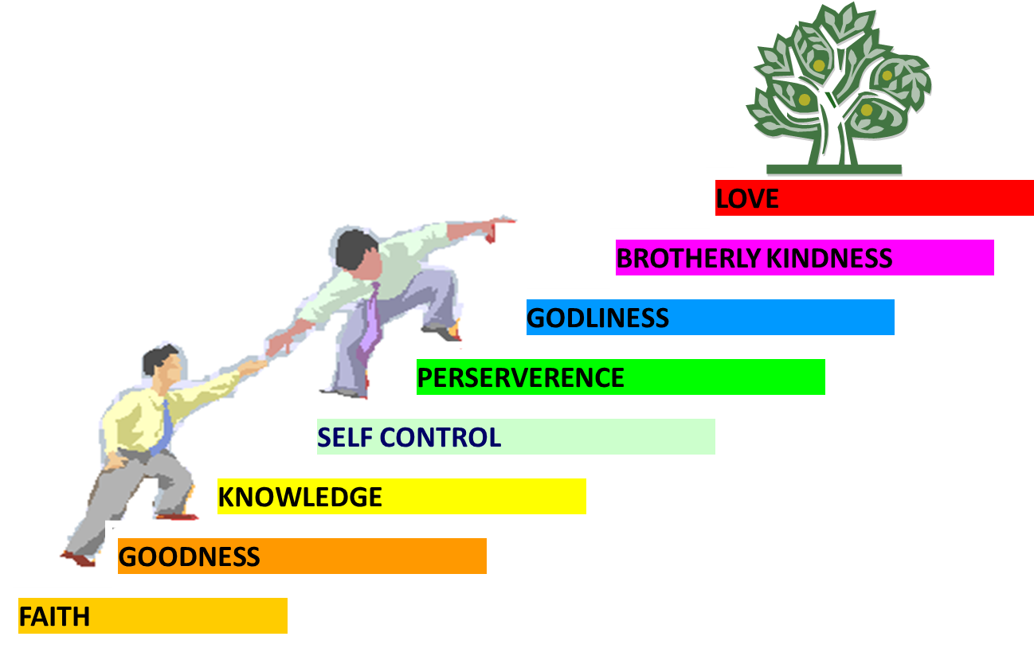
PORTRAIT OF GROWTH 1:5-7

Slide 124
Genesis 50:1-26 Death & Burial of Jacob & Joseph
Events following Jacob’s death (1-3)
Jacob’s burial (4-14)
Brothers’ fear & Joseph’s reassurance (15-21)
Joseph’s death (22-26)

Slide 125
IV. Genesis 50:22-26 Joseph’s Death
Joseph’s lifespan (22)
Joseph’s seed (23)
Joseph’s charge (24-25)
Joseph’s death (26)

Slide 126
IV. Genesis 50:22-26 Joseph’s Death
Joseph’s lifespan (22)
Joseph’s seed (23)
Joseph’s charge (24-25)
Joseph’s death (26)

Slide 127
Genesis 50:22 Joseph’s Lifespan
Place (22a)
Years (22b)

Slide 128
Genesis 50:22 Joseph’s Lifespan
Place (22a)
Years (22b)

Slide 129
Genesis 50:22 Joseph’s Lifespan
Place (22a)
Years (22b)

Slide 130
Dr. Arnold G. Fruchtenbaum
The Book of Genesis, 660-61
“Moreover, living up to 110 was considered a very ideal age for an Egyptian, in fact, so ideal that in Ancient Egyptian Texts there are twenty-seven references to this age. For example, in the Inscriptions of Vizier Ptah Hotep, who held the same position that Joseph did, states: ‘What I have done on earth is not inconsiderable. I attained 110 years of life which the king gave me, with favor foremost among the ancestors through doing right for the King up to the point of veneration.’”

Slide 131
IV. Genesis 50:22-26 Joseph’s Death
Joseph’s lifespan (22)
Joseph’s seed (23)
Joseph’s charge (24-25)
Joseph’s death (26)

Slide 132
Genesis 50:23 Joseph’s Seed
Ephraim (23a)
Manasseh (23b)

Slide 133
Genesis 50:23 Joseph’s Seed
Ephraim (23a)
Manasseh (23b)

Slide 134
Genesis 50:23 Joseph’s Seed
Ephraim (23a)
Manasseh (23b)

Slide 135
IV. Genesis 50:22-26 Joseph’s Death
Joseph’s lifespan (22)
Joseph’s seed (23)
Joseph’s charge (24-25)
Joseph’s death (26)

Slide 136
Genesis 50:24-25 Joseph’s Charge
Prediction of his death (24a)
Prediction of return to Canaan (24b)
Oath (25)

Slide 137
Genesis 50:24-25 Joseph’s Charge
Prediction of his death (24a)
Prediction of return to Canaan (24b)
Oath (25)

Slide 138
Genesis 50:24-25 Joseph’s Charge
Prediction of his death (24a)
Prediction of return to Canaan (24b)
Oath (25)

Slide 139
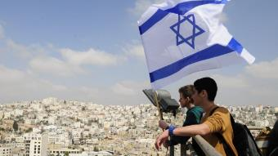
Reliability of the “Divine Regathering” Predictions
 | RETURN | PREDICTED | FULFILLED
1st | From Egypt to Canaan | Gen. 15:13-14 | Joshua 1‒12
2nd | From Babylon to Israel | Jer. 25:11; 29:10 | Ezra & Nehemiah
3rd | From the Diaspora to Israel’s restoration | Ezekiel 36:24-28 | Millennial Kingdom

Slide 140
Genesis 15:18-21
¹⁸ On that day the Lord made a covenant with Abram, saying, “To your descendants I have given this land, From the river of Egypt as far as the great river, the river Euphrates: ¹⁹ the Kenite and the Kenizzite and the Kadmonite ²⁰ and the Hittite and the Perizzite and the Rephaim ²¹ and the Amorite and the Canaanite and the Girgashite and the Jebusite.”

Slide 141
Evidence of Abrahamic Covenant’s Unconditional Nature
ANE covenant ratification ceremony (Gen 15)
Lack of stated conditions for Israel’s obedience (Gen 15)
Covenant's eternality (Gen 17:7, 13, 19; Ps. 90:2)
Covenant's immutability (Heb 6:13-18; Mal. 3:6)
Trans-generational reaffirmation despite perpetual national disobedience (Jer 31:35-37)
Walvoord, The Millennial Kingdom, 149-52

Slide 143
Genesis 50:24-25 Joseph’s Charge
Prediction of his death (24a)
Prediction of return to Canaan (24b)
Oath (25)

Slide 146
IV. Genesis 50:22-26 Joseph’s Death
Joseph’s lifespan (22)
Joseph’s seed (23)
Joseph’s charge (24-25)
Joseph’s death (26)

Slide 147
Genesis 50:26 Joseph’s Death
Age (26a)
Burial (26b)

Slide 148
Genesis 50:26 Joseph’s Death
Age (26a)
Burial (26b)

Slide 149
Genesis 50:26 Joseph’s Death
Age (26a)
Burial (26b)

Slide 150
Conclusion

Slide 151
Genesis 50:1-26 Death & Burial of Jacob & Joseph
Events following Jacob’s death (1-3)
Jacob’s burial (4-14)
Brothers’ fear & Joseph’s reassurance (15-21)
Joseph’s death (22-26)

Slide 152
²⁴ The Lord bless you, and keep you; ²⁵ The Lord make His face shine on you, And be gracious to you; ²⁶ The Lord lift up His countenance on you, And give you peace.
Numbers 6:24–26 (NASB95)

