Slide 1
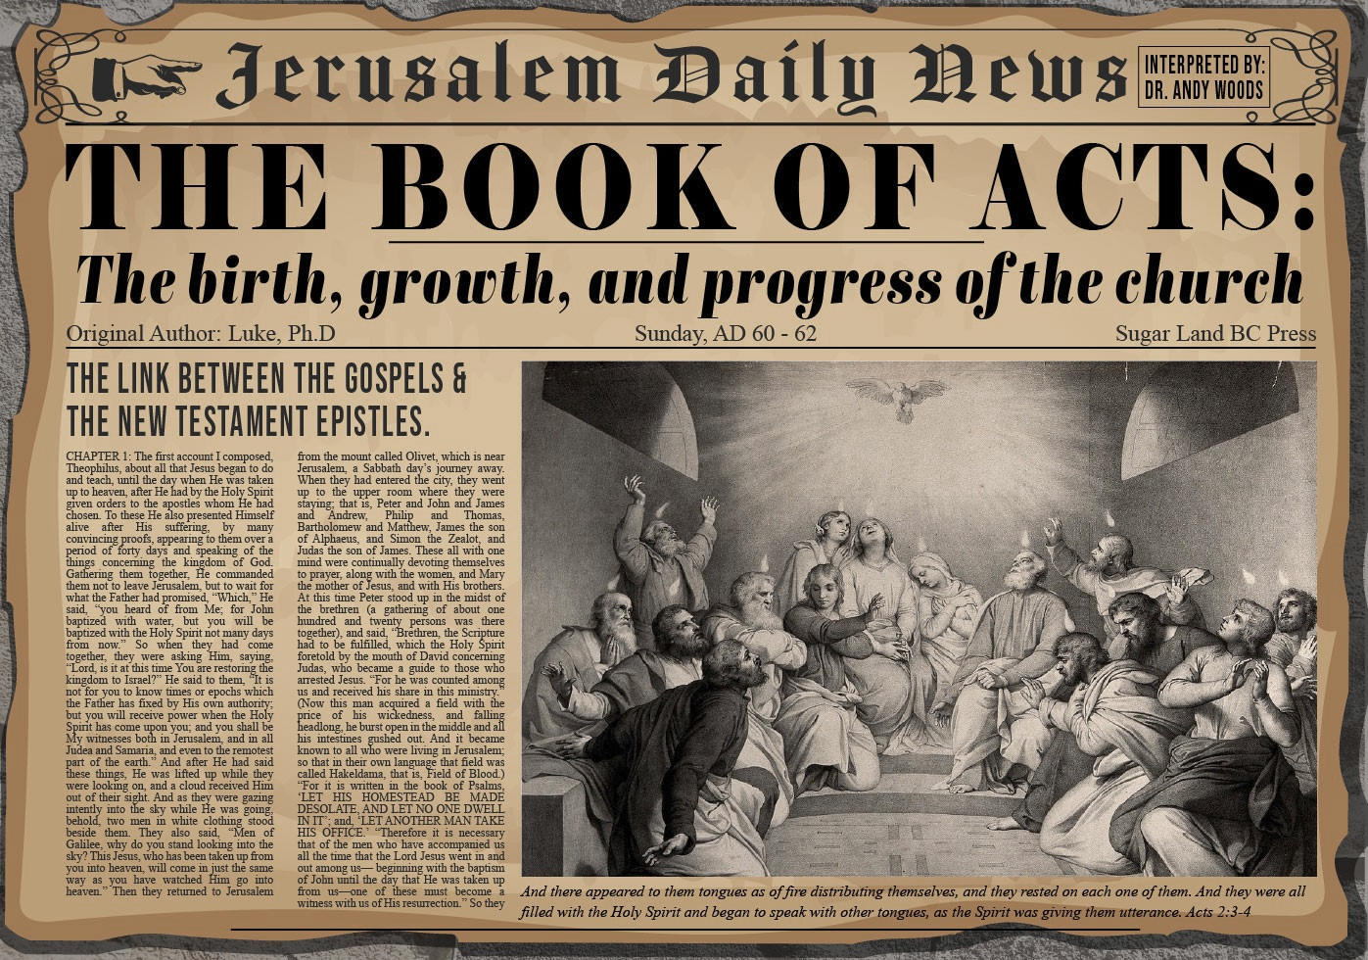


Slide 2
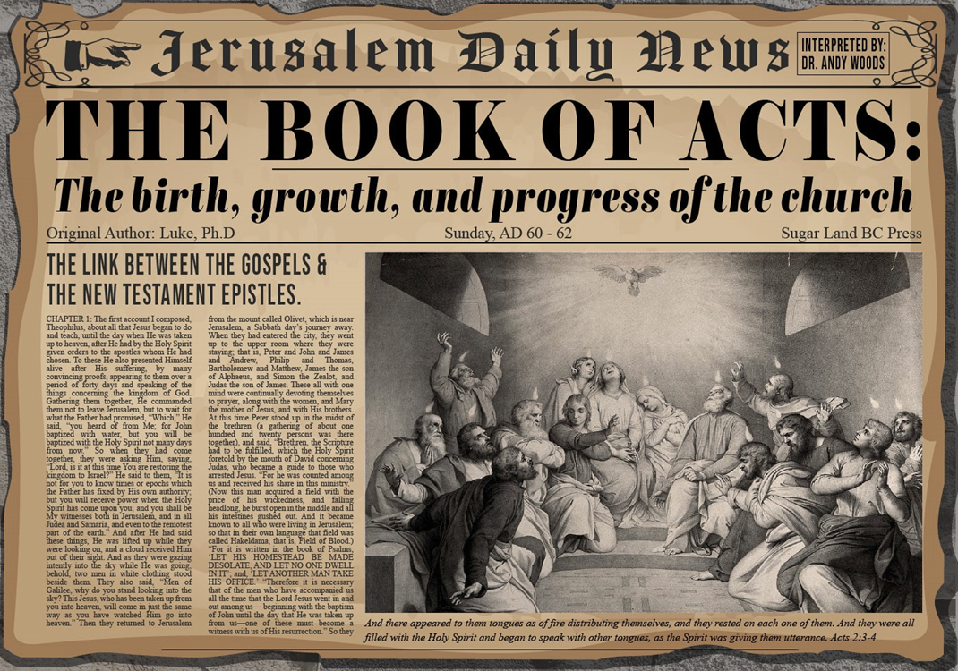
Acts 12:1-25
4th Persecution of Jerusalem Church
  James’ Death (12:1-2)
  Peter’s imprisonment (12:3-5)
  Peter’s Deliverance (12:6-17)
  Results of Peter’s Escape (12:18-25)

Slide 3
III. Peter’s Deliverance
Acts 12:6-17
  Peter’s escape (6-11)
  Peter’s arrival at Mary’s house (12-17)

Slide 4
Acts 12:12-17
Peter’s Arrival at Mary’s House
      Peter arrives at Mary’s house (12)
      Peter and Rhoda (13-15)
      Peter’s meeting with the disciples (16-17)

Slide 5
Acts 12:12-17
Peter’s Arrival at Mary’s House
      Peter arrives at Mary’s house (12)
      Peter and Rhoda (13-15)
      Peter’s meeting with the disciples (16-17)

Slide 6

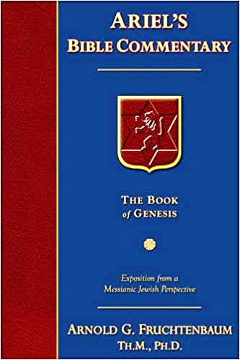
Dr. Arnold G. Fruchtenbaum
The Book of Acts, 273-74
“John Mark played a minor role in the book of Acts, but a major role in the history of the church in that he wrote the Gospel of Mark. He had two names: John, which in Hebrew is Yochanan, and Mark or Marcus, his Latin name. He probably also had a Greek name, but it was not given. According to Colossians 4:10, John Mark was a cousin of Barnabas. He was best known among the Romans, and it was for them that he wrote his Gospel. This is also the reason that he was better known by his Latin name, Mark, rather than his Jewish name of Yochanan (or John).”

Slide 7
Dr. Arnold G. Fruchtenbaum
The Book of Acts, 273-74
“John Mark appears a total of eight times in the New Testament: Acts 12:12, 25; 15:37, 39; Colossians 4:10; II Timothy 4:11; Philemon 24; and I Peter 5:13. In I Peter 5:13, Peter referred to Mark as his ‘son,’ which means Peter was the one who led Mark to the Lord. Subsequently, Mark became his disciple.”

Slide 8
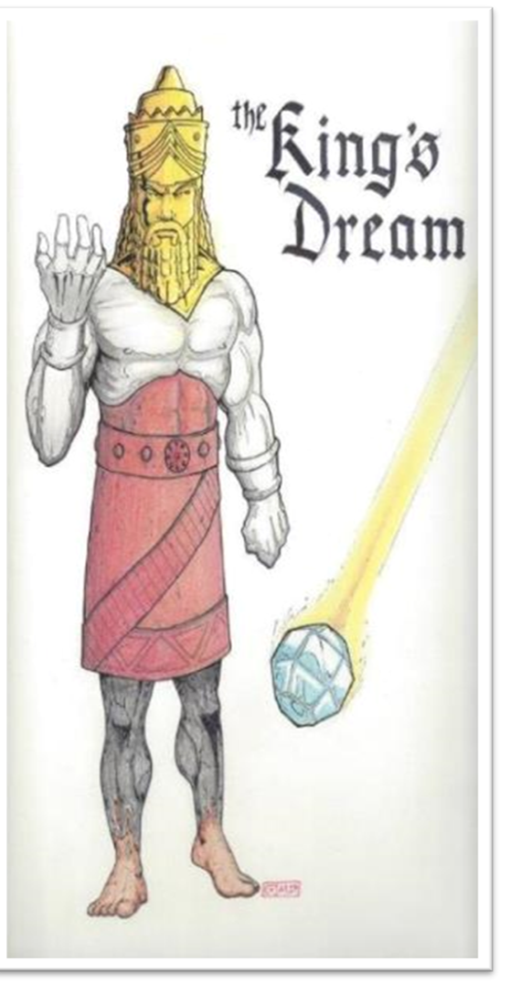

Slide 9
Acts 12:12-17
Peter’s Arrival at Mary’s House
      Peter arrives at Mary’s house (12)
      Peter and Rhoda (13-15)
      Peter’s meeting with the disciples (16-17)

Slide 10
Acts 12:13-15
Peter and Rhoda
      Peter knocks (13)
      Rhoda’s report to the apostles (14)
      Disciples’ unbelieving response (15)

Slide 11
Acts 12:13-15
Peter and Rhoda
      Peter knocks (13)
      Rhoda’s report to the apostles (14)
      Disciples’ unbelieving response (15)

Slide 12
Acts 12:13-15
Peter and Rhoda
      Peter knocks (13)
      Rhoda’s report to the apostles (14)
      Disciples’ unbelieving response (15)

Slide 13
Acts 12:13-15
Peter and Rhoda
      Peter knocks (13)
      Rhoda’s report to the apostles (14)
      Disciples’ unbelieving response (15)

Slide 14
Acts 12:12-17
Peter’s Arrival at Mary’s House
      Peter arrives at Mary’s house (12)
      Peter and Rhoda (13-15)
      Peter’s meeting with the disciples (16-17)

Slide 15
Acts 12:16-17
Peter’s Meeting with the Apostles
      Disciples’ realization (16)
      Peter’s explanation & charge (17a)
      Peter’s departure (17b)

Slide 16
Acts 12:16-17
Peter’s Meeting with the Apostles
      Disciples’ realization (16)
      Peter’s explanation & charge (17a)
      Peter’s departure (17b)

Slide 17
Acts 12:16-17
Peter’s Meeting with the Apostles
      Disciples’ realization (16)
      Peter’s explanation & charge (17a)
      Peter’s departure (17b)

Slide 18
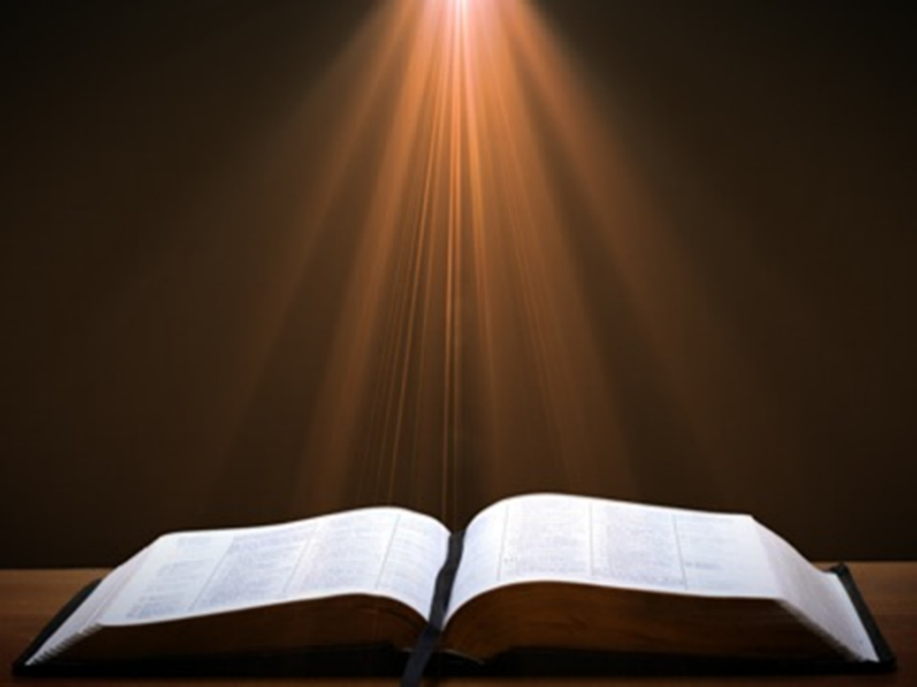
Acts 1:13-14
“¹³ When they had entered the city, they went up to the upper room where they were staying; that is, Peter and John and James and Andrew, Philip and Thomas, Bartholomew and Matthew, James the son of Alphaeus, and Simon the Zealot, and Judas the son of James. ¹⁴ These all with one mind were continually devoting themselves to prayer, along with the women, and Mary the mother of Jesus, and with His brothers.”

Slide 19
Acts 12:16-17
Peter’s Meeting with the Apostles
      Disciples’ realization (16)
      Peter’s explanation & charge (17a)
      Peter’s departure (17b)

Slide 20
Dr. Arnold G. Fruchtenbaum
The Book of Acts, 276
“After having spoken to the disciples, Peter departed, and went to another place (v. 17b). He fled out of Jerusalem. Luke chose not to disclose where Peter went, but we do know something about Peter’s travels from other passages. According to I Corinthians 9:5, he had an itinerant ministry; according to I Corinthians 1:12, he spent some time in Corinth; according to Galatians 2:11, he was in Antioch of Pisidia; according to I Peter 1:1, he was in Asia Minor; and according to I Peter 5:13, he was in Babylon.”

Slide 21

Galatians 2:7-8
“⁷ But on the contrary, seeing that I had been entrusted with the gospel to the uncircumcised, just as Peter had been to the circumcised ⁸ (for He who effectually worked for Peter in his apostleship to the circumcised effectually worked for me also to the Gentiles).”

Slide 22
From Peter to Paul
REFERENCE | CENTER | PERSON | PLACE | OUTREACH
Acts 1–12 | Jerusalem | Peter | Jerusalem, Judea, Samaria | Jewish
Acts 13–28 | Antioch | Paul | Uttermost parts | Gentiles

Slide 23
From Peter to Paul
PETER | PAUL
Heals a man lame from birth (3:1-11) | Heals a man lame from birth (14:8-18)
Heals by shadow (5:15-16) | Heals by handkerchief (19:11-12)
Success is a cause of jealousy (5:17) | Success is a cause of jealousy (13:45)
Confronts a sorcerer (8:9-24) | Confronts a sorcerer (13:6-11)
Raises Dorcas (9:36-41) | Raises Eutychus (20:9-12)
Jailed and miraculously freed (12:3-19) | Jailed and miraculously freed (16:25-34)

Slide 24
Acts 12:1-25
4th Persecution of Jerusalem Church
  James’ Death (12:1-2)
  Peter’s imprisonment (12:3-5)
  Peter’s Deliverance (12:6-17)
  Results of Peter’s Escape (12:18-25)

Slide 25
IV. Results of Peter’s Escape
Acts 12:18-25
  On Herod (18-23)
  On the Church (24-25)

Slide 26
IV. Results of Peter’s Escape
Acts 12:18-25
  On Herod (18-23)
  On the Church (24-25)

Slide 27
Acts 12:18-23
On Herod
      Soldiers’ reaction (18)
      Herod’s reaction (19)
      Herod’s death (20-23)

Slide 28
Acts 12:18-23
On Herod
      Soldiers’ reaction (18)
      Herod’s reaction (19)
      Herod’s death (20-23)

Slide 29
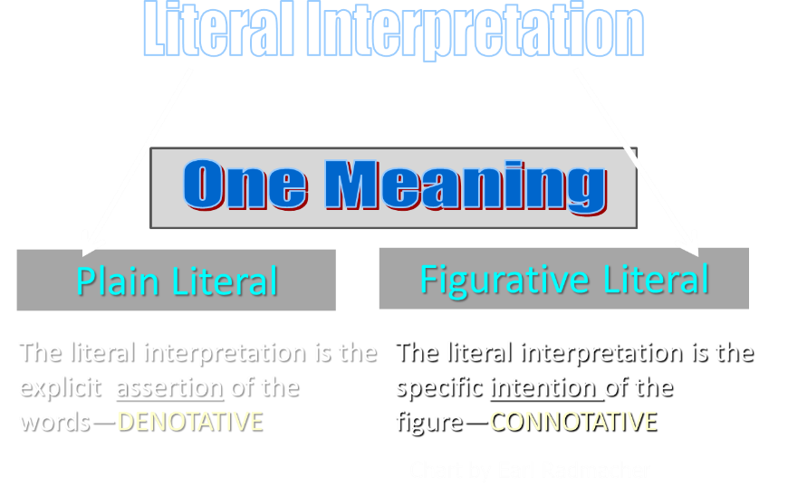

Slide 30
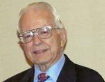

Dr. Roy B. Zuck
Basic Bible Interpretation, p.156-57.
“Litotes. A litotes is an understatement or a negative statement to express an affirmation. This is the opposite of hyperbole. When we say, ‘He is not a bad preacher,’ we mean he is a very good preacher. The understatement is made for emphasis. When Paul wrote, ‘I am a Jew … a citizen of no insignificant city’ (Acts 21:39, nasb), he meant that Tarsus was in fact a rather significant city. A litotes is at times a belittling statement, as in Numbers 13:33, ‘We seemed like grasshoppers in our own eyes, and we looked the same to them.’ Luke used a number of litotes. He spoke of ‘no small disturbance among the soldiers’ (Acts 12:18, nasb), ‘no little business’ (19:24), and ‘no small storm’ (27:20, nasb).”

Slide 31
Dr. Roy B. Zuck
Basic Bible Interpretation, p.156-57.
“When Luke wrote that Paul and Barnabas stayed in Antioch ‘a long time’ (14:28), the Greek has a litotes. It is literally, ‘they stayed there not a little time.’ Paul belittled himself with a litotes in 1 Corinthians 15:9, ‘For I am the least of the apostles.’ This statement of genuine humility was written to highlight God’s grace in his life as an undeserving sinner (see v. 10).”

Slide 32
Acts 12:18-23
On Herod
      Soldiers’ reaction (18)
      Herod’s reaction (19)
      Herod’s death (20-23)

Slide 33
Acts 12:19
Herod’s Reaction
      Examination of the soldiers (19a)
      Execution of the soldiers (19b)
      Departure to Caesarea (19c)

Slide 34
Acts 12:19
Herod’s Reaction
      Examination of the soldiers (19a)
      Execution of the soldiers (19b)
      Departure to Caesarea (19c)

Slide 35
Acts 12:19
Herod’s Reaction
      Examination of the soldiers (19a)
      Execution of the soldiers (19b)
      Departure to Caesarea (19c)

Slide 36
Naturalistic Theories
Swoon theory
Theft theory
Hallucination theory
Wrong tomb theory

Slide 37

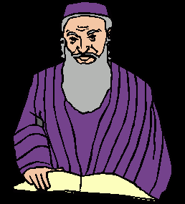
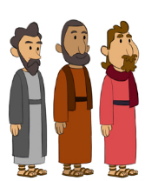
2. Theft Theories
Rome
Jews
Disciples

Slide 38
How Does Jesus Compare?
Deity | Tomb Status
Confucius | Occupied
Buddha | Occupied
Mohammed | Occupied
Jesus | ***EMPTY***
G.B. Hardy, Countdown

Slide 39
Acts 12:19
Herod’s Reaction
      Examination of the soldiers (19a)
      Execution of the soldiers (19b)
      Departure to Caesarea (19c)

Slide 40
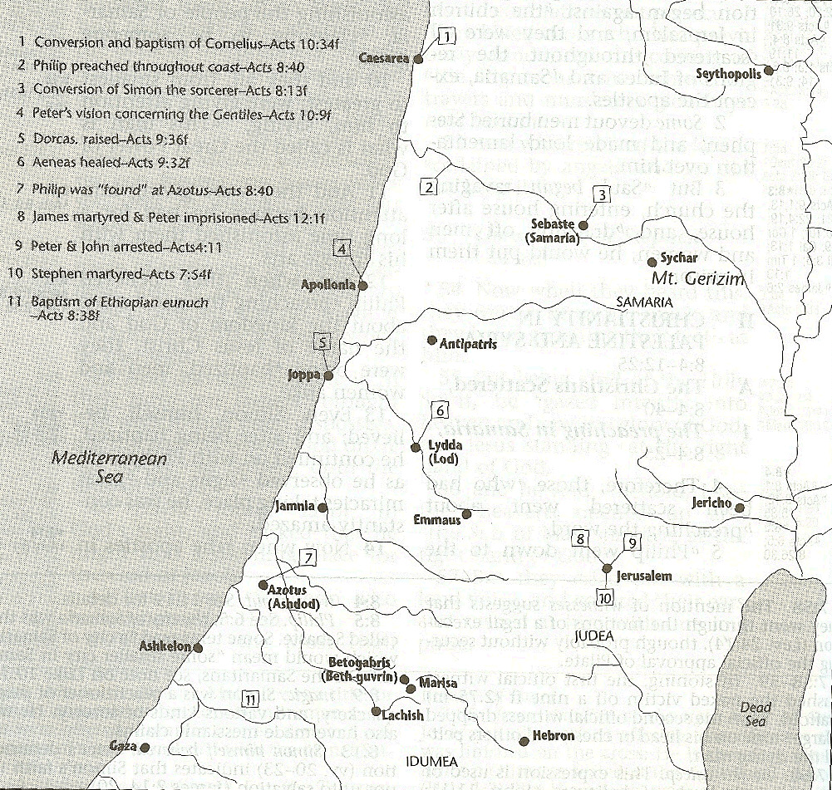



Slide 41
Dr. Arnold G. Fruchtenbaum
The Book of Acts, 277
“It was then that Herod went down from Judea to Caesarea, and tarried there. This was also a standard procedure for the ruler of Judea following the Passover. Once again Luke proved his Jewishness by showing that from Jerusalem one always goes down. The king tarried in Caesarea because the city was the political capital and Roman headquarters for Judea.”

Slide 42
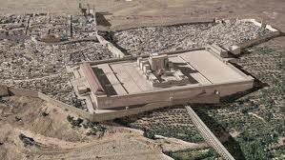
Christ’s Five Trips to Jerusalem
Feast | Verse
Passover | 2:23
Unnamed | 5:1
Tabernacles | 7:2
Dedication | 10:22
Passover | 13:1

Slide 43
Acts 12:18-23
On Herod
      Soldiers’ reaction (18)
      Herod’s reaction (19)
      Herod’s death (20-23)

Slide 44
Acts 12:20-23
Herod’s Death
      Herod’s displeasure with Tyre & Sidon (20)
      Herod’s speech at the Festival (21)
      Response of the people (22)
      Judgment upon Herod (23)

Slide 45
Acts 12:20-23
Herod’s Death
      Herod’s displeasure with Tyre & Sidon (20)
      Herod’s speech at the Festival (21)
      Response of the people (22)
      Judgment upon Herod (23)

Slide 46
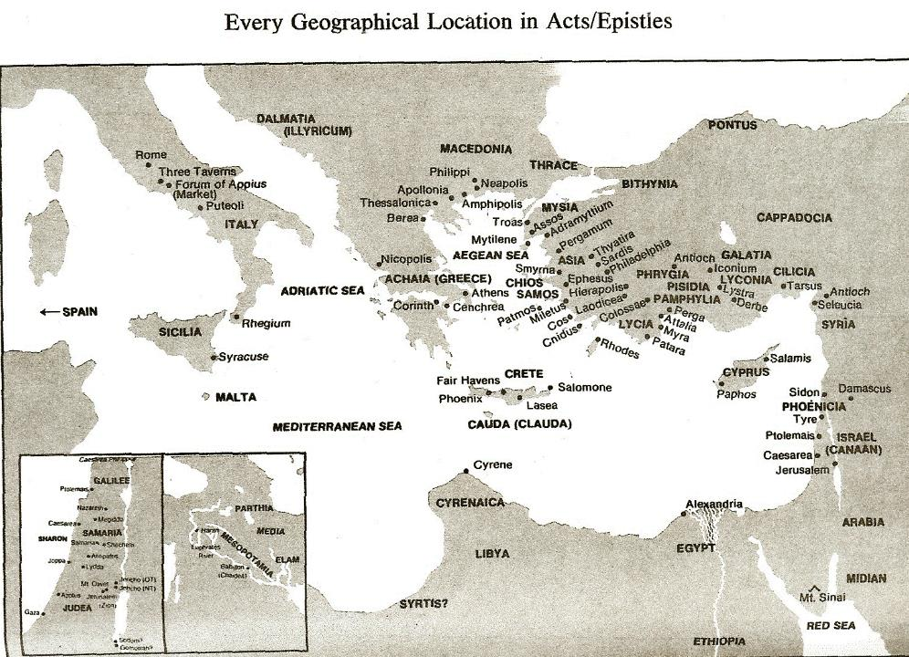

Slide 47
Acts 12:20-23
Herod’s Death
      Herod’s displeasure with Tyre & Sidon (20)
      Herod’s speech at the Festival (21)
      Response of the people (22)
      Judgment upon Herod (23)

Slide 48
Acts 12:20-23
Herod’s Death
      Herod’s displeasure with Tyre & Sidon (20)
      Herod’s speech at the Festival (21)
      Response of the people (22)
      Judgment upon Herod (23)

Slide 49
Acts 12:20-23
Herod’s Death
      Herod’s displeasure with Tyre & Sidon (20)
      Herod’s speech at the Festival (21)
      Response of the people (22)
      Judgment upon Herod (23)

Slide 50
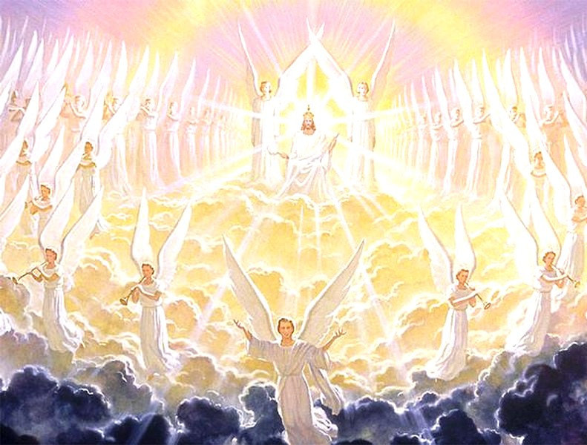
Activities of the Angels
PAST
    Witnessed creation (Job 38:7)
    Brought judgment (Gen 19:22; Acts 12:22-23)
    Accompanied the Law (Gal 3:19)
    Announced births of John and Christ (Luke 1:11-13, 26-27)
    Strengthened Christ (Matt 4:11)
    Announced resurrection (Matt 28:1-7)
    Observed Ascension (Acts 1:11)
    Brought messages (Luke 1:13)

Slide 51
Activities of the Angels
FUTURE
    Rapture (1 Thess. 4:16)
    Judged by humans (1 Cor 6:3)
    Tribulation judgments (Rev 8:2; 16:1)
    Return of Christ (Matt 24:31; 25:31)
    Bind Satan (Rev 20:1-2)

Slide 52
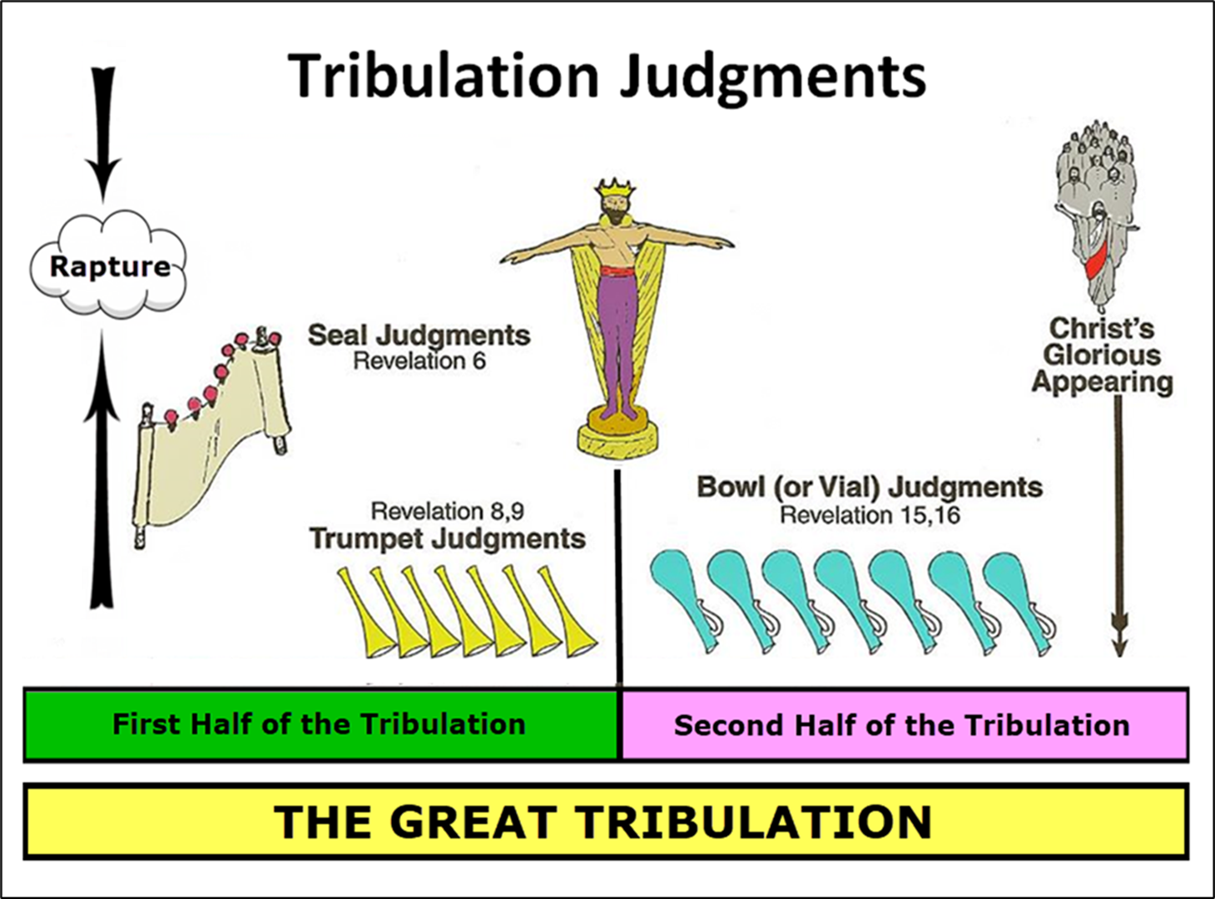

Slide 53
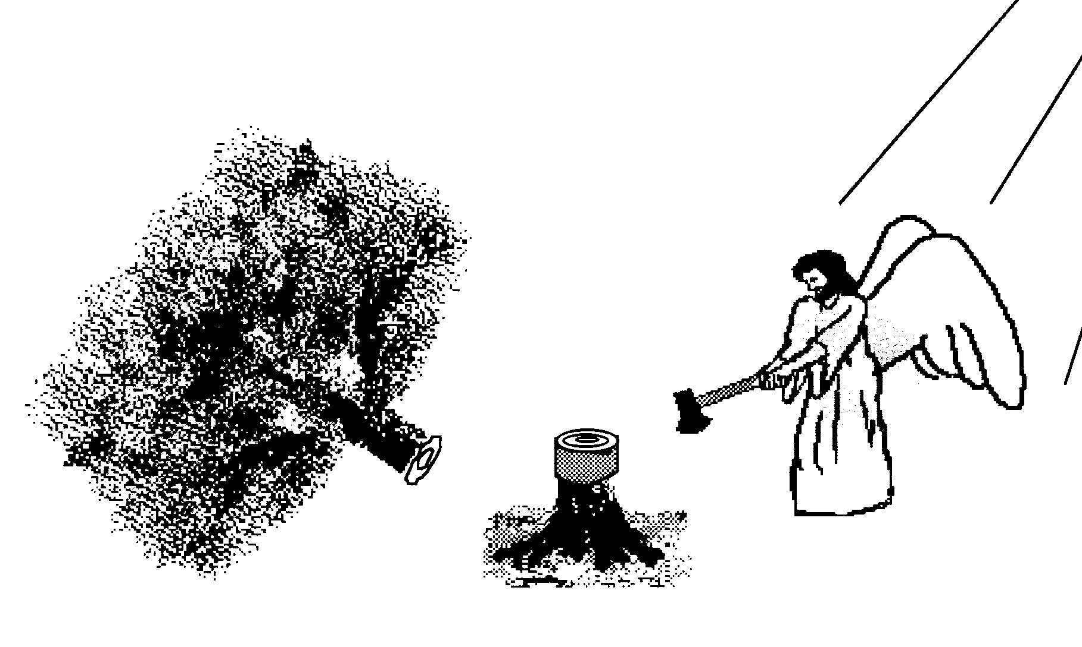
Scripture and Pride
Prov 16:18
Isa 14:12-15; Ezek 28:12-17
1 Tim 3:6
Acts 12:21-23
2 Cor 12:7
1 Pet 5:5

Slide 54
Hall of the Humbled
(Prov. 16:18; 1 Peter 5:5)
Satan (Isa. 14:12-15; Ezek. 28:12-17; 1 Tim. 3:6)
Uzziah (2 Chron. 26:16)
Herod (Acts 12:20-23)
Paul (2 Cor. 12:1-10)

Slide 55
Dr. Arnold G. Fruchtenbaum
The Book of Acts, 278-79
“As a result, Agrippa was eaten of worms. The Greek expression is genomenos skōlēkobrōtos and literally means ‘becoming worm-eaten.’ Robertson notes: ‘The word skóléx was used of intestinal worms and Herodotus . . . describes Pheretima, Queen of Cyrene, as having swarms of worms which ate her flesh while still alive.’ In other words, Agrippa died of acute intestinal problems. This was not an uncommon way for someone to die in ancient times. Josephus described the death as occurring five days after the painful stomach condition started, stating ‘that the rotting of his flesh produced worms, an item in harmony with the narrative of Luke.’”

Slide 56
IV. Results of Peter’s Escape
Acts 12:18-25
  On Herod (18-23)
  On the Church (24-25)

Slide 57
Acts 12:24-25
On the Church
      Progress report (24)
      Paul & Barnabas return to Antioch (25)

Slide 58
Acts 12:24-25
On the Church
      Progress report (24)
      Paul & Barnabas return to Antioch (25)

Slide 59
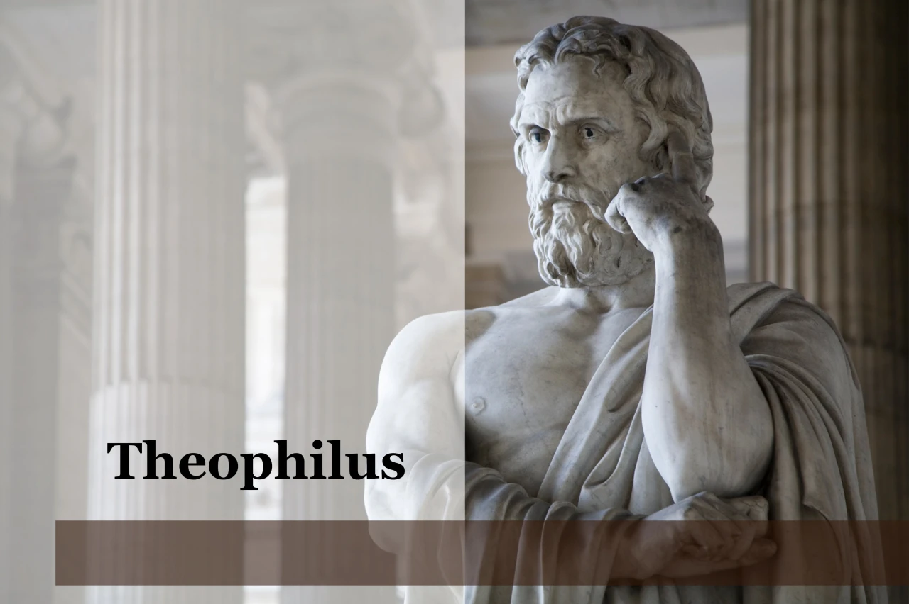
Purpose
  To present Theophilus with an orderly account of the birth and growth of the church so as to affirm him in what he has believed.

Slide 60

Message
  Birth and growth of the church numerically, geographically, ethnically.
  Components
  Numerically (progress reports)
  Geographically (From Jerusalem to Rome)
  Ethnically (From Judaism to Gentile domination)

Slide 61
Progress Reports
  Clearest: Acts 2:47; 6:7; 9:31; 12:24; 16:5; 19:20; 28:30-31
  Less clear: Acts 1:13, 15; 2:41, 47; 4:4, 31; 5:14, 42; 8:25, 40; 11:21; 13:49; 17:6

Slide 62
Acts 12:24-25
On the Church
      Progress report (24)
      Paul & Barnabas return to Antioch (25)

Slide 64
Conclusion

Slide 65
Acts 12:1-25
4th Persecution of Jerusalem Church
  James’ Death (12:1-2)
  Peter’s Imprisonment (12:3-5)
  Peter’s Deliverance (12:6-17)
  Results of Peter’s Escape (12:18-25)

