Slide 1
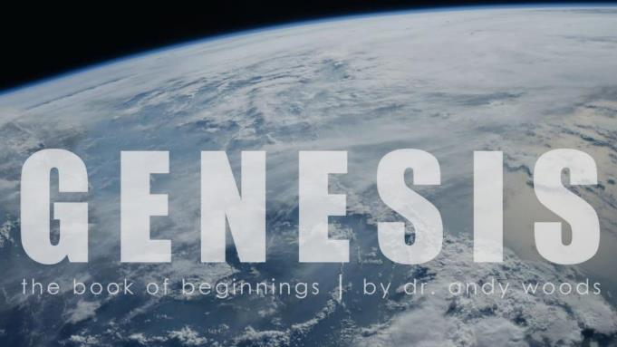
Genesis 12‒50
Israel’s Birth & Preservation

Slide 2
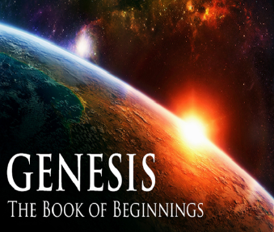
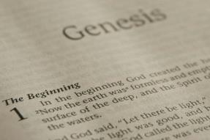
GENESIS STRUCTURE
Genesis 12-50 (four people)
Abraham (12:1–25:11)
Isaac (25:12–26:35)
Jacob (27–36)
Joseph (37–50)

Slide 3
Genesis 37‒50 Joseph
Joseph sold unto Egypt (37)
Canaan’s corruption (38)
Joseph falsely accused (39)
Joseph’s short-term predictions (40)
Joseph’s elevation (41)
Joseph’s first reunion with his brothers (42)
Joseph’s second reunion with his brothers (43‒45)
Joseph’s second reunion with his brothers (43‒45)
Sojourn to Egypt (46:1‒47:12)
Famine’s course (47:13-26)
Jacob in Egypt (47:27-31)
Jacob blesses Joseph’s sons (48)
Jacob blesses his sons (49)

Slide 4
Genesis 49:1-33 Jacob Blesses His Sons
Call (49:1)
Introduction (49:2)
Jacob’s blessings on his sons (49:3-27)
Concluding summary (49:28)
Jacob’s death (49:29-33)

Slide 5
V. Genesis 49:29-33 Jacob’s Death
Charge (29a)
Announcement of death (29b)
Request (29c)
Place of burial (29d-30)
Others buried there (31)
Burial place repeated (32)
Jacob’s death (33)

Slide 7
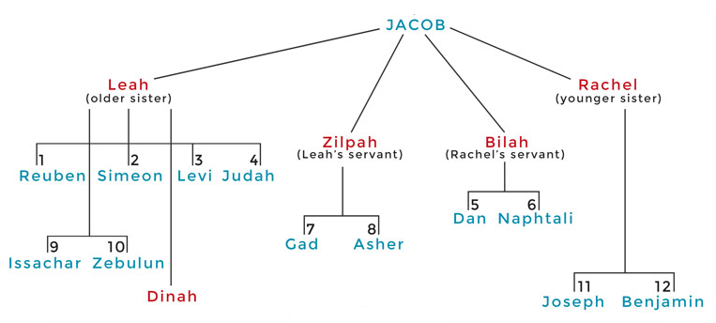

Slide 8
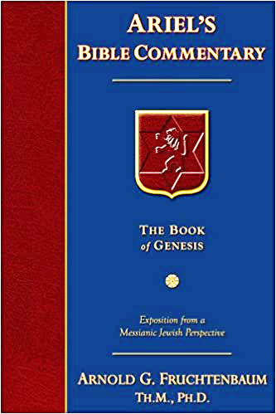
Dr. Arnold G. Fruchtenbaum
The Book of Genesis, 652-53
“In verse 31, he listed those who were buried there: There they buried Abraham and Sarah his wife; there they buried Isaac and Rebekah, his wife; and there I buried Leah. This is the only mention of Leah’s death, which was not recorded as an event in the Book of Genesis as Rachel’s death had been reported. Yet it was Leah and not Rachel who was buried in the Cave of Machpelah. Leah finally achieved in death what she was unable to achieve in life: to be the close one to Jacob.”

Slide 9
V. Genesis 49:29-33 Jacob’s Death
Charge (29a)
Announcement of death (29b)
Request (29c)
Place of burial (29d-30)
Others buried there (31)
Burial place repeated (32)
Jacob’s death (33)

Slide 10
Genesis 12‒25 Abraham’s Early Journeys
Unconditional promises (Gen. 12:1-3) From Haran to Canaan (Gen. 12:4-5) In Canaan (Gen. 12:6-9) In Egypt (Gen. 12:10-20) Abram and Lot Separate (Gen. 13:1-13) Reaffirmation of Abram’s promises (Gen. 13:14-18) Abram Rescues Lot (14:1-24) Abrahamic Covenant (15:1-21) Hagar & Ishmael (16:1-16) Circumcision (Gen. 17:1-27) | Sodom & Gomorrah (Gen. 18‒19) Abraham & Abimelech (Gen. 20) Isaac’s birth (Gen. 21:1-7) Ishmael’s expulsion (21:8-21) Abraham & Abimelech’s covenant (21:22-34) Abraham sacrifices Isaac (22) Sarah’s death (23) Isaac’s marriage (24) Abraham & Keturah (25:1-6) Abraham’s death (25:7-11)

Slide 11
V. Genesis 49:29-33 Jacob’s Death
Charge (29a)
Announcement of death (29b)
Request (29c)
Place of burial (29d-30)
Others buried there (31)
Burial place repeated (32)
Jacob’s death (33)

Slide 12
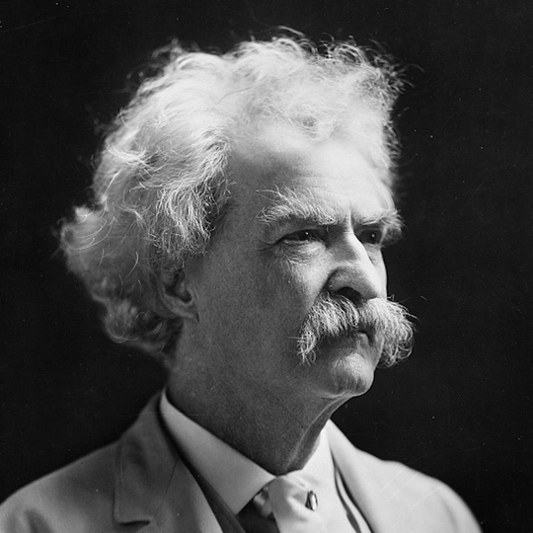
Mark Twain Autobiography, 2:37
“A myriad of men are born; they labor and sweat and struggle for bread; they squabble and scold and fight; they scramble for little mean advantages over each other. Age creeps upon them and infirmities follow; shames and humiliations bring down their prides and their vanities. Those they love are taken from them, and the joy of life is turned to aching grief. The burden of pain, care, and misery grows heavier year by year. At length ambition is dead, pride is dead, vanity is dead; longing for release is in their place. It comes at last-the only un-poisoned gift earth ever had for them-and they vanish from a world where they were of no consequence; where they achieved nothing, where they were a mistake and a failure and a foolishness; where they left no sign that they have existed – a world that will lament them a day and forget them forever.”

Slide 14
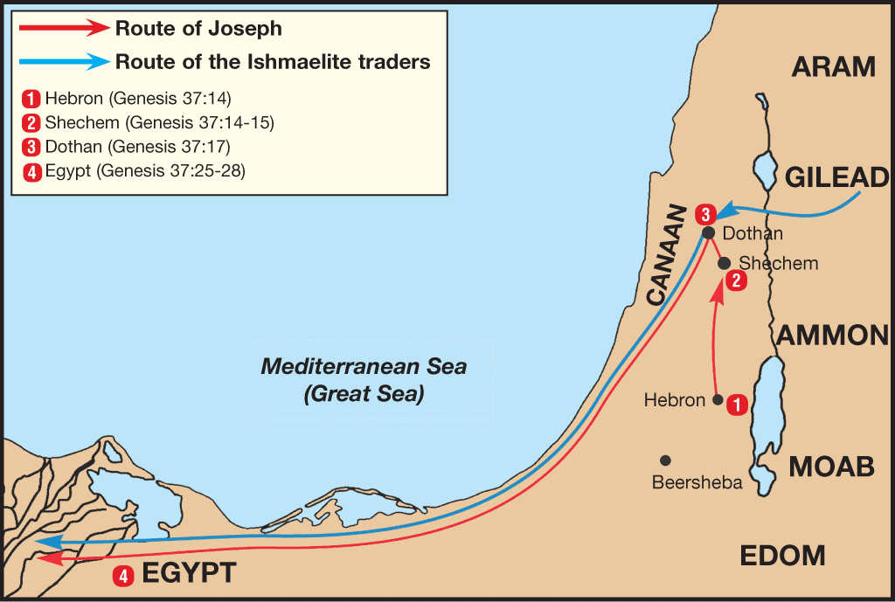

Slide 15
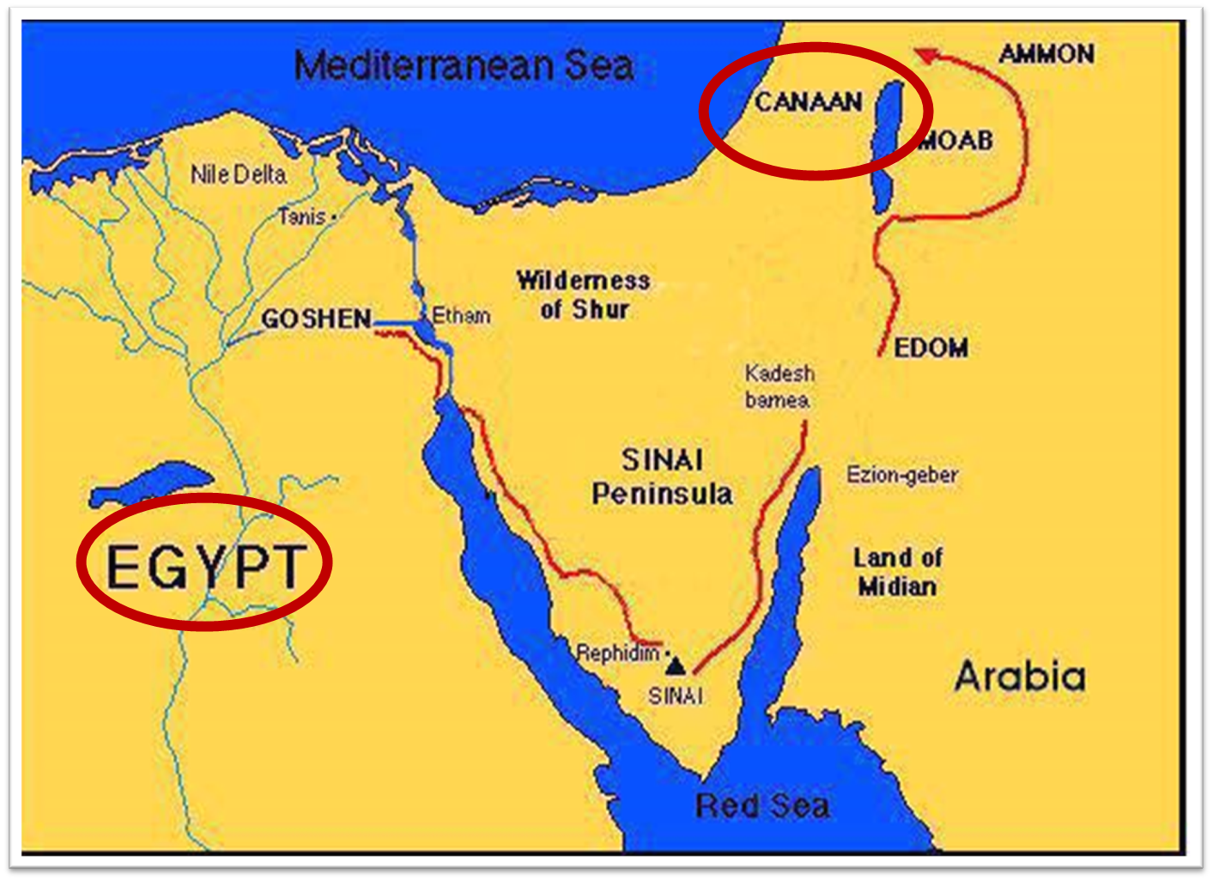

Slide 16
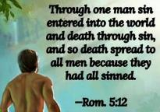
Genesis 2:16-17
“¹⁶ The Lord God commanded the man, saying, ‘From any tree of the garden you may eat freely; ¹⁷ but from the tree of the knowledge of good and evil you shall not eat, for in the day that you eat from it you will surely die (muwth).’”

Slide 17
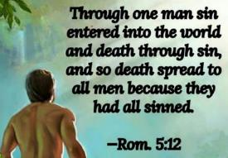
Genesis 3:19
“By the sweat of your face You will eat bread, Till you return to the ground, Because from it you were taken; For you are dust, And to dust you shall return.”

Slide 18
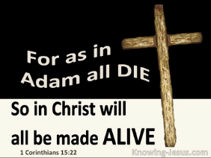
1 Corinthians 15:21-22
“²¹ For since by a man came death, by a man also came the resurrection of the dead. ²² For as in Adam all die, so also in Christ all will be made alive.”

Slide 19
Romans 5:12
“Therefore, just as through one man sin entered into the world, and death through sin, and so death spread to all men, because all sinned—.”

Slide 20
Romans 6:23
“For the wages of sin is death, but the free gift of God is eternal life in Christ Jesus our Lord.”

Slide 21
Hebrews 9:27
“And inasmuch as it is appointed for men to die once and after this comes judgment.”

Slide 22
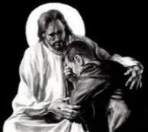
Revelation 21:4
“and He will wipe away every tear from their eyes; and there will no longer be any death; there will no longer be any mourning, or crying, or pain; the first things have passed away.”

Slide 24
Conclusion

Slide 25
Genesis 49:1-33 Jacob Blesses His Sons
Call (49:1)
Introduction (49:2)
Jacob’s blessings on his sons (49:3-27)
Concluding summary (49:28)
Jacob’s death (49:29-33)

Slide 26
²⁴ The Lord bless you, and keep you; ²⁵ The Lord make His face shine on you, And be gracious to you; ²⁶ The Lord lift up His countenance on you, And give you peace.
Numbers 6:24–26 (NASB95)

Slide 27
Genesis 37‒50 Joseph
Joseph sold unto Egypt (37)
Canaan’s corruption (38)
Joseph falsely accused (39)
Joseph’s short-term predictions (40)
Joseph’s elevation (41)
Joseph’s first reunion with his brothers (42)
Joseph’s second reunion with his brothers (43‒45)
Joseph’s second reunion with his brothers (43‒45)
Sojourn to Egypt (46:1‒47:12)
Famine’s course (47:13-26)
Jacob in Egypt (47:27-31)
Jacob blesses Joseph’s sons (48)
Jacob blesses his sons (49)
Death & burial of Jacob & Joseph (50)

Slide 28
Genesis 50:1-26 Death & Burial of Jacob & Joseph
Events following Jacob’s death (1-3)
Jacob’s burial (4-14)
Brothers’ fear & Joseph’s reassurance (15-21)
Joseph’s death (22-26)

Slide 29
Genesis 50:1-26 Death & Burial of Jacob & Joseph
Events following Jacob’s death (1-3)
Jacob’s burial (4-14)
Brothers’ fear & Joseph’s reassurance (15-21)
Joseph’s death (22-26)

Slide 30
I. Genesis 50:1-3 Events Following Jacob’s Death
Weeping (1)
Embalming (2-3)

Slide 31
I. Genesis 50:1-3 Events Following Jacob’s Death
Weeping (1)
Embalming (2-3)

Slide 32
1 Thessalonians 4:13-18
^{13 “}But we do not want you to be uninformed, brethren, about those who are asleep, so that you will not grieve as do the rest who have no hope. ¹⁴ For if we believe that Jesus died and rose again, even so God will bring with Him those who have fallen asleep in Jesus. ¹⁵ For this we say to you by the word of the Lord, that we who are alive and remain until the coming of the Lord, will not precede. . .

Slide 33
I. Genesis 50:1-3 Events Following Jacob’s Death
Weeping (1)
Embalming (2-3)

Slide 34
Genesis 50:2-3 Embalming
Command (2)
Days of embalming (3)

Slide 35
Genesis 50:2-3 Embalming
Command (2)
Days of embalming (3)

Slide 36
Dr. Arnold G. Fruchtenbaum
The Book of Genesis, 654-55
“Sixth, later, the four entrails of the liver, the lungs, the stomach, and the intestines were put in four jars and each was dedicated to the four genies of the underworld. It was because of this particular magical, mystical art that was practiced that Joseph probably chose to use physicians rather than professional embalmers.”

Slide 37
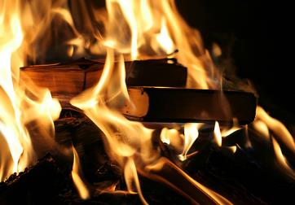
Acts 19:19
“And many of those who practiced magic brought their books together and began burning them in the sight of everyone; and they counted up the price of them and found it fifty thousand pieces of silver.”

Slide 38
Charles Ryrie
The Ryrie Study Bible
“19:19 Magic. Magical spells written on scrolls. Fifty thousand pieces of silver. If the silver drachma is meant, the value would have been the equivalent of about 138 years’ pay for a rural worker.”

Slide 39
Genesis 50:2-3 Embalming
Command (2)
Days of embalming (3)

Slide 40
Genesis 50:3 Days of Embalming
Egyptian embalming (3a)
Egyptian weeping (3b)

Slide 41
Genesis 50:3 Days of Embalming
Egyptian embalming (3a)
Egyptian weeping (3b)

Slide 42
Genesis 50:3 Days of Embalming
Egyptian embalming (3a)
Egyptian weeping (3b)

Slide 43
Shaping and Populating (Gen 1:1)
Day 1: | Light | Day 4: | Luminaries
Day 2: | Water, sky | Day 5: | Sea animals, birds
Day 3: | Land, vegetation | Day 6: | Land animals, man

