Slide 1
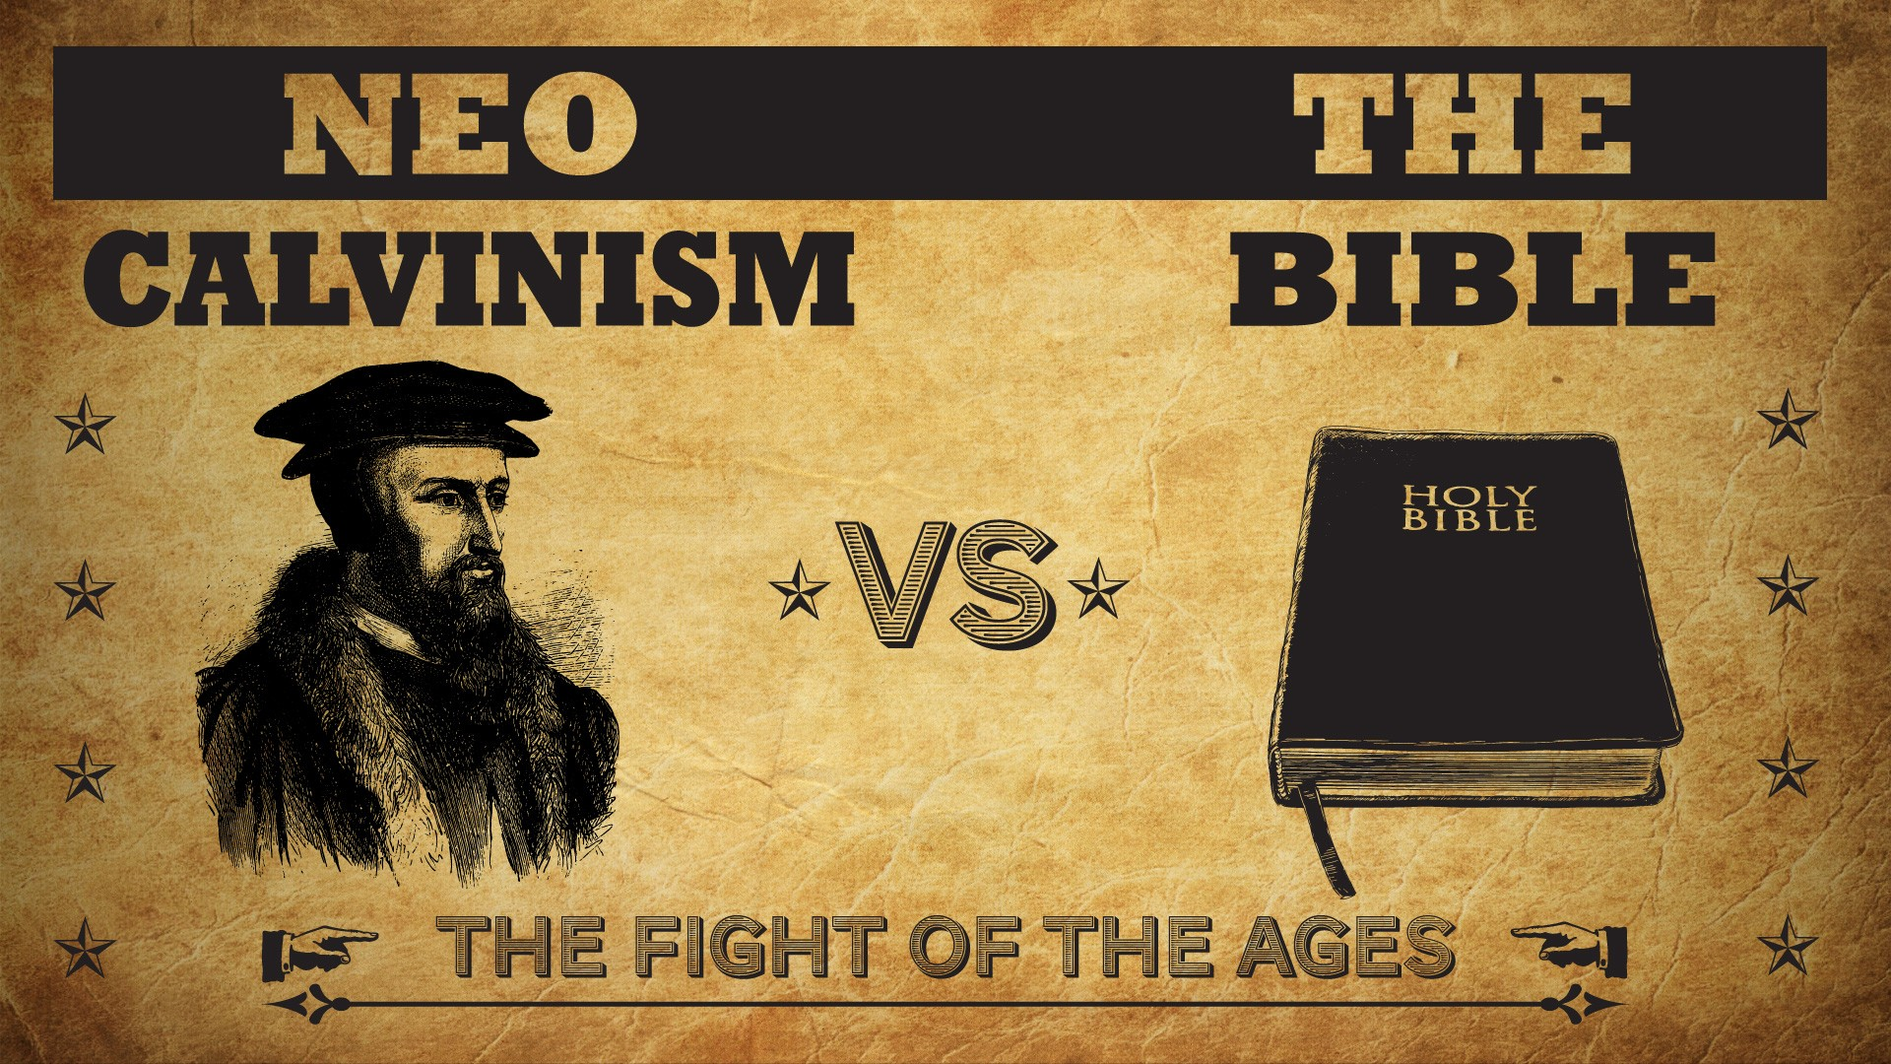


Slide 2
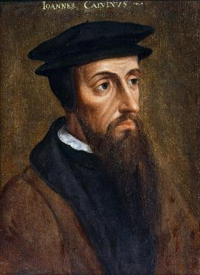
Neo-Calvinism vs. The Bible
Calvinism’s Mixed Blessing
Why Critique Calvinism?
The Source of Calvin’s Theology
Calvin’s Manner of Life
TULIP Through the Grid of Scripture
Conclusion

Slide 3

V. Running TULIP Through the Grid of Scripture
Total Depravity
Unconditional Election
Limited Atonement
Irresistible Grace
Perseverance of the Saints

Slide 4
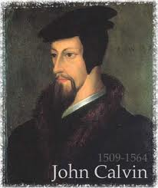
Unconditional Election
  Divine sovereignty vs. human freewill = a profound mystery
  Calvinism and double predestination
  Calvinism’s overstatement of Divine Sovereignty

Slide 5

Chafer Theological Seminary Distinctives:
election
"We believe Scripture reveals two clear and indisputable lines of evidence. One line shows God sovereignly choosing His own in Christ; the other shows man possessing the function of volition, able to receive or reject God's uniquely born Son (regarding sovereignty, see Job 42:2; Psalm 135:6; Isaiah 46:9–10; Jeremiah 1:5; Matthew 24:22, 24, 31; Luke 18:7; Romans 8:29–33; Galatians 1:15; 2 Timothy 2:10; 1 Peter 1:1–2; regarding human volition, see John 1:9–13; 3:16, 36; 6:47; 20:30–31; Acts 16:30–31; Romans 10:11–13; 1 John 5:9–13, as well as every command in the epistles).”
https://www.chafer.edu/soteriology

Slide 6
Unconditional Election
  Divine sovereignty vs. human freewill = a profound mystery
  Calvinism and double predestination
  Calvinism’s overstatement of Divine Sovereignty

Slide 7

Calvin wrote: “Now, since the arrangement of all things is in the hand of God, since to him belongs the disposal of life and death, he arranges all things by his sovereign counsel, in such a way that individuals are born, who are doomed from the womb to certain death, and are to glorify him by their destruction.”
John Calvin
John Calvin, Institutes of the Christian Religion, Vol. 3, Chapter 23, section 6.

Slide 8
Unconditional Election
  Divine sovereignty vs. human freewill = a profound mystery
  Calvinism and double predestination
  Calvinism’s overstatement of Divine Sovereignty

Slide 9

  Calvinism’s overstatement of Divine Sovereignty
Omni-causality
Salvation is available to all
Election proof texts John 6:44; 15:16; Rom. 8:29-30)
Double predestination proof texts (Rom. 9)
Loss of evangelism
Loss of love for the lost (Ezek. 18:23, 32; 33:11)
Babies in hell? (2 Sam. 12:19-24)

Slide 10

Acts 13:48
“When the Gentiles heard this, they began rejoicing and glorifying the word of the Lord; and as many as had been appointed [tassō] to eternal life believed.”
Acts 13:48 (NA26)
⁴⁸ Ἀκούοντα δὲ τὰ ἔθνη ἔχαιρον καὶ ἐδόξαζον τὸν λόγον τοῦ κυρίου καὶ ἐπίστευσαν ὅσοι ἦσαν τεταγμένοι εἰς ζωὴν αἰώνιον·

Slide 11
  Calvinism’s overstatement of Divine Sovereignty
Omni-causality
Salvation is available to all
Election proof texts John 6:44; 15:16; Rom. 8:29-30)
Double predestination proof texts (Rom. 9)
Loss of evangelism
Loss of love for the lost (Ezek. 18:23, 32; 33:11)
Babies in hell? (2 Sam. 12:19-24)

Slide 12
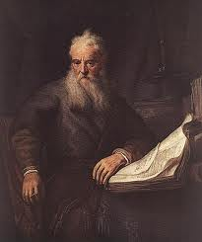
Romans Outline
Salutation (1:1-17)
Sin (1:18–3:20)
Salvation (3:21–5:21)
Sanctification (6–8)
Sovereignty (9–11)
Service (12:1–15:13)
Summation (15:14–16:27)

Slide 13
Romans Outline
Salutation (1:1-17)
Sin (1:18–3:20)
Salvation (3:21–5:21)
Sanctification (6–8)
Sovereignty (9–11)
Service (12:1–15:13)
Summation (15:14–16:27)

Slide 14

Romans 8:29–30
²⁹ For those whom He foreknew, He also predestined to become conformed to the image of His Son, so that He would be the firstborn among many brethren; ³⁰ and these whom He predestined, He also called; and these whom He called, He also justified; and these whom He justified, He also glorified.
Where’s sanctification?

Slide 15
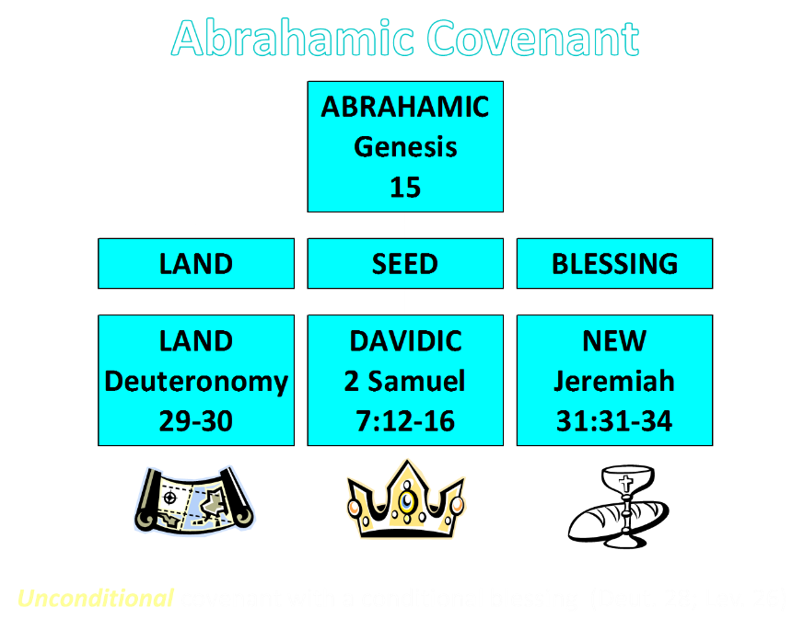

Slide 16


Slide 17
Romans Outline
Salutation (1:1-17)
Sin (1:18–3:20)
Salvation (3:21–5:21)
Sanctification (6–8)
Sovereignty (9–11)
Service (12:1–15:13)
Summation (15:14–16:27)

Slide 18
V. Sovereignty (Rom 9–11)
Israel in the past: elected (Rom 9)
Israel in the present: rejected (Rom 10)
Israel in the future: accepted (Rom 11)

Slide 19
Romans Outline
Salutation (1:1-17)
Sin (1:18–3:20)
Salvation (3:21–5:21)
Sanctification (6–8)
Sovereignty (9–11)
Service (12:1–15:13)
Summation (15:14–16:27)

Slide 20


Romans 12:1
“Therefore I urge you, brethren, by the mercies of God, to present your bodies a living and holy sacrifice, acceptable to God, which is your spiritual service of worship.”

Slide 21

Isaiah 65:21–22
²¹ “They will build houses and inhabit them; They will also plant vineyards and eat their fruit. ²² “They will not build and another inhabit, They will not plant and another eat; For as the lifetime of a tree, so will be the days of My people, And My chosen ones will wear out the work of their hands.

Slide 22

Matthew 24:21-22
“²¹ For then there will be a great tribulation, such as has not occurred since the beginning of the world until now, nor ever will. ²² Unless those days had been cut short, no life would have been saved; but for the sake of the elect those days will be cut short.”

Slide 23

Matthew 23:37-39
³⁷ “Jerusalem, Jerusalem, who kills the prophets and stones those who are sent to her! How often I wanted to gather [episynagō] your children together, the way a hen gathers [episynagō] her chicks under her wings, and you were unwilling. ³⁸ Behold, your house is being left to you desolate! ³⁹ For I say to you, from now on you will not see Me until you say, ‘Blessed is He who comes in the name of the Lord!’”

Slide 24
The Plagues of Egypt
NO. | DESCRIPTION | SCRIPTURE | Egyptian Deity
1. | Water to Blood | Exod. 7:14-25 | Hapi, Khnum
2. | Frogs | Exod. 8:1-15 | Heqt
3. | Gnats | Exod. 8:16-19 | Set
4. | Flies | Exod. 8:20-32 | Uatchit
5. | Disease on Cattle | Exod. 9:1-7 | Hathor, Apis
6. | Boils | Exod. 9:8-12 | Sekhmet, Serapis
7. | Hail | Exod. 9:13-35 | Seth, Nut
8. | Locusts | Exod. 10:1-20 | Seth, Nut, Osiris
9. | Darkness | Exod. 10:21-29 | Re, Horus, Atum
10. | Death of the First Born | Exod. 12:29-36 | Min, Osiris, Heqt, Isis

Slide 25
  Calvinism’s overstatement of Divine Sovereignty
Omni-causality
Salvation is available to all
Election proof texts John 6:44; 15:16; Rom. 8:29-30)
Double predestination proof texts (Rom. 9)
Loss of evangelism
Loss of love for the lost (Ezek. 18:23, 32; 33:11)
Babies in hell? (2 Sam. 12:19-24)

Slide 26

John Winthrop (A.D. 1630)
“For we must consider that we shall be as a City set upon a Hill; the eyes of all people are upon us; so that if we shall deal falsely with our God in this work we have undertaken and so cause him to withdraw his present help from us, we shall be a story and a by-word through the world.”
John Winthrop, “A Model of Christian Charity,” Winthrop Papers, 2:292-95.

Slide 27


Harvard University
“Let every student be plainly instructed and earnestly pressed to consider well the main end of his life and studies is to know God and Jesus Christ which is eternal life (John 17:3) and therefore to lay Christ in the bottom as the only foundation of all sound knowledge and learning. And seeing the Lord only giveth wisdom, let everyone seriously set himself by prayer in secret to seek it of Him (Prov. 2, 3). Everyone shall exercise himself in reading the Scriptures twice a day that he shall be ready to give such an account of his proficiency therein.”
Rules of Harvard in 1636; quoted in David Barton, Original Intent, 81

Slide 28
J.C. Rylands to William Carey
William Carey: (1761‒1834): "My question to you is whether the command given to the apostles to ‘teach all nations,' was not obligatory on all succeeding ministers to the end of the world, seeing that the accompanying promise was of equal extent? Is it not the duty of Christians to attempt the spread of the Gospel amongst heathen nations."
J.C. Rylands: (1753–1825) "Young man, sit down; when God is pleased to convert the heathen world, He will do it without your help or mine...you are a most miserable enthusiast...nothing like that could ever be done before another Pentecost!"
Laurence M. Vance, The Other Side of Calvinism, rev. ed. (Pensacola, FL: Vance Publications, 1999), 24; Kenneth H. Good, Are Baptists Calvinists?, rev. ed. (Rochester, NY: Backus Book Publishers, 1988), 73.

Slide 29
  Calvinism’s overstatement of Divine Sovereignty
Omni-causality
Salvation is available to all
Election proof texts John 6:44; 15:16; Rom. 8:29-30)
Double predestination proof texts (Rom. 9)
Loss of evangelism
Loss of love for the lost (Ezek. 18:23, 32; 33:11)
Babies in hell? (2 Sam. 12:19-24)

Slide 30
Calvin’s Lack of Love for Unelected Lost
“The primary teaching in Calvinism is the teaching on ‘election’ in that the majority of people God created, He did not elect to save nor did He love them. In fact, He hated them from before they were even born. Under the Calvinist view of election, wherein God does not love every human being or desires that each one come to faith and be saved, it makes sense that John Calvin did not have God’s love toward those he saw as his unsaved fellow man. After all, if God does not even love them, why should he? It is this reasoning that would have made it easy for Calvin to justify the torture and murder of people whom he believed, in his own estimation, to be heretics. But the Bible . . .
Bob Kirkland, Calvinism: None Dare Call It Heresy; Spotlight on the Life and Teachings of John Calvin (Eureka, MT: Lighthouse Trails, 2018), 24-25.

Slide 31
Calvin’s Lack of Love for Unelected Lost
. . . says that God is love. And He is righteous, true, faithful, and just. Such are fruits of the Spirit as described in Galatians 5:22, and love is the first one mentioned. It is hard not to believe that John Calvin was under the influence of some other spirit than the Holy Spirit. You will have to look long and hard to find anything in Calvin’s writings about love. It is certainly not obvious in his manner of life.”
Bob Kirkland, Calvinism: None Dare Call It Heresy; Spotlight on the Life and Teachings of John Calvin (Eureka, MT: Lighthouse Trails, 2018), 24-25.

Slide 32

Calvin said of God, “for, (as he hates sin) he can only love those whom he justifies [i.e., the elect].”
John Calvin
John Calvin, Institutes of the Christian Religion, Vol. 3, Chapter xi, section 11.

Slide 33

John 3:16
“For God so loved the world, that He gave His only begotten Son, that whoever believes in Him shall not perish, but have eternal life.”

Slide 34

1 John 4:8
“The one who does not love does not know God, for God is love.”

Slide 35
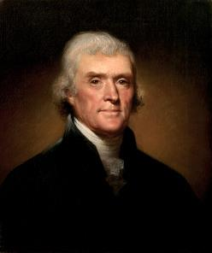
Thomas Jefferson
"I can never join Calvin in addressing his god. He was indeed an Atheist, which I can never be; or rather his religion was Daemonism. If ever man worshipped a false god, he did. The being described in his 5 points is not the god whom you and I acknowledge and adore, the Creator and benevolent and governor of the world, but a daemon of malignant spirit. It would be more pardonable to believe in no god at all, than to blaspheme him by the atrocious attributes of Calvin.”
Jefferson, Letter to John Adams, April 11, 1823

Slide 36
Thomas Jefferson
"The Presbyterian clergy are loudest, the most intolerant of all sects, the most tyrannical, and ambitious; ready at the word of the lawgiver, if such a word could be now obtained, to put the torch to the pile, and to rekindle in this virgin hemisphere, the flames in which their oracle Calvin consumed the poor Servetus, because he could not find in his Euclid the proposition which has demonstrated that three are one, and one is three, nor subscribe to that of Calvin that magistrates have a right to exterminate all heretics to Calvinistic creed.”
Jefferson, letter to William Short, April 13, 1820.

Slide 37
  Calvinism’s overstatement of Divine Sovereignty
Omni-causality
Salvation is available to all
Election proof texts John 6:44; 15:16; Rom. 8:29-30)
Double predestination proof texts (Rom. 9)
Loss of evangelism
Loss of love for the lost (Ezek. 18:23, 32; 33:11)
Babies in hell? (2 Sam. 12:19-24)

Slide 38

1 Timothy 2:3-4
“³ This is good and acceptable in the sight of God our Savior, ⁴ who desires all men to be saved and to come to the knowledge of the truth.”

Slide 39
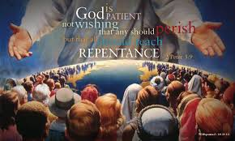
2 Peter 3:9
“The Lord is not slow about His promise, as some count slowness, but is patient toward you, not wishing for any to perish but for all to come to repentance.”

Slide 40
V. Running TULIP Through the Grid of Scripture
Total Depravity
Unconditional Election
Limited Atonement
Irresistible Grace
Perseverance of the Saints

