Slide 1
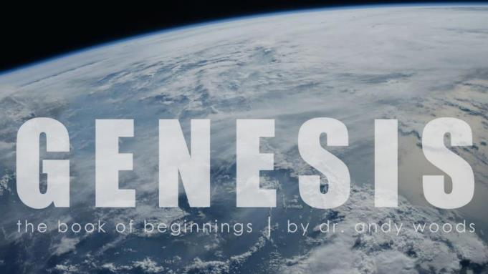
Genesis 12‒50
Israel’s Birth & Preservation

Slide 2
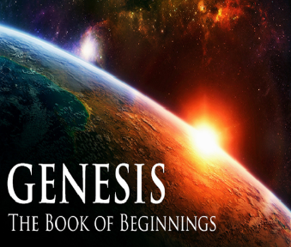
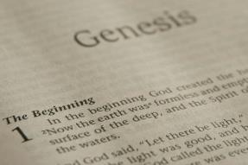
GENESIS STRUCTURE
Genesis 12-50 (four people)
Abraham (12:1–25:11)
Isaac (25:12–26:35)
Jacob (27–36)
Joseph (37–50)

Slide 3
Genesis 37‒50 Joseph
Joseph sold unto Egypt (37)
Canaan’s corruption (38)
Joseph falsely accused (39)
Joseph’s short-term predictions (40)
Joseph’s elevation (41)
Joseph’s first reunion with his brothers (42)
Joseph’s second reunion with his brothers (43‒45)
Joseph’s second reunion with his brothers (43‒45)
Sojourn to Egypt (46:1‒47:12)
Famine’s course (47:13-26)
Jacob in Egypt (47:27-31)
Jacob blesses Joseph’s sons (48)
Jacob blesses his sons (49)

Slide 4
Genesis 49:1-33 Jacob Blesses His Sons
Call (49:1)
Introduction (49:2)
Jacob’s blessings on his sons (49:3-27)
Concluding summary (49:28)
Jacob’s death (49:29-33)

Slide 5
III. Genesis 49:3-27 Jacob’s Blessings on His Sons
Reuben (3-4)
Simeon & Levi (5-7)
Judah (8-12)
Zebulun (13)
Issachar (14-15)
Dan (16-18)
Gad (19)
Asher (20)
Naphtali (21)
Joseph (22-26)
Benjamin (27)

Slide 6
Genesis 49:27 Benjamin
Ravenous wolf (27a)
Devours prey (27b)
Share spoil due to success (27c)

Slide 7
Genesis 49:27 Benjamin
Ravenous wolf (27a)
Devours prey (27b)
Share spoil due to success (27c)

Slide 8
Genesis 49:27 Benjamin
Ravenous wolf (27a)
Devours prey (27b)
Share spoil due to success (27c)

Slide 9
Genesis 49:27 Benjamin
Ravenous wolf (27a)
Devours prey (27b)
Share spoil due to success (27c)

Slide 10
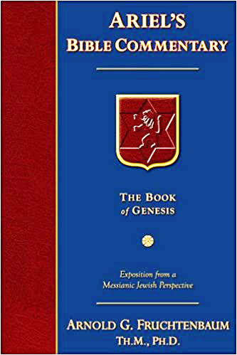
Dr. Arnold G. Fruchtenbaum
The Book of Genesis, 652
“Indeed, the Tribe of Benjamin did produce some rather famous fighters. It produced one of the Judges, Ehud (Judg. 3:15–30). It produced Saul (I Sam. 9:1–11:15) and Jonathan (I Sam. 14:1–52). Among other famous Benjaminites in the Old Testament were Mordecai and Esther; in the New Testament, the Apostle Paul (Rom. 11:1–2). Other references to this tribe include: Judges 5:14 and 19–21; I Chronicles 8:1–40 and 12:1–7; and II Chronicles 14:8 and 17:17.”

Slide 11
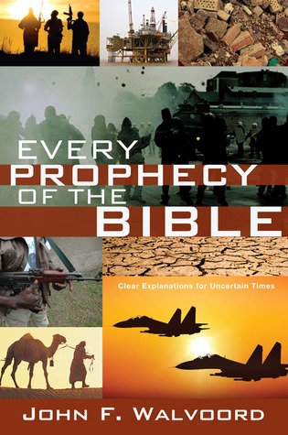

Slide 12
Genesis 49:1-33 Jacob Blesses His Sons
Call (49:1)
Introduction (49:2)
Jacob’s blessings on his sons (49:3-27)
Concluding summary (49:28)
Jacob’s death (49:29-33)

Slide 13
IV. Genesis 49:28 Concluding Summary
Prophecies beyond sons (28a)
Summary of Jacob’s blessings (28b)

Slide 14
IV. Genesis 49:28 Concluding Summary
Prophecies beyond sons (28a)
Summary of Jacob’s blessings (28b)

Slide 15
Matthew 19:28
“And Jesus said to them, ‘Truly I say to you, that you who have followed Me, in the regeneration when the Son of Man will sit on His glorious throne, you also shall sit upon twelve thrones, judging the twelve tribes of Israel.’”

Slide 16
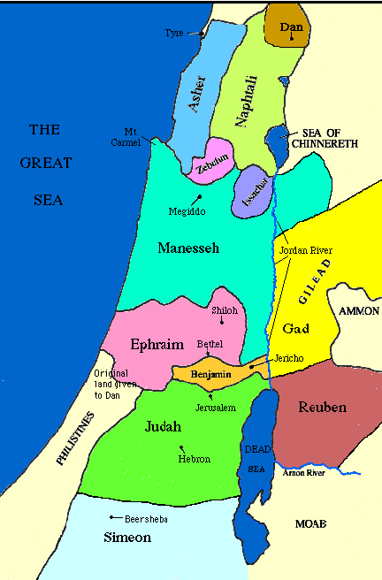

Slide 17
Distinctions Between 144,000 & Multitude
144,000 | MULTITUDE
Revelation 7:1-8 | Revelation 7:9-17
Numbered | Innumerable
Jews | All nations
Sealed (First Fruits) | Slain (Martyrs)
Sealed before the Tribulation | Converted out of the Tribulation
Hitchcock and Ice, The Truth Behind Left Behind, 77

Slide 18
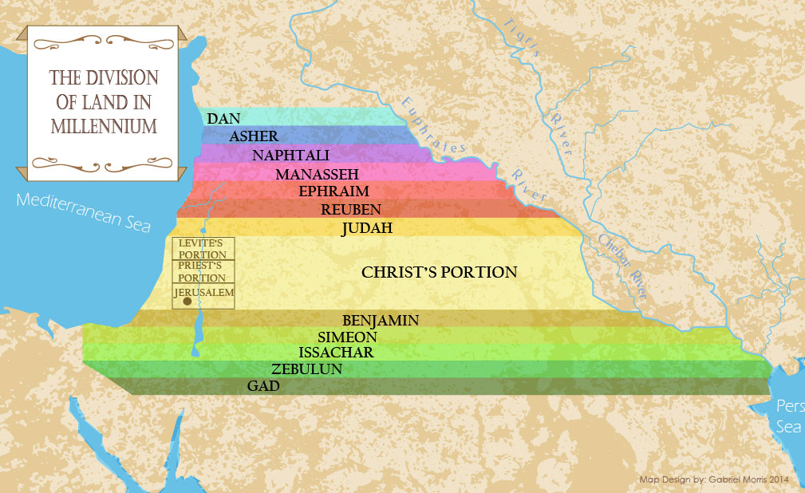

Slide 19
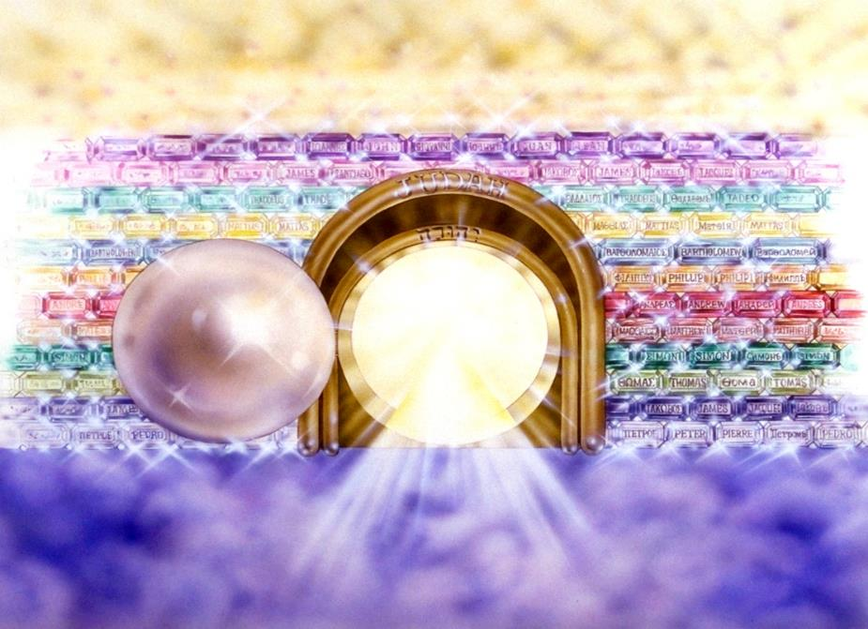
Notes:
Here you see an artist’s ideas of…
12 Gates = 12 Tribes of Israel
12 Foundation Stones = 12 Apostles of the Church

Slide 20
IV. Genesis 49:28 Concluding Summary
Prophecies beyond sons (28a)
Summary of Jacob’s blessings (28b)

Slide 21
Genesis 49:1-33 Jacob Blesses His Sons
Call (49:1)
Introduction (49:2)
Jacob’s blessings on his sons (49:3-27)
Concluding summary (49:28)
Jacob’s death (49:29-33)

Slide 22
V. Genesis 49:29-33 Jacob’s Death
Charge (29a)
Announcement of death (29b)
Request (29c)
Place of burial (29d-30)
Others buried there (31)
Burial place repeated (32)
Jacob’s death (33)

Slide 23
V. Genesis 49:29-33 Jacob’s Death
Charge (29a)
Announcement of death (29b)
Request (29c)
Place of burial (29d-30)
Others buried there (31)
Burial place repeated (32)
Jacob’s death (33)

Slide 24
V. Genesis 49:29-33 Jacob’s Death
Charge (29a)
Announcement of death (29b)
Request (29c)
Place of burial (29d-30)
Others buried there (31)
Burial place repeated (32)
Jacob’s death (33)

Slide 25
V. Genesis 49:29-33 Jacob’s Death
Charge (29a)
Announcement of death (29b)
Request (29c)
Place of burial (29d-30)
Others buried there (31)
Burial place repeated (32)
Jacob’s death (33)

Slide 27
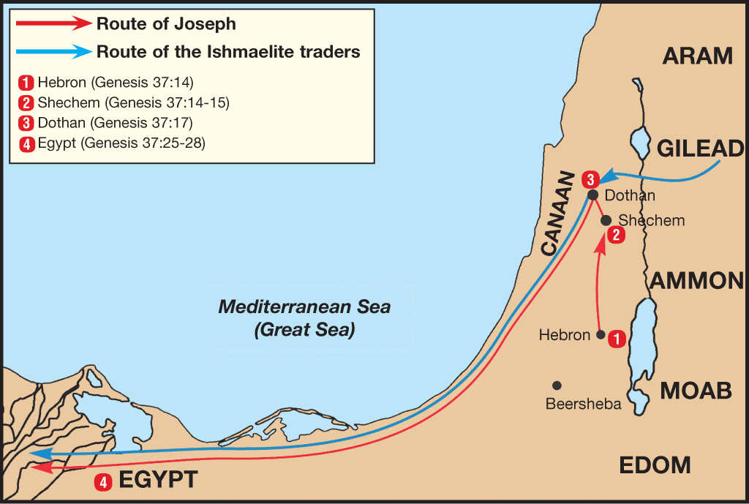

Slide 28
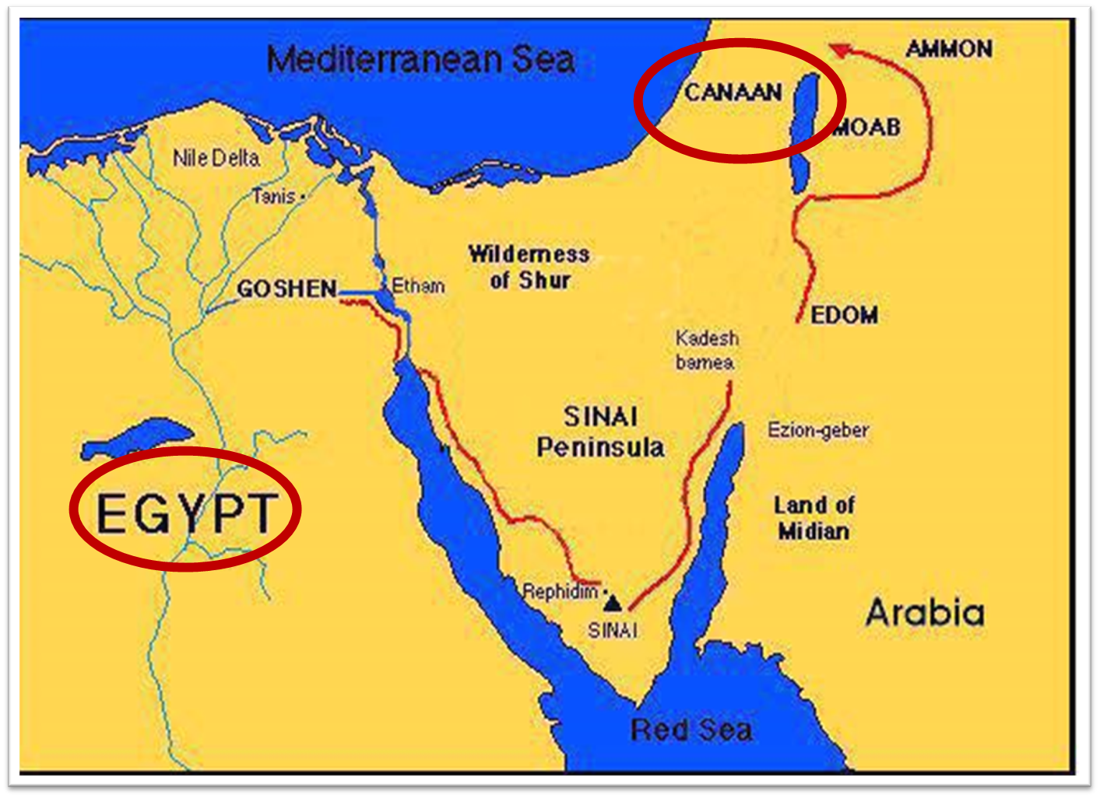

Slide 29
Dr. Arnold G. Fruchtenbaum
The Book of Genesis, 392
“This phrase ‘gathered to his people’ is used ten times, and only in the Pentateuch: Genesis 25:8, of Abraham; 25:17, of Ishmael; 35:29, of Isaac; 49:29, of Jacob; 49:33, of Jacob; Numbers 20:24, of Aaron; 20:26, of Aaron; 27:13, of Moses; 31:2, of Moses; and Deuteronomy 32:50, of Aaron and Moses. A parallel phrase is gathered to his fathers in Genesis 15:15 and 47:30.”

Slide 30
Dr. Arnold G. Fruchtenbaum
The Book of Genesis, 653
“In verse 29a, Jacob announced his coming death: I am to be gathered unto my people, again, an expression of a faith in the afterlife. Then came the request: Bury me with my fathers; again, the chronology is that he was first to be gathered unto his own people, but then his body was to be taken to be with the fathers. The distinction shows that being gathered to his people is distinct from being buried with the fathers.”

Slide 31
Daniel 12:1-2
“¹ Now at that time Michael, the great prince who stands guard over the sons of your people, will arise. And there will be a time of distress such as never occurred since there was a nation until that time; and at that time your people, everyone who is found written in the book, will be rescued. ² Many of those who sleep in the dust of the ground will awake, these to everlasting life, but the others to disgrace and everlasting contempt.”

Slide 32
Genesis as the Seed-Plot of the Bible
“…Genesis gives us a synoptic preface to the entire Bible. It is the seed-plot of the Bible. The germ or beginning of all truth is within this wonderful book. Genesis is the foundation upon which the entire revelation rests; the root out of which the rest grows. Truths found here are developed in successive ages.”
Herbert Lockyer, The Gospel in the Pentateuch (Chicago: The Bible Institute Colportage Association, 1939), 25.

Slide 33
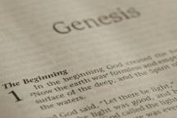
Beginning Themes
Universe Life Man Marriage Evil Clothing | Religion Salvation Language Government Nations Israel
Morris, Genesis Record, 18-20

Slide 34
V. Genesis 49:29-33 Jacob’s Death
Charge (29a)
Announcement of death (29b)
Request (29c)
Place of burial (29d-30)
Others buried there (31)
Burial place repeated (32)
Jacob’s death (33)

Slide 35
Genesis 12‒25 Abraham’s Early Journeys
Unconditional promises (Gen. 12:1-3) From Haran to Canaan (Gen. 12:4-5) In Canaan (Gen. 12:6-9) In Egypt (Gen. 12:10-20) Abram and Lot Separate (Gen. 13:1-13) Reaffirmation of Abram’s promises (Gen. 13:14-18) Abram Rescues Lot (14:1-24) Abrahamic Covenant (15:1-21) Hagar & Ishmael (16:1-16) Circumcision (Gen. 17:1-27) | Sodom & Gomorrah (Gen. 18‒19) Abraham & Abimelech (Gen. 20) Isaac’s birth (Gen. 21:1-7) Ishmael’s expulsion (21:8-21) Abraham & Abimelech’s covenant (21:22-34) Abraham sacrifices Isaac (22) Sarah’s death (23) Isaac’s marriage (24) Abraham & Keturah (25:1-6) Abraham’s death (25:7-11)

Slide 36
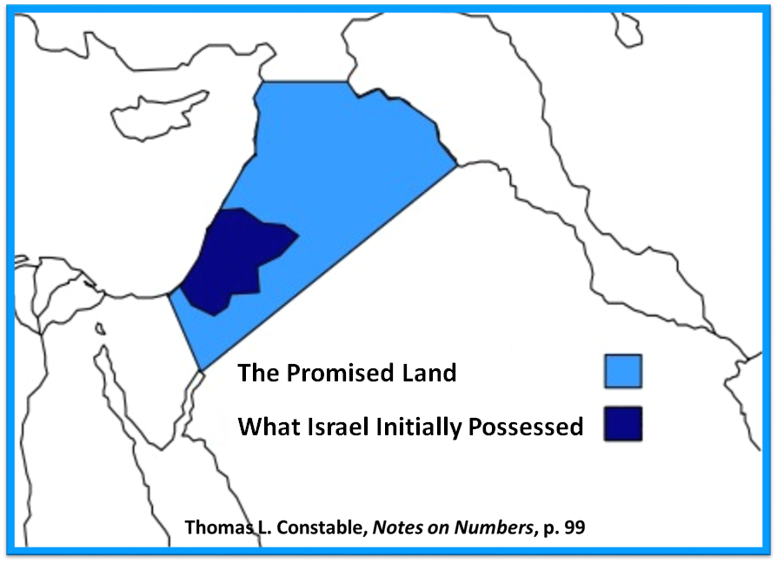

Slide 37
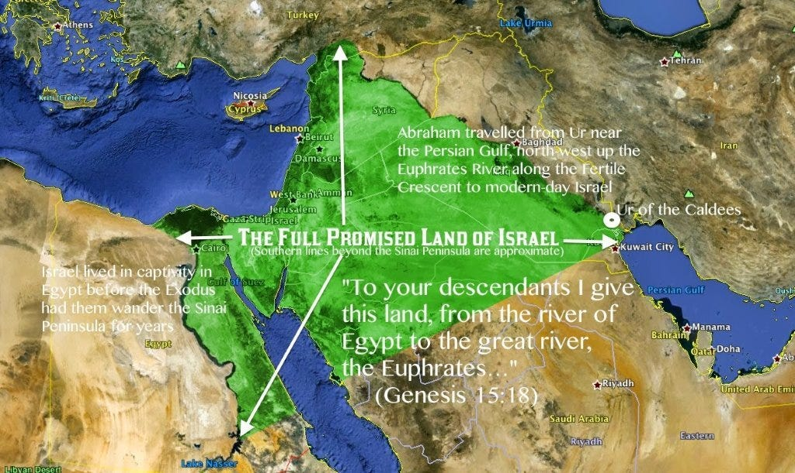

Slide 39
V. Genesis 49:29-33 Jacob’s Death
Charge (29a)
Announcement of death (29b)
Request (29c)
Place of burial (29d-30)
Others buried there (31)
Burial place repeated (32)
Jacob’s death (33)

Slide 41
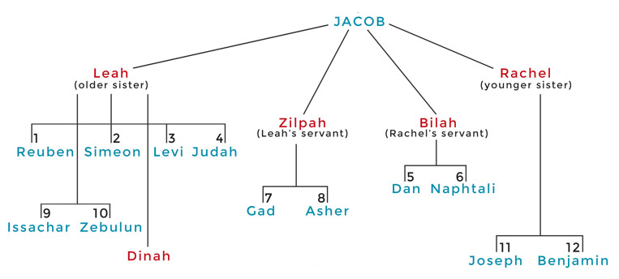

Slide 42
Dr. Arnold G. Fruchtenbaum
The Book of Genesis, 652-53
“In verse 31, he listed those who were buried there: There they buried Abraham and Sarah his wife; there they buried Isaac and Rebekah, his wife; and there I buried Leah. This is the only mention of Leah’s death, which was not recorded as an event in the Book of Genesis as Rachel’s death had been reported. Yet it was Leah and not Rachel who was buried in the Cave of Machpelah. Leah finally achieved in death what she was unable to achieve in life: to be the close one to Jacob.”

Slide 43
V. Genesis 49:29-33 Jacob’s Death
Charge (29a)
Announcement of death (29b)
Request (29c)
Place of burial (29d-30)
Others buried there (31)
Burial place repeated (32)
Jacob’s death (33)

Slide 44
V. Genesis 49:29-33 Jacob’s Death
Charge (29a)
Announcement of death (29b)
Request (29c)
Place of burial (29d-30)
Others buried there (31)
Burial place repeated (32)
Jacob’s death (33)

Slide 45
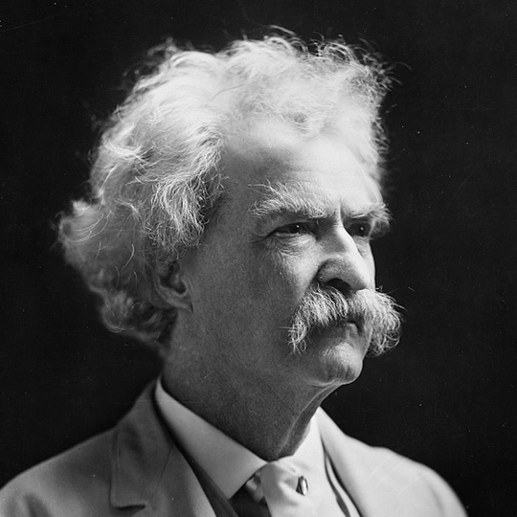
Mark Twain Autobiography, 2:37
“A myriad of men are born; they labor and sweat and struggle for bread; they squabble and scold and fight; they scramble for little mean advantages over each other. Age creeps upon them and infirmities follow; shames and humiliations bring down their prides and their vanities. Those they love are taken from them, and the joy of life is turned to aching grief. The burden of pain, care, and misery grows heavier year by year. At length ambition is dead, pride is dead, vanity is dead; longing for release is in their place. It comes at last-the only un-poisoned gift earth ever had for them-and they vanish from a world where they were of no consequence; where they achieved nothing, where they were a mistake and a failure and a foolishness; where they left no sign that they have existed – a world that will lament them a day and forget them forever.”

Slide 49
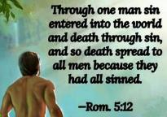
Genesis 2:16-17
“¹⁶ The Lord God commanded the man, saying, ‘From any tree of the garden you may eat freely; ¹⁷ but from the tree of the knowledge of good and evil you shall not eat, for in the day that you eat from it you will surely die (muwth).’”

Slide 50
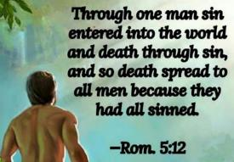
Genesis 3:19
“By the sweat of your face You will eat bread, Till you return to the ground, Because from it you were taken; For you are dust, And to dust you shall return.”

Slide 51
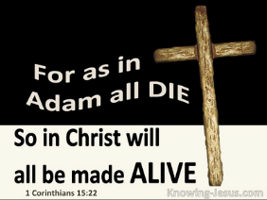
1 Corinthians 15:21-22
“²¹ For since by a man came death, by a man also came the resurrection of the dead. ²² For as in Adam all die, so also in Christ all will be made alive.”

Slide 52
Romans 5:12
“Therefore, just as through one man sin entered into the world, and death through sin, and so death spread to all men, because all sinned—.”

Slide 53
Romans 6:23
“For the wages of sin is death, but the free gift of God is eternal life in Christ Jesus our Lord.”

Slide 54
Hebrews 9:27
“And inasmuch as it is appointed for men to die once and after this comes judgment.”

Slide 55
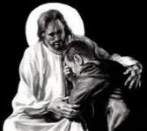
Revelation 21:4
“and He will wipe away every tear from their eyes; and there will no longer be any death; there will no longer be any mourning, or crying, or pain; the first things have passed away.”

Slide 57
Conclusion

Slide 58
Genesis 49:1-33 Jacob Blesses His Sons
Call (49:1)
Introduction (49:2)
Jacob’s blessings on his sons (49:3-27)
Concluding summary (49:28)
Jacob’s death (49:29-33)

Slide 59
²⁴ The Lord bless you, and keep you; ²⁵ The Lord make His face shine on you, And be gracious to you; ²⁶ The Lord lift up His countenance on you, And give you peace.
Numbers 6:24–26 (NASB95)

