Slide 1
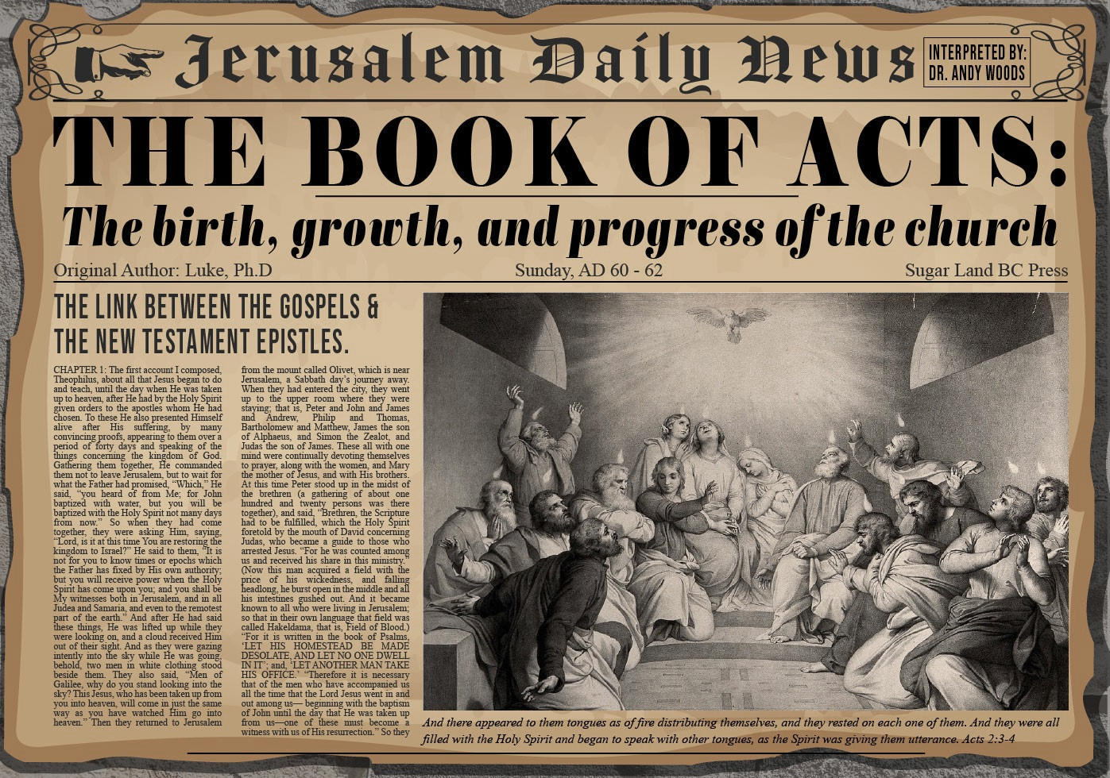


Slide 2
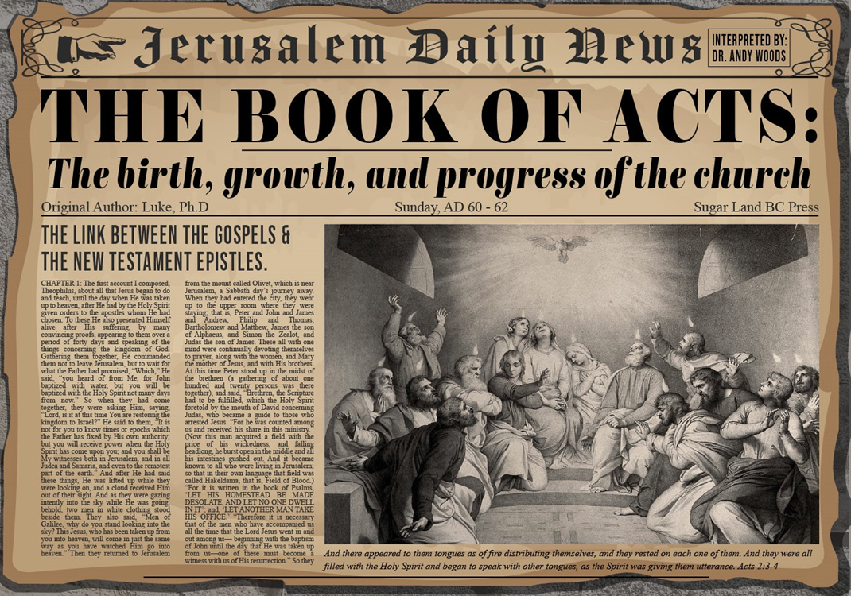
Acts 12:1-25
4th Persecution of Jerusalem Church
  James’ Death (12:1-2)
  Peter’s Imprisonment (12:3-5)
  Peter’s Deliverance (12:6-17)
  Results of Peter’s Escape (12:18-25)

Slide 3
II. Peter’s Imprisonment
Acts 12:3-5
  Peter’s arrest (3)
  Peter’s incarceration (4)
  Church’s reaction (5)

Slide 4
Acts 12:5
Church’s Reaction
      Circumstances (5a)
      Prayer (5b)

Slide 5
Acts 12:5
Church’s Reaction
      Circumstances (5a)
      Prayer (5b)

Slide 6
Acts 12:5
Church’s Reaction
      Circumstances (5a)
      Prayer (5b)

Slide 7
Acts 12:1-25
4th Persecution of Jerusalem Church
  James’ Death (12:1-2)
  Peter’s imprisonment (12:3-5)
  Peter’s Deliverance (12:6-17)
  Results of Peter’s Escape (12:18-25)

Slide 8
III. Peter’s Deliverance
Acts 12:6-17
  Peter’s escape (6-11)
  Peter’s arrival at Mary’s house (12-17)

Slide 9
III. Peter’s Deliverance
Acts 12:6-17
  Peter’s escape (6-11)
  Peter’s arrival at Mary’s house (12-17)

Slide 10
Acts 12:6-11
Peter’s Escape
      Circumstances (6)
      Preparation (7-8)
      Escape (9-10)
      Peter’s realization (11)

Slide 11
Acts 12:6-11
Peter’s Escape
      Circumstances (6)
      Preparation (7-8)
      Escape (9-10)
      Peter’s realization (11)

Slide 12
Acts 12:6-11
Peter’s Escape
      Circumstances (6)
      Preparation (7-8)
      Escape (9-10)
      Peter’s realization (11)

Slide 13
Acts 12:7-8
Preparation
      Angelic visitation (7)
      Instructions (8)

Slide 14
Acts 12:7-8
Preparation
      Angelic visitation (7)
      Instructions (8)

Slide 15
Acts 12:7
Angelic Visitation
      Arrival (7a)
      Awakening (7b)
      Removal of chains (7c)

Slide 16
Acts 12:7
Angelic Visitation
      Arrival (7a)
      Awakening (7b)
      Removal of chains (7c)

Slide 17
Acts 12:7
Angelic Visitation
      Arrival (7a)
      Awakening (7b)
      Removal of chains (7c)

Slide 18







Preterism Advocates
Recent Preterist Commentators
  R.C. Sproul
  N.T. Wright
  Scott Hahn
  J. Massyngbaerde Ford
  David Chilton
  Hank Hanegraaff
  Kenneth Gentry

Slide 19
“TIME-TEXTS” IN REVELATION R.C. Sproul, The Last Days According to Jesus, p.139
SHORTLY, QUICKLY “TACOS”
1:1 | …Things which must shortly take place
2:16 | Repent, or else I will come to you quickly.
3:11 | Behold, I come quickly!
22:6 | …Which must shortly take place.
22:7 | Behold, I come quickly!
22:12 | Behold, I am coming quickly!
22:20 | Surely, I am coming quickly!
NEAR, AT HAND “ENGYS”
1:3 | The time is near.
22:10 | The time is at hand.
ABOUT TO, ON THE POINT OF “MELLŌ”
1:19 | Write…the things that are about to take place.
3:10 | …the hour of trial…is about to come upon the whole world.

Slide 20
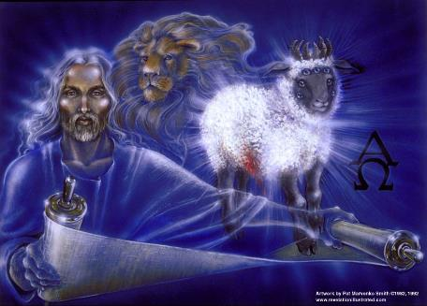
“Time Texts”
Preterist = chronological
Futurist = adverbial, qualitative, imminent

Slide 21
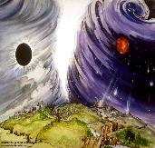
Chronological vs. Adverbial Use of Tacos
“I hope to come to you soon” (1 Tim 3:14) vs. “Leave Jerusalem quickly” (Acts 22:18)
LXX
  Isaiah 13:22: “Her fateful time also will soon come”
  Isaiah 51:5: “My righteous is near, My salvation has gone forth, And my arms will judge the peoples; The coastlands will wait upon me, And on My arms they will trust.”
Thomas Ice, End Times Controversy, pp.102-108

Slide 22
Acts 12:7
Angelic Visitation
      Arrival (7a)
      Awakening (7b)
      Removal of chains (7c)

Slide 23
Acts 12:7-8
Preparation
      Angelic visitation (7)
      Instructions (8)

Slide 24
Acts 12:8
Instructions
      Gird (8a)
      Sandals (8b)
      Garments (8c)

Slide 25
Acts 12:8
Instructions
      Gird (8a)
      Sandals (8b)
      Garments (8c)

Slide 26
Acts 12:8
Instructions
      Gird (8a)
      Sandals (8b)
      Garments (8c)

Slide 27
Acts 12:8
Instructions
      Gird (8a)
      Sandals (8b)
      Garments (8c)

Slide 28
Acts 12:6-11
Peter’s Escape
      Circumstances (6)
      Preparation (7-8)
      Escape (9-10)
      Peter’s realization (11)

Slide 29
Acts 12:9-10
Escape
      Peter’s state of mind (9)
      Peter’s exit (10)

Slide 30
Acts 12:9-10
Escape
      Peter’s state of mind (9)
      Peter’s exit (10)

Slide 31
Acts 12:9-10
Escape
      Peter’s state of mind (9)
      Peter’s exit (10)

Slide 32
Acts 12:10
Peter’s Exit
      1st guard (10a)
      2nd guard (10b)
      Gate (10c)
      Angelic departure (10d)

Slide 33
Acts 12:10
Peter’s Exit
      1st guard (10a)
      2nd guard (10b)
      Gate (10c)
      Angelic departure (10d)

Slide 34
Acts 12:10
Peter’s Exit
      1st guard (10a)
      2nd guard (10b)
      Gate (10c)
      Angelic departure (10d)

Slide 35
Acts 12:10
Peter’s Exit
      1st guard (10a)
      2nd guard (10b)
      Gate (10c)
      Angelic departure (10d)

Slide 36
Acts 12:10
Peter’s Exit
      1st guard (10a)
      2nd guard (10b)
      Gate (10c)
      Angelic departure (10d)

Slide 37
Acts 12:6-11
Peter’s Escape
      Circumstances (6)
      Preparation (7-8)
      Escape (9-10)
      Peter’s realization (11)

Slide 38
Acts 12:11
Peter’s Realization
      God used an angel (11a)
      Deliverance from Herod & the Jews (11b)

Slide 39
Acts 12:11
Peter’s Realization
      God used an angel (11a)
      Deliverance from Herod & the Jews (11b)

Slide 40
Acts 12:11
Peter’s Realization
      God used an angel (11a)
      Deliverance from Herod & the Jews (11b)

Slide 41
III. Peter’s Deliverance
Acts 12:6-17
  Peter’s escape (6-11)
  Peter’s arrival at Mary’s house (12-17)

Slide 42
Acts 12:12-17
Peter’s Arrival at Mary’s House
      Peter arrives at Mary’s house (12)
      Peter and Rhoda (13-15)
      Peter’s meeting with the disciples (16-17)

Slide 43
Acts 12:12-17
Peter’s Arrival at Mary’s House
      Peter arrives at Mary’s house (12)
      Peter and Rhoda (13-15)
      Peter’s meeting with the disciples (16-17)

Slide 44

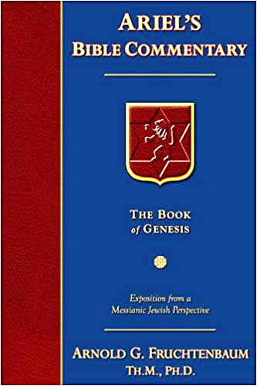
Dr. Arnold G. Fruchtenbaum
The Book of Acts, 273-74
“John Mark played a minor role in the book of Acts, but a major role in the history of the church in that he wrote the Gospel of Mark. He had two names: John, which in Hebrew is Yochanan, and Mark or Marcus, his Latin name. He probably also had a Greek name, but it was not given. According to Colossians 4:10, John Mark was a cousin of Barnabas. He was best known among the Romans, and it was for them that he wrote his Gospel. This is also the reason that he was better known by his Latin name, Mark, rather than his Jewish name of Yochanan (or John).”

Slide 45
Dr. Arnold G. Fruchtenbaum
The Book of Acts, 273-74
“John Mark appears a total of eight times in the New Testament: Acts 12:12, 25; 15:37, 39; Colossians 4:10; II Timothy 4:11; Philemon 24; and I Peter 5:13. In I Peter 5:13, Peter referred to Mark as his ‘son,’ which means Peter was the one who led Mark to the Lord. Subsequently, Mark became his disciple.”

Slide 46
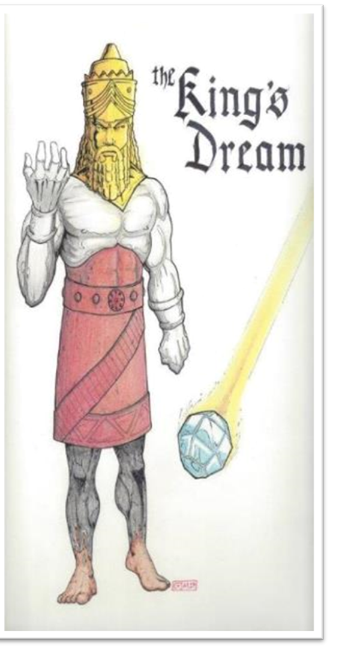

Slide 47
Acts 12:12-17
Peter’s Arrival at Mary’s House
      Peter arrives at Mary’s house (12)
      Peter and Rhoda (13-15)
      Peter’s meeting with the disciples (16-17)

Slide 48
Acts 12:13-15
Peter and Rhoda
      Peter knocks (13)
      Rhoda’s report to the apostles (14)
      Disciples’ unbelieving response (15)

Slide 49
Acts 12:13-15
Peter and Rhoda
      Peter knocks (13)
      Rhoda’s report to the apostles (14)
      Disciples’ unbelieving response (15)

Slide 50
Acts 12:13-15
Peter and Rhoda
      Peter knocks (13)
      Rhoda’s report to the apostles (14)
      Disciples’ unbelieving response (15)

Slide 51
Acts 12:13-15
Peter and Rhoda
      Peter knocks (13)
      Rhoda’s report to the apostles (14)
      Disciples’ unbelieving response (15)

Slide 52
Acts 12:12-17
Peter’s Arrival at Mary’s House
      Peter arrives at Mary’s house (12)
      Peter and Rhoda (13-15)
      Peter’s meeting with the disciples (16-17)

Slide 53
Acts 12:16-17
Peter’s Meeting with the Apostles
      Disciples’ realization (16)
      Peter’s explanation & charge (17a)
      Peter’s departure (17b)

Slide 54
Acts 12:16-17
Peter’s Meeting with the Apostles
      Disciples’ realization (16)
      Peter’s explanation & charge (17a)
      Peter’s departure (17b)

Slide 55
Acts 12:16-17
Peter’s Meeting with the Apostles
      Disciples’ realization (16)
      Peter’s explanation & charge (17a)
      Peter’s departure (17b)

Slide 56
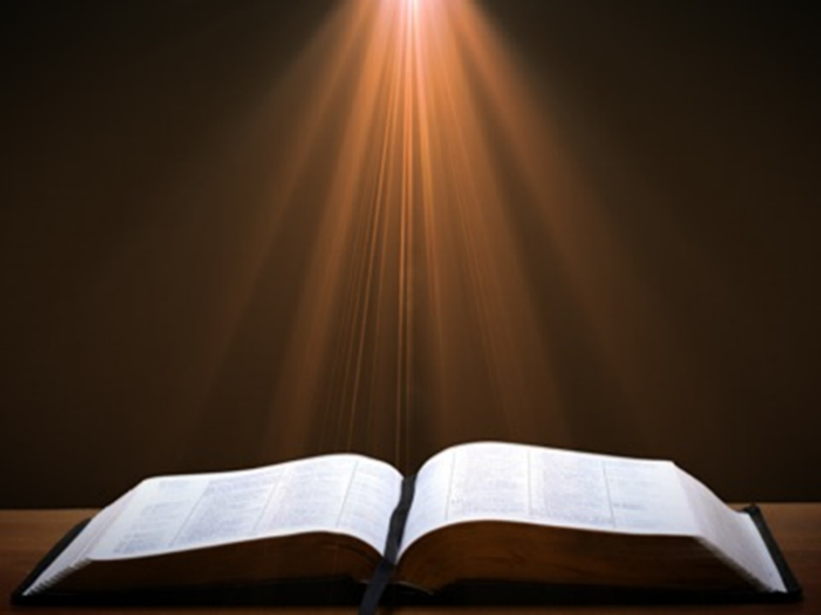
Acts 1:13-14
“¹³ When they had entered the city, they went up to the upper room where they were staying; that is, Peter and John and James and Andrew, Philip and Thomas, Bartholomew and Matthew, James the son of Alphaeus, and Simon the Zealot, and Judas the son of James. ¹⁴ These all with one mind were continually devoting themselves to prayer, along with the women, and Mary the mother of Jesus, and with His brothers.”

Slide 57
Acts 12:16-17
Peter’s Meeting with the Apostles
      Disciples’ realization (16)
      Peter’s explanation & charge (17a)
      Peter’s departure (17b)

Slide 58
Dr. Arnold G. Fruchtenbaum
The Book of Acts, 276
“After having spoken to the disciples, Peter departed, and went to another place (v. 17b). He fled out of Jerusalem. Luke chose not to disclose where Peter went, but we do know something about Peter’s travels from other passages. According to I Corinthians 9:5, he had an itinerant ministry; according to I Corinthians 1:12, he spent some time in Corinth; according to Galatians 2:11, he was in Antioch of Pisidia; according to I Peter 1:1, he was in Asia Minor; and according to I Peter 5:13, he was in Babylon.”

Slide 59

Galatians 2:7-8
“⁷ But on the contrary, seeing that I had been entrusted with the gospel to the uncircumcised, just as Peter had been to the circumcised ⁸ (for He who effectually worked for Peter in his apostleship to the circumcised effectually worked for me also to the Gentiles).”

Slide 60
From Peter to Paul
REFERENCE | CENTER | PERSON | PLACE | OUTREACH
Acts 1–12 | Jerusalem | Peter | Jerusalem, Judea, Samaria | Jewish
Acts 13–28 | Antioch | Paul | Uttermost parts | Gentiles

Slide 61
From Peter to Paul
PETER | PAUL
Heals a man lame from birth (3:1-11) | Heals a man lame from birth (14:8-18)
Heals by shadow (5:15-16) | Heals by handkerchief (19:11-12)
Success is a cause of jealousy (5:17) | Success is a cause of jealousy (13:45)
Confronts a sorcerer (8:9-24) | Confronts a sorcerer (13:6-11)
Raises Dorcas (9:36-41) | Raises Eutychus (20:9-12)
Jailed and miraculously freed (12:3-19) | Jailed and miraculously freed (16:25-34)

Slide 62
Acts 12:1-25
4th Persecution of Jerusalem Church
  James’ Death (12:1-2)
  Peter’s imprisonment (12:3-5)
  Peter’s Deliverance (12:6-17)
  Results of Peter’s Escape (12:18-25)

Slide 63
IV. Results of Peter’s Escape
Acts 12:18-25
  On Herod (18-23)
  On the Church (24-25)

Slide 64
IV. Results of Peter’s Escape
Acts 12:18-25
  On Herod (18-23)
  On the Church (24-25)

Slide 65
Acts 12:18-23
On Herod
      Soldiers’ reaction (18)
      Herod’s reaction (19)
      Herod’s death (20-23)

Slide 66
Acts 12:18-23
On Herod
      Soldiers’ reaction (18)
      Herod’s reaction (19)
      Herod’s death (20-23)

Slide 67
Acts 12:18-23
On Herod
      Soldiers’ reaction (18)
      Herod’s reaction (19)
      Herod’s death (20-23)

Slide 68
Acts 12:19
Herod’s Reaction
      Examination of the soldiers (19a)
      Execution of the soldiers (19b)
      Departure to Caesarea (19c)

Slide 69
Acts 12:19
Herod’s Reaction
      Examination of the soldiers (19a)
      Execution of the soldiers (19b)
      Departure to Caesarea (19c)

Slide 70
Acts 12:19
Herod’s Reaction
      Examination of the soldiers (19a)
      Execution of the soldiers (19b)
      Departure to Caesarea (19c)

Slide 71
Naturalistic Theories
Swoon theory
Theft theory
Hallucination theory
Wrong tomb theory

Slide 72

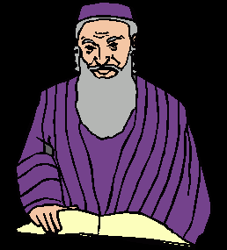
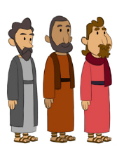
2. Theft Theories
Rome
Jews
Disciples

Slide 73
How Does Jesus Compare?
Deity | Tomb Status
Confucius | Occupied
Buddha | Occupied
Mohammed | Occupied
Jesus | ***EMPTY***
G.B. Hardy, Countdown

Slide 74
Acts 12:19
Herod’s Reaction
      Examination of the soldiers (19a)
      Execution of the soldiers (19b)
      Departure to Caesarea (19c)

Slide 75
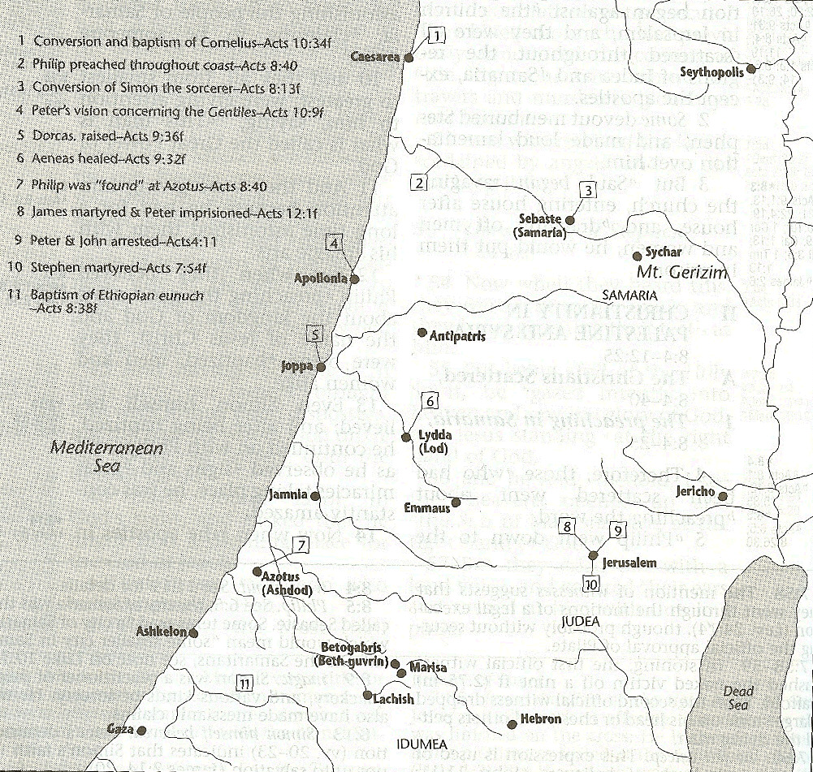



Slide 76
Dr. Arnold G. Fruchtenbaum
The Book of Acts, 277
“It was then that Herod went down from Judea to Caesarea, and tarried there. This was also a standard procedure for the ruler of Judea following the Passover. Once again Luke proved his Jewishness by showing that from Jerusalem one always goes down. The king tarried in Caesarea because the city was the political capital and Roman headquarters for Judea.”

Slide 77
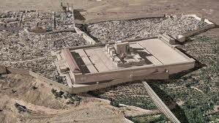
Christ’s Five Trips to Jerusalem
Feast | Verse
Passover | 2:23
Unnamed | 5:1
Tabernacles | 7:2
Dedication | 10:22
Passover | 13:1

Slide 78
Acts 12:18-23
On Herod
      Soldiers’ reaction (18)
      Herod’s reaction (19)
      Herod’s death (20-23)

Slide 79
Acts 12:20-23
Herod’s Death
      Herod’s displeasure with Tyre & Sidon (20)
      Herod’s speech at the Festival (21)
      Response of the people (22)
      Judgment upon Herod (23)

Slide 80
Acts 12:20-23
Herod’s Death
      Herod’s displeasure with Tyre & Sidon (20)
      Herod’s speech at the Festival (21)
      Response of the people (22)
      Judgment upon Herod (23)

Slide 81
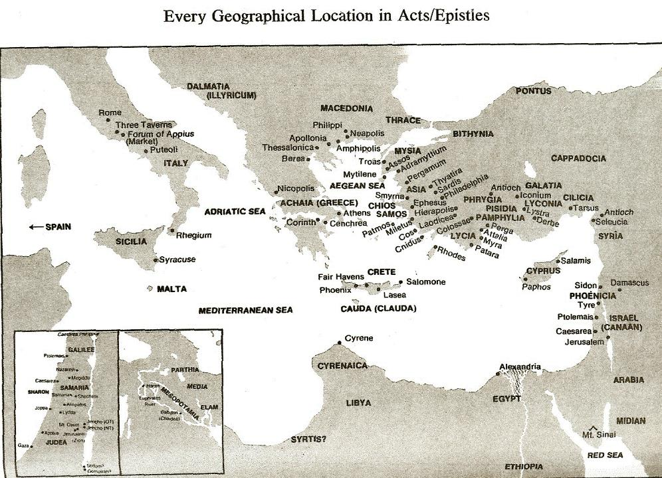

Slide 82
Acts 12:20-23
Herod’s Death
      Herod’s displeasure with Tyre & Sidon (20)
      Herod’s speech at the Festival (21)
      Response of the people (22)
      Judgment upon Herod (23)

Slide 83
Acts 12:20-23
Herod’s Death
      Herod’s displeasure with Tyre & Sidon (20)
      Herod’s speech at the Festival (21)
      Response of the people (22)
      Judgment upon Herod (23)

Slide 84
Acts 12:20-23
Herod’s Death
      Herod’s displeasure with Tyre & Sidon (20)
      Herod’s speech at the Festival (21)
      Response of the people (22)
      Judgment upon Herod (23)

Slide 85
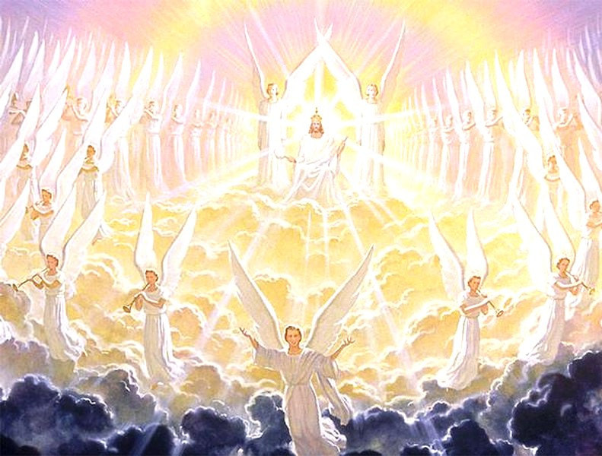
Activities of the Angels
PAST
    Witnessed creation (Job 38:7)
    Brought judgment (Gen 19:22; Acts 12:22-23)
    Accompanied the Law (Gal 3:19)
    Announced births of John and Christ (Luke 1:11-13, 26-27)
    Strengthened Christ (Matt 4:11)
    Announced resurrection (Matt 28:1-7)
    Observed Ascension (Acts 1:11)
    Brought messages (Luke 1:13)

Slide 86
Activities of the Angels
FUTURE
    Rapture (1 Thess. 4:16)
    Judged by humans (1 Cor 6:3)
    Tribulation judgments (Rev 8:2; 16:1)
    Return of Christ (Matt 24:31; 25:31)
    Bind Satan (Rev 20:1-2)

Slide 87
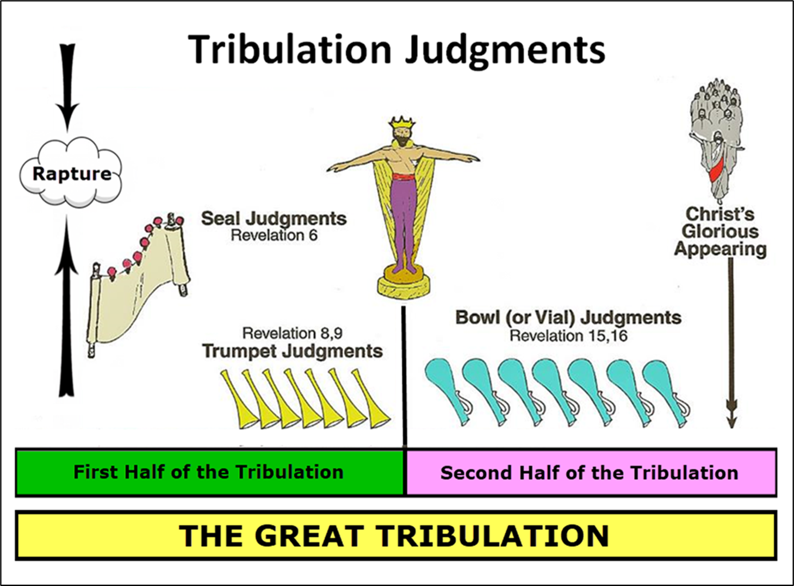

Slide 88
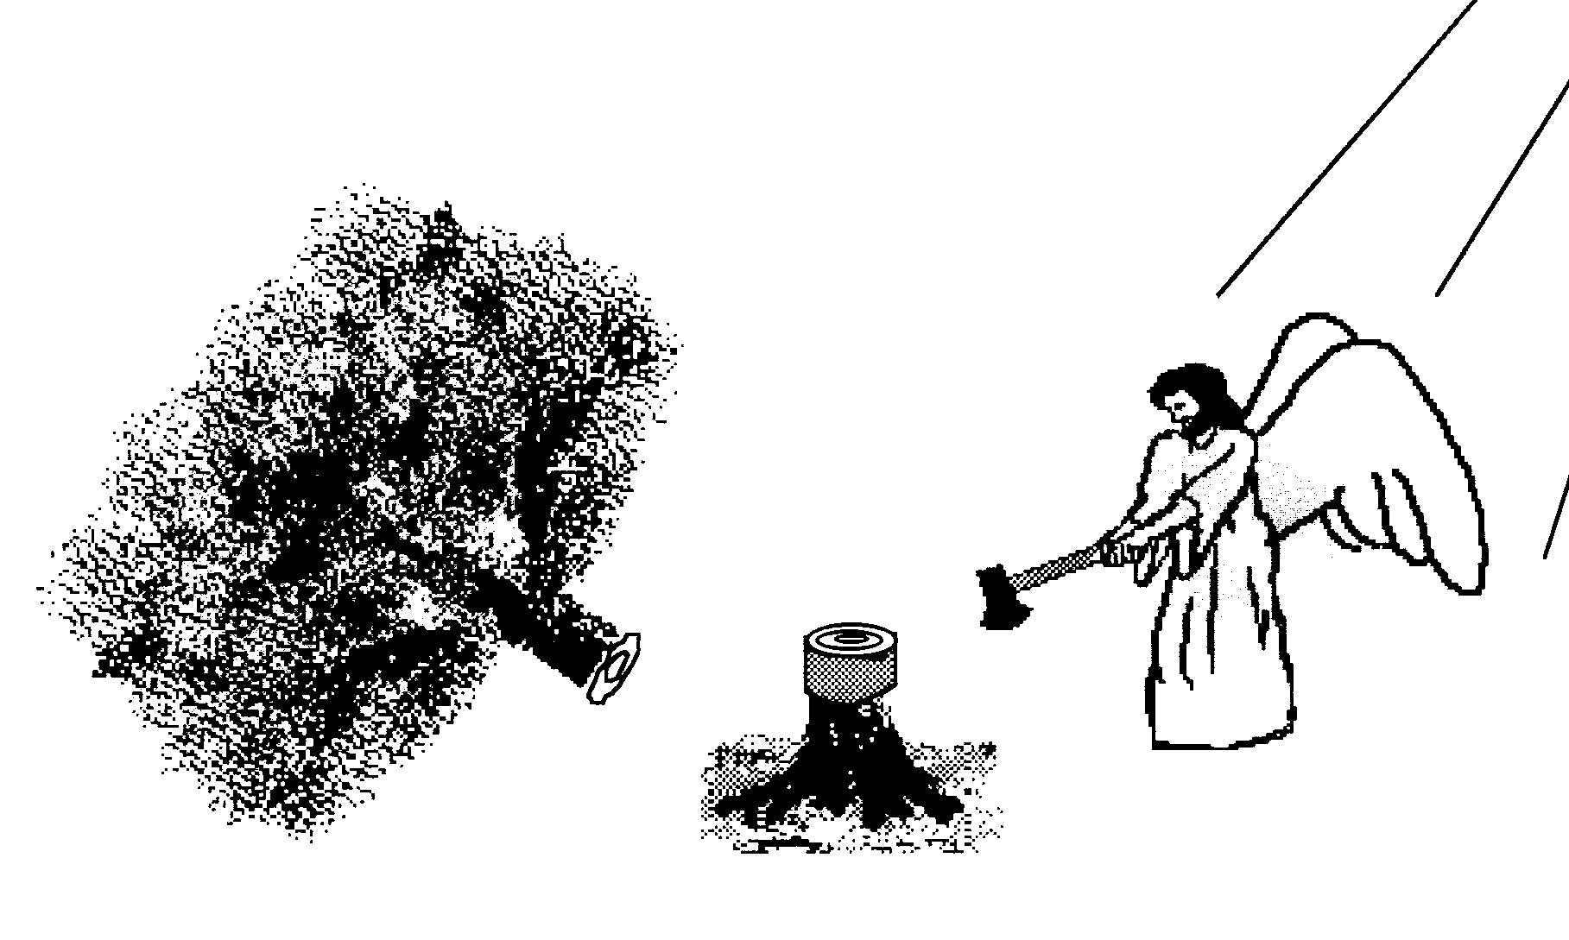
Scripture and Pride
Prov 16:18
Isa 14:12-15; Ezek 28:12-17
1 Tim 3:6
Acts 12:21-23
2 Cor 12:7
1 Pet 5:5

Slide 89
Hall of the Humbled
(Prov. 16:18; 1 Peter 5:5)
Satan (Isa. 14:12-15; Ezek. 28:12-17; 1 Tim. 3:6)
Uzziah (2 Chron. 26:16)
Herod (Acts 12:20-23)
Paul (2 Cor. 12:1-10)

Slide 90
Dr. Arnold G. Fruchtenbaum
The Book of Acts, 278-79
“As a result, Agrippa was eaten of worms. The Greek expression is genomenos skōlēkobrōtos and literally means ‘becoming worm-eaten.’ Robertson notes: ‘The word skóléx was used of intestinal worms and Herodotus . . . describes Pheretima, Queen of Cyrene, as having swarms of worms which ate her flesh while still alive.’ In other words, Agrippa died of acute intestinal problems. This was not an uncommon way for someone to die in ancient times. Josephus described the death as occurring five days after the painful stomach condition started, stating ‘that the rotting of his flesh produced worms, an item in harmony with the narrative of Luke.’”

Slide 91
IV. Results of Peter’s Escape
Acts 12:18-25
  On Herod (18-23)
  On the Church (24-25)

Slide 92
Acts 12:24-25
On the Church
      Progress report (24)
      Paul & Barnabas return to Antioch (25)

Slide 93
Acts 12:24-25
On the Church
      Progress report (24)
      Paul & Barnabas return to Antioch (25)

Slide 94
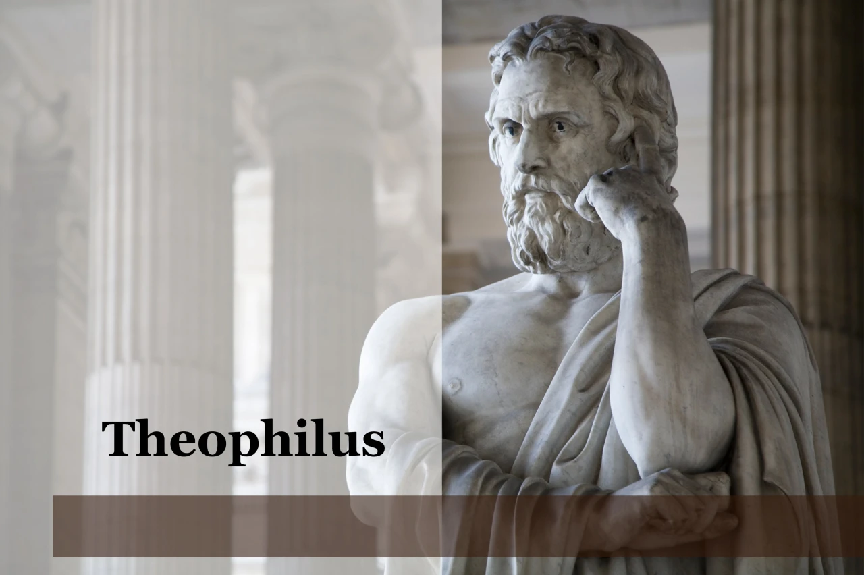
Purpose
  To present Theophilus with an orderly account of the birth and growth of the church so as to affirm him in what he has believed.

Slide 95

Message
  Birth and growth of the church numerically, geographically, ethnically.
  Components
  Numerically (progress reports)
  Geographically (From Jerusalem to Rome)
  Ethnically (From Judaism to Gentile domination)

Slide 96
Progress Reports
  Clearest: Acts 2:47; 6:7; 9:31; 12:24; 16:5; 19:20; 28:30-31
  Less clear: Acts 1:13, 15; 2:41, 47; 4:4, 31; 5:14, 42; 8:25, 40; 11:21; 13:49; 17:6

Slide 97
Acts 12:24-25
On the Church
      Progress report (24)
      Paul & Barnabas return to Antioch (25)

Slide 99
Conclusion

Slide 100
Acts 12:1-25
4th Persecution of Jerusalem Church
  James’ Death (12:1-2)
  Peter’s Imprisonment (12:3-5)
  Peter’s Deliverance (12:6-17)
  Results of Peter’s Escape (12:18-25)

