Slide 1
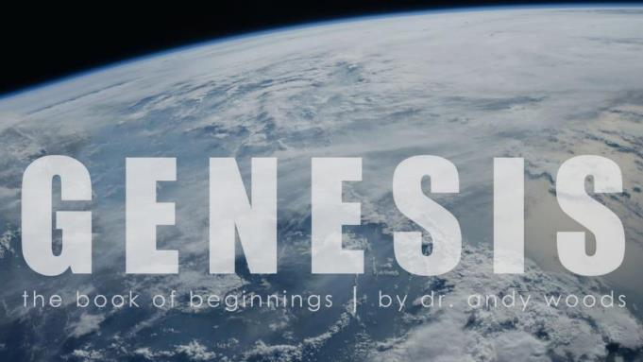
Genesis 12‒50
Israel’s Birth & Preservation

Slide 2
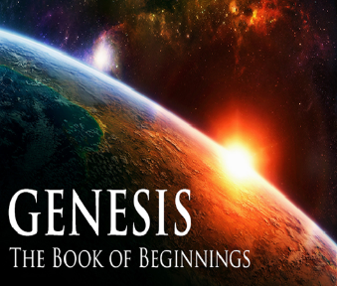
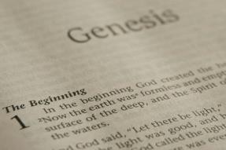
GENESIS STRUCTURE
Genesis 12-50 (four people)
Abraham (12:1–25:11)
Isaac (25:12–26:35)
Jacob (27–36)
Joseph (37–50)

Slide 3
Genesis 37‒50 Joseph
Joseph sold unto Egypt (37)
Canaan’s corruption (38)
Joseph falsely accused (39)
Joseph’s short-term predictions (40)
Joseph’s elevation (41)
Joseph’s first reunion with his brothers (42)
Joseph’s second reunion with his brothers (43‒45)
Joseph’s second reunion with his brothers (43‒45)
Sojourn to Egypt (46:1‒47:12)
Famine’s course (47:13-26)
Jacob in Egypt (47:27-31)
Jacob blesses Joseph’s sons (48)
Jacob blesses his sons (49)

Slide 4
Genesis 49:1-33 Jacob Blesses His Sons
Call (49:1)
Introduction (49:2)
Jacob’s blessings on his sons (49:3-27)
Concluding summary (49:28)
Jacob’s death (49:29-33)

Slide 5
III. Genesis 49:3-27 Jacob’s Blessings on His Sons
Reuben (3-4)
Simeon & Levi (5-7)
Judah (8-12)
Zebulun (13)
Issachar (14-15)
Dan (16-18)
Gad (19)
Asher (20)
Naphtali (21)
Joseph (22-26)
Benjamin (27)

Slide 6
Genesis 49:22-26 Joseph
Progeny (22)
Persecution (23)
Survival (24)
Future blessings (25)
Joseph to receive blessings (26)

Slide 7
Genesis 49:25 Future Blessings
God as source (25a-b)
Other sources (25c-e)

Slide 8
Genesis 49:25 Future Blessings
God as source (25a-b)
Other sources (25c-e)

Slide 9
Genesis 49:25a-b God as Source
Your Father (25a)
Almighty (25b)

Slide 10
Genesis 49:25a-b God as Source
Your Father (25a)
Almighty (25b)

Slide 11
John 14:16-17
¹⁶ I will ask the Father, and He will give you another Helper, that He may be with you forever; ¹⁷ that is the Spirit of truth, whom the world cannot receive, because it does not see Him or know Him, but you know Him because He abides with you and will be in you.

Slide 12
Genesis 49:25a-b God as Source
Your Father (25a)
Almighty (25b)

Slide 13
Revelation 1:3
“Blessed [makarios] is he who reads and those who hear the words of the prophecy, and heed the things which are written in it; for the time is near.”

Slide 14
Genesis 49:25 Future Blessings
God as source (25a-b)
Other sources (25c-e)

Slide 15
Genesis 49:25c-e Other Sources
Dews (25c)
Springs & fountains (25d)
Breasts & womb (25e)

Slide 16
Genesis 49:25c-e Other Sources
Dews (25c)
Springs & fountains (25d)
Breasts & womb (25e)

Slide 17
Genesis 49:25c-e Other Sources
Dews (25c)
Springs & fountains (25d)
Breasts & womb (25e)

Slide 18
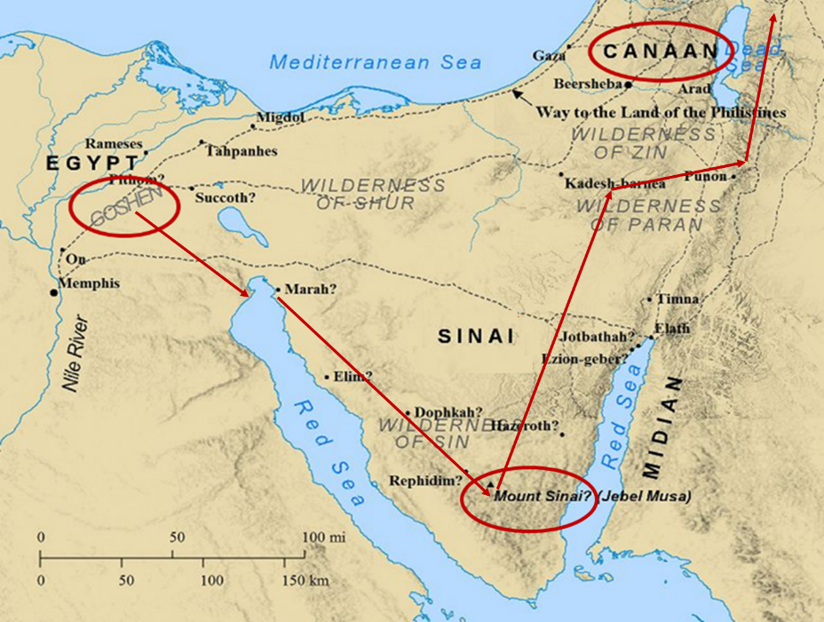

Slide 19
Genesis 49:25c-e Other Sources
Dews (25c)
Springs & fountains (25d)
Breasts & womb (25e)

Slide 20
Genesis 49:22-26 Joseph
Progeny (22)
Persecution (23)
Survival (24)
Future blessings (25)
Joseph to receive blessings (26)

Slide 21
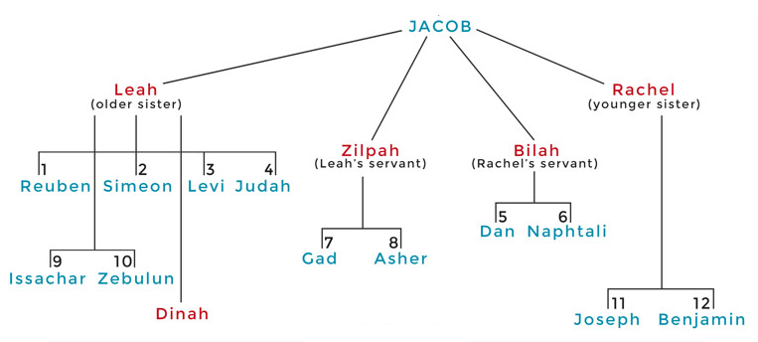

Slide 22
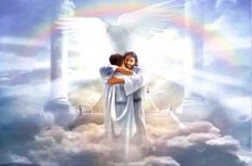
Ephesians 1:3
“Blessed be the God and Father of our Lord Jesus Christ, who has blessed us with every spiritual blessing in the heavenly places in Christ.”

Slide 23
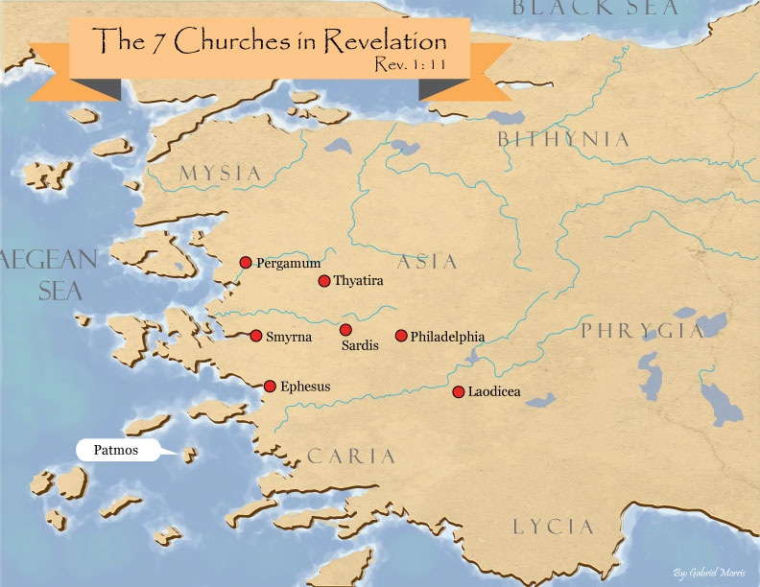

Slide 24
Revelation 2:9
“I know your tribulation and your poverty (but you are rich), and the blasphemy by those who say they are Jews and are not, but are a synagogue of Satan.”

Slide 26
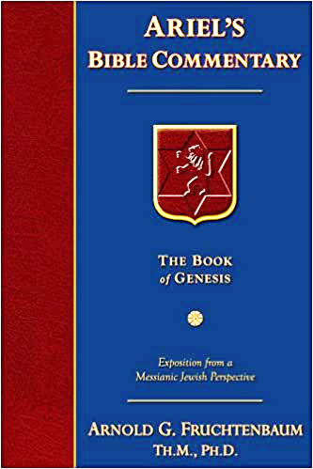
Dr. Arnold G. Fruchtenbaum
The Book of Genesis, 651
“In the blessing of Joseph, five different titles of God were used: Mighty One of Jacob, Shepherd, Stone of Israel; Your Father’s God; and the Almighty.”

Slide 29
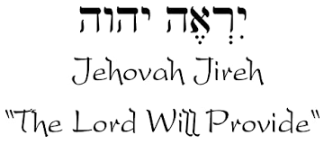

Slide 30
Names for God in Genesis
Elohim (1:1) - Power
Yahweh (2:4) - Relational
El Roi (Gen. 16:13) – Aware
El Olam (21:33) – Eternal
Jehovah Jireh (22:14) - Provision
God Isaac Feared (31:42, 53) - Reverenced
God, the God of Israel (33:20) - National

Slide 31
III. Genesis 49:3-27 Jacob’s Blessings on His Sons
Reuben (3-4)
Simeon & Levi (5-7)
Judah (8-12)
Zebulun (13)
Issachar (14-15)
Dan (16-18)
Gad (19)
Asher (20)
Naphtali (21)
Joseph (22-26)
Benjamin (27)

Slide 32
Genesis 49:27 Benjamin
Ravenous wolf (27a)
Devours prey (27b)
Share spoil due to success (27c)

Slide 33
Genesis 49:27 Benjamin
Ravenous wolf (27a)
Devours prey (27b)
Share spoil due to success (27c)

Slide 34
Genesis 49:27 Benjamin
Ravenous wolf (27a)
Devours prey (27b)
Share spoil due to success (27c)

Slide 35
Genesis 49:27 Benjamin
Ravenous wolf (27a)
Devours prey (27b)
Share spoil due to success (27c)

Slide 36
Dr. Arnold G. Fruchtenbaum
The Book of Genesis, 652
“Indeed, the Tribe of Benjamin did produce some rather famous fighters. It produced one of the Judges, Ehud (Judg. 3:15–30). It produced Saul (I Sam. 9:1–11:15) and Jonathan (I Sam. 14:1–52). Among other famous Benjaminites in the Old Testament were Mordecai and Esther; in the New Testament, the Apostle Paul (Rom. 11:1–2). Other references to this tribe include: Judges 5:14 and 19–21; I Chronicles 8:1–40 and 12:1–7; and II Chronicles 14:8 and 17:17.”

Slide 38
Genesis 49:1-33 Jacob Blesses His Sons
Call (49:1)
Introduction (49:2)
Jacob’s blessings on his sons (49:3-27)
Concluding summary (49:28)
Jacob’s death (49:29-33)

Slide 39
IV. Genesis 49:28 Concluding Summary
Prophecies beyond sons (28a)
Summary of Jacob’s blessings (28b)

Slide 40
IV. Genesis 49:28 Concluding Summary
Prophecies beyond sons (28a)
Summary of Jacob’s blessings (28b)

Slide 41
IV. Genesis 49:28 Concluding Summary
Prophecies beyond sons (28a)
Summary of Jacob’s blessings (28b)

Slide 42
Conclusion

Slide 43
Genesis 49:1-33 Jacob Blesses His Sons
Call (49:1)
Introduction (49:2)
Jacob’s blessings on his sons (49:3-27)
Concluding summary (49:28)
Jacob’s death (49:29-33)

Slide 44
²⁴ The Lord bless you, and keep you; ²⁵ The Lord make His face shine on you, And be gracious to you; ²⁶ The Lord lift up His countenance on you, And give you peace.
Numbers 6:24–26 (NASB95)

Slide 45
Genesis 49:1-33 Jacob Blesses His Sons
Call (49:1)
Introduction (49:2)
Jacob’s blessings on his sons (49:3-27)
Concluding summary (49:28)
Jacob’s death (49:29-33)

Slide 46
V. Genesis 49:29-33 Jacob’s Death
Charge (29a)
Announcement of death (29b)
Request (29c)
Place of burial (29d-30)
Others buried there (31)
Burial place repeated (32)
Jacob’s death (33)

Slide 47
V. Genesis 49:29-33 Jacob’s Death
Charge (29a)
Announcement of death (29b)
Request (29c)
Place of burial (29d-30)
Others buried there (31)
Burial place repeated (32)
Jacob’s death (33)

Slide 48
V. Genesis 49:29-33 Jacob’s Death
Charge (29a)
Announcement of death (29b)
Request (29c)
Place of burial (29d-30)
Others buried there (31)
Burial place repeated (32)
Jacob’s death (33)

Slide 49
V. Genesis 49:29-33 Jacob’s Death
Charge (29a)
Announcement of death (29b)
Request (29c)
Place of burial (29d-30)
Others buried there (31)
Burial place repeated (32)
Jacob’s death (33)

Slide 50
V. Genesis 49:29-33 Jacob’s Death
Charge (29a)
Announcement of death (29b)
Request (29c)
Place of burial (29d-30)
Others buried there (31)
Burial place repeated (32)
Jacob’s death (33)

Slide 51
V. Genesis 49:29-33 Jacob’s Death
Charge (29a)
Announcement of death (29b)
Request (29c)
Place of burial (29d-30)
Others buried there (31)
Burial place repeated (32)
Jacob’s death (33)

Slide 52
V. Genesis 49:29-33 Jacob’s Death
Charge (29a)
Announcement of death (29b)
Request (29c)
Place of burial (29d-30)
Others buried there (31)
Burial place repeated (32)
Jacob’s death (33)

Slide 53
V. Genesis 49:29-33 Jacob’s Death
Charge (29a)
Announcement of death (29b)
Request (29c)
Place of burial (29d-30)
Others buried there (31)
Burial place repeated (32)
Jacob’s death (33)

Slide 54
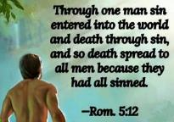
Genesis 2:16-17
“¹⁶ The Lord God commanded the man, saying, ‘From any tree of the garden you may eat freely; ¹⁷ but from the tree of the knowledge of good and evil you shall not eat, for in the day that you eat from it you will surely die (muwth).’”

Slide 55
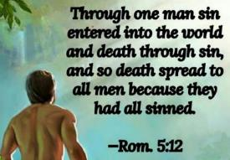
Genesis 3:19
“By the sweat of your face You will eat bread, Till you return to the ground, Because from it you were taken; For you are dust, And to dust you shall return.”

Slide 56
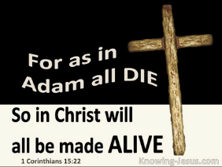
1 Corinthians 15:21-22
“²¹ For since by a man came death, by a man also came the resurrection of the dead. ²² For as in Adam all die, so also in Christ all will be made alive.”

Slide 57
Romans 5:12
“Therefore, just as through one man sin entered into the world, and death through sin, and so death spread to all men, because all sinned—.”

Slide 58
Romans 6:23
“For the wages of sin is death, but the free gift of God is eternal life in Christ Jesus our Lord.”

Slide 59
Hebrews 9:27
“And inasmuch as it is appointed for men to die once and after this comes judgment.”

Slide 60
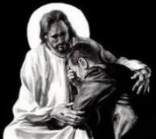
Revelation 21:4
“and He will wipe away every tear from their eyes; and there will no longer be any death; there will no longer be any mourning, or crying, or pain; the first things have passed away.”

Slide 62
Conclusion

Slide 63
Genesis 49:1-33 Jacob Blesses His Sons
Call (49:1)
Introduction (49:2)
Jacob’s blessings on his sons (49:3-27)
Concluding summary (49:28)
Jacob’s death (49:29-33)

Slide 64
²⁴ The Lord bless you, and keep you; ²⁵ The Lord make His face shine on you, And be gracious to you; ²⁶ The Lord lift up His countenance on you, And give you peace.
Numbers 6:24–26 (NASB95)

