Slide 2
Acts 11:19-30 The Church at Antioch
Development of the Church (11:19-26)
Benevolence of the Church (Acts 11:27-30)

Slide 3
I. Development of the Church Acts 11:19-26
Jewish evangelism in the Diaspora (19)
Gentile evangelism (20)
Progress report (21)
Barnabas’ ministry (22-24)
Saul reintroduced (25-26a)
Barnabas & Saul minister at Antioch (26b-d)

Slide 4
Acts 11:25-26a Saul Reintroduced
Barnabas searches for Saul (25)
Barnabas brings Saul to Antioch (26a)

Slide 5
Acts 11:25-26a Saul Reintroduced
Barnabas searches for Saul (25)
Barnabas brings Saul to Antioch (26a)

Slide 6
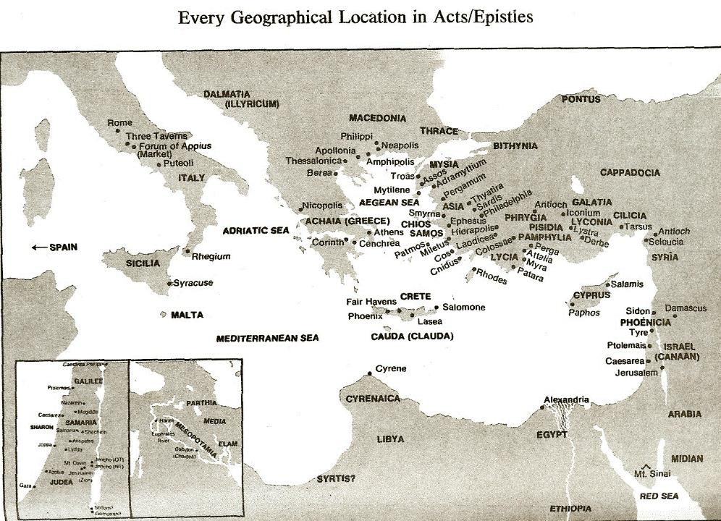

Slide 7
Acts 11:25-26a Saul Reintroduced
Barnabas searches for Saul (25)
Barnabas brings Saul to Antioch (26a)

Slide 9
I. Development of the Church Acts 11:19-26
Jewish evangelism in the Diaspora (19)
Gentile evangelism (20)
Progress report (21)
Barnabas’ ministry (22-24)
Saul reintroduced (25-26a)
Barnabas & Saul minister at Antioch (26b-d)

Slide 10
Acts 11:26b-d Barnabas & Saul Minister at Antioch
Duration (26b)
Size (26c)
Name (26d)

Slide 11
Acts 11:26b-d Barnabas & Saul Minister at Antioch
Duration (26b)
Size (26c)
Name (26d)

Slide 12
Acts 11:26b-d Barnabas & Saul Minister at Antioch
Duration (26b)
Size (26c)
Name (26d)

Slide 13
Purpose
To present Theophilus with an orderly account of the birth and growth of the church so as to affirm him in what he has believed.

Slide 14
Message
Birth and growth of the church numerically, geographically, ethnically.
Components
Numerically (progress reports)
Geographically (From Jerusalem to Rome)
Ethnically (From Judaism to Gentile domination)

Slide 15
Progress Reports
Clearest: Acts 2:47; 6:7; 9:31; 12:24; 16:5; 19:20; 28:30-31
Less clear: Acts 1:13, 15; 2:41, 47; 4:4, 31; 5:14, 42; 8:25, 40; 11:21; 13:49; 17:6

Slide 16
Acts 11:26b-d Barnabas & Saul Minister at Antioch
Duration (26b)
Size (26c)
Name (26d)

Slide 17
John 14:6
“Jesus said to him, ‘I am the way, and the truth, and the life; no one comes to the Father but through Me.’”

Slide 18
Purpose
To present Theophilus with an orderly account of the birth and growth of the church so as to affirm him in what he has believed.

Slide 19
Message
Birth and growth of the church numerically, geographically, ethnically.
Components
Numerically (progress reports)
Geographically (From Jerusalem to Rome)
Ethnically (From Judaism to Gentile domination)

Slide 20
Acts 11:19-30 The Church at Antioch
Development of the Church (11:19-26)
Benevolence of the Church (Acts 11:27-30)

Slide 21
II. Benevolence of the Church Acts 11:27-30
Agabus’ prophecy (27-28)
Relief fund (29-30)

Slide 22
II. Benevolence of the Church Acts 11:27-30
Agabus’ prophecy (27-28)
Relief fund (29-30)

Slide 23
Acts 11:27-28 Agabus’ Prophecy
Occasion (27)
Agabus introduced (28a)
Agabus’ prophecy (28b)
Fulfilment of Agabus’ prophecy (28c)

Slide 24
Acts 11:27-28 Agabus’ Prophecy
Occasion (27)
Agabus introduced (28a)
Agabus’ prophecy (28b)
Fulfilment of Agabus’ prophecy (28c)

Slide 26
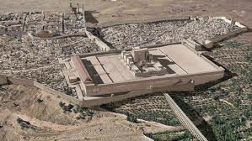
Christ’s Five Trips to Jerusalem
Feast | Verse
Passover | 2:23
Unnamed | 5:1
Tabernacles | 7:2
Dedication | 10:22
Passover | 13:1

Slide 27
Acts 11:27-28 Agabus’ Prophecy
Occasion (27)
Agabus introduced (28a)
Agabus’ prophecy (28b)
Fulfilment of Agabus’ prophecy (28c)

Slide 28
Acts 11:27-28 Agabus’ Prophecy
Occasion (27)
Agabus introduced (28a)
Agabus’ prophecy (28b)
Fulfilment of Agabus’ prophecy (28c)

Slide 29
The Whole World? (Revelation 3:10)
Oikouménē – known world? (Luke 2:1; Acts 11:28)
Oikouménē – entire world (Luke 4:5; Acts 17:31; Rev. 12:9)
Context favors the global definition
Adjective “whole” (holos)
Rev. 6‒18

Slide 30
Acts 11:27-28 Agabus’ Prophecy
Occasion (27)
Agabus introduced (28a)
Agabus’ prophecy (28b)
Fulfilment of Agabus’ prophecy (28c)

Slide 33
II. Benevolence of the Church Acts 11:27-30
Agabus’ prophecy (27-28)
Relief fund (29-30)

Slide 34
Acts 11:29-30 Relief Fund
Money collected (29)
Money sent (30)

Slide 35
Acts 11:29-30 Relief Fund
Money collected (29)
Money sent (30)

Slide 36
Activities of the Local Church (Acts 2:41-47)
Doctrine (Acts 2:42)
Ordinances (Acts 2:41-42, 46)
Prayer (Acts 2:42)
Evangelism (Acts 2:47)
Worship (Acts 2:47)
Benevolence (Acts 2:44-45)
Fellowship (Acts 2:42, 46-47)

Slide 37
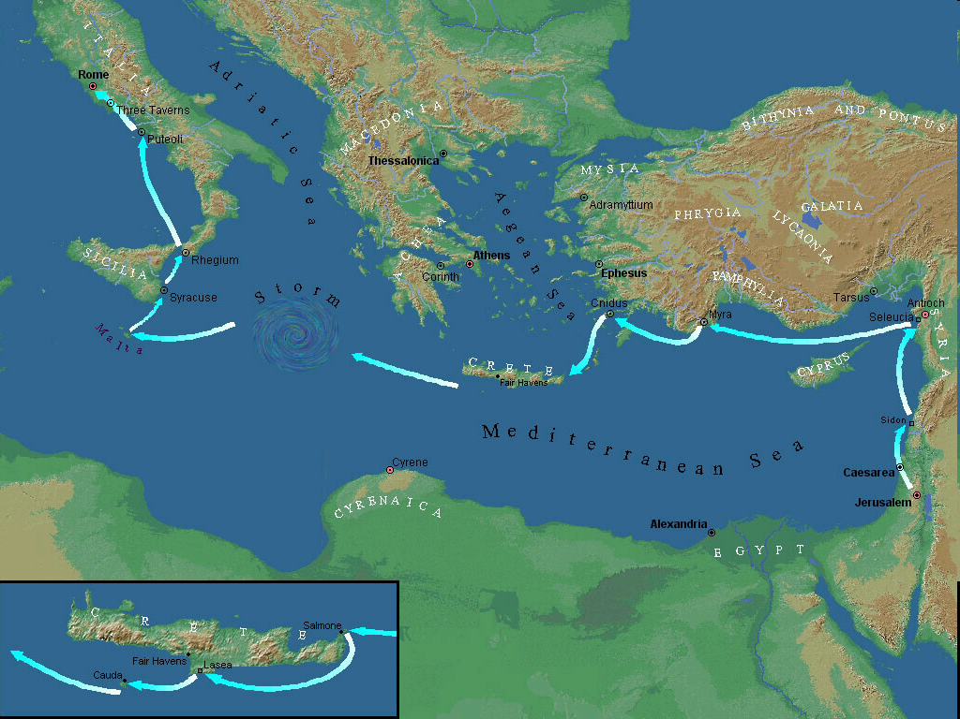

Slide 38
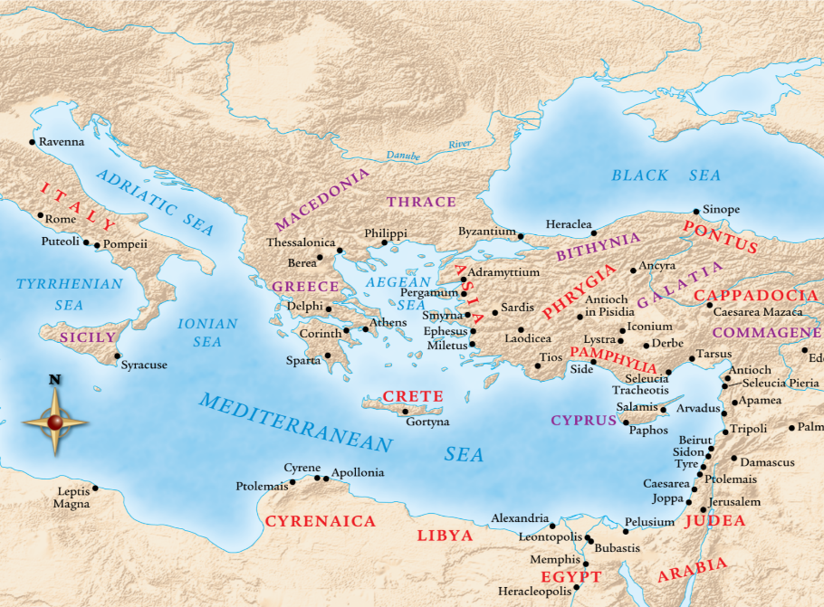

Slide 39
Acts 11:29-30 Relief Fund
Money collected (29)
Money sent (30)

Slide 40
Acts 11:30 Money Sent
Saul (30a)
Barnabas (30b)
Elders (30c)

Slide 41
Acts 11:30 Money Sent
Saul (30a)
Barnabas (30b)
Elders (30c)

Slide 42
Acts 11:30 Money Sent
Saul (30a)
Barnabas (30b)
Elders (30c)

Slide 43
Acts 11:30 Money Sent
Saul (30a)
Barnabas (30b)
Elders (30c)

Slide 44
Local Church Government
Episcopalian / bishop rule – Acts 15:2, 6
Congregational rule – Acts 6:1-7
Presbyterian / elder rule – Acts 20:28; 1 Tim 5:17; 4:14

Slide 45
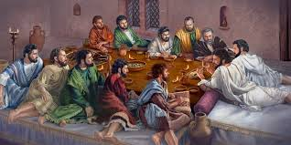
Ephesians 2:20
“having been built on the foundation of the apostles and prophets, Christ Jesus Himself being the corner stone.”

Slide 46
Conclusion

Slide 47
Acts 11:19-30 The Church at Antioch
Development of the Church (11:19-26)
Benevolence of the Church (Acts 11:27-30)

