Slide 2
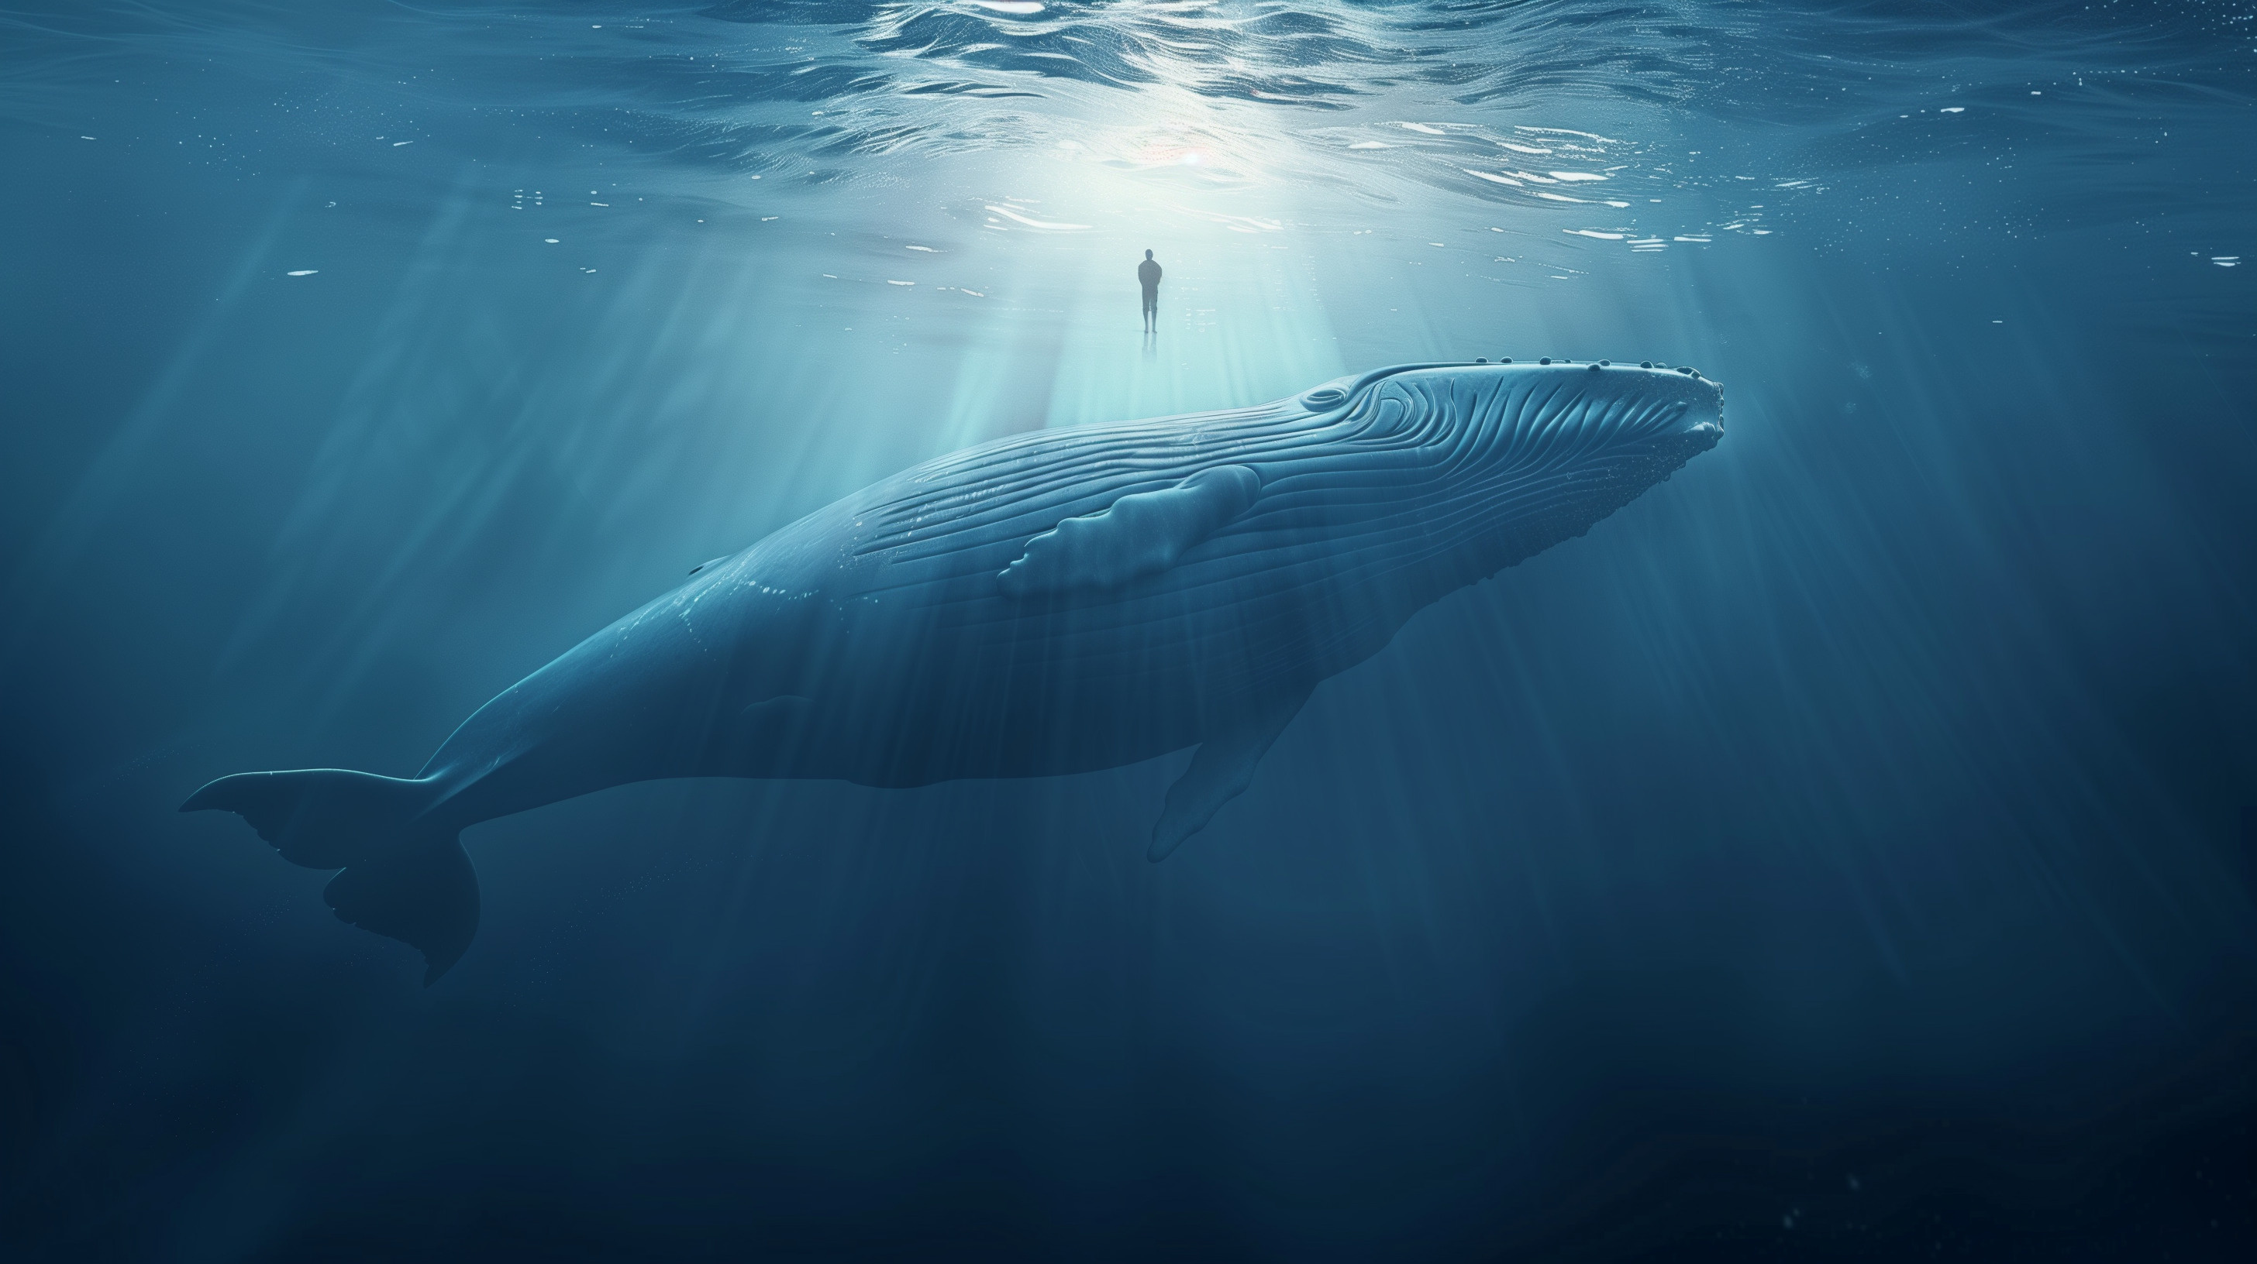
“And the LORD appointed a great fish to swallow Jonah, and Jonah was in the stomach of the fish three days and three nights.” Jonah 1:17

Slide 3
Jonah 1:17 ?
Practical Perspective
Theological Perspective
Historical Perspective
Typological Perspective
Exegetical Perspective

Slide 4
Outline of Jonah
Defiance (1-2)
The running prophet (1)
The praying prophet (2)
Compliance (3-4)
The preaching prophet (3)
The pouting prophet (4)

Slide 5
Outline of Jonah
Defiance (1-2)
The running prophet (1)
The praying prophet (2)
Compliance (3-4)
The preaching prophet (3)
The pouting prophet (4)

Slide 6
B. The Praying Prophet (2)
The place of prayer
Jonah’s unique location (v. 1)
The Plea for Help
Jonah’s desperate cry to God (v. 2)
From Sheol’s belly (v. 2b)

Slide 7
B. The Praying Prophet (2)
The Divine Hand
a) God’s sovereignty acknowledged (v. 3)
The Depths of Despair
Banished (v. 4)
Engulfed (v. 5)
Descended (6a)

Slide 8
B. The Praying Prophet (2)
The place of prayer
Jonah’s unique location (v. 1)
The Plea for Help
Jonah’s desperate cry to God (v. 2)
From Sheol’s belly (v. 2b)

Slide 9
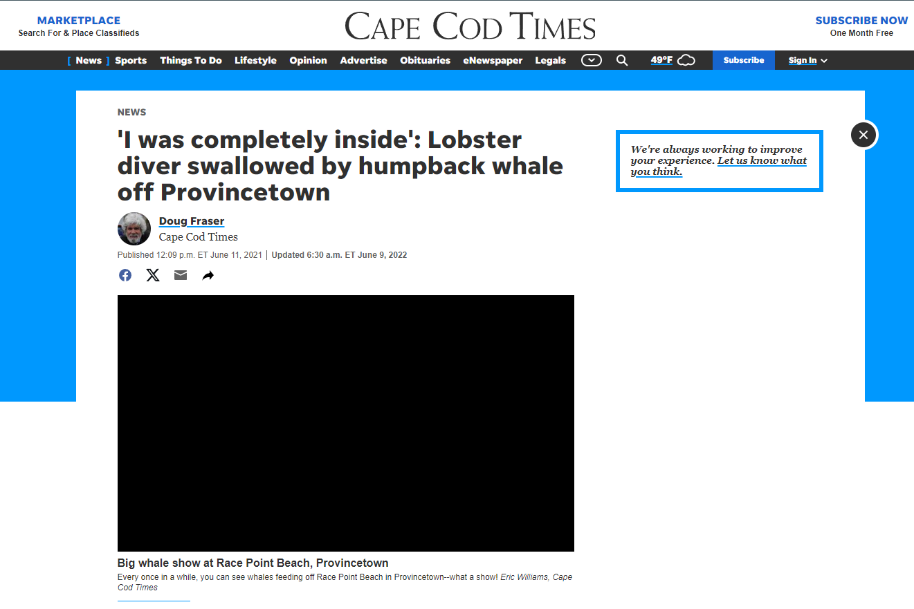
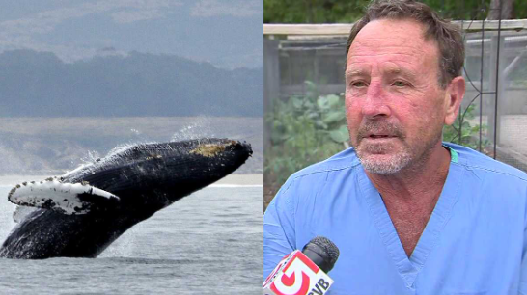

Slide 10
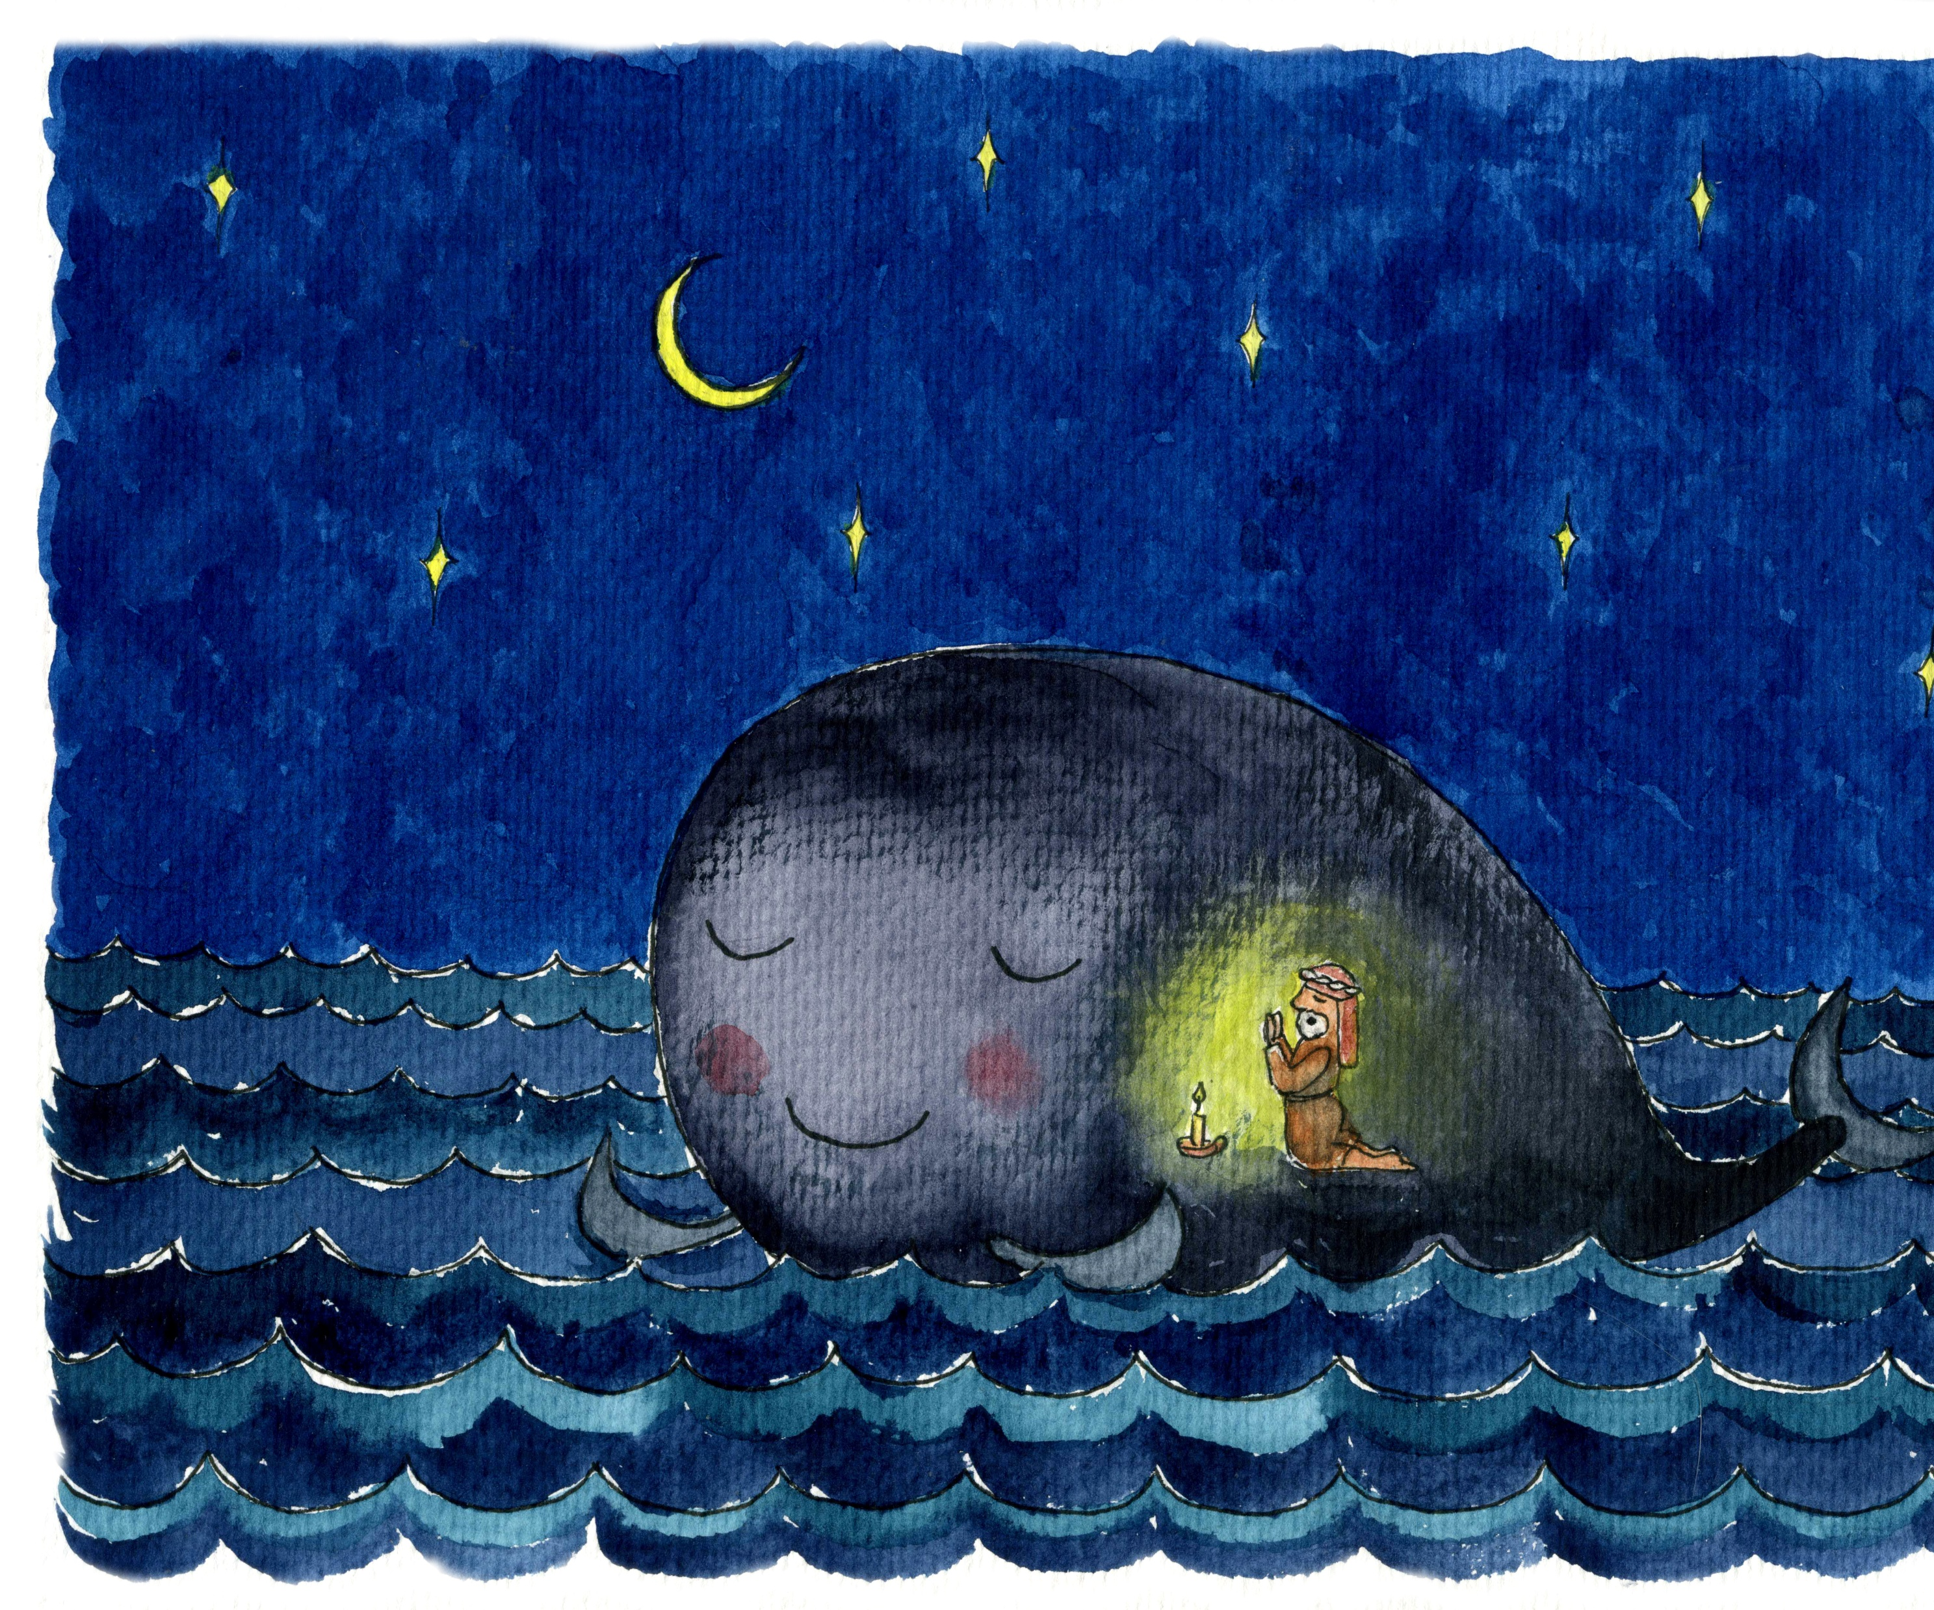
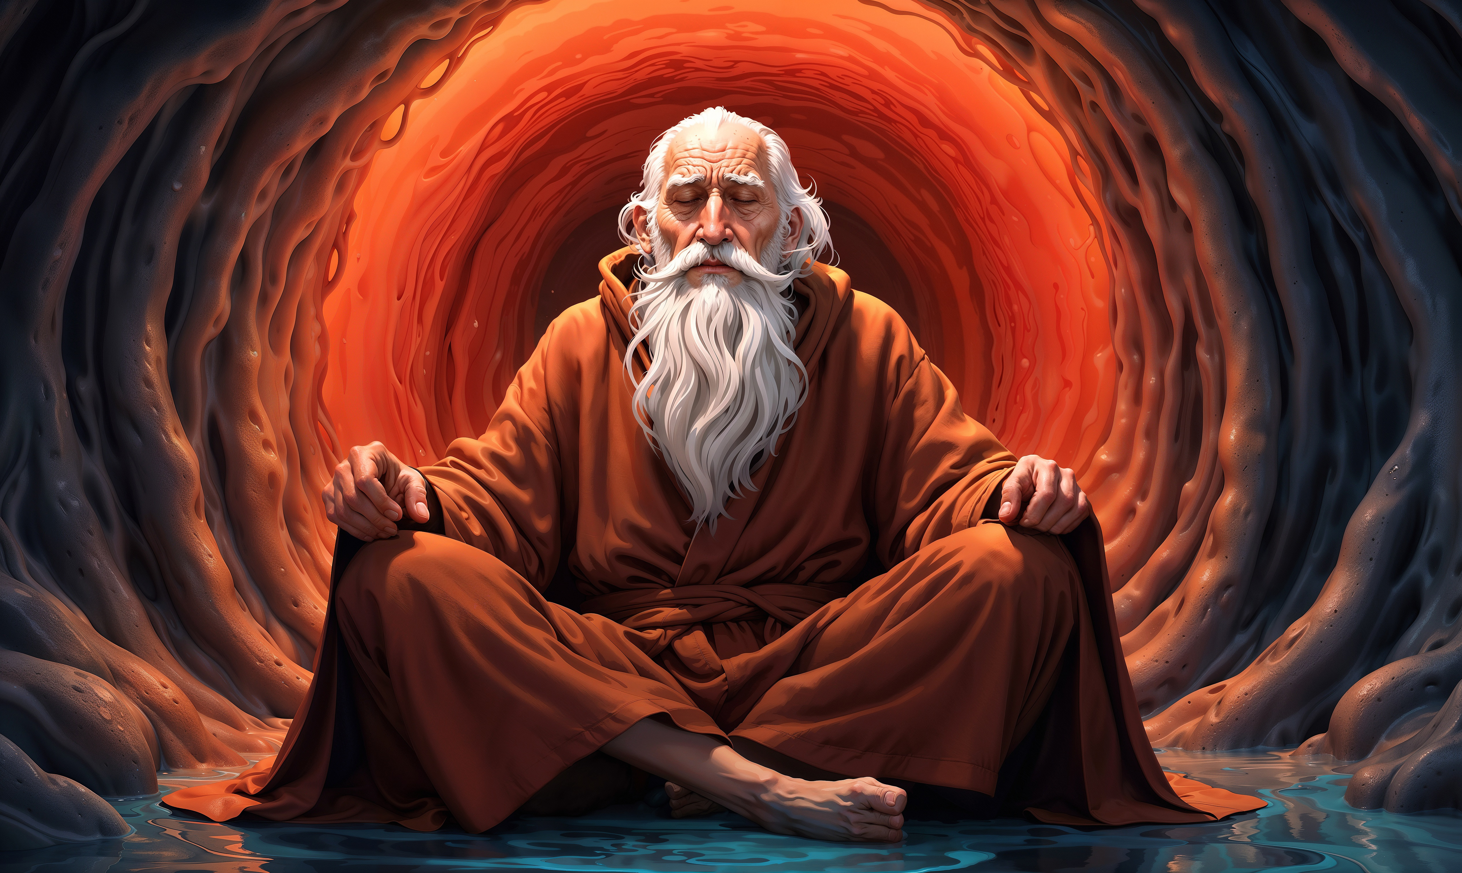

Slide 11
B. The Praying Prophet (2)
The place of prayer
Jonah’s unique location (v. 1)
The Plea for Help
Jonah’s desperate cry to God (v. 2)
From Sheol’s belly (v. 2b)

Slide 12
Jonah 4:2
He prayed to the LORD and said, “Please LORD, was not this what I said while I was still in my own country? Therefore, in order to forestall this I fled to Tarshish, for I knew that You are a gracious and compassionate God, slow to anger and abundant in lovingkindness, and one who relents concerning calamity.

Slide 13
B. The Praying Prophet (2)
The place of prayer
Jonah’s unique location (v. 1)
The Plea for Help
Jonah’s desperate cry to God (v. 2)
From Sheol’s belly (v. 2b)

Slide 14
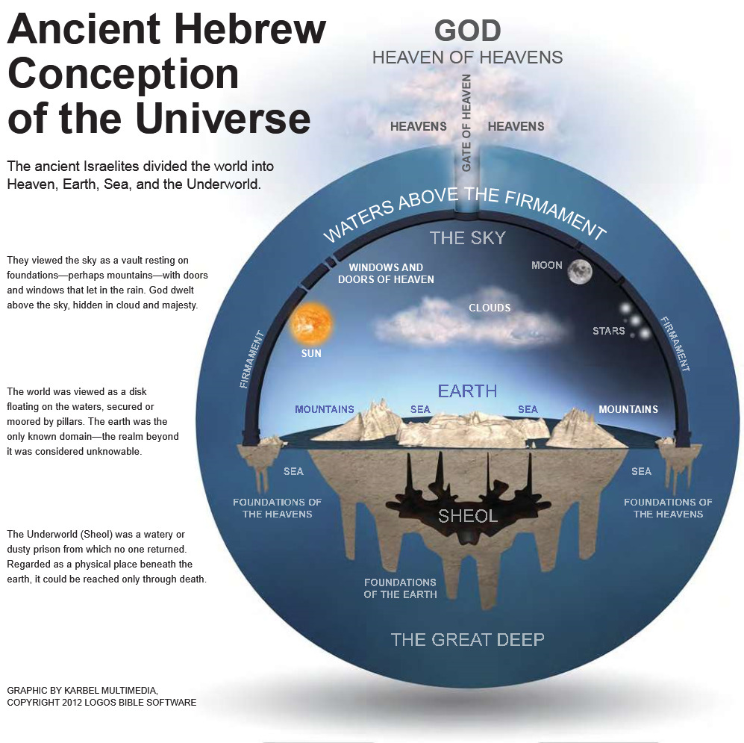

Slide 15
Psalm 49:14
“As sheep they are appointed for Sheol; Death shall be their shepherd; And the upright shall rule over them in the morning, And their form shall be for Sheol to consume So that they have no habitation. But God will redeem my soul from the power of Sheol, For He will receive me. Selah.”

Slide 16
B. The Praying Prophet (2)
The Divine Hand
a) God’s sovereignty acknowledged (v. 3)
The Depths of Despair
Banished (v. 4)
Engulfed (v. 5)
Descended (6a)

Slide 17
B. The Praying Prophet (2)
The Divine Hand
a) God’s sovereignty acknowledged (v. 3)
The Depths of Despair
Banished (v. 4)
Engulfed (v. 5)
Descended (6a)

Slide 18
B. The Praying Prophet (2)
The Divine Hand
a) God’s sovereignty acknowledged (v. 3)
The Depths of Despair
Banished (v. 4)
Engulfed (v. 5)
Descended (6a)

Slide 19
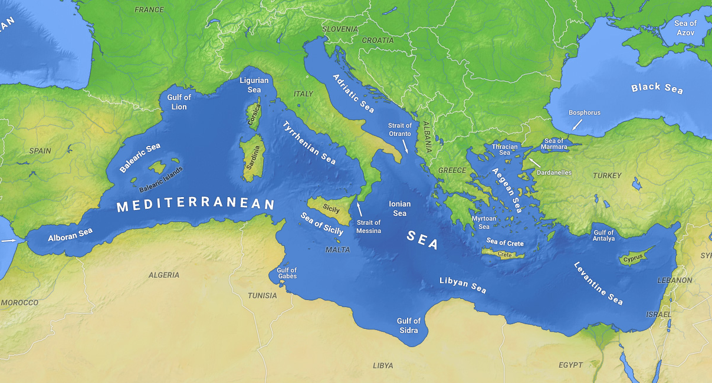

Slide 20
B. The Praying Prophet (2)
The Divine Hand
a) God’s sovereignty acknowledged (v. 3)
The Depths of Despair
Banished (v. 4)
Engulfed (v. 5)
Descended (6a)

Slide 21
B. The Praying Prophet (2)
The place of prayer
Jonah’s unique location (v. 1)
The Plea for Help
Jonah’s desperate cry to God (v. 2)
From Sheol’s belly (v. 2b)

Slide 22
B. The Praying Prophet (2)
The Divine Hand
a) God’s sovereignty acknowledged (v. 3)
The Depths of Despair
Banished (v. 4)
Engulfed (v. 5)
Descended (6a)

Slide 23
Conclusion

Slide 24
THE MESSAGE OF JONAH
To showcase God’s universal love and plan of redemption which extends beyond Israel to include all nations.

