Slide 1
Law and Grace: An Overview Jim McGowan, Th.D. Sugar Land Bible Church 02-16-2025
…but grace and truth were realized through Jesus Christ - John 1:17
For the Law was given through Moses…
Special thanks to Dr. Vern Peterman for access to his insights and resources.

Slide 2
Session 46 Outline
Review
Purpose, Aim, and Objective
Session 45
A No Star Cast – Matthew 8:14-34
General Information
Matt. 8:14-34
Concluding Observations

Slide 3
OUR PURPOSE, AIM AND OBJECTIVE
Law and Grace
…is to Compare and Contrast Law and Grace so as to properly understand these two important themes and how they are related to the life of the New Testament Believer.

Slide 4
POINTS OF CONTRAST AND COMPARISON
Law vs. Grace: Session 1: An Overview
Governing Principle | LAW | GRACE
Steward | MOSES | CHRIST
People Group | ISRAEL | CHURCH
Whose Works are you depending on? | Self | Christ
Baptism (Identification) | Into Moses (Law) | Into Christ
Ministry Characteristic | Death /Condemnation | Spirit /Righteousness
Nature of Blessings | Conditional (If) / Earthly | Unconditional / Heavenly
Earthly Difficulties | Curses for disobedience | Growth or discipline
Notes:
Points of Comparison & Contrast
Steward MOSES CHRIST
Scripture portrays both Moses and Christ as Stewards. Each was entrusted by God with the establishment of something.
Principle Israel under Law The Church under Grace
The principle of Law reigns over Israel while the principle of Grace reigns over the Church.
Who’s Works are you depending on? Self Christ
Under the Law – Do’s and Don’ts to be blessed or cursed. Under Grace we rely on Christ’s works! It is His works that save and make me who I am “In Christ”.
People Group ISRAEL CHURCH
Baptism Into Moses Into Christ
The people groups mentioned above are spoken of as having been baptized into (identified with and joined to) either Moses (LAW) or Christ (GRACE). We as believers have been baptized into Christ which has great significance for us.
Ministry Characteristic Death Condemnation Spirit Righteousness
2 Cor. 3
Nature of Blessings Conditional (If) / Earthly Unconditional / Heavenly
Deut. 28:1-14 (Blessings) 15-68 (Curses) Eph. 1:3; 4 (practical implications)
Earthly Difficulties Curses for disobedience Growth or discipline
NEXT SLIDE

Slide 5
Henry Ironside
The Continual Burnt Offering: Daily Meditations on the Word of God (p. 265). Neptune, NJ: Loizeaux Brothers.
In Romans 7 we have a man renewed by the Spirit of God, but struggling under law, hoping thereby to subdue or find deliverance from the power of the old Adamic nature. In chapter 8 we have God’s way of deliverance through the death and resurrection of Christ with which the believer is identified before God. The chapter begins with “no condemnation” and ends with “no separation.” All who are in Christ Jesus are accepted in the Beloved and as free from every charge of guilt as He is Himself. He paid our penalty on the cross. Now we are linked up with Him in resurrection, not under law but under grace.

Slide 6
Matthew’s 3-Fold Purpose
Law and Grace: Review Matthew
To explain:
that Jesus in whom they had believed was the long-awaited Jewish Messiah
why the kingdom had been postponed despite the fact that the king had arrived
the interim program of God during the kingdom’s absence

Slide 7
Matthew’s Message
Law and Grace: Review
Jesus is the predicted Jewish king who ushered in an interim program by building the sons of the kingdom into the Church in between Israel’s past rejection and future acceptance of her king.

Slide 8
Session 46 Outline
Review
Purpose, Aim, and Objective
Session 45
A No Star Cast – Matthew 8:14-34
General Information
Matt. 8:14-34
Concluding Observations

Slide 9
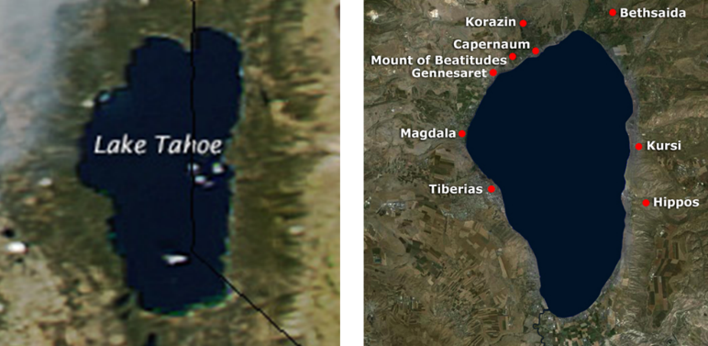
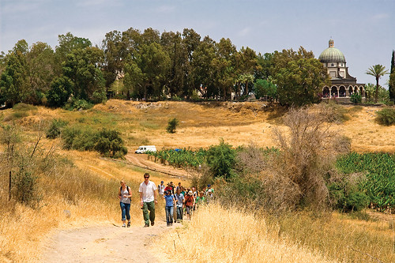
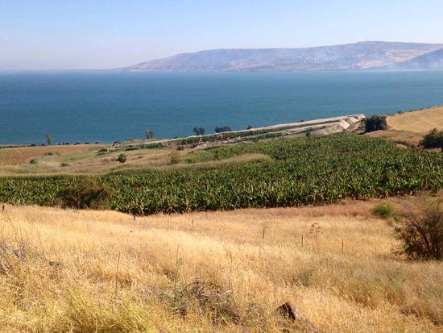
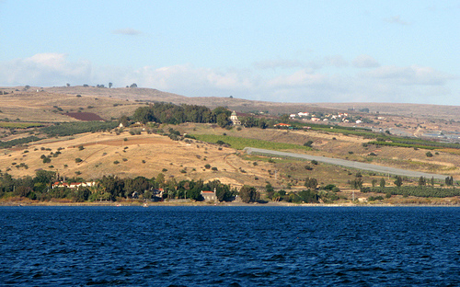
Law and Grace: Review Lesson 45 – Matthew 8:1-13
Just after the Sermon on the Mount
Matthew 8:1-13

Slide 10
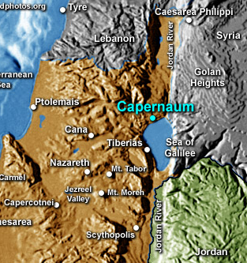
Law and Grace: Review Lesson 45 – Matthew 8:1-13
Just after the Sermon on the Mount
Matthew 8:1-13
Capernaum served as a sort of head-quarters for His ministry in the Sea of Galilee region, named 16 times and in all four Gospels.
“…and leaving Nazareth, He came and settled in Capernaum, which is by the sea, in the region of Zebulun and Naphtali” (Matthew 4:13).

Slide 11
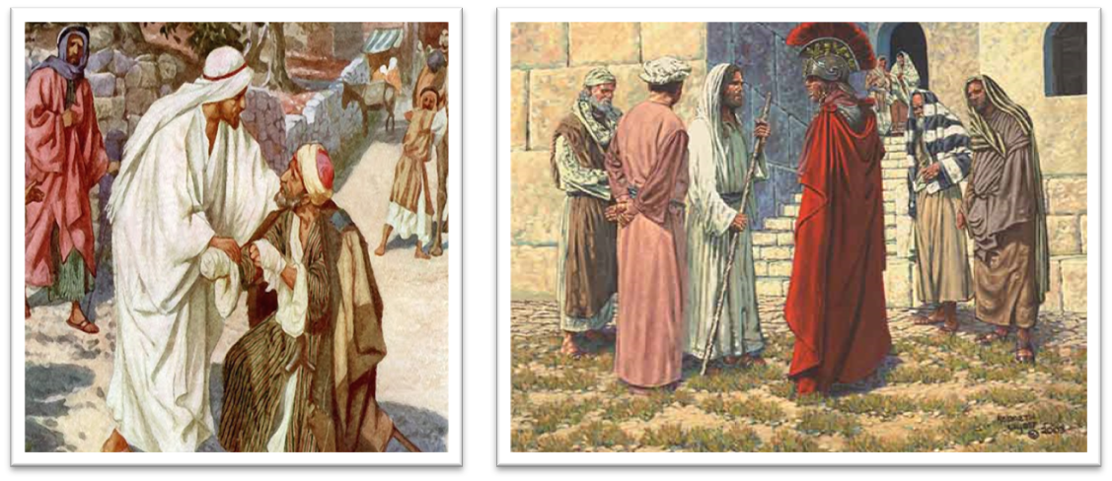
Law and Grace: Review Lesson 45 – Matthew 8:1-13
Two things happened on the way…
Matthew 8:1-13
As Jesus was headed down from the Mount to Capernaum, He was met by a leper.
And as He came into Capernaum He was met by a Roman centurion who asked that his servant be healed.

Slide 12
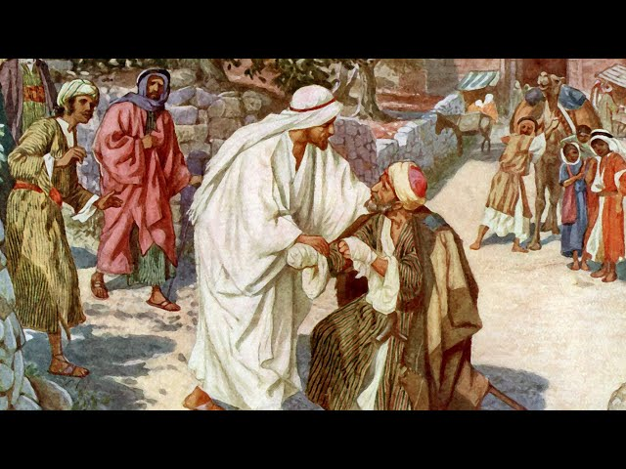
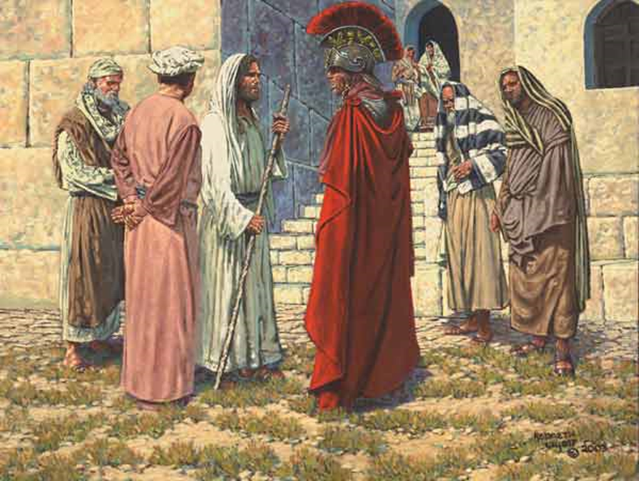
Law and Grace: Review Lesson 45 – Matthew 8:1-13
Two things happened on the way…
Matthew 8:1-13
Each will find that Christ heals, as a validation that He was the Messiah, but we’ll also find remarkable contrasts.

Slide 13
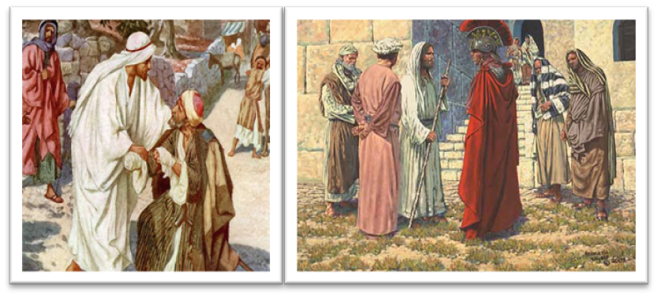
Law and Grace: Review Lesson 45 – Matthew 8:1-13
We were and are…
Matthew 8:1-13
By way of application, though we are in the body of Christ, each of us was, spiritually speaking, like the leper whom Jesus touched and healed (cf. Rom. 5:6, 8, 10).
Like the centurion, who was unworthy of having the Lord of glory come into his home, we also were unworthy of having Christ come into our heart’s home!

Slide 14
Law and Grace: Review Lesson 45 – Matthew 8:1-13
We were and are…
Matthew 8:1-13
But Jesus not only came into our hearts home, ABBA, Father, has also positioned us ‘in Him’. Why would He do this? Because we are intended for intimacy with Christ!

Slide 15
Session 46 Outline
Review
Purpose, Aim, and Objective
Session 45
A No Star Cast – Matthew 8:14-34
General Information
Matt. 8:14-34
Concluding Observations

Slide 16
Law and Grace: Matthew 8:14-34
Jesus, the Messiah, validated!
Matthew 8:14-34
Matthew 8 consists of several accounts of Jesus performing miracles that validated His singular identity as God’s Messiah, the King of Israel (Matthew 8:17; Isaiah 29:18-19…).

Slide 17
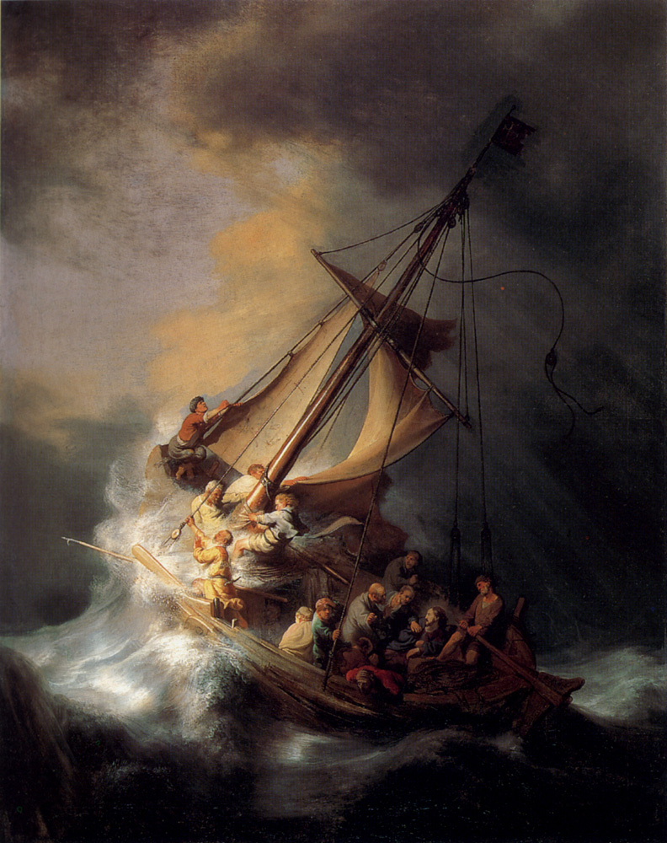
Law and Grace: Matthew 8:14-34
Jesus, the Messiah, validated!
Matthew 8:14-34
In Matthew 8:14-34 we’ll see Jesus:
cure Peter’s mother-in-law (14-15),
publicly cast out demons (16-17),
calm a storm and challenge those who would be His disciples (18-27), and
privately cast out demons and drown a herd of swine (28-34).

Slide 18
Law and Grace: Matthew 8:14-34
Dr. Arnold Fruchtenbaum
The Messianic Bible Study Collection (Vol. 3, pp. 3–4). Ariel Ministries. (1983).
The purpose of all His miracles between [Matthew] chapters 4 and 12 is to authenticate His Person and His message. They are signs to force the nation of Israel to come to a decision regarding two things: first, His Person, that He is the Messiah; and secondly, His message, the gospel of the Kingdom.

Slide 19
Session 46 Outline
Review
Purpose, Aim, and Objective
Session 45
A No Star Cast – Matthew 8:14-34
General Information
Matt. 8:14-34
Concluding Observations

Slide 20
Matthew 8:14–15
¹⁴ When Jesus came into Peter’s home, He saw his mother-in-law lying sick in bed with a fever. ¹⁵ He touched her hand, and the fever left her; and she got up and waited on Him.

Slide 21
Law and Grace: Matthew 8:14-34
Jesus came into Capernaum
Matthew 8:14-17
Jesus had come to the city of Capernaum and once there, He came to the house of Peter, where his mother-in-law was discovered to have a fever. Jesus then heals her with a touch.

Slide 22
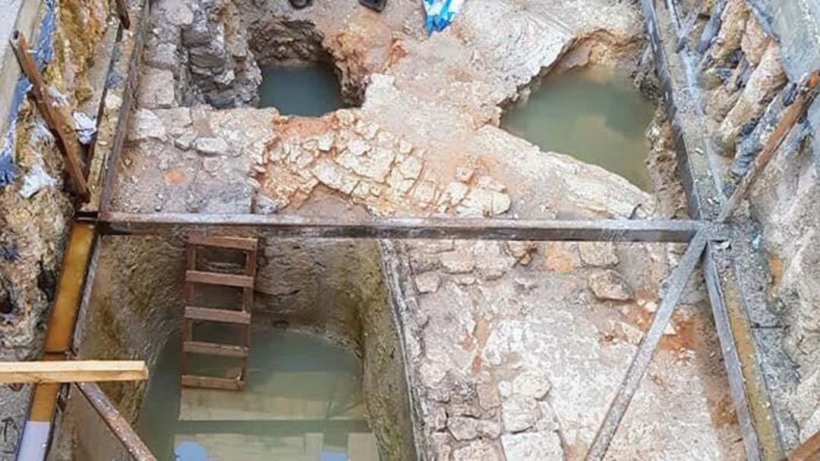
Law and Grace: Matthew 8:14-34
Jesus came into Capernaum
Matthew 8:14-17
An interesting fact is that all throughout Israel ritual baths for purification called mikvah baths have been found (`700) because the Jews used them for ceremonial purification. But there are no mikvah baths found in Capernaum.

Slide 23
Law and Grace: Matthew 8:14-34
CHIASM IN MATTHEW
Matthew 8:14-15
A chiasm is a mirror image in written form

Slide 24
Chiasm in Matthew 8:14-15
And when
Jesus had come to Peter's home,
He saw his mother-in-law lying
sick in bed with a fever. And
He touched her hand, and
the fever left her; and
she arose, and
waited on Him.
Once Jesus touched Peter’s mother-in-law, each line is the reversal of the corresponding line before: “with a fever” > “fever left her” / “mother-in-law lying” / “she arose”, etc.

Slide 25
Chiasm in Matthew 8:14-15
And when
Jesus had come to Peter's home,
He saw his mother-in-law lying
sick in bed with a fever. And
He touched her hand, and
the fever left her; and
she arose, and
waited on Him.
Once Jesus touched Peter’s mother-in-law, each line is the reversal of the corresponding line before: “with a fever” > “fever left her” / “mother-in-law lying” / “she arose”, etc.

Slide 26
Chiasm in Matthew 8:14-15
And when
Jesus had come to Peter's home,
He saw his mother-in-law lying
sick in bed with a fever. And
He touched her hand, and
the fever left her; and
she arose, and
waited on Him.
Once Jesus touched Peter’s mother-in-law, each line is the reversal of the corresponding line before: “with a fever” > “fever left her” / “mother-in-law lying” / “she arose”, etc.

Slide 27
Chiasm in Matthew 8:14-15
And when
Jesus had come to Peter's home,
He saw his mother-in-law lying
sick in bed with a fever. And
He touched her hand, and
the fever left her; and
she arose, and
waited on Him.
Once Jesus touched Peter’s mother-in-law, each line is the reversal of the corresponding line before: “with a fever” > “fever left her” / “mother-in-law lying” / “she arose”, etc.

Slide 28
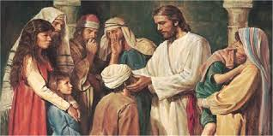
Matthew 8:16–17
¹⁶ When evening came, they brought to Him many who were demon-possessed; and He cast out the spirits with a word, and healed all who were ill. ¹⁷ This was to fulfill what was spoken through Isaiah the prophet: “He Himself took our infirmities and carried away our diseases.”

Slide 29
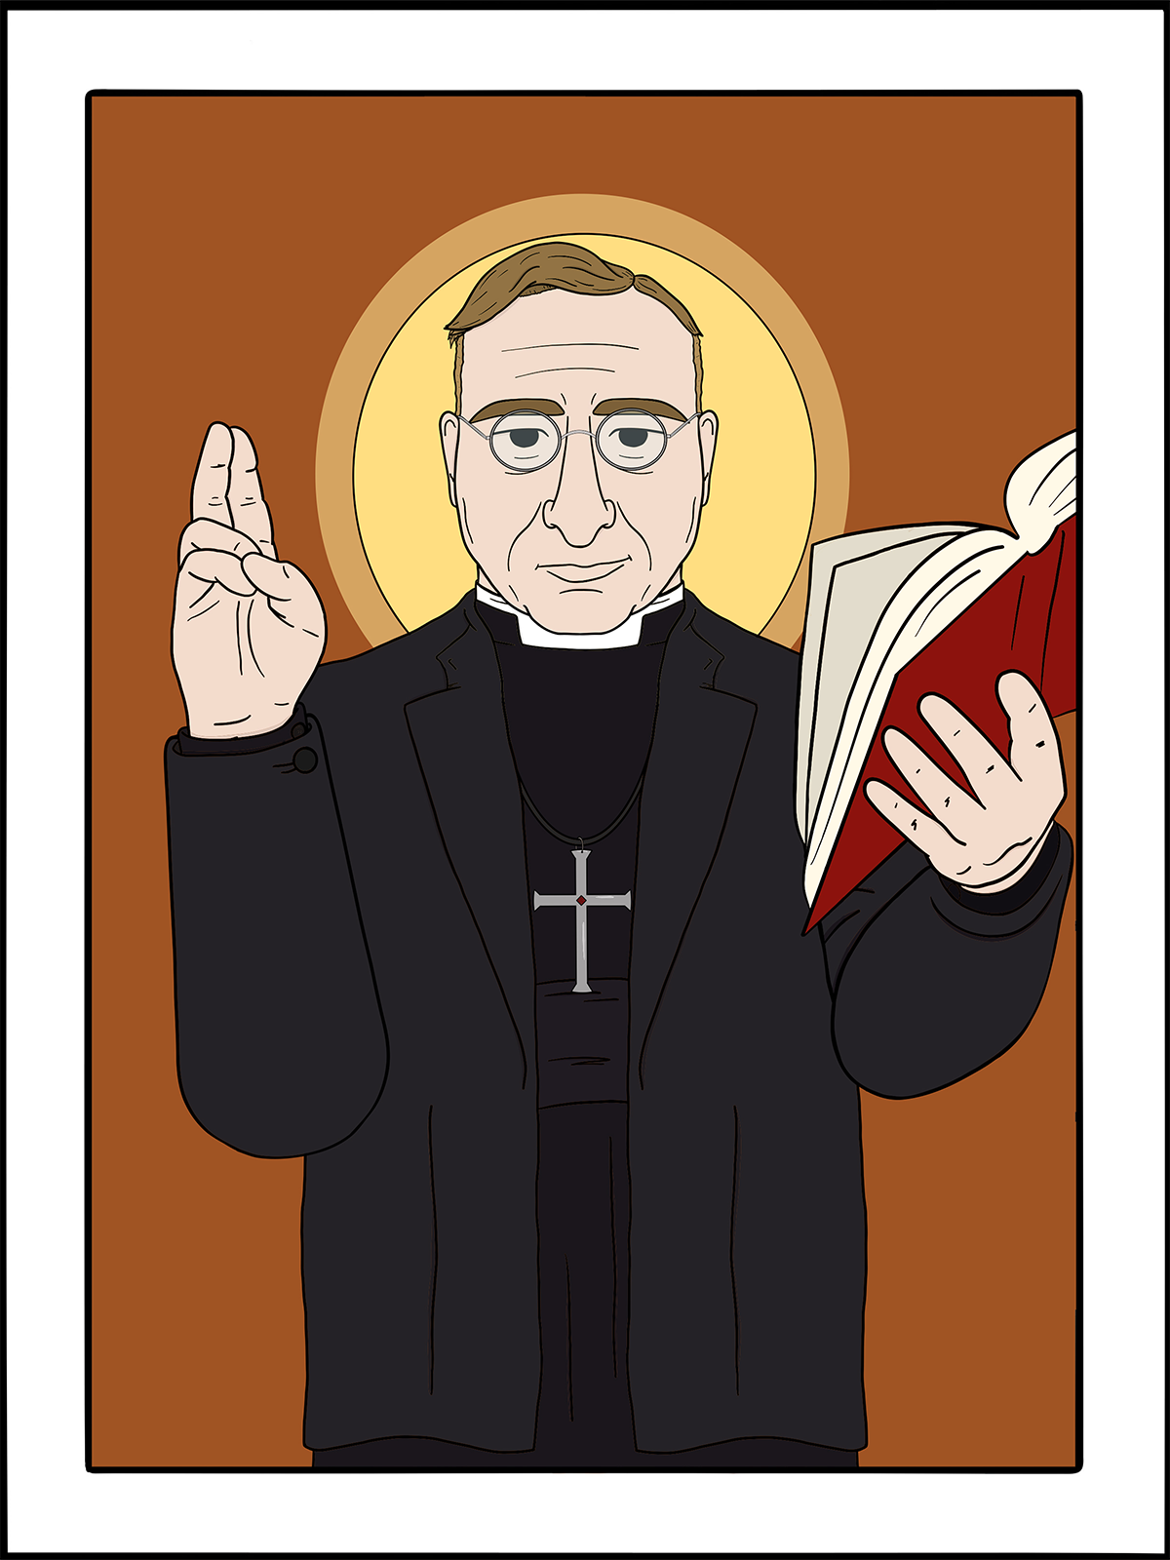
Law and Grace: Matthew 8:14-34
Demon-possession ≠ disease
Matthew 8:16-17
Some secularists and liberal theologians have said that the gospel writers were just ignorant, unable to discern demon-possession from physical illness.

Slide 30
Law and Grace: Matthew 8:14-34
Demon-possession ≠ disease
Matthew 8:16-17
But that is not at all what we see in this passage.
Jesus cast out the spirits from those possessed by the demons.
Physical illness is recognized, and is healed, but not by casting out the spirits.

Slide 31
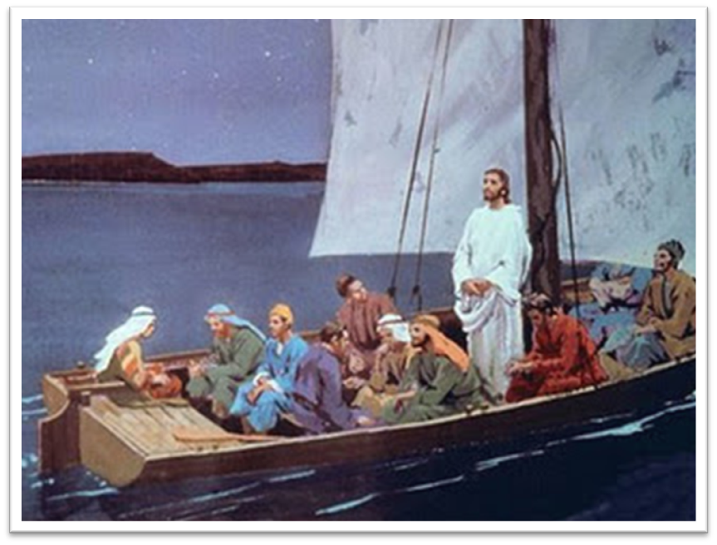
Matthew 8:18
¹⁸ Now when Jesus saw a crowd around Him, He gave orders to depart to the other side of the sea.

Slide 32
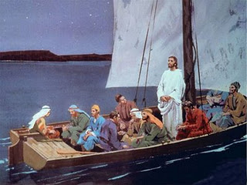
Law and Grace: Matthew 8:14-34
Some of Jesus’ disciples had boats
Matthew 8:18
Since some of Jesus’ disciples were fishermen, they had boats enough to carry them all across the sea of Galilee.

Slide 33
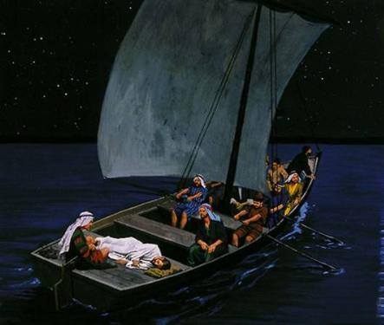
Law and Grace: Matthew 8:14-34
Some of Jesus’ disciples had boats
Matthew 8:18
And the boats were one way for them to get away from the press and demands of the crowds, and to spend quality time with Christ, temporarily.

Slide 34
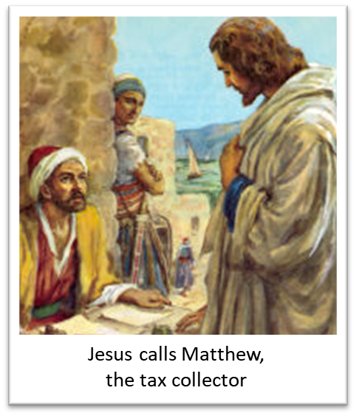
Law and Grace: Matthew 8:14-34
Who are truly disciples?
Matthew 8:19-22
Jesus had not yet called all of the twelve disciples (cf. Matthew 9:9), and there were to be other disciples than the twelve.

Slide 35
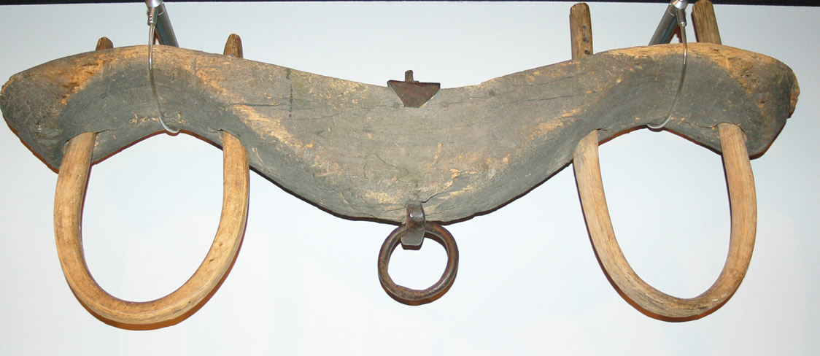
Law and Grace: Matthew 8:14-34
Who are truly disciples?
Matthew 8:19-22
All of the rabbis in the time of Christ called and challenged disciples in similar ways to how Christ did – so what was different with Christ?
Only Christ was deity, sent from the Father, and the long-promised Messiah who taught with authority and healed!
“Take my yoke…” Matthew 11:29

Slide 36
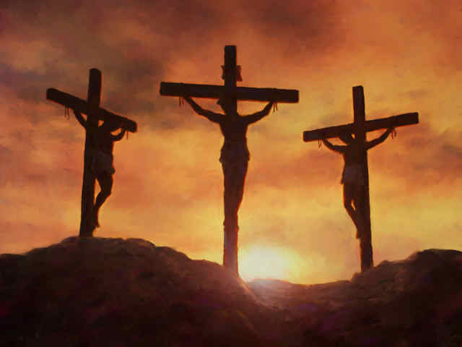
No other rabbi volunteered to die for man’s sin!
Law and Grace: Matthew 8:14-34
Who are truly disciples?
Matthew 8:19-22

Slide 37
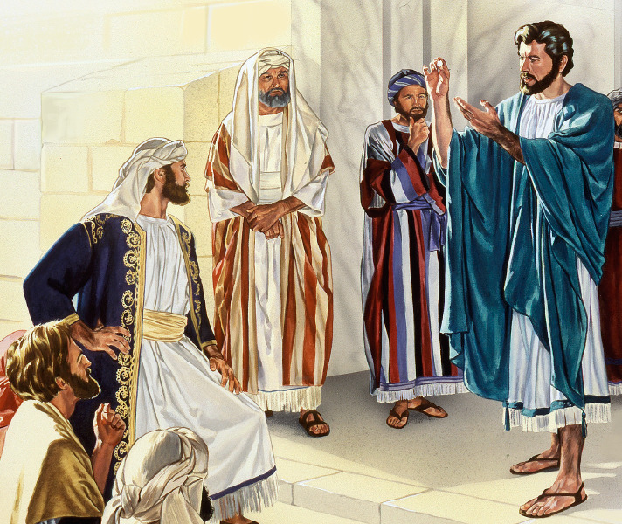
Matthew 8:19–20
¹⁹ Then a scribe came and said to Him, “Teacher, I will follow You wherever You go.” ²⁰ Jesus said to him, “The foxes have holes and the birds of the air have nests, but the Son of Man has nowhere to lay His head.” ²¹ Another of the disciples said to “Lord, permit me first to go and bury my father.” ²² But Jesus said to him, “Follow Me, and allow the dead to bury their own dead.”

Slide 38
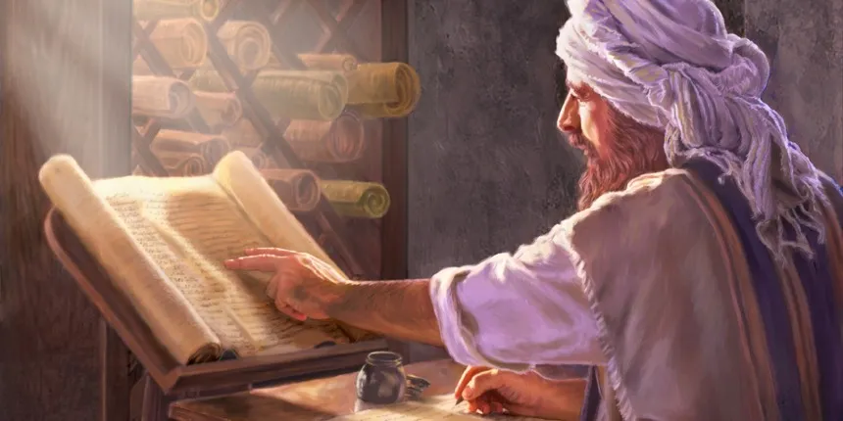
Law and Grace: Matthew 8:14-34
Challenges too, to two disciples!
Matthew 8:19-22
A scribe (a pharisee and expert in the Law) promises that he will follow Jesus wherever He goes.
However, Jesus neither encourages nor discourages him, but tells him “the Son of Man has nowhere to lay His head”, in other words, count the cost!

Slide 39
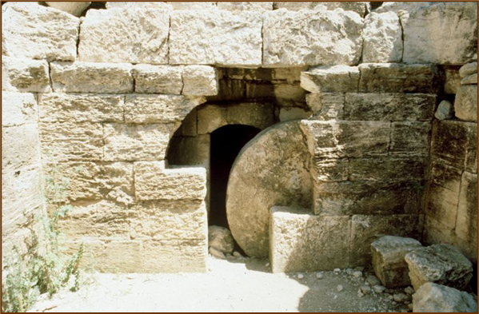
Matthew 8:21–22
¹⁹ Then a scribe came and said to Him, “Teacher, I will follow You wherever You go.” ²⁰ Jesus said to him, “The foxes have holes and the birds of the air have nests, but the Son of Man has nowhere to lay His head.” ²¹ Another of the disciples said to “Lord, permit me first to go and bury my father.” ²² But Jesus said to him, “Follow Me, and allow the dead to bury their own dead.”

Slide 40
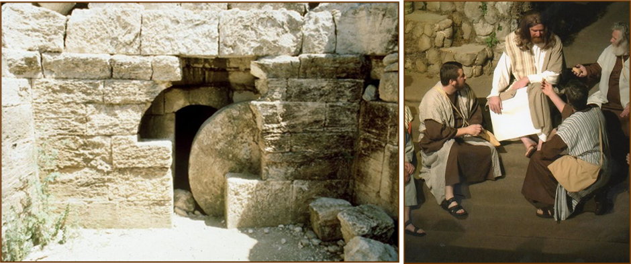
Law and Grace: Matthew 8:14-34
Challenges, too, to two disciples!
Matthew 8:19-22
Another ‘disciple’ requested to be allowed to bury his father basically, offering an excuse for failing to continue as a disciple.

Slide 41
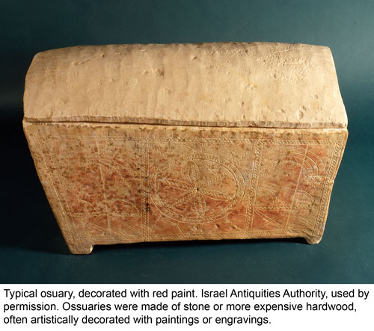
Law and Grace: Matthew 8:14-34
First-Century Jewish Burial Practices
“The second burial occurred about a year later when family members reentered the tomb, carefully took the bones of the deceased (once the flesh had completely decomposed), and placed them in a specially prepared, separate container known as an ossuary (from Latin os, “a bone”). These chests were placed in small niches in the tomb for permanent burial. Gathering the bones following the primary burial was considered one of the important duties of a son and was viewed as a time of rejoicing. This practice ended by the middle or end of the third century AD.”
https://rsc.byu.edu/behold-lamb-god/jesus-ossuaries-first-century-jewish-burial-practices-lost-tomb-jesus

Slide 42
Law and Grace: Matthew 8:14-34
Challenges, too, to two disciples!
Matthew 8:19-22
Jesus was testing this man’s priorities. Jesus was saying, “Following me now is more important than waiting to do so until his father died.”

Slide 43
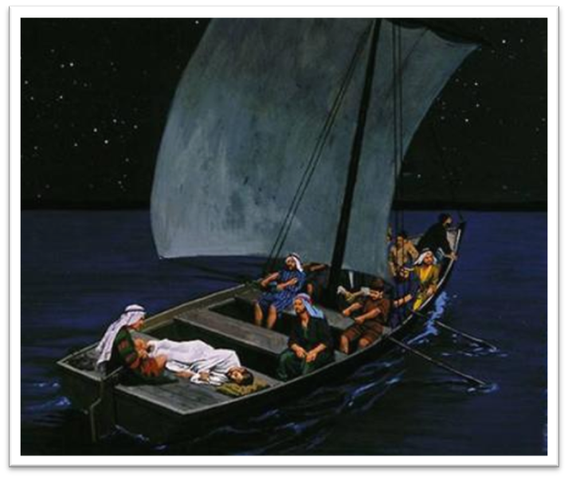
Matthew 8:23–27
²³ When He got into the boat, His disciples followed Him. ²⁴ And behold, there arose a great storm on the sea, so that the boat was being covered with the waves; but Jesus Himself was asleep. ²⁵ And they came to Him and woke Him, saying, “Save us, Lord; we are perishing!” ²⁶ He said to them, “Why are you afraid, you men of little faith?” Then He got up and rebuked the winds and the sea, and it became perfectly calm. ²⁷ The men were amazed, and said, “What kind of a man is this, that even the winds and the sea obey Him?”

Slide 44
Law and Grace: Matthew 8:14-34
Storm, sleep, panic & peace
Matthew 8:23-27
After the disciples get into the boat with Jesus, a storm arises while Jesus is asleep.
The disciples are in a panic over the fierceness of the storm, so they awaken Jesus.

Slide 45
Matthew 8:23–27
²³ When He got into the boat, His disciples followed Him. ²⁴ And behold, there arose a great storm on the sea, so that the boat was being covered with the waves; but Jesus Himself was asleep. ²⁵ And they came to Him and woke Him, saying, “Save us, Lord; we are perishing!” ²⁶ He said to them, “Why are you afraid, you men of little faith?” Then He got up and rebuked the winds and the sea, and it became perfectly calm. ²⁷ The men were amazed, and said, “What kind of a man is this, that even the winds and the sea obey Him?”

Slide 46
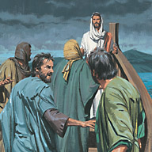
Law and Grace: Matthew 8:14-34
Storm, sleep, panic & peace
Matthew 8:23-27
At first Jesus openly questions the faith of the disciples and then calms the storm.
The disciples have their eyes opened, marveling that even the wind and the sea obey the command of Christ the Lord.

Slide 47
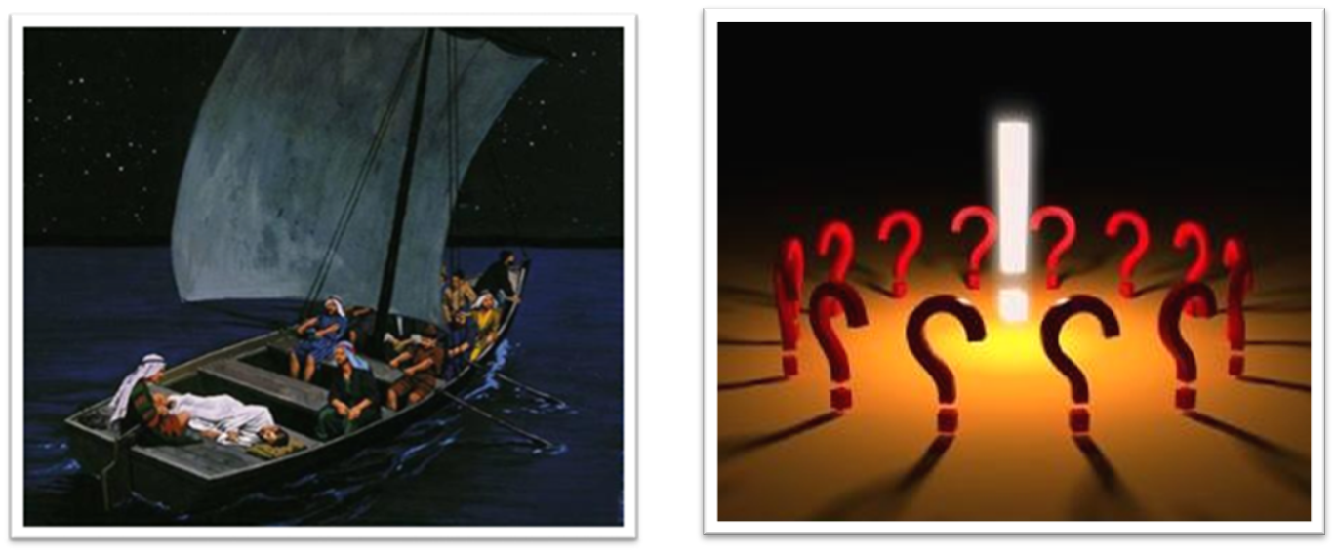
Law and Grace: Matthew 8:14-34
Here’s a question!
Matthew 8:23-27
Was it negligence for Christ to sleep?

Slide 48
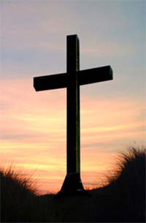
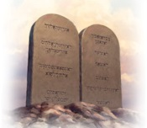
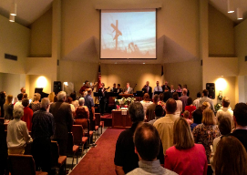
Law and Grace: Matthew 8:14-34
Here’s a question!
Matthew 8:23-27
Do these verses promise that all threats will be safely resolved? NO!
We are not Christ’s Jewish disciples with Christ in the boat, in the land of Israel, at the start of His ministry. We are a different people for whom God has different plans and purposes.

Slide 49
Law and Grace: Matthew 8:14-34
What has God promised? – Confirmation!
Matthew 8:23-27
We’re going to be confirmed to the end on the day we go to see the Lord! Who will make sure that it happens – The Lord Jesus.

Slide 50
Law and Grace: Matthew 8:14-34
What has God promised? – Conformity
Matthew 8:23-27
Trials are part of God's process of conforming us into the image of Christ – a conformity to which we are predestined, (it's going to happen) as an aspect of grace. (Philippians 1:29, James 1:2–3 Romans. 8:28-29).

Slide 51
Philippians 1:29
“For to you it has been granted for Christ’s sake, not only to believe in Him, but also to suffer for His sake,…”
James 1:2–3
“² Consider it all joy, my brethren, when you encounter various trials, ³ knowing that the testing of your faith produces endurance.”

Slide 52
Romans 8:28–29
²⁸ And we know that God causes all things to work together for good to those who love God, to those who are called according to His purpose. ²⁹ For those whom He foreknew, He also predestined to become conformed to the image of His Son, so that He would be the firstborn among many brethren;

Slide 53
Law and Grace: Matthew 8:14-34
A small question with a big answer
Matthew 8:27
The small question is the one that the disciples asked in v. 27 – a very good question.

Slide 54
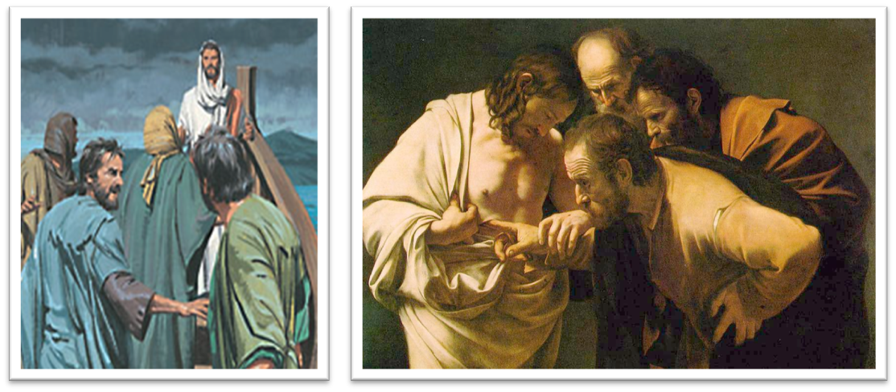
Law and Grace: Matthew 8:14-34
A small question with a big answer
Matthew 8:27
The truth is that these men would continue to discover ‘what kind of man Jesus is’ for years.
Like Jesus’ disciples, we, too can spend years, even decades, discovering Him…and who we in Him are as we discover Him.

Slide 55
Matthew 8:28–32
²⁸ When He came to the other side into the country of the Gadarenes, two men who were demon-possessed met Him as they were coming out of the tombs. They were so extremely violent that no one could pass by that way. ²⁹ And they cried out, saying, “What business do we have with each other, Son of God? Have You come here to torment us before the time?” ³⁰ Now there was a herd of many swine feeding at a distance from them. ³¹ The demons began to entreat Him, saying, “If You are going to cast us out, send us into the herd of swine.” ³² And He said to them, “Go!” And they came out and went into the swine, and the whole herd rushed down the steep bank into the sea and perished in the waters.

Slide 56
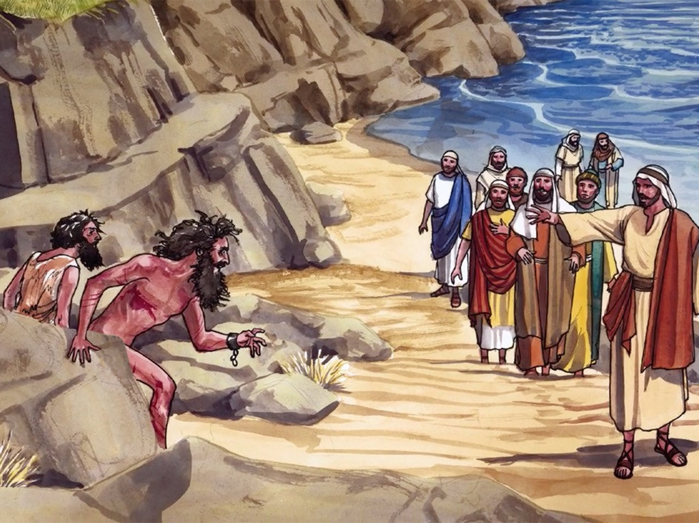
Law and Grace: Matthew 8:14-34
Just when you thought the rough part was over
Matthew 8:28-34
When Jesus and His disciples get to the other side of the Sea of Galilee, they encounter a pair of dangerous men who are possessed by demons (fallen angels).
The demons in the men express concern that their time of torture is about to begin earlier than expected.

Slide 57
Matthew 8:28–32
²⁸ When He came to the other side into the country of the Gadarenes, two men who were demon-possessed met Him as they were coming out of the tombs. They were so extremely violent that no one could pass by that way. ²⁹ And they cried out, saying, “What business do we have with each other, Son of God? Have You come here to torment us before the time?” ³⁰ Now there was a herd of many swine feeding at a distance from them. ³¹ The demons began to entreat Him, saying, “If You are going to cast us out, send us into the herd of swine.” ³² And He said to them, “Go!” And they came out and went into the swine, and the whole herd rushed down the steep bank into the sea and perished in the waters.

Slide 58
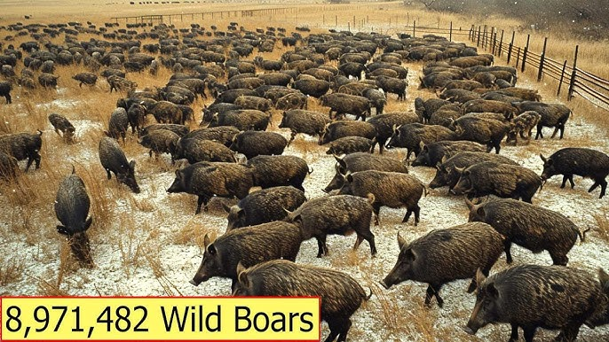
Law and Grace: Matthew 8:14-34
The porcine solution!
Matthew 8:28-34
The demons then request to go into the bodies of a nearby herd of pigs.
Why were there pigs present at all, if the people living in that area were Jews?

Slide 59
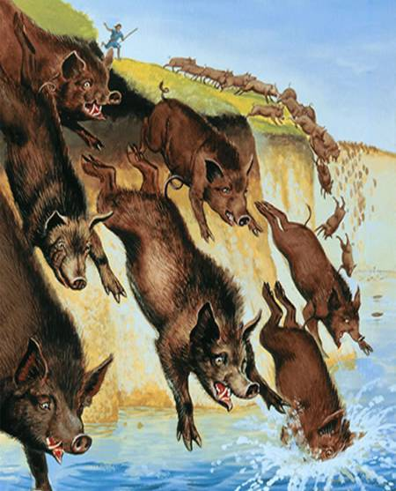
Law and Grace: Matthew 8:14-34
The porcine solution!
Matthew 8:28-34
Jesus grants permission for the demons to enter the pigs and the entire herd (~2000) plunged into the Sea of Galilee. What was the result?

Slide 60
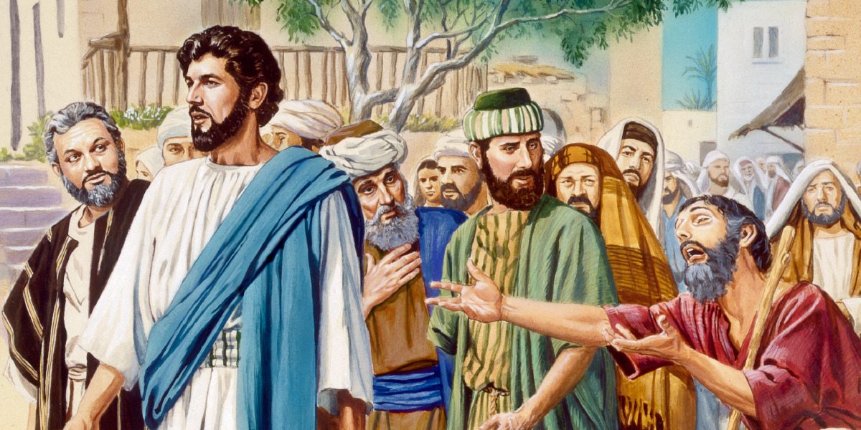
Matthew 8:33–34
³³ The herdsmen ran away, and went to the city and reported everything, including what had happened to the demoniacs. ³⁴ And behold, the whole city came out to meet Jesus; and when they saw Him, they implored Him to leave their region.

Slide 61
Law and Grace: Matthew 8:14-34
Jesus leaves the crowd, then the crowd begs Jesus to leave!
Matthew 8:28-34
Rather than being glad that Jesus had resolved the local problem with the demoniacs, the crowd observes what has just happened and begs Jesus to leave!

Slide 62
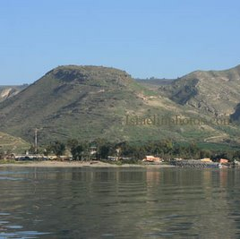
Law and Grace: Matthew 8:14-34
Jesus leaves the crowd, then the crowd begs Jesus to leave!
Matthew 8:28-34
They see in Jesus several serious problems:
Economic & labor
Food supply
Jewish / Gentile tensions and Jewish purity debates
The region of the demon-possessed men and suicidal pigs events.

Slide 63
Session 46 Outline
Review
Purpose, Aim, and Objective
Session 45
A No Star Cast – Matthew 8:14-34
General Information
Matt. 8:14-34
Concluding Observations

Slide 64
Law and Grace: Matthew 8:14-34
Discovering who Jesus is!
Matthew 8:14-34
Along with the presentation of the Gospel of the Kingdom, the disciples were discovering who Jesus was and that would become more apparent to them over the decades.

Slide 65
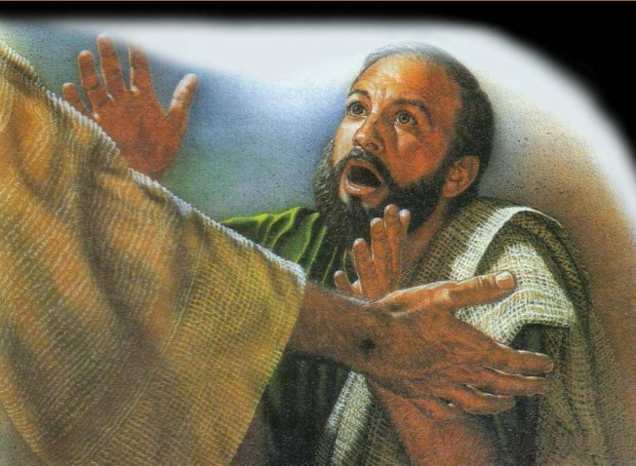
Law and Grace: Matthew 8:14-34
Discovering who Jesus is!
Matthew 8:14-34
When we believe the Gospel of Substitution, we too begin a journey of discovering who Jesus is, and that continues until we meet Him in glory through death or by way of the Rapture.

Slide 66
Law and Grace: Matthew 8:14-34
Discovering who He is, means discovering who we are!
Matthew 8:28-34
Discovering who He is means discovering who each of us is, since each one of us who believes has been placed into Him.

Slide 67
Law and Grace: Matthew 8:14-34
Discovering who He is, means discovering who we are!
Matthew 8:28-34
Discovering who He is means discovering who each of us is, since He has been made to dwell in each of us who has believed.

Slide 68
Law and Grace: Matthew 8:14-34
Discovering who He is, means discovering who we are!
Matthew 8:28-34
That discovery means spiritual intimacy, spiritual growth, and biblical clarity regarding our spiritual history and identity in Christ!

Slide 69
Law and Grace: An Overview Jim McGowan, Th.D. Sugar Land Bible Church 02-16-2025
…but grace and truth were realized through Jesus Christ - John 1:17
For the Law was given through Moses…
Special thanks to Dr. Vern Peterman for access to his insights and resources.

