Slide 2
Acts 11:19-30 The Church at Antioch
Development of the Church (11:19-26)
Benevolence of the Church (Acts 11:27-30)

Slide 3
Acts 11:19-30 The Church at Antioch
Development of the Church (11:19-26)
Benevolence of the Church (Acts 11:27-30)

Slide 4
I. Development of the Church Acts 11:19-26
Jewish evangelism in the Diaspora (19)
Gentile evangelism (20)
Progress report (21)
Barnabas’ ministry (22-24)
Saul reintroduced (25-26a)
Barnabas & Saul minister at Antioch (26b-d)

Slide 5
I. Development of the Church Acts 11:19-26
Jewish evangelism in the Diaspora (19)
Gentile evangelism (20)
Progress report (21)
Barnabas’ ministry (22-24)
Saul reintroduced (25-26a)
Barnabas & Saul minister at Antioch (26b-d)

Slide 6
Acts 8:3-4; 11:19
“³ But Saul began ravaging the church, entering house after house, and dragging off men and women, he would put them in prison. ⁴ Therefore, those who had been scattered went about preaching the word…¹⁹ So then those who were scattered because of the persecution that occurred in connection with Stephen made their way to Phoenicia and Cyprus and Antioch, speaking the word to no one except to Jews alone.”

Slide 7
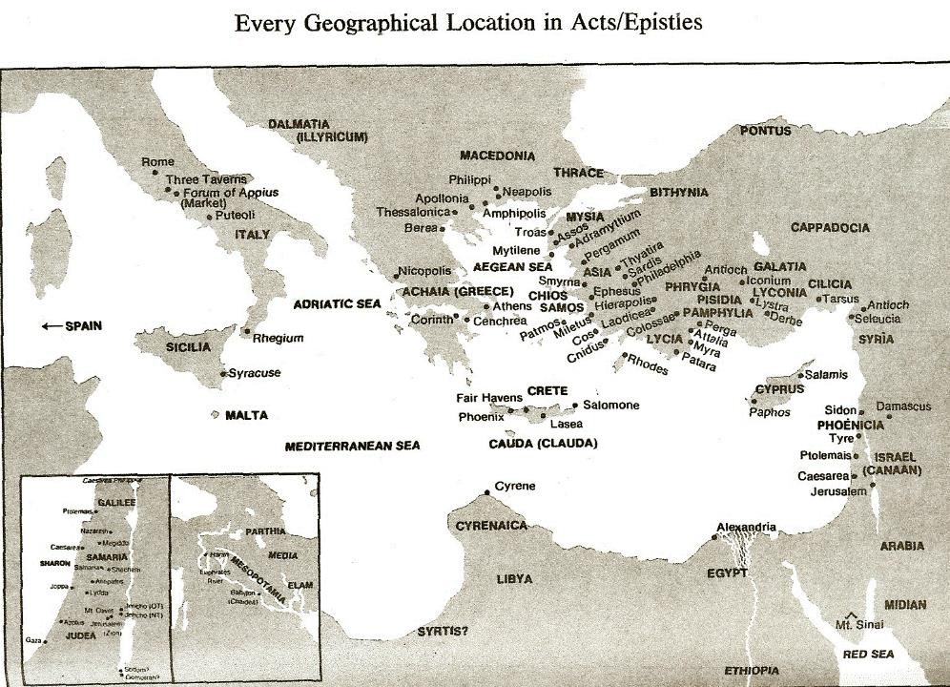

Slide 8
Acts 10:1‒11:18 Cornelius’ Salvation
Cornelius’ Vision (10:1-8)
Peter’s Vision (Acts 10:9-16)
Vision’s Application (10:17-23a)
Caesarean Ministry (10:23b-33)
Peter & The Keys of the Kingdom (10:34-43)
Gentiles’ Salvation (10:44-48)
Peter’s Defense in Jerusalem (11:1-18)

Slide 9
John 1:14
“And the Word [logos] became flesh, and dwelt among us, and we saw His glory, glory as of the only begotten [monogenēs] from the Father, full of grace and truth.”

Slide 10
I. Development of the Church Acts 11:19-26
Jewish evangelism in the Diaspora (19)
Gentile evangelism (20)
Progress report (21)
Barnabas’ ministry (22-24)
Saul reintroduced (25-26a)
Barnabas & Saul minister at Antioch (26b-d)

Slide 12
Acts 10:1‒11:18 Cornelius’ Salvation
Cornelius’ Vision (10:1-8)
Peter’s Vision (Acts 10:9-16)
Vision’s Application (10:17-23a)
Caesarean Ministry (10:23b-33)
Peter & The Keys of the Kingdom (10:34-43)
Gentiles’ Salvation (10:44-48)
Peter’s Defense in Jerusalem (11:1-18)

Slide 13
I. Development of the Church Acts 11:19-26
Jewish evangelism in the Diaspora (19)
Gentile evangelism (20)
Progress report (21)
Barnabas’ ministry (22-24)
Saul reintroduced (25-26a)
Barnabas & Saul minister at Antioch (26b-d)

Slide 14
Purpose
To present Theophilus with an orderly account of the birth and growth of the church so as to affirm him in what he has believed.

Slide 15
Message
Birth and growth of the church numerically, geographically, ethnically.
Components
Numerically (progress reports)
Geographically (From Jerusalem to Rome)
Ethnically (From Judaism to Gentile domination)

Slide 16
Progress Reports
Clearest: Acts 2:47; 6:7; 9:31; 12:24; 16:5; 19:20; 28:30-31
Less clear: Acts 1:13, 15; 2:41, 47; 4:4, 31; 5:14, 42; 8:25, 40; 11:21; 13:49; 17:6

Slide 17
A.T. Robertson
Word Pictures (Acts 20:21)
“In verse 21, the means of the preaching was that the hand of the Lord was with them. As a result, a great number that believed turned unto the Lord. Robertson notes that the Greek word for ‘to turn,’ epistrephó, was ‘the usual expression for Gentiles turning to the true God (Acts 14:15; Acts 15:3, 19; Acts 26:18, 20; 1 Th. 1:9).’”

Slide 18
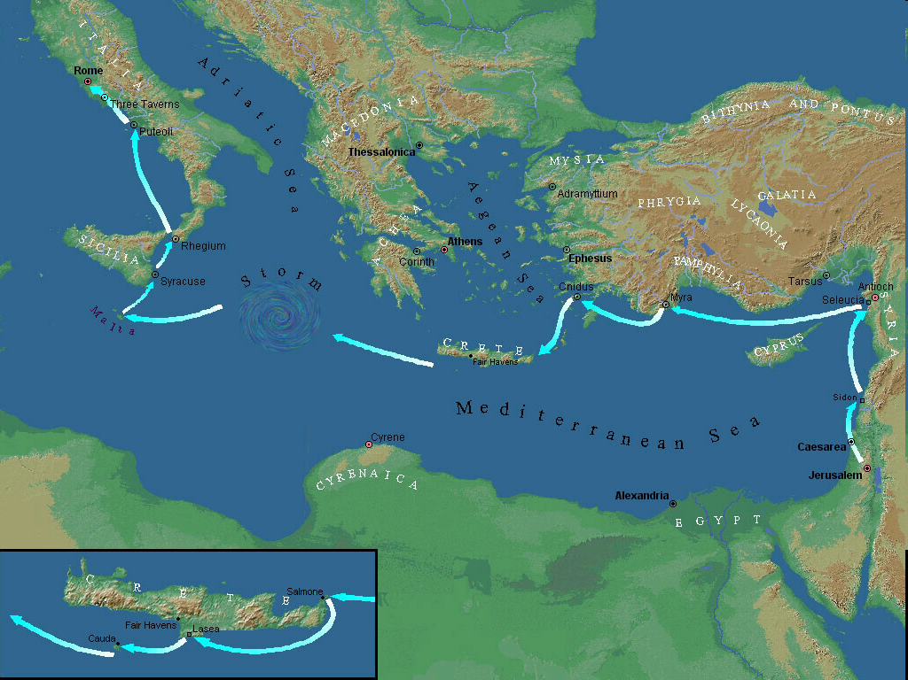

Slide 19
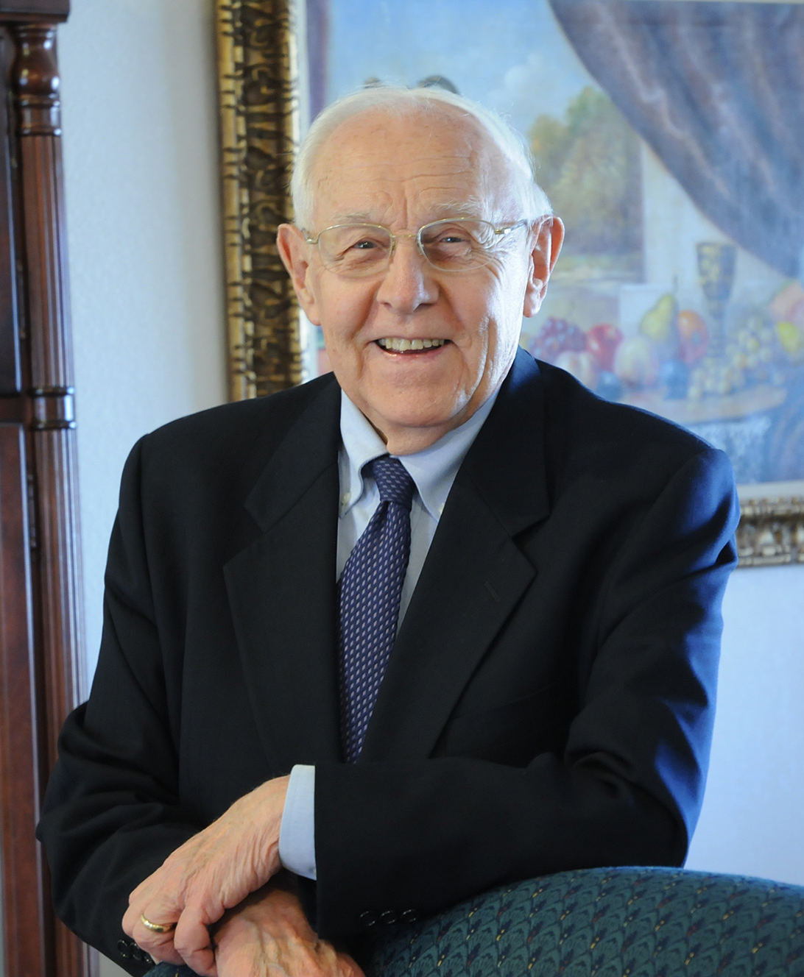
Dr. Stanley Toussaint
The Bible Knowledge Commentary, 383
Quoting the Roman poet and satirist Juvenal, The Bible Knowledge Commentary notes: “‘The sewage of the Syrian Orontes has for a long time been discharged into the Tiber.’ By this he meant that Antioch was so corrupt it was impacting Rome, more than 1,300 miles away.”

Slide 21
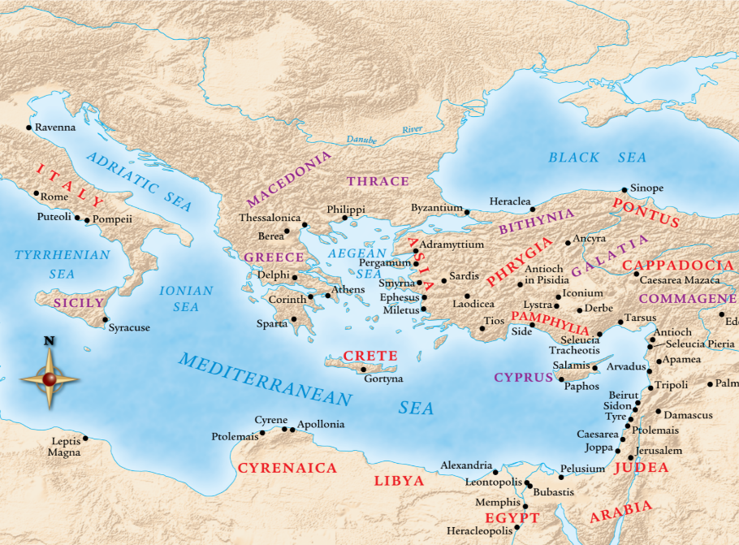

Slide 22
I. Development of the Church Acts 11:19-26
Jewish evangelism in the Diaspora (19)
Gentile evangelism (20)
Progress report (21)
Barnabas’ ministry (22-24)
Saul reintroduced (25-26a)
Barnabas & Saul minister at Antioch (26b-d)

Slide 23
Acts 11:22-24 Barnabas’ Ministry
Commission (22)
Activities (23)
Personality (24)

Slide 24
Acts 11:22-24 Barnabas’ Ministry
Commission (22)
Activities (23)
Personality (24)

Slide 26
Acts 11:22-24 Barnabas’ Ministry
Commission (22)
Activities (23)
Personality (24)

Slide 27
Acts 11:22-24 Barnabas’ Ministry
Commission (22)
Activities (23)
Personality (24)

Slide 28
Acts 6:3a Deacon Qualifications
Believers
Males
Reputable
Spiritual
Wise

Slide 29
1 Corinthians 3:1-3 (NKJV)
¹ And I, brethren, could not speak to you as to spiritual people but as to carnal, as to babes in Christ. ² I fed you with milk and not with solid food; for until now you were not able to receive it, and even now you are still not able; ³ for you are still carnal. For where there are envy, strife, and divisions among you, are you not carnal and behaving like mere men?

Slide 30
Notes:
Ray Steadman – “1st Californians”
Unbelievers vs Categories of Believers
Unbelievers – ψυχικός psuchikós; Natural, pertaining to the natural as distinguished from the spiritual
Spiritual Believers – πνευματικός pneumatikós; of persons who are spiritual, enlightened by the Holy Spirit
Infant Believers – σάρκινος sárkinos; with propensities of the flesh unto sin; νήπιος nḗpios; an infant, child, baby without any definite limitation of age. (This relates to immaturity and lack of instruction)
Carnal Believers – σαρκικός sarkikós; tendency to satisfy the flesh, implying sinfulness, sinful propensity, carnal (This relates to disobedience and open rebellion)

Slide 31
2 Peter 1:5-7
⁵ Now for this very reason also, applying all diligence, in your faith supply moral excellence, and in your moral excellence, knowledge, ⁶ and in your knowledge, self-control, and in your self-control, perseverance, and in your perseverance, godliness, ⁷ and in your godliness, brotherly kindness, and in your brotherly kindness, love.

Slide 32
PORTRAIT OF GROWTH 1:5-7

Slide 33
Purpose
To present Theophilus with an orderly account of the birth and growth of the church so as to affirm him in what he has believed.

Slide 34
Message
Birth and growth of the church numerically, geographically, ethnically.
Components
Numerically (progress reports)
Geographically (From Jerusalem to Rome)
Ethnically (From Judaism to Gentile domination)

Slide 35
Progress Reports
Clearest: Acts 2:47; 6:7; 9:31; 12:24; 16:5; 19:20; 28:30-31
Less clear: Acts 1:13, 15; 2:41, 47; 4:4, 31; 5:14, 42; 8:25, 40; 11:21; 13:49; 17:6

Slide 36
I. Development of the Church Acts 11:19-26
Jewish evangelism in the Diaspora (19)
Gentile evangelism (20)
Progress report (21)
Barnabas’ ministry (22-24)
Saul reintroduced (25-26a)
Barnabas & Saul minister at Antioch (26b-d)

Slide 37
Acts 11:25-26a Saul Reintroduced
Barnabas searches for Saul (25)
Barnabas brings Saul to Antioch (26a)

Slide 38
Acts 11:25-26a Saul Reintroduced
Barnabas searches for Saul (25)
Barnabas brings Saul to Antioch (26a)

Slide 40
Acts 11:25-26a Saul Reintroduced
Barnabas searches for Saul (25)
Barnabas brings Saul to Antioch (26a)

Slide 42
I. Development of the Church Acts 11:19-26
Jewish evangelism in the Diaspora (19)
Gentile evangelism (20)
Progress report (21)
Barnabas’ ministry (22-24)
Saul reintroduced (25-26a)
Barnabas & Saul minister at Antioch (26b-d)

Slide 43
Acts 11:26b-d Barnabas & Saul Minister at Antioch
Duration (26b)
Size (26c)
Name (26d)

Slide 44
Acts 11:26b-d Barnabas & Saul Minister at Antioch
Duration (26b)
Size (26c)
Name (26d)

Slide 45
Acts 11:26b-d Barnabas & Saul Minister at Antioch
Duration (26b)
Size (26c)
Name (26d)

Slide 46
Purpose
To present Theophilus with an orderly account of the birth and growth of the church so as to affirm him in what he has believed.

Slide 47
Message
Birth and growth of the church numerically, geographically, ethnically.
Components
Numerically (progress reports)
Geographically (From Jerusalem to Rome)
Ethnically (From Judaism to Gentile domination)

Slide 48
Progress Reports
Clearest: Acts 2:47; 6:7; 9:31; 12:24; 16:5; 19:20; 28:30-31
Less clear: Acts 1:13, 15; 2:41, 47; 4:4, 31; 5:14, 42; 8:25, 40; 11:21; 13:49; 17:6

Slide 49
Acts 11:26b-d Barnabas & Saul Minister at Antioch
Duration (26b)
Size (26c)
Name (26d)

Slide 50
John 14:6
“Jesus said to him, ‘I am the way, and the truth, and the life; no one comes to the Father but through Me.’”

Slide 51
Purpose
To present Theophilus with an orderly account of the birth and growth of the church so as to affirm him in what he has believed.

Slide 52
Message
Birth and growth of the church numerically, geographically, ethnically.
Components
Numerically (progress reports)
Geographically (From Jerusalem to Rome)
Ethnically (From Judaism to Gentile domination)

Slide 53
Acts 11:19-30 The Church at Antioch
Development of the Church (11:19-26)
Benevolence of the Church (Acts 11:27-30)

Slide 54
II. Benevolence of the Church Acts 11:27-30
Agabus’ prophecy (27-28)
Relief fund (29-30)

Slide 55
II. Benevolence of the Church Acts 11:27-30
Agabus’ prophecy (27-28)
Relief fund (29-30)

Slide 56
Acts 11:27-28 Agabus’ Prophecy
Occasion (27)
Agabus introduced (28a)
Agabus’ prophecy (28b)
Fulfilment of Agabus’ prophecy (28c)

Slide 57
Acts 11:27-28 Agabus’ Prophecy
Occasion (27)
Agabus introduced (28a)
Agabus’ prophecy (28b)
Fulfilment of Agabus’ prophecy (28c)

Slide 59
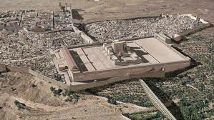
Christ’s Five Trips to Jerusalem
Feast | Verse
Passover | 2:23
Unnamed | 5:1
Tabernacles | 7:2
Dedication | 10:22
Passover | 13:1

Slide 60
Acts 11:27-28 Agabus’ Prophecy
Occasion (27)
Agabus introduced (28a)
Agabus’ prophecy (28b)
Fulfilment of Agabus’ prophecy (28c)

Slide 61
Acts 11:27-28 Agabus’ Prophecy
Occasion (27)
Agabus introduced (28a)
Agabus’ prophecy (28b)
Fulfilment of Agabus’ prophecy (28c)

Slide 62
The Whole World? (Revelation 3:10)
Oikouménē – known world? (Luke 2:1; Acts 11:28)
Oikouménē – entire world (Luke 4:5; Acts 17:31; Rev. 12:9)
Context favors the global definition
Adjective “whole” (holos)
Rev. 6‒18

Slide 63
Acts 11:27-28 Agabus’ Prophecy
Occasion (27)
Agabus introduced (28a)
Agabus’ prophecy (28b)
Fulfilment of Agabus’ prophecy (28c)

Slide 66
II. Benevolence of the Church Acts 11:27-30
Agabus’ prophecy (27-28)
Relief fund (29-30)

Slide 67
Acts 11:29-30 Relief Fund
Money collected (29)
Money sent (30)

Slide 68
Acts 11:29-30 Relief Fund
Money collected (29)
Money sent (30)

Slide 69
Activities of the Local Church (Acts 2:41-47)
Doctrine (Acts 2:42)
Ordinances (Acts 2:41-42, 46)
Prayer (Acts 2:42)
Evangelism (Acts 2:47)
Worship (Acts 2:47)
Benevolence (Acts 2:44-45)
Fellowship (Acts 2:42, 46-47)

Slide 72
Acts 11:29-30 Relief Fund
Money collected (29)
Money sent (30)

Slide 73
Acts 11:30 Money Sent
Saul (30a)
Barnabas (30b)
Elders (30c)

Slide 74
Acts 11:30 Money Sent
Saul (30a)
Barnabas (30b)
Elders (30c)

Slide 75
Acts 11:30 Money Sent
Saul (30a)
Barnabas (30b)
Elders (30c)

Slide 76
Acts 11:30 Money Sent
Saul (30a)
Barnabas (30b)
Elders (30c)

Slide 77
Local Church Government
Episcopalian / bishop rule – Acts 15:2, 6
Congregational rule – Acts 6:1-7
Presbyterian / elder rule – Acts 20:28; 1 Tim 5:17; 4:14

Slide 78
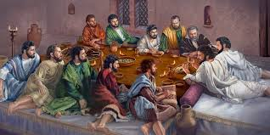
Ephesians 2:20
“having been built on the foundation of the apostles and prophets, Christ Jesus Himself being the corner stone.”

Slide 79
Conclusion

Slide 80
Acts 11:19-30 The Church at Antioch
Development of the Church (11:19-26)
Benevolence of the Church (Acts 11:27-30)

