Slide 1



Slide 2
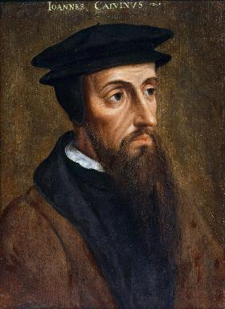
Neo-Calvinism vs. The Bible
Calvinism’s Mixed Blessing
Why Critique Calvinism?
The Source of Calvin’s Theology
Calvin’s Manner of Life
TULIP Through the Grid of Scripture
Conclusion

Slide 3

V. Running TULIP Through the Grid of Scripture
Total Depravity
Unconditional Election
Limited Atonement
Irresistible Grace
Perseverance of the Saints

Slide 4
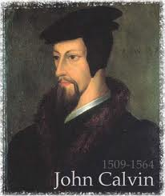
Unconditional Election
  Divine sovereignty vs. human freewill = a profound mystery
  Calvinism and double predestination
  Calvinism’s overstatement of Divine Sovereignty

Slide 5
Unconditional Election
  Divine sovereignty vs. human freewill = a profound mystery
  Calvinism and double predestination
  Calvinism’s overstatement of Divine Sovereignty

Slide 6
  Divine sovereignty vs. human freewill
  = a profound mystery
Some passages indicate God chooses us
Other passages indicate that we choose God
Miscellaneous approaches: foreknowledge, group election, etc…
Live with the tension (Isa. 55:8-9)
Husband‒wife analogy (Eph. 5:22-33)
The common mistake
God’s business vs. man’s business

Slide 7

Chafer Theological Seminary Distinctives:
election
"We believe Scripture reveals two clear and indisputable lines of evidence. One line shows God sovereignly choosing His own in Christ; the other shows man possessing the function of volition, able to receive or reject God's uniquely born Son (regarding sovereignty, see Job 42:2; Psalm 135:6; Isaiah 46:9–10; Jeremiah 1:5; Matthew 24:22, 24, 31; Luke 18:7; Romans 8:29–33; Galatians 1:15; 2 Timothy 2:10; 1 Peter 1:1–2; regarding human volition, see John 1:9–13; 3:16, 36; 6:47; 20:30–31; Acts 16:30–31; Romans 10:11–13; 1 John 5:9–13, as well as every command in the epistles).”
https://www.chafer.edu/soteriology

Slide 8
Unconditional Election
  Divine sovereignty vs. human freewill = a profound mystery
  Calvinism and double predestination
  Calvinism’s overstatement of Divine Sovereignty

Slide 9
Unconditional Election = Double Predestination
“U” stands for “Unconditional Election.” God determined before the foundation of the world whom He would save and whom He would send to Hell. Man would have no choice or free will to either accept or reject Christ as Savior.
Bob Kirkland, Calvinism: None Dare Call It Heresy; Spotlight on the Life and Teachings of John Calvin (Eureka, MT: Lighthouse Trails, 2018), 34.

Slide 10

Calvin said: “By predestination we mean the eternal decree of God, by which he determined with himself whatever he wished to happen with regard to every man. All are not created on equal terms, but some are preordained to eternal life, others to eternal damnation; and, accordingly, as each has been created for one or other of these ends, we say that he has been predestinated to life or to death.”
John Calvin
John Calvin, Institutes of the Christian Religion, Vol. 3, (Orlando, Signalman Publishing, from the 4th edition, 2009, Kindle edition), Chapter 21, section 5, Kindle location 17221.

Slide 11
Calvin said: “We say, then, that Scripture clearly proves this much, that God by his eternal and immutable counsel determined once for all those whom it was his pleasure one day to admit to salvation, and those whom, on the other hand, it was his pleasure to doom to destruction.”
John Calvin
John Calvin, Institutes of the Christian Religion, Vol. 3, Chapter 23, section 7.

Slide 12
Calvin said: “I say with Augustine, that the Lord has created those who, as he certainly foreknow, were to go to destruction, and he did so because he so willed. Why he willed it is not ours to ask, as we cannot comprehend, nor can it become us even to raise a controversy as to the justice of the divine will. Whenever we speak of it, we are speaking of the supreme standard of justice.”
John Calvin
John Calvin, Institutes of the Christian Religion, Vol. 3, Chapter 23, section 5.

Slide 13
Calvin wrote: “Now, since the arrangement of all things is in the hand of God, since to him belongs the disposal of life and death, he arranges all things by his sovereign counsel, in such a way that individuals are born, who are doomed from the womb to certain death, and are to glorify him by their destruction.”
John Calvin
John Calvin, Institutes of the Christian Religion, Vol. 3, Chapter 23, section 6.

Slide 14

Spurgeon
"You have made heaven mourn; you have made earth sad; you have dug hell for yourself! Confess your iniquity with shame and with confusion of face! Bow down before the God of mercy and acknowledge that if He spares you, it will be His free mercy [i.e., election] that shall do it—but if He destroys you, you shall not have one word to say against the justice of the solemn sentence!” (emphasis added)
[Charles H. Spurgeon, “Christ’s First and Last Subject” (Sermon #329, https:// www.spurgeon.org/ resource-library/ sermons/ christs-first-and-last-subject# flipbook)].

Slide 15
Spurgeon
“In other words, you can cry out to the Lord in humility and repentance and ask Him to save your soul, and He may or may not do it, and there is nothing you can do to gain salvation. Yet, the Bible is filled with verses declaring that God is a merciful God to those who call upon Him. God has ordained to show mercy on those who call upon His name.”
Bob Kirkland, Calvinism: None Dare Call It Heresy; Spotlight on the Life and Teachings of John Calvin (Eureka, MT: Lighthouse Trails, 2018), 55.

Slide 16
Westminster Confession III, iii, iv
“By the decree of God, for the manifestation of His glory, some men and angels are predestinated unto everlasting life; and others foreordained to everlasting death. These angels and men, thus predestinated, and foreordained, are particularly and unchangeably designed, and their number so certain and definite, that it cannot be either increased or diminished.”
Notes:
Error of reductionism – oversimplification of a complex subject

Slide 17
Unconditional Election
  Divine sovereignty vs. human freewill = a profound mystery
  Calvinism and double predestination
  Calvinism’s overstatement of Divine Sovereignty

Slide 18

  Calvinism’s overstatement of Divine Sovereignty
Omni-causality
Salvation is available to all
Election proof texts John 6:44; 15:16; Rom. 8:29-30)
Double predestination proof texts (Rom. 9)
Loss of evangelism
Loss of love for the lost (Ezek. 18:23, 32; 33:11)
Babies in hell? (2 Sam. 12:19-24)

Slide 19
  Calvinism’s overstatement of Divine Sovereignty
Omni-causality
Salvation is available to all
Election proof texts John 6:44; 15:16; Rom. 8:29-30)
Double predestination proof texts (Rom. 9)
Loss of evangelism
Loss of love for the lost (Ezek. 18:23, 32; 33:11)
Babies in hell? (2 Sam. 12:19-24)

Slide 20
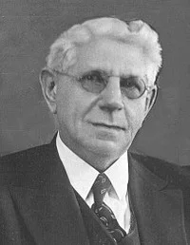
Omnicausality?
"Reformed theology stresses the sovereignty of God in virtue of which He has sovereignly determined from all eternity whatsoever will come to pass, and works His sovereign will in His entire creation, both natural and spiritual, according to His pre-determined plan.”
Louis Berkhof, Systematic Theology: With a Complete Textual Index, 4th and rev. ed. (Grand Rapids: Eerdman's, 1932; reprint, Grand Rapids: Baker, 1996), 100.

Slide 21
Calvin said: “Nor ought it to seem absurd when I say, that God not only foresaw the fall of the first man, and in him the ruin of his posterity; but also at his own pleasure arranged it.”
John Calvin
John Calvin, Institutes of the Christian Religion, Vol. 3, Chapter 23, section 7.

Slide 22
Edwin Palmer
In Edwin Palmer’s book, The Five Points of Calvinism, he states: “God is in back of everything. He decides and causes all things to happen that do happen…even sin…God ordained sin and unbelief.”
Edwin H. Palmer, The Five Points of Calvinism (Grand Rapids, MI: Baker Books, Enlarged Edition, 1980, 24th printing, 2005), pp. 25, 102.

Slide 23
R. C. Sproul Jr.
R. C. Sproul Jr. (R. C. Sproul’s Calvinist son) said that God “desired that man would fall into sin … [God] created sin.”
R.C. Sproul Jr., Almighty Over All (Grand Rapids, MI: Baker Books, 1999, Second printing, July 1999), pp. 53-54.

Slide 24

A. W. Pink
Sovereignty of God, p. 201.
“That God decreed sin should enter this world through the disobedience of our first parents was a secret hid in His own breast.”

Slide 25
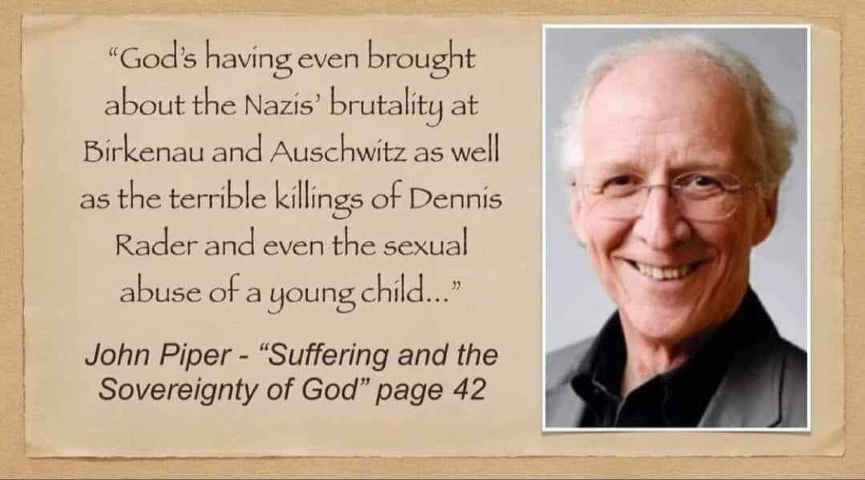

Slide 26
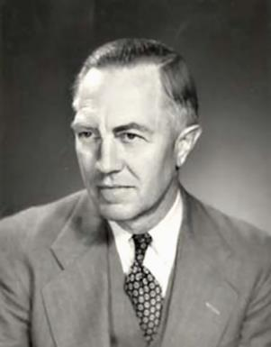
Loraine Boettner, The Reformed Doctrine of Predestination (Philipsburg, NJ: Presbyterian and Reformed, 1932), 32.
Loraine Boettner
God “…creates the very thoughts and intents of the soul.”

Slide 27

Mark 7:20–23
²⁰ And He was saying, “That which proceeds out of the man, that is what defiles the man. ²¹ “For from within, out of the heart of men, proceed the evil thoughts, fornications, thefts, murders, adulteries, ²² deeds of coveting and wickedness, as well as deceit, sensuality, envy, slander, pride and foolishness. ²³ “All these evil things proceed from within and defile the man.”

Slide 28
Romans 8:19-22
¹⁹ For the anxious longing of the creation waits eagerly for the revealing of the sons of God. ²⁰ For the creation was subjected to futility, not willingly, but because of Him who subjected it, in hope ²¹ that the creation itself also will be set free from its slavery to corruption into the freedom of the glory of the children of God. ²² For we know that the whole creation groans and suffers the pains of childbirth together until now.

Slide 29


James 1:13
“Let no one say when he is tempted, ‘I am being tempted by God’; for God cannot be tempted by evil, and He Himself does not tempt anyone.”

Slide 30


1 John 1:5
This is the message we have heard from Him and announce to you, that God is Light, and in Him there is no darkness at all.

Slide 31
  Calvinism’s overstatement of Divine Sovereignty
Omni-causality
Salvation is available to all
Election proof texts John 6:44; 15:16; Rom. 8:29-30)
Double predestination proof texts (Rom. 9)
Loss of evangelism
Loss of love for the lost (Ezek. 18:23, 32; 33:11)
Babies in hell? (2 Sam. 12:19-24)

Slide 32

Salvation is Available to All
  Everyone is savable but not necessarily saved (2 Cor. 5:19-20)
  God desires all to be saved (1 Tim. 2:4; 2 Pet. 3:9)
  Whosoever wills (John 3:16; Rom. 10:13; 1 John 5:1; Rev. 22:17
  God commands all to repent (Acts 17:30)
  God’s grace has appeared to all (Titus 2:11)
  God is not a respecter of persons (Acts 10:34; Rom. 2:11; Ephes. 6:9; Col. 3:25)

Slide 33
Salvation is Available to All
  Everyone is savable but not necessarily saved (2 Cor. 5:19-20)
  God desires all to be saved (1 Tim. 2:4; 2 Pet. 3:9)
  Whosoever wills (John 3:16; Rom. 10:13; 1 John 5:1; Rev. 22:17
  God commands all to repent (Acts 17:30)
  God’s grace has appeared to all (Titus 2:11)
  God is not a respecter of persons (Acts 10:34; Rom. 2:11; Ephes. 6:9; Col. 3:25)

Slide 34
Salvation is Available to All
  Everyone is savable but not necessarily saved (2 Cor. 5:19-20)
  God desires all to be saved (1 Tim. 2:4; 2 Pet. 3:9)
  Whosoever wills (John 3:16; Rom. 10:13; 1 John 5:1; Rev. 22:17
  God commands all to repent (Acts 17:30)
  God’s grace has appeared to all (Titus 2:11)
  God is not a respecter of persons (Acts 10:34; Rom. 2:11; Ephes. 6:9; Col. 3:25)

Slide 35

1 Timothy 2:3-4
“³ This is good and acceptable in the sight of God our Savior, ⁴ who desires all men to be saved and to come to the knowledge of the truth.”

Slide 36
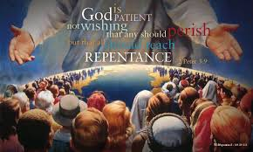
2 Peter 3:9
“The Lord is not slow about His promise, as some count slowness, but is patient toward you, not wishing for any to perish but for all to come to repentance.”

Slide 37
Salvation is Available to All
  Everyone is savable but not necessarily saved (2 Cor. 5:19-20)
  God desires all to be saved (1 Tim. 2:4; 2 Pet. 3:9)
  Whosoever wills (John 3:16; Rom. 10:13; 1 John 5:1; Rev. 22:17
  God commands all to repent (Acts 17:30)
  God’s grace has appeared to all (Titus 2:11)
  God is not a respecter of persons (Acts 10:34; Rom. 2:11; Ephes. 6:9; Col. 3:25)

Slide 38

Revelation 22:17
“¹⁷ The Spirit and the bride say, ‘Come.’ And let the one who hears say, ‘Come.’ And let the one who is thirsty come; let the one who wishes (thelō) take the water of life without cost.”

Slide 39

1 Corinthians 7:39
“A wife is bound as long as her husband lives; but if her husband is dead, she is free to be married to whom she wishes (thelō), only in the Lord.”

Slide 40
Salvation is Available to All
  Everyone is savable but not necessarily saved (2 Cor. 5:19-20)
  God desires all to be saved (1 Tim. 2:4; 2 Pet. 3:9)
  Whosoever wills (John 3:16; Rom. 10:13; 1 John 5:1; Rev. 22:17
  God commands all to repent (Acts 17:30)
  God’s grace has appeared to all (Titus 2:11)
  God is not a respecter of persons (Acts 10:34; Rom. 2:11; Ephes. 6:9; Col. 3:25)

Slide 41
Salvation is Available to All
  Everyone is savable but not necessarily saved (2 Cor. 5:19-20)
  God desires all to be saved (1 Tim. 2:4; 2 Pet. 3:9)
  Whosoever wills (John 3:16; Rom. 10:13; 1 John 5:1; Rev. 22:17
  God commands all to repent (Acts 17:30)
  God’s grace has appeared to all (Titus 2:11)
  God is not a respecter of persons (Acts 10:34; Rom. 2:11; Ephes. 6:9; Col. 3:25)

Slide 42
Salvation is Available to All
  Everyone is savable but not necessarily saved (2 Cor. 5:19-20)
  God desires all to be saved (1 Tim. 2:4; 2 Pet. 3:9)
  Whosoever wills (John 3:16; Rom. 10:13; 1 John 5:1; Rev. 22:17
  God commands all to repent (Acts 17:30)
  God’s grace has appeared to all (Titus 2:11)
  God is not a respecter of persons (Acts 10:34; Rom. 2:11; Ephes. 6:9; Col. 3:25)

Slide 43
  Calvinism’s overstatement of Divine Sovereignty
Omni-causality
Salvation is available to all
Election proof texts John 6:44; 15:16; Rom. 8:29-30)
Double predestination proof texts (Rom. 9)
Loss of evangelism
Loss of love for the lost (Ezek. 18:23, 32; 33:11)
Babies in hell? (2 Sam. 12:19-24)

Slide 44
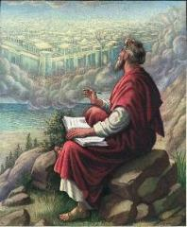
John 6:44
“No one can come to Me unless the Father who sent Me draws (helkyō) him; and I will raise him up on the last day.”

Slide 45

John 6:40
“For this is the will of My Father, that everyone who beholds the Son and believes in Him will have eternal life, and I Myself will raise him up on the last day.”

Slide 46
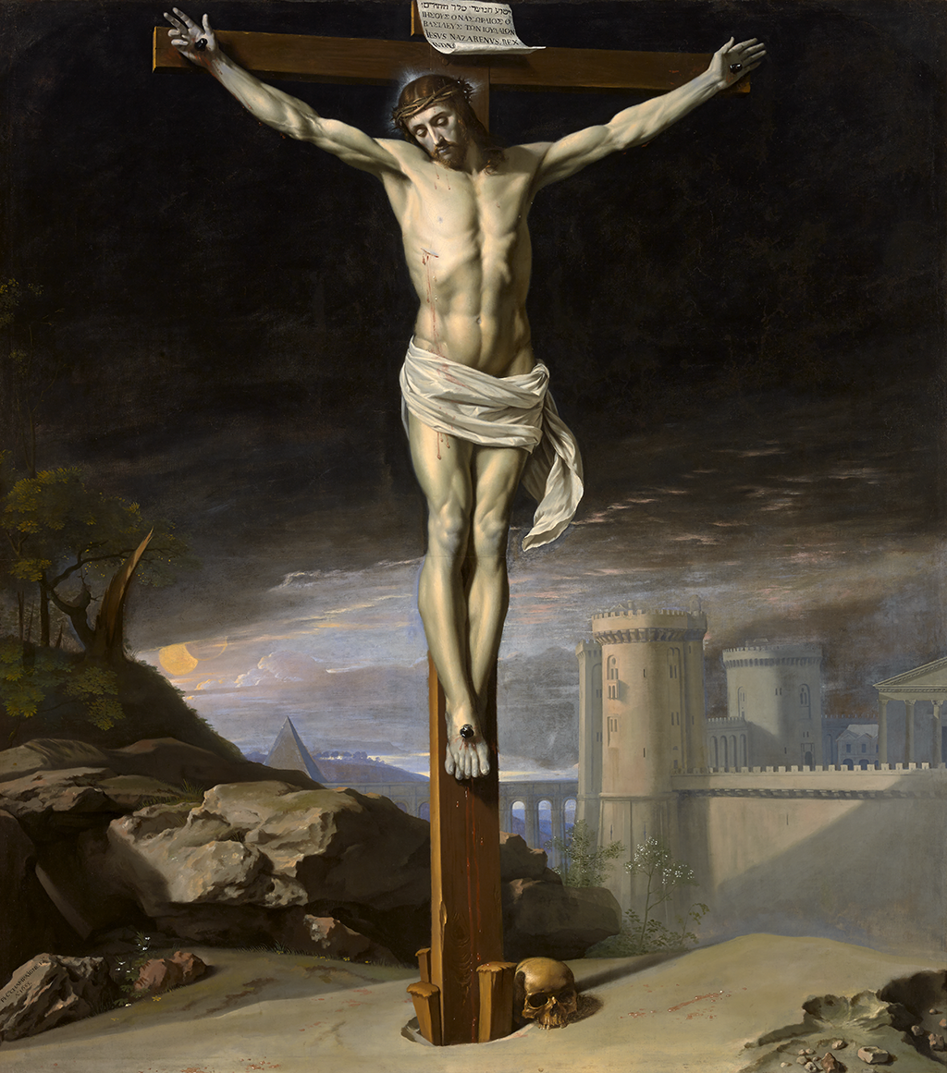
John 12:32
“And I, if I am lifted up from the earth, will draw (helkyō) all men to Myself.”

Slide 47
John 16:7-11
“⁷ But I tell you the truth, it is to your advantage that I go away; for if I do not go away, the Helper will not come to you; but if I go, I will send Him to you. ⁸ And He, when He comes, will convict the world concerning sin (hamartia, singular noun) and righteousness and judgment; ⁹ concerning sin, because they do not believe in Me; ¹⁰ and concerning righteousness, because I go to the Father and you no longer see Me; ¹¹ and concerning judgment, because the ruler of this world has been judged.”

Slide 48

John 15:16
“You did not choose Me but I chose you, and appointed you that you would go and bear fruit, and that your fruit would remain, so that whatever you ask of the Father in My name He may give to you.”

Slide 49

Acts 13:48
“When the Gentiles heard this, they began rejoicing and glorifying the word of the Lord; and as many as had been appointed [tassō] to eternal life believed.”

Slide 50
Laurence M. Vance
“Every Calvinist, no matter what else he believes, uses this verse to prove Unconditional Election. Every Calvinist claims that on the basis of this verse, every person who has ever been saved (Old or New Testament) or ever will be saved (Church age or Tribulation or Millennium) was ‘ordained to life’ before the foundation of the world by a sovereign, eternal decree.”
Laurence M. Vance, The Other Side of Calvinism, rev. ed. (Pensacola, FL: Vance Publications, 1999); citing Calvin, Institutes, 345..

Slide 51

Acts 13:48?
One verse cannot be used to undo hundreds of others (1 Tim. 2:4; 2 Pet. 3:9)
Sometimes the Greek word for “appointed”(NASB) or “ordained” (KJV) is translated “wanted” (LB) or “disposed” (REB) in other English translations
Tassō is used (rather than proorizō), which never refers to predestination unto Salvation in any of its other New Testament uses (Matt. 28:16; Luke 7:38; Acts 15:2; 22:10; 28:23; Rom. 13:1; 1 Cor. 16:15)

Slide 52
Acts 13:48?
The corrupted, Roman Catholic Latin Vulgate mistranslates tassō as “preordained.”
The context of the book of Acts pertains to the predisposition of the Gentiles (rather than the Jews) toward the Gospel (Acts 13:44-47; 28:26-28)
The middle voice of the participle tassō indicates those responding to Paul’s preaching (Acts 14:1) by arranging themselves toward eternal life.

Slide 53
Romans 8:29–30
²⁹ For those whom He foreknew [proginōskō], He also predestined to become conformed to the image of His Son, so that He would be the firstborn among many brethren; ³⁰ and these whom He predestined, He also called; and these whom He called, He also justified; and these whom He justified, He also glorified.

Slide 54
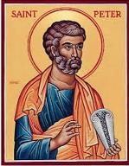
2 Peter 3:17
“You therefore, beloved, knowing this beforehand [proginōskō], be on your guard so that you are not carried away by the error of unprincipled men and fall from your own steadfastness.”

Slide 55
  Calvinism’s overstatement of Divine Sovereignty
Omni-causality
Salvation is available to all
Election proof texts John 6:44; 15:16; Rom. 8:29-30)
Double predestination proof texts (Rom. 9)
Loss of evangelism
Loss of love for the lost (Ezek. 18:23, 32; 33:11)
Babies in hell? (2 Sam. 12:19-24)

Slide 56
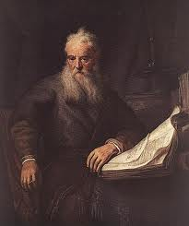
Romans Outline
Salutation (1:1-17)
Sin (1:18–3:20)
Salvation (3:21–5:21)
Sanctification (6–8)
Sovereignty (9–11)
Service (12:1–15:13)
Summation (15:14–16:27)

Slide 57
Romans Outline
Salutation (1:1-17)
Sin (1:18–3:20)
Salvation (3:21–5:21)
Sanctification (6–8)
Sovereignty (9–11)
Service (12:1–15:13)
Summation (15:14–16:27)

Slide 58

Romans 8:29–30
²⁹ For those whom He foreknew, He also predestined to become conformed to the image of His Son, so that He would be the firstborn among many brethren; ³⁰ and these whom He predestined, He also called; and these whom He called, He also justified; and these whom He justified, He also glorified.
Where’s sanctification?

Slide 59
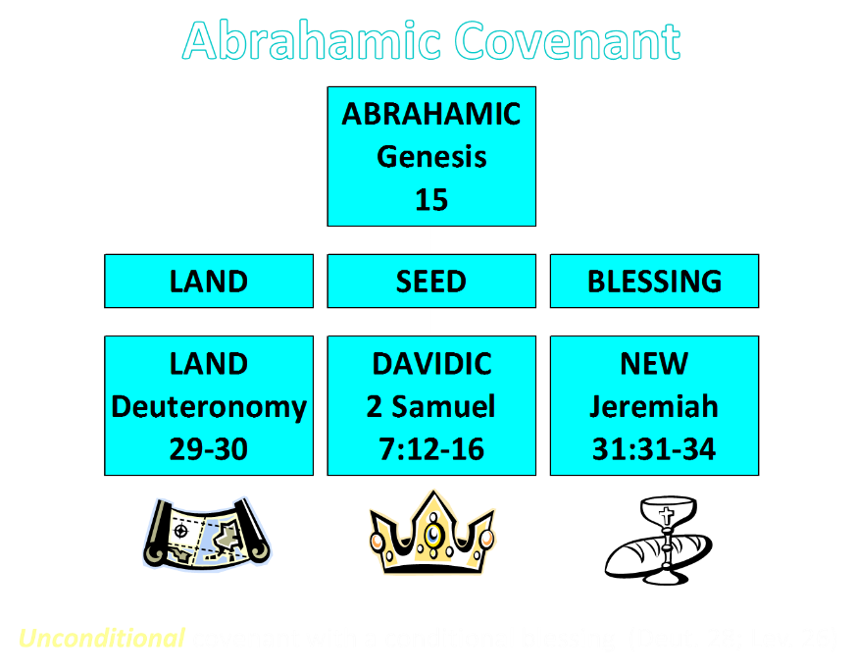

Slide 60


Slide 61
Romans Outline
Salutation (1:1-17)
Sin (1:18–3:20)
Salvation (3:21–5:21)
Sanctification (6–8)
Sovereignty (9–11)
Service (12:1–15:13)
Summation (15:14–16:27)

Slide 62
V. Sovereignty (Rom 9–11)
Israel in the past: elected (Rom 9)
Israel in the present: rejected (Rom 10)
Israel in the future: accepted (Rom 11)

Slide 63
Romans Outline
Salutation (1:1-17)
Sin (1:18–3:20)
Salvation (3:21–5:21)
Sanctification (6–8)
Sovereignty (9–11)
Service (12:1–15:13)
Summation (15:14–16:27)

Slide 64


Romans 12:1
“Therefore I urge you, brethren, by the mercies of God, to present your bodies a living and holy sacrifice, acceptable to God, which is your spiritual service of worship.”

Slide 65

Isaiah 65:21–22
²¹ “They will build houses and inhabit them; They will also plant vineyards and eat their fruit. ²² “They will not build and another inhabit, They will not plant and another eat; For as the lifetime of a tree, so will be the days of My people, And My chosen ones will wear out the work of their hands.

Slide 66

Matthew 24:21-22
“²¹ For then there will be a great tribulation, such as has not occurred since the beginning of the world until now, nor ever will. ²² Unless those days had been cut short, no life would have been saved; but for the sake of the elect those days will be cut short.”

Slide 67
Matthew 23:37-39
³⁷ “Jerusalem, Jerusalem, who kills the prophets and stones those who are sent to her! How often I wanted to gather [episynagō] your children together, the way a hen gathers [episynagō] her chicks under her wings, and you were unwilling. ³⁸ Behold, your house is being left to you desolate! ³⁹ For I say to you, from now on you will not see Me until you say, ‘Blessed is He who comes in the name of the Lord!’”

Slide 68
The Plagues of Egypt
NO. | DESCRIPTION | SCRIPTURE | Egyptian Deity
1. | Water to Blood | Exod. 7:14-25 | Hapi, Khnum
2. | Frogs | Exod. 8:1-15 | Heqt
3. | Gnats | Exod. 8:16-19 | Set
4. | Flies | Exod. 8:20-32 | Uatchit
5. | Disease on Cattle | Exod. 9:1-7 | Hathor, Apis
6. | Boils | Exod. 9:8-12 | Sekhmet, Serapis
7. | Hail | Exod. 9:13-35 | Seth, Nut
8. | Locusts | Exod. 10:1-20 | Seth, Nut, Osiris
9. | Darkness | Exod. 10:21-29 | Re, Horus, Atum
10. | Death of the First Born | Exod. 12:29-36 | Min, Osiris, Heqt, Isis

Slide 69
  Calvinism’s overstatement of Divine Sovereignty
Omni-causality
Salvation is available to all
Election proof texts John 6:44; 15:16; Rom. 8:29-30)
Double predestination proof texts (Rom. 9)
Loss of evangelism
Loss of love for the lost (Ezek. 18:23, 32; 33:11)
Babies in hell? (2 Sam. 12:19-24)

Slide 70

John Winthrop (A.D. 1630)
“For we must consider that we shall be as a City set upon a Hill; the eyes of all people are upon us; so that if we shall deal falsely with our God in this work we have undertaken and so cause him to withdraw his present help from us, we shall be a story and a by-word through the world.”
John Winthrop, “A Model of Christian Charity,” Winthrop Papers, 2:292-95.

Slide 71


Harvard University
“Let every student be plainly instructed and earnestly pressed to consider well the main end of his life and studies is to know God and Jesus Christ which is eternal life (John 17:3) and therefore to lay Christ in the bottom as the only foundation of all sound knowledge and learning. And seeing the Lord only giveth wisdom, let everyone seriously set himself by prayer in secret to seek it of Him (Prov. 2, 3). Everyone shall exercise himself in reading the Scriptures twice a day that he shall be ready to give such an account of his proficiency therein.”
Rules of Harvard in 1636; quoted in David Barton, Original Intent, 81

Slide 72
J.C. Rylands to William Carey
William Carey: (1761‒1834): "My question to you is whether the command given to the apostles to ‘teach all nations,' was not obligatory on all succeeding ministers to the end of the world, seeing that the accompanying promise was of equal extent? Is it not the duty of Christians to attempt the spread of the Gospel amongst heathen nations."
J.C. Rylands: (1753–1825) "Young man, sit down; when God is pleased to convert the heathen world, He will do it without your help or mine...you are a most miserable enthusiast...nothing like that could ever be done before another Pentecost!"
Laurence M. Vance, The Other Side of Calvinism, rev. ed. (Pensacola, FL: Vance Publications, 1999), 24; Kenneth H. Good, Are Baptists Calvinists?, rev. ed. (Rochester, NY: Backus Book Publishers, 1988), 73.

Slide 73
  Calvinism’s overstatement of Divine Sovereignty
Omni-causality
Salvation is available to all
Election proof texts John 6:44; 15:16; Rom. 8:29-30)
Double predestination proof texts (Rom. 9)
Loss of evangelism
Loss of love for the lost (Ezek. 18:23, 32; 33:11)
Babies in hell? (2 Sam. 12:19-24)

Slide 74
Calvin’s Lack of Love for Unelected Lost
“The primary teaching in Calvinism is the teaching on ‘election’ in that the majority of people God created, He did not elect to save nor did He love them. In fact, He hated them from before they were even born. Under the Calvinist view of election, wherein God does not love every human being or desires that each one come to faith and be saved, it makes sense that John Calvin did not have God’s love toward those he saw as his unsaved fellow man. After all, if God does not even love them, why should he? It is this reasoning that would have made it easy for Calvin to justify the torture and murder of people whom he believed, in his own estimation, to be heretics. But the Bible . . .
Bob Kirkland, Calvinism: None Dare Call It Heresy; Spotlight on the Life and Teachings of John Calvin (Eureka, MT: Lighthouse Trails, 2018), 24-25.

Slide 75
Calvin’s Lack of Love for Unelected Lost
. . . says that God is love. And He is righteous, true, faithful, and just. Such are fruits of the Spirit as described in Galatians 5:22, and love is the first one mentioned. It is hard not to believe that John Calvin was under the influence of some other spirit than the Holy Spirit. You will have to look long and hard to find anything in Calvin’s writings about love. It is certainly not obvious in his manner of life.”
Bob Kirkland, Calvinism: None Dare Call It Heresy; Spotlight on the Life and Teachings of John Calvin (Eureka, MT: Lighthouse Trails, 2018), 24-25.

Slide 76

Calvin said of God, “for, (as he hates sin) he can only love those whom he justifies [i.e., the elect].”
John Calvin
John Calvin, Institutes of the Christian Religion, Vol. 3, Chapter xi, section 11.

Slide 77

John 3:16
“For God so loved the world, that He gave His only begotten Son, that whoever believes in Him shall not perish, but have eternal life.”

Slide 78

1 John 4:8
“The one who does not love does not know God, for God is love.”

Slide 79
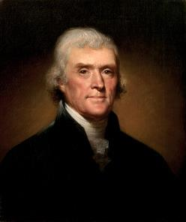
Thomas Jefferson
"I can never join Calvin in addressing his god. He was indeed an Atheist, which I can never be; or rather his religion was Daemonism. If ever man worshipped a false god, he did. The being described in his 5 points is not the god whom you and I acknowledge and adore, the Creator and benevolent and governor of the world, but a daemon of malignant spirit. It would be more pardonable to believe in no god at all, than to blaspheme him by the atrocious attributes of Calvin.”
Jefferson, Letter to John Adams, April 11, 1823

Slide 80
Thomas Jefferson
"The Presbyterian clergy are loudest, the most intolerant of all sects, the most tyrannical, and ambitious; ready at the word of the lawgiver, if such a word could be now obtained, to put the torch to the pile, and to rekindle in this virgin hemisphere, the flames in which their oracle Calvin consumed the poor Servetus, because he could not find in his Euclid the proposition which has demonstrated that three are one, and one is three, nor subscribe to that of Calvin that magistrates have a right to exterminate all heretics to Calvinistic creed.”
Jefferson, letter to William Short, April 13, 1820.

Slide 81
  Calvinism’s overstatement of Divine Sovereignty
Omni-causality
Salvation is available to all
Election proof texts John 6:44; 15:16; Rom. 8:29-30)
Double predestination proof texts (Rom. 9)
Loss of evangelism
Loss of love for the lost (Ezek. 18:23, 32; 33:11)
Babies in hell? (2 Sam. 12:19-24)

Slide 82
1 Timothy 2:3-4
“³ This is good and acceptable in the sight of God our Savior, ⁴ who desires all men to be saved and to come to the knowledge of the truth.”

Slide 83
2 Peter 3:9
“The Lord is not slow about His promise, as some count slowness, but is patient toward you, not wishing for any to perish but for all to come to repentance.”

Slide 84
V. Running TULIP Through the Grid of Scripture
Total Depravity
Unconditional Election
Limited Atonement
Irresistible Grace
Perseverance of the Saints

