Slide 1
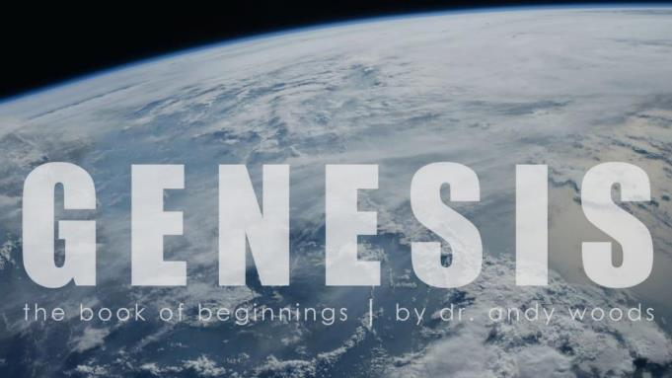
Genesis 12‒50
Israel’s Birth & Preservation

Slide 2
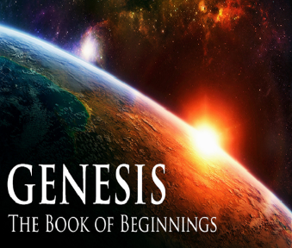
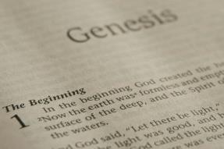
GENESIS STRUCTURE
Genesis 12-50 (four people)
Abraham (12:1–25:11)
Isaac (25:12–26:35)
Jacob (27–36)
Joseph (37–50)

Slide 3
Genesis 37‒50 Joseph
Joseph sold unto Egypt (37)
Canaan’s corruption (38)
Joseph falsely accused (39)
Joseph’s short-term predictions (40)
Joseph’s elevation (41)
Joseph’s first reunion with his brothers (42)
Joseph’s second reunion with his brothers (43‒45)
Joseph’s second reunion with his brothers (43‒45)
Sojourn to Egypt (46:1‒47:12)
Famine’s course (47:13-26)
Jacob in Egypt (47:27-31)
Jacob blesses Joseph’s sons (48)
Jacob blesses his sons (49)

Slide 4
Genesis 49:1-33 Jacob Blesses His Sons
Call (49:1)
Introduction (49:2)
Jacob’s blessings on his sons (49:3-27)
Concluding summary (49:28)
Jacob’s death (49:29-33)

Slide 5
III. Genesis 49:3-27 Jacob’s Blessings on His Sons
Reuben (3-4)
Simeon & Levi (5-7)
Judah (8-12)
Zebulun (13)
Issachar (14-15)
Dan (16-18)
Gad (19)
Asher (20)
Naphtali (21)
Joseph (22-26)
Benjamin (27)

Slide 6
Genesis 49:22-26 Joseph
Progeny (22)
Persecution (23)
Survival (24)
Future blessings (25)
Joseph to receive blessings (26)

Slide 7
Genesis 49:22-26 Joseph
Progeny (22)
Persecution (23)
Survival (24)
Future blessings (25)
Joseph to receive blessings (26)

Slide 8
Genesis 49:22 Progeny
Fruitful (22a)
Water supply (22b)
Spread out (22c)

Slide 9
Genesis 49:22 Progeny
Fruitful (22a)
Water supply (22b)
Spread out (22c)

Slide 10
Genesis 49:22 Progeny
Fruitful (22a)
Water supply (22b)
Spread out (22c)

Slide 11
Genesis 49:22 Progeny
Fruitful (22a)
Water supply (22b)
Spread out (22c)

Slide 12
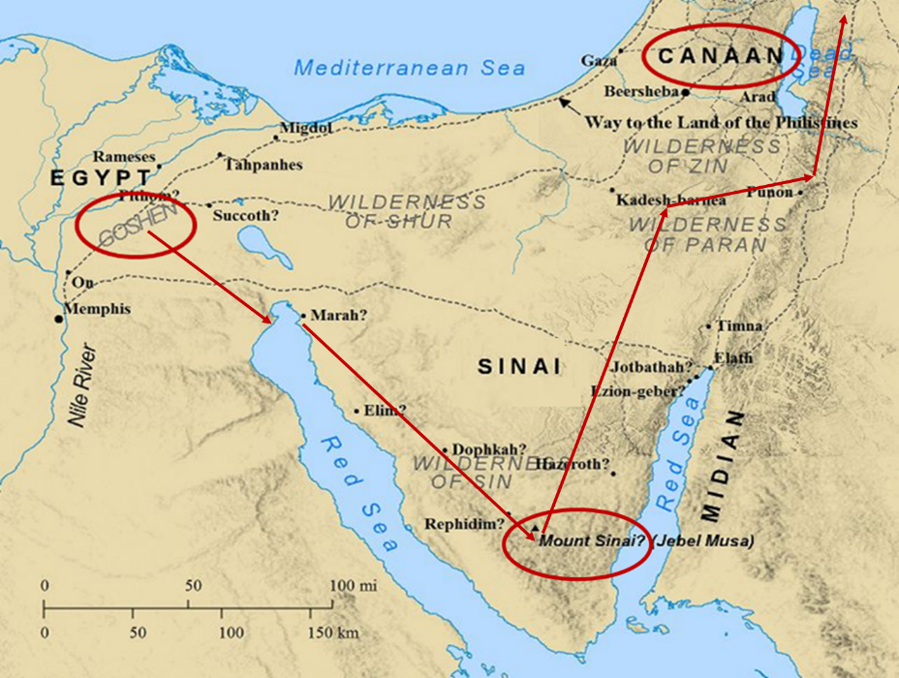

Slide 13
Genesis 49:22-26 Joseph
Progeny (22)
Persecution (23)
Survival (24)
Future blessings (25)
Joseph to receive blessings (26)

Slide 14
Genesis 49:23 Persecution
Grieved (23a)
Shot (23b)
Persecuted (23c)

Slide 15
Genesis 49:23 Persecution
Grieved (23a)
Shot (23b)
Persecuted (23c)

Slide 16
Genesis 49:23 Persecution
Grieved (23a)
Shot (23b)
Persecuted (23c)

Slide 17
Genesis 49:23 Persecution
Grieved (23a)
Shot (23b)
Persecuted (23c)

Slide 18
Genesis 49:22-26 Joseph
Progeny (22)
Persecution (23)
Survival (24)
Future blessings (25)
Joseph to receive blessings (26)

Slide 19
Genesis 49:24 Survival
Strength (24a)
Tested growth (24b)
Prevailed through God (24c)
God to bring Messiah (24d)

Slide 20
Genesis 49:24 Survival
Strength (24a)
Tested growth (24b)
Prevailed through God (24c)
God to bring Messiah (24d)

Slide 21
Genesis 49:24 Survival
Strength (24a)
Tested growth (24b)
Prevailed through God (24c)
God to bring Messiah (24d)

Slide 22
Genesis 49:24 Survival
Strength (24a)
Tested growth (24b)
Prevailed through God (24c)
God to bring Messiah (24d)

Slide 23
Genesis 49:24 Survival
Strength (24a)
Tested growth (24b)
Prevailed through God (24c)
God to bring Messiah (24d)

Slide 24
7 “I AM” statements in John
I am the Bread of Life | 6:35
I am the Light of the world | 8:12
I am the Gate for the sheep | 10:7; cf. v.9
I am the Good Shepherd | 10:11,14
I am the Resurrection and the Life | 11:25
I am the Way and the Truth and the Life | 14:6
I am the true Vine | 15:1; cf. v.5

Slide 25
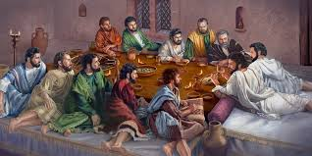
Ephesians 2:20
“having been built on the foundation of the apostles and prophets, Christ Jesus Himself being the corner stone.”

Slide 27
Messiah Must Be:
A man (Gen 3:15)
Semitic (Gen 9:26)
From Abraham’s line (Gen 12:3)
From Isaac’s line (Gen 17:18-19)
From Jacob’s line (Gen 28:14)
From the tribe of Judah (Gen 49:10)

Slide 28
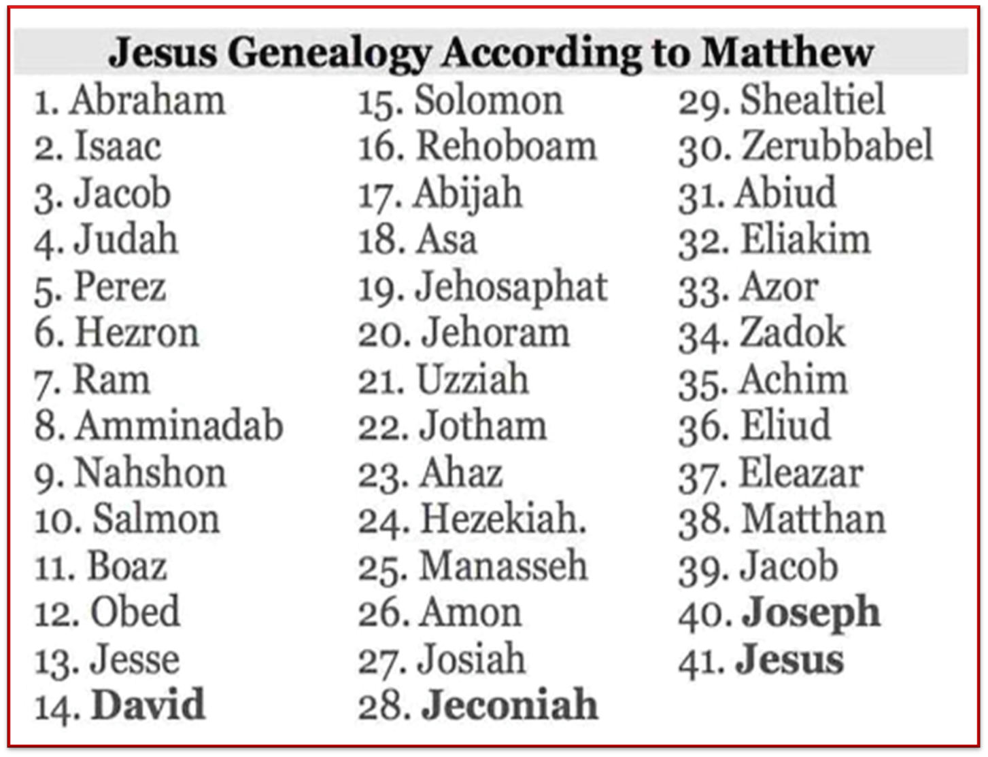

Slide 29
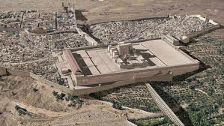
Christ’s Five Trips to Jerusalem
Feast | Verse
Passover | 2:23
Unnamed | 5:1
Tabernacles | 7:2
Dedication | 10:22
Passover | 13:1

Slide 30
Genesis 49:22-26 Joseph
Progeny (22)
Persecution (23)
Survival (24)
Future blessings (25)
Joseph to receive blessings (26)

Slide 31
Genesis 49:25 Future Blessings
God as source (25a-b)
Other sources (25c-e)

Slide 32
Genesis 49:25 Future Blessings
God as source (25a-b)
Other sources (25c-e)

Slide 33
Genesis 49:25a-b God as Source
Your Father (25a)
Almighty (25b)

Slide 34
Genesis 49:25a-b God as Source
Your Father (25a)
Almighty (25b)

Slide 35
John 14:16-17
¹⁶ I will ask the Father, and He will give you another Helper, that He may be with you forever; ¹⁷ that is the Spirit of truth, whom the world cannot receive, because it does not see Him or know Him, but you know Him because He abides with you and will be in you.

Slide 36
Genesis 49:25a-b God as Source
Your Father (25a)
Almighty (25b)

Slide 37
Revelation 1:3
“Blessed [makarios] is he who reads and those who hear the words of the prophecy, and heed the things which are written in it; for the time is near.”

Slide 38
Genesis 49:25 Future Blessings
God as source (25a-b)
Other sources (25c-e)

Slide 39
Genesis 49:25c-e Other Sources
Dews (25c)
Springs & fountains (25d)
Breasts & womb (25e)

Slide 40
Genesis 49:25c-e Other Sources
Dews (25c)
Springs & fountains (25d)
Breasts & womb (25e)

Slide 41
Genesis 49:25c-e Other Sources
Dews (25c)
Springs & fountains (25d)
Breasts & womb (25e)

Slide 43
Genesis 49:25c-e Other Sources
Dews (25c)
Springs & fountains (25d)
Breasts & womb (25e)

Slide 44
Genesis 49:22-26 Joseph
Progeny (22)
Persecution (23)
Survival (24)
Future blessings (25)
Joseph to receive blessings (26)

Slide 45
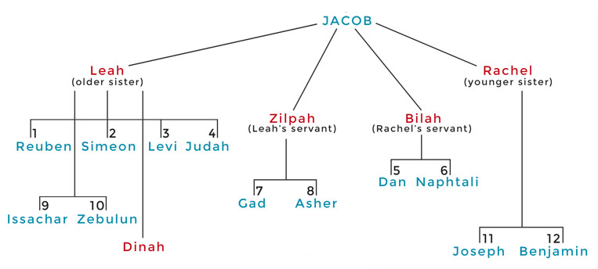

Slide 46
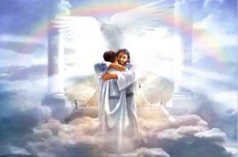
Ephesians 1:3
“Blessed be the God and Father of our Lord Jesus Christ, who has blessed us with every spiritual blessing in the heavenly places in Christ.”

Slide 47
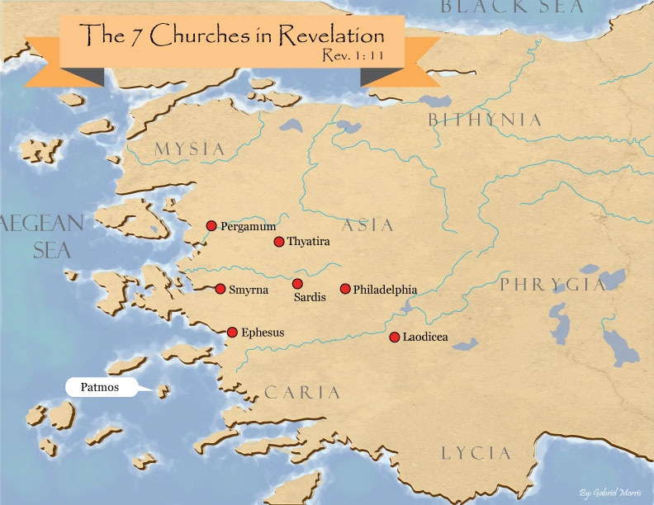

Slide 48
Revelation 2:9
“I know your tribulation and your poverty (but you are rich), and the blasphemy by those who say they are Jews and are not, but are a synagogue of Satan.”

Slide 50
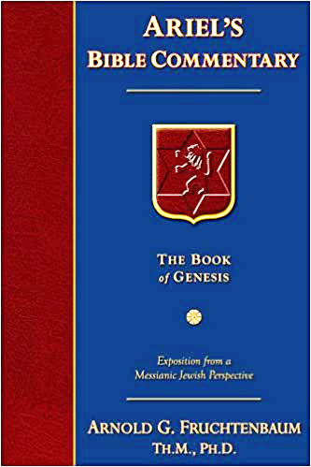
Dr. Arnold G. Fruchtenbaum
The Book of Genesis, 651
“In the blessing of Joseph, five different titles of God were used: Mighty One of Jacob, Shepherd, Stone of Israel; Your Father’s God; and the Almighty.”

Slide 53
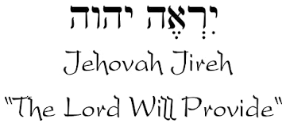

Slide 54
Names for God in Genesis
Elohim (1:1) - Power
Yahweh (2:4) - Relational
El Roi (Gen. 16:13) – Aware
El Olam (21:33) – Eternal
Jehovah Jireh (22:14) - Provision
God Isaac Feared (31:42, 53) - Reverenced
God, the God of Israel (33:20) - National

Slide 55
Conclusion

Slide 56
Genesis 49:22-26 Joseph
Progeny (22)
Persecution (23)
Survival (24)
Future blessings (25)
Joseph to receive blessings (26)

Slide 57
²⁴ The Lord bless you, and keep you; ²⁵ The Lord make His face shine on you, And be gracious to you; ²⁶ The Lord lift up His countenance on you, And give you peace.
Numbers 6:24–26 (NASB95)

