Slide 2
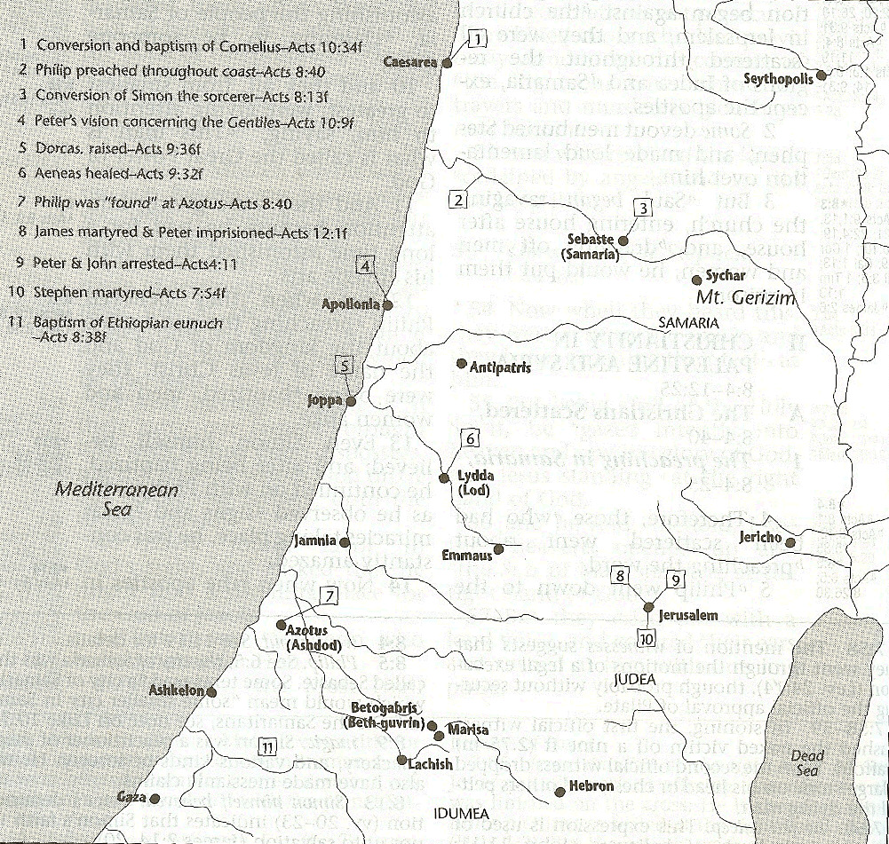

Slide 3
VII. Peter’s Defense in Jerusalem Acts 11:1-18
Charge against Peter (1-3)
Peter’s defense (4-17)
The verdict (18)

Slide 4
Acts 11:4-17 Peter’s Defense
Peter’s exposition (4)
Vision (5-6)
Command (7-10)
Gentiles arrive (11-12a)
Journey to Caesarea (12b)
Entrance into the house (12c)
Cornelius’s salvation (13-14)
Evidence (15-16)
Peter’s conclusion (17)

Slide 5
Passage Conditioning Salvation on Faith Alone (Sola Fide)
Genesis 15:6
John 3:16; 5:24; 6:28-29, 47; 16:8-9; 20:30-31
Acts 16:30-31
Romans 1:16; Ephesians 2:8-9
Hebrews 11:6

Slide 6
Belief – God’s One Condition for Justification
Gen 15:6
Then he believed in the LORD; and He reckoned it to him as righteousness.
John 3:16
For God so loved the world, that He gave His only begotten Son, that whoever believes in Him shall not perish, but have eternal life.
Acts 16:30-31
"Sirs, what must I do to be saved?" They said, "Believe in the Lord Jesus, and you will be saved..."

Slide 7
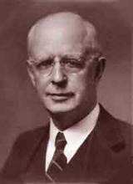
Lewis Sperry Chafer, vol. 7, Systematic Theology (Grand Rapids, MI: Kregel Publications, 1993), 265-66.
Belief – God’s One Condition for Justification
“…because upwards of 150 passages of Scripture condition salvation upon believing only (cf. John 3:16; Acts 16:31).”

Slide 8
Acts 2:38
“Peter said to them, “Repent [metanoeō], and each of you be baptized in the name of Jesus Christ for (eis) the forgiveness of your sins; and you will receive the gift of the Holy Spirit.”

Slide 9
Matthew 12:41
“The men of Nineveh will stand up with this generation at the judgment and will condemn it because they repented at [in the face of/because of] (eis) the preaching of Jonah; and behold, something greater than Jonah is here.”

Slide 10
VII. Peter’s Defense in Jerusalem Acts 11:1-18
Charge against Peter (1-3)
Peter’s defense (4-17)
The verdict (18)

Slide 11
Acts 11:18 The Verdict
Stopped wrangling (18a)
Glorified God (18b)
Concluded: Gospel to the Gentiles (18c)

Slide 12
Acts 11:18 The Verdict
Stopped wrangling (18a)
Glorified God (18b)
Concluded: Gospel to the Gentiles (18c)

Slide 13
Acts 11:18 The Verdict
Stopped wrangling (18a)
Glorified God (18b)
Concluded: Gospel to the Gentiles (18c)

Slide 14
DISPENSATIONAL THEOLOGY IS A SYSTEM OF THEOLOGY
Traditional-normative dispensational theology is a system that embodies three essential, fundamental concepts called the sine qua non (lit. “without which is not”):
The consistent use of a plain, normal, literal, grammatical-historical method of interpretation;
Which reveals that the Church is distinct from Israel;
God’s overall purpose is to bring glory to Himself (Eph. 1:6, 12, 14).
Dr. Charles Ryrie, Dispensationalism, pp. 38-41

Slide 15
DOXOLOGICAL PURPOSE
God’s ultimate purpose for the ages is to glorify Himself. Scripture is not human-centered, as though salvation were the principle point, but God-centered, because His glory is at the center.
The glory of God is the primary principle that unifies all dispensations, the program of salvation being just one of the means by which God glorifies Himself. Each successive revelation of God’s plan for the ages, as well as His dealing with the elect, non-elect, angels, and nations all manifest His glory.
Dictionary of Premillennial Theology, Charles Ryrie, p. 94

Slide 17
Acts 11:18 The Verdict
Stopped wrangling (18a)
Glorified God (18b)
Concluded: Gospel to the Gentiles (18c)

Slide 18
Purpose
To present Theophilus with an orderly account of the birth and growth of the church so as to affirm him in what he has believed.

Slide 19
Message
Birth and growth of the church numerically, geographically, ethnically.
Components
Numerically (progress reports)
Geographically (From Jerusalem to Rome)
Ethnically (From Judaism to Gentile domination)

Slide 20
John 16:7-11
“⁷ But I tell you the truth, it is to your advantage that I go away; for if I do not go away, the Helper will not come to you; but if I go, I will send Him to you. ⁸ And He, when He comes, will convict the world concerning sin and righteousness and judgment; ⁹ concerning sin, because they do not believe in Me; ¹⁰ and concerning righteousness, because I go to the Father and you no longer see Me; ¹¹ and concerning judgment, because the ruler of this world has been judged.”

Slide 21
Conclusion

Slide 22
Acts 10:1‒11:18 Cornelius’ Salvation
Cornelius’ Vision (10:1-8)
Peter’s Vision (Acts 10:9-16)
Vision’s Application (10:17-23a)
Caesarean Ministry (10:23b-33)
Peter & The Keys of the Kingdom (10:34-43)
Gentiles’ Salvation (10:44-48)
Peter’s Defense in Jerusalem (11:1-18)

Slide 23
VII. Peter’s Defense in Jerusalem Acts 11:1-18
Charge against Peter (1-3)
Peter’s defense (4-17)
The verdict (18)

Slide 24
Acts 11:19-30 The Church at Antioch
Development of the Church (11:19-26)
Benevolence of the Church (Acts 11:27-30)

Slide 25
Acts 11:19-30 The Church at Antioch
Development of the Church (11:19-26)
Benevolence of the Church (Acts 11:27-30)

Slide 26
I. Development of the Church Acts 11:19-26
Jewish evangelism in the Diaspora (19)
Gentile evangelism (20)
Progress report (21)
Barnabas’ ministry (22-24)
Saul reintroduced (25-26a)
Barnabas & Saul minister at Antioch (26b-d)

Slide 27
I. Development of the Church Acts 11:19-26
Jewish evangelism in the Diaspora (19)
Gentile evangelism (20)
Progress report (21)
Barnabas’ ministry (22-24)
Saul reintroduced (25-26a)
Barnabas & Saul minister at Antioch (26b-d)

Slide 28
Acts 8:3-4; 11:19
“³ But Saul began ravaging the church, entering house after house, and dragging off men and women, he would put them in prison. ⁴ Therefore, those who had been scattered went about preaching the word…¹⁹ So then those who were scattered because of the persecution that occurred in connection with Stephen made their way to Phoenicia and Cyprus and Antioch, speaking the word to no one except to Jews alone.”

Slide 29
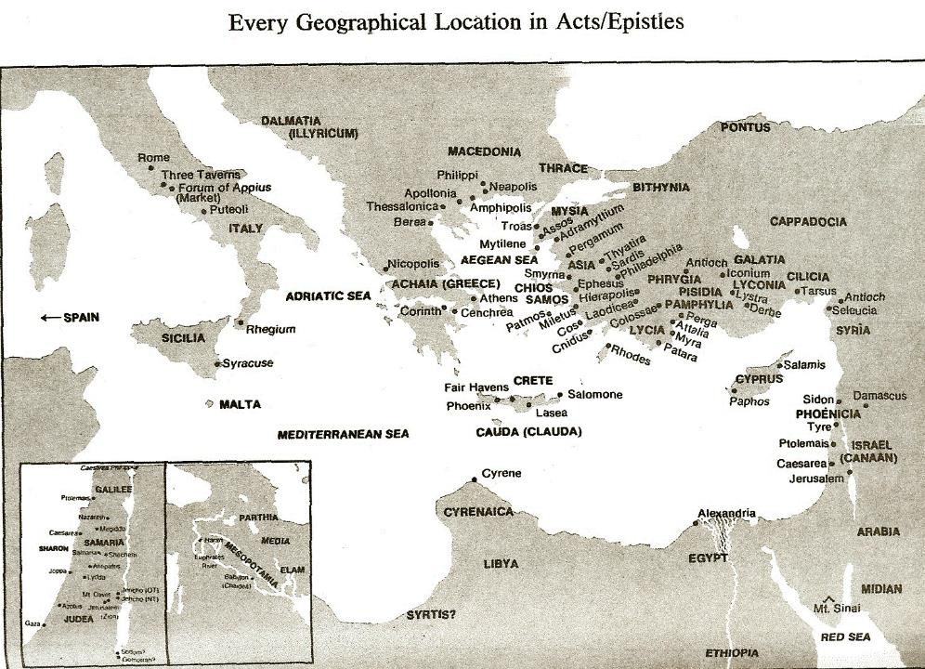

Slide 30
Acts 10:1‒11:18 Cornelius’ Salvation
Cornelius’ Vision (10:1-8)
Peter’s Vision (Acts 10:9-16)
Vision’s Application (10:17-23a)
Caesarean Ministry (10:23b-33)
Peter & The Keys of the Kingdom (10:34-43)
Gentiles’ Salvation (10:44-48)
Peter’s Defense in Jerusalem (11:1-18)

Slide 31
John 1:14
“And the Word [logos] became flesh, and dwelt among us, and we saw His glory, glory as of the only begotten [monogenēs] from the Father, full of grace and truth.”

Slide 32
I. Development of the Church Acts 11:19-26
Jewish evangelism in the Diaspora (19)
Gentile evangelism (20)
Progress report (21)
Barnabas’ ministry (22-24)
Saul reintroduced (25-26a)
Barnabas & Saul minister at Antioch (26b-d)

Slide 34
Acts 10:1‒11:18 Cornelius’ Salvation
Cornelius’ Vision (10:1-8)
Peter’s Vision (Acts 10:9-16)
Vision’s Application (10:17-23a)
Caesarean Ministry (10:23b-33)
Peter & The Keys of the Kingdom (10:34-43)
Gentiles’ Salvation (10:44-48)
Peter’s Defense in Jerusalem (11:1-18)

Slide 35
I. Development of the Church Acts 11:19-26
Jewish evangelism in the Diaspora (19)
Gentile evangelism (20)
Progress report (21)
Barnabas’ ministry (22-24)
Saul reintroduced (25-26a)
Barnabas & Saul minister at Antioch (26b-d)

Slide 36
Purpose
To present Theophilus with an orderly account of the birth and growth of the church so as to affirm him in what he has believed.

Slide 37
Message
Birth and growth of the church numerically, geographically, ethnically.
Components
Numerically (progress reports)
Geographically (From Jerusalem to Rome)
Ethnically (From Judaism to Gentile domination)

Slide 38
Progress Reports
Clearest: Acts 2:47; 6:7; 9:31; 12:24; 16:5; 19:20; 28:30-31
Less clear: Acts 1:13, 15; 2:41, 47; 4:4, 31; 5:14, 42; 8:25, 40; 11:21; 13:49; 17:6

Slide 39
A.T. Robertson
Word Pictures (Acts 20:21)
“In verse 21, the means of the preaching was that the hand of the Lord was with them. As a result, a great number that believed turned unto the Lord. Robertson notes that the Greek word for ‘to turn,’ epistrephó, was ‘the usual expression for Gentiles turning to the true God (Acts 14:15; Acts 15:3, 19; Acts 26:18, 20; 1 Th. 1:9).’”

Slide 40
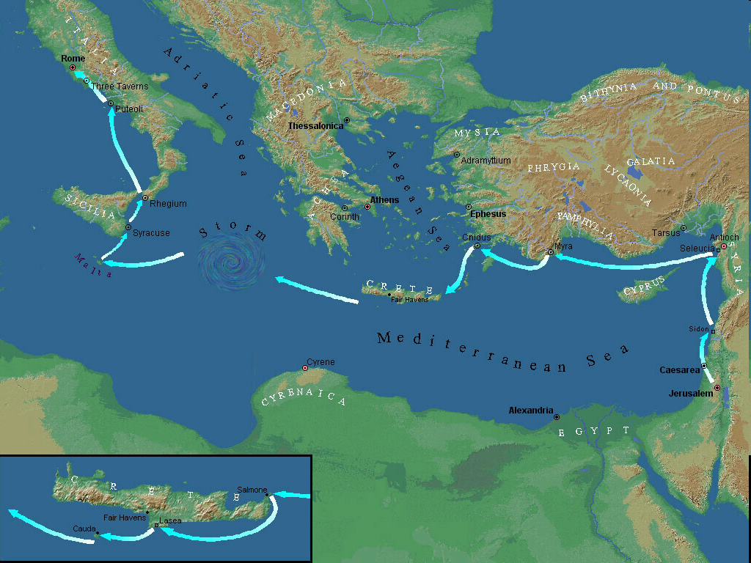

Slide 41
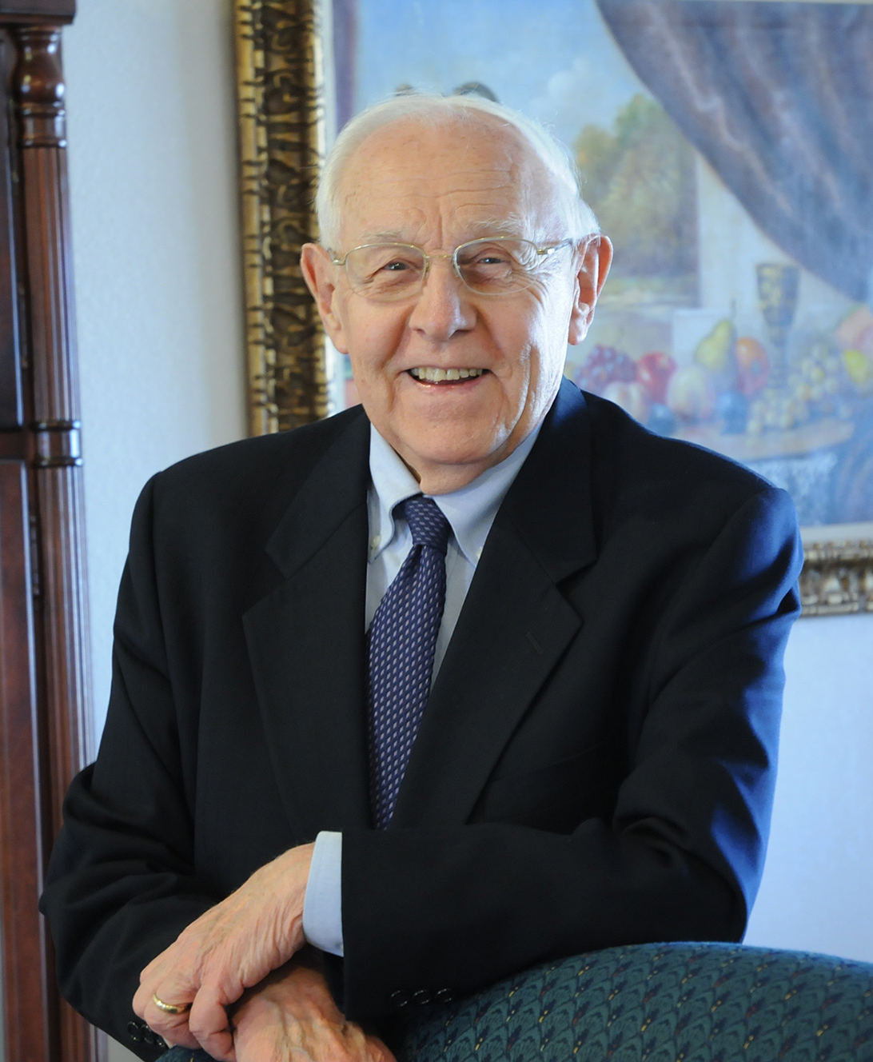
Dr. Stanley Toussaint
The Bible Knowledge Commentary, 383
Quoting the Roman poet and satirist Juvenal, The Bible Knowledge Commentary notes: “The sewage of the Syrian Orontes has for a long time been discharged into the Tiber.’ By this he meant that Antioch was so corrupt it was impacting Rome, more than 1,300 miles away.”

Slide 43
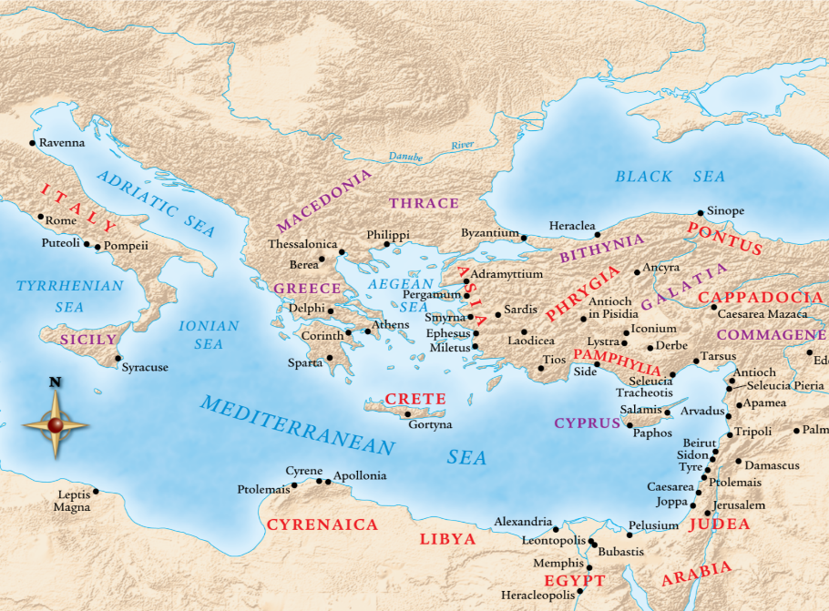

Slide 44
I. Development of the Church Acts 11:19-26
Jewish evangelism in the Diaspora (19)
Gentile evangelism (20)
Progress report (21)
Barnabas’ ministry (22-24)
Saul reintroduced (25-26a)
Barnabas & Saul minister at Antioch (26b-d)

Slide 45
Acts 11:22-24 Barnabas’ Ministry
Commission (22)
Activities (23)
Personality (24)

Slide 46
Acts 11:22-24 Barnabas’ Ministry
Commission (22)
Activities (23)
Personality (24)

Slide 48
Acts 11:22-24 Barnabas’ Ministry
Commission (22)
Activities (23)
Personality (24)

Slide 49
Acts 11:22-24 Barnabas’ Ministry
Commission (22)
Activities (23)
Personality (24)

Slide 50
Acts 6:3a Deacon Qualifications
Believers
Males
Reputable
Spiritual
Wise

Slide 51
1 Corinthians 3:1-3 (NKJV)
¹ And I, brethren, could not speak to you as to spiritual people but as to carnal, as to babes in Christ. ² I fed you with milk and not with solid food; for until now you were not able to receive it, and even now you are still not able; ³ for you are still carnal. For where there are envy, strife, and divisions among you, are you not carnal and behaving like mere men?

Slide 52
Notes:
Ray Steadman – “1st Californians”
Unbelievers vs Categories of Believers
Unbelievers – ψυχικός psuchikós; Natural, pertaining to the natural as distinguished from the spiritual
Spiritual Believers – πνευματικός pneumatikós; of persons who are spiritual, enlightened by the Holy Spirit
Infant Believers – σάρκινος sárkinos; with propensities of the flesh unto sin; νήπιος nḗpios; an infant, child, baby without any definite limitation of age. (This relates to immaturity and lack of instruction)
Carnal Believers – σαρκικός sarkikós; tendency to satisfy the flesh, implying sinfulness, sinful propensity, carnal (This relates to disobedience and open rebellion)

Slide 53
2 Peter 1:5-7
⁵ Now for this very reason also, applying all diligence, in your faith supply moral excellence, and in your moral excellence, knowledge, ⁶ and in your knowledge, self-control, and in your self-control, perseverance, and in your perseverance, godliness, ⁷ and in your godliness, brotherly kindness, and in your brotherly kindness, love.

Slide 54
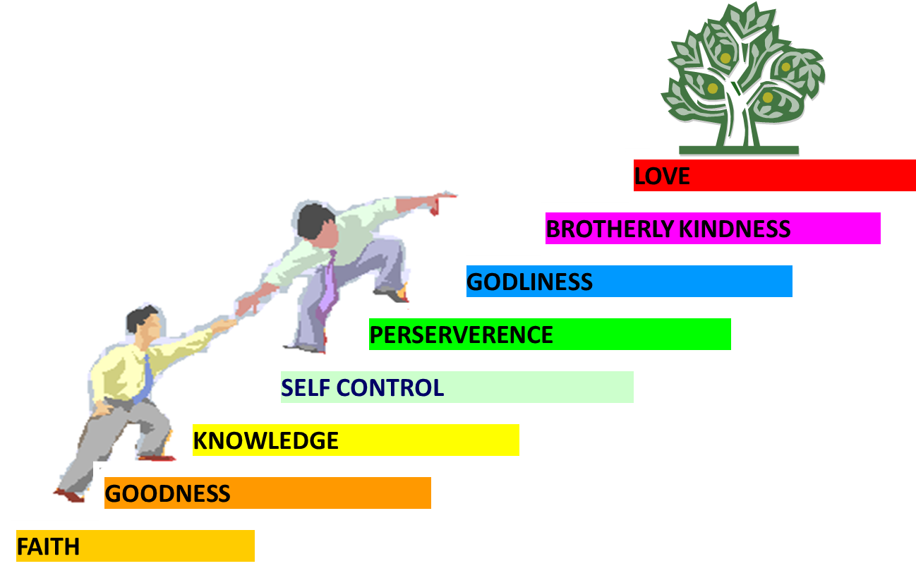
PORTRAIT OF GROWTH 1:5-7

Slide 55
Purpose
To present Theophilus with an orderly account of the birth and growth of the church so as to affirm him in what he has believed.

Slide 56
Message
Birth and growth of the church numerically, geographically, ethnically.
Components
Numerically (progress reports)
Geographically (From Jerusalem to Rome)
Ethnically (From Judaism to Gentile domination)

Slide 57
Progress Reports
Clearest: Acts 2:47; 6:7; 9:31; 12:24; 16:5; 19:20; 28:30-31
Less clear: Acts 1:13, 15; 2:41, 47; 4:4, 31; 5:14, 42; 8:25, 40; 11:21; 13:49; 17:6

Slide 58
I. Development of the Church Acts 11:19-26
Jewish evangelism in the Diaspora (19)
Gentile evangelism (20)
Progress report (21)
Barnabas’ ministry (22-24)
Saul reintroduced (25-26a)
Barnabas & Saul minister at Antioch (26b-d)

Slide 59
Acts 11:25-26a Saul Reintroduced
Barnabas searches for Saul (25)
Barnabas brings Saul to Antioch (26a)

Slide 60
Acts 11:25-26a Saul Reintroduced
Barnabas searches for Saul (25)
Barnabas brings Saul to Antioch (26a)

Slide 62
Acts 11:25-26a Saul Reintroduced
Barnabas searches for Saul (25)
Barnabas brings Saul to Antioch (26a)

Slide 64
I. Development of the Church Acts 11:19-26
Jewish evangelism in the Diaspora (19)
Gentile evangelism (20)
Progress report (21)
Barnabas’ ministry (22-24)
Saul reintroduced (25-26a)
Barnabas & Saul minister at Antioch (26b-d)

Slide 65
Acts 11:26b-d Barnabas & Saul Minister at Antioch
Duration (26b)
Size (26c)
Name (26d)

Slide 66
Acts 11:26b-d Barnabas & Saul Minister at Antioch
Duration (26b)
Size (26c)
Name (26d)

Slide 67
Acts 11:26b-d Barnabas & Saul Minister at Antioch
Duration (26b)
Size (26c)
Name (26d)

Slide 68
Purpose
To present Theophilus with an orderly account of the birth and growth of the church so as to affirm him in what he has believed.

Slide 69
Message
Birth and growth of the church numerically, geographically, ethnically.
Components
Numerically (progress reports)
Geographically (From Jerusalem to Rome)
Ethnically (From Judaism to Gentile domination)

Slide 70
Progress Reports
Clearest: Acts 2:47; 6:7; 9:31; 12:24; 16:5; 19:20; 28:30-31
Less clear: Acts 1:13, 15; 2:41, 47; 4:4, 31; 5:14, 42; 8:25, 40; 11:21; 13:49; 17:6

Slide 71
Acts 11:26b-d Barnabas & Saul Minister at Antioch
Duration (26b)
Size (26c)
Name (26d)

Slide 72
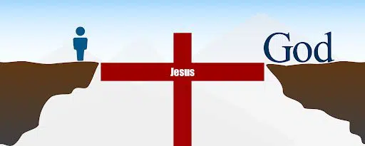
John 14:6
“Jesus said to him, ‘I am the way, and the truth, and the life; no one comes to the Father but through Me.’”

Slide 73
Purpose
To present Theophilus with an orderly account of the birth and growth of the church so as to affirm him in what he has believed.

Slide 74
Message
Birth and growth of the church numerically, geographically, ethnically.
Components
Numerically (progress reports)
Geographically (From Jerusalem to Rome)
Ethnically (From Judaism to Gentile domination)

Slide 75
Acts 11:19-30 The Church at Antioch
Development of the Church (11:19-26)
Benevolence of the Church (Acts 11:27-30)

Slide 76
II. Benevolence of the Church Acts 11:27-30
Agabus’ prophecy (27-28)
Relief fund (29-30)

Slide 77
II. Benevolence of the Church Acts 11:27-30
Agabus’ prophecy (27-28)
Relief fund (29-30)

Slide 78
Acts 11:27-28 Agabus’ Prophecy
Occasion (27)
Agabus introduced (28a)
Agabus’ prophecy (28b)
Fulfilment of Agabus’ prophecy (28c)

Slide 79
Acts 11:27-28 Agabus’ Prophecy
Occasion (27)
Agabus introduced (28a)
Agabus’ prophecy (28b)
Fulfilment of Agabus’ prophecy (28c)

Slide 81
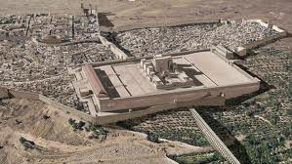
Christ’s Five Trips to Jerusalem
Feast | Verse
Passover | 2:23
Unnamed | 5:1
Tabernacles | 7:2
Dedication | 10:22
Passover | 13:1

Slide 82
Acts 11:27-28 Agabus’ Prophecy
Occasion (27)
Agabus introduced (28a)
Agabus’ prophecy (28b)
Fulfilment of Agabus’ prophecy (28c)

Slide 83
Acts 11:27-28 Agabus’ Prophecy
Occasion (27)
Agabus introduced (28a)
Agabus’ prophecy (28b)
Fulfilment of Agabus’ prophecy (28c)

Slide 84
The Whole World? (Revelation 3:10)
Oikouménē – known world? (Luke 2:1; Acts 11:28)
Oikouménē – entire world (Luke 4:5; Acts 17:31; Rev. 12:9)
Context favors the global definition
Adjective “whole” (holos)
Rev. 6‒18

Slide 85
Acts 11:27-28 Agabus’ Prophecy
Occasion (27)
Agabus introduced (28a)
Agabus’ prophecy (28b)
Fulfilment of Agabus’ prophecy (28c)

Slide 88
II. Benevolence of the Church Acts 11:27-30
Agabus’ prophecy (27-28)
Relief fund (29-30)

Slide 89
Acts 11:29-30 Relief Fund
Money collected (29)
Money sent (30)

Slide 90
Acts 11:29-30 Relief Fund
Money collected (29)
Money sent (30)

Slide 91
Activities of the Local Church (Acts 2:41-47)
Doctrine (Acts 2:42)
Ordinances (Acts 2:41-42, 46)
Prayer (Acts 2:42)
Evangelism (Acts 2:47)
Worship (Acts 2:47)
Benevolence (Acts 2:44-45)
Fellowship (Acts 2:42, 46-47)

Slide 94
Acts 11:29-30 Relief Fund
Money collected (29)
Money sent (30)

Slide 95
Acts 11:30 Money Sent
Saul (30a)
Barnabas (30b)
Elders (30c)

Slide 96
Acts 11:30 Money Sent
Saul (30a)
Barnabas (30b)
Elders (30c)

Slide 97
Acts 11:30 Money Sent
Saul (30a)
Barnabas (30b)
Elders (30c)

Slide 98
Acts 11:30 Money Sent
Saul (30a)
Barnabas (30b)
Elders (30c)

Slide 99
Local Church Government
Episcopalian / bishop rule – Acts 15:2, 6
Congregational rule – Acts 6:1-7
Presbyterian / elder rule – Acts 20:28; 1 Tim 5:17; 4:14

Slide 100
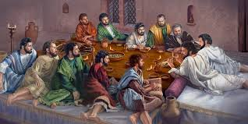
Ephesians 2:20
“having been built on the foundation of the apostles and prophets, Christ Jesus Himself being the corner stone.”

Slide 101
Conclusion

Slide 102
Acts 11:19-30 The Church at Antioch
Development of the Church (11:19-26)
Benevolence of the Church (Acts 11:27-30)

