Slide 2
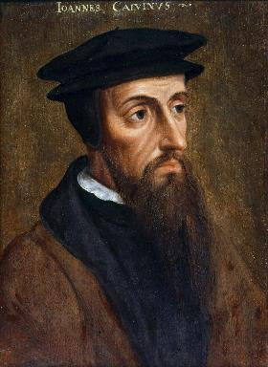
Neo-Calvinism vs. The Bible
Calvinism’s Mixed Blessing
Why Critique Calvinism?
The Source of Calvin’s Theology
Calvin’s Manner of Life
TULIP Through the Grid of Scripture
Conclusion

Slide 3
V. Running TULIP Through the Grid of Scripture
Total Depravity
Unconditional Election
Limited Atonement
Irresistible Grace
Perseverance of the Saints

Slide 4
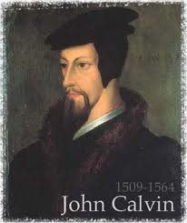
Total Depravity
The starting point
Total Depravity properly defined
Calvinism: Total Depravity = inability
Calvinism’s overstatement of Total Depravity

Slide 5
Calvinism’s Overstatement of Total Depravity
Confusion over intensity vs. extent (Gen. 3:22; Matt. 7:7-11; Rom. 2:14-15)
Operates contrary to man’s design
Mis-defines “death” (Eph. 2:1) as non-existence rather than separation
Underestimates what lost man can do

Slide 6
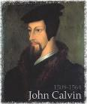
Calvinism Underestimates What Lost Man Can Do
Lost man can seek God (John 16:7-11; Acts 10‒11)
Lost man can hear from God (Acts 10:30-32, 44-48; 11:14)
Lost man can reason (Matt. 21:23-27)
Lost man can believe (exercise faith) in God (John 3:18)

Slide 7
Calvinism Underestimates What Lost Man Can Do
Lost man can seek God (John 16:7-11; Acts 10‒11)
Lost man can hear from God (Acts 10:30-32, 44-48; 11:14)
Lost man can reason (Matt. 21:23-27)
Lost man can believe (exercise faith) in God (John 3:18)

Slide 8
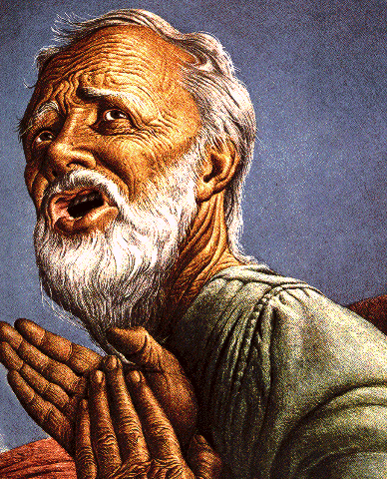
Passage Conditioning Salvation on Faith Alone (Sola Fide)
Genesis 15:6
John 3:16; 5:24; 6:28-29, 47; 16:8-9; 20:30-31
Acts 16:30-31
Romans 1:16; Ephesians 2:8-9
Hebrews 11:6

Slide 9
Belief – God’s One Condition for Justification
Gen 15:6
Then he believed in the LORD; and He reckoned it to him as righteousness.
John 3:16
For God so loved the world, that He gave His only begotten Son, that whoever believes in Him shall not perish, but have eternal life.
Acts 16:30-31
"Sirs, what must I do to be saved?" They said, "Believe in the Lord Jesus, and you will be saved..."

Slide 10
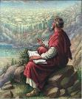
John 20:30-31
“Therefore many other signs Jesus also performed in the presence of the disciples, which are not written in this book; but these have been written so that you may believe that Jesus is the Christ, the Son of God; and that believing you may have life in His name.”

Slide 11
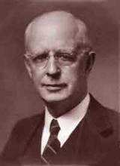
Lewis Sperry Chafer, vol. 7, Systematic Theology (Grand Rapids, MI: Kregel Publications, 1993), 265-66.
Belief-God’s One Condition for Justification
“…because upwards of 150 passages of Scripture condition salvation upon believing only (cf. John 3:16; Acts 16:31).”

Slide 12
Hebrews 6:4-6
⁴ “For in the case of those who have once been enlightened and have tasted of the heavenly gift and have been made partakers of the Holy Spirit, ⁵ and have tasted the good word of God and the powers of the age to come, ⁶ and then have fallen away, it is impossible to renew them again to repentance, since they again crucify to themselves the Son of God and put Him to open shame.”

Slide 13
Romans 1:18–20
¹⁸ For the wrath of God is revealed from heaven against all ungodliness and unrighteousness of men who suppress the truth in unrighteousness, ¹⁹ because that which is known about God is evident within them; for God made it evident to them. ²⁰ For since the creation of the world His invisible attributes, His eternal power and divine nature, have been clearly seen, being understood through what has been made, so that they are without excuse.

Slide 14
Dr. Robert R. Congdon
Oops! I Thought I Was a Four - Pt Calvinist (Greer, SC: Congdon Ministries International, 2014), 51.
“Furthermore, why would God admonish and warn unbelievers for being spiritually blind and deaf if it were not in their power to respond?…Is this not a mockery? It would be like chiding a legless man for being unable to walk.”

Slide 16
V. Running TULIP Through the Grid of Scripture
Total Depravity
Unconditional Election
Limited Atonement
Irresistible Grace
Perseverance of the Saints

Slide 17
Total Depravity
The starting point
Total Depravity properly defined
Calvinism: Total Depravity = inability
Calvinism’s overstatement of Total Depravity

Slide 18
Calvinism’s Overstatement of Total Depravity
Confusion over intensity vs. extent (Gen. 3:22; Matt. 7:7-11; Rom. 2:14-15)
Operates contrary to man’s design
Mis-defines “death” (Eph. 2:1) as non-existence rather than separation
Underestimates what lost man can do

Slide 19
Calvinism Underestimates What Lost Man Can Do
Lost man can seek God (John 16:7-11; Acts 10‒11)
Lost man can hear from God (Acts 10:30-32, 44-48; 11:14)
Lost man can reason (Matt. 21:23-27)
Lost man can believe (exercise faith) in God (John 3:18)

Slide 20
V. Running TULIP Through the Grid of Scripture
Total Depravity
Unconditional Election
Limited Atonement
Irresistible Grace
Perseverance of the Saints

