Slide 1
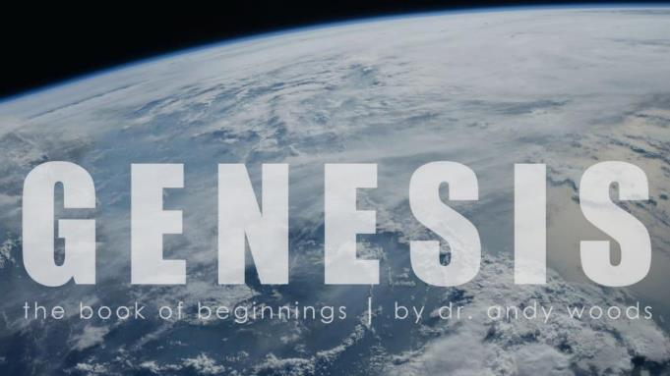
Genesis 12‒50
Israel’s Birth & Preservation

Slide 2
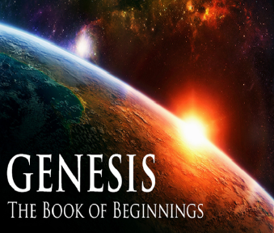
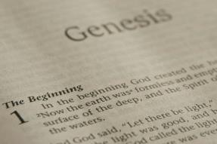
GENESIS STRUCTURE
Genesis 12-50 (four people)
Abraham (12:1–25:11)
Isaac (25:12–26:35)
Jacob (27–36)
Joseph (37–50)

Slide 3
Genesis 37‒50 Joseph
Joseph sold unto Egypt (37)
Canaan’s corruption (38)
Joseph falsely accused (39)
Joseph’s short-term predictions (40)
Joseph’s elevation (41)
Joseph’s first reunion with his brothers (42)
Joseph’s second reunion with his brothers (43‒45)
Joseph’s second reunion with his brothers (43‒45)
Sojourn to Egypt (46:1‒47:12)
Famine’s course (47:13-26)
Jacob in Egypt (47:27-31)
Jacob blesses Joseph’s sons (48)
Jacob blesses his sons (49)

Slide 4
Genesis 49:1-33 Jacob Blesses His Sons
Call (49:1)
Introduction (49:2)
Jacob’s blessings on his sons (49:3-27)
Concluding summary (49:28)
Jacob’s death (49:29-33)

Slide 5
III. Genesis 49:3-27 Jacob’s Blessings on His Sons
Reuben (3-4)
Simeon & Levi (5-7)
Judah (8-12)
Zebulun (13)
Issachar (14-15)
Dan (16-18)
Gad (19)
Asher (20)
Naphtali (21)
Joseph (22-26)
Benjamin (27)

Slide 6
Genesis 49:19 Gad
Will be pressed upon (19a)
Will overcome (19b)

Slide 7
Genesis 49:19 Gad
Will be pressed upon (19a)
Will overcome (19b)

Slide 8
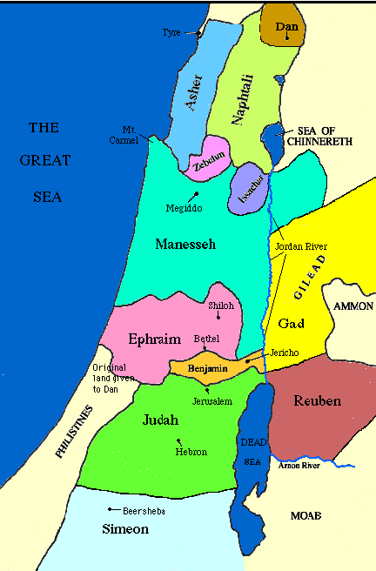

Slide 10
Genesis 49:19 Gad
Will be pressed upon (19a)
Will overcome (19b)

Slide 11
III. Genesis 49:3-27 Jacob’s Blessings on His Sons
Reuben (3-4)
Simeon & Levi (5-7)
Judah (8-12)
Zebulun (13)
Issachar (14-15)
Dan (16-18)
Gad (19)
Asher (20)
Naphtali (21)
Joseph (22-26)
Benjamin (27)

Slide 12
Genesis 49:20 Asher
Wealth (20a)
Produce delicacies (20b)

Slide 13
Genesis 49:20 Asher
Wealth (20a)
Produce delicacies (20b)

Slide 15
Deuteronomy 33:24
“Of Asher he said, ‘More blessed than sons is Asher; May he be favored by his brothers, And may he dip his foot in oil.’”

Slide 16
Todd Strandberg
“Could Israel Become a Major Oil Exporter,” online: www.bibleprophecy.com, accessed 26 May 2015.
In the summer of 2010, "...huge deposits of natural gas were found along Israel's northern coastline…Israel is actually sitting on top of a vast amount of oil. According to Harold Vinegar, the former chief scientist of Royal Dutch Shell, the Shefla Basin holds the world’s second-largest shale deposits outside the United States, from which around 250 billion barrels of oil–about the same as Saudi Arabia’s proven reserves...Estimates of global deposits range from 2.8 trillion to 3.3 trillion barrels of recoverable oil...The technology curb has now reached the point where shale is becoming an exploitable resource...the Shefla shale is in a hospitable location. It also contains oil of the light, sweet variety that is easy to refine into gasoline or other common end products. Most of all, the Jews have proven themselves to be very talented at exploiting resources. If they can't make shale oil work, I doubt any nation can.”

Slide 17
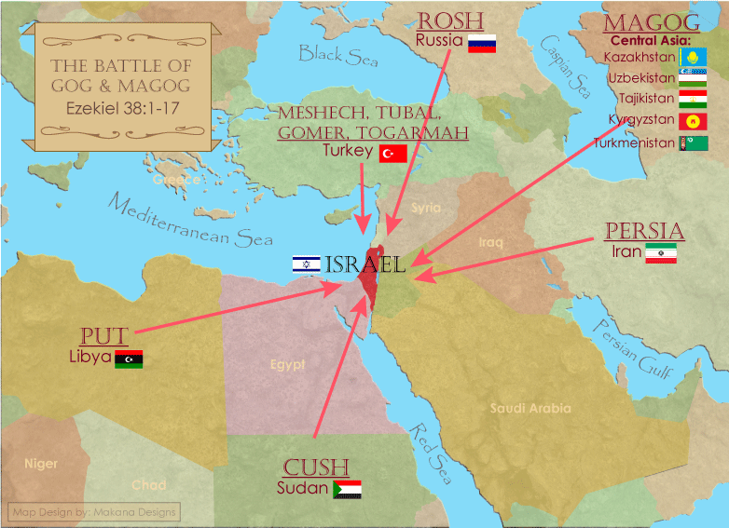

Slide 18
Ezekiel 38:12
“to capture spoil and to seize plunder, to turn your hand against the waste places which are now inhabited, and against the people who are gathered from the nations, who have acquired cattle and goods, who live at the center of the world.”

Slide 19
Ezekiel 38:13
“Sheba and Dedan and the merchants of Tarshish with all its villages will say to you, ‘Have you come to capture spoil? Have you assembled your company to seize plunder, to carry away silver and gold, to take away cattle and goods, to capture great spoil?’”

Slide 20
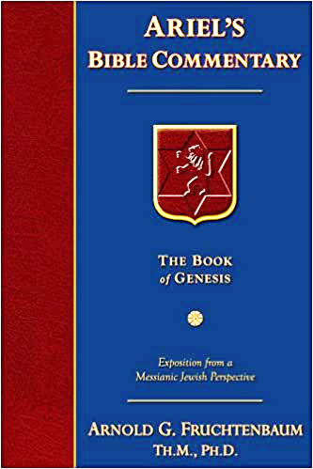
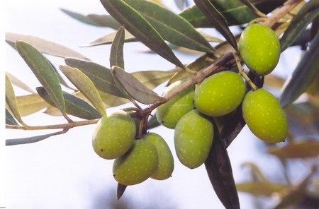
Dr. Arnold G. Fruchtenbaum
The Book of Genesis, 648
“In fact, he was assigned land along the Mediterranean Coast, which is very suitable for growing many things; and to this day, it is rich in olive trees producing olive oil.”

Slide 21
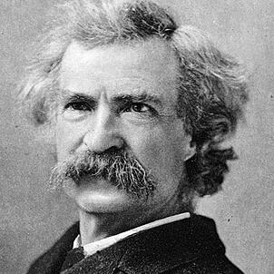
Mark Twain
The Innocents Abroad, Complete, 1st ed. (A Public Domain Book, 1869), 267, 285, 302. These quotes can be found in chapters 47, 49, 52.
“... A desolate country whose soil is rich enough, but is given over wholly to weeds… a silent mournful expanse…. a desolation is here that not even imagination can grace with the pomp of life and action…. we never saw a human being on the whole route…. there was hardly a tree or shrub anywhere. Even the olive tree and the cactus, those fast friends of a worthless soil, had almost deserted the country.”

Slide 22
Why?
COUNTRY | GROSS DOMESTIC PRODUCT (in U.S. $)
ISRAEL | $467 BILLION
Egypt | $396 billion
Jordan | $45 billion
Lebanon | $19 billion
Syria (no data after 2010) | $60 billion (est. 2010)
Source: I.M.F., 2021

Slide 23
Genesis 49:20 Asher
Wealth (20a)
Produce delicacies (20b)

Slide 24
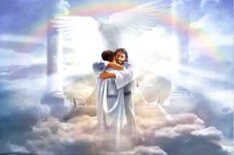
Ephesians 1:3
“Blessed be the God and Father of our Lord Jesus Christ, who has blessed us with every spiritual blessing in the heavenly places in Christ.”

Slide 25
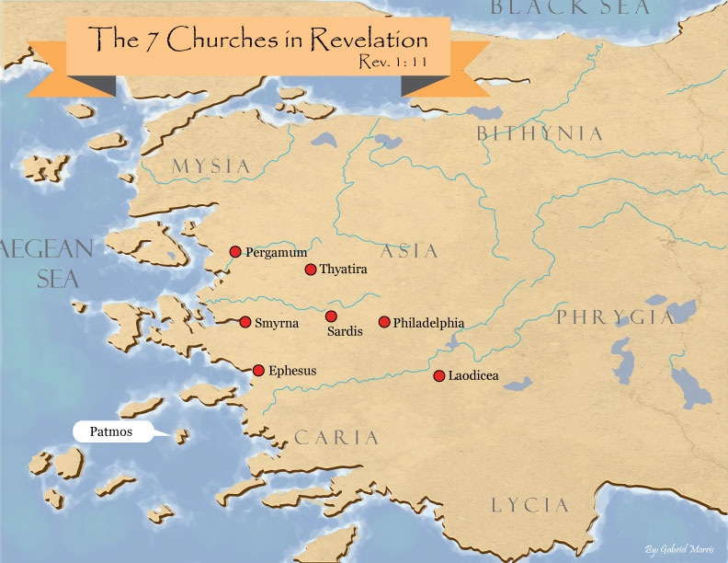

Slide 26
Revelation 2:9
“I know your tribulation and your poverty (but you are rich), and the blasphemy by those who say they are Jews and are not, but are a synagogue of Satan.”

Slide 27
III. Genesis 49:3-27 Jacob’s Blessings on His Sons
Reuben (3-4)
Simeon & Levi (5-7)
Judah (8-12)
Zebulun (13)
Issachar (14-15)
Dan (16-18)
Gad (19)
Asher (20)
Naphtali (21)
Joseph (22-26)
Benjamin (27)

Slide 28
Genesis 49:21 Naphtali
Unrestrained movement (21a)
Speech sophistication (21b)

Slide 29
Genesis 49:21 Naphtali
Unrestrained movement (21a)
Speech sophistication (21b)

Slide 30
Genesis 49:21 Naphtali
Unrestrained movement (21a)
Speech sophistication (21b)

Slide 31
III. Genesis 49:3-27 Jacob’s Blessings on His Sons
Reuben (3-4)
Simeon & Levi (5-7)
Judah (8-12)
Zebulun (13)
Issachar (14-15)
Dan (16-18)
Gad (19)
Asher (20)
Naphtali (21)
Joseph (22-26)
Benjamin (27)

Slide 32
Genesis 49:22-26 Joseph
Progeny (22)
Persecution (23)
Survival (24)
Future blessings (25)
Joseph to receive blessings (26)

Slide 33
Genesis 49:22-26 Joseph
Progeny (22)
Persecution (23)
Survival (24)
Future blessings (25)
Joseph to receive blessings (26)

Slide 34
Genesis 49:22 Progeny
Fruitful (22a)
Water supply (22b)
Spread out (22c)

Slide 35
Genesis 49:22 Progeny
Fruitful (22a)
Water supply (22b)
Spread out (22c)

Slide 36
Genesis 49:22 Progeny
Fruitful (22a)
Water supply (22b)
Spread out (22c)

Slide 37
Genesis 49:22 Progeny
Fruitful (22a)
Water supply (22b)
Spread out (22c)

Slide 38
Genesis 49:22-26 Joseph
Progeny (22)
Persecution (23)
Survival (24)
Future blessings (25)
Joseph to receive blessings (26)

Slide 39
Genesis 49:23 Persecution
Grieved (23a)
Shot (23b)
Persecuted (23c)

Slide 40
Genesis 49:23 Persecution
Grieved (23a)
Shot (23b)
Persecuted (23c)

Slide 41
Genesis 49:23 Persecution
Grieved (23a)
Shot (23b)
Persecuted (23c)

Slide 42
Genesis 49:23 Persecution
Grieved (23a)
Shot (23b)
Persecuted (23c)

Slide 43
Genesis 49:22-26 Joseph
Progeny (22)
Persecution (23)
Survival (24)
Future blessings (25)
Joseph to receive blessings (26)

Slide 44
Genesis 49:24 Survival
Strength (24a)
Tested growth (24b)
Prevailed through God (24c)
God to bring Messiah (24d)

Slide 45
Genesis 49:24 Survival
Strength (24a)
Tested growth (24b)
Prevailed through God (24c)
God to bring Messiah (24d)

Slide 46
Genesis 49:24 Survival
Strength (24a)
Tested growth (24b)
Prevailed through God (24c)
God to bring Messiah (24d)

Slide 47
Genesis 49:24 Survival
Strength (24a)
Tested growth (24b)
Prevailed through God (24c)
God to bring Messiah (24d)

Slide 48
Genesis 49:24 Survival
Strength (24a)
Tested growth (24b)
Prevailed through God (24c)
God to bring Messiah (24d)

Slide 49
Genesis 49:22-26 Joseph
Progeny (22)
Persecution (23)
Survival (24)
Future blessings (25)
Joseph to receive blessings (26)

Slide 50
Genesis 49:25 Future Blessings
God as source (25a-b)
Other sources (25c-e)

Slide 51
Genesis 49:25 Future Blessings
God as source (25a-b)
Other sources (25c-e)

Slide 52
Genesis 49:25a-b God as Source
Your Father (25a)
Almighty (25b)

Slide 53
Genesis 49:25a-b God as Source
Your Father (25a)
Almighty (25b)

Slide 54
Genesis 49:25a-b God as Source
Your Father (25a)
Almighty (25b)

Slide 55
Genesis 49:25 Future Blessings
God as source (25a-b)
Other sources (25c-e)

Slide 56
Genesis 49:25c-e Other Sources
Dews (25c)
Springs & fountains (25d)
Breasts & womb (25e)

Slide 57
Genesis 49:25c-e Other Sources
Dews (25c)
Springs & fountains (25d)
Breasts & womb (25e)

Slide 58
Genesis 49:25c-e Other Sources
Dews (25c)
Springs & fountains (25d)
Breasts & womb (25e)

Slide 59
Genesis 49:25c-e Other Sources
Dews (25c)
Springs & fountains (25d)
Breasts & womb (25e)

Slide 60
Genesis 49:22-26 Joseph
Progeny (22)
Persecution (23)
Survival (24)
Future blessings (25)
Joseph to receive blessings (26)

Slide 61
III. Genesis 49:3-27 Jacob’s Blessings on His Sons
Reuben (3-4)
Simeon & Levi (5-7)
Judah (8-12)
Zebulun (13)
Issachar (14-15)
Dan (16-18)
Gad (19)
Asher (20)
Naphtali (21)
Joseph (22-26)
Benjamin (27)

Slide 62
Genesis 49:27 Benjamin
Ravenous wolf (27a)
Devours prey (27b)
Share spoil due to success (27c)

Slide 63
Genesis 49:27 Benjamin
Ravenous wolf (27a)
Devours prey (27b)
Share spoil due to success (27c)

Slide 64
Genesis 49:27 Benjamin
Ravenous wolf (27a)
Devours prey (27b)
Share spoil due to success (27c)

Slide 65
Genesis 49:27 Benjamin
Ravenous wolf (27a)
Devours prey (27b)
Share spoil due to success (27c)

Slide 66
Genesis 49:1-33 Jacob Blesses His Sons
Call (49:1)
Introduction (49:2)
Jacob’s blessings on his sons (49:3-27)
Concluding summary (49:28)
Jacob’s death (49:29-33)

Slide 67
IV. Genesis 49:28 Concluding Summary
Prophecies beyond sons (28a)
Summary of Jacob’s blessings (28b)

Slide 68
IV. Genesis 49:28 Concluding Summary
Prophecies beyond sons (28a)
Summary of Jacob’s blessings (28b)

Slide 69
IV. Genesis 49:28 Concluding Summary
Prophecies beyond sons (28a)
Summary of Jacob’s blessings (28b)

Slide 70
Genesis 49:1-33 Jacob Blesses His Sons
Call (49:1)
Introduction (49:2)
Jacob’s blessings on his sons (49:3-27)
Concluding summary (49:28)
Jacob’s death (49:29-33)

Slide 71
V. Genesis 49:29-33 Jacob’s Death
Charge (29a)
Announcement of death (29b)
Request (29c)
Place of burial (29d-30)
Others buried there (31)
Burial place repeated (32)
Jacob’s death (33)

Slide 72
V. Genesis 49:29-33 Jacob’s Death
Charge (29a)
Announcement of death (29b)
Request (29c)
Place of burial (29d-30)
Others buried there (31)
Burial place repeated (32)
Jacob’s death (33)

Slide 73
V. Genesis 49:29-33 Jacob’s Death
Charge (29a)
Announcement of death (29b)
Request (29c)
Place of burial (29d-30)
Others buried there (31)
Burial place repeated (32)
Jacob’s death (33)

Slide 74
V. Genesis 49:29-33 Jacob’s Death
Charge (29a)
Announcement of death (29b)
Request (29c)
Place of burial (29d-30)
Others buried there (31)
Burial place repeated (32)
Jacob’s death (33)

Slide 75
V. Genesis 49:29-33 Jacob’s Death
Charge (29a)
Announcement of death (29b)
Request (29c)
Place of burial (29d-30)
Others buried there (31)
Burial place repeated (32)
Jacob’s death (33)

Slide 76
V. Genesis 49:29-33 Jacob’s Death
Charge (29a)
Announcement of death (29b)
Request (29c)
Place of burial (29d-30)
Others buried there (31)
Burial place repeated (32)
Jacob’s death (33)

Slide 77
V. Genesis 49:29-33 Jacob’s Death
Charge (29a)
Announcement of death (29b)
Request (29c)
Place of burial (29d-30)
Others buried there (31)
Burial place repeated (32)
Jacob’s death (33)

Slide 78
V. Genesis 49:29-33 Jacob’s Death
Charge (29a)
Announcement of death (29b)
Request (29c)
Place of burial (29d-30)
Others buried there (31)
Burial place repeated (32)
Jacob’s death (33)

Slide 79
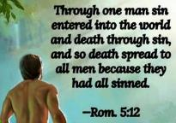
Genesis 2:16-17
“¹⁶ The Lord God commanded the man, saying, ‘From any tree of the garden you may eat freely; ¹⁷ but from the tree of the knowledge of good and evil you shall not eat, for in the day that you eat from it you will surely die (muwth).’”

Slide 80
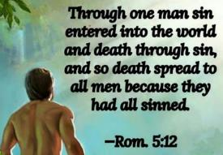
Genesis 3:19
“By the sweat of your face You will eat bread, Till you return to the ground, Because from it you were taken; For you are dust, And to dust you shall return.”

Slide 81
1 Corinthians 15:21-22
“²¹ For since by a man came death, by a man also came the resurrection of the dead. ²² For as in Adam all die, so also in Christ all will be made alive.”

Slide 82
Romans 5:12
“Therefore, just as through one man sin entered into the world, and death through sin, and so death spread to all men, because all sinned—.”

Slide 83
Romans 6:23
“For the wages of sin is death, but the free gift of God is eternal life in Christ Jesus our Lord.”

Slide 84
Hebrews 9:27
“And inasmuch as it is appointed for men to die once and after this comes judgment.”

Slide 85
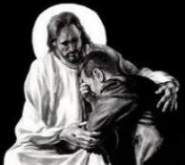
Revelation 21:4
“and He will wipe away every tear from their eyes; and there will no longer be any death; there will no longer be any mourning, or crying, or pain; the first things have passed away.”

Slide 87
Conclusion

Slide 88
Genesis 49:1-33 Jacob Blesses His Sons
Call (49:1)
Introduction (49:2)
Jacob’s blessings on his sons (49:3-27)
Concluding summary (49:28)
Jacob’s death (49:29-33)

Slide 89
²⁴ The Lord bless you, and keep you; ²⁵ The Lord make His face shine on you, And be gracious to you; ²⁶ The Lord lift up His countenance on you, And give you peace.
Numbers 6:24–26 (NASB95)

