Slide 2
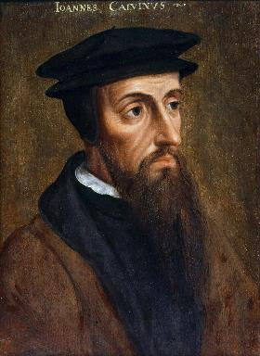
Neo-Calvinism vs. The Bible
Calvinism’s Mixed Blessing
Why Critique Calvinism?
The Source of Calvin’s Theology
Calvin’s Manner of Life
TULIP Through the Grid of Scripture
Conclusion

Slide 3
V. Running TULIP Through the Grid of Scripture
Total Depravity
Unconditional Election
Limited Atonement
Irresistible Grace
Perseverance of the Saints

Slide 4
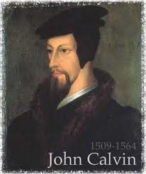
Total Depravity
The starting point
Total Depravity properly defined
Calvinism: Total Depravity = inability
Calvinism’s overstatement of Total Depravity

Slide 5
Calvinism’s Overstatement of Total Depravity
Confusion over intensity vs. extent (Gen. 3:22; Matt. 7:7-11; Rom. 2:14-15)
Operates contrary to man’s design
Mis-defines “death” (Eph. 2:1) as non-existence rather than separation
Underestimates what lost man can do

Slide 6
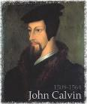
Calvinism Underestimates What Lost Man Can Do
Lost man can seek God (John 16:7-11; Acts 10‒11)
Lost man can hear from God (Acts 10:30-32, 44-48; 11:14)
Lost man can reason (Matt. 21:23-27)
Lost man can believe (exercise faith) in God (John 3:18)

Slide 7
Calvinism Underestimates What Lost Man Can Do
Lost man can seek God (John 16:7-11; Acts 10‒11)
Lost man can hear from God (Acts 10:30-32, 44-48; 11:14)
Lost man can reason (Matt. 21:23-27)
Lost man can believe (exercise faith) in God (John 3:18)

Slide 9
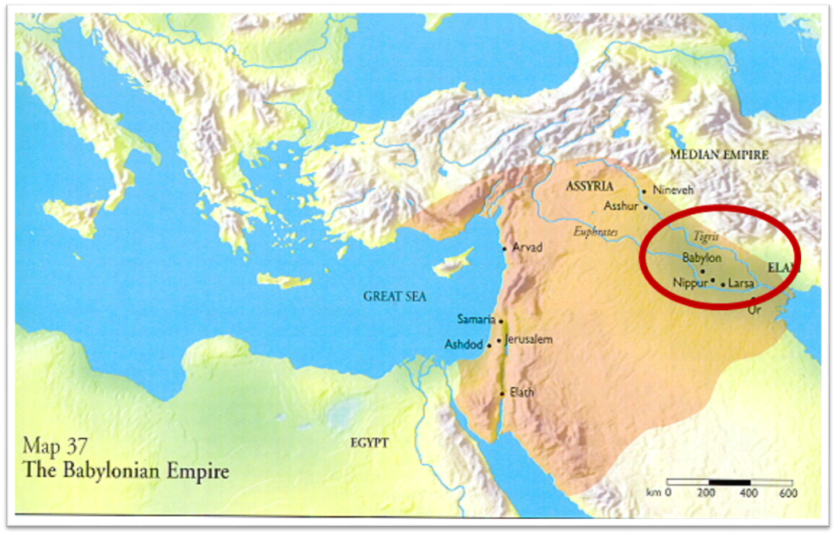

Slide 10
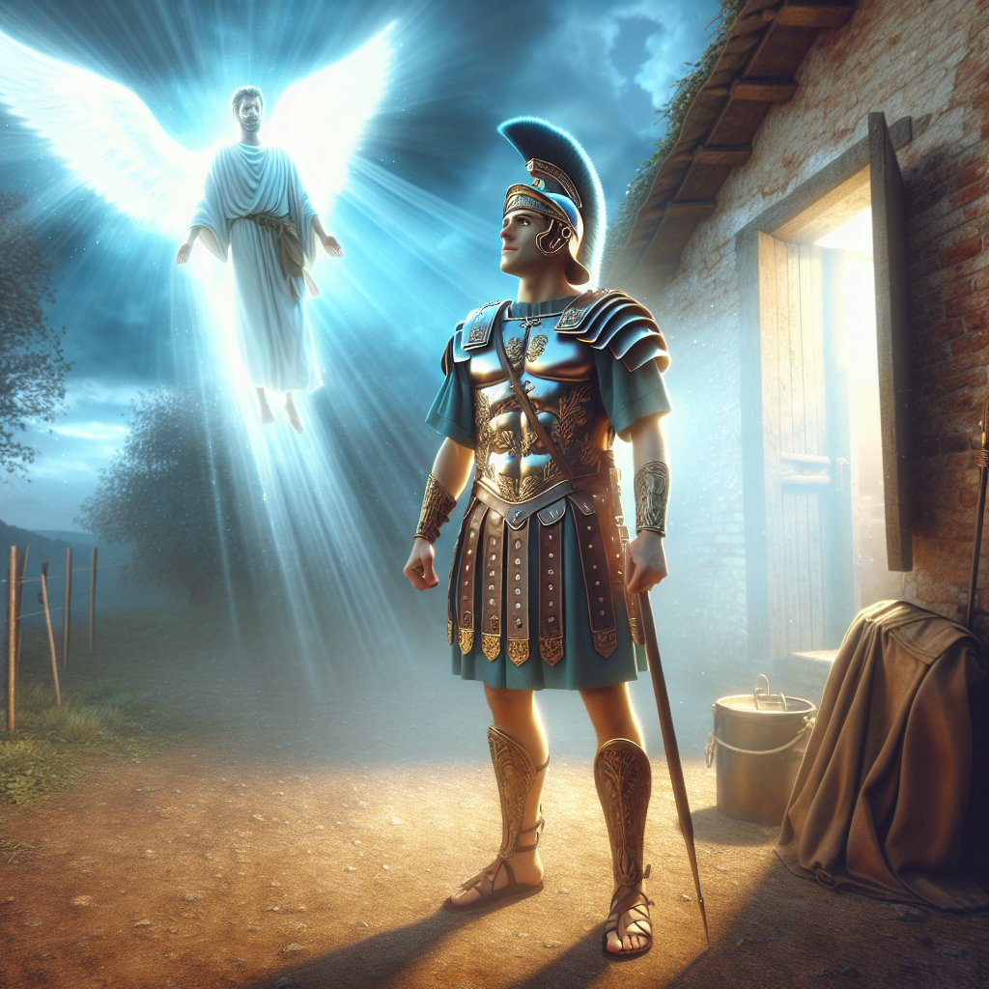
Acts 10:2
“¹ Now there was a man at Caesarea named Cornelius, a centurion of what was called the Italian cohort, ² a devout man and one who feared God with all his household, and gave many alms to the Jewish people and prayed to God continually.”

Slide 11
Acts 11:14
“and he will speak words to you by which you [Cornelius] will be saved, you and all your household.”

Slide 12
Acts 17:26-27
²⁶ and He made from one man every nation of mankind to live on all the face of the earth, having determined their appointed times and the boundaries of their habitation, ²⁷ that they would seek God, if perhaps they might grope for Him and find Him, though He is not far from each one of us (Italics added)

Slide 13
Romans 1:18–20
¹⁸ For the wrath of God is revealed from heaven against all ungodliness and unrighteousness of men who suppress the truth in unrighteousness, ¹⁹ because that which is known about God is evident within them; for God made it evident to them. ²⁰ For since the creation of the world His invisible attributes, His eternal power and divine nature, have been clearly seen, being understood through what has been made, so that they are without excuse.

Slide 14
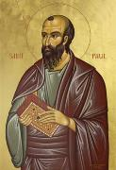
Romans 3:11
“There is none who understands, There is none who seeks for God.”

Slide 15
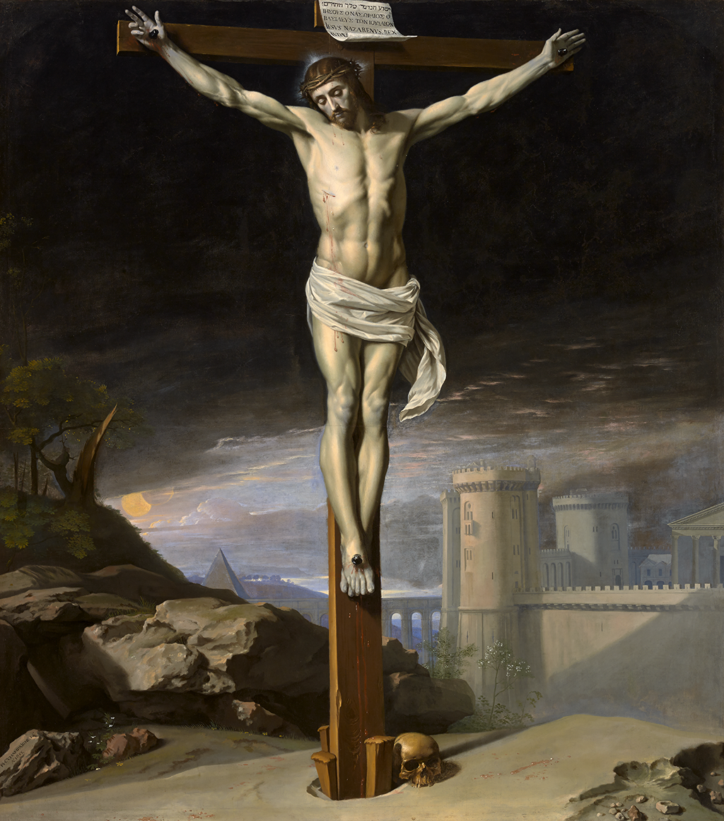
John 12:32
“And I, if I am lifted up from the earth, will draw all men to Myself.”

Slide 16
John 16:7-11
“⁷ But I tell you the truth, it is to your advantage that I go away; for if I do not go away, the Helper will not come to you; but if I go, I will send Him to you. ⁸ And He, when He comes, will convict the world concerning sin and righteousness and judgment; ⁹ concerning sin, because they do not believe in Me; ¹⁰ and concerning righteousness, because I go to the Father and you no longer see Me; ¹¹ and concerning judgment, because the ruler of this world has been judged.”

Slide 17
Isaiah 55:10-11
¹⁰ “For as the rain and the snow come down from heaven, And do not return there without watering the earth And making it bear and sprout, And furnishing seed to the sower and bread to the eater; ¹¹ So will My word be which goes forth from My mouth; It will not return to Me empty, Without accomplishing what I desire, And without succeeding in the matter for which I sent it.”

Slide 18
2 Timothy 3:15
“and that from childhood you have known the sacred writings which are able to give you the wisdom that leads to salvation through faith which is in Christ Jesus.”

Slide 19
2 Timothy 3:16-17
“All Scripture is inspired by God [theopneustos] and profitable for teaching, for reproof, for correction, for training in righteousness; so that the man of God may be adequate, equipped for every good work.”

Slide 20
Romans 1:16
“For I am not ashamed of the gospel, for it is the power of God for salvation to everyone who believes, to the Jew first and also to the Greek.”

Slide 21
Romans 1:18-20
“¹⁸ For the wrath of God is revealed from heaven against all ungodliness and unrighteousness of men who suppress the truth in unrighteousness, ¹⁹ because that which is known about God is evident within them; for God made it evident to them. ²⁰ For since the creation of the world His invisible attributes, His eternal power and divine nature, have been clearly seen, being understood through what has been made, so that they are without excuse.”

Slide 22
Psalm 19:1-4
“¹ The heavens are telling of the glory of God; And their expanse is declaring the work of His hands. ² Day to day pours forth speech, And night to night reveals knowledge. ³ There is no speech, nor are there words; Their voice is not heard. ⁴ Their line has gone out through all the earth, And their utterances to the end of the world. In them He has placed a tent for the sun.”

Slide 23
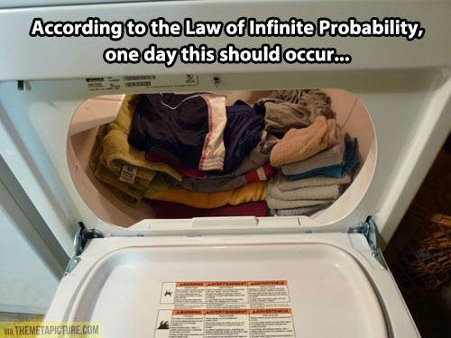

Slide 24
GENERAL VS. SPECIAL REVELATION
 | GENERAL | SPECIAL
EXAMPLES | Nature, conscience (Rom 1–2) | Incarnation, Scripture, miracles
AVAILABILITY | All | Some
ACCOMPLISHMENT | Accountability (Rom 1) | Salvation (Acts 4:12; 2 Tim 3:15)
FORM | Non-written or non-verbal | Written
QUALITY | Natural | Supernatural, miraculous

Slide 25
Calvinism Underestimates What Lost Man Can Do
Lost man can seek God (John 16:7-11; Acts 10‒11)
Lost man can hear from God (Acts 10:30-32, 44-48; 11:14)
Lost man can reason (Matt. 21:23-27)
Lost man can believe (exercise faith) in God (John 3:18)

Slide 26
Acts 11:14
“and he will speak words to you by which you [Cornelius] will be saved, you and all your household.”

Slide 27
Calvinism Underestimates What Lost Man Can Do
Lost man can seek God (John 16:7-11; Acts 10‒11)
Lost man can hear from God (Acts 10:30-32, 44-48; 11:14)
Lost man can reason (Matt. 21:23-27)
Lost man can believe (exercise faith) in God (John 3:18)

Slide 28
Calvinism Underestimates What Lost Man Can Do
Lost man can seek God (John 16:7-11; Acts 10‒11)
Lost man can hear from God (Acts 10:30-32, 44-48; 11:14)
Lost man can reason (Matt. 21:23-27)
Lost man can believe (exercise faith) in God (John 3:18)

Slide 29
Passage Conditioning Salvation on Faith Alone (Sola Fide)
Genesis 15:6
John 3:16; 5:24; 6:28-29, 47; 16:8-9; 20:30-31
Acts 16:30-31
Romans 1:16; Ephesians 2:8-9
Hebrews 11:6

Slide 30
Belief – God’s One Condition for Justification
Gen 15:6
Then he believed in the LORD; and He reckoned it to him as righteousness.
John 3:16
For God so loved the world, that He gave His only begotten Son, that whoever believes in Him shall not perish, but have eternal life.
Acts 16:30-31
"Sirs, what must I do to be saved?" They said, "Believe in the Lord Jesus, and you will be saved..."

Slide 31
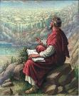
John 20:30-31
“Therefore many other signs Jesus also performed in the presence of the disciples, which are not written in this book; but these have been written so that you may believe that Jesus is the Christ, the Son of God; and that believing you may have life in His name.”

Slide 32
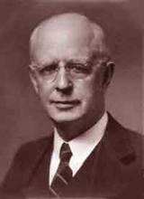
Lewis Sperry Chafer, vol. 7, Systematic Theology (Grand Rapids, MI: Kregel Publications, 1993), 265-66.
Belief-God’s One Condition for Justification
“…because upwards of 150 passages of Scripture condition salvation upon believing only (cf. John 3:16; Acts 16:31).”

Slide 33
Dr. Robert R. Congdon
Oops! I Thought I Was a Four - Pt Calvinist (Greer, SC: Congdon Ministries International, 2014), 51.
“Furthermore, why would God admonish and warn unbelievers for being spiritually blind and deaf if it were not in their power to respond?…Is this not a mockery? It would be like chiding a legless man for being unable to walk.”

Slide 34
V. Running TULIP Through the Grid of Scripture
Total Depravity
Unconditional Election
Limited Atonement
Irresistible Grace
Perseverance of the Saints

Slide 35
Total Depravity
The starting point
Total Depravity properly defined
Calvinism: Total Depravity = inability
Calvinism’s overstatement of Total Depravity

Slide 36
Calvinism’s Overstatement of Total Depravity
Confusion over intensity vs. extent (Gen. 3:22; Matt. 7:7-11; Rom. 2:14-15)
Operates contrary to man’s design
Mis-defines “death” (Eph. 2:1) as non-existence rather than separation
Underestimates what lost man can do

Slide 37
Calvinism Underestimates What Lost Man Can Do
Lost man can seek God (John 16:7-11; Acts 10‒11)
Lost man can hear from God (Acts 10:30-32, 44-48; 11:14)
Lost man can reason (Matt. 21:23-27)
Lost man can believe (exercise faith) in God (John 3:18)

