Slide 1
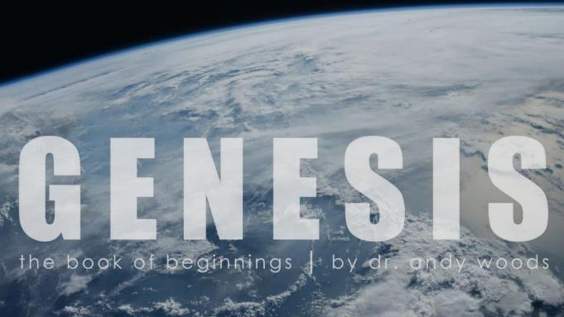

Genesis 12‒50
Israel’s Birth & Preservation

Slide 2
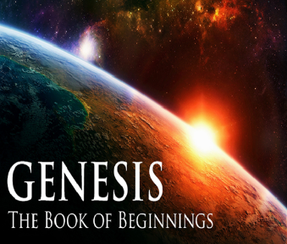
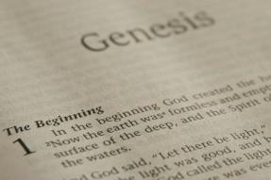
GENESIS STRUCTURE
  Genesis 12-50 (four people)
    Abraham (12:1–25:11)
    Isaac (25:12–26:35)
    Jacob (27–36)
    Joseph (37–50)

Slide 3
Genesis 37‒50
Joseph
  Joseph sold unto Egypt (37)
  Canaan’s corruption (38)
  Joseph falsely accused (39)
  Joseph’s short-term predictions (40)
  Joseph’s elevation (41)
  Joseph’s first reunion with his brothers (42)
  Joseph’s second reunion with his brothers (43‒45)
  Joseph’s second reunion with his brothers (43‒45)
  Sojourn to Egypt (46:1‒47:12)
  Famine’s course (47:13-26)
  Jacob in Egypt (47:27-31)
  Jacob blesses Joseph’s sons (48)
  Jacob blesses his sons (49)

Slide 4
Genesis 49:1-33
Jacob Blesses His Sons
  Call (49:1)
  Introduction (49:2)
  Jacob’s blessings on his sons (49:3-27)
  Concluding summary (49:28)
  Jacob’s death (49:29-33)

Slide 5
III. Genesis 49:3-27
Jacob’s Blessings on His Sons
    Reuben (3-4)
    Simeon & Levi (5-7)
    Judah (8-12)
    Zebulun (13)
    Issachar (14-15)
    Dan (16-18)
    Gad (19)
    Asher (20)
    Naphtali (21)
    Joseph (22-26)
    Benjamin (27)

Slide 6
Genesis 49:8-12
Judah
      Preeminence (8)
      Power (9)
      Messianic line (10)
      Prosperity (11)
      Final result (12)

Slide 7
Genesis 49:8-12
Judah
      Preeminence (8)
      Power (9)
      Messianic line (10)
      Prosperity (11)
      Final result (12)

Slide 8
Genesis 49:8
Preeminence
      Praise (8a)
      Successful in war (8b)
      Brothers bow down to you (8c)

Slide 9
Genesis 49:8
Preeminence
      Praise (8a)
      Successful in war (8b)
      Brothers bow down to you (8c)

Slide 10
Genesis 49:8
Preeminence
      Praise (8a)
      Successful in war (8b)
      Brothers bow down to you (8c)

Slide 11
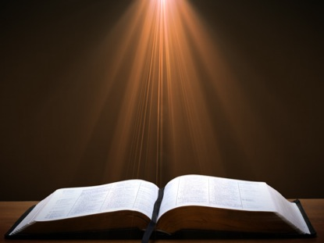
Genesis 11:1-4
¹ Now the whole earth used the same language and the same words. ² It came about as they journeyed east, that they found a plain in the land of Shinar and settled there. ³ They said to one another, “Come, let us make bricks and burn them thoroughly.” And they used brick for stone, and they used tar for mortar. ⁴ They said, “Come, let us build for ourselves a city, and a tower whose top will reach into heaven, and let us make for ourselves a name, otherwise we will be scattered abroad over the face of the whole earth.”

Slide 12
8 New Promises
Genesis 12:1-3
    Land (Gen. 12:1b)
    Great nation (Gen. 12:2a)
    Personal blessing (Gen. 12:2b)
    Great name (Gen. 12:2c)
    Blessing to others (Gen. 12:2d)
    Blessing to blessers (Gen. 12:3a)
    Cursing to cursers (Gen. 12:3b)
    Blessing to the world (Gen. 12:3c)

Slide 13
Genesis 49:8
Preeminence
      Praise (8a)
      Successful in war (8b)
      Brothers bow down to you (8c)

Slide 14
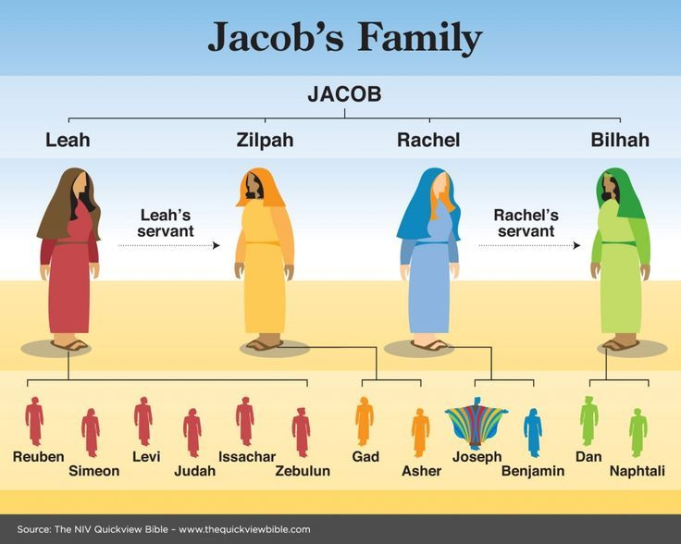

Slide 15
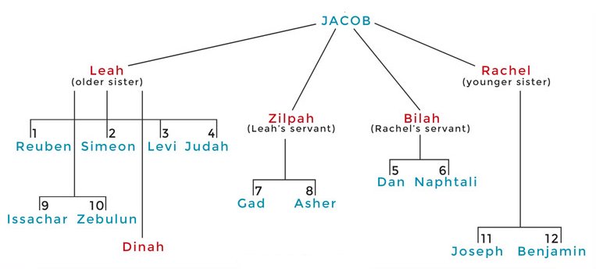

Slide 16

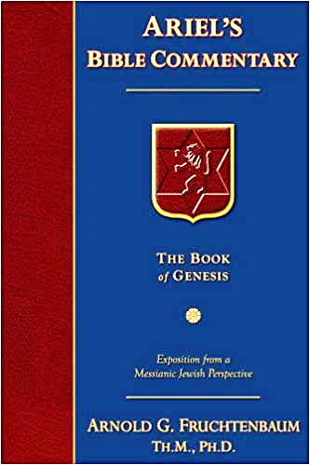
Dr. Arnold G. Fruchtenbaum
The Book of Genesis, 638-39
“Then he added: Your father’s sons shall bow down before you, again showing the preeminence of Judah. Indeed, he did gain the preeminence over the other tribes. In Numbers 2:9, in the wilderness wanderings, Judah set forth first; in Numbers 10:14, he headed the march through the wilderness. In I Chronicles 5:2, Judah prevailed above his brethren. In Judges 1:1–2, Judah is chosen by God to go up first against the Canaanites. Indeed, Judah received the preeminence.”

Slide 17
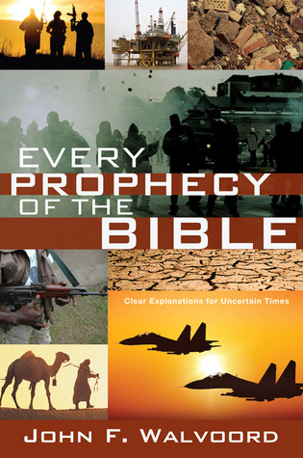

Slide 18
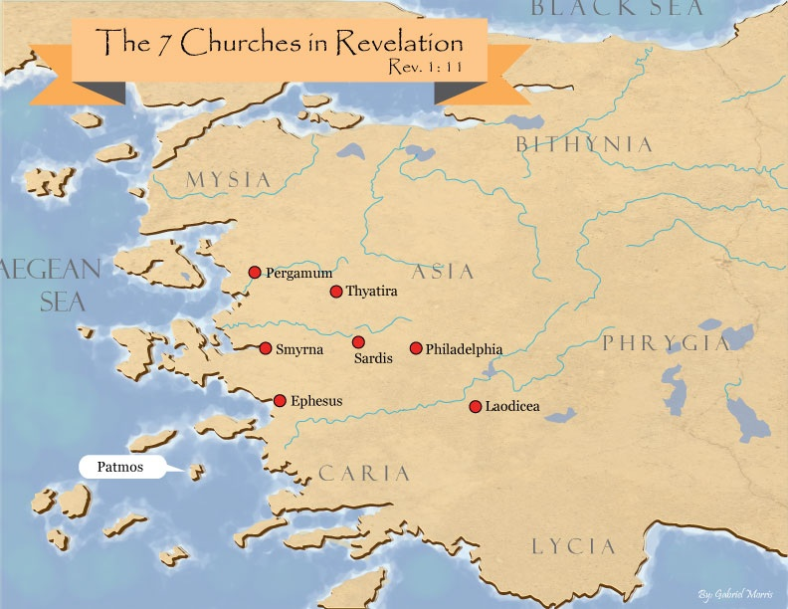
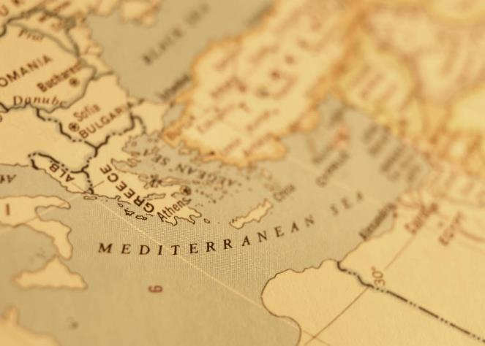

Slide 19
Genesis 49:8-12
Judah
      Preeminence (8)
      Power (9)
      Messianic line (10)
      Prosperity (11)
      Final result (12)

Slide 20
Genesis 49:9
Power
      Lion’s whelp (9a)
      Killing prey (9b)
      Couched as a lion (9c)
      Lioness (9d)

Slide 21
Genesis 49:9
Power
      Lion’s whelp (9a)
      Killing prey (9b)
      Couched as a lion (9c)
      Lioness (9d)

Slide 22
Genesis 49:9
Power
      Lion’s whelp (9a)
      Killing prey (9b)
      Couched as a lion (9c)
      Lioness (9d)

Slide 23
Genesis 49:9
Power
      Lion’s whelp (9a)
      Killing prey (9b)
      Couched as a lion (9c)
      Lioness (9d)

Slide 24
Genesis 49:9
Power
      Lion’s whelp (9a)
      Killing prey (9b)
      Couched as a lion (9c)
      Lioness (9d)

Slide 25

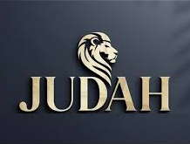
Revelation 5:5
“and one of the elders said to me, “Stop weeping; behold, the Lion that is from the tribe of Judah, the Root of David, has overcome so as to open the book and its seven seals.”

Slide 26
Genesis 49:8-12
Judah
      Preeminence (8)
      Power (9)
      Messianic line (10)
      Prosperity (11)
      Final result (12)

Slide 27
Genesis 49:10
Messianic Line
      Scepter (10a)
      Ruler’s staff (10b)
      Shiloh (10c)
      Obedience of the nations (10d)

Slide 28
Genesis 49:10
Messianic Line
      Scepter (10a)
      Ruler’s staff (10b)
      Shiloh (10c)
      Obedience of the nations (10d)

Slide 29
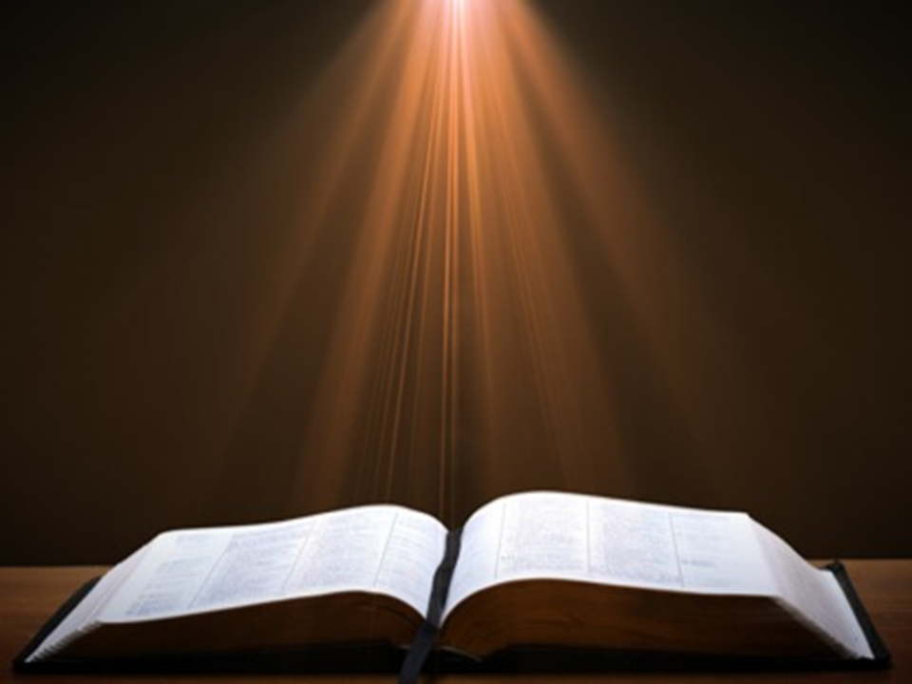
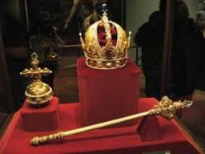
Genesis 49:10
“The scepter shall not depart from Judah, Nor the ruler’s staff from between his feet, Until Shiloh comes, And to him shall be the obedience of the peoples.”

Slide 30
Genesis 49:10
Messianic Line
      Scepter (10a)
      Ruler’s staff (10b)
      Shiloh (10c)
      Obedience of the nations (10d)

Slide 31
Genesis 49:10
Messianic Line
      Scepter (10a)
      Ruler’s staff (10b)
      Shiloh (10c)
      Obedience of the nations (10d)

Slide 32
Dr. Arnold G. Fruchtenbaum
The Book of Genesis, 640
“The point is that the ruling staff and the scepter will not depart from Judah until he come whose right it is and then He will receive it forever… ‘He, to whom, it is,’ or ‘until he come whose right it is,’ and, of course, this is the Messiah...What it means is that Judah will exercise royal power finally, to the end when the Messiah comes to rule the world. Royal power will be passed from generation to generation in Judah in succession until He come whose right it is. Once it is given to the Messiah, royal power remains forever with Him; this is ultimately a reference to the Second Coming when Messiah comes to rule the earth.”

Slide 33
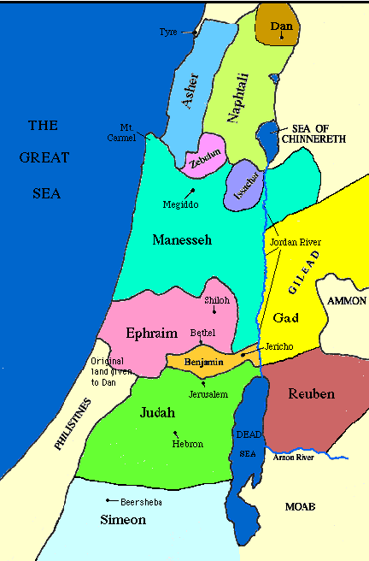

Slide 34
Messiah must be from the tribe of Judah
Genesis 49:10
Revelation 5:5

Slide 35
Revelation 5:5
“and one of the elders said to me, “Stop weeping; behold, the Lion that is from the tribe of Judah, the Root of David, has overcome so as to open the book and its seven seals.”

Slide 36
Genesis 49:10
Messianic Line
      Scepter (10a)
      Ruler’s staff (10b)
      Shiloh (10c)
      Obedience of the nations (10d)

Slide 37
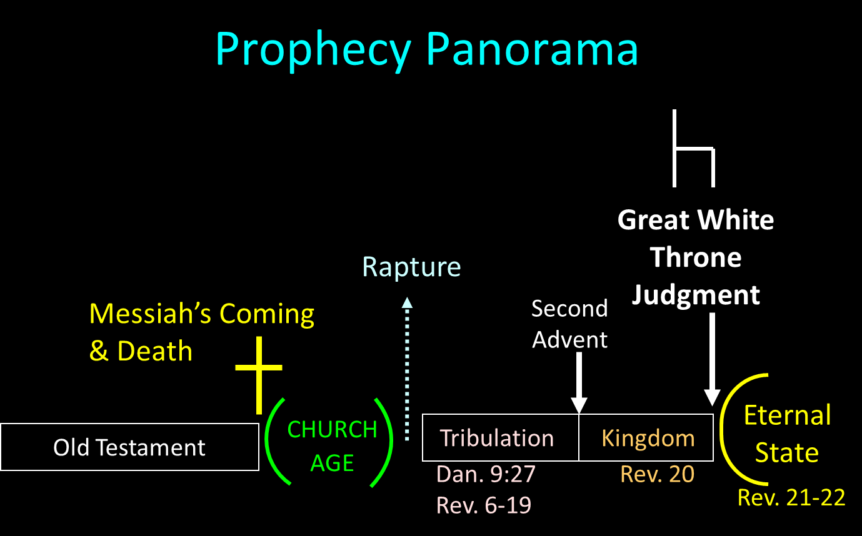

Slide 38

Isaiah 2:1-4
¹ “The word which Isaiah the son of Amoz saw concerning Judah and Jerusalem.² Now it will come about that In the last days The mountain of the house of the Lord Will be established as the chief of the mountains, And will be raised above the hills; And all the nations will stream to it.³ And many peoples will come and say, “Come, let us go up to the mountain of the Lord, To the house of the God of Jacob; . . .

Slide 39

Isaiah 2:1-4
. . .That He may teach us concerning His ways And that we may walk in His paths.” For the law will go forth from Zion And the word of the Lord from Jerusalem.⁴ And He will judge between the nations, And will render decisions for many peoples; And they will hammer their swords into plowshares and their spears into pruning hooks. Nation will not lift up sword against nation, And never again will they learn war.”

Slide 40
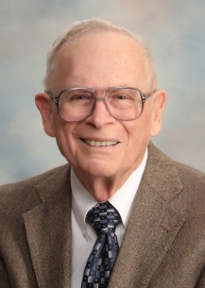
Robert Thomas
Four Views on the Book of Revelation, page 207.
“At the end of the Millennium that city will be Satan’s prime objective with his rebel army, because Israel will be a leader among the nations.”

Slide 41

Zechariah 14:16-18
“Then it will come about that any who are left of all the nations that went against Jerusalem will go up from year to year to worship the King, the Lord of hosts, and to celebrate the Feast of Booths. ¹⁷ And it will be that whichever of the families of the earth does not go up to Jerusalem to worship the King, the Lord of hosts, there will be no rain on them. ¹⁸ If the family of Egypt does not go up or enter, then no rain will fall on them; it will be the plague with which the Lord smites the nations who do not go up to celebrate the Feast of Booths.”

Slide 42
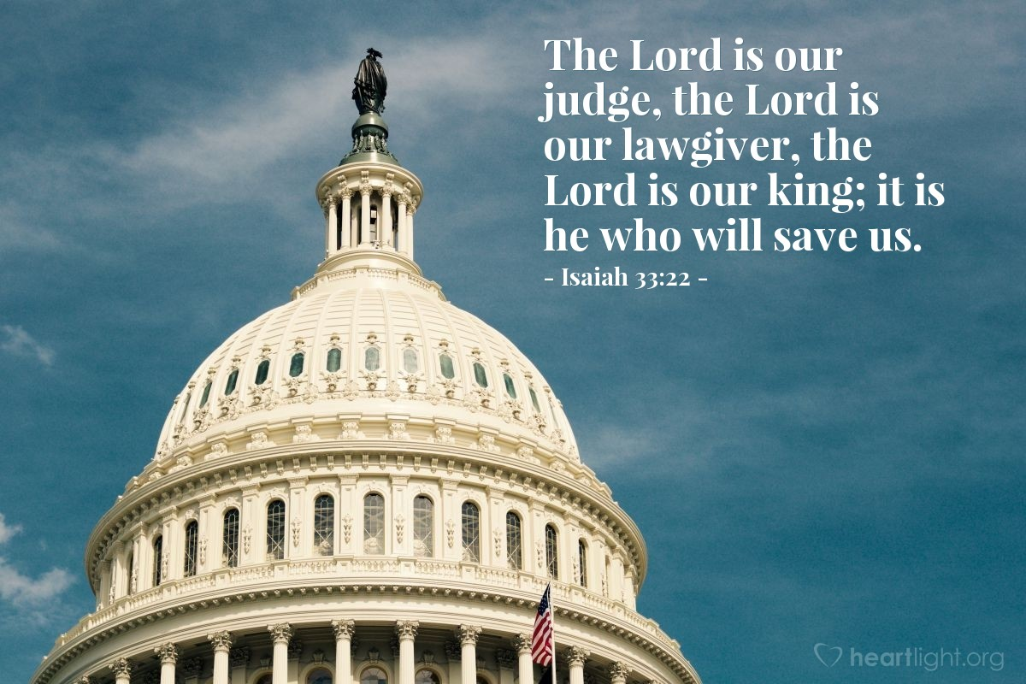
Isaiah 33:22
“For the LORD is our judge, The LORD is our lawgiver, The LORD is our king.”

Slide 43

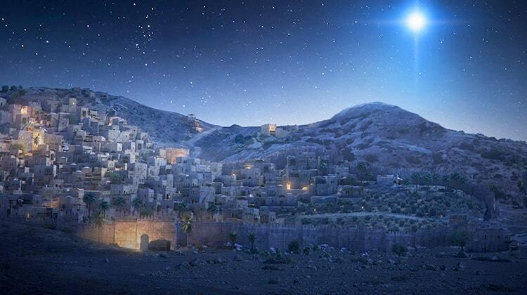
Micah 5:2
“But as for you, Bethlehem Ephrathah, Too little to be among the clans of Judah, From you One will go forth for Me to be ruler in Israel. His goings forth are from long ago, From the days of eternity.”

Slide 44
Three Tenses of Salvation
Phase | Justification | Sanctification | Glorification
Tense | Past | Present | Future
Saved from sin’s: | Penalty | Power | Presence
Scripture | Eph 2:8-9; Titus 3:5 | Philip 2:12 | Rom 5:10

Slide 45
Genesis 49:8-12
Judah
      Preeminence (8)
      Power (9)
      Messianic line (10)
      Prosperity (11)
      Final result (12)

Slide 46
Genesis 49:11
Prosperity
      Binding coalt to vine (11a)
      Binding coalt to choice vine (11b)
      Washed garment in vine (11c)
      Vesture in blood of grapes (11d)

Slide 47
Genesis 49:11
Prosperity
      Binding coalt to vine (11a)
      Binding coalt to choice vine (11b)
      Washed garment in vine (11c)
      Vesture in blood of grapes (11d)

Slide 48
Genesis 49:11
Prosperity
      Binding coalt to vine (11a)
      Binding coalt to choice vine (11b)
      Washed garment in vine (11c)
      Vesture in blood of grapes (11d)

Slide 49

Isaiah 65:21–22
²¹ “They will build houses and inhabit them; They will also plant vineyards and eat their fruit. ²² “They will not build and another inhabit, They will not plant and another eat; For as the lifetime of a tree, so will be the days of My people, And My chosen ones will wear out the work of their hands.

Slide 50

Amos 9:13
¹³ “Behold, days are coming,” declares the Lord, “When the plowman will overtake the reaper And the treader of grapes him who sows seed; When the mountains will drip sweet wine And all the hills will be dissolved.”

Slide 51
Messiah must present himself to Israel in a particular way
Zechariah 9:9

Slide 52
Zechariah 9:9
“Rejoice greatly, O daughter of Zion! Shout in triumph, O daughter of Jerusalem! Behold, your king is coming to you; He is just and endowed with salvation, Humble, and mounted on a donkey, Even on a colt, the foal of a donkey.”

Slide 53
Genesis 49:11
Prosperity
      Binding coalt to vine (11a)
      Binding coalt to choice vine (11b)
      Washed garment in vine (11c)
      Vesture in blood of grapes (11d)

Slide 54
Genesis 49:11
Prosperity
      Binding coalt to vine (11a)
      Binding coalt to choice vine (11b)
      Washed garment in vine (11c)
      Vesture in blood of grapes (11d)

Slide 55


Revelation 6:16-17
^{“16} and they said to the mountains and the rocks, ‘Fall on us and hide us from the sight of Him who sits on the throne, and from the wrath [orgḗ] of the Lamb; ¹⁷ for the great day of Their wrath [orgḗ] has come, and who is able to stand?’”

Slide 56
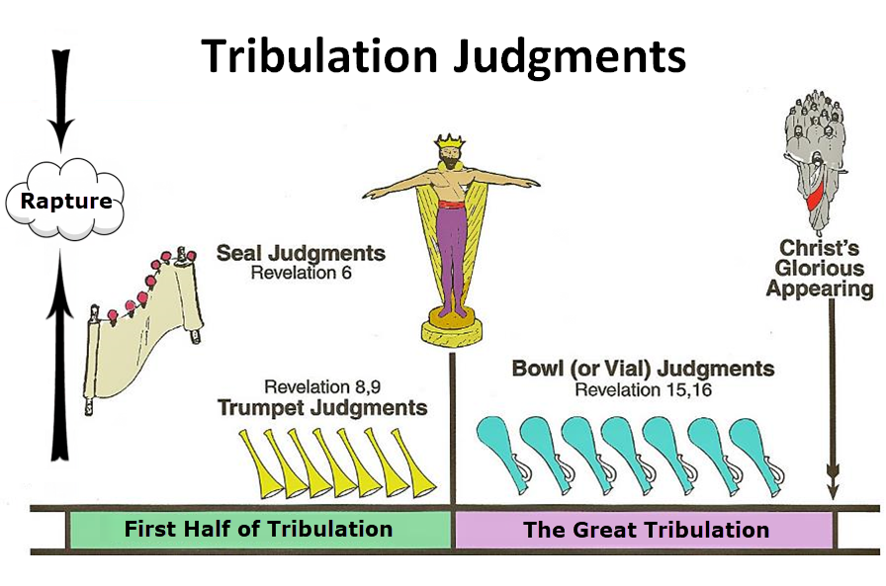

Slide 57
Genesis 49:8-12
Judah
      Preeminence (8)
      Power (9)
      Messianic line (10)
      Prosperity (11)
      Final result (12)

Slide 58
Genesis 49:12
Final Result
      Messiah’s eyes (12a)
      Messiah’s teeth (12b)

Slide 59
Genesis 49:12
Final Result
      Messiah’s eyes (12a)
      Messiah’s teeth (12b)

Slide 60
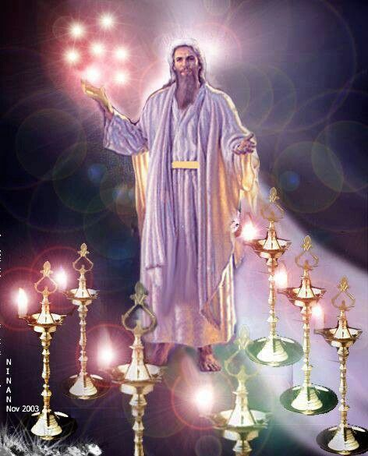

Slide 61
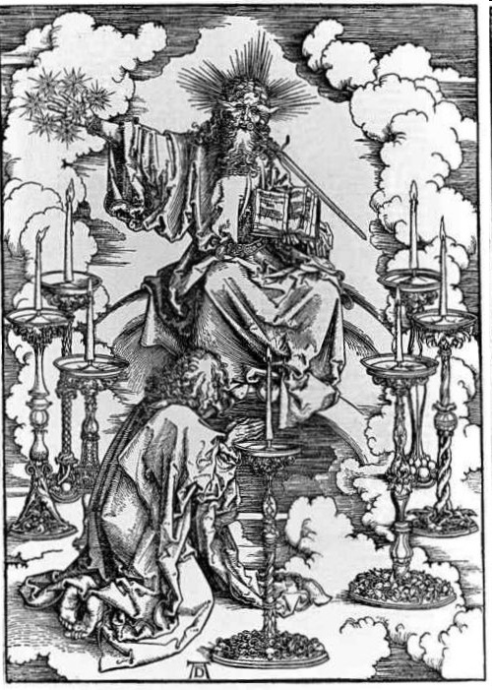
His Body
(Rev. 1:14-16)
His hair (14a)
His eyes (14b)
His feet (15a)
His voice (15b)
His right hand (16a)
His mouth (16b)
His face (16c)

Slide 62
Genesis 49:12
Final Result
      Messiah’s eyes (12a)
      Messiah’s teeth (12b)

Slide 63
Conclusion

Slide 64
Genesis 49:8-12
Judah
      Preeminence (8)
      Power (9)
      Messianic line (10)
      Prosperity (11)
      Final result (12)

Slide 65


Slide 66
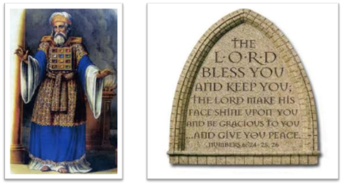
²⁴ The Lord bless you, and keep you; ²⁵ The Lord make His face shine on you, And be gracious to you; ²⁶ The Lord lift up His countenance on you, And give you peace.
Numbers 6:24–26 (NASB95)

