Slide 2
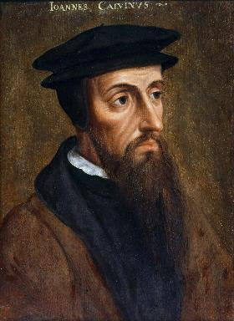
Neo-Calvinism vs. The Bible
Calvinism’s Mixed Blessing
Why Critique Calvinism?
The Source of Calvin’s Theology
Calvin’s Manner of Life
TULIP Through the Grid of Scripture
Conclusion

Slide 3
V. Running TULIP Through the Grid of Scripture
Total Depravity
Unconditional Election
Limited Atonement
Irresistible Grace
Perseverance of the Saints

Slide 4
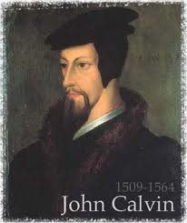
Total Depravity
The starting point
Total Depravity properly defined
Calvinism: Total Depravity = inability
Calvinism’s overstatement of Total Depravity

Slide 5
Calvinism’s Overstatement of Total Depravity
Confusion over intensity vs. extent (Gen. 3:22; Matt. 7:7-11; Rom. 2:14-15)
Operates contrary to man’s design
Mis-defines “death” (Eph. 2:1) as non-existence rather than separation
Underestimates what lost man can do

Slide 6
Calvinism’s Misunderstanding of Death
Ephesians 2:1, 5
Calvinism's anachronistic misunderstanding: non-existence
Lexical definition: separation
Physical death (Gen. 35:18; Eccles. 12:7; Matt. 27:50-51; Luke 23:46; Acts 7:59; Dan. 12:2; Matt. 25:46; 2 Cor. 5:8; Philip. 1:21-23)
Other examples (Gen. 2:17; 3:8; Isa. 59:1-2)
Faith is possible (absent regeneration 1st) though the Spirit’s conviction (John 16:8), the Word’s proclamation (Isa. 55:8-9; Rom. 10:17; 2 Tim. 3:15; 1 Pet. 1:23; Jas. 1:18)

Slide 7
Calvinism’s Misunderstanding of Death
Ephesians 2:1, 5
Calvinism's anachronistic misunderstanding: non-existence
Lexical definition: separation
Physical death (Gen. 35:18; Eccles. 12:7; Matt. 27:50-51; Luke 23:46; Acts 7:59; Dan. 12:2; Matt. 25:46; 2 Cor. 5:8; Philip. 1:21-23)
Other examples (Gen. 2:17; 3:8; Isa. 59:1-2)
Faith is possible (absent regeneration 1st) though the Spirit’s conviction (John 16:8), the Word’s proclamation (Isa. 55:8-9; Rom. 10:17; 2 Tim. 3:15; 1 Pet. 1:23; Jas. 1:18)

Slide 8
Ephesians 2:1-5
¹ “And you were dead in your trespasses and sins, ² in which you formerly walked according to the course of this world, according to the prince of the power of the air, of the spirit that is now working in the sons of disobedience. ³ Among them we too all formerly lived in the lusts of our flesh, indulging the desires of the flesh and of the mind, and were by nature children of wrath, even as the rest. ⁴ But God, being rich in mercy, because of His great love with which He loved us, ⁵ even when we were dead in our transgressions, made us alive together with Christ (by grace you have been saved)”

Slide 9
Calvinism’s Misunderstanding of Death
Ephesians 2:1, 5
Calvinism's anachronistic misunderstanding: non-existence
Lexical definition: separation
Physical death (Gen. 35:18; Eccles. 12:7; Matt. 27:50-51; Luke 23:46; Acts 7:59; Dan. 12:2; Matt. 25:46; 2 Cor. 5:8; Philip. 1:21-23)
Other examples (Gen. 2:17; 3:8; Isa. 59:1-2)
Faith is possible (absent regeneration 1st) though the Spirit’s conviction (John 16:8), the Word’s proclamation (Isa. 55:8-9; Rom. 10:17; 2 Tim. 3:15; 1 Pet. 1:23; Jas. 1:18)

Slide 10
Loraine Boettner
“In the Epistle to the Ephesians Paul declares that Prior to the quickening of the Spirit of God each individual soul lies dead in trespasses and sins. Now it will surely be admitted that to be dead, and to be dead in sin, is clear and positive evidence that there is neither aptitude nor Power remaining for the performance of any spiritual action. If a man were dead, in a natural and physical sense, it would at once be readily granted that there is no further possibility of that man being able to perform any physical actions. A corpse cannot act in any way whatever, and that man would be reckoned to have taken . . .

Slide 11
Loraine Boettner, The Reformed Doctrine of Predestination (Philipsburg, NJ: Presbyterian and Reformed, 1932), 65-66; quoting Warburton, Calvinism, p. 48.
Loraine Boettner
. . .leave of his senses who asserted that it could. If a man is dead spiritually, therefore, it is surely equally as evident that he is unable to perform any spiritual actions, and thus the doctrine of man's moral inability rests upon strong Scriptural evidence.”

Slide 12
Arthur Custance
“A corpse does not cry out for help.”
Arthur Custance, The Sovereignty of Grace (P & R Press; First Edition, 1979), p. 18.

Slide 13
Using a Foolish Analogy to Support Calvinism
“Calvinists say, ‘Since he is dead, it is impossible for him to believe.’ This is a foolish analogy!...A person who is physically dead cannot receive Christ as his Savior, but neither can he speak, breathe, laugh, walk, live a righteous life, or sin.”
Bob Kirkland, Calvinism: None Dare Call It Heresy; Spotlight on the Life and Teachings of John Calvin (Eureka, MT: Lighthouse Trails, 2018), 35.

Slide 14
Calvinism’s Misunderstanding of Death
Ephesians 2:1, 5
Calvinism's anachronistic misunderstanding: non-existence
Lexical definition: separation
Physical death (Gen. 35:18; Eccles. 12:7; Matt. 27:50-51; Luke 23:46; Acts 7:59; Dan. 12:2; Matt. 25:46; 2 Cor. 5:8; Philip. 1:21-23)
Other examples (Gen. 2:17; 3:8; Isa. 59:1-2)
Faith is possible (absent regeneration 1st) though the Spirit’s conviction (John 16:8), the Word’s proclamation (Isa. 55:8-9; Rom. 10:17; 2 Tim. 3:15; 1 Pet. 1:23; Jas. 1:18)

Slide 15
“Death” in the Old Testament
māwet: “Death is the consequences and the punishment of sin. It originated with sin. A grand theme of the Old Testament is God’s holiness, which separates Him from all that is in harmony with His character. Death, then, in the Old Testament means ultimate separation from God due to sin.”
Elmer B. Smick, “māwet," in Theological Wordbook of the Old Testament, ed. R. Laird Harris and Gleason L. Archer and Bruce K. Waltke(Chicago: Moody, 1980), 1:1169.

Slide 16
“Death” in the New Testament
thanatos: “that separation (whether natural or violent) of the soul from the body by which the life on earth is ended.”
Joseph Henry Thayer, Death - Thanatos, Greek-English Lexicon of the New Testament Being Grmm's Wilke's Clavis Novi Testamenti (Grand Rapids: Zondervan, 1977), 282.

Slide 17
Calvinism’s Misunderstanding of Death
Ephesians 2:1, 5
Calvinism's anachronistic misunderstanding: non-existence
Lexical definition: separation
Physical death (Gen. 35:18; Eccles. 12:7; Matt. 27:50-51; Luke 23:46; Acts 7:59; Dan. 12:2; Matt. 25:46; 2 Cor. 5:8; Philip. 1:21-23)
Other examples (Gen. 2:17; 3:8; Isa. 59:1-2)
Faith is possible (absent regeneration 1st) though the Spirit’s conviction (John 16:8), the Word’s proclamation (Isa. 55:8-9; Rom. 10:17; 2 Tim. 3:15; 1 Pet. 1:23; Jas. 1:18)

Slide 18
Daniel 12:2
“Many of those who sleep in the dust of the ground will awake, these to everlasting (olam) life, but the others to disgrace and everlasting (olam) contempt.”

Slide 19
Matthew 25:46
“These will go away into eternal (aiōnios) punishment, but the righteous into eternal (aiōnios) life.”

Slide 20
Luke 16:24-26
“²⁴ And he cried out and said, ‘Father Abraham, have mercy on me, and send Lazarus so that he may dip the tip of his finger in water and cool off my tongue, for I am in agony in this flame.’ ²⁵ But Abraham said, ‘Child, remember that during your life you received your good things, and likewise Lazarus bad things; but now he is being comforted here, and you are in agony. ²⁶ And besides all this, between us and you there is a great chasm fixed, so that those who wish to come over from here to you will not be able, and that none may cross over from there to us.’”

Slide 21
Calvinism’s Misunderstanding of Death
Ephesians 2:1, 5
Calvinism's anachronistic misunderstanding: non-existence
Lexical definition: separation
Physical death (Gen. 35:18; Eccles. 12:7; Matt. 27:50-51; Luke 23:46; Acts 7:59; Dan. 12:2; Matt. 25:46; 2 Cor. 5:8; Philip. 1:21-23)
Other examples (Gen. 2:17; 3:8; Isa. 59:1-2)
Faith is possible (absent regeneration 1st) though the Spirit’s conviction (John 16:8), the Word’s proclamation (Isa. 55:8-9; Rom. 10:17; 2 Tim. 3:15; 1 Pet. 1:23; Jas. 1:18)

Slide 22
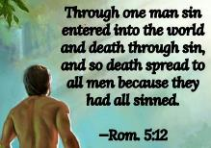
Genesis 2:16-17
“¹⁶ The Lord God commanded the man, saying, ‘From any tree of the garden you may eat freely; ¹⁷ but from the tree of the knowledge of good and evil you shall not eat, for in the day that you eat from it you will surely die (muwth).’”

Slide 23
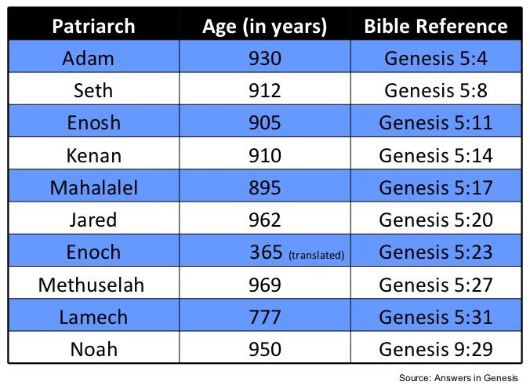

Slide 24
Calvinism’s Misunderstanding of Death
Ephesians 2:1, 5
Calvinism's anachronistic misunderstanding: non-existence
Lexical definition: separation
Physical death (Gen. 35:18; Eccles. 12:7; Matt. 27:50-51; Luke 23:46; Acts 7:59; Dan. 12:2; Matt. 25:46; 2 Cor. 5:8; Philip. 1:21-23)
Other examples (Gen. 2:17; 3:8; Isa. 59:1-2)
Faith is possible (absent regeneration 1st) though the Spirit’s conviction (John 16:8), the Word’s proclamation (Isa. 55:8-9; Rom. 10:17; 2 Tim. 3:15; 1 Pet. 1:23; Jas. 1:18)

Slide 25
John 16:7-11
“⁷ But I tell you the truth, it is to your advantage that I go away; for if I do not go away, the Helper will not come to you; but if I go, I will send Him to you. ⁸ And He, when He comes, will convict the world concerning sin and righteousness and judgment; ⁹ concerning sin, because they do not believe in Me; ¹⁰ and concerning righteousness, because I go to the Father and you no longer see Me; ¹¹ and concerning judgment, because the ruler of this world has been judged.”

Slide 26
Isaiah 55:10-11
¹⁰ “For as the rain and the snow come down from heaven, And do not return there without watering the earth And making it bear and sprout, And furnishing seed to the sower and bread to the eater; ¹¹ So will My word be which goes forth from My mouth; It will not return to Me empty, Without accomplishing what I desire, And without succeeding in the matter for which I sent it.”

Slide 27
2 Timothy 3:15
“and that from childhood you have known the sacred writings which are able to give you the wisdom that leads to salvation through faith which is in Christ Jesus.”

Slide 28
Romans 1:16
“For I am not ashamed of the gospel, for it is the power of God for salvation to everyone who believes, to the Jew first and also to the Greek.”

Slide 29
Dr. Robert R. Congdon
Oops! I Thought I Was a Four - Pt Calvinist (Greer, SC: Congdon Ministries International, 2014), 48.
“While I do agree that salvation comes through the workings of the Holy Spirit and the Word of God, I disagree with the idea that God must first predispose some to believe and receive it, for the Word of God and the Holy Spirit are sufficient in and of themselves in bringing about the new birth. Instead of forcing individuals to be saved through the irresistible prompting of the Holy Spirit, God uses His Word and the convicting work of the Holy Spirit to confirm its truth in order to bring individuals to the point of decision. It is certainly God’s grace that offers it, but at this point they are free to accept or reject salvation.”

Slide 30
Dr. Robert R. Congdon
Oops! I Thought I Was a Four - Pt Calvinist (Greer, SC: Congdon Ministries International, 2014), 69-70.
“…their [Calvinism’s] definition of total depravity negates the sufficiency of the power of the Word of God and the Holy Spirit to give life...”

Slide 31
Death: Calvinism vs Biblicism
 | CALVINISM | BIBLICISM
Spiritual death: | Corpse, cadaver | Separated
Consciousness: | Cessation, lifeless | Aware
Results: | Inability | Can hear and believe
Spiritual response: | Regeneration first | God’s Word, Spirit’s conviction, Gospel’s power
Regeneration: | Before faith | Result of faith
Adapted from Robert R. Congdon, Oops! I Thought I Was a Four - Pt Calvinist (Greer, SC: Congdon Ministries International, 2014), 22.

Slide 32
Calvinism’s Overstatement of Total Depravity
Confusion over intensity vs. extent (Gen. 3:22; Matt. 7:7-11; Rom. 2:14-15)
Operates contrary to man’s design
Mis-defines “death” (Eph. 2:1) as non-existence rather than separation
Underestimates what lost man can do

Slide 33
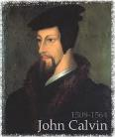
Calvinism Underestimates What Lost Man Can Do
Lost man can seek God (John 16:7-11; Acts 10‒11)
Lost man can hear from God (Acts 10:30-32, 44-48; 11:14)
Lost man can reason (Matt. 21:23-27)
Lost man can believe (exercise faith) in God (John 3:18)

Slide 34
Calvinism Underestimates What Lost Man Can Do
Lost man can seek God (John 16:7-11; Acts 10‒11)
Lost man can hear from God (Acts 10:30-32, 44-48; 11:14)
Lost man can reason (Matt. 21:23-27)
Lost man can believe (exercise faith) in God (John 3:18)

Slide 36
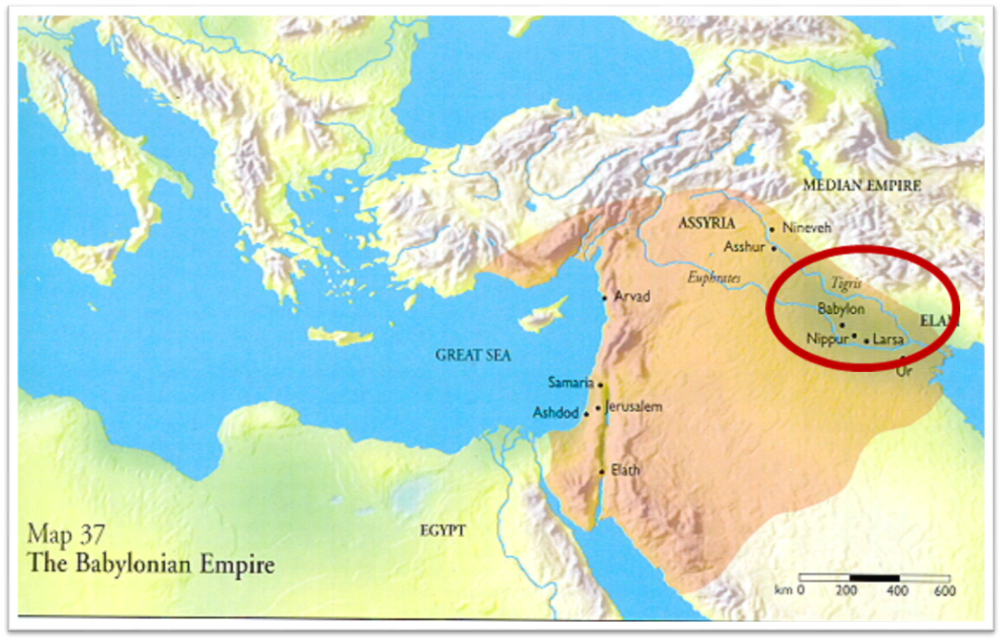

Slide 37
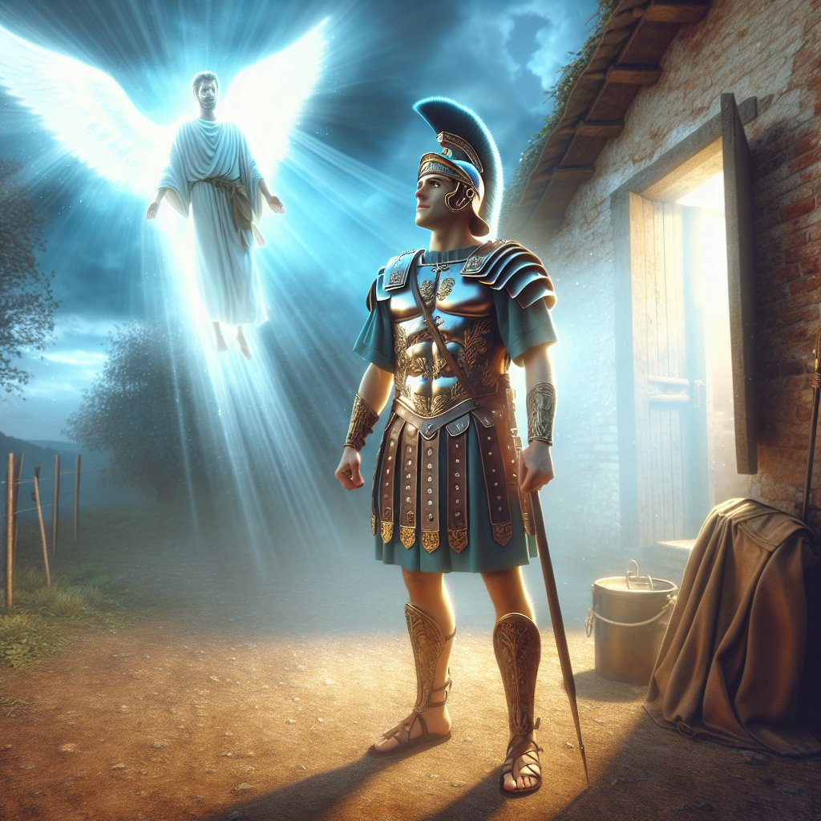
Acts 10:2
“¹ Now there was a man at Caesarea named Cornelius, a centurion of what was called the Italian cohort, ² a devout man and one who feared God with all his household, and gave many alms to the Jewish people and prayed to God continually.”

Slide 38
Acts 11:14
“and he will speak words to you by which you [Cornelius] will be saved, you and all your household.”

Slide 39
Acts 17:26-27
²⁶ and He made from one man every nation of mankind to live on all the face of the earth, having determined their appointed times and the boundaries of their habitation, ²⁷ that they would seek God, if perhaps they might grope for Him and find Him, though He is not far from each one of us (Italics added)

Slide 40
Romans 1:18–20
¹⁸ For the wrath of God is revealed from heaven against all ungodliness and unrighteousness of men who suppress the truth in unrighteousness, ¹⁹ because that which is known about God is evident within them; for God made it evident to them. ²⁰ For since the creation of the world His invisible attributes, His eternal power and divine nature, have been clearly seen, being understood through what has been made, so that they are without excuse.

Slide 41
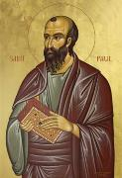
Romans 3:11
“There is none who understands, There is none who seeks for God.”

Slide 42
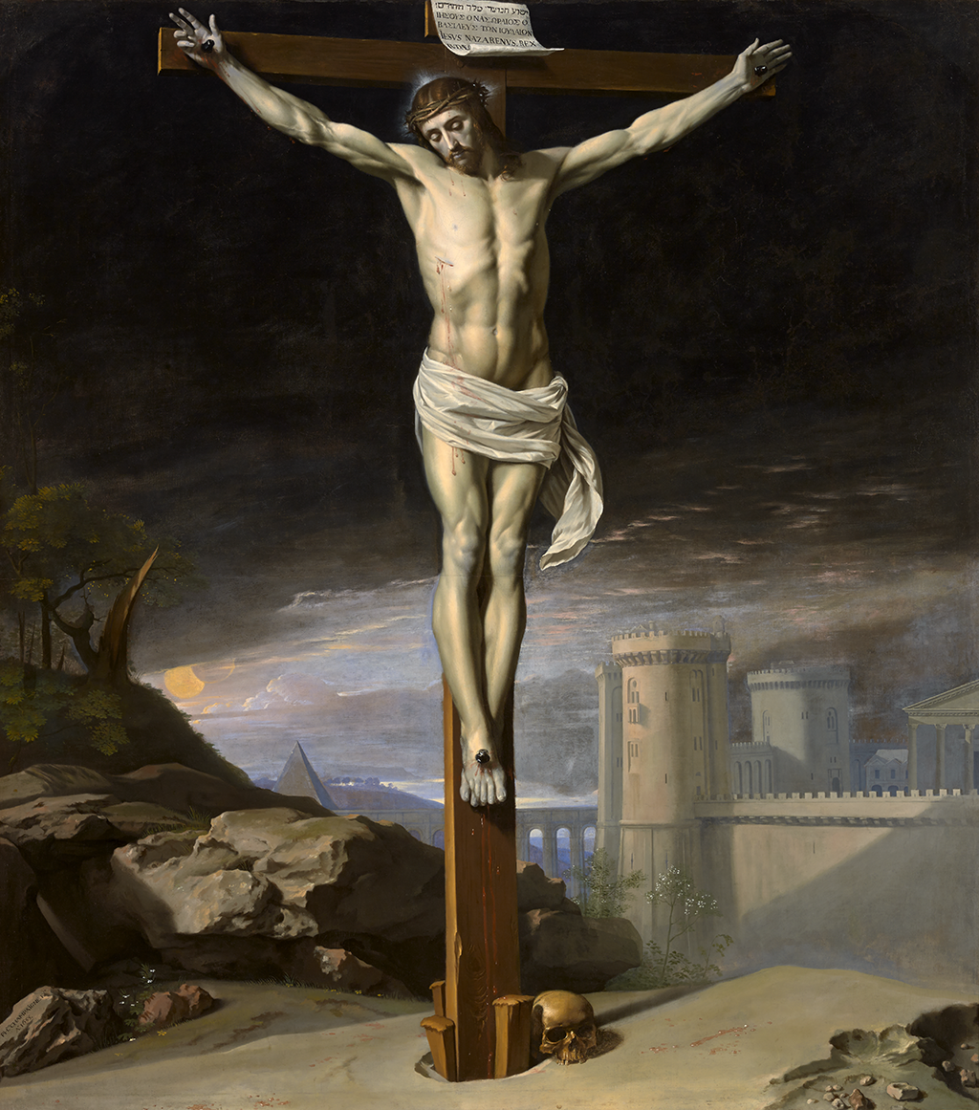
John 12:32
“And I, if I am lifted up from the earth, will draw all men to Myself.”

Slide 43
John 16:7-11
“⁷ But I tell you the truth, it is to your advantage that I go away; for if I do not go away, the Helper will not come to you; but if I go, I will send Him to you. ⁸ And He, when He comes, will convict the world concerning sin and righteousness and judgment; ⁹ concerning sin, because they do not believe in Me; ¹⁰ and concerning righteousness, because I go to the Father and you no longer see Me; ¹¹ and concerning judgment, because the ruler of this world has been judged.”

Slide 44
Isaiah 55:10-11
¹⁰ “For as the rain and the snow come down from heaven, And do not return there without watering the earth And making it bear and sprout, And furnishing seed to the sower and bread to the eater; ¹¹ So will My word be which goes forth from My mouth; It will not return to Me empty, Without accomplishing what I desire, And without succeeding in the matter for which I sent it.”

Slide 45
2 Timothy 3:15
“and that from childhood you have known the sacred writings which are able to give you the wisdom that leads to salvation through faith which is in Christ Jesus.”

Slide 46
2 Timothy 3:16-17
“All Scripture is inspired by God [theopneustos] and profitable for teaching, for reproof, for correction, for training in righteousness; so that the man of God may be adequate, equipped for every good work.”

Slide 47
Romans 1:16
“For I am not ashamed of the gospel, for it is the power of God for salvation to everyone who believes, to the Jew first and also to the Greek.”

Slide 48
Romans 1:18-20
“¹⁸ For the wrath of God is revealed from heaven against all ungodliness and unrighteousness of men who suppress the truth in unrighteousness, ¹⁹ because that which is known about God is evident within them; for God made it evident to them. ²⁰ For since the creation of the world His invisible attributes, His eternal power and divine nature, have been clearly seen, being understood through what has been made, so that they are without excuse.”

Slide 49
Psalm 19:1-4
“¹ The heavens are telling of the glory of God; And their expanse is declaring the work of His hands. ² Day to day pours forth speech, And night to night reveals knowledge. ³ There is no speech, nor are there words; Their voice is not heard. ⁴ Their line has gone out through all the earth, And their utterances to the end of the world. In them He has placed a tent for the sun.”

Slide 50
Calvinism Underestimates What Lost Man Can Do
Lost man can seek God (John 16:7-11; Acts 10‒11)
Lost man can hear from God (Acts 10:30-32, 44-48; 11:14)
Lost man can reason (Matt. 21:23-27)
Lost man can believe (exercise faith) in God (John 3:18)

Slide 51
Acts 11:14
“and he will speak words to you by which you [Cornelius] will be saved, you and all your household.”

Slide 52
Calvinism Underestimates What Lost Man Can Do
Lost man can seek God (John 16:7-11; Acts 10‒11)
Lost man can hear from God (Acts 10:30-32, 44-48; 11:14)
Lost man can reason (Matt. 21:23-27)
Lost man can believe (exercise faith) in God (John 3:18)

Slide 53
Calvinism Underestimates What Lost Man Can Do
Lost man can seek God (John 16:7-11; Acts 10‒11)
Lost man can hear from God (Acts 10:30-32, 44-48; 11:14)
Lost man can reason (Matt. 21:23-27)
Lost man can believe (exercise faith) in God (John 3:18)

Slide 54
Passage Conditioning Salvation on Faith Alone (Sola Fide)
Genesis 15:6
John 3:16; 5:24; 6:28-29, 47; 16:8-9; 20:30-31
Acts 16:30-31
Romans 1:16; Ephesians 2:8-9
Hebrews 11:6

Slide 55
Belief – God’s One Condition for Justification
Gen 15:6
Then he believed in the LORD; and He reckoned it to him as righteousness.
John 3:16
For God so loved the world, that He gave His only begotten Son, that whoever believes in Him shall not perish, but have eternal life.
Acts 16:30-31
"Sirs, what must I do to be saved?" They said, "Believe in the Lord Jesus, and you will be saved..."

Slide 56
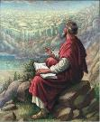
John 20:30-31
“Therefore many other signs Jesus also performed in the presence of the disciples, which are not written in this book; but these have been written so that you may believe that Jesus is the Christ, the Son of God; and that believing you may have life in His name.”

Slide 57
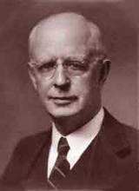
Lewis Sperry Chafer, vol. 7, Systematic Theology (Grand Rapids, MI: Kregel Publications, 1993), 265-66.
Belief-God’s One Condition for Justification
“…because upwards of 150 passages of Scripture condition salvation upon believing only (cf. John 3:16; Acts 16:31).”

Slide 58
Dr. Robert R. Congdon
Oops! I Thought I Was a Four - Pt Calvinist (Greer, SC: Congdon Ministries International, 2014), 51.
“Furthermore, why would God admonish and warn unbelievers for being spiritually blind and deaf if it were not in their power to respond?…Is this not a mockery? It would be like chiding a legless man for being unable to walk.”

Slide 59
V. Running TULIP Through the Grid of Scripture
Total Depravity
Unconditional Election
Limited Atonement
Irresistible Grace
Perseverance of the Saints

Slide 60
Total Depravity
The starting point
Total Depravity properly defined
Calvinism: Total Depravity = inability
Calvinism’s overstatement of Total Depravity

Slide 61
Calvinism’s Overstatement of Total Depravity
Confusion over intensity vs. extent (Gen. 3:22; Matt. 7:7-11; Rom. 2:14-15)
Operates contrary to man’s design
Mis-defines “death” (Eph. 2:1) as non-existence rather than separation
Underestimates what lost man can do

