Slide 1
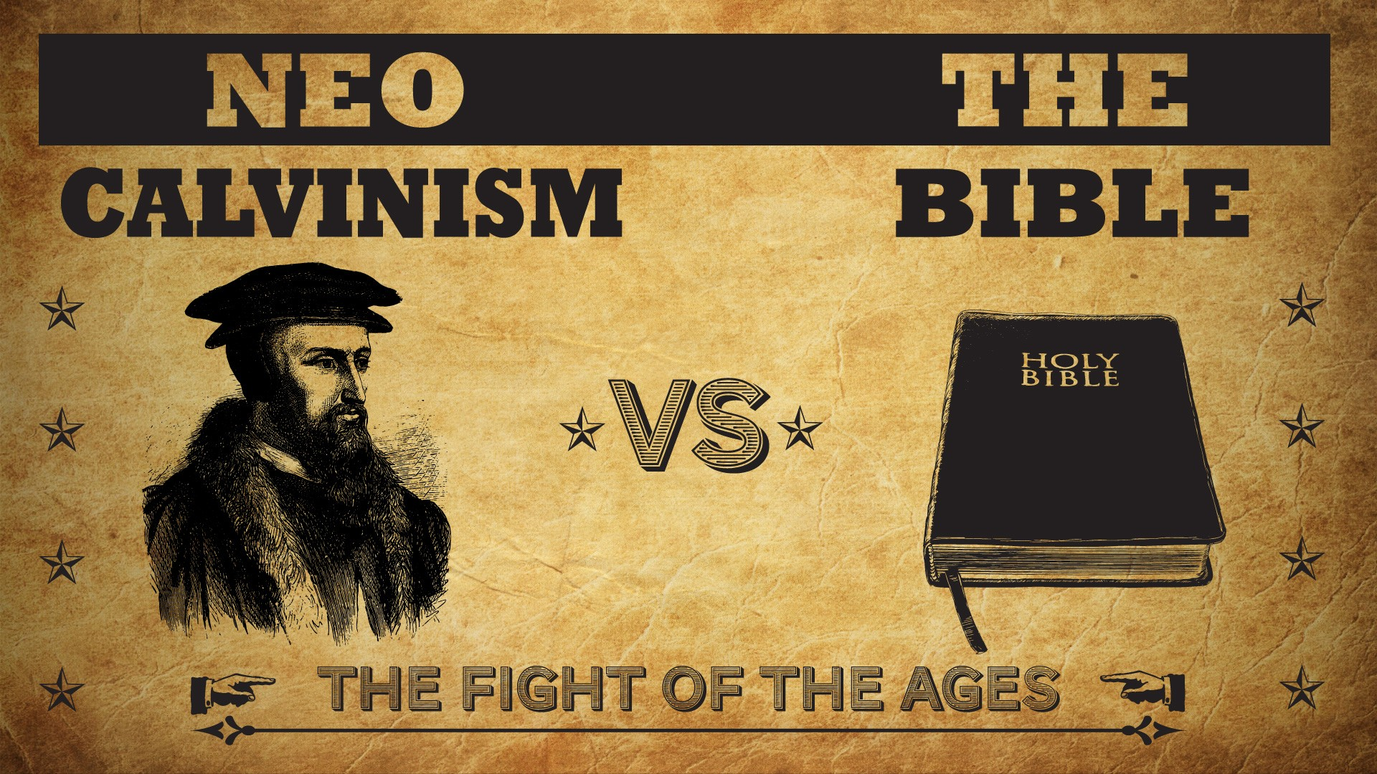


Slide 2
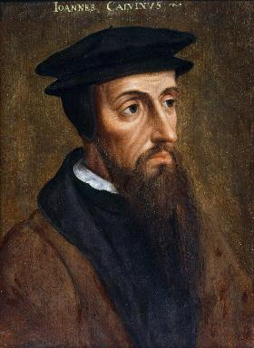
Neo-Calvinism vs. The Bible
Calvinism’s Mixed Blessing
Why Critique Calvinism?
The Source of Calvin’s Theology
Calvin’s Manner of Life
TULIP Through the Grid of Scripture
Conclusion

Slide 3

V. Running TULIP Through the Grid of Scripture
Total Depravity
Unconditional Election
Limited Atonement
Irresistible Grace
Perseverance of the Saints

Slide 4
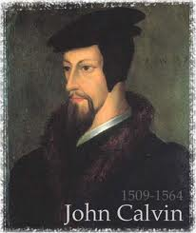
Total Depravity
  The starting point
  Total Depravity properly defined
  Calvinism: Total Depravity = inability
  Calvinism’s overstatement of Total Depravity

Slide 5

  Calvinism’s Overstatement of Total Depravity
Confusion over intensity vs. extent (Gen. 3:22; Matt. 7:7-11; Rom. 2:14-15)
Operates contrary to man’s design
Mis-defines “death” (Eph. 2:1) as non-existence rather than separation
Underestimates what lost man can do

Slide 6
  Calvinism’s Overstatement of Total Depravity
Confusion over intensity vs. extent (Gen. 3:22; Matt. 7:7-11; Rom. 2:14-15)
Operates contrary to man’s design
Mis-defines “death” (Eph. 2:1) as non-existence rather than separation
Underestimates what lost man can do

Slide 7
Henry Clarence Thiessen
“The Scriptures speak of human nature as totally depraved. However, the doctrine of ‘total depravity’ is easily misunderstood and misinterpreted. From the negative standpoint, it is important to know both what it does not mean and what it does mean. This does not mean that every sinner is devoid of all qualities pleasing to men; that he commits or is prone to every form of sin; or that he is bitterly opposed to God as it is possible for him to be. Jesus recognize the existence of pleasing qualities in some individuals (Mark 10:21); He said that the scribes and Pharisees did some things God demanded (Matt. 23:23); Paul asserted that some . . .

Slide 8
Henry Clarence Thiessen
. . .things God demanded (Matt. 23:23); Paul asserted that some Gentiles ‘do instinctively the things of the law’ (Rom. 2:14); God told Abraham that the iniquity of the Amorites would grow worse (Gen. 15:16); and Paul says that ‘evil men and imposters will proceed from bad to worse’ (2 Tim. 3:13).”
Henry Clarence Thiessen, Lectures in Systematic Theology, rev. ed. (Grand Rapids: Eerdmans, 1979), 191.

Slide 9
  Calvinism’s Overstatement of Total Depravity
Confusion over intensity vs. extent (Gen. 3:22; Matt. 7:7-11; Rom. 2:14-15)
Operates contrary to man’s design
Mis-defines “death” (Eph. 2:1) as non-existence rather than separation
Underestimates what lost man can do

Slide 10

Operates contrary to man’s design
  Man as an image bearer of God (Gen. 1:26-28)
  Omnipotence vs. omni-causality
  The Fall (Gen. 3) merely effaced rather than erased man’s status as a divine image bearer (Gen. 5:1; 9:6; Jas. 3:9; 1 Cor. 11:7)

Slide 11
Operates contrary to man’s design
  Man as an image bearer of God (Gen. 1:26-28)
  Omnipotence vs. omni-causality
  The Fall (Gen. 3) merely effaced rather than erased man’s status as a divine image bearer (Gen. 5:1; 9:6; Jas. 3:9; 1 Cor. 11:7)

Slide 12

Genesis 1:26-28
“²⁶ Then God said, “Let Us make man in Our image, according to Our likeness; and let them rule over the fish of the sea and over the birds of the sky and over the cattle and over all the earth, and over every creeping thing that creeps on the earth.” ²⁷ God created man in His own image, in the image of God He created him; male and female He created them. ²⁸ God blessed them; and God said to them, “Be fruitful and multiply, and fill the earth, and subdue it; and rule over the fish of the sea and over the birds of the sky and over every living thing that moves on the earth.”

Slide 13
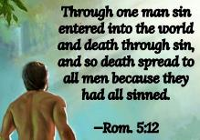
Genesis 2:16-17
“¹⁶ The Lord God commanded the man, saying, ‘From any tree of the garden you may eat freely; ¹⁷ but from the tree of the knowledge of good and evil you shall not eat, for in the day that you eat from it you will surely die (muwth).’”

Slide 14
Operates contrary to man’s design
  Man as an image bearer of God (Gen. 1:26-28)
  Omnipotence vs. omni-causality
  The Fall (Gen. 3) merely effaced rather than erased man’s status as a divine image bearer (Gen. 5:1; 9:6; Jas. 3:9; 1 Cor. 11:7)

Slide 15

Calvin said: “The Fall of Adam was not by accident, nor by chance, but was ordained by the secret counsel of God.” He also said that, “The first man fell because the Lord deemed it meet that he should.”
John Calvin
John Calvin, Calvin’s Calvinism: God’s Eternal Predestination and Secret Providence (Reformed Free Publishing Association, Kindle edition from the 2009 2nd edition), Kindle location 3796; idem, Institutes of the Christian Religion, op., cit., Kindle location 17793.

Slide 16
Edwin Palmer
In Edwin Palmer’s book, The Five Points of Calvinism, he states: “God is in back of everything. He decides and causes all things to happen that do happen … even sin. … God ordained sin and unbelief.”
Edwin H. Palmer, The Five Points of Calvinism (Grand Rapids, MI: Baker Books, Enlarged Edition, 1980, 24th printing, 2005), pp. 25, 102.

Slide 17
R. C. Sproul Jr.
R. C. Sproul Jr. (R. C. Sproul’s Calvinist son) said that God “desired that man would fall into sin … [God] created sin.”
R.C. Sproul Jr., Almighty Over All (Grand Rapids, MI: Baker Books, 1999, Second printing, July 1999), pp. 53-54.

Slide 18
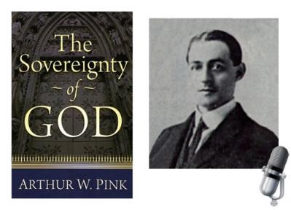
A. W. Pink
Sovereignty of God, p. 201.
“That God decreed sin should enter this world through the disobedience of our first parents was a secret hid in His own breast.”

Slide 19


Romans 5:12
“Therefore, just as through one man sin entered into the world, and death through sin, and so death spread to all men, because all sinned—.”

Slide 20
Romans 8:19-22
¹⁹ For the anxious longing of the creation waits eagerly for the revealing of the sons of God. ²⁰ For the creation was subjected to futility, not willingly, but because of Him who subjected it, in hope ²¹ that the creation itself also will be set free from its slavery to corruption into the freedom of the glory of the children of God. ²² For we know that the whole creation groans and suffers the pains of childbirth together until now.

Slide 21
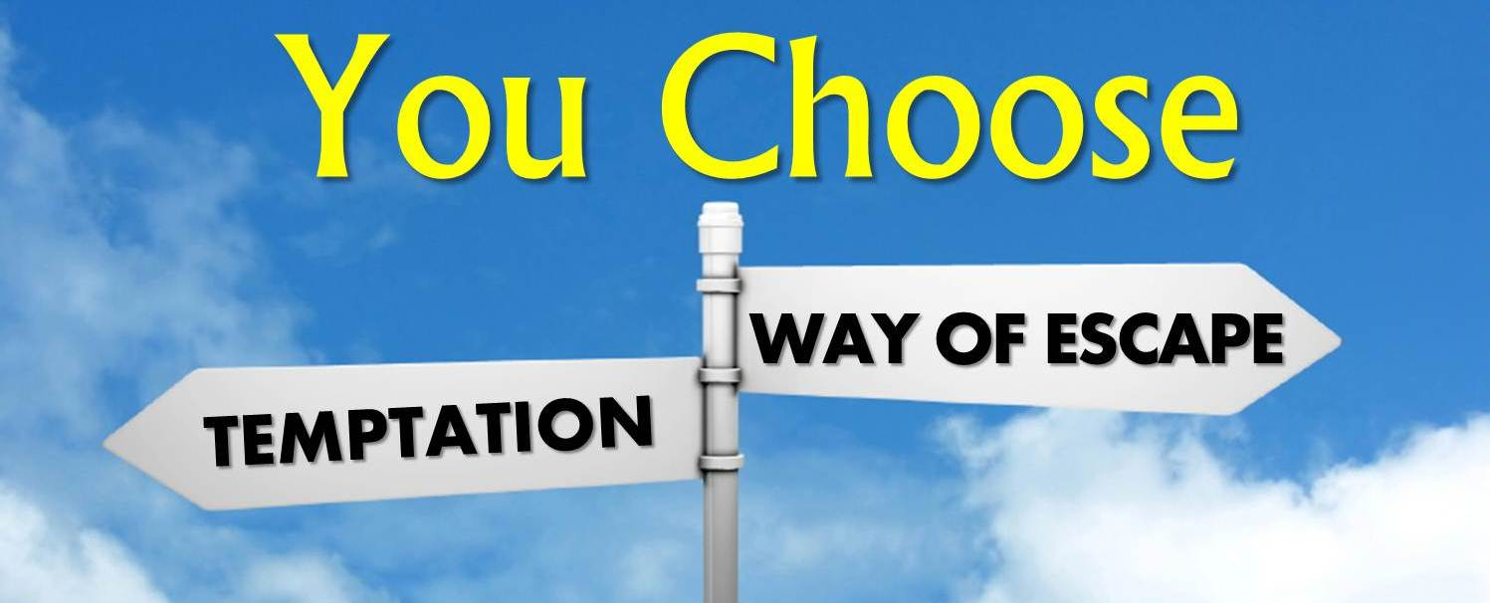
James 1:13
”Let no one say when he is tempted, ‘I am being tempted by God’; for God cannot be tempted by evil, and He Himself does not tempt anyone.”

Slide 22

1 Timothy 6:16
who alone possesses immortality and dwells in unapproachable light, whom no man has seen or can see. To Him be honor and eternal dominion! Amen.

Slide 23

1 John 1:5
This is the message we have heard from Him and announce to you, that God is Light, and in Him there is no darkness at all.

Slide 24
Operates contrary to man’s design
  Man as an image bearer of God (Gen. 1:26-28)
  Omnipotence vs. omni-causality
  The Fall (Gen. 3) merely effaced rather than erased man’s status as a divine image bearer (Gen. 5:1; 9:6; Jas. 3:9; 1 Cor. 11:7)

Slide 25
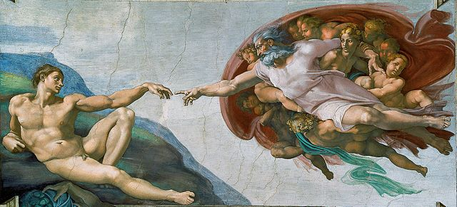
Genesis 9:6
Whoever sheds man’s blood, By man his blood shall be shed, For in the image of God He made man.

Slide 26
James 3:9
With it we bless our Lord and Father, and with it we curse men, who have been made in the likeness of God.

Slide 27
  Calvinism’s Overstatement of Total Depravity
Confusion over intensity vs. extent (Gen. 3:22; Matt. 7:7-11; Rom. 2:14-15)
Operates contrary to man’s design
Mis-defines “death” (Eph. 2:1) as non-existence rather than separation
Underestimates what lost man can do

Slide 28

Calvinism’s Misunderstanding of Death
Ephesians 2:1, 5
Calvinism's anachronistic misunderstanding: non-existence
Lexical definition: separation
Physical death (Gen. 35:18; Eccles. 12:7; Matt. 27:50-51; Luke 23:46; Acts 7:59; Dan. 12:2; Matt. 25:46; 2 Cor. 5:8; Philip. 1:21-23)
Other examples (Gen. 2:17; 3:8; Isa. 59:1-2)
Faith is possible (absent regeneration 1st) though the Spirit’s conviction (John 16:8), the Word’s proclamation (Isa. 55:8-9; Rom. 10:17; 2 Tim. 3:15; 1 Pet. 1:23; Jas. 1:18)

Slide 29
Calvinism’s Misunderstanding of Death
Ephesians 2:1, 5
Calvinism's anachronistic misunderstanding: non-existence
Lexical definition: separation
Physical death (Gen. 35:18; Eccles. 12:7; Matt. 27:50-51; Luke 23:46; Acts 7:59; Dan. 12:2; Matt. 25:46; 2 Cor. 5:8; Philip. 1:21-23)
Other examples (Gen. 2:17; 3:8; Isa. 59:1-2)
Faith is possible (absent regeneration 1st) though the Spirit’s conviction (John 16:8), the Word’s proclamation (Isa. 55:8-9; Rom. 10:17; 2 Tim. 3:15; 1 Pet. 1:23; Jas. 1:18)

Slide 30

Ephesians 2:1-5
¹ “And you were dead in your trespasses and sins, ² in which you formerly walked according to the course of this world, according to the prince of the power of the air, of the spirit that is now working in the sons of disobedience. ³ Among them we too all formerly lived in the lusts of our flesh, indulging the desires of the flesh and of the mind, and were by nature children of wrath, even as the rest. ⁴ But God, being rich in mercy, because of His great love with which He loved us, ⁵ even when we were dead in our transgressions, made us alive together with Christ (by grace you have been saved)”

Slide 31
Calvinism’s Misunderstanding of Death
Ephesians 2:1, 5
Calvinism's anachronistic misunderstanding: non-existence
Lexical definition: separation
Physical death (Gen. 35:18; Eccles. 12:7; Matt. 27:50-51; Luke 23:46; Acts 7:59; Dan. 12:2; Matt. 25:46; 2 Cor. 5:8; Philip. 1:21-23)
Other examples (Gen. 2:17; 3:8; Isa. 59:1-2)
Faith is possible (absent regeneration 1st) though the Spirit’s conviction (John 16:8), the Word’s proclamation (Isa. 55:8-9; Rom. 10:17; 2 Tim. 3:15; 1 Pet. 1:23; Jas. 1:18)

Slide 32

Loraine Boettner
“In the Epistle to the Ephesians Paul declares that Prior to the quickening of the Spirit of God each individual soul lies dead in trespasses and sins. Now it will surely be admitted that to be dead, and to be dead in sin, is clear and positive evidence that there is neither aptitude nor Power remaining for the performance of any spiritual action. If a man were dead, in a natural and physical sense, it would at once be readily granted that there is no further possibility of that man being able to perform any physical actions. A corpse cannot act in any way whatever, and that man would be reckoned to have taken . . .

Slide 33
Loraine Boettner, The Reformed Doctrine of Predestination (Philipsburg, NJ: Presbyterian and Reformed, 1932), 65-66; quoting Warburton, Calvinism, p. 48.
Loraine Boettner
. . .leave of his senses who asserted that it could. If a man is dead spiritually, therefore, it is surely equally as evident that he is unable to perform any spiritual actions, and thus the doctrine of man's moral inability rests upon strong Scriptural evidence.”

Slide 34
Arthur Custance
“A corpse does not cry out for help.”
Arthur Custance, The Sovereignty of Grace (P & R Press; First Edition, 1979), p. 18.

Slide 35
Using a Foolish Analogy to Support Calvinism
“Calvinists say, ‘Since he is dead, it is impossible for him to believe.’ This is a foolish analogy!...A person who is physically dead cannot receive Christ as his Savior, but neither can he speak, breathe, laugh, walk, live a righteous life, or sin.”
Bob Kirkland, Calvinism: None Dare Call It Heresy; Spotlight on the Life and Teachings of John Calvin (Eureka, MT: Lighthouse Trails, 2018), 35.

Slide 36
Calvinism’s Misunderstanding of Death
Ephesians 2:1, 5
Calvinism's anachronistic misunderstanding: non-existence
Lexical definition: separation
Physical death (Gen. 35:18; Eccles. 12:7; Matt. 27:50-51; Luke 23:46; Acts 7:59; Dan. 12:2; Matt. 25:46; 2 Cor. 5:8; Philip. 1:21-23)
Other examples (Gen. 2:17; 3:8; Isa. 59:1-2)
Faith is possible (absent regeneration 1st) though the Spirit’s conviction (John 16:8), the Word’s proclamation (Isa. 55:8-9; Rom. 10:17; 2 Tim. 3:15; 1 Pet. 1:23; Jas. 1:18)

Slide 37
“Death” in the Old Testament
māwet: “Death is the consequences and the punishment of sin. It originated with sin. A grand theme of the Old Testament is God’s holiness, which separates Him from all that is in harmony with His character. Death, then, in the Old Testament means ultimate separation from God due to sin.”
Elmer B. Smick, “māwet," in Theological Wordbook of the Old Testament, ed. R. Laird Harris and Gleason L. Archer and Bruce K. Waltke(Chicago: Moody, 1980), 1:1169.

Slide 38
“Death” in the New Testament
thanatos: “that separation (whether natural or violent) of the soul from the body by which the life on earth is ended.”
Joseph Henry Thayer, Death - Thanatos, Greek-English Lexicon of the New Testament Being Grmm's Wilke's Clavis Novi Testamenti (Grand Rapids: Zondervan, 1977), 282.

Slide 39
Calvinism’s Misunderstanding of Death
Ephesians 2:1, 5
Calvinism's anachronistic misunderstanding: non-existence
Lexical definition: separation
Physical death (Gen. 35:18; Eccles. 12:7; Matt. 27:50-51; Luke 23:46; Acts 7:59; Dan. 12:2; Matt. 25:46; 2 Cor. 5:8; Philip. 1:21-23)
Other examples (Gen. 2:17; 3:8; Isa. 59:1-2)
Faith is possible (absent regeneration 1st) though the Spirit’s conviction (John 16:8), the Word’s proclamation (Isa. 55:8-9; Rom. 10:17; 2 Tim. 3:15; 1 Pet. 1:23; Jas. 1:18)

Slide 40

Daniel 12:2
“Many of those who sleep in the dust of the ground will awake, these to everlasting (olam) life, but the others to disgrace and everlasting (olam) contempt.”

Slide 41

Matthew 25:46
“These will go away into eternal (aiōnios) punishment, but the righteous into eternal (aiōnios) life.”

Slide 42
Calvinism’s Misunderstanding of Death
Ephesians 2:1, 5
Calvinism's anachronistic misunderstanding: non-existence
Lexical definition: separation
Physical death (Gen. 35:18; Eccles. 12:7; Matt. 27:50-51; Luke 23:46; Acts 7:59; Dan. 12:2; Matt. 25:46; 2 Cor. 5:8; Philip. 1:21-23)
Other examples (Gen. 2:17; 3:8; Isa. 59:1-2)
Faith is possible (absent regeneration 1st) though the Spirit’s conviction (John 16:8), the Word’s proclamation (Isa. 55:8-9; Rom. 10:17; 2 Tim. 3:15; 1 Pet. 1:23; Jas. 1:18)

Slide 43
Genesis 2:16-17
“¹⁶ The Lord God commanded the man, saying, ‘From any tree of the garden you may eat freely; ¹⁷ but from the tree of the knowledge of good and evil you shall not eat, for in the day that you eat from it you will surely die (muwth).’”

Slide 44
Calvinism’s Misunderstanding of Death
Ephesians 2:1, 5
Calvinism's anachronistic misunderstanding: non-existence
Lexical definition: separation
Physical death (Gen. 35:18; Eccles. 12:7; Matt. 27:50-51; Luke 23:46; Acts 7:59; Dan. 12:2; Matt. 25:46; 2 Cor. 5:8; Philip. 1:21-23)
Other examples (Gen. 2:17; 3:8; Isa. 59:1-2)
Faith is possible (absent regeneration 1st) though the Spirit’s conviction (John 16:8), the Word’s proclamation (Isa. 55:8-9; Rom. 10:17; 2 Tim. 3:15; 1 Pet. 1:23; Jas. 1:18)

Slide 45

John 16:7-11
“⁷ But I tell you the truth, it is to your advantage that I go away; for if I do not go away, the Helper will not come to you; but if I go, I will send Him to you. ⁸ And He, when He comes, will convict the world concerning sin and righteousness and judgment; ⁹ concerning sin, because they do not believe in Me; ¹⁰ and concerning righteousness, because I go to the Father and you no longer see Me; ¹¹ and concerning judgment, because the ruler of this world has been judged.”

Slide 46
Isaiah 55:10-11
¹⁰ “For as the rain and the snow come down from heaven, And do not return there without watering the earth And making it bear and sprout, And furnishing seed to the sower and bread to the eater; ¹¹ So will My word be which goes forth from My mouth; It will not return to Me empty, Without accomplishing what I desire, And without succeeding in the matter for which I sent it.”

Slide 47

2 Timothy 3:15
“and that from childhood you have known the sacred writings which are able to give you the wisdom that leads to salvation through faith which is in Christ Jesus.”

Slide 48

Romans 1:16
“For I am not ashamed of the gospel, for it is the power of God for salvation to everyone who believes, to the Jew first and also to the Greek.”

Slide 49

Dr. Robert R. Congdon
Oops! I Thought I Was a Four - Pt Calvinist (Greer, SC: Congdon Ministries International, 2014), 48.
“While I do agree that salvation comes through the workings of the Holy Spirit and the Word of God, I disagree with the idea that God must first predispose some to believe and receive it, for the Word of God and the Holy Spirit are sufficient in and of themselves in bringing about the new birth. Instead of forcing individuals to be saved through the irresistible prompting of the Holy Spirit, God uses His Word and the convicting work of the Holy Spirit to confirm its truth in order to bring individuals to the point of decision. It is certainly God’s grace that offers it, but at this point they are free to accept or reject salvation.”

Slide 50
Dr. Robert R. Congdon
Oops! I Thought I Was a Four - Pt Calvinist (Greer, SC: Congdon Ministries International, 2014), 69-70.
“…their [Calvinism’s] definition of total depravity negates the sufficiency of the power of the Word of God and the Holy Spirit to give life...”

Slide 51
Death: Calvinism vs Biblicism
 | CALVINISM | BIBLICISM
Spiritual death: | Corpse, cadaver | Separated
Consciousness: | Cessation, lifeless | Aware
Results: | Inability | Can hear and believe
Spiritual response: | Regeneration first | God’s Word, Spirit’s conviction, Gospel’s power
Regeneration: | Before faith | Result of faith
Adapted from Robert R. Congdon, Oops! I Thought I Was a Four - Pt Calvinist (Greer, SC: Congdon Ministries International, 2014), 22.

Slide 52
  Calvinism’s Overstatement of Total Depravity
Confusion over intensity vs. extent (Gen. 3:22; Matt. 7:7-11; Rom. 2:14-15)
Operates contrary to man’s design
Mis-defines “death” (Eph. 2:1) as non-existence rather than separation
Underestimates what lost man can do

Slide 53
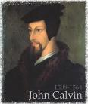
Calvinism Underestimates What Lost Man Can Do
  Lost man can seek God (John 16:7-11; Acts 10‒11)
  Lost man can hear from God (Acts 10:30-32, 44-48; 11:14)
  Lost man can reason (Matt. 21:23-27)
  Lost man can believe (exercise faith) in God (John 3:18)

Slide 54
Calvinism Underestimates What Lost Man Can Do
  Lost man can seek God (John 16:7-11; Acts 10‒11)
  Lost man can hear from God (Acts 10:30-32, 44-48; 11:14)
  Lost man can reason (Matt. 21:23-27)
  Lost man can believe (exercise faith) in God (John 3:18)

Slide 55
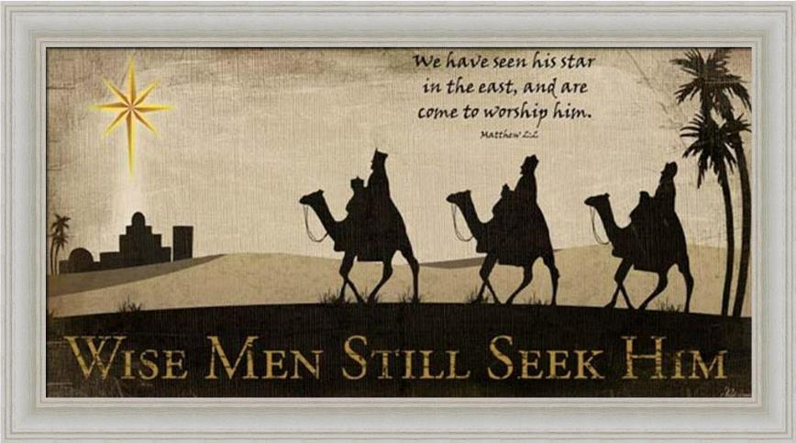

Slide 56
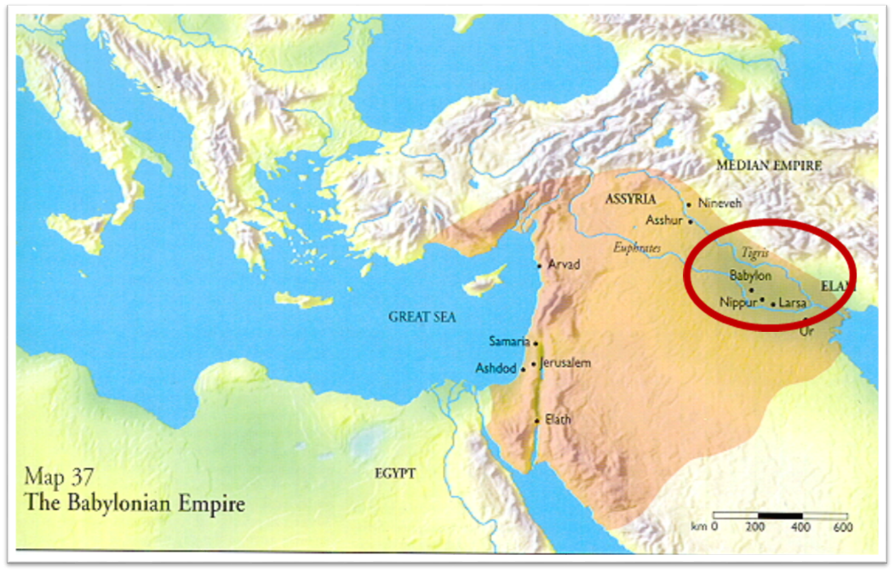

Slide 57
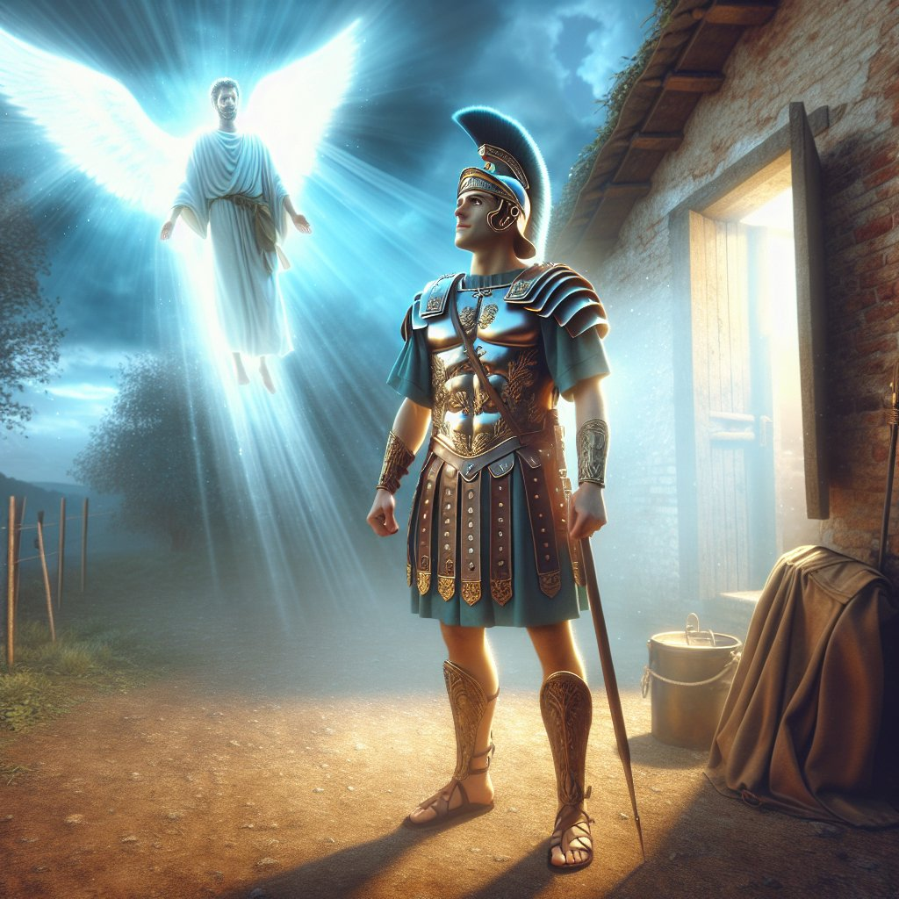
Acts 10:2
“¹ Now there was a man at Caesarea named Cornelius, a centurion of what was called the Italian cohort, ² a devout man and one who feared God with all his household, and gave many alms to the Jewish people and prayed to God continually.”

Slide 58
Acts 11:14
“and he will speak words to you by which you [Cornelius] will be saved, you and all your household.”

Slide 59

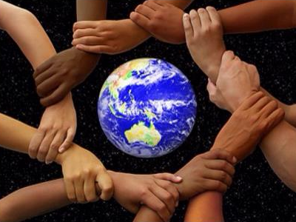
Acts 17:26-27
²⁶ and He made from one man every nation of mankind to live on all the face of the earth, having determined their appointed times and the boundaries of their habitation, ²⁷ that they would seek God, if perhaps they might grope for Him and find Him, though He is not far from each one of us (Italics added)

Slide 60
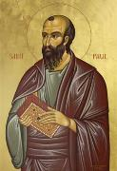
Romans 3:11
“There is none who understands, There is none who seeks for God.”

Slide 61
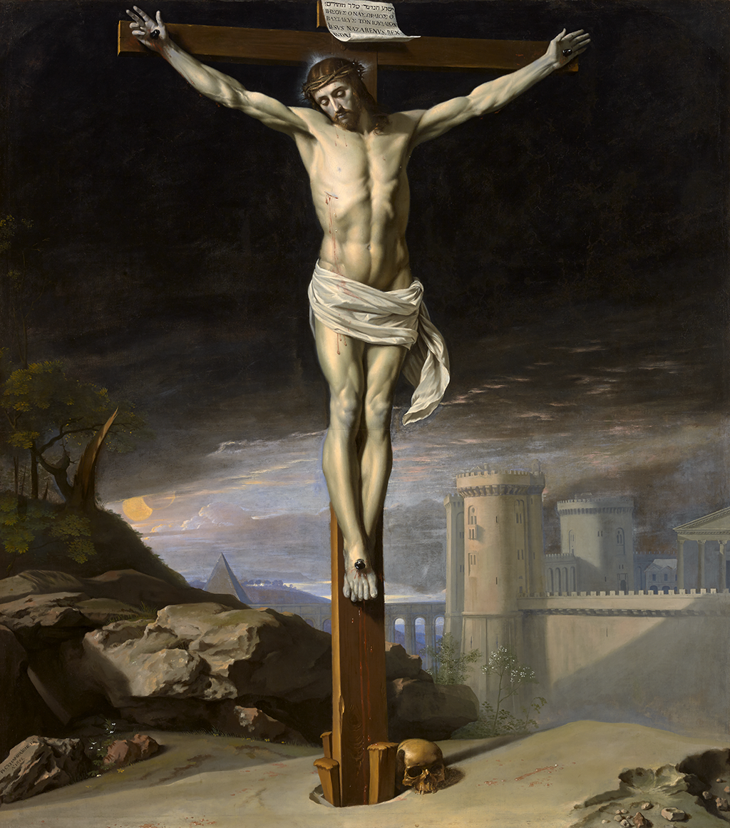
John 12:32
“And I, if I am lifted up from the earth, will draw all men to Myself.”

Slide 62
John 16:7-11
“⁷ But I tell you the truth, it is to your advantage that I go away; for if I do not go away, the Helper will not come to you; but if I go, I will send Him to you. ⁸ And He, when He comes, will convict the world concerning sin and righteousness and judgment; ⁹ concerning sin, because they do not believe in Me; ¹⁰ and concerning righteousness, because I go to the Father and you no longer see Me; ¹¹ and concerning judgment, because the ruler of this world has been judged.”

Slide 63
Isaiah 55:10-11
¹⁰ “For as the rain and the snow come down from heaven, And do not return there without watering the earth And making it bear and sprout, And furnishing seed to the sower and bread to the eater; ¹¹ So will My word be which goes forth from My mouth; It will not return to Me empty, Without accomplishing what I desire, And without succeeding in the matter for which I sent it.”

Slide 64
2 Timothy 3:15
“and that from childhood you have known the sacred writings which are able to give you the wisdom that leads to salvation through faith which is in Christ Jesus.”

Slide 65
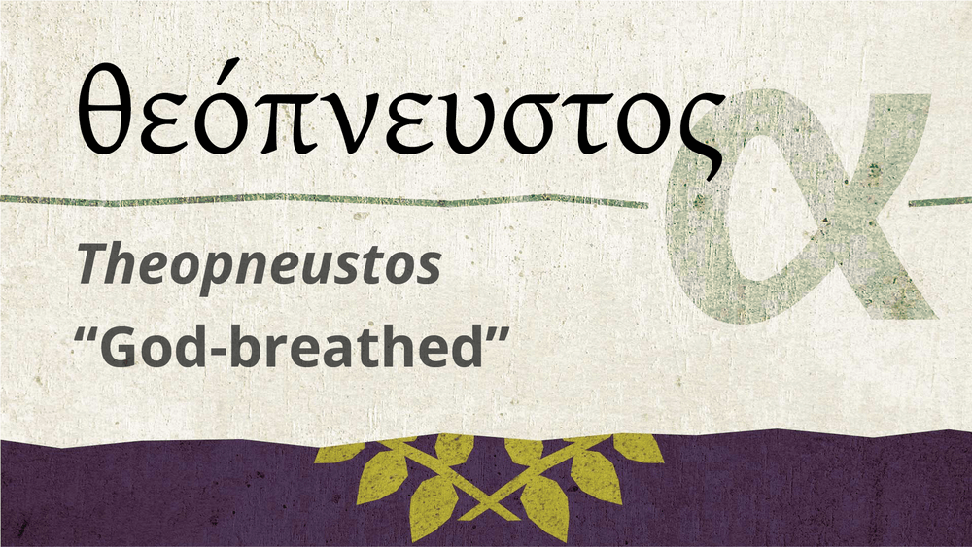
2 Timothy 3:16-17
“All Scripture is inspired by God [theopneustos] and profitable for teaching, for reproof, for correction, for training in righteousness; so that the man of God may be adequate, equipped for every good work.”

Slide 66
Romans 1:16
“For I am not ashamed of the gospel, for it is the power of God for salvation to everyone who believes, to the Jew first and also to the Greek.”

Slide 67
Romans 1:18-20
“¹⁸ For the wrath of God is revealed from heaven against all ungodliness and unrighteousness of men who suppress the truth in unrighteousness, ¹⁹ because that which is known about God is evident within them; for God made it evident to them. ²⁰ For since the creation of the world His invisible attributes, His eternal power and divine nature, have been clearly seen, being understood through what has been made, so that they are without excuse.”

Slide 68
Psalm 19:1-4
“¹ The heavens are telling of the glory of God; And their expanse is declaring the work of His hands. ² Day to day pours forth speech, And night to night reveals knowledge. ³ There is no speech, nor are there words; Their voice is not heard. ⁴ Their line has gone out through all the earth, And their utterances to the end of the world. In them He has placed a tent for the sun.”

Slide 69
Calvinism Underestimates What Lost Man Can Do
  Lost man can seek God (John 16:7-11; Acts 10‒11)
  Lost man can hear from God (Acts 10:30-32, 44-48; 11:14)
  Lost man can reason (Matt. 21:23-27)
  Lost man can believe (exercise faith) in God (John 3:18)

Slide 70
Acts 11:14
“and he will speak words to you by which you [Cornelius] will be saved, you and all your household.”

Slide 71
Calvinism Underestimates What Lost Man Can Do
  Lost man can seek God (John 16:7-11; Acts 10‒11)
  Lost man can hear from God (Acts 10:30-32, 44-48; 11:14)
  Lost man can reason (Matt. 21:23-27)
  Lost man can believe (exercise faith) in God (John 3:18)

Slide 72
Calvinism Underestimates What Lost Man Can Do
  Lost man can seek God (John 16:7-11; Acts 10‒11)
  Lost man can hear from God (Acts 10:30-32, 44-48; 11:14)
  Lost man can reason (Matt. 21:23-27)
  Lost man can believe (exercise faith) in God (John 3:18)

Slide 73
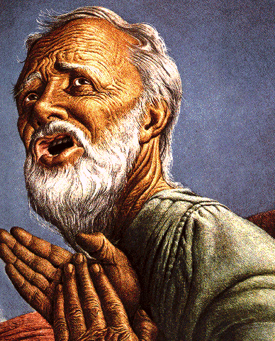
Passage Conditioning Salvation on Faith Alone (Sola Fide)
Genesis 15:6
John 3:16; 5:24; 6:28-29, 47; 16:8-9; 20:30-31
Acts 16:30-31
Romans 1:16; Ephesians 2:8-9
Hebrews 11:6

Slide 74
Belief – God’s One Condition for Justification
Gen 15:6
Then he believed in the LORD; and He reckoned it to him as righteousness.
John 3:16
For God so loved the world, that He gave His only begotten Son, that whoever believes in Him shall not perish, but have eternal life.
Acts 16:30-31
"Sirs, what must I do to be saved?" They said, "Believe in the Lord Jesus, and you will be saved..."

Slide 75

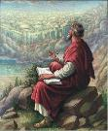
John 20:30-31
“Therefore many other signs Jesus also performed in the presence of the disciples, which are not written in this book; but these have been written so that you may believe that Jesus is the Christ, the Son of God; and that believing you may have life in His name.”

Slide 76
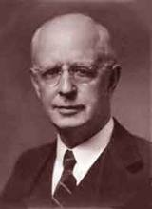
Lewis Sperry Chafer, vol. 7, Systematic Theology
(Grand Rapids, MI: Kregel Publications, 1993), 265-66.
Belief-God’s One Condition for Justification
“…because upwards of 150 passages of Scripture condition salvation upon believing only (cf. John 3:16; Acts 16:31).”

Slide 77
Dr. Robert R. Congdon
Oops! I Thought I Was a Four - Pt Calvinist (Greer, SC: Congdon Ministries International, 2014), 51.
“Furthermore, why would God admonish and warn unbelievers for being spiritually blind and deaf if it were not in their power to respond?…Is this not a mockery? It would be like chiding a legless man for being unable to walk.”

Slide 78
V. Running TULIP Through the Grid of Scripture
Total Depravity
Unconditional Election
Limited Atonement
Irresistible Grace
Perseverance of the Saints

Slide 79
Total Depravity
  The starting point
  Total Depravity properly defined
  Calvinism: Total Depravity = inability
  Calvinism’s overstatement of Total Depravity

Slide 80
  Calvinism’s Overstatement of Total Depravity
Confusion over intensity vs. extent (Gen. 3:22; Matt. 7:7-11; Rom. 2:14-15)
Operates contrary to man’s design
Mis-defines “death” (Eph. 2:1) as non-existence rather than separation
Underestimates what lost man can do

