Slide 1
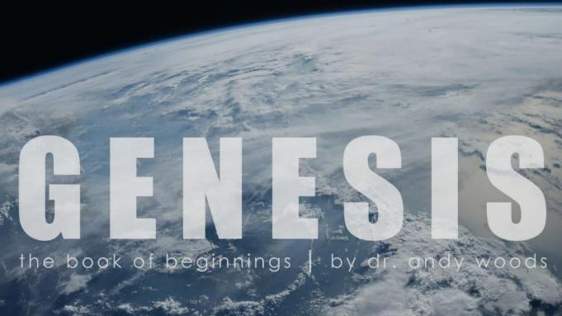

Genesis 12‒50
Israel’s Birth & Preservation

Slide 2
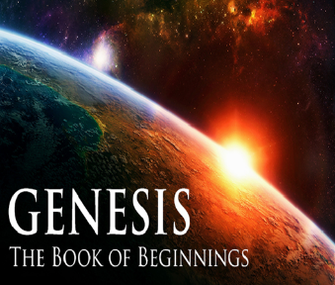
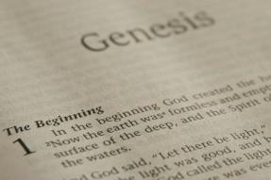
GENESIS STRUCTURE
  Genesis 12-50 (four people)
    Abraham (12:1–25:11)
    Isaac (25:12–26:35)
    Jacob (27–36)
    Joseph (37–50)

Slide 3
Genesis 37‒50
Joseph
  Joseph sold unto Egypt (37)
  Canaan’s corruption (38)
  Joseph falsely accused (39)
  Joseph’s short-term predictions (40)
  Joseph’s elevation (41)
  Joseph’s first reunion with his brothers (42)
  Joseph’s second reunion with his brothers (43‒45)
  Joseph’s second reunion with his brothers (43‒45)
  Sojourn to Egypt (46:1‒47:12)
  Famine’s course (47:13-26)
  Jacob in Egypt (47:27-31)
  Jacob blesses Joseph’s sons (48)
  Jacob blesses his sons (49)

Slide 4
Genesis 49:1-33
Jacob Blesses His Sons
  Call (49:1)
  Introduction (49:2)
  Jacob’s blessings on his sons (49:3-27)
  Concluding summary (49:28)
  Jacob’s death (49:29-33)

Slide 5
III. Genesis 49:3-27
Jacob’s Blessings on His Sons
    Reuben (3-4)
    Simeon & Levi (5-7)
    Judah (8-12)
    Zebulun (13)
    Issachar (14-15)
    Dan (16-18)
    Gad (19)
    Asher (20)
    Naphtali (21)
    Joseph (22-26)
    Benjamin (27)

Slide 6
Genesis 49:5-7
Simeon & Levi
      Similarities (5)
      Disassociation (6a)
      Sins (6b-c)
      Jacob’s judgment (7)

Slide 7
Genesis 49:5-7
Simeon & Levi
      Similarities (5)
      Disassociation (6a)
      Sins (6b-c)
      Jacob’s judgment (7)

Slide 8
Genesis 49:5
Similarities
      Full brothers (5a)
      Equal in violence (5b)

Slide 9
Genesis 49:5
Similarities
      Full brothers (5a)
      Equal in violence (5b)

Slide 10
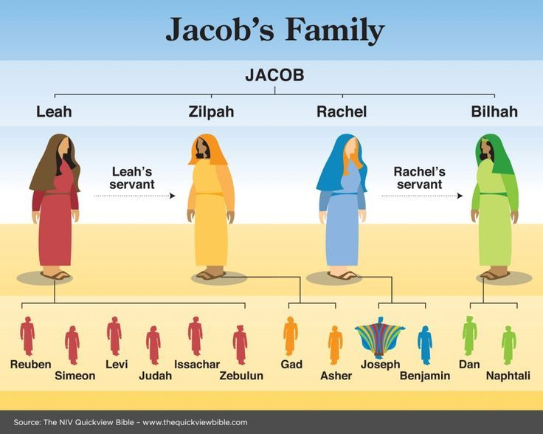

Slide 11
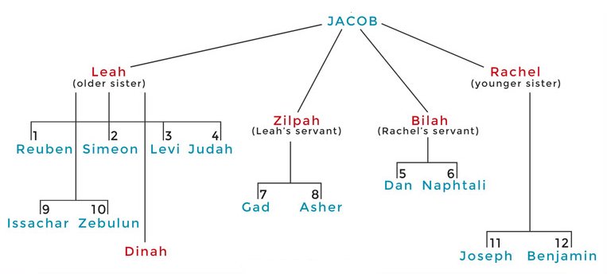

Slide 12
Genesis 49:5
Similarities
      Full brothers (5a)
      Equal in violence (5b)

Slide 13
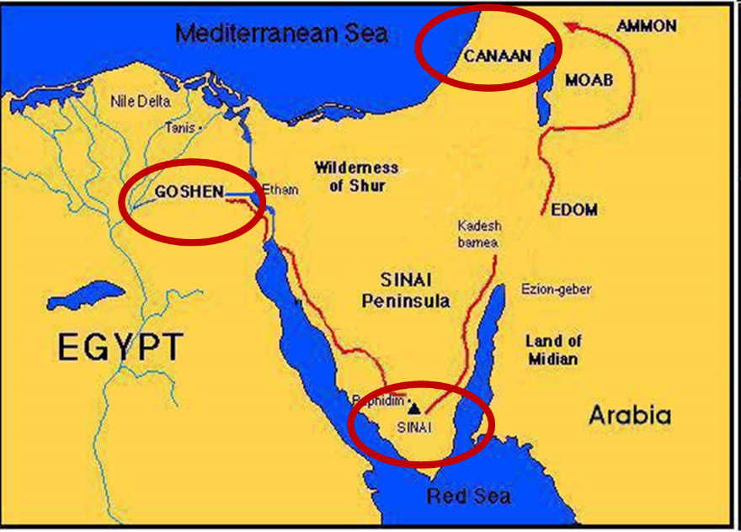

Slide 14
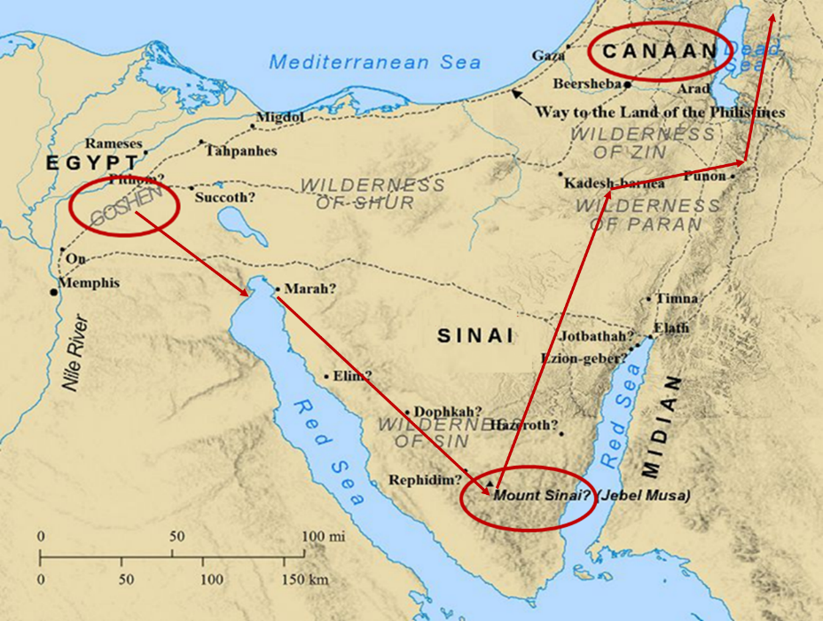

Slide 15
Genesis 49:5-7
Simeon & Levi
      Similarities (5)
      Disassociation (6a)
      Sins (6b-c)
      Jacob’s judgment (7)

Slide 16
Genesis 49:5-7
Simeon & Levi
      Similarities (5)
      Disassociation (6a)
      Sins (6b-c)
      Jacob’s judgment (7)

Slide 17
Genesis 49:6b-c
Sins
      Men (6b)
      Animals (6c)

Slide 18
Genesis 49:6b-c
Sins
      Men (6b)
      Animals (6c)

Slide 21

Genesis 6:11-13
“¹¹ Now the earth was corrupt in the sight of God, and the earth was filled with violence [חָמָס; chamas]. ¹² And God looked on the earth, and behold, it was corrupt; for humanity had corrupted its way upon the earth. ¹³ Then God said to Noah, ‘The end of humanity has come before Me; for the earth is filled with violence [חָמָס; chamas] because of people; and behold, I am about to destroy them with the earth.’”

Slide 22


Slide 23
Genesis 49:6b-c
Sins
      Men (6b)
      Animals (6c)

Slide 26

Genesis 1:26-28
“²⁶ Then God said, “Let Us make man in Our image, according to Our likeness; and let them rule over the fish of the sea and over the birds of the sky and over the cattle and over all the earth, and over every creeping thing that creeps on the earth.” ²⁷ God created man in His own image, in the image of God He created him; male and female He created them. ²⁸ God blessed them; and God said to them, “Be fruitful and multiply, and fill the earth, and subdue it; and rule over the fish of the sea and over the birds of the sky and over every living thing that moves on the earth.”

Slide 27
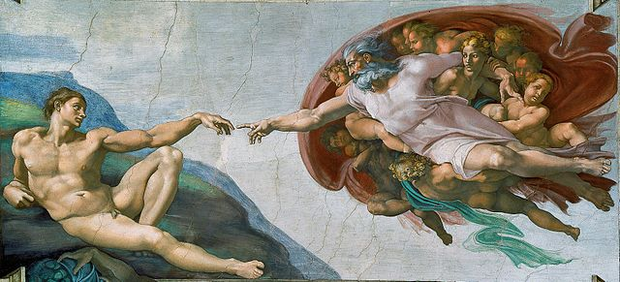
Genesis 9:6
Whoever sheds man’s blood, By man his blood shall be shed, For in the image of God He made man.

Slide 28
Genesis 49:5-7
Simeon & Levi
      Similarities (5)
      Disassociation (6a)
      Sins (6b-c)
      Jacob’s judgment (7)

Slide 29
Genesis 49:7
Jacob’s Judgment
      Deeds (7a)
      Seed (7b)

Slide 30
Genesis 49:7
Jacob’s Judgment
      Deeds (7a)
      Seed (7b)

Slide 31

Matthew 5:21-22
“²¹ “You have heard that the ancients were told, ‘You shall not commit murder’ and ‘Whoever commits murder shall be liable to the court.’ ²² But I say to you that everyone who is angry with his brother shall be guilty before the court; and whoever says to his brother, ‘You good-for-nothing,’ shall be guilty before the supreme court; and whoever says, ‘You fool,’ shall be guilty enough to go into the fiery hell.”

Slide 32
Genesis 49:7
Jacob’s Judgment
      Deeds (7a)
      Seed (7b)

Slide 33

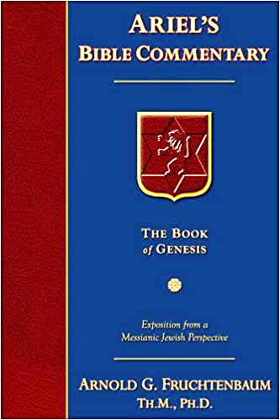
Dr. Arnold G. Fruchtenbaum
The Book of Genesis, 637-38
“Second, his judgment falls on their seed: I will divide them in Jacob, And scatter them in Israel. In keeping with the judgment, neither tribe received its own territory in the Land; their territories were within the territory of other tribes; they did not receive their own tribal holdings. Simeon turned out to be the weakest tribe in number. In the first census (Num. 1:23), his tribe numbered 59,300. In the second census (Num. 26:14), it went all the way down to 22,200. A member of Simeon’s tribe was involved in the sin of worshipping Baal-Peor (Num. 25:14) through immorality.”

Slide 34
Dr. Arnold G. Fruchtenbaum
The Book of Genesis, 637-38
“Simeon is omitted from the tribal blessings of Moses in Deuteronomy 33. When the Jews did get the Land of Israel, Simeon settled, not in his own territory, but in the southern part of Judah’s territory (Josh. 19:1–9, Judg. 1:3). In subsequent history, Simeon smote the inhabitants of Mount Seir (I Chron. 4:42–43). The Tribe of Levi did side with Moses in the sin of the golden calf (Exod. 32:26–29); but in keeping with Jacob’s curse, Levi did not receive his own territory. Rather, the Tribe of Levi was scattered in forty-eight different Levitical Cities throughout the other Tribes of Israel (Num. 18:20–24, 35:1–8; Deut. 10:8–9; Josh. 14:4, 21:1–42).”

Slide 35
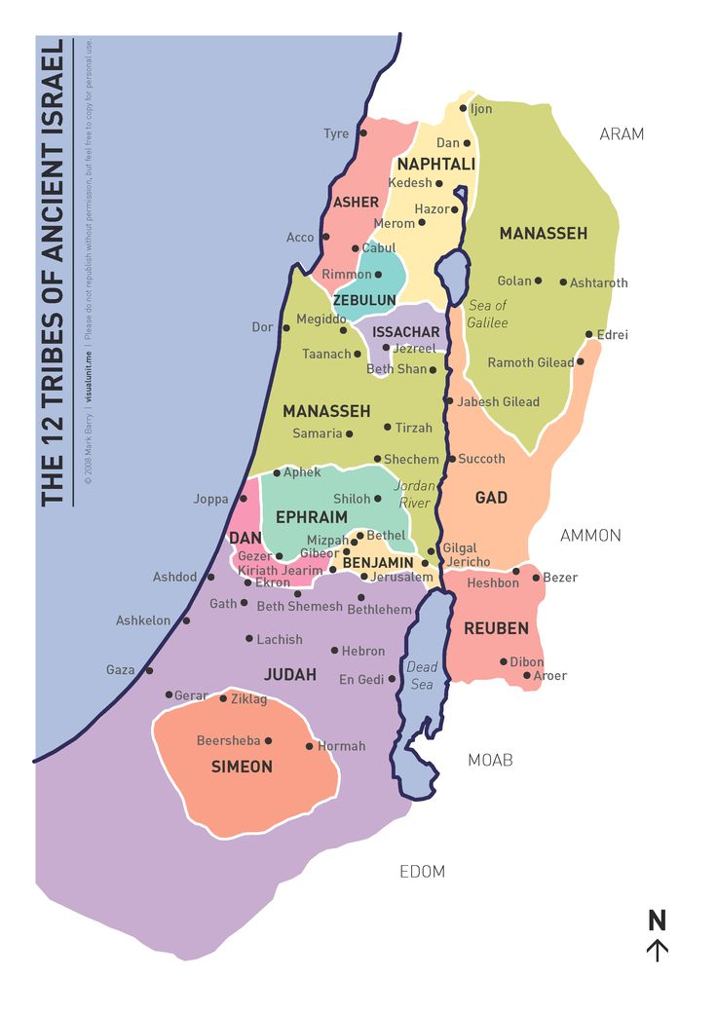

Slide 36
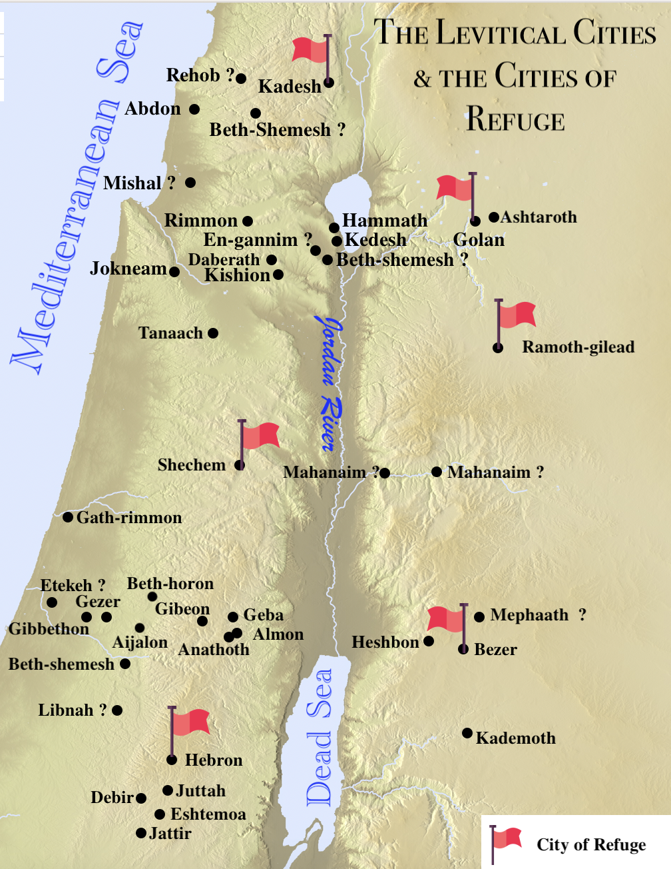

Slide 37


Slide 38
III. Genesis 49:3-27
Jacob’s Blessings on His Sons
    Reuben (3-4)
    Simeon & Levi (5-7)
    Judah (8-12)
    Zebulun (13)
    Issachar (14-15)
    Dan (16-18)
    Gad (19)
    Asher (20)
    Naphtali (21)
    Joseph (22-26)
    Benjamin (27)

Slide 39
Genesis 49:8-12
Judah
      Preeminence (8)
      Power (9)
      Messianic line (10)
      Prosperity (11)
      Final result (12)

Slide 40
Genesis 49:8-12
Judah
      Preeminence (8)
      Power (9)
      Messianic line (10)
      Prosperity (11)
      Final result (12)

Slide 41
Genesis 49:8
Preeminence
      Praise (8a)
      Successful in war (8b)
      Brothers bow down to you (8c)

Slide 42
Genesis 49:8
Preeminence
      Praise (8a)
      Successful in war (8b)
      Brothers bow down to you (8c)

Slide 43
Genesis 49:8
Preeminence
      Praise (8a)
      Successful in war (8b)
      Brothers bow down to you (8c)

Slide 44
Genesis 49:8
Preeminence
      Praise (8a)
      Successful in war (8b)
      Brothers bow down to you (8c)

Slide 47
Dr. Arnold G. Fruchtenbaum
The Book of Genesis, 638-39
“Then he added: Your father’s sons shall bow down before you, again showing the preeminence of Judah. Indeed, he did gain the preeminence over the other tribes. In Numbers 2:9, in the wilderness wanderings, Judah set forth first; in Numbers 10:14, he headed the march through the wilderness. In I Chronicles 5:2, Judah prevailed above his brethren. In Judges 1:1–2, Judah is chosen by God to go up first against the Canaanites. Indeed, Judah received the preeminence.”

Slide 49
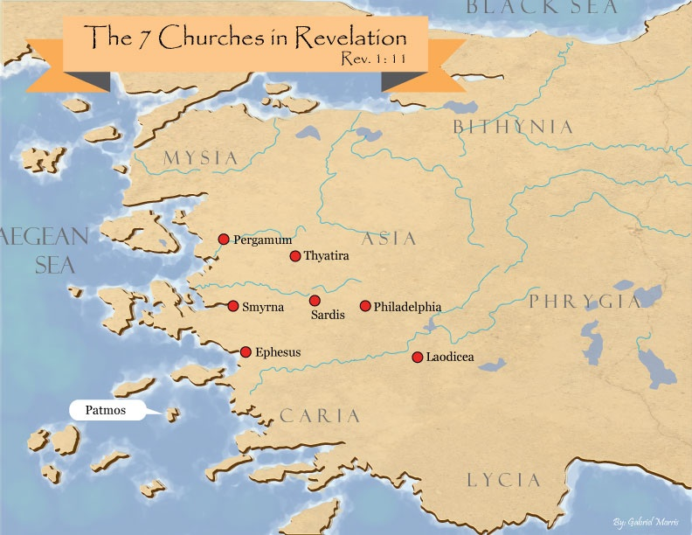
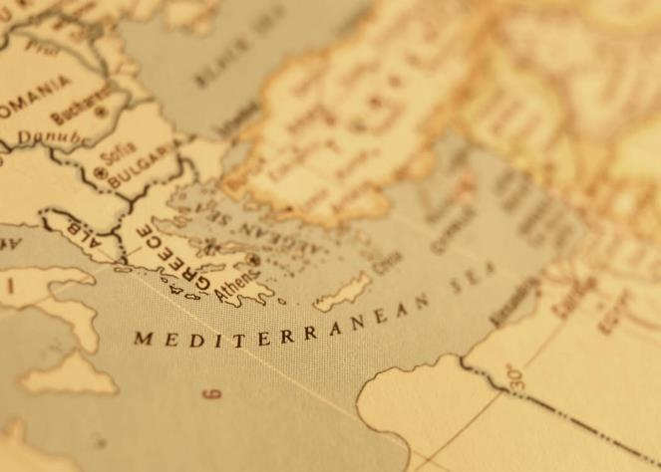

Slide 50
Genesis 49:8-12
Judah
      Preeminence (8)
      Power (9)
      Messianic line (10)
      Prosperity (11)
      Final result (12)

Slide 51
Genesis 49:9
Power
      Lion’s whelp (9a)
      Killing prey (9b)
      Couched as a lion (9c)
      Lioness (9d)

Slide 52
Genesis 49:9
Power
      Lion’s whelp (9a)
      Killing prey (9b)
      Couched as a lion (9c)
      Lioness (9d)

Slide 53
Genesis 49:9
Power
      Lion’s whelp (9a)
      Killing prey (9b)
      Couched as a lion (9c)
      Lioness (9d)

Slide 54
Genesis 49:9
Power
      Lion’s whelp (9a)
      Killing prey (9b)
      Couched as a lion (9c)
      Lioness (9d)

Slide 55
Genesis 49:9
Power
      Lion’s whelp (9a)
      Killing prey (9b)
      Couched as a lion (9c)
      Lioness (9d)

Slide 56
Genesis 49:8-12
Judah
      Preeminence (8)
      Power (9)
      Messianic line (10)
      Prosperity (11)
      Final result (12)

Slide 57
Genesis 49:10
Messianic Line
      Scepter (10a)
      Ruler’s staff (10b)
      Shiloh (10c)
      Obedience of the nations (10d)

Slide 58
Genesis 49:10
Messianic Line
      Scepter (10a)
      Ruler’s staff (10b)
      Shiloh (10c)
      Obedience of the nations (10d)

Slide 59

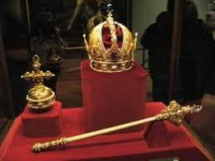
Genesis 49:10
“The scepter shall not depart from Judah, Nor the ruler’s staff from between his feet, Until Shiloh comes, And to him shall be the obedience of the peoples.”

Slide 60
Genesis 49:10
Messianic Line
      Scepter (10a)
      Ruler’s staff (10b)
      Shiloh (10c)
      Obedience of the nations (10d)

Slide 61
Genesis 49:10
Messianic Line
      Scepter (10a)
      Ruler’s staff (10b)
      Shiloh (10c)
      Obedience of the nations (10d)

Slide 62
Dr. Arnold G. Fruchtenbaum
The Book of Genesis, 640
“The point is that the ruling staff and the scepter will not depart from Judah until he come whose right it is and then He will receive it forever… ’He, to whom, it is,’ or ‘until he come whose right it is,’ and, of course, this is the Messiah...What it means is that Judah will exercise royal power finally, to the end when the Messiah comes to rule the world. Royal power will be passed from generation to generation in Judah in succession until He come whose right it is. Once it is given to the Messiah, royal power remains forever with Him; this is ultimately a reference to the Second Coming when Messiah comes to rule the earth.”

Slide 63
Messiah must be from the tribe of Judah
Genesis 49:10
Revelation 5:5

Slide 64

Revelation 5:5
“and one of the elders said to me, “Stop weeping; behold, the Lion that is from the tribe of Judah, the Root of David, has overcome so as to open the book and its seven seals.”

Slide 65
Genesis 49:10
Messianic Line
      Scepter (10a)
      Ruler’s staff (10b)
      Shiloh (10c)
      Obedience of the nations (10d)

Slide 66
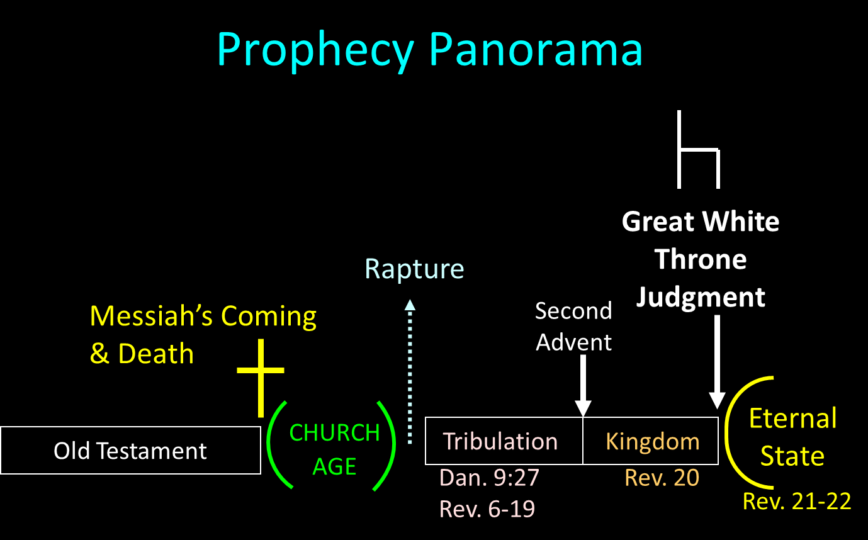

Slide 67
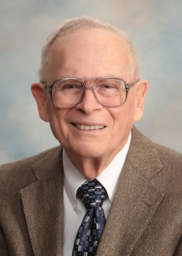
Robert Thomas
Four Views on the Book of Revelation, page 207.
“At the end of the Millennium that city will be Satan’s prime objective with his rebel army, because Israel will be a leader among the nations.”

Slide 68

Zechariah 14:16-18
“Then it will come about that any who are left of all the nations that went against Jerusalem will go up from year to year to worship the King, the Lord of hosts, and to celebrate the Feast of Booths. ¹⁷ And it will be that whichever of the families of the earth does not go up to Jerusalem to worship the King, the Lord of hosts, there will be no rain on them. ¹⁸ If the family of Egypt does not go up or enter, then no rain will fall on them; it will be the plague with which the Lord smites the nations who do not go up to celebrate the Feast of Booths.”

Slide 69
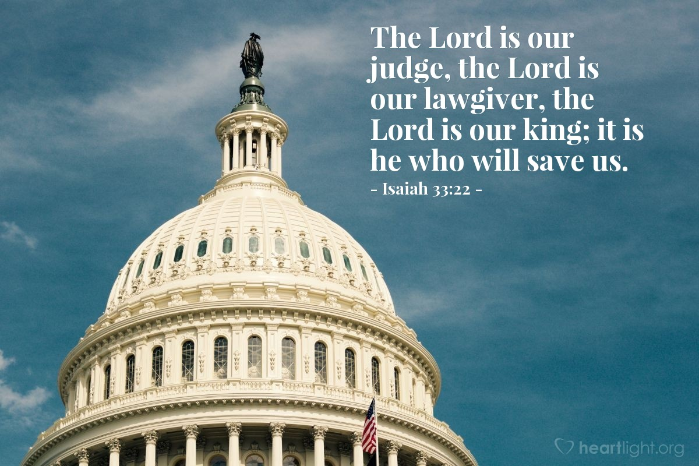
Isaiah 33:22
“For the LORD is our judge, The LORD is our lawgiver, The LORD is our king.”

Slide 70

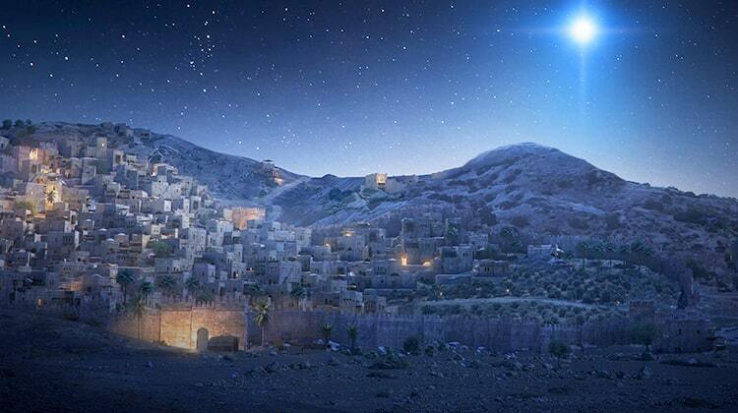
Micah 5:2
“But as for you, Bethlehem Ephrathah, Too little to be among the clans of Judah, From you One will go forth for Me to be ruler in Israel. His goings forth are from long ago, From the days of eternity.”

Slide 71
Three Tenses of Salvation
Phase | Justification | Sanctification | Glorification
Tense | Past | Present | Future
Saved from sin’s: | Penalty | Power | Presence
Scripture | Eph 2:8-9; Titus 3:5 | Philip 2:12 | Rom 5:10

Slide 72
Genesis 49:8-12
Judah
      Preeminence (8)
      Power (9)
      Messianic line (10)
      Prosperity (11)
      Final result (12)

Slide 73
Genesis 49:11
Prosperity
      Binding coalt to vine (11a)
      Binding coalt to choice vine (11b)
      Washed garment in vine (11c)
      Vesture in blood of grapes (11d)

Slide 74
Genesis 49:11
Prosperity
      Binding coalt to vine (11a)
      Binding coalt to choice vine (11b)
      Washed garment in vine (11c)
      Vesture in blood of grapes (11d)

Slide 75
Genesis 49:11
Prosperity
      Binding coalt to vine (11a)
      Binding coalt to choice vine (11b)
      Washed garment in vine (11c)
      Vesture in blood of grapes (11d)

Slide 76

Isaiah 65:21–22
²¹ “They will build houses and inhabit them; They will also plant vineyards and eat their fruit. ²² “They will not build and another inhabit, They will not plant and another eat; For as the lifetime of a tree, so will be the days of My people, And My chosen ones will wear out the work of their hands.

Slide 77

Amos 9:13
¹³ “Behold, days are coming,” declares the Lord, “When the plowman will overtake the reaper And the treader of grapes him who sows seed; When the mountains will drip sweet wine And all the hills will be dissolved.”

Slide 78
Messiah must present himself to Israel in a particular way
Zechariah 9:9

Slide 79
Zechariah 9:9
“Rejoice greatly, O daughter of Zion! Shout in triumph, O daughter of Jerusalem! Behold, your king is coming to you; He is just and endowed with salvation, Humble, and mounted on a donkey, Even on a colt, the foal of a donkey.”

Slide 80
Genesis 49:11
Prosperity
      Binding coalt to vine (11a)
      Binding coalt to choice vine (11b)
      Washed garment in vine (11c)
      Vesture in blood of grapes (11d)

Slide 81
Genesis 49:11
Prosperity
      Binding coalt to vine (11a)
      Binding coalt to choice vine (11b)
      Washed garment in vine (11c)
      Vesture in blood of grapes (11d)

Slide 82


Revelation 6:16-17
^{“16} and they said to the mountains and the rocks, ‘Fall on us and hide us from the sight of Him who sits on the throne, and from the wrath [orgḗ] of the Lamb; ¹⁷ for the great day of Their wrath [orgḗ] has come, and who is able to stand?’”

Slide 83
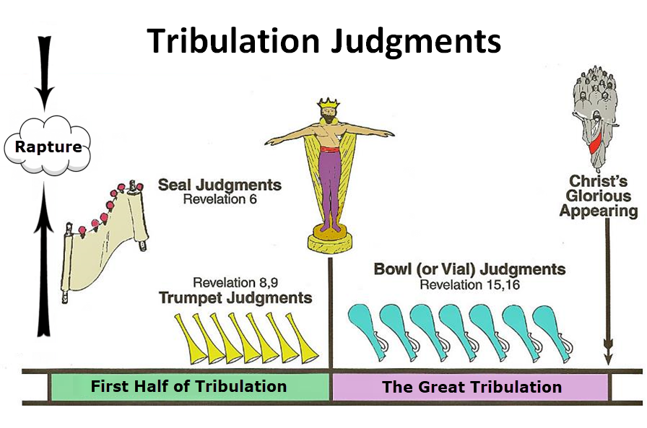

Slide 84
Genesis 49:8-12
Judah
      Preeminence (8)
      Power (9)
      Messianic line (10)
      Prosperity (11)
      Final result (12)

Slide 85
Genesis 49:12
Final Result
      Messiah’s eyes (12a)
      Messiah’s teeth (12b)

Slide 86
Genesis 49:12
Final Result
      Messiah’s eyes (12a)
      Messiah’s teeth (12b)

Slide 87
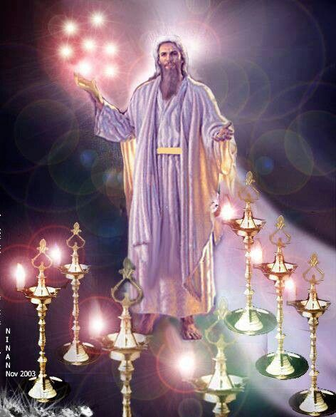

Slide 88
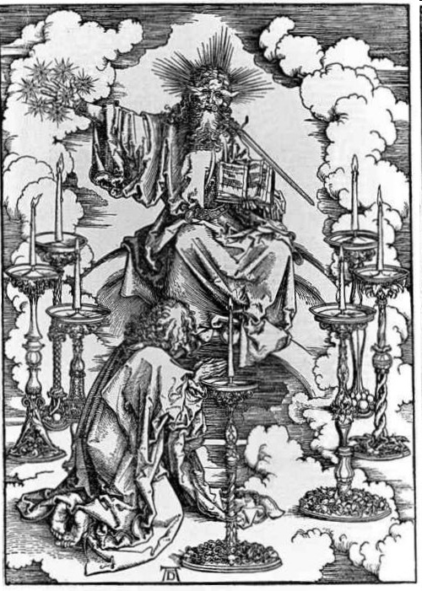
His Body
(Rev. 1:14-16)
His hair (14a)
His eyes (14b)
His feet (15a)
His voice (15b)
His right hand (16a)
His mouth (16b)
His face (16c)

Slide 89
Genesis 49:12
Final Result
      Messiah’s eyes (12a)
      Messiah’s teeth (12b)

Slide 90
III. Genesis 49:3-27
Jacob’s Blessings on His Sons
    Reuben (3-4)
    Simeon & Levi (5-7)
    Judah (8-12)
    Zebulun (13)
    Issachar (14-15)
    Dan (16-18)
    Gad (19)
    Asher (20)
    Naphtali (21)
    Joseph (22-26)
    Benjamin (27)

Slide 91
Genesis 49:13
Zebulun
      Dwell near sea (13a)
      Shelter for ships (13b)
      Border Sidon (13c)

Slide 92
Genesis 49:13
Zebulun
      Dwell near sea (13a)
      Shelter for ships (13b)
      Border Sidon (13c)

Slide 93
Genesis 49:13
Zebulun
      Dwell near sea (13a)
      Shelter for ships (13b)
      Border Sidon (13c)

Slide 94
Genesis 49:13
Zebulun
      Dwell near sea (13a)
      Shelter for ships (13b)
      Border Sidon (13c)

Slide 96
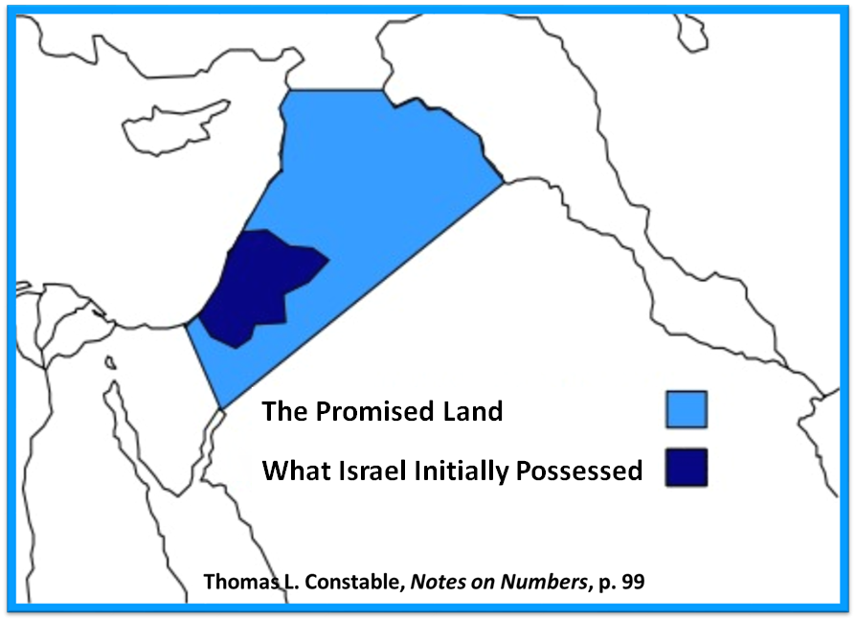

Slide 97
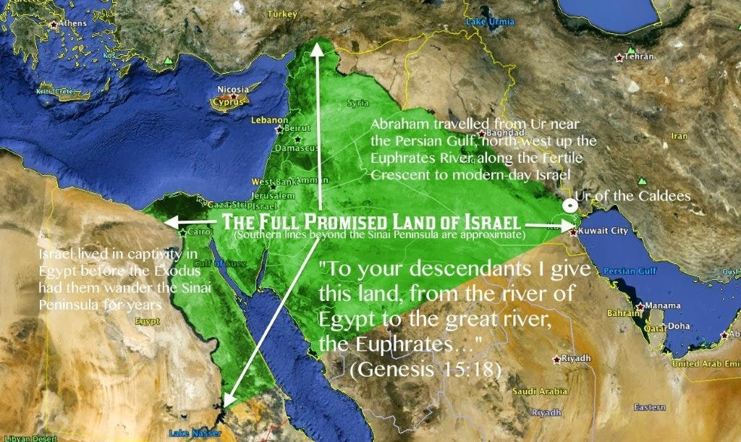

Slide 98
III. Genesis 49:3-27
Jacob’s Blessings on His Sons
    Reuben (3-4)
    Simeon & Levi (5-7)
    Judah (8-12)
    Zebulun (13)
    Issachar (14-15)
    Dan (16-18)
    Gad (19)
    Asher (20)
    Naphtali (21)
    Joseph (22-26)
    Benjamin (27)

Slide 99
Genesis 49:14-15
Issachar
      Nature (14)
      Actions (15)

Slide 100
Genesis 49:14-15
Issachar
      Nature (14)
      Actions (15)

Slide 101
Genesis 49:14
Nature
      Strength (14a)
      Preferred leisure (14b)

Slide 102
Genesis 49:14
Nature
      Strength (14a)
      Preferred leisure (14b)

Slide 103
Genesis 49:14
Nature
      Strength (14a)
      Preferred leisure (14b)

Slide 104
Genesis 49:14-15
Issachar
      Nature (14)
      Actions (15)

Slide 105
Genesis 49:15
Actions
      Saw resting place (15a)
      Saw land was pleasant (15b)
      Bowed shoulder to bear (15c)
      Became servant under task work (15d)

Slide 106
Genesis 49:15
Actions
      Saw resting place (15a)
      Saw land was pleasant (15b)
      Bowed shoulder to bear (15c)
      Became servant under task work (15d)

Slide 107
Genesis 49:15
Actions
      Saw resting place (15a)
      Saw land was pleasant (15b)
      Bowed shoulder to bear (15c)
      Became servant under task work (15d)

Slide 108
Genesis 49:15
Actions
      Saw resting place (15a)
      Saw land was pleasant (15b)
      Bowed shoulder to bear (15c)
      Became servant under task work (15d)

Slide 109
Genesis 49:15
Actions
      Saw resting place (15a)
      Saw land was pleasant (15b)
      Bowed shoulder to bear (15c)
      Became servant under task work (15d)

Slide 110
III. Genesis 49:3-27
Jacob’s Blessings on His Sons
    Reuben (3-4)
    Simeon & Levi (5-7)
    Judah (8-12)
    Zebulun (13)
    Issachar (14-15)
    Dan (16-18)
    Gad (19)
    Asher (20)
    Naphtali (21)
    Joseph (22-26)
    Benjamin (27)

Slide 111
Genesis 49:16-18
Dan
      Judge (16)
      Warrior (17)
      Salvation (18)

Slide 112
Genesis 49:16-18
Dan
      Judge (16)
      Warrior (17)
      Salvation (18)

Slide 113
Genesis 49:16-18
Dan
      Judge (16)
      Warrior (17)
      Salvation (18)

Slide 114
Genesis 49:17
Warrior
      Serpent (17a)
      Adder (17b)
      Bites horses’ heels (17c)

Slide 115
Genesis 49:17
Warrior
      Serpent (17a)
      Adder (17b)
      Bites horses’ heels (17c)

Slide 116
Genesis 49:17
Warrior
      Serpent (17a)
      Adder (17b)
      Bites horses’ heels (17c)

Slide 117
Genesis 49:17
Warrior
      Serpent (17a)
      Adder (17b)
      Bites horses’ heels (17c)

Slide 118
Genesis 49:16-18
Dan
      Judge (16)
      Warrior (17)
      Salvation (18)

Slide 119
III. Genesis 49:3-27
Jacob’s Blessings on His Sons
    Reuben (3-4)
    Simeon & Levi (5-7)
    Judah (8-12)
    Zebulun (13)
    Issachar (14-15)
    Dan (16-18)
    Gad (19)
    Asher (20)
    Naphtali (21)
    Joseph (22-26)
    Benjamin (27)

Slide 120
Genesis 49:19
Gad
      Will be pressed upon (19a)
      Will overcome (19b)

Slide 121
Genesis 49:19
Gad
      Will be pressed upon (19a)
      Will overcome (19b)

Slide 122
Genesis 49:19
Gad
      Will be pressed upon (19a)
      Will overcome (19b)

Slide 123
III. Genesis 49:3-27
Jacob’s Blessings on His Sons
    Reuben (3-4)
    Simeon & Levi (5-7)
    Judah (8-12)
    Zebulun (13)
    Issachar (14-15)
    Dan (16-18)
    Gad (19)
    Asher (20)
    Naphtali (21)
    Joseph (22-26)
    Benjamin (27)

Slide 124
Genesis 49:20
Asher
      Wealth (20a)
      Produce delicacies (20b)

Slide 125
Genesis 49:20
Asher
      Wealth (20a)
      Produce delicacies (20b)

Slide 126
Genesis 49:20
Asher
      Wealth (20a)
      Produce delicacies (20b)

Slide 127
III. Genesis 49:3-27
Jacob’s Blessings on His Sons
    Reuben (3-4)
    Simeon & Levi (5-7)
    Judah (8-12)
    Zebulun (13)
    Issachar (14-15)
    Dan (16-18)
    Gad (19)
    Asher (20)
    Naphtali (21)
    Joseph (22-26)
    Benjamin (27)

Slide 128
Genesis 49:21
Naphtali
      Unrestrained movement (21a)
      Speech sophistication (21b)

Slide 129
Genesis 49:21
Naphtali
      Unrestrained movement (21a)
      Speech sophistication (21b)

Slide 130
Genesis 49:21
Naphtali
      Unrestrained movement (21a)
      Speech sophistication (21b)

Slide 131
III. Genesis 49:3-27
Jacob’s Blessings on His Sons
    Reuben (3-4)
    Simeon & Levi (5-7)
    Judah (8-12)
    Zebulun (13)
    Issachar (14-15)
    Dan (16-18)
    Gad (19)
    Asher (20)
    Naphtali (21)
    Joseph (22-26)
    Benjamin (27)

Slide 132
Genesis 49:22-26
Joseph
      Progeny (22)
      Persecution (23)
      Survival (24)
      Future blessings (25)
      Joseph to receive blessings (26)

Slide 133
Genesis 49:22-26
Joseph
      Progeny (22)
      Persecution (23)
      Survival (24)
      Future blessings (25)
      Joseph to receive blessings (26)

Slide 134
Genesis 49:22
Progeny
      Fruitful (22a)
      Water supply (22b)
      Spread out (22c)

Slide 135
Genesis 49:22
Progeny
      Fruitful (22a)
      Water supply (22b)
      Spread out (22c)

Slide 136
Genesis 49:22
Progeny
      Fruitful (22a)
      Water supply (22b)
      Spread out (22c)

Slide 137
Genesis 49:22
Progeny
      Fruitful (22a)
      Water supply (22b)
      Spread out (22c)

Slide 138
Genesis 49:22-26
Joseph
      Progeny (22)
      Persecution (23)
      Survival (24)
      Future blessings (25)
      Joseph to receive blessings (26)

Slide 139
Genesis 49:23
Persecution
      Grieved (23a)
      Shot (23b)
      Persecuted (23c)

Slide 140
Genesis 49:23
Persecution
      Grieved (23a)
      Shot (23b)
      Persecuted (23c)

Slide 141
Genesis 49:23
Persecution
      Grieved (23a)
      Shot (23b)
      Persecuted (23c)

Slide 142
Genesis 49:23
Persecution
      Grieved (23a)
      Shot (23b)
      Persecuted (23c)

Slide 143
Genesis 49:22-26
Joseph
      Progeny (22)
      Persecution (23)
      Survival (24)
      Future blessings (25)
      Joseph to receive blessings (26)

Slide 144
Genesis 49:24
Survival
      Strength (24a)
      Tested growth (24b)
      Prevailed through God (24c)
      God to bring Messiah (24d)

Slide 145
Genesis 49:24
Survival
      Strength (24a)
      Tested growth (24b)
      Prevailed through God (24c)
      God to bring Messiah (24d)

Slide 146
Genesis 49:24
Survival
      Strength (24a)
      Tested growth (24b)
      Prevailed through God (24c)
      God to bring Messiah (24d)

Slide 147
Genesis 49:24
Survival
      Strength (24a)
      Tested growth (24b)
      Prevailed through God (24c)
      God to bring Messiah (24d)

Slide 148
Genesis 49:24
Survival
      Strength (24a)
      Tested growth (24b)
      Prevailed through God (24c)
      God to bring Messiah (24d)

Slide 149
Genesis 49:22-26
Joseph
      Progeny (22)
      Persecution (23)
      Survival (24)
      Future blessings (25)
      Joseph to receive blessings (26)

Slide 150
Genesis 49:25
Future Blessings
      God as source (25a-b)
      Other sources (25c-e)

Slide 151
Genesis 49:25
Future Blessings
      God as source (25a-b)
      Other sources (25c-e)

Slide 152
Genesis 49:25a-b
God as Source
      Your Father (25a)
      Almighty (25b)

Slide 153
Genesis 49:25a-b
God as Source
      Your Father (25a)
      Almighty (25b)

Slide 154
Genesis 49:25a-b
God as Source
      Your Father (25a)
      Almighty (25b)

Slide 155
Genesis 49:25
Future Blessings
      God as source (25a-b)
      Other sources (25c-e)

Slide 156
Genesis 49:25c-e
Other Sources
      Dews (25c)
      Springs & fountains (25d)
      Breasts & womb (25e)

Slide 157
Genesis 49:25c-e
Other Sources
      Dews (25c)
      Springs & fountains (25d)
      Breasts & womb (25e)

Slide 158
Genesis 49:25c-e
Other Sources
      Dews (25c)
      Springs & fountains (25d)
      Breasts & womb (25e)

Slide 159
Genesis 49:25c-e
Other Sources
      Dews (25c)
      Springs & fountains (25d)
      Breasts & womb (25e)

Slide 160
Genesis 49:22-26
Joseph
      Progeny (22)
      Persecution (23)
      Survival (24)
      Future blessings (25)
      Joseph to receive blessings (26)

Slide 161
III. Genesis 49:3-27
Jacob’s Blessings on His Sons
    Reuben (3-4)
    Simeon & Levi (5-7)
    Judah (8-12)
    Zebulun (13)
    Issachar (14-15)
    Dan (16-18)
    Gad (19)
    Asher (20)
    Naphtali (21)
    Joseph (22-26)
    Benjamin (27)

Slide 162
Genesis 49:27
Benjamin
      Ravenous wolf (27a)
      Devours prey (27b)
      Share spoil due to success (27c)

Slide 163
Genesis 49:27
Benjamin
      Ravenous wolf (27a)
      Devours prey (27b)
      Share spoil due to success (27c)

Slide 164
Genesis 49:27
Benjamin
      Ravenous wolf (27a)
      Devours prey (27b)
      Share spoil due to success (27c)

Slide 165
Genesis 49:27
Benjamin
      Ravenous wolf (27a)
      Devours prey (27b)
      Share spoil due to success (27c)

Slide 166
Genesis 49:1-33
Jacob Blesses His Sons
  Call (49:1)
  Introduction (49:2)
  Jacob’s blessings on his sons (49:3-27)
  Concluding summary (49:28)
  Jacob’s death (49:29-33)

Slide 167
IV. Genesis 49:28
Concluding Summary
    Prophecies beyond sons (28a)
    Summary of Jacob’s blessings (28b)

Slide 168
IV. Genesis 49:28
Concluding Summary
    Prophecies beyond sons (28a)
    Summary of Jacob’s blessings (28b)

Slide 169
IV. Genesis 49:28
Concluding Summary
    Prophecies beyond sons (28a)
    Summary of Jacob’s blessings (28b)

Slide 170
Genesis 49:1-33
Jacob Blesses His Sons
  Call (49:1)
  Introduction (49:2)
  Jacob’s blessings on his sons (49:3-27)
  Concluding summary (49:28)
  Jacob’s death (49:29-33)

Slide 171
V. Genesis 49:29-33
Jacob’s Death
    Charge (29a)
    Announcement of death (29b)
    Request (29c)
    Place of burial (29d-30)
    Others buried there (31)
    Burial place repeated (32)
    Jacob’s death (33)

Slide 172
V. Genesis 49:29-33
Jacob’s Death
    Charge (29a)
    Announcement of death (29b)
    Request (29c)
    Place of burial (29d-30)
    Others buried there (31)
    Burial place repeated (32)
    Jacob’s death (33)

Slide 173
V. Genesis 49:29-33
Jacob’s Death
    Charge (29a)
    Announcement of death (29b)
    Request (29c)
    Place of burial (29d-30)
    Others buried there (31)
    Burial place repeated (32)
    Jacob’s death (33)

Slide 174
V. Genesis 49:29-33
Jacob’s Death
    Charge (29a)
    Announcement of death (29b)
    Request (29c)
    Place of burial (29d-30)
    Others buried there (31)
    Burial place repeated (32)
    Jacob’s death (33)

Slide 175
V. Genesis 49:29-33
Jacob’s Death
    Charge (29a)
    Announcement of death (29b)
    Request (29c)
    Place of burial (29d-30)
    Others buried there (31)
    Burial place repeated (32)
    Jacob’s death (33)

Slide 176
V. Genesis 49:29-33
Jacob’s Death
    Charge (29a)
    Announcement of death (29b)
    Request (29c)
    Place of burial (29d-30)
    Others buried there (31)
    Burial place repeated (32)
    Jacob’s death (33)

Slide 177
V. Genesis 49:29-33
Jacob’s Death
    Charge (29a)
    Announcement of death (29b)
    Request (29c)
    Place of burial (29d-30)
    Others buried there (31)
    Burial place repeated (32)
    Jacob’s death (33)

Slide 178
V. Genesis 49:29-33
Jacob’s Death
    Charge (29a)
    Announcement of death (29b)
    Request (29c)
    Place of burial (29d-30)
    Others buried there (31)
    Burial place repeated (32)
    Jacob’s death (33)

Slide 179

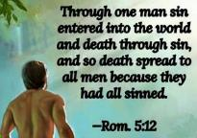
Genesis 2:16-17
“¹⁶ The Lord God commanded the man, saying, ‘From any tree of the garden you may eat freely; ¹⁷ but from the tree of the knowledge of good and evil you shall not eat, for in the day that you eat from it you will surely die (muwth).’”

Slide 180
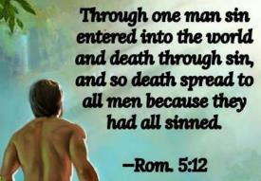
Genesis 3:19
“By the sweat of your face You will eat bread, Till you return to the ground, Because from it you were taken; For you are dust, And to dust you shall return.”

Slide 181
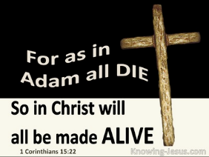
1 Corinthians 15:21-22
“²¹ For since by a man came death, by a man also came the resurrection of the dead. ²² For as in Adam all die, so also in Christ all will be made alive.”

Slide 182
Romans 5:12
“Therefore, just as through one man sin entered into the world, and death through sin, and so death spread to all men, because all sinned—.”

Slide 183

Romans 6:23
“For the wages of sin is death, but the free gift of God is eternal life in Christ Jesus our Lord.”

Slide 184
Hebrews 9:27
“And inasmuch as it is appointed for men to die once and after this comes judgment.”

Slide 185
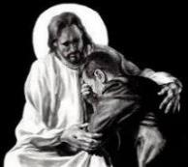
Revelation 21:4
“and He will wipe away every tear from their eyes; and there will no longer be any death; there will no longer be any mourning, or crying, or pain; the first things have passed away.”

Slide 187
Conclusion

Slide 188
Genesis 49:1-33
Jacob Blesses His Sons
  Call (49:1)
  Introduction (49:2)
  Jacob’s blessings on his sons (49:3-27)
  Concluding summary (49:28)
  Jacob’s death (49:29-33)

Slide 189
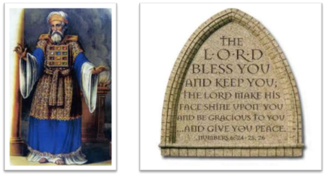
²⁴ The Lord bless you, and keep you; ²⁵ The Lord make His face shine on you, And be gracious to you; ²⁶ The Lord lift up His countenance on you, And give you peace.
Numbers 6:24–26 (NASB95)

