Slide 1
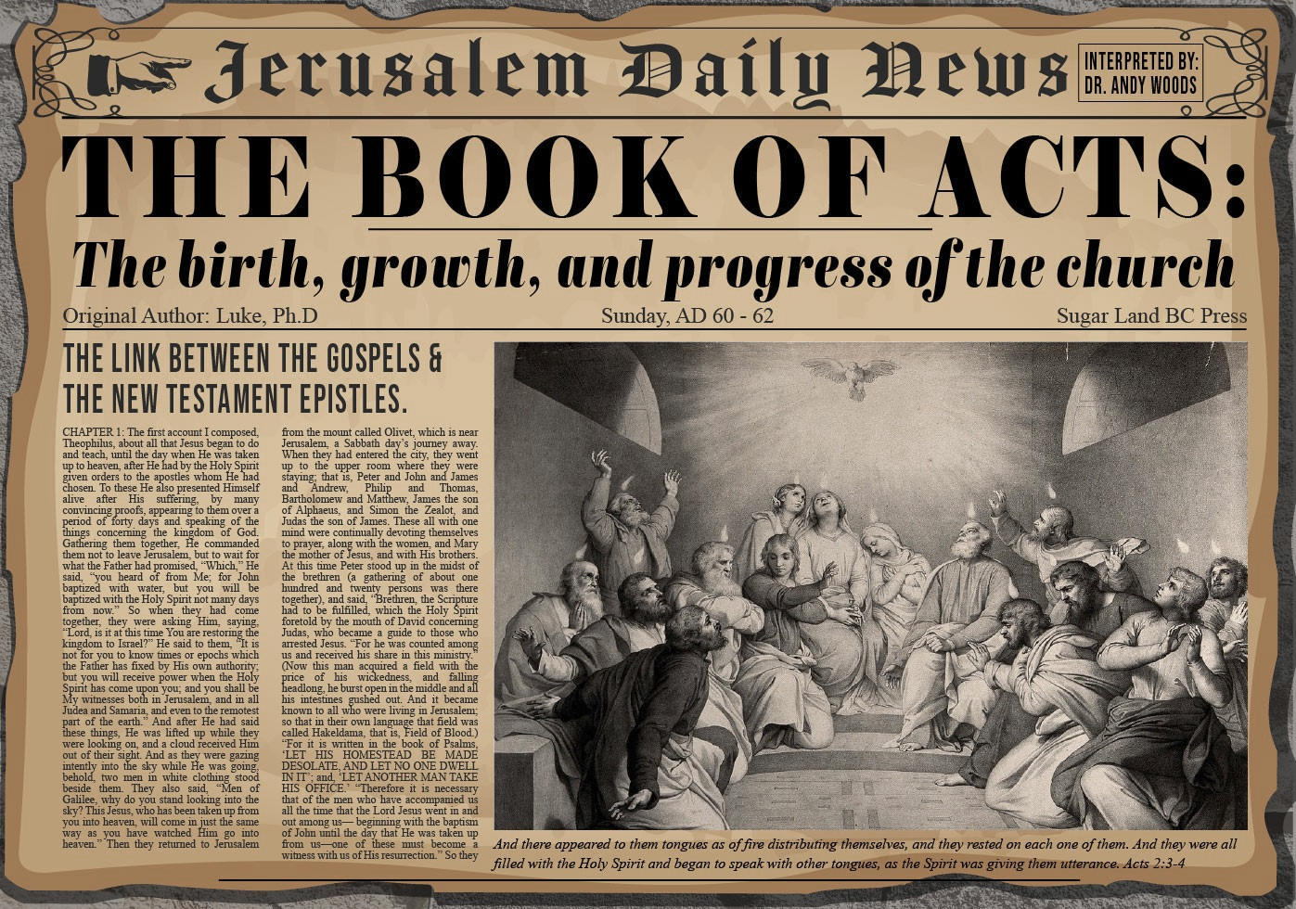


Slide 2
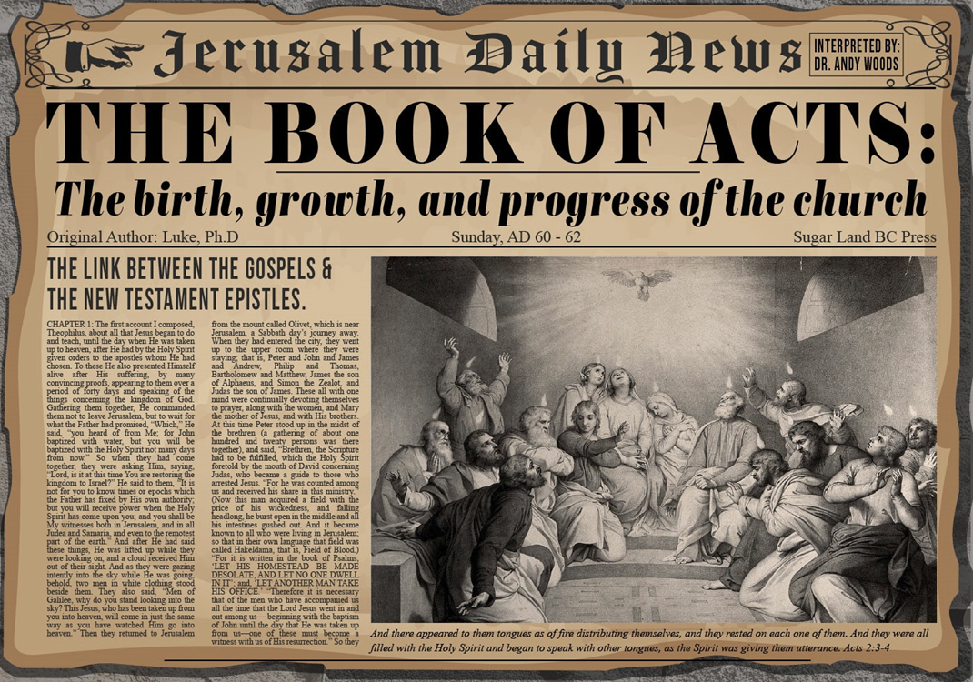
Acts 10:1‒11:18
Cornelius’ Salvation
  Cornelius’ Vision (10:1-8)
  Peter’s Vision (Acts 10:9-16)
  Vision’s Application (10:17-23a)
  Caesarean Ministry (10:23b-33)
  Peter & The Keys of the Kingdom (10:34-43)
  Gentiles’ Salvation (10:44-48)
  Peter’s Defense in Jerusalem (11:1-18)

Slide 3
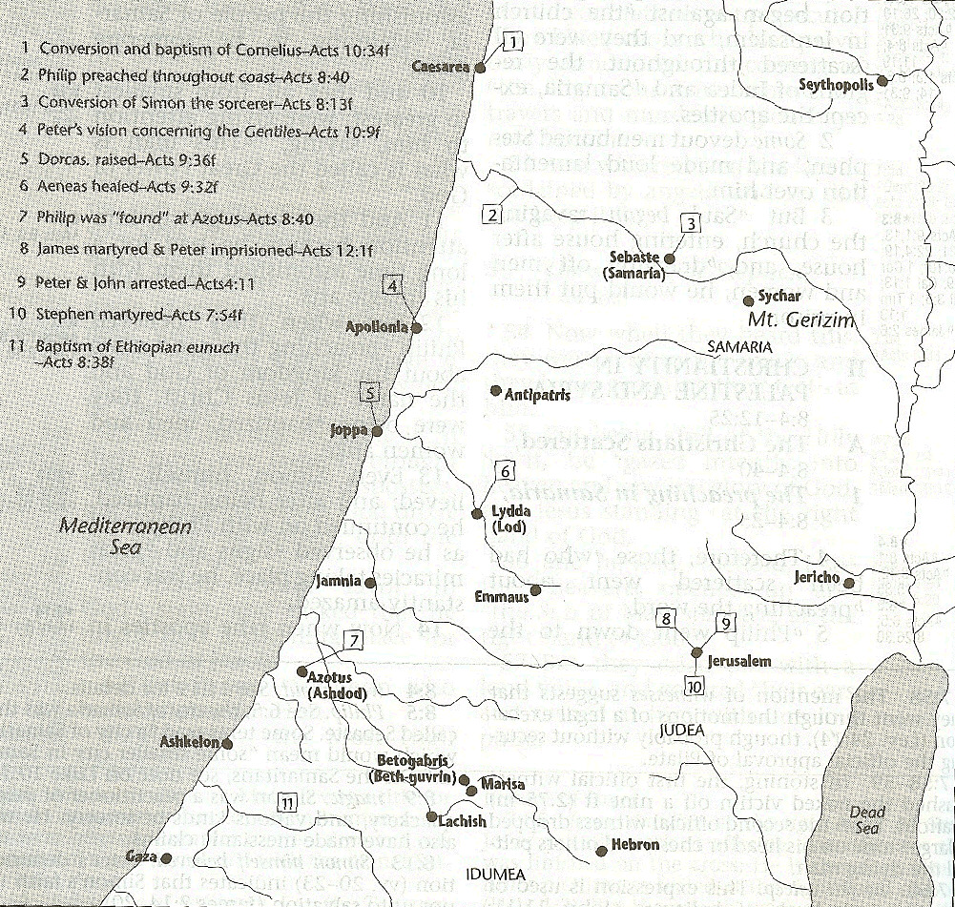



Slide 4
VII. Peter’s Defense in Jerusalem
Acts 11:1-18
  Charge against Peter (1-3)
  Peter’s defense (4-17)
  The verdict (18)

Slide 5
VII. Peter’s Defense in Jerusalem
Acts 11:1-18
  Charge against Peter (1-3)
  Peter’s defense (4-17)
  The verdict (18)

Slide 6
Acts 11:1-3
Charge Against Peter
      Groups that heard about Gentile salvation (1)
      Occasion for the charge (2)
      Accusation (3)

Slide 7
Acts 11:1-3
Charge Against Peter
      Groups that heard about Gentile salvation (1)
      Occasion for the charge (2)
      Accusation (3)

Slide 8
Acts 11:1
Groups That Heard About Gentile Salvation
      Apostles (1a)
      Brethren (1b)

Slide 9
Acts 11:1
Groups That Heard About Gentile Salvation
      Apostles (1a)
      Brethren (1b)

Slide 10
Acts 11:1
Groups That Heard About Gentile Salvation
      Apostles (1a)
      Brethren (1b)

Slide 11
Acts 11:1-3
Charge Against Peter
      Groups that heard about Gentile salvation (1)
      Occasion for the charge (2)
      Accusation (3)

Slide 12
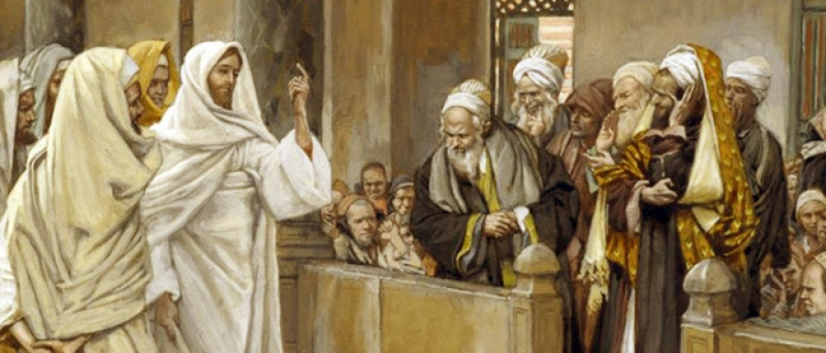
TYPES OF PHARISEES
TYPE | OVERTHROWN
Justification | Matthew 5:20
Sanctification | Galatians 3:3
Ecclesiology | Acts 15

Slide 13
Acts 11:1-3
Charge Against Peter
      Groups that heard about Gentile salvation (1)
      Occasion for the charge (2)
      Accusation (3)

Slide 14
VII. Peter’s Defense in Jerusalem
Acts 11:1-18
  Charge against Peter (1-3)
  Peter’s defense (4-17)
  The verdict (18)

Slide 15
Acts 11:4-17
Peter’s Defense
      Peter’s exposition (4)
      Vision (5-6)
      Command (7-10)
      Gentiles arrive (11-12a)
      Journey to Caesarea (12b)
      Entrance into the house (12c)
      Cornelius’s salvation (13-14)
      Evidence (15-16)
      Peter’s conclusion (17)

Slide 16
Acts 11:4-17
Peter’s Defense
      Peter’s exposition (4)
      Vision (5-6)
      Command (7-10)
      Gentiles arrive (11-12a)
      Journey to Caesarea (12b)
      Entrance into the house (12c)
      Cornelius’s salvation (13-14)
      Evidence (15-16)
      Peter’s conclusion (17)

Slide 17
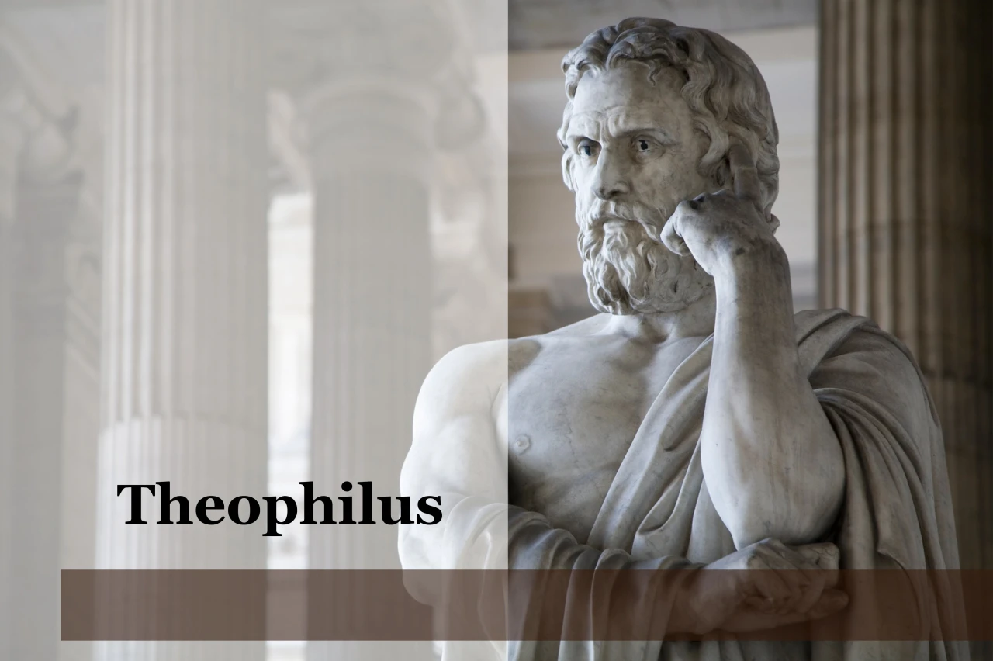
Purpose
  To present Theophilus with an orderly account of the birth and growth of the church so as to affirm him in what he has believed.

Slide 18
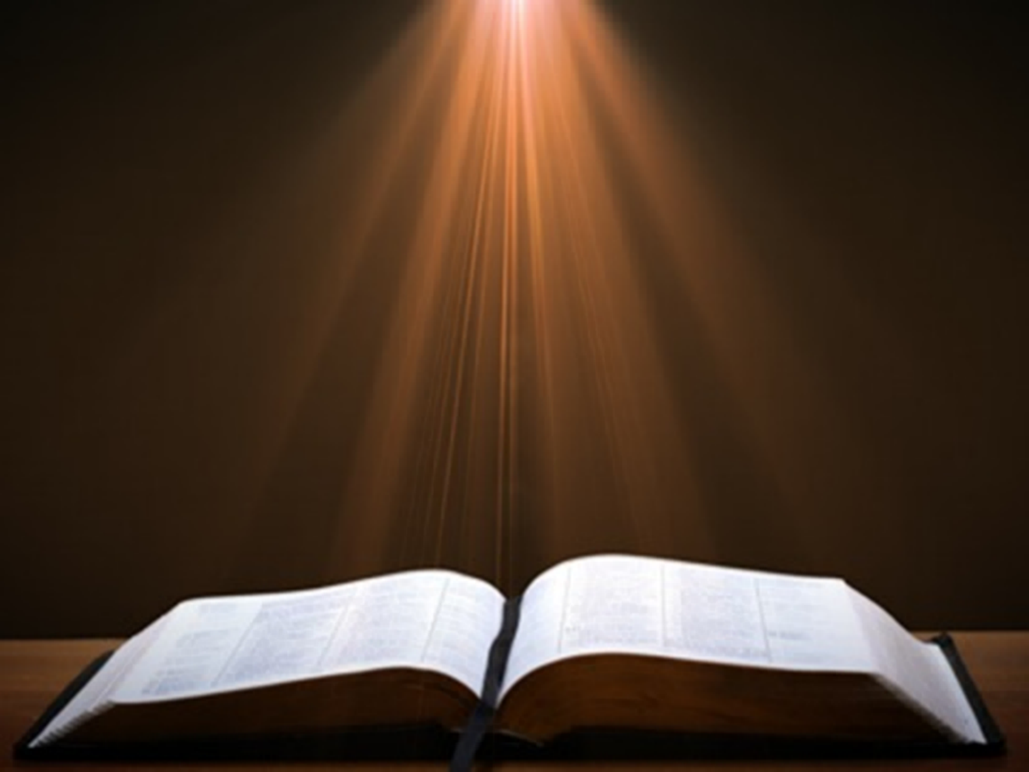
Luke 1:1–4
¹ Inasmuch as many have undertaken to compile an account of the things accomplished among us, ² just as they were handed down to us by those who from the beginning were eyewitnesses and servants of the word, ³ it seemed fitting for me as well, having investigated everything carefully from the beginning, to write it out for you in consecutive order, most excellent Theophilus; ⁴ so that you may know the exact truth about the things you have been taught.

Slide 19

Acts 1:1–2
¹ The first account I composed, Theophilus, about all that Jesus began to do and teach, ² until the day when He was taken up to heaven, after He had by the Holy Spirit given orders to the apostles whom He had chosen.

Slide 20
Acts 11:4-17
Peter’s Defense
      Peter’s exposition (4)
      Vision (5-6)
      Command (7-10)
      Gentiles arrive (11-12a)
      Journey to Caesarea (12b)
      Entrance into the house (12c)
      Cornelius’s salvation (13-14)
      Evidence (15-16)
      Peter’s conclusion (17)

Slide 21
Acts 11:5-6
Vision
      Down to Peter (5a)
      Upon Peter (5b)
      Content (6)

Slide 22
Acts 11:5-6
Vision
      Down to Peter (5a)
      Upon Peter (5b)
      Content (6)

Slide 23
Acts 11:5-6
Vision
      Down to Peter (5a)
      Upon Peter (5b)
      Content (6)

Slide 24
Acts 11:5-6
Vision
      Down to Peter (5a)
      Upon Peter (5b)
      Content (6)

Slide 25
Acts 11:4-17
Peter’s Defense
      Peter’s exposition (4)
      Vision (5-6)
      Command (7-10)
      Gentiles arrive (11-12a)
      Journey to Caesarea (12b)
      Entrance into the house (12c)
      Cornelius’s salvation (13-14)
      Evidence (15-16)
      Peter’s conclusion (17)

Slide 26
Acts 11:7-10
Command
      3-fold command (7)
      Peter’s response (8)
      Second command (9)
      3-fold repetition (10a)
      Drawn back to heaven (10b)

Slide 27
Acts 11:7-10
Command
      3-fold command (7)
      Peter’s response (8)
      Second command (9)
      3-fold repetition (10a)
      Drawn back to heaven (10b)

Slide 28
Acts 11:7-10
Command
      3-fold command (7)
      Peter’s response (8)
      Second command (9)
      3-fold repetition (10a)
      Drawn back to heaven (10b)

Slide 29
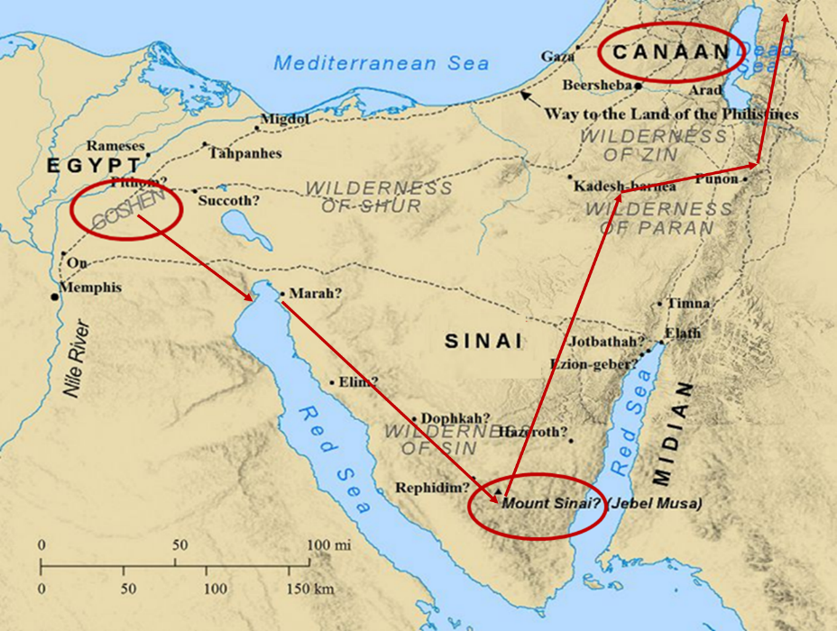

Slide 30

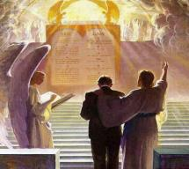
1 Corinthians 3:10-15
“¹⁴ If any man’s work which he has built on it remains, he will receive a reward. ¹⁵ If any man’s work is burned up, he will suffer loss; but he himself will be saved, yet so as through fire.”

Slide 31
Three Tenses of Salvation
Phase | Justification | Sanctification | Glorification
Tense | Past | Present | Future
Saved from sin’s: | Penalty | Power | Presence
Scripture | Eph 2:8-9; Titus 3:5 | Philip 2:12 | Rom 5:10

Slide 32
Acts 11:7-10
Command
      3-fold command (7)
      Peter’s response (8)
      Second command (9)
      3-fold repetition (10a)
      Drawn back to heaven (10b)

Slide 33
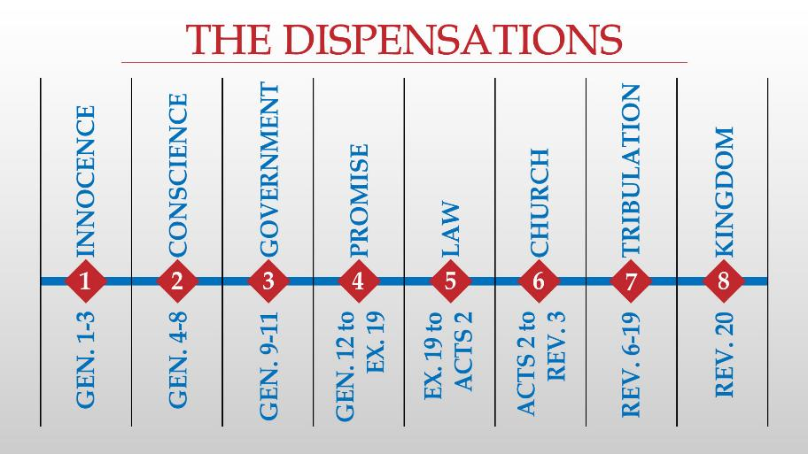

Slide 34
Acts 11:7-10
Command
      3-fold command (7)
      Peter’s response (8)
      Second command (9)
      3-fold repetition (10a)
      Drawn back to heaven (10b)

Slide 35
Acts 11:7-10
Command
      3-fold command (7)
      Peter’s response (8)
      Second command (9)
      3-fold repetition (10a)
      Drawn back to heaven (10b)

Slide 36
Acts 11:4-17
Peter’s Defense
      Peter’s exposition (4)
      Vision (5-6)
      Command (7-10)
      Gentiles arrive (11-12a)
      Journey to Caesarea (12b)
      Entrance into the house (12c)
      Cornelius’s salvation (13-14)
      Evidence (15-16)
      Peter’s conclusion (17)

Slide 37
Acts 11:11-12a
Gentiles Arrive
      Men who came to Caesarea (11)
      God’s command to Peter to join them (12a)

Slide 38
Acts 11:11-12a
Gentiles Arrive
      Men who came to Caesarea (11)
      God’s command to Peter to join them (12a)

Slide 39
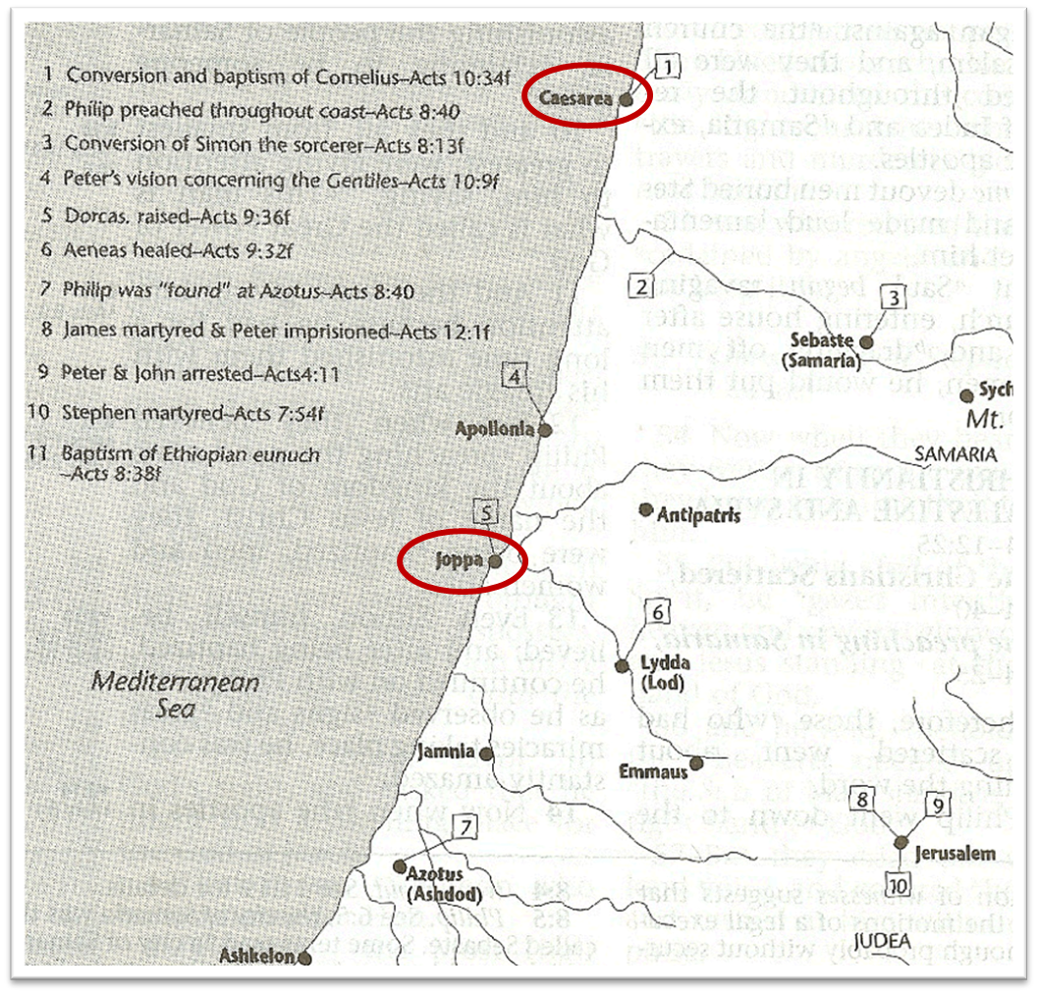

Slide 40
Acts 11:11-12a
Gentiles Arrive
      Men who came to Caesarea (11)
      God’s command to Peter to join them (12a)

Slide 41
Acts 11:4-17
Peter’s Defense
      Peter’s exposition (4)
      Vision (5-6)
      Command (7-10)
      Gentiles arrive (11-12a)
      Journey to Caesarea (12b)
      Entrance into the house (12c)
      Cornelius’s salvation (13-14)
      Evidence (15-16)
      Peter’s conclusion (17)

Slide 42
Acts 11:4-17
Peter’s Defense
      Peter’s exposition (4)
      Vision (5-6)
      Command (7-10)
      Gentiles arrive (11-12a)
      Journey to Caesarea (12b)
      Entrance into the house (12c)
      Cornelius’s salvation (13-14)
      Evidence (15-16)
      Peter’s conclusion (17)

Slide 43
Acts 11:4-17
Peter’s Defense
      Peter’s exposition (4)
      Vision (5-6)
      Command (7-10)
      Gentiles arrive (11-12a)
      Journey to Caesarea (12b)
      Entrance into the house (12c)
      Cornelius’s salvation (13-14)
      Evidence (15-16)
      Peter’s conclusion (17)

Slide 44
Acts 11:13-14
Cornelius’ Salvation
      Sent for Peter (13)
      Purpose (14)

Slide 45
Acts 11:13-14
Cornelius’ Salvation
      Sent for Peter (13)
      Purpose (14)

Slide 46
Acts 11:13-14
Cornelius’ Salvation
      Sent for Peter (13)
      Purpose (14)

Slide 47

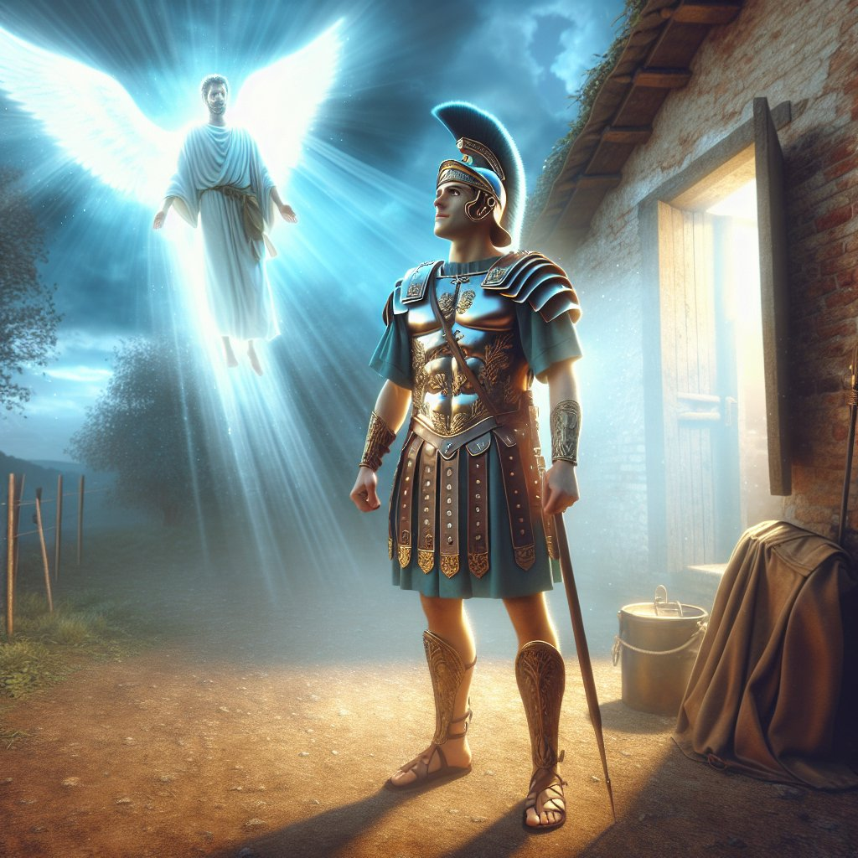
Acts 11:14
“and he will speak words to you by which you [Cornelius] will be saved, you and all your household.”

Slide 48
Acts 10:2
“Now there was a man at Caesarea named Cornelius, a centurion of what was called the Italian cohort, ² a devout man and one who feared God with all his household, and gave many alms to the Jewish people and prayed to God continually.”

Slide 49
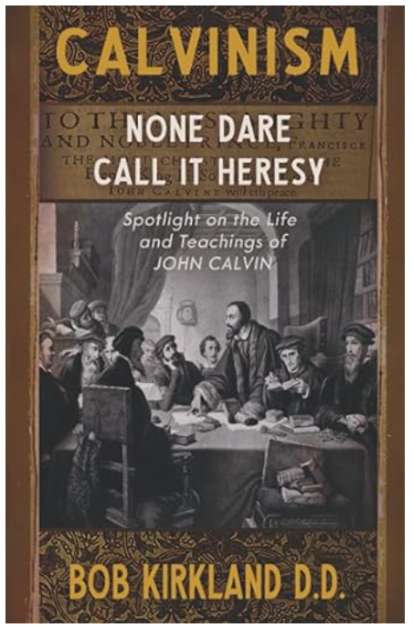
Total Depravity = Inability
“T” stands for “Total Depravity.” Man is completely and wholly depraved and has no ability whatsoever to respond (repent or believe) to God until he is first “regenerated” by God.
Bob Kirkland, Calvinism: None Dare Call It Heresy; Spotlight on the Life
and Teachings of John Calvin (Eureka, MT: Lighthouse Trails, 2018), 34.

Slide 50

John MacArthur
Faith Works, p. 64-65
“Because we were dead to God, we were dead to truth, righteousness, peace, happiness, and every other good thing, no more capable to respond to God than a cadaver” and are “spiritual zombies, death-walkers, unable even to understand the gravity of their situation. They are lifeless.”
John F. MacArthur Jr., Faith Works: The Gospel According to the Apostles (Dallas: Word, 1993), 64-65.

Slide 51

“…one of the mistakes that human beings make is believing that there is only one way…We don’t accept that there are diverse ways of being in the world; that there are millions of ways to be a human being. And many ways…many paths to what you call God. That her path might be something else and when she gets there she might call it the light. But her loving, and her kindness, and her generosity brings her to the…same point that it brings you…
www.youtube.com/watch?v=Lb2RUpMDk34

Slide 52
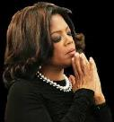
…It doesn’t matter whether she called it ‘God’ along the way or not…There couldn’t possibly be just one way!…There couldn’t possibly be only one way with millions of people in the world!...You think…if you are somewhere on the planet and you never hear the name of Jesus but yet you live with a loving heart. You lived as Jesus would have had you to live. You lived for the same purpose as Jesus came to the planet to teach us all, but you are in some remote part of the earth and you never heard the name of Jesus. You cannot get to Heaven…?”
www.youtube.com/watch?v=Lb2RUpMDk34

Slide 53
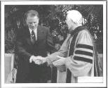
https://www.youtube.com/watch?v=hrf60-zHl9A
Dr. Schuller: "Tell me, what is the future of Christianity?"
Dr. Graham: "Well, Christianity and being a true believer, you know, I think there's the body of Christ which comes from all the Christian groups around the world, or outside the Christian groups. I think that everybody that loves Christ or knows Christ, whether they're conscious of it or not, they're members of the body of Christ. And I don't think that we're going to see a great sweeping revival that will turn the whole world to Christ at any time…and that’s what God is doing today. He is calling people out of the world for His name. Whether they come from the Muslim world, or the Buddhist world, or the Christian world, or the non-believing world, they are members of the body of Christ because they've been called . . .

Slide 54
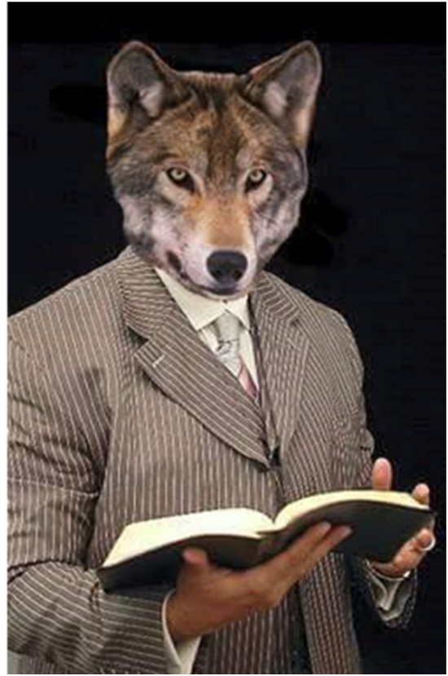
https://www.youtube.com/watch?v=hrf60-zHl9A
…by God. They may not even know the name of Jesus, but they know in their hearts they need something that they don't have and they turn to the only light that they have and I think they're saved and they're going to be with us in heaven.”
Dr. Schuller: "This is fantastic. I'm so thrilled to hear you say that. There's a wideness in God's mercy.”
Dr. Graham: “There is."

Slide 55
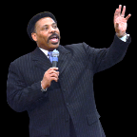
Tony Evans
Totally Saved: Understanding, Experiencing and Enjoying the
Greatness of Your Salvation (Chicago: Moody, 2002), 355, 359.
“In a class I once taught at Dallas Seminary, I inadvertently asked an exam question on material I had not covered in class. One of the students brought this discrepancy to my attention. To be fair, I had to rescore all of the test papers because I could not hold the students liable for information they had never been given…So the premise is that God will not hold people accountable for a decision they cannot make, based on information they have not received…And people in faraway lands who have never heard the gospel still have their own sins to answer for. This means we need to talk about the provision God has made for those who cannot believe….Here's the spiritual principle at work: When people respond to what they do know of God, He takes personal responsibility for giving them more information about Himself.... In the case of a person…

Slide 56
Tony Evans
Totally Saved: Understanding, Experiencing and Enjoying the
Greatness of Your Salvation (Chicago: Moody, 2002), 355, 359.
…who never hears the gospel and never knows the name of Jesus, but who responds to the light he has, God, treats that person like an Old Testament saint, if you will. That is, if the person trusts in what God has revealed, God deals with that person based on the knowledge he has, not the information he never received. I call this trans-dispensationalism...By this I mean if a person is sincerely seeking God and desiring to know Him, and is responding to the truth he knows, if there is no missionary or direct manifestation of God, then God judges that person based on his faith in the light he has received. And as in the case of Abraham, God will retroactively count this person as righteous by applying the death of Christ from the dispensation of grace.”

Slide 57
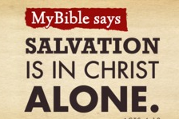
Acts 4:12
“And there is salvation in no one else; for there is no other name under heaven that has been given among men by which we must [dei] be saved.”

Slide 58
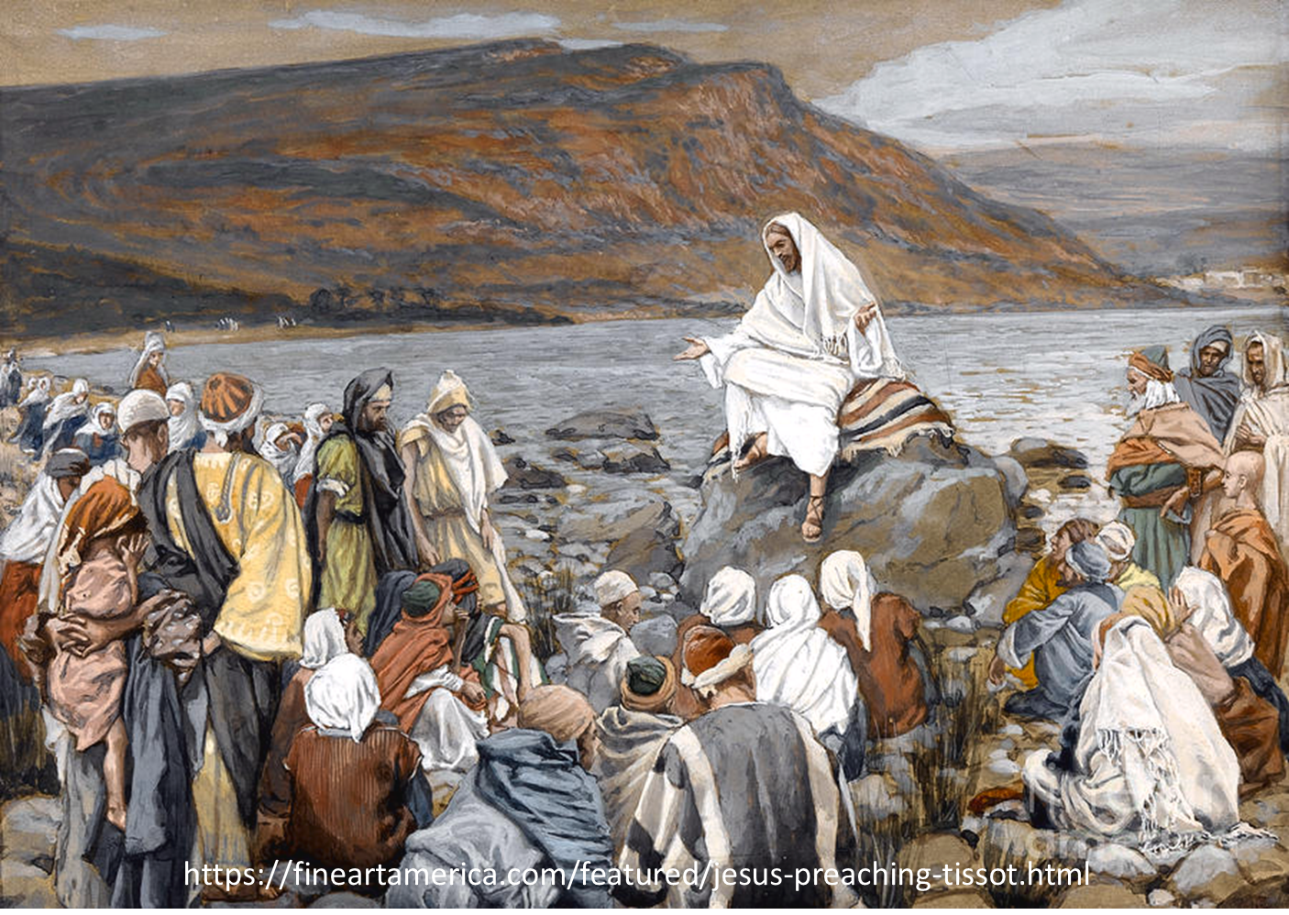
Luke 4:43
“But He said to them, “I must [dei] preach the kingdom of God to the other cities also, for I was sent for this purpose.”

Slide 59
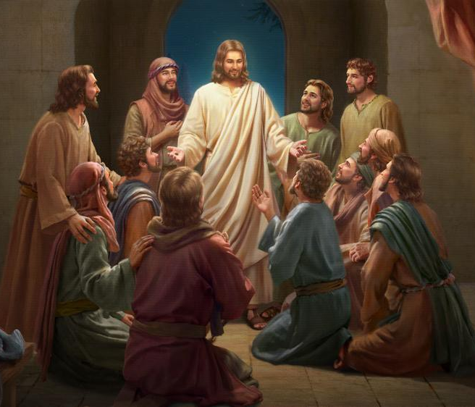
Luke 24:44
“Now He said to them, “These are My words which I spoke to you while I was still with you, that all things which are written about Me in the Law of Moses and the Prophets and the Psalms must [dei] be fulfilled.”

Slide 60
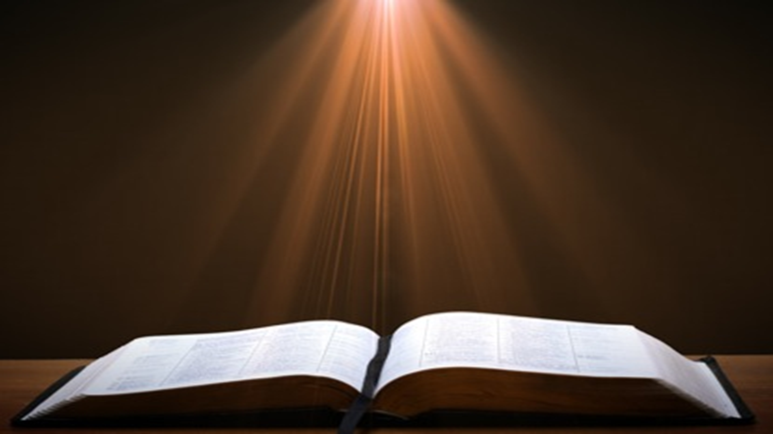
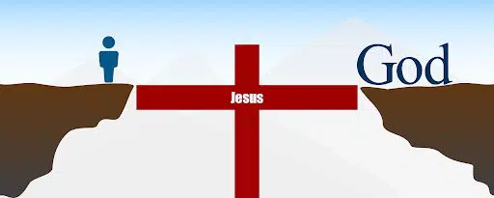
John 14:6
“Jesus said to him, ‘I am the way, and the truth, and the life; no one comes to the Father but through Me.’”

Slide 61
1 Timothy 2:5
“For there is one God, and one mediator also between God and men, the man Christ Jesus.”

Slide 62
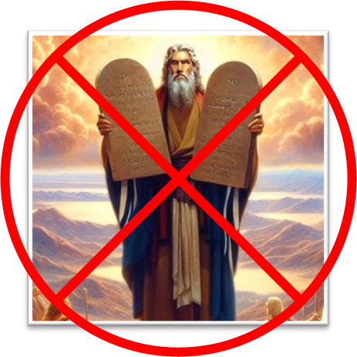
Galatians 2:21
“I do not nullify the grace of God, for if righteousness comes through the Law, then Christ died needlessly.”

Slide 63
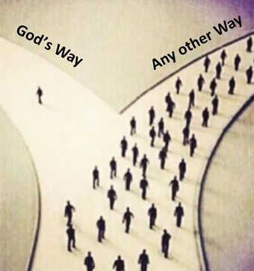
Mathew 7:13-14
“Enter through the narrow gate; for the gate is wide and the way is broad that leads to destruction, and there are many who enter through it. ¹⁴ For the gate is small and the way is narrow that leads to life, and there are few who find it.”

Slide 64

General vs. Special Revelation
 | General | Special
Examples | Nature, conscience (Rom 1–2) | Incarnation, Scripture, miracles
Availability | All | Some
Accomplishment | Accountability (Rom 1) | Salvation (Acts 4:12; 2 Tim 3:15)
Form | Non-written or non-verbal | Written
Quality | Natural | Supernatural, miraculous

Slide 65

Romans 1:18–20
¹⁸ For the wrath of God is revealed from heaven against all ungodliness and unrighteousness of men who suppress the truth in unrighteousness, ¹⁹ because that which is known about God is evident within them; for God made it evident to them. ²⁰ For since the creation of the world His invisible attributes, His eternal power and divine nature, have been clearly seen, being understood through what has been made, so that they are without excuse.

Slide 66
Acts 11:4-17
Peter’s Defense
      Peter’s exposition (4)
      Vision (5-6)
      Command (7-10)
      Gentiles arrive (11-12a)
      Journey to Caesarea (12b)
      Entrance into the house (12c)
      Cornelius’s salvation (13-14)
      Evidence (15-16)
      Peter’s conclusion (17)

Slide 67
Acts 11:15-16
Evidence
      Spirit’s baptism (15)
      Acts 1:5 fulfilled (16)

Slide 68
Acts 11:15-16
Evidence
      Spirit’s baptism (15)
      Acts 1:5 fulfilled (16)

Slide 69


Acts 11:15-16
¹⁵ And as I began to speak, the Holy Spirit fell upon them just as He did upon us at the beginning. ¹⁶ And I remembered the word of the Lord, how He used to say, ‘John baptized with water, but you will be baptized with the Holy Spirit.’

Slide 70

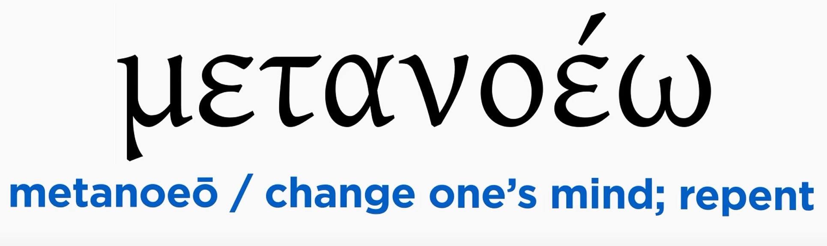
Acts 2:38
“Peter said to them, “Repent [metanoeō], and each of you be baptized in the name of Jesus Christ for (eis) the forgiveness of your sins; and you will receive the gift of the Holy Spirit.”

Slide 71
Matthew 12:41
“The men of Nineveh will stand up with this generation at the judgment and will condemn it because they repented at [in the face of/because of] (eis) the preaching of Jonah; and behold, something greater than Jonah is here.”

Slide 72
Acts 11:15-16
Evidence
      Spirit’s baptism (15)
      Acts 1:5 fulfilled (16)

Slide 73
Acts 11:15-16
¹⁵ And as I began to speak, the Holy Spirit fell upon them just as He did upon us at the beginning. ¹⁶ And I remembered the word of the Lord, how He used to say, ‘John baptized with water, but you will be baptized with the Holy Spirit.’

Slide 74

When Did the Church Begin?
      Christ referred to the Church in the future tense (Matt. 16:18)
      Paul referred to the Church as a “mystery” (Eph. 3:4-5, 9)
      The Church did not exist prior to Acts 1 since Christ became the head of the Church (Eph. 5:23) after His Ascension (Eph. 1:20-22)
      The Church did not exist prior to Acts 1 since spiritual gifts (1 Cor. 12:7; 14:26) only came into existence after His Ascension (Eph. 4:7-11)

Slide 75
When Did the Church Begin?
      Christ referred to the Church in the future tense (Matt. 16:18)
      Paul referred to the Church as a “mystery” (Eph. 3:4-5, 9)
      The Church did not exist prior to Acts 1 since Christ became the head of the Church (Eph. 5:23) after His Ascension (Eph. 1:20-22)
      The Church did not exist prior to Acts 1 since spiritual gifts (1 Cor. 12:7; 14:26) only came into existence after His Ascension (Eph. 4:7-11)

Slide 76

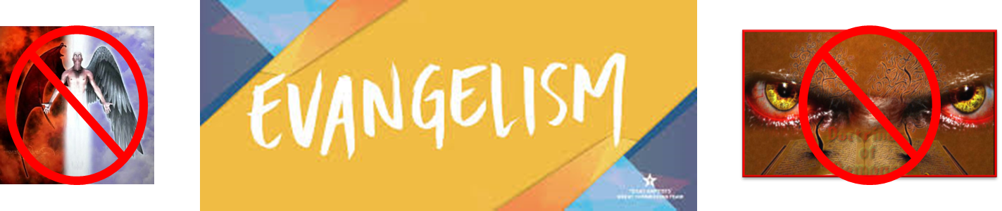
Matthew 16:18
“I also say to you that you are Peter, and upon this rock I will build [oikodomeō] My church; and the gates of Hades WILL NOT overpower it.”

Slide 77
When Did the Church Begin?
      Christ referred to the Church in the future tense (Matt. 16:18)
      Paul referred to the Church as a “mystery” (Eph. 3:4-5, 9)
      The Church did not exist prior to Acts 1 since Christ became the head of the Church (Eph. 5:23) after His Ascension (Eph. 1:20-22)
      The Church did not exist prior to Acts 1 since spiritual gifts (1 Cor. 12:7; 14:26) only came into existence after His Ascension (Eph. 4:7-11)

Slide 78
When Did the Church Begin?
      The Church existed before Paul’s conversion in Acts 9 (Acts 5:11; 8:1,3; Rom. 16:7)
      The Baptizing (joining, uniting, identifying) ministry of the Holy Spirit began in Acts 2
        1 Cor. 12:13
        Acts 1:5
        Acts 11:15-16
        Acts 2:1-4, 37-41

Slide 79
When Did the Church Begin?
      The Church existed before Paul’s conversion in Acts 9 (Acts 5:11; 8:1,3; Rom. 16:7)
      The Baptizing (joining, uniting, identifying) ministry of the Holy Spirit began in Acts 2
        1 Cor. 12:13
        Acts 1:5
        Acts 11:15-16
        Acts 2:1-4, 37-41

Slide 80
When Did the Church Begin?
      The Church existed before Paul’s conversion in Acts 9 (Acts 5:11; 8:1,3; Rom. 16:7)
      The Baptizing (joining, uniting, identifying) ministry of the Holy Spirit began in Acts 2
        1 Cor. 12:13
        Acts 1:5
        Acts 11:15-16
        Acts 2:1-4, 37-41

Slide 81
1 Corinthians 12:13
“For by one Spirit we were all baptized into one body, whether Jews or Greeks, whether slaves or free, and we were all made to drink of one Spirit.”

Slide 82
When Did the Church Begin?
      The Church existed before Paul’s conversion in Acts 9 (Acts 5:11; 8:1,3; Rom. 16:7)
      The Baptizing (joining, uniting, identifying) ministry of the Holy Spirit began in Acts 2
        1 Cor. 12:13
        Acts 1:5
        Acts 11:15-16
        Acts 2:1-4, 37-41

Slide 83
Acts 1:5
for John baptized with water, but you will be baptized with the Holy Spirit not many days from now.

Slide 84
When Did the Church Begin?
      The Church existed before Paul’s conversion in Acts 9 (Acts 5:11; 8:1,3; Rom. 16:7)
      The Baptizing (joining, uniting, identifying) ministry of the Holy Spirit began in Acts 2
        1 Cor. 12:13
        Acts 1:5
        Acts 11:15-16
        Acts 2:1-4, 37-41

Slide 85
Acts 11:15-16
¹⁵ And as I began to speak, the Holy Spirit fell upon them just as He did upon us at the beginning. ¹⁶ And I remembered the word of the Lord, how He used to say, ‘John baptized with water, but you will be baptized with the Holy Spirit.’

Slide 86
When Did the Church Begin?
      The Church existed before Paul’s conversion in Acts 9 (Acts 5:11; 8:1,3; Rom. 16:7)
      The Baptizing (joining, uniting, identifying) ministry of the Holy Spirit began in Acts 2
        1 Cor. 12:13
        Acts 1:5
        Acts 11:15-16
        Acts 2:1-4, 37-41

Slide 87
Acts 11:4-17
Peter’s Defense
      Peter’s exposition (4)
      Vision (5-6)
      Command (7-10)
      Gentiles arrive (11-12a)
      Journey to Caesarea (12b)
      Entrance into the house (12c)
      Cornelius’s salvation (13-14)
      Evidence (15-16)
      Peter’s conclusion (17)

Slide 88
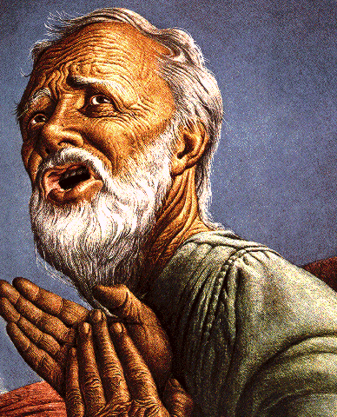
Passage Conditioning Salvation on Faith Alone (Sola Fide)
Genesis 15:6
John 3:16; 5:24; 6:28-29, 47; 16:8-9; 20:30-31
Acts 16:30-31
Romans 1:16; Ephesians 2:8-9
Hebrews 11:6

Slide 89
Belief – God’s One Condition for Justification
Gen 15:6
Then he believed in the LORD; and He reckoned it to him as righteousness.
John 3:16
For God so loved the world, that He gave His only begotten Son, that whoever believes in Him shall not perish, but have eternal life.
Acts 16:30-31
"Sirs, what must I do to be saved?" They said, "Believe in the Lord Jesus, and you will be saved..."

Slide 90
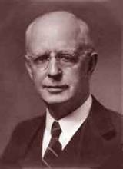
Lewis Sperry Chafer, vol. 7, Systematic Theology
(Grand Rapids, MI: Kregel Publications, 1993), 265-66.
Belief – God’s One Condition for Justification
“…because upwards of 150 passages of Scripture condition salvation upon believing only (cf. John 3:16; Acts 16:31).”

Slide 91
Acts 2:38
“Peter said to them, “Repent [metanoeō], and each of you be baptized in the name of Jesus Christ for (eis) the forgiveness of your sins; and you will receive the gift of the Holy Spirit.”

Slide 92
Matthew 12:41
“The men of Nineveh will stand up with this generation at the judgment and will condemn it because they repented at [in the face of/because of] (eis) the preaching of Jonah; and behold, something greater than Jonah is here.”

Slide 93
VII. Peter’s Defense in Jerusalem
Acts 11:1-18
  Charge against Peter (1-3)
  Peter’s defense (4-17)
  The verdict (18)

Slide 94
Acts 11:18
The Verdict
      Stopped wrangling (18a)
      Glorified God (18b)
      Concluded: Gospel to the Gentiles (18c)

Slide 95
Acts 11:18
The Verdict
      Stopped wrangling (18a)
      Glorified God (18b)
      Concluded: Gospel to the Gentiles (18c)

Slide 96
Acts 11:18
The Verdict
      Stopped wrangling (18a)
      Glorified God (18b)
      Concluded: Gospel to the Gentiles (18c)

Slide 97
Acts 11:18
The Verdict
      Stopped wrangling (18a)
      Glorified God (18b)
      Concluded: Gospel to the Gentiles (18c)

Slide 98
Purpose
  To present Theophilus with an orderly account of the birth and growth of the church so as to affirm him in what he has believed.

Slide 99

Message
  Birth and growth of the church numerically, geographically, ethnically.
  Components
  Numerically (progress reports)
  Geographically (From Jerusalem to Rome)
  Ethnically (From Judaism to Gentile domination)

Slide 100

John 16:7-11
“⁷ But I tell you the truth, it is to your advantage that I go away; for if I do not go away, the Helper will not come to you; but if I go, I will send Him to you. ⁸ And He, when He comes, will convict the world concerning sin and righteousness and judgment; ⁹ concerning sin, because they do not believe in Me; ¹⁰ and concerning righteousness, because I go to the Father and you no longer see Me; ¹¹ and concerning judgment, because the ruler of this world has been judged.”

Slide 101
Conclusion

Slide 102
Acts 10:1‒11:18
Cornelius’ Salvation
  Cornelius’ Vision (10:1-8)
  Peter’s Vision (Acts 10:9-16)
  Vision’s Application (10:17-23a)
  Caesarean Ministry (10:23b-33)
  Peter & The Keys of the Kingdom (10:34-43)
  Gentiles’ Salvation (10:44-48)
  Peter’s Defense in Jerusalem (11:1-18)

Slide 103
VII. Peter’s Defense in Jerusalem
Acts 11:1-18
  Charge against Peter (1-3)
  Peter’s defense (4-17)
  The verdict (18)

