Slide 1
Genesis 12‒50
Israel’s Birth & Preservation

Slide 2
GENESIS STRUCTURE
Genesis 12-50 (four people)
Abraham (12:1–25:11)
Isaac (25:12–26:35)
Jacob (27–36)
Joseph (37–50)

Slide 3
Genesis 37‒50 Joseph
Joseph sold unto Egypt (37)
Canaan’s corruption (38)
Joseph falsely accused (39)
Joseph’s short-term predictions (40)
Joseph’s elevation (41)
Joseph’s first reunion with his brothers (42)
Joseph’s second reunion with his brothers (43‒45)
Joseph’s second reunion with his brothers (43‒45)
Sojourn to Egypt (46:1‒47:12)
Famine’s course (47:13-26)
Jacob in Egypt (47:27-31)
Jacob blesses Joseph’s sons (48)
Jacob blesses his sons (49)

Slide 4
Genesis 49:1-33 Jacob Blesses His Sons
Call (49:1)
Introduction (49:2)
Jacob’s blessings on his sons (49:3-27)
Concluding summary (49:28)
Jacob’s death (49:29-33)

Slide 5
Genesis 49:1-33 Jacob Blesses His Sons
Call (49:1)
Introduction (49:2)
Jacob’s blessings on his sons (49:3-27)
Concluding summary (49:28)
Jacob’s death (49:29-33)

Slide 6
I. Genesis 49:1 Call
Call (1a)
Reason (1b)

Slide 7
I. Genesis 49:1 Call
Call (1a)
Reason (1b)

Slide 8
I. Genesis 49:1 Call
Call (1a)
Reason (1b)

Slide 9
Dr. Arnold G. Fruchtenbaum
The Book of Genesis, 632
“The term latter days is found thirteen times in the Old Testament (Gen. 49:1; Num. 24:14; Deut. 4:30, 31:29; Isa. 2:2; Jer. 23:20, 30:24, 48:47, 49:39; Ezek. 38:16; Hos. 3:5; Mic. 4:1; Dan. 10:14). It is consistently used of the distant prophetic future.”

Slide 10
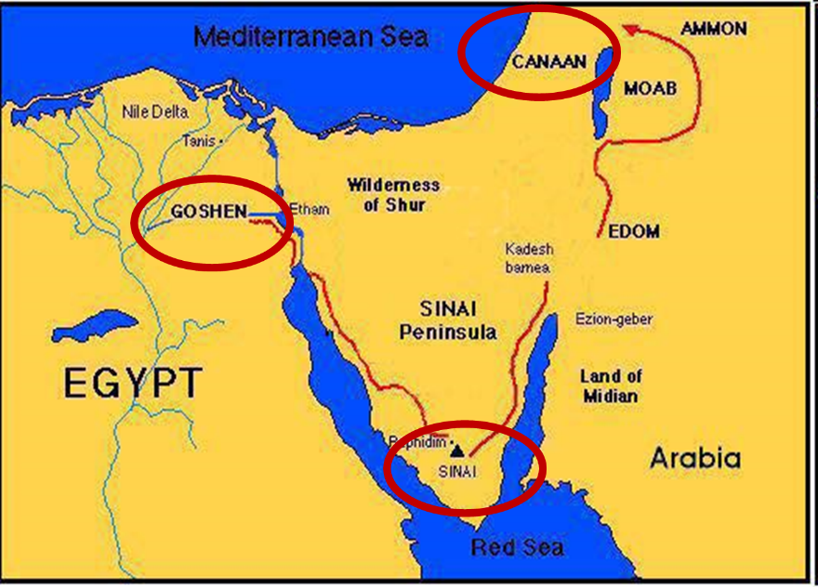

Slide 12
Genesis 49:1-33 Jacob Blesses His Sons
Call (49:1)
Introduction (49:2)
Jacob’s blessings on his sons (49:3-27)
Concluding summary (49:28)
Jacob’s death (49:29-33)

Slide 13
II. Genesis 49:2 Introduction
Assemble (2a)
Listen (2b)

Slide 14
II. Genesis 49:2 Introduction
Assemble (2a)
Listen (2b)

Slide 15
II. Genesis 49:2 Introduction
Assemble (2a)
Listen (2b)

Slide 16
Deuteronomy 6:4-7
⁴ “Hear, O Israel! The Lord is our God, the Lord is one!...⁶ These words, which I am commanding you today, shall be on your heart. ⁷ You shall teach them diligently to your sons and shall talk of them when you sit in your house and when you walk by the way and when you lie down and when you rise up.”

Slide 17
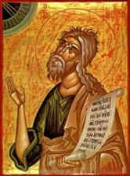
Jeremiah 30:7
“ Alas! for that day is great, There is none like it; And it is the time of Jacob’s distress, But he will be saved from it.”

Slide 18
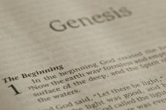
Beginning Themes
Universe Life Man Marriage Evil Clothing | Religion Salvation Language Government Nations Israel
Morris, Genesis Record, 18-20

Slide 19
Dr. Arnold G. Fruchtenbaum
The Book of Genesis, 634-35
“Before detailing Jacob’s prophecy, the following five observations can be noted. First, the order of the sons as Jacob deals with them is not the same as found in Genesis 30–31, except for the first four. Second, the actual order runs as follows. He begins with the sons of Leah: Reuben, Simeon, and Levi; and Judah, Zebulun, and Issachar. Then he deals with the sons of the handmaids beginning with Bilhah’s son Dan. He then deals with Zilpah’s two sons, Gad and Asher; then back to Bilhah’s other son Naphtali. At the end of the list, he then deals with the sons of Rachel, Joseph and Benjamin.”

Slide 20
Dr. Arnold G. Fruchtenbaum
The Book of Genesis, 634-35
“Third, except for Zebulun, no specific locations are given; and even for Zebulun, the emphasis is on what he will become, not where he will be. He will become a people of commerce. Fourth, Jacob prophesied the future and not the sites of the Tribes, in keeping with the emphasis of 49:1: which shall befall you in the latter days. Fifth, the future history of the tribes is viewed as an outgrowth of the present character of each son. The character of each son, to some degree, becomes the character of his tribe.”

Slide 22
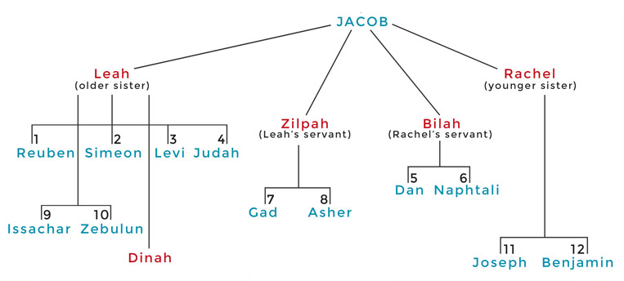

Slide 23
Genesis 49:1-33 Jacob Blesses His Sons
Call (49:1)
Introduction (49:2)
Jacob’s blessings on his sons (49:3-27)
Concluding summary (49:28)
Jacob’s death (49:29-33)

Slide 24
III. Genesis 49:3-27 Jacob’s Blessings on His Sons
Reuben (3-4)
Simeon & Levi (5-7)
Judah (8-12)
Zebulun (13)
Issachar (14-15)
Dan (16-18)
Gad (19)
Asher (20)
Naphtali (21)
Joseph (22-26)
Benjamin (27)

Slide 25
III. Genesis 49:3-27 Jacob’s Blessings on His Sons
Reuben (3-4)
Simeon & Levi (5-7)
Judah (8-12)
Zebulun (13)
Issachar (14-15)
Dan (16-18)
Gad (19)
Asher (20)
Naphtali (21)
Joseph (22-26)
Benjamin (27)

Slide 26
Genesis 49:3-4 Reuben
Position (3a-c)
Power (3d)
Loss (4)

Slide 27
Genesis 49:3-4 Reuben
Position (3a-c)
Power (3d)
Loss (4)

Slide 28
Genesis 49:3a-c Position
1st born (3a)
My might (3b)
Beginning of my strength (3c)

Slide 29
Genesis 49:3a-c Position
1st born (3a)
My might (3b)
Beginning of my strength (3c)

Slide 32
Genesis 49:3a-c Position
1st born (3a)
My might (3b)
Beginning of my strength (3c)

Slide 33
Genesis 49:3a-c Position
1st born (3a)
My might (3b)
Beginning of my strength (3c)

Slide 34
Genesis 49:3-4 Reuben
Position (3a-c)
Power (3d)
Loss (4)

Slide 35
Genesis 49:3-4 Reuben
Position (3a-c)
Power (3d)
Loss (4)

Slide 36
Genesis 49:4 Loss
Cause (4a)
Curse (4b)
Sin (4c)

Slide 37
Genesis 49:4 Loss
Cause (4a)
Curse (4b)
Sin (4c)

Slide 38
2 Peter 1:5-7
⁵ Now for this very reason also, applying all diligence, in your faith supply moral excellence, and in your moral excellence, knowledge, ⁶ and in your knowledge, self-control, and in your self-control, perseverance, and in your perseverance, godliness, ⁷ and in your godliness, brotherly kindness, and in your brotherly kindness, love.

Slide 39
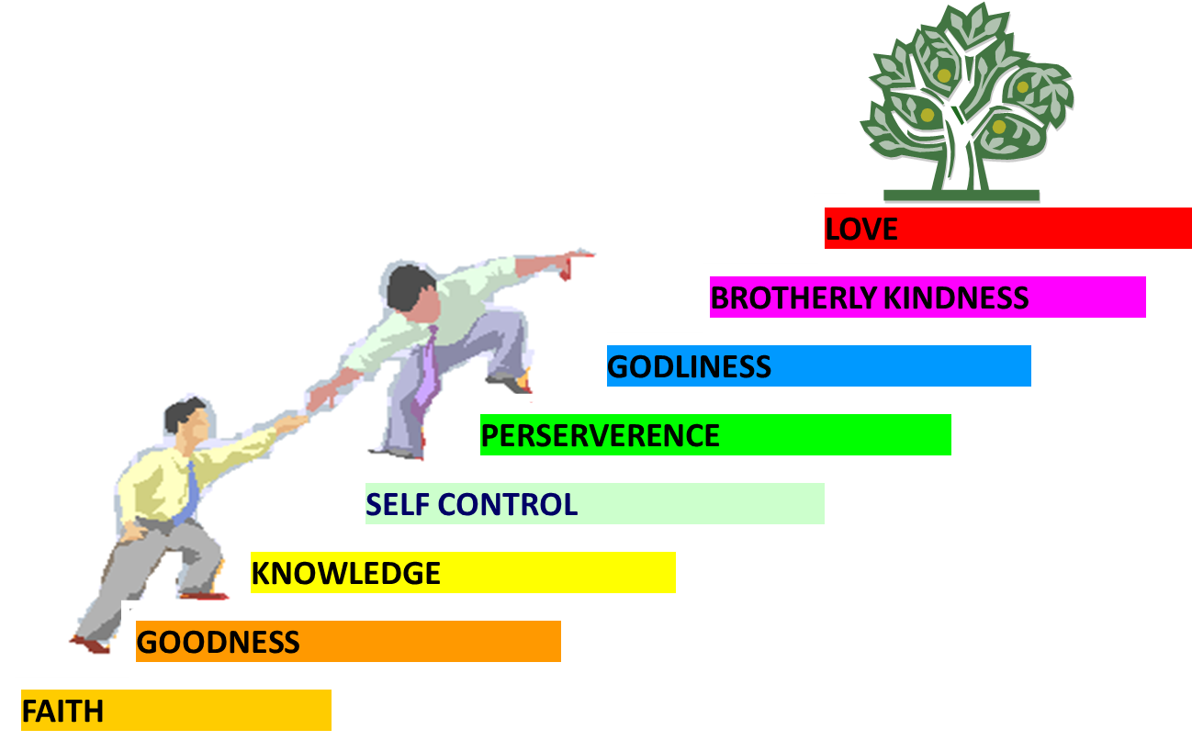
PORTRAIT OF GROWTH 1:5-7

Slide 40
Genesis 49:4 Loss
Cause (4a)
Curse (4b)
Sin (4c)

Slide 43
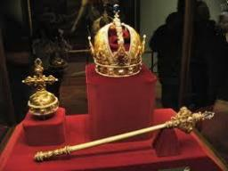
Genesis 49:10
“The scepter shall not depart from Judah, Nor the ruler’s staff from between his feet, Until Shiloh comes, And to him shall be the obedience of the peoples.”

Slide 44
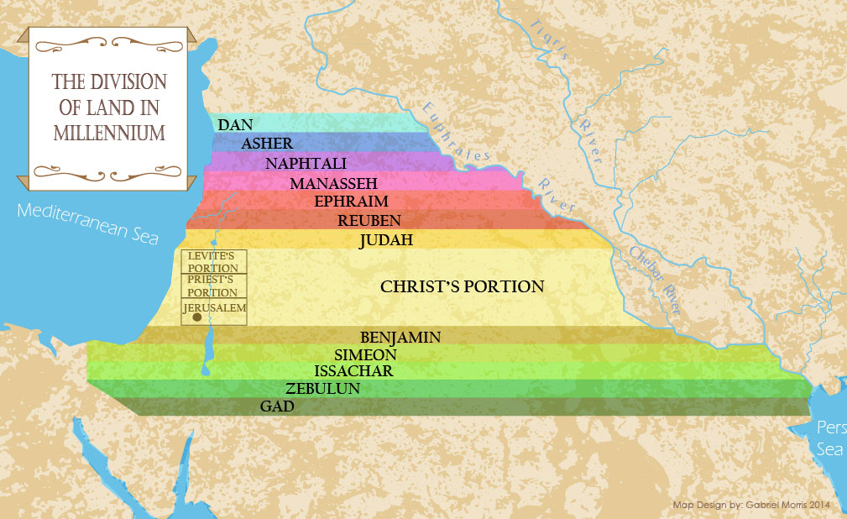

Slide 45
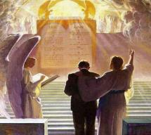
1 Corinthians 3:10-15
“¹⁴ If any man’s work which he has built on it remains, he will receive a reward. ¹⁵ If any man’s work is burned up, he will suffer loss; but he himself will be saved, yet so as through fire.”

Slide 46
Genesis 49:4 Loss
Cause (4a)
Curse (4b)
Sin (4c)

Slide 47
Dr. Arnold G. Fruchtenbaum
The Book of Genesis, 636
“The Tribe of Reuben never produced anyone of significance; it never produced a judge, a prophet, or a leader. His failure in leadership during the period of the Judges is brought out in Judges 5:15. He was overshadowed by Gad and overrun by Moab (II Kings 10:32–33; I Chron. 26:31–32). In the first census (Num. 1:20–21), he numbered 46,500; in the second census (Num. 26:5–7), he numbered 43,730, a decrease. The prayer of Moses in Deuteronomy 33:6 was: Let Reuben live, and not die; Nor let his men be few. Moses had to intercede to make sure Reuben did not disappear. Reuben played a minor role in Israel’s subsequent history.”

Slide 48
III. Genesis 49:3-27 Jacob’s Blessings on His Sons
Reuben (3-4)
Simeon & Levi (5-7)
Judah (8-12)
Zebulun (13)
Issachar (14-15)
Dan (16-18)
Gad (19)
Asher (20)
Naphtali (21)
Joseph (22-26)
Benjamin (27)

Slide 49
Genesis 49:5-7 Simeon & Levi
Similarities (5)
Disassociation (6a)
Sins (6b-c)
Jacob’s judgment (7)

Slide 50
Genesis 49:5-7 Simeon & Levi
Similarities (5)
Disassociation (6a)
Sins (6b-c)
Jacob’s judgment (7)

Slide 51
Genesis 49:5 Similarities
Full brothers (5a)
Equal in violence (5b)

Slide 52
Genesis 49:5 Similarities
Full brothers (5a)
Equal in violence (5b)

Slide 55
Genesis 49:5 Similarities
Full brothers (5a)
Equal in violence (5b)

Slide 58
Genesis 49:5-7 Simeon & Levi
Similarities (5)
Disassociation (6a)
Sins (6b-c)
Jacob’s judgment (7)

Slide 59
Genesis 49:5-7 Simeon & Levi
Similarities (5)
Disassociation (6a)
Sins (6b-c)
Jacob’s judgment (7)

Slide 60
Genesis 49:6b-c Sins
Men (6b)
Animals (6c)

Slide 61
Genesis 49:6b-c Sins
Men (6b)
Animals (6c)

Slide 64
Genesis 6:11-13
“¹¹ Now the earth was corrupt in the sight of God, and the earth was filled with violence [חָמָס; chamas]. ¹² And God looked on the earth, and behold, it was corrupt; for humanity had corrupted its way upon the earth. ¹³ Then God said to Noah, ‘The end of humanity has come before Me; for the earth is filled with violence [חָמָס; chamas] because of people; and behold, I am about to destroy them with the earth.’”

Slide 65
Genesis 49:6b-c Sins
Men (6b)
Animals (6c)

Slide 68
Genesis 49:5-7 Simeon & Levi
Similarities (5)
Disassociation (6a)
Sins (6b-c)
Jacob’s judgment (7)

Slide 69
Genesis 49:7 Jacob’s Judgment
Deeds (7a)
Seed (7b)

Slide 70
Genesis 49:7 Jacob’s Judgment
Deeds (7a)
Seed (7b)

Slide 71
Matthew 5:21-22
“²¹ “You have heard that the ancients were told, ‘You shall not commit murder’ and ‘Whoever commits murder shall be liable to the court.’ ²² But I say to you that everyone who is angry with his brother shall be guilty before the court; and whoever says to his brother, ‘You good-for-nothing,’ shall be guilty before the supreme court; and whoever says, ‘You fool,’ shall be guilty enough to go into the fiery hell.”

Slide 72
Genesis 49:7 Jacob’s Judgment
Deeds (7a)
Seed (7b)

Slide 73
Dr. Arnold G. Fruchtenbaum
The Book of Genesis, 637-38
“Second, his judgment falls on their seed: I will divide them in Jacob, And scatter them in Israel. In keeping with the judgment, neither tribe received its own territory in the Land; their territories were within the territory of other tribes; they did not receive their own tribal holdings. Simeon turned out to be the weakest tribe in number. In the first census (Num. 1:23), his tribe numbered 59,300. In the second census (Num. 26:14), it went all the way down to 22,200. A member of Simeon’s tribe was involved in the sin of worshipping Baal-Peor (Num. 25:14) through immorality.”

Slide 74
Dr. Arnold G. Fruchtenbaum
The Book of Genesis, 637-38
“Simeon is omitted from the tribal blessings of Moses in Deuteronomy 33. When the Jews did get the Land of Israel, Simeon settled, not in his own territory, but in the southern part of Judah’s territory (Josh. 19:1–9, Judg. 1:3). In subsequent history, Simeon smote the inhabitants of Mount Seir (I Chron. 4:42–43). The Tribe of Levi did side with Moses in the sin of the golden calf (Exod. 32:26–29); but in keeping with Jacob’s curse, Levi did not receive his own territory. Rather, the Tribe of Levi was scattered in forty-eight different Levitical Cities throughout the other Tribes of Israel (Num. 18:20–24, 35:1–8; Deut. 10:8–9; Josh. 14:4, 21:1–42).”

Slide 75
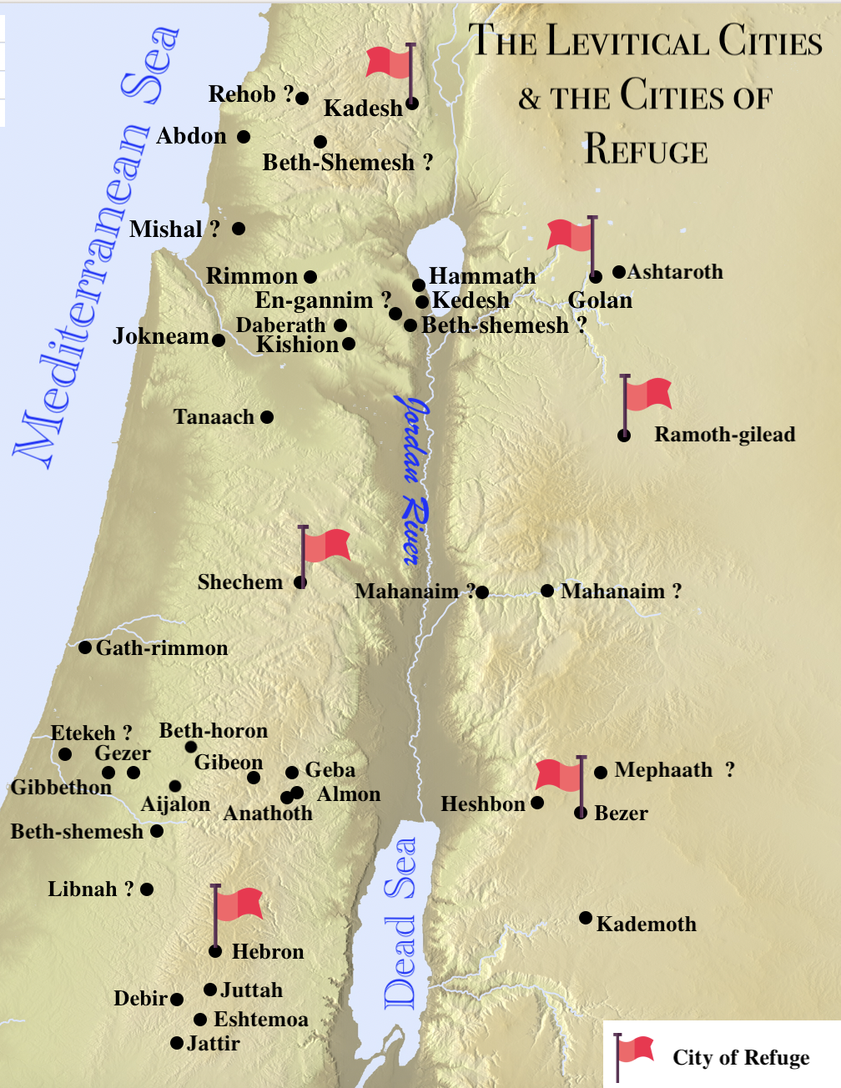

Slide 76
III. Genesis 49:3-27 Jacob’s Blessings on His Sons
Reuben (3-4)
Simeon & Levi (5-7)
Judah (8-12)
Zebulun (13)
Issachar (14-15)
Dan (16-18)
Gad (19)
Asher (20)
Naphtali (21)
Joseph (22-26)
Benjamin (27)

Slide 77
Genesis 49:8-12 Judah
Preeminence (8)
Power (9)
Messianic line (10)
Prosperity (11)
Final result (12)

Slide 78
Genesis 49:8-12 Judah
Preeminence (8)
Power (9)
Messianic line (10)
Prosperity (11)
Final result (12)

Slide 79
Genesis 49:8 Preeminence
Praise (8a)
Successful in war (8b)
Brothers bow down to you (8c)

Slide 80
Genesis 49:8 Preeminence
Praise (8a)
Successful in war (8b)
Brothers bow down to you (8c)

Slide 81
Genesis 49:8 Preeminence
Praise (8a)
Successful in war (8b)
Brothers bow down to you (8c)

Slide 82
Genesis 49:8 Preeminence
Praise (8a)
Successful in war (8b)
Brothers bow down to you (8c)

Slide 83
Genesis 49:8-12 Judah
Preeminence (8)
Power (9)
Messianic line (10)
Prosperity (11)
Final result (12)

Slide 84
Genesis 49:9 Power
Lion’s whelp (9a)
Killing prey (9b)
Couched as a lion (9c)
Lioness (9d)

Slide 85
Genesis 49:9 Power
Lion’s whelp (9a)
Killing prey (9b)
Couched as a lion (9c)
Lioness (9d)

Slide 86
Genesis 49:9 Power
Lion’s whelp (9a)
Killing prey (9b)
Couched as a lion (9c)
Lioness (9d)

Slide 87
Genesis 49:9 Power
Lion’s whelp (9a)
Killing prey (9b)
Couched as a lion (9c)
Lioness (9d)

Slide 88
Genesis 49:9 Power
Lion’s whelp (9a)
Killing prey (9b)
Couched as a lion (9c)
Lioness (9d)

Slide 89
Genesis 49:8-12 Judah
Preeminence (8)
Power (9)
Messianic line (10)
Prosperity (11)
Final result (12)

Slide 90
Genesis 49:10 Messianic Line
Scepter (10a)
Ruler’s staff (10b)
Shiloh (10c)
Obedience of the nations (10d)

Slide 91
Genesis 49:10 Messianic Line
Scepter (10a)
Ruler’s staff (10b)
Shiloh (10c)
Obedience of the nations (10d)

Slide 92
Genesis 49:10 Messianic Line
Scepter (10a)
Ruler’s staff (10b)
Shiloh (10c)
Obedience of the nations (10d)

Slide 93
Genesis 49:10 Messianic Line
Scepter (10a)
Ruler’s staff (10b)
Shiloh (10c)
Obedience of the nations (10d)

Slide 94
Genesis 49:10 Messianic Line
Scepter (10a)
Ruler’s staff (10b)
Shiloh (10c)
Obedience of the nations (10d)

Slide 95
Genesis 49:8-12 Judah
Preeminence (8)
Power (9)
Messianic line (10)
Prosperity (11)
Final result (12)

Slide 96
Genesis 49:11 Prosperity
Binding coalt to vine (11a)
Binding coalt to choice vine (11b)
Washed garment in vine (11c)
Vesture in blood of grapes (11d)

Slide 97
Genesis 49:11 Prosperity
Binding coalt to vine (11a)
Binding coalt to choice vine (11b)
Washed garment in vine (11c)
Vesture in blood of grapes (11d)

Slide 98
Genesis 49:11 Prosperity
Binding coalt to vine (11a)
Binding coalt to choice vine (11b)
Washed garment in vine (11c)
Vesture in blood of grapes (11d)

Slide 99
Genesis 49:11 Prosperity
Binding coalt to vine (11a)
Binding coalt to choice vine (11b)
Washed garment in vine (11c)
Vesture in blood of grapes (11d)

Slide 100
Genesis 49:11 Prosperity
Binding coalt to vine (11a)
Binding coalt to choice vine (11b)
Washed garment in vine (11c)
Vesture in blood of grapes (11d)

Slide 101
Genesis 49:8-12 Judah
Preeminence (8)
Power (9)
Messianic line (10)
Prosperity (11)
Final result (12)

Slide 102
Genesis 49:12 Final Result
Messiah’s eyes (12a)
Messiah’s teeth (12b)

Slide 103
Genesis 49:12 Final Result
Messiah’s eyes (12a)
Messiah’s teeth (12b)

Slide 104
Genesis 49:12 Final Result
Messiah’s eyes (12a)
Messiah’s teeth (12b)

Slide 105
III. Genesis 49:3-27 Jacob’s Blessings on His Sons
Reuben (3-4)
Simeon & Levi (5-7)
Judah (8-12)
Zebulun (13)
Issachar (14-15)
Dan (16-18)
Gad (19)
Asher (20)
Naphtali (21)
Joseph (22-26)
Benjamin (27)

Slide 106
Genesis 49:13 Zebulun
Dwell near sea (13a)
Shelter for ships (13b)
Border Sidon (13c)

Slide 107
Genesis 49:13 Zebulun
Dwell near sea (13a)
Shelter for ships (13b)
Border Sidon (13c)

Slide 108
Genesis 49:13 Zebulun
Dwell near sea (13a)
Shelter for ships (13b)
Border Sidon (13c)

Slide 109
Genesis 49:13 Zebulun
Dwell near sea (13a)
Shelter for ships (13b)
Border Sidon (13c)

Slide 111
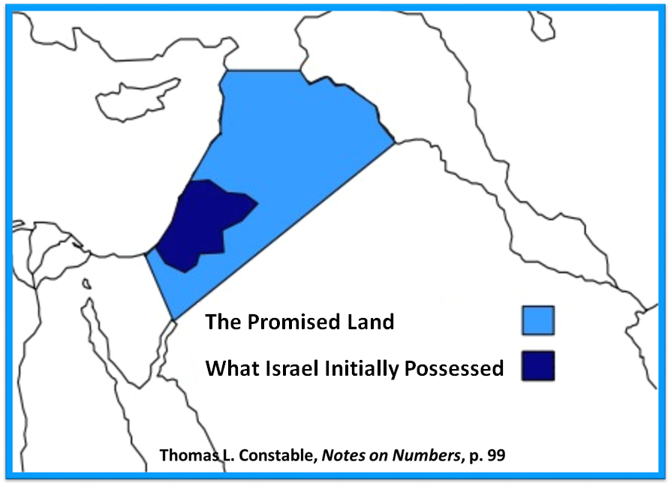

Slide 112
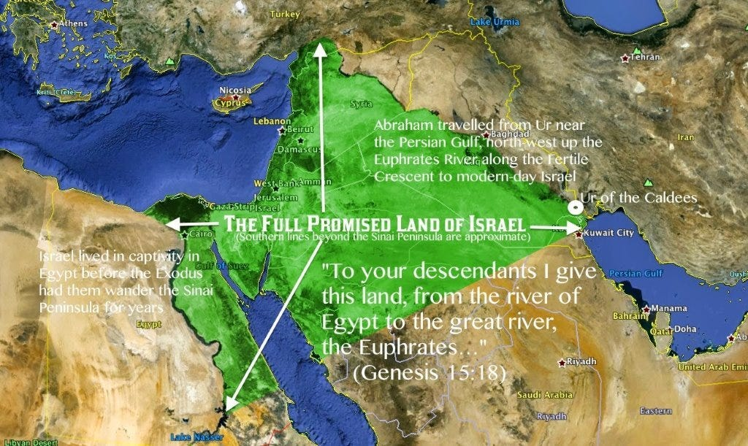

Slide 113
III. Genesis 49:3-27 Jacob’s Blessings on His Sons
Reuben (3-4)
Simeon & Levi (5-7)
Judah (8-12)
Zebulun (13)
Issachar (14-15)
Dan (16-18)
Gad (19)
Asher (20)
Naphtali (21)
Joseph (22-26)
Benjamin (27)

Slide 114
Genesis 49:14-15 Issachar
Nature (14)
Actions (15)

Slide 115
Genesis 49:14-15 Issachar
Nature (14)
Actions (15)

Slide 116
Genesis 49:14 Nature
Strength (14a)
Preferred leisure (14b)

Slide 117
Genesis 49:14 Nature
Strength (14a)
Preferred leisure (14b)

Slide 118
Genesis 49:14 Nature
Strength (14a)
Preferred leisure (14b)

Slide 119
Genesis 49:14-15 Issachar
Nature (14)
Actions (15)

Slide 120
Genesis 49:15 Actions
Saw resting place (15a)
Saw land was pleasant (15b)
Bowed shoulder to bear (15c)
Became servant under task work (15d)

Slide 121
Genesis 49:15 Actions
Saw resting place (15a)
Saw land was pleasant (15b)
Bowed shoulder to bear (15c)
Became servant under task work (15d)

Slide 122
Genesis 49:15 Actions
Saw resting place (15a)
Saw land was pleasant (15b)
Bowed shoulder to bear (15c)
Became servant under task work (15d)

Slide 123
Genesis 49:15 Actions
Saw resting place (15a)
Saw land was pleasant (15b)
Bowed shoulder to bear (15c)
Became servant under task work (15d)

Slide 124
Genesis 49:15 Actions
Saw resting place (15a)
Saw land was pleasant (15b)
Bowed shoulder to bear (15c)
Became servant under task work (15d)

Slide 125
III. Genesis 49:3-27 Jacob’s Blessings on His Sons
Reuben (3-4)
Simeon & Levi (5-7)
Judah (8-12)
Zebulun (13)
Issachar (14-15)
Dan (16-18)
Gad (19)
Asher (20)
Naphtali (21)
Joseph (22-26)
Benjamin (27)

Slide 126
Genesis 49:16-18 Dan
Judge (16)
Warrior (17)
Salvation (18)

Slide 127
Genesis 49:16-18 Dan
Judge (16)
Warrior (17)
Salvation (18)

Slide 128
Genesis 49:16-18 Dan
Judge (16)
Warrior (17)
Salvation (18)

Slide 129
Genesis 49:17 Warrior
Serpent (17a)
Adder (17b)
Bites horses’ heels (17c)

Slide 130
Genesis 49:17 Warrior
Serpent (17a)
Adder (17b)
Bites horses’ heels (17c)

Slide 131
Genesis 49:17 Warrior
Serpent (17a)
Adder (17b)
Bites horses’ heels (17c)

Slide 132
Genesis 49:17 Warrior
Serpent (17a)
Adder (17b)
Bites horses’ heels (17c)

Slide 133
Genesis 49:16-18 Dan
Judge (16)
Warrior (17)
Salvation (18)

Slide 134
III. Genesis 49:3-27 Jacob’s Blessings on His Sons
Reuben (3-4)
Simeon & Levi (5-7)
Judah (8-12)
Zebulun (13)
Issachar (14-15)
Dan (16-18)
Gad (19)
Asher (20)
Naphtali (21)
Joseph (22-26)
Benjamin (27)

Slide 135
Genesis 49:19 Gad
Will be pressed upon (19a)
Will overcome (19b)

Slide 136
Genesis 49:19 Gad
Will be pressed upon (19a)
Will overcome (19b)

Slide 137
Genesis 49:19 Gad
Will be pressed upon (19a)
Will overcome (19b)

Slide 138
III. Genesis 49:3-27 Jacob’s Blessings on His Sons
Reuben (3-4)
Simeon & Levi (5-7)
Judah (8-12)
Zebulun (13)
Issachar (14-15)
Dan (16-18)
Gad (19)
Asher (20)
Naphtali (21)
Joseph (22-26)
Benjamin (27)

Slide 139
Genesis 49:20 Asher
Wealth (20a)
Produce delicacies (20b)

Slide 140
Genesis 49:20 Asher
Wealth (20a)
Produce delicacies (20b)

Slide 141
Genesis 49:20 Asher
Wealth (20a)
Produce delicacies (20b)

Slide 142
III. Genesis 49:3-27 Jacob’s Blessings on His Sons
Reuben (3-4)
Simeon & Levi (5-7)
Judah (8-12)
Zebulun (13)
Issachar (14-15)
Dan (16-18)
Gad (19)
Asher (20)
Naphtali (21)
Joseph (22-26)
Benjamin (27)

Slide 143
Genesis 49:21 Naphtali
Unrestrained movement (21a)
Speech sophistication (21b)

Slide 144
Genesis 49:21 Naphtali
Unrestrained movement (21a)
Speech sophistication (21b)

Slide 145
Genesis 49:21 Naphtali
Unrestrained movement (21a)
Speech sophistication (21b)

Slide 146
III. Genesis 49:3-27 Jacob’s Blessings on His Sons
Reuben (3-4)
Simeon & Levi (5-7)
Judah (8-12)
Zebulun (13)
Issachar (14-15)
Dan (16-18)
Gad (19)
Asher (20)
Naphtali (21)
Joseph (22-26)
Benjamin (27)

Slide 147
Genesis 49:22-26 Joseph
Progeny (22)
Persecution (23)
Survival (24)
Future blessings (25)
Joseph to receive blessings (26)

Slide 148
Genesis 49:22-26 Joseph
Progeny (22)
Persecution (23)
Survival (24)
Future blessings (25)
Joseph to receive blessings (26)

Slide 149
Genesis 49:22 Progeny
Fruitful (22a)
Water supply (22b)
Spread out (22c)

Slide 150
Genesis 49:22 Progeny
Fruitful (22a)
Water supply (22b)
Spread out (22c)

Slide 151
Genesis 49:22 Progeny
Fruitful (22a)
Water supply (22b)
Spread out (22c)

Slide 152
Genesis 49:22 Progeny
Fruitful (22a)
Water supply (22b)
Spread out (22c)

Slide 153
Genesis 49:22-26 Joseph
Progeny (22)
Persecution (23)
Survival (24)
Future blessings (25)
Joseph to receive blessings (26)

Slide 154
Genesis 49:23 Persecution
Grieved (23a)
Shot (23b)
Persecuted (23c)

Slide 155
Genesis 49:23 Persecution
Grieved (23a)
Shot (23b)
Persecuted (23c)

Slide 156
Genesis 49:23 Persecution
Grieved (23a)
Shot (23b)
Persecuted (23c)

Slide 157
Genesis 49:23 Persecution
Grieved (23a)
Shot (23b)
Persecuted (23c)

Slide 158
Genesis 49:22-26 Joseph
Progeny (22)
Persecution (23)
Survival (24)
Future blessings (25)
Joseph to receive blessings (26)

Slide 159
Genesis 49:24 Survival
Strength (24a)
Tested growth (24b)
Prevailed through God (24c)
God to bring Messiah (24d)

Slide 160
Genesis 49:24 Survival
Strength (24a)
Tested growth (24b)
Prevailed through God (24c)
God to bring Messiah (24d)

Slide 161
Genesis 49:24 Survival
Strength (24a)
Tested growth (24b)
Prevailed through God (24c)
God to bring Messiah (24d)

Slide 162
Genesis 49:24 Survival
Strength (24a)
Tested growth (24b)
Prevailed through God (24c)
God to bring Messiah (24d)

Slide 163
Genesis 49:24 Survival
Strength (24a)
Tested growth (24b)
Prevailed through God (24c)
God to bring Messiah (24d)

Slide 164
Genesis 49:22-26 Joseph
Progeny (22)
Persecution (23)
Survival (24)
Future blessings (25)
Joseph to receive blessings (26)

Slide 165
Genesis 49:25 Future Blessings
God as source (25a-b)
Other sources (25c-e)

Slide 166
Genesis 49:25 Future Blessings
God as source (25a-b)
Other sources (25c-e)

Slide 167
Genesis 49:25a-b God as Source
Your Father (25a)
Almighty (25b)

Slide 168
Genesis 49:25a-b God as Source
Your Father (25a)
Almighty (25b)

Slide 169
Genesis 49:25a-b God as Source
Your Father (25a)
Almighty (25b)

Slide 170
Genesis 49:25 Future Blessings
God as source (25a-b)
Other sources (25c-e)

Slide 171
Genesis 49:25c-e Other Sources
Dews (25c)
Springs & fountains (25d)
Breasts & womb (25e)

Slide 172
Genesis 49:25c-e Other Sources
Dews (25c)
Springs & fountains (25d)
Breasts & womb (25e)

Slide 173
Genesis 49:25c-e Other Sources
Dews (25c)
Springs & fountains (25d)
Breasts & womb (25e)

Slide 174
Genesis 49:25c-e Other Sources
Dews (25c)
Springs & fountains (25d)
Breasts & womb (25e)

Slide 175
Genesis 49:22-26 Joseph
Progeny (22)
Persecution (23)
Survival (24)
Future blessings (25)
Joseph to receive blessings (26)

Slide 176
III. Genesis 49:3-27 Jacob’s Blessings on His Sons
Reuben (3-4)
Simeon & Levi (5-7)
Judah (8-12)
Zebulun (13)
Issachar (14-15)
Dan (16-18)
Gad (19)
Asher (20)
Naphtali (21)
Joseph (22-26)
Benjamin (27)

Slide 177
Genesis 49:27 Benjamin
Ravenous wolf (27a)
Devours prey (27b)
Share spoil due to success (27c)

Slide 178
Genesis 49:27 Benjamin
Ravenous wolf (27a)
Devours prey (27b)
Share spoil due to success (27c)

Slide 179
Genesis 49:27 Benjamin
Ravenous wolf (27a)
Devours prey (27b)
Share spoil due to success (27c)

Slide 180
Genesis 49:27 Benjamin
Ravenous wolf (27a)
Devours prey (27b)
Share spoil due to success (27c)

Slide 181
Genesis 49:1-33 Jacob Blesses His Sons
Call (49:1)
Introduction (49:2)
Jacob’s blessings on his sons (49:3-27)
Concluding summary (49:28)
Jacob’s death (49:29-33)

Slide 182
IV. Genesis 49:28 Concluding Summary
Prophecies beyond sons (28a)
Summary of Jacob’s blessings (28b)

Slide 183
IV. Genesis 49:28 Concluding Summary
Prophecies beyond sons (28a)
Summary of Jacob’s blessings (28b)

Slide 184
IV. Genesis 49:28 Concluding Summary
Prophecies beyond sons (28a)
Summary of Jacob’s blessings (28b)

Slide 185
Genesis 49:1-33 Jacob Blesses His Sons
Call (49:1)
Introduction (49:2)
Jacob’s blessings on his sons (49:3-27)
Concluding summary (49:28)
Jacob’s death (49:29-33)

Slide 186
V. Genesis 49:29-33 Jacob’s Death
Charge (29a)
Announcement of death (29b)
Request (29c)
Place of burial (29d-30)
Others buried there (31)
Burial place repeated (32)
Jacob’s death (33)

Slide 187
V. Genesis 49:29-33 Jacob’s Death
Charge (29a)
Announcement of death (29b)
Request (29c)
Place of burial (29d-30)
Others buried there (31)
Burial place repeated (32)
Jacob’s death (33)

Slide 188
V. Genesis 49:29-33 Jacob’s Death
Charge (29a)
Announcement of death (29b)
Request (29c)
Place of burial (29d-30)
Others buried there (31)
Burial place repeated (32)
Jacob’s death (33)

Slide 189
V. Genesis 49:29-33 Jacob’s Death
Charge (29a)
Announcement of death (29b)
Request (29c)
Place of burial (29d-30)
Others buried there (31)
Burial place repeated (32)
Jacob’s death (33)

Slide 190
V. Genesis 49:29-33 Jacob’s Death
Charge (29a)
Announcement of death (29b)
Request (29c)
Place of burial (29d-30)
Others buried there (31)
Burial place repeated (32)
Jacob’s death (33)

Slide 191
V. Genesis 49:29-33 Jacob’s Death
Charge (29a)
Announcement of death (29b)
Request (29c)
Place of burial (29d-30)
Others buried there (31)
Burial place repeated (32)
Jacob’s death (33)

Slide 192
V. Genesis 49:29-33 Jacob’s Death
Charge (29a)
Announcement of death (29b)
Request (29c)
Place of burial (29d-30)
Others buried there (31)
Burial place repeated (32)
Jacob’s death (33)

Slide 193
V. Genesis 49:29-33 Jacob’s Death
Charge (29a)
Announcement of death (29b)
Request (29c)
Place of burial (29d-30)
Others buried there (31)
Burial place repeated (32)
Jacob’s death (33)

Slide 194
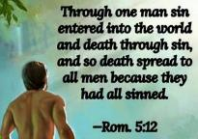
Genesis 2:16-17
“¹⁶ The Lord God commanded the man, saying, ‘From any tree of the garden you may eat freely; ¹⁷ but from the tree of the knowledge of good and evil you shall not eat, for in the day that you eat from it you will surely die (muwth).’”

Slide 195
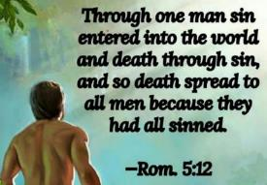
Genesis 3:19
“By the sweat of your face You will eat bread, Till you return to the ground, Because from it you were taken; For you are dust, And to dust you shall return.”

Slide 196
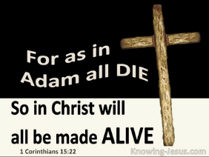
1 Corinthians 15:21-22
“²¹ For since by a man came death, by a man also came the resurrection of the dead. ²² For as in Adam all die, so also in Christ all will be made alive.”

Slide 197
Romans 5:12
“Therefore, just as through one man sin entered into the world, and death through sin, and so death spread to all men, because all sinned—.”

Slide 198
Romans 6:23
“For the wages of sin is death, but the free gift of God is eternal life in Christ Jesus our Lord.”

Slide 199
Hebrews 9:27
“And inasmuch as it is appointed for men to die once and after this comes judgment.”

Slide 200
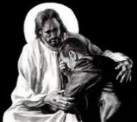
Revelation 21:4
“and He will wipe away every tear from their eyes; and there will no longer be any death; there will no longer be any mourning, or crying, or pain; the first things have passed away.”

Slide 202
Conclusion

Slide 203
Genesis 49:1-33 Jacob Blesses His Sons
Call (49:1)
Introduction (49:2)
Jacob’s blessings on his sons (49:3-27)
Concluding summary (49:28)
Jacob’s death (49:29-33)

Slide 204
²⁴ The Lord bless you, and keep you; ²⁵ The Lord make His face shine on you, And be gracious to you; ²⁶ The Lord lift up His countenance on you, And give you peace.
Numbers 6:24–26 (NASB95)

