Slide 1
Genesis 12‒50
Israel’s Birth & Preservation

Slide 2
GENESIS STRUCTURE
Genesis 12-50 (four people)
Abraham (12:1–25:11)
Isaac (25:12–26:35)
Jacob (27–36)
Joseph (37–50)

Slide 3
Genesis 37‒50 Joseph
Joseph sold unto Egypt (37)
Canaan’s corruption (38)
Joseph falsely accused (39)
Joseph’s short-term predictions (40)
Joseph’s elevation (41)
Joseph’s first reunion with his brothers (42)
Joseph’s second reunion with his brothers (43‒45)
Joseph’s second reunion with his brothers (43‒45)
Sojourn to Egypt (46:1‒47:12)
Famine’s course (47:13-26)
Jacob in Egypt (47:27-31)
Jacob blesses Joseph’s sons (48)

Slide 4
Genesis 48:1-22 Jacob Blesses Joseph’s Sons
Adoption (48:1-7)
Blessing of Manasseh & Ephraim (48:8-20)
Exodus prophecy (48:21-22)

Slide 5
III. Genesis 48:21-22 Exodus Prophecy
Exodus prophecy (21)
Joseph’s additional inheritance (22)

Slide 6
III. Genesis 48:21-22 Exodus Prophecy
Exodus prophecy (21)
Joseph’s additional inheritance (22)

Slide 7
Genesis 48:21 Exodus Prophecy
Immediate future: Jacob’s death (21a)
Distant future: Exodus (21b)

Slide 8
Genesis 48:21 Exodus Prophecy
Immediate future: Jacob’s death (21a)
Distant future: Exodus (21b)

Slide 9
Matthew 24:1-2
“¹ Jesus came out from the temple and was going away when His disciples came up to point out the temple buildings to Him. ² And He said to them, “Do you not see all these things? Truly I say to you, not one stone here will be left upon another, which will not be torn down.”

Slide 10
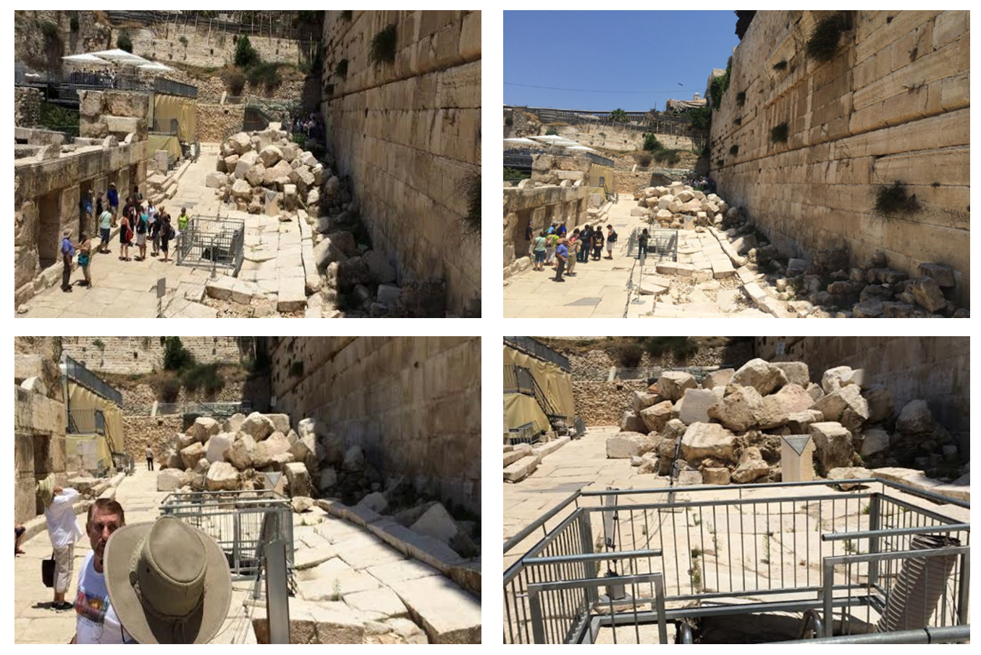

Slide 11
Matt 24 / Rev 6 Parallels
Prediction | Birth pangs (Matt 24) | Seal judgments (Rev 6)
False Christ | 24:5 | 6:2
War | 24:6 | 6:3-4
Famine | 24:7 | 6:5-6
Death | 24:6-7 | 6:7-8
Martyrs | 24:9-13 | 6:9-11
Earthquakes | 24:7 | 6:12-17
Evangelism | 24:14 | 7:1-9

Slide 13
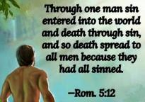
Genesis 2:16-17
“¹⁶ The Lord God commanded the man, saying, ‘From any tree of the garden you may eat freely; ¹⁷ but from the tree of the knowledge of good and evil you shall not eat, for in the day that you eat from it you will surely die (muwth).’”

Slide 14
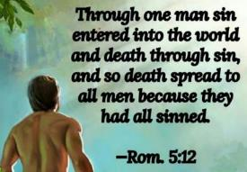
Genesis 3:19
“By the sweat of your face You will eat bread, Till you return to the ground, Because from it you were taken; For you are dust, And to dust you shall return.”

Slide 15
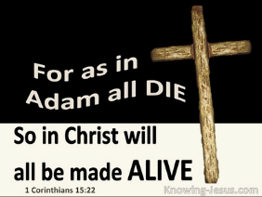
1 Corinthians 15:21-22
“²¹ For since by a man came death, by a man also came the resurrection of the dead. ²² For as in Adam all die, so also in Christ all will be made alive.”

Slide 16
Romans 5:12
“Therefore, just as through one man sin entered into the world, and death through sin, and so death spread to all men, because all sinned—.”

Slide 17
Romans 6:23
“For the wages of sin is death, but the free gift of God is eternal life in Christ Jesus our Lord.”

Slide 18
Hebrews 9:27
“And inasmuch as it is appointed for men to die once and after this comes judgment.”

Slide 19
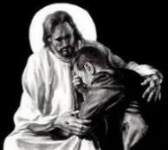
Revelation 21:4
“and He will wipe away every tear from their eyes; and there will no longer be any death; there will no longer be any mourning, or crying, or pain; the first things have passed away.”

Slide 21
Genesis 48:21 Exodus Prophecy
Immediate future: Jacob’s death (21a)
Distant future: Exodus (21b)

Slide 22
John 14:16-17
¹⁶ I will ask the Father, and He will give you another Helper, that He may be with you forever; ¹⁷ that is the Spirit of truth, whom the world cannot receive, because it does not see Him or know Him, but you know Him because He abides with you and will be in you.

Slide 23
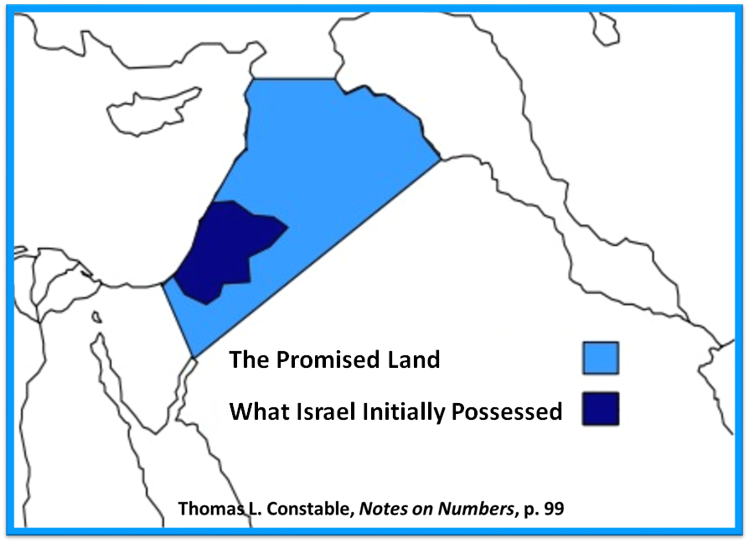

Slide 24
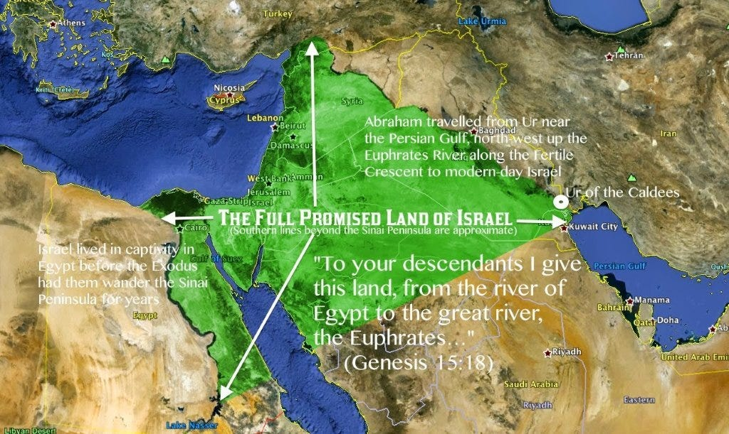

Slide 25
Genesis 15:13–14, 16
¹³ God said to Abram, “Know for certain that your descendants will be strangers in a land that is not theirs, where they will be enslaved and oppressed four hundred years. ¹⁴ “But I will also judge the nation whom they will serve, and afterward they will come out with many possessions….¹⁶ “Then in the fourth generation they will return here, for the iniquity of the Amorite is not yet complete.”

Slide 26
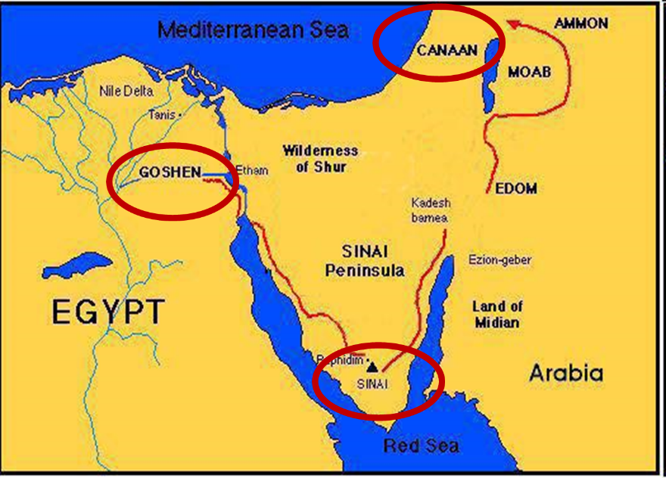

Slide 28
III. Genesis 48:21-22 Exodus Prophecy
Exodus prophecy (21)
Joseph’s additional inheritance (22)

Slide 29
Genesis 48:22 Joseph’s Additional Inheritance
Jacob’s gift to Joseph (22a)
Jacob’s original acquisition (22b)

Slide 30
Genesis 48:22 Joseph’s Additional Inheritance
Jacob’s gift to Joseph (22a)
Jacob’s original acquisition (22b)

Slide 31
Dr. Arnold G. Fruchtenbaum
The Book of Genesis, 631
“In 48:22, Jacob gave a special inheritance to Joseph: Moreover I have given to you one portion above your brethren. This may refer to the double portion given to the firstborn; and therefore, instead of being the father of one tribe, he became the father of two tribes. The Hebrew text reads shechem, translated as portion, but it is also the name of the City of Shechem. Therefore, this word might very well be a reference to the City of Shechem where Jacob bought a parcel of ground (Gen. 33:19). Thus Jacob gave that parcel of ground that he bought by the City of Shechem to the ownership of Joseph.”

Slide 32
1 Peter 1:3–5
³ “Blessed be the God and Father of our Lord Jesus Christ, who according to His great mercy has caused us to be born again to a living hope through the resurrection of Jesus Christ from the dead, ⁴ to obtain an inheritance which is imperishable and undefiled and will not fade away, reserved in heaven for you, ⁵ who are protected by the power of God through faith for a salvation ready to be revealed in the last time.”

Slide 33
Genesis 48:22 Joseph’s Additional Inheritance
Jacob’s gift to Joseph (22a)
Jacob’s original acquisition (22b)

Slide 34
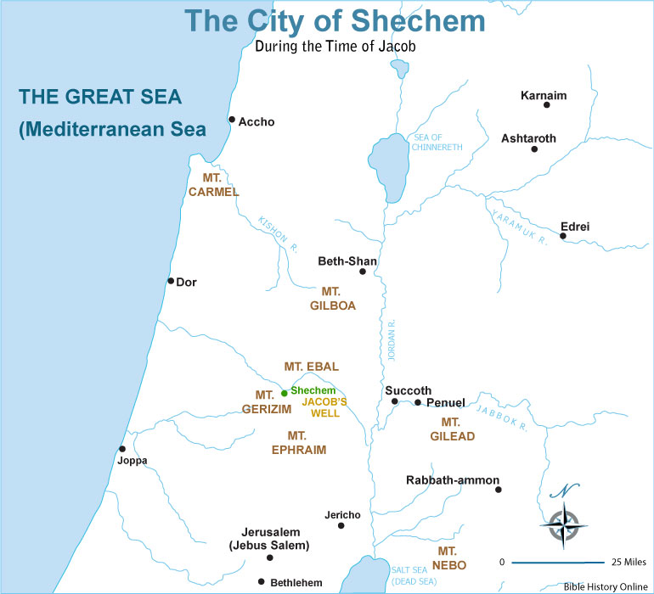

Slide 35
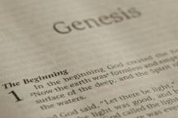
Beginning Themes
Universe Life Man Marriage Evil Clothing | Religion Salvation Language Government Nations Israel
Morris, Genesis Record, 18-20

Slide 37
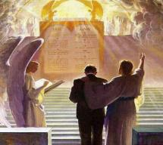
1 Corinthians 3:10-15
“¹⁴ If any man’s work which he has built on it remains, he will receive a reward. ¹⁵ If any man’s work is burned up, he will suffer loss; but he himself will be saved, yet so as through fire.”

Slide 38
Conclusion

Slide 39
Genesis 48:1-22 Jacob Blesses Joseph’s Sons
Adoption (48:1-7)
Blessing of Manasseh & Ephraim (48:8-20)
Exodus prophecy (48:21-22)

Slide 40
III. Genesis 48:21-22 Exodus Prophecy
Exodus prophecy (21)
Joseph’s additional inheritance (22)

Slide 41
²⁴ The Lord bless you, and keep you; ²⁵ The Lord make His face shine on you, And be gracious to you; ²⁶ The Lord lift up His countenance on you, And give you peace.
Numbers 6:24–26 (NASB95)

