Slide 1
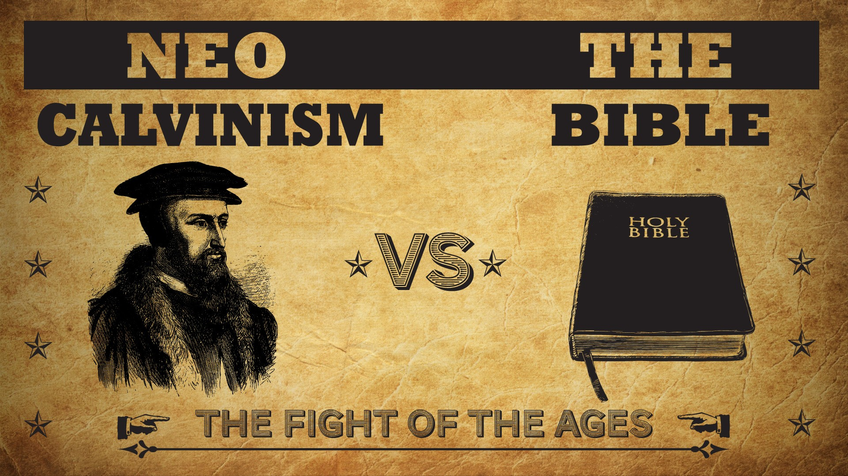


Slide 2
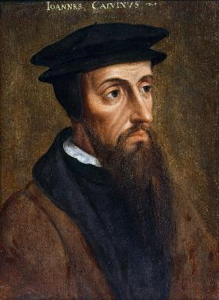
Neo-Calvinism vs. The Bible
Calvinism’s Mixed Blessing
Why Critique Calvinism?
The Source of Calvin’s Theology
Calvin’s Manner of Life
TULIP Through the Grid of Scripture
Conclusion

Slide 3

V. Running TULIP Through the Grid of Scripture
Total Depravity
Unconditional Election
Limited Atonement
Irresistible Grace
Perseverance of the Saints

Slide 4
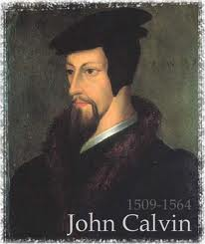
Total Depravity
  The starting point
  Total Depravity properly defined
  Calvinism: Total Depravity = inability
  Calvinism’s overstatement of Total Depravity

Slide 5
Total Depravity
What total depravity is not:
  Man is as evil as he can possibly be & indulges every possible sin
  Man is incapable of doing good things
    Gen. 3:22
    Matt. 7:11
    Acts 10:1-2
    Rom. 2:14-15

Slide 6
Total Depravity
What total depravity is:
  Every area of man’s being is touched by sin
    Intellect (Prov. 3:5-6; 14:12; 2 Cor. 4:4; Rom. 3:11a)
    Conscience (1 Tim 4:2)
    Will (Rom 1:28; 3:11b)
    Deeds (Rom. 3:12)
    Speech (Rom. 3:13-14)
    Feet (Rom. 3:15)

Slide 7
Total Depravity
What total depravity is:
  Every area of man’s being is touched by sin
    Intellect (Prov. 3:5-6; 14:12; 2 Cor. 4:4; Rom. 3:11a)
    Conscience (1 Tim 4:2)
    Will (Rom 1:28; 3:11b)
    Deeds (Rom. 3:12)
    Speech (Rom. 3:13-14)
    Feet (Rom. 3:15)

Slide 8

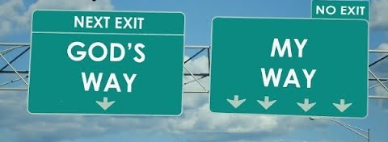
Proverbs 14:12
“There is a way which seems right to a man, But its end is the way of death.”

Slide 9
Total Depravity
What total depravity is:
  Every area of man’s being is touched by sin
    Intellect (Prov. 3:5-6; 14:12; 2 Cor. 4:4; Rom. 3:11a)
    Conscience (1 Tim 4:2)
    Will (Rom 1:28; 3:11b)
    Deeds (Rom. 3:12)
    Speech (Rom. 3:13-14)
    Feet (Rom. 3:15)

Slide 10

Total Depravity
What total depravity is:
  Every area of man’s being is touched by sin (cont’d)
    Heart (Mark 7:21; Eph 4:18)
    Body (Gen 3:19; Rom. 8:23)
    Total being (Rom 1:18–3:20)
  Man is incapable of earning merit favor from God (Isa 64:6; Eph. 2:8-9)

Slide 11
Total Depravity
What total depravity is:
  Every area of man’s being is touched by sin (cont’d)
    Heart (Mark 7:21; Eph 4:18)
    Body (Gen 3:19; Rom. 8:23)
    Total being (Rom 1:18–3:20)
  Man is incapable of earning merit favor from God (Isa 64:6; Eph. 2:8-9)

Slide 12


Jeremiah 17:9
“The heart is more deceitful than all else And is desperately sick; Who can understand it?.”

Slide 13
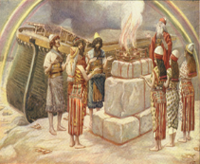
Genesis 8:21
The Lord smelled the soothing aroma; and the Lord said to Himself, “I will never again curse the ground on account of man, for the intent of man’s heart is evil from his youth; and I will never again destroy every living thing, as I have done.[emphasis mine].

Slide 14
Mark 7:20–23
²⁰ And He was saying, “That which proceeds out of the man, that is what defiles the man. ²¹ “For from within, out of the heart of men, proceed the evil thoughts, fornications, thefts, murders, adulteries, ²² deeds of coveting and wickedness, as well as deceit, sensuality, envy, slander, pride and foolishness. ²³ “All these evil things proceed from within and defile the man.”

Slide 15
Total Depravity
What total depravity is:
  Every area of man’s being is touched by sin (cont’d)
    Heart (Mark 7:21; Eph 4:18)
    Body (Gen 3:19; Rom. 8:23)
    Total being (Rom 1:18–3:20)
  Man is incapable of earning merit favor from God (Isa 64:6; Eph. 2:8-9)

Slide 16

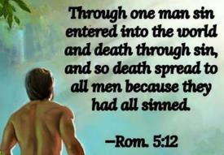
Genesis 3:19
“By the sweat of your face You will eat bread, Till you return to the ground, Because from it you were taken; For you are dust, And to dust you shall return.”

Slide 17

2 Corinthians 4:16
Therefore we do not lose heart, but though our outer man is decaying, yet our inner man is being renewed day by day.

Slide 18
Total Depravity
What total depravity is:
  Every area of man’s being is touched by sin (cont’d)
    Heart (Mark 7:21; Eph 4:18)
    Body (Gen 3:19; Rom. 8:23)
    Total being (Rom 1:18–3:20)
  Man is incapable of earning merit favor from God (Isa 64:6; Eph. 2:8-9)

Slide 19

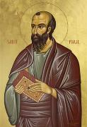
Ephesians 2:8-9
“⁸ For by grace you have been saved through faith [pistis]; and that [touto] not of yourselves, it is the gift [dōron] of God; ⁹ not as a result of works, so that no one may boast. ”

Slide 20
Total Depravity
  The starting point
  Total Depravity properly defined
  Calvinism: Total Depravity = inability
  Calvinism’s overstatement of Total Depravity

Slide 21
Total Depravity = Inability
“T” stands for “Total Depravity.” Man is completely and wholly depraved and has no ability whatsoever to respond (repent or believe) to God until he is first “regenerated” by God.
Bob Kirkland, Calvinism: None Dare Call It Heresy; Spotlight on the Life and Teachings of John Calvin (Eureka, MT: Lighthouse Trails, 2018), 34.

Slide 22

Ephesians 2:1-5
¹ “And you were dead in your trespasses and sins, ² in which you formerly walked according to the course of this world, according to the prince of the power of the air, of the spirit that is now working in the sons of disobedience. ³ Among them we too all formerly lived in the lusts of our flesh, indulging the desires of the flesh and of the mind, and were by nature children of wrath, even as the rest. ⁴ But God, being rich in mercy, because of His great love with which He loved us, ⁵ even when we were dead in our transgressions, made us alive together with Christ (by grace you have been saved)”

Slide 23
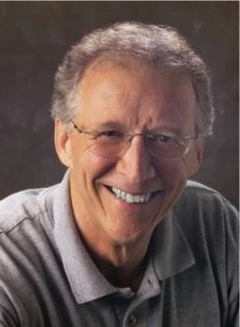
John Piper
John Piper and Pastoral Staff, TULIP: What We Believe About the Five Points of Calvinism: Position Paper of the Pastoral Staff” (Minneapolis, MN: Desiring God Ministries, 1997), Desiring God website, March 1, 1998.
John Piper defines spiritual death as the state of being “incapable of any life with God [before salvation]. Our hearts were like a stone toward God (Ephesians 4:18; Ezekiel 36:26).”

Slide 24
Westminster Confession 10:1
Westminster Confession 10:1. All those whom God hath predestinated unto life, and those only, He is pleased in His appointed and accepted time effectually to call, by His Word and Spirit, out of that state of sin and death, in which they are by nature, to grace and salvation by Jesus Christ; enlightening their minds spiritually and savingly to understand the things of God, taking away their heart of stone, and giving unto them a heart of flesh; renewing their wills, and, by His almighty power determining them to that which is good, and effectually drawing them to Jesus Christ: yet so, as they come most freely, being made willing by His grace.
Notes:
Error of reductionism – oversimplification of a complex subject

Slide 25
John H. Gerstner
Gerstner argues that if John 3: 16 “is supposed to teach that God so loved everyone in the world that He gave His only Son to provide them an opportunity to be saved by faith... such love on God’s part... would be a refinement of cruelty…. Offering a gift of life to a spiritual corpse, a brilliant sunset to a blind man, and a reward to a legless cripple if only he will come and get it, are horrible mockeries.”
John H. Gerstner, Wrongly Dividing the Word of Truth: A Critique of Dispensationalism (Brentwood, TN: Wolgemuth and Hyatt, Publishers, Inc., 1991), 124.

Slide 26

Loraine Boettner
“In the Epistle to the Ephesians Paul declares that Prior to the quickening of the Spirit of God each individual soul lies dead in trespasses and sins. Now it will surely be admitted that to be dead, and to be dead in sin, is clear and positive evidence that there is neither aptitude nor power remaining for the performance of any spiritual action. If a man were dead, in a natural and physical sense, it would at once be readily granted that there is no further possibility of that man being able to perform any physical actions. A corpse cannot act in any way whatsoever, and that man would be reckoned to have taken . . .

Slide 27
Loraine Boettner, The Reformed Doctrine of Predestination (Philipsburg, NJ: Presbyterian and Reformed, 1932), 65-66; quoting Warburton, Calvinism, p. 48.
Loraine Boettner
. . . leave of his senses who asserted that it could. If a man is dead spiritually, therefore, it is surely equally as evident that he is unable to perform any spiritual actions, and thus the doctrine of man's moral inability rests upon strong Scriptural evidence.”

Slide 28

John MacArthur
Faith Works, p. 64-65
“Because we were dead to God, we were dead to truth, righteousness, peace, happiness, and every other good thing, no more capable to respond to God than a cadaver” and are “spiritual zombies, death-walkers, unable even to understand the gravity of their situation. They are lifeless.”
John F. MacArthur Jr., Faith Works: The Gospel According to the Apostles (Dallas: Word, 1993), 64-65.

Slide 29
Samuel H. Turner
Samuel H. Turner says being spiritually dead is “a state of insensibility to the impressions of true religion, so that the party denoted thereby is uninfluenced by its sanctions and representations. . . . It expresses also the inability to raise oneself from the condition denoted by the word.”
Samuel H. Turner, The Epistle to the Ephesians in Greek and English: With an Analysis and Exegetical Commentary [New York: Dana, 1856], 43– 44.

Slide 30
James White
“Unregenerate men who are enemies of God most assuredly respond to God: in a universally negative fashion.”
James R. White, The Potter’s Freedom (Amityville, NY: Calvary Press Publishing, 2000), 98.

Slide 31
Arthur Custance
“A corpse does not cry out for help.”
Arthur Custance, The Sovereignty of Grace (P & R Press; First Edition, 1979), p. 18.

Slide 32
Gordon H. Clark
“A [spiritually] dead man … cannot exercise faith in Jesus Christ.”
Gordon H. Clark, Predestination (Phillipsburg, NJ: Presbyterian and Reformed Publishing, 1987), p. 102.

Slide 33

A. W. Pink
Sovereignty of God, p. 57.
“Faith is a spiritual grace, the fruit of the spiritual nature, and because the unregenerate are spiritually dead – ‘dead in trespasses and sins’ – then it follows that faith from them is impossible, for a dead man cannot believe anything.”

Slide 34
Herman Hoeksema
“[T]he sinner is of himself neither capable nor willing to receive that salvation.”
Herman Hoeksema, Whosoever Will (Grand Rapids, MI: Eerdman’s Publishing Company, First Edition 1945, reprinted 1973), p. 14.

Slide 35
David N. Steele & Curtis C. Thomas
“Because of the fall, man is an unable of himself to savingly believe the gospel. The sinner is dead, blind, and deaf to the things of God; his heart is deceitful and desperately corrupt. His will is not free, it is in bondage to his evil nature, therefore, he will not – indeed he cannot – choose good over evil in the spiritual realm. Consequently, it takes much more than the Spirit’s assistance to bring a sinner to Christ – it takes regeneration by which He makes the sinner alive and gives him a new nature. Faith is not something man contributes to salvation, but is itself a part of God‘s gift of salvation – it is God’s gift to the sinner, not the sinner’s gift to God.”
David N. Steele, Curtis C. Thomas, and S. Lance Quinn, The Five Points of Calvinism, 2nd ed. (Phillipsburg, NJ: Presbyterian and Reformed Publishing, 1963), 5-6.

Slide 36

John 16:7-11
“⁷ But I tell you the truth, it is to your advantage that I go away; for if I do not go away, the Helper will not come to you; but if I go, I will send Him to you. ⁸ And He, when He comes, will convict the world concerning sin and righteousness and judgment; ⁹ concerning sin, because they do not believe in Me; ¹⁰ and concerning righteousness, because I go to the Father and you no longer see Me; ¹¹ and concerning judgment, because the ruler of this world has been judged.”

Slide 37
Gordon H. Clark
“A dead man cannot…exercise faith in Jesus Christ. Faith is an activity of spiritual life, and without the life there can be no activity. Furthermore, faith… does not come by any independent decision. The Scripture is explicit, plain, and unmistakable: ‘for by grace are you saved through faith, and that is not of yourselves, it is the gift of God’ (Ephesians 2:8). Look at the words again, ‘it is the gift of God.’ If God does not give a man faith no amount of willpower and decision can manufacture it for him.”
Gordon H. Clark, Predestination (Phillipsburg, NJ: Presbyterian and Reformed Publishing, 1987), 102.

Slide 38
James White
White argues that because the Bible says Christ saves sinners, we can’t change it to say that he “saves synergistically with the assistance of the sinner himself.”
James R. White, The Potter’s Freedom (Amityville, NY: Calvary Press Publishing, 2000), 247.

Slide 39
James White
White writes, “The Reformed assertion is that man cannot understand and embrace the gospel nor respond in faith and repentance toward Christ without God first freeing him from sin and giving him spiritual life (regeneration).”
James R. White, The Potter’s Freedom (Amityville, NY: Calvary Press Publishing, 2000), 101.

Slide 40
Lorraine Boettner
“The elect of God are chosen by Him to be His children, in order that they might be made to believe, not because He foresaw that they would believe.”
Lorraine Boettner, The Reformed Doctrine of Predestination (Phillipsburg, NJ: Presbyterian and Reformed Publishing Company, 1932, 14th printing), page 101, citing Augustine.

Slide 41
Tom Wells
Wells compares spiritual deadness to “an old dry [Christmas] tree with ―no fruit or ornaments of his own [his faith]. Then God comes along and hangs the bright jewel of faith on him. . . . There is no real connection between what he is and this gift of faith from God.”
Tom Wells, Faith: The Gift of God (Carlisle, PA: Banner of Truth Trust, 1983), 56–57

Slide 42
A. W. Pink
Sovereignty of God, p. 57.
“Faith is not the cause of the new birth, but the consequence of it. This ought not to need arguing. Faith (in God) is an exotic, something that is not native to the human heart.”

Slide 43
A. W. Pink
Sovereignty of God, p. 57, 113, 120.
“Personally, we have no more to do with our spiritual birth than we had with our natural birth…[Man is] utterly incapable of willing anything…the sinner, of himself, cannot repent and believe.”

Slide 44
Total Depravity
  The starting point
  Total Depravity properly defined
  Calvinism: Total Depravity = inability
  Calvinism’s overstatement of Total Depravity

Slide 45

  Calvinism’s Overstatement of Total Depravity
Confusion over intensity vs. extent (Gen. 3:22; Matt. 7:7-11; Rom. 2:14-15)
Operates contrary to man’s design
Mis-defines “death” (Eph. 2:1) as non-existence rather than separation
Underestimates what lost man can do

Slide 46
  Calvinism’s Overstatement of Total Depravity
Confusion over intensity vs. extent (Gen. 3:22; Matt. 7:7-11; Rom. 2:14-15)
Operates contrary to man’s design
Mis-defines “death” (Eph. 2:1) as non-existence rather than separation
Underestimates what lost man can do

Slide 47
Henry Clarence Thiessen
“The Scriptures speak of human nature as totally depraved. However, the doctrine of ‘total depravity’ is easily misunderstood and misinterpreted. From the negative standpoint, it is important to know both what it does not mean and what it does mean. This does not mean that every sinner is devoid of all qualities pleasing to men; that he commits or is prone to every form of sin; or that he is bitterly opposed to God as it is possible for him to be. Jesus recognize the existence of pleasing qualities in some individuals (Mark 10:21); He said that the scribes and Pharisees did some things God demanded (Matt. 23:23); Paul asserted that some . . .

Slide 48
Henry Clarence Thiessen
. . .things God demanded (Matt. 23:23); Paul asserted that some Gentiles ‘do instinctively the things of the law’ (Rom. 2:14); God told Abraham that the iniquity of the Amorites would grow worse (Gen. 15:16); and Paul says that ‘evil men and imposters will proceed from bad to worse’ (2 Tim. 3:13).”
Henry Clarence Thiessen, Lectures in Systematic Theology, rev. ed. (Grand Rapids: Eerdmans, 1979), 191.

Slide 49
  Calvinism’s Overstatement of Total Depravity
Confusion over intensity vs. extent (Gen. 3:22; Matt. 7:7-11; Rom. 2:14-15)
Operates contrary to man’s design
Mis-defines “death” (Eph. 2:1) as non-existence rather than separation
Underestimates what lost man can do

Slide 50

Operates contrary to man’s design
  Man as an image bearer of God (Gen. 1:26-28)
  Omnipotence vs. omni-causality
  The Fall (Gen. 3) merely effaced rather than erased man’s status as a divine image bearer (Gen. 5:1; 9:6; Jas. 3:9; 1 Cor. 11:7)

Slide 51
Operates contrary to man’s design
  Man as an image bearer of God (Gen. 1:26-28)
  Omnipotence vs. omni-causality
  The Fall (Gen. 3) merely effaced rather than erased man’s status as a divine image bearer (Gen. 5:1; 9:6; Jas. 3:9; 1 Cor. 11:7)

Slide 52
Genesis 1:26-28
“²⁶ Then God said, “Let Us make man in Our image, according to Our likeness; and let them rule over the fish of the sea and over the birds of the sky and over the cattle and over all the earth, and over every creeping thing that creeps on the earth.” ²⁷ God created man in His own image, in the image of God He created him; male and female He created them. ²⁸ God blessed them; and God said to them, “Be fruitful and multiply, and fill the earth, and subdue it; and rule over the fish of the sea and over the birds of the sky and over every living thing that moves on the earth.”

Slide 53

Genesis 2:16-17
“¹⁶ The Lord God commanded the man, saying, ‘From any tree of the garden you may eat freely; ¹⁷ but from the tree of the knowledge of good and evil you shall not eat, for in the day that you eat from it you will surely die (muwth).’”

Slide 54
Operates contrary to man’s design
  Man as an image bearer of God (Gen. 1:26-28)
  Omnipotence vs. omni-causality
  The Fall (Gen. 3) merely effaced rather than erased man’s status as a divine image bearer (Gen. 5:1; 9:6; Jas. 3:9; 1 Cor. 11:7)

Slide 55

Calvin said: “The Fall of Adam was not by accident, nor by chance, but was ordained by the secret counsel of God.” He also said that, “The first man fell because the Lord deemed it meet that he should.”
John Calvin
John Calvin, Calvin’s Calvinism: God’s Eternal Predestination and Secret Providence (Reformed Free Publishing Association, Kindle edition from the 2009 2nd edition), Kindle location 3796; idem, Institutes of the Christian Religion, op., cit., Kindle location 17793.

Slide 56
Edwin Palmer
In Edwin Palmer’s book, The Five Points of Calvinism, he states: “God is in back of everything. He decides and causes all things to happen that do happen … even sin. … God ordained sin and unbelief.”
Edwin H. Palmer, The Five Points of Calvinism (Grand Rapids, MI: Baker Books, Enlarged Edition, 1980, 24th printing, 2005), pp. 25, 102.

Slide 57
R. C. Sproul Jr.
R. C. Sproul Jr. (R. C. Sproul’s Calvinist son) said that God “desired that man would fall into sin … [God] created sin.”
R.C. Sproul Jr., Almighty Over All (Grand Rapids, MI: Baker Books, 1999, Second printing, July 1999), pp. 53-54.

Slide 58
A. W. Pink
Sovereignty of God, p. 201.
“That God decreed sin should enter this world through the disobedience of our first parents was a secret hid in His own breast.”

Slide 59

Romans 5:12
“Therefore, just as through one man sin entered into the world, and death through sin, and so death spread to all men, because all sinned—.”

Slide 60
Romans 8:19-22
¹⁹ For the anxious longing of the creation waits eagerly for the revealing of the sons of God. ²⁰ For the creation was subjected to futility, not willingly, but because of Him who subjected it, in hope ²¹ that the creation itself also will be set free from its slavery to corruption into the freedom of the glory of the children of God. ²² For we know that the whole creation groans and suffers the pains of childbirth together until now.

Slide 61
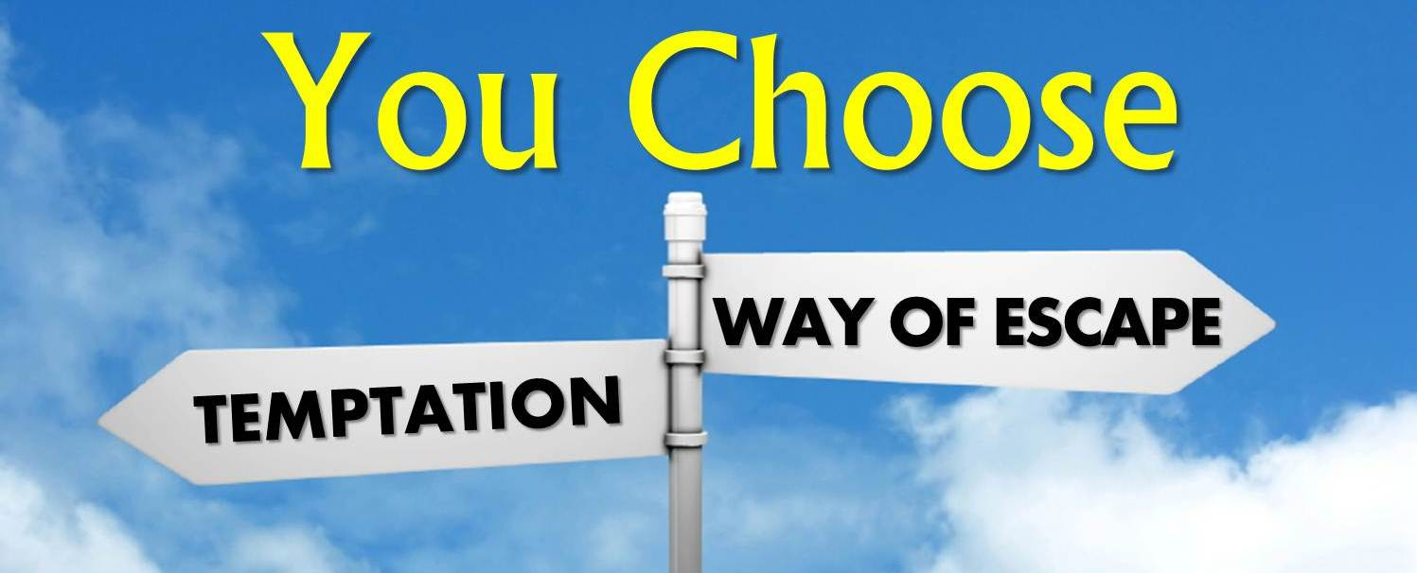
James 1:13
”Let no one say when he is tempted, ‘I am being tempted by God’; for God cannot be tempted by evil, and He Himself does not tempt anyone.”

Slide 62

1 Timothy 6:16
who alone possesses immortality and dwells in unapproachable light, whom no man has seen or can see. To Him be honor and eternal dominion! Amen.

Slide 63

1 John 1:5
This is the message we have heard from Him and announce to you, that God is Light, and in Him there is no darkness at all.

Slide 64
Operates contrary to man’s design
  Man as an image bearer of God (Gen. 1:26-28)
  Omnipotence vs. omni-causality
  The Fall (Gen. 3) merely effaced rather than erased man’s status as a divine image bearer (Gen. 5:1; 9:6; Jas. 3:9; 1 Cor. 11:7)

Slide 65
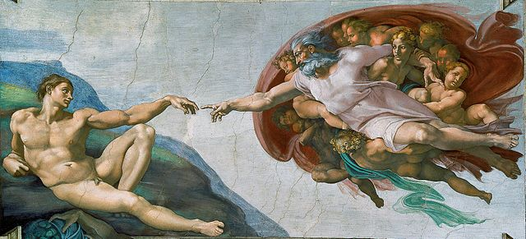
Genesis 9:6
Whoever sheds man’s blood, By man his blood shall be shed, For in the image of God He made man.

Slide 66
James 3:9
With it we bless our Lord and Father, and with it we curse men, who have been made in the likeness of God.

Slide 67
  Calvinism’s Overstatement of Total Depravity
Confusion over intensity vs. extent (Gen. 3:22; Matt. 7:7-11; Rom. 2:14-15)
Operates contrary to man’s design
Mis-defines “death” (Eph. 2:1) as non-existence rather than separation
Underestimates what lost man can do

Slide 68

Calvinism’s Misunderstanding of Death
Ephesians 2:1, 5
Calvinism's anachronistic misunderstanding: non-existence
Lexical definition: separation
Physical death (Gen. 35:18; Eccles. 12:7; Matt. 27:50-51; Luke 23:46; Acts 7:59; Dan. 12:2; Matt. 25:46; 2 Cor. 5:8; Philip. 1:21-23)
Other examples (Gen. 2:17; 3:8; Isa. 59:1-2)
Faith is possible (absent regeneration 1st) though the Spirit’s conviction (John 16:8), the Word’s proclamation (Isa. 55:8-9; Rom. 10:17; 2 Tim. 3:15; 1 Pet. 1:23; Jas. 1:18)

Slide 69
Calvinism’s Misunderstanding of Death
Ephesians 2:1, 5
Calvinism's anachronistic misunderstanding: non-existence
Lexical definition: separation
Physical death (Gen. 35:18; Eccles. 12:7; Matt. 27:50-51; Luke 23:46; Acts 7:59; Dan. 12:2; Matt. 25:46; 2 Cor. 5:8; Philip. 1:21-23)
Other examples (Gen. 2:17; 3:8; Isa. 59:1-2)
Faith is possible (absent regeneration 1st) though the Spirit’s conviction (John 16:8), the Word’s proclamation (Isa. 55:8-9; Rom. 10:17; 2 Tim. 3:15; 1 Pet. 1:23; Jas. 1:18)

Slide 70
Ephesians 2:1-5
¹ “And you were dead in your trespasses and sins, ² in which you formerly walked according to the course of this world, according to the prince of the power of the air, of the spirit that is now working in the sons of disobedience. ³ Among them we too all formerly lived in the lusts of our flesh, indulging the desires of the flesh and of the mind, and were by nature children of wrath, even as the rest. ⁴ But God, being rich in mercy, because of His great love with which He loved us, ⁵ even when we were dead in our transgressions, made us alive together with Christ (by grace you have been saved)”

Slide 71
Calvinism’s Misunderstanding of Death
Ephesians 2:1, 5
Calvinism's anachronistic misunderstanding: non-existence
Lexical definition: separation
Physical death (Gen. 35:18; Eccles. 12:7; Matt. 27:50-51; Luke 23:46; Acts 7:59; Dan. 12:2; Matt. 25:46; 2 Cor. 5:8; Philip. 1:21-23)
Other examples (Gen. 2:17; 3:8; Isa. 59:1-2)
Faith is possible (absent regeneration 1st) though the Spirit’s conviction (John 16:8), the Word’s proclamation (Isa. 55:8-9; Rom. 10:17; 2 Tim. 3:15; 1 Pet. 1:23; Jas. 1:18)

Slide 72
Loraine Boettner
“In the Epistle to the Ephesians Paul declares that Prior to the quickening of the Spirit of God each individual soul lies dead in trespasses and sins. Now it will surely be admitted that to be dead, and to be dead in sin, is clear and positive evidence that there is neither aptitude nor Power remaining for the performance of any spiritual action. If a man were dead, in a natural and physical sense, it would at once be readily granted that there is no further possibility of that man being able to perform any physical actions. A corpse cannot act in any way whatever, and that man would be reckoned to have taken . . .

Slide 73
Loraine Boettner, The Reformed Doctrine of Predestination (Philipsburg, NJ: Presbyterian and Reformed, 1932), 65-66; quoting Warburton, Calvinism, p. 48.
Loraine Boettner
. . .leave of his senses who asserted that it could. If a man is dead spiritually, therefore, it is surely equally as evident that he is unable to perform any spiritual actions, and thus the doctrine of man's moral inability rests upon strong Scriptural evidence.”

Slide 74
Arthur Custance
“A corpse does not cry out for help.”
Arthur Custance, The Sovereignty of Grace (P & R Press; First Edition, 1979), p. 18.

Slide 75
Using a Foolish Analogy to Support Calvinism
“Calvinists say, ‘Since he is dead, it is impossible for him to believe.’ This is a foolish analogy!...A person who is physically dead cannot receive Christ as his Savior, but neither can he speak, breathe, laugh, walk, live a righteous life, or sin.”
Bob Kirkland, Calvinism: None Dare Call It Heresy; Spotlight on the Life and Teachings of John Calvin (Eureka, MT: Lighthouse Trails, 2018), 35.

Slide 76
Calvinism’s Misunderstanding of Death
Ephesians 2:1, 5
Calvinism's anachronistic misunderstanding: non-existence
Lexical definition: separation
Physical death (Gen. 35:18; Eccles. 12:7; Matt. 27:50-51; Luke 23:46; Acts 7:59; Dan. 12:2; Matt. 25:46; 2 Cor. 5:8; Philip. 1:21-23)
Other examples (Gen. 2:17; 3:8; Isa. 59:1-2)
Faith is possible (absent regeneration 1st) though the Spirit’s conviction (John 16:8), the Word’s proclamation (Isa. 55:8-9; Rom. 10:17; 2 Tim. 3:15; 1 Pet. 1:23; Jas. 1:18)

Slide 77
“Death” in the Old Testament
māwet: “Death is the consequences and the punishment of sin. It originated with sin. A grand theme of the Old Testament is God’s holiness, which separates Him from all that is in harmony with His character. Death, then, in the Old Testament means ultimate separation from God due to sin.”
Elmer B. Smick, “māwet," in Theological Wordbook of the Old Testament, ed. R. Laird Harris and Gleason L. Archer and Bruce K. Waltke(Chicago: Moody, 1980), 1:1169.

Slide 78
“Death” in the New Testament
thanatos: “that separation (whether natural or violent) of the soul from the body by which the life on earth is ended.”
Joseph Henry Thayer, Death - Thanatos, Greek-English Lexicon of the New Testament Being Grmm's Wilke's Clavis Novi Testamenti (Grand Rapids: Zondervan, 1977), 282.

Slide 79
Calvinism’s Misunderstanding of Death
Ephesians 2:1, 5
Calvinism's anachronistic misunderstanding: non-existence
Lexical definition: separation
Physical death (Gen. 35:18; Eccles. 12:7; Matt. 27:50-51; Luke 23:46; Acts 7:59; Dan. 12:2; Matt. 25:46; 2 Cor. 5:8; Philip. 1:21-23)
Other examples (Gen. 2:17; 3:8; Isa. 59:1-2)
Faith is possible (absent regeneration 1st) though the Spirit’s conviction (John 16:8), the Word’s proclamation (Isa. 55:8-9; Rom. 10:17; 2 Tim. 3:15; 1 Pet. 1:23; Jas. 1:18)

Slide 80

Daniel 12:2
“Many of those who sleep in the dust of the ground will awake, these to everlasting (olam) life, but the others to disgrace and everlasting (olam) contempt.”

Slide 81

Matthew 25:46
“These will go away into eternal (aiōnios) punishment, but the righteous into eternal (aiōnios) life.”

Slide 82
Calvinism’s Misunderstanding of Death
Ephesians 2:1, 5
Calvinism's anachronistic misunderstanding: non-existence
Lexical definition: separation
Physical death (Gen. 35:18; Eccles. 12:7; Matt. 27:50-51; Luke 23:46; Acts 7:59; Dan. 12:2; Matt. 25:46; 2 Cor. 5:8; Philip. 1:21-23)
Other examples (Gen. 2:17; 3:8; Isa. 59:1-2)
Faith is possible (absent regeneration 1st) though the Spirit’s conviction (John 16:8), the Word’s proclamation (Isa. 55:8-9; Rom. 10:17; 2 Tim. 3:15; 1 Pet. 1:23; Jas. 1:18)

Slide 83
Genesis 2:16-17
“¹⁶ The Lord God commanded the man, saying, ‘From any tree of the garden you may eat freely; ¹⁷ but from the tree of the knowledge of good and evil you shall not eat, for in the day that you eat from it you will surely die (muwth).’”

Slide 84
Calvinism’s Misunderstanding of Death
Ephesians 2:1, 5
Calvinism's anachronistic misunderstanding: non-existence
Lexical definition: separation
Physical death (Gen. 35:18; Eccles. 12:7; Matt. 27:50-51; Luke 23:46; Acts 7:59; Dan. 12:2; Matt. 25:46; 2 Cor. 5:8; Philip. 1:21-23)
Other examples (Gen. 2:17; 3:8; Isa. 59:1-2)
Faith is possible (absent regeneration 1st) though the Spirit’s conviction (John 16:8), the Word’s proclamation (Isa. 55:8-9; Rom. 10:17; 2 Tim. 3:15; 1 Pet. 1:23; Jas. 1:18)

Slide 85
John 16:7-11
“⁷ But I tell you the truth, it is to your advantage that I go away; for if I do not go away, the Helper will not come to you; but if I go, I will send Him to you. ⁸ And He, when He comes, will convict the world concerning sin and righteousness and judgment; ⁹ concerning sin, because they do not believe in Me; ¹⁰ and concerning righteousness, because I go to the Father and you no longer see Me; ¹¹ and concerning judgment, because the ruler of this world has been judged.”

Slide 86

Dr. Robert R. Congdon
Oops! I Thought I Was a Four - Pt Calvinist (Greer, SC: Congdon Ministries International, 2014), 48.
“While I do agree that salvation comes through the workings of the Holy Spirit and the Word of God, I disagree with the idea that God must first predispose some to believe and receive it, for the Word of God and the Holy Spirit are sufficient in and of themselves in bringing about the new birth. Instead of forcing individuals to be saved through the irresistible prompting of the Holy Spirit, God uses His Word and the convicting work of the Holy Spirit to confirm its truth in order to bring individuals to the point of decision. It is certainly God’s grace that offers it, but at this point they are free to accept or reject salvation.”

Slide 87
Dr. Robert R. Congdon
Oops! I Thought I Was a Four - Pt Calvinist (Greer, SC: Congdon Ministries International, 2014), 69-70.
“…their [Calvinism’s] definition of total depravity negates the sufficiency of the power of the Word of God and the Holy Spirit to give life...”

Slide 88
Death: Calvinism vs Biblicism
 | CALVINISM | BIBLICISM
Spiritual death: | Corpse, cadaver | Separated
Consciousness: | Cessation, lifeless | Aware
Results: | Inability | Can hear and believe
Spiritual response: | Regeneration first | God’s Word, Spirit’s conviction, Gospel’s power
Regeneration: | Before faith | Result of faith
Adapted from Robert R. Congdon, Oops! I Thought I Was a Four - Pt Calvinist (Greer, SC: Congdon Ministries International, 2014), 22.

Slide 89
  Calvinism’s Overstatement of Total Depravity
Confusion over intensity vs. extent (Gen. 3:22; Matt. 7:7-11; Rom. 2:14-15)
Operates contrary to man’s design
Mis-defines “death” (Eph. 2:1) as non-existence rather than separation
Underestimates what lost man can do

Slide 90
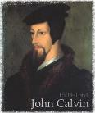
Calvinism Underestimates What Lost Man Can Do
  Lost man can seek God (John 16:7-11; Acts 10‒11)
  Lost man can hear from God (Acts 10:30-32, 44-48; 11:14)
  Lost man can reason (Matt. 21:23-27)
  Lost man can believe (exercise faith) in God (John 3:18)

Slide 91
Calvinism Underestimates What Lost Man Can Do
  Lost man can seek God (John 16:7-11; Acts 10‒11)
  Lost man can hear from God (Acts 10:30-32, 44-48; 11:14)
  Lost man can reason (Matt. 21:23-27)
  Lost man can believe (exercise faith) in God (John 3:18)

Slide 92
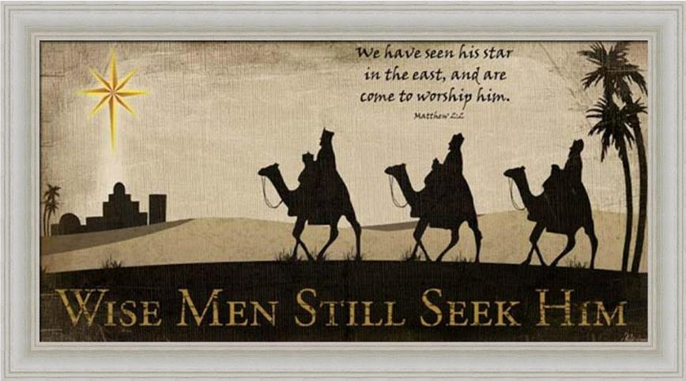

Slide 93
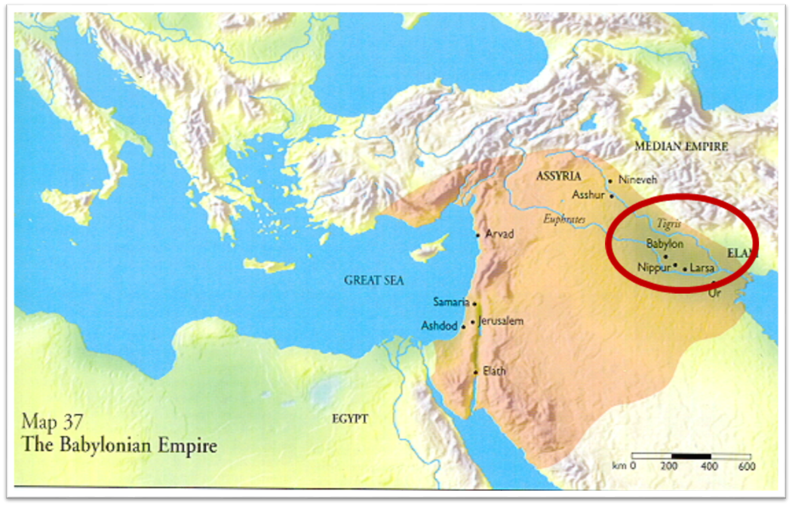

Slide 94
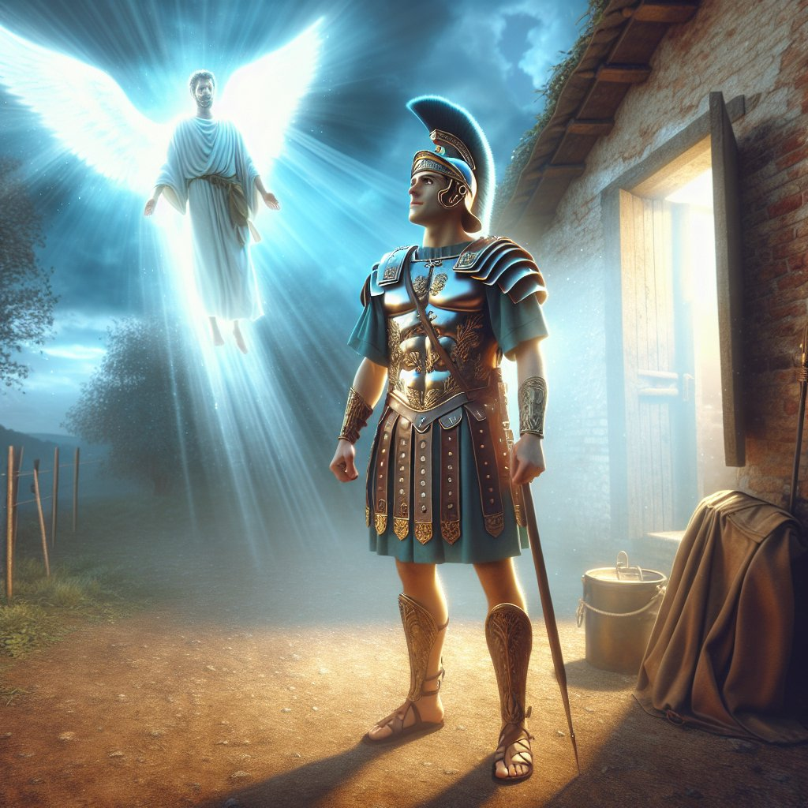
Acts 10:2
“¹ Now there was a man at Caesarea named Cornelius, a centurion of what was called the Italian cohort, ² a devout man and one who feared God with all his household, and gave many alms to the Jewish people and prayed to God continually.”

Slide 95
Acts 11:14
“and he will speak words to you by which you [Cornelius] will be saved, you and all your household.”

Slide 96

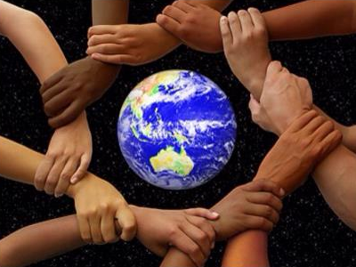
Acts 17:26-27
²⁶ and He made from one man every nation of mankind to live on all the face of the earth, having determined their appointed times and the boundaries of their habitation, ²⁷ that they would seek God, if perhaps they might grope for Him and find Him, though He is not far from each one of us (Italics added)

Slide 97
Romans 3:11
“There is none who understands, There is none who seeks for God.”

Slide 98
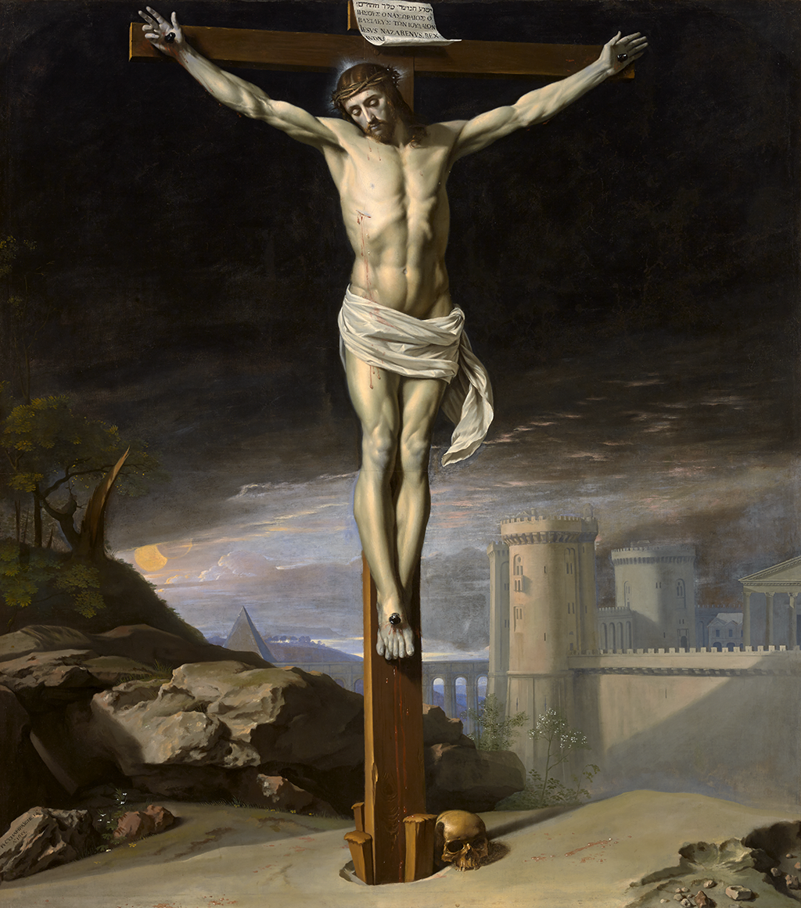
John 12:32
“And I, if I am lifted up from the earth, will draw all men to Myself.”

Slide 99
John 16:7-11
“⁷ But I tell you the truth, it is to your advantage that I go away; for if I do not go away, the Helper will not come to you; but if I go, I will send Him to you. ⁸ And He, when He comes, will convict the world concerning sin and righteousness and judgment; ⁹ concerning sin, because they do not believe in Me; ¹⁰ and concerning righteousness, because I go to the Father and you no longer see Me; ¹¹ and concerning judgment, because the ruler of this world has been judged.”

Slide 100
Isaiah 55:10-11
¹⁰ “For as the rain and the snow come down from heaven, And do not return there without watering the earth And making it bear and sprout, And furnishing seed to the sower and bread to the eater; ¹¹ So will My word be which goes forth from My mouth; It will not return to Me empty, Without accomplishing what I desire, And without succeeding in the matter for which I sent it.”

Slide 101

2 Timothy 3:15
“and that from childhood you have known the sacred writings which are able to give you the wisdom that leads to salvation through faith which is in Christ Jesus.”

Slide 102
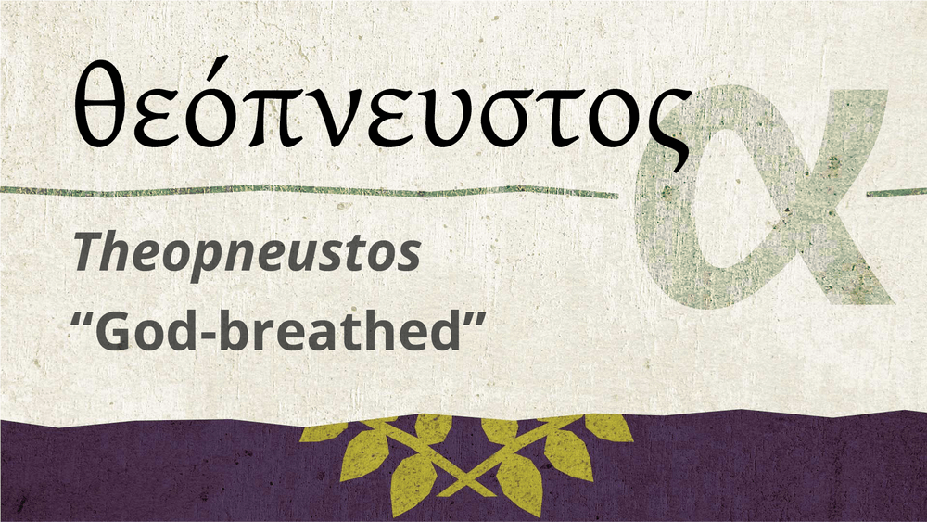
2 Timothy 3:16-17
“All Scripture is inspired by God [theopneustos] and profitable for teaching, for reproof, for correction, for training in righteousness; so that the man of God may be adequate, equipped for every good work.”

Slide 103

Romans 1:16
“For I am not ashamed of the gospel, for it is the power of God for salvation to everyone who believes, to the Jew first and also to the Greek.”

Slide 104
Romans 1:18-20
“¹⁸ For the wrath of God is revealed from heaven against all ungodliness and unrighteousness of men who suppress the truth in unrighteousness, ¹⁹ because that which is known about God is evident within them; for God made it evident to them. ²⁰ For since the creation of the world His invisible attributes, His eternal power and divine nature, have been clearly seen, being understood through what has been made, so that they are without excuse.”

Slide 105
Psalm 19:1-4
“¹ The heavens are telling of the glory of God; And their expanse is declaring the work of His hands. ² Day to day pours forth speech, And night to night reveals knowledge. ³ There is no speech, nor are there words; Their voice is not heard. ⁴ Their line has gone out through all the earth, And their utterances to the end of the world. In them He has placed a tent for the sun.”

Slide 106
Calvinism Underestimates What Lost Man Can Do
  Lost man can seek God (John 16:7-11; Acts 10‒11)
  Lost man can hear from God (Acts 10:30-32, 44-48; 11:14)
  Lost man can reason (Matt. 21:23-27)
  Lost man can believe (exercise faith) in God (John 3:18)

Slide 107
Acts 11:14
“and he will speak words to you by which you [Cornelius] will be saved, you and all your household.”

Slide 108
Calvinism Underestimates What Lost Man Can Do
  Lost man can seek God (John 16:7-11; Acts 10‒11)
  Lost man can hear from God (Acts 10:30-32, 44-48; 11:14)
  Lost man can reason (Matt. 21:23-27)
  Lost man can believe (exercise faith) in God (John 3:18)

Slide 109
Calvinism Underestimates What Lost Man Can Do
  Lost man can seek God (John 16:7-11; Acts 10‒11)
  Lost man can hear from God (Acts 10:30-32, 44-48; 11:14)
  Lost man can reason (Matt. 21:23-27)
  Lost man can believe (exercise faith) in God (John 3:18)

Slide 110
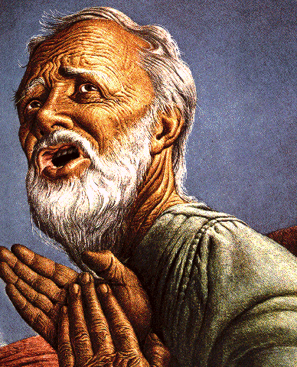
Passage Conditioning Salvation on Faith Alone (Sola Fide)
Genesis 15:6
John 3:16; 5:24; 6:28-29, 47; 16:8-9; 20:30-31
Acts 16:30-31
Romans 1:16; Ephesians 2:8-9
Hebrews 11:6

Slide 111
Belief – God’s One Condition for Justification
Gen 15:6
Then he believed in the LORD; and He reckoned it to him as righteousness.
John 3:16
For God so loved the world, that He gave His only begotten Son, that whoever believes in Him shall not perish, but have eternal life.
Acts 16:30-31
"Sirs, what must I do to be saved?" They said, "Believe in the Lord Jesus, and you will be saved..."

Slide 112

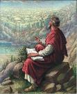
John 20:30-31
“Therefore many other signs Jesus also performed in the presence of the disciples, which are not written in this book; but these have been written so that you may believe that Jesus is the Christ, the Son of God; and that believing you may have life in His name.”

Slide 113
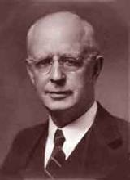
Lewis Sperry Chafer, vol. 7, Systematic Theology
(Grand Rapids, MI: Kregel Publications, 1993), 265-66.
Belief-God’s One Condition for Justification
“…because upwards of 150 passages of Scripture condition salvation upon believing only (cf. John 3:16; Acts 16:31).”

Slide 114
Dr. Robert R. Congdon
Oops! I Thought I Was a Four - Pt Calvinist (Greer, SC: Congdon Ministries International, 2014), 51.
“Furthermore, why would God admonish and warn unbelievers for being spiritually blind and deaf if it were not in their power to respond?…Is this not a mockery? It would be like chiding a legless man for being unable to walk.”

Slide 115
V. Running TULIP Through the Grid of Scripture
Total Depravity
Unconditional Election
Limited Atonement
Irresistible Grace
Perseverance of the Saints

Slide 116
Total Depravity
  The starting point
  Total Depravity properly defined
  Calvinism: Total Depravity = inability
  Calvinism’s overstatement of Total Depravity

