Slide 1
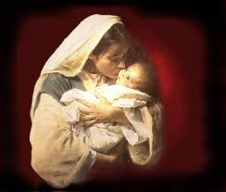

Christmas Eve
Micah 5:2
Andrew Marshall Woods, Th.M., JD., PhD.
Sr. Pastor, Sugar Land Bible Church

Slide 2
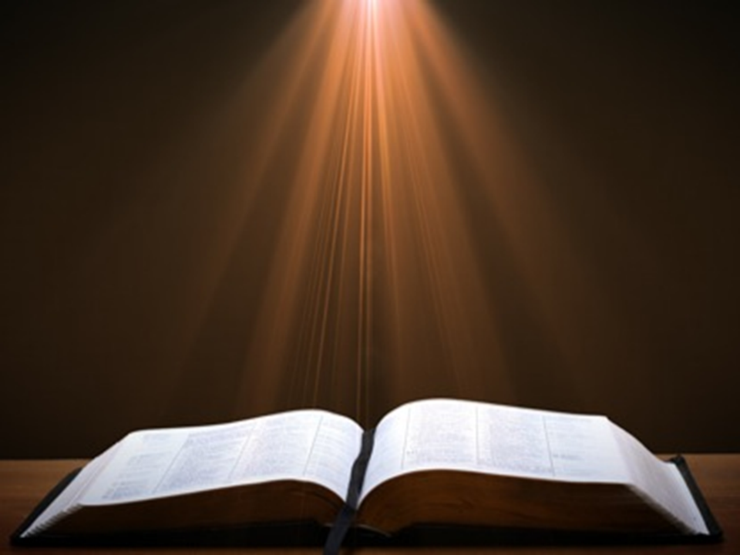
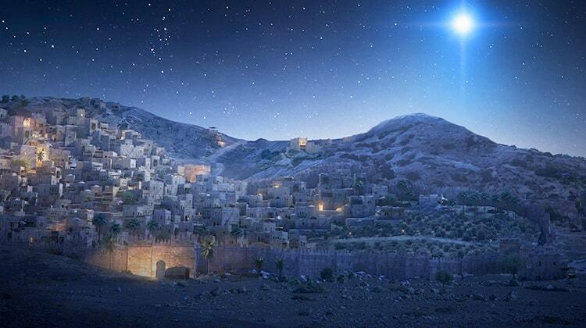
Micah 5:2
“But as for you, Bethlehem Ephrathah, Too little to be among the clans of Judah, From you One will go forth for Me to be ruler in Israel. His goings forth are from long ago, From the days of eternity.”

Slide 3
Seven Words from Micah 5:2
Eternity
Ruler
Israel
Judah
Bethlehem
Ephrathah
Little

Slide 4
Seven Words from Micah 5:2
Eternity
Ruler
Israel
Judah
Bethlehem
Ephrathah
Little

Slide 5
Micah 5:2
“But as for you, Bethlehem Ephrathah, Too little to be among the clans of Judah, From you One will go forth for Me to be ruler in Israel. His goings forth are from long ago, From the days of eternity (olam).”

Slide 6

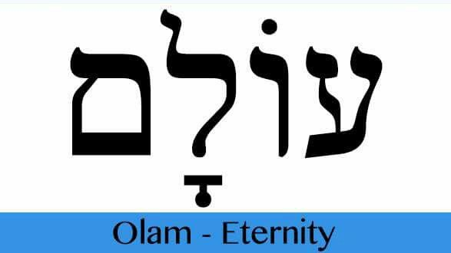
Psalm 90:2
“Before the mountains were born Or You gave birth to the earth and the world, Even from everlasting (olam) to everlasting (olam), You are God.”

Slide 7

2 Samuel 7:8, 16
“⁸ Now therefore, thus you shall say to My servant David, ‘Thus says the Lord of hosts, “I took you from the pasture, from following the sheep, to be ruler over My people Israel… ¹⁶ Your house and your kingdom shall endure before Me forever; your throne shall be established forever.”

Slide 8
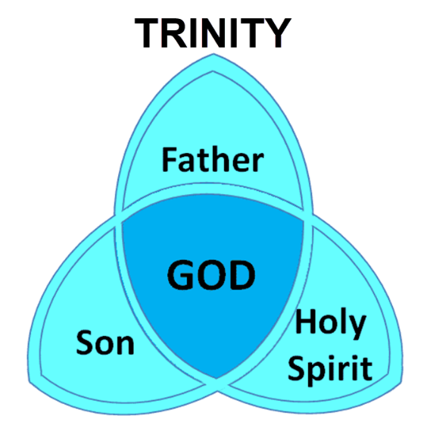
Virgin Birth Emphasizes Christ’s Eternality

Slide 9
Seven Words from Micah 5:2
Eternity
Ruler
Israel
Judah
Bethlehem
Ephrathah
Little

Slide 10
Micah 5:2
“But as for you, Bethlehem Ephrathah, Too little to be among the clans of Judah, From you One will go forth for Me to be ruler in Israel. His goings forth are from long ago, From the days of eternity.”

Slide 11
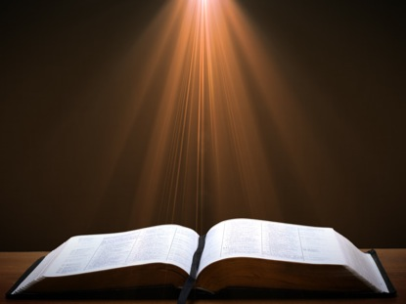
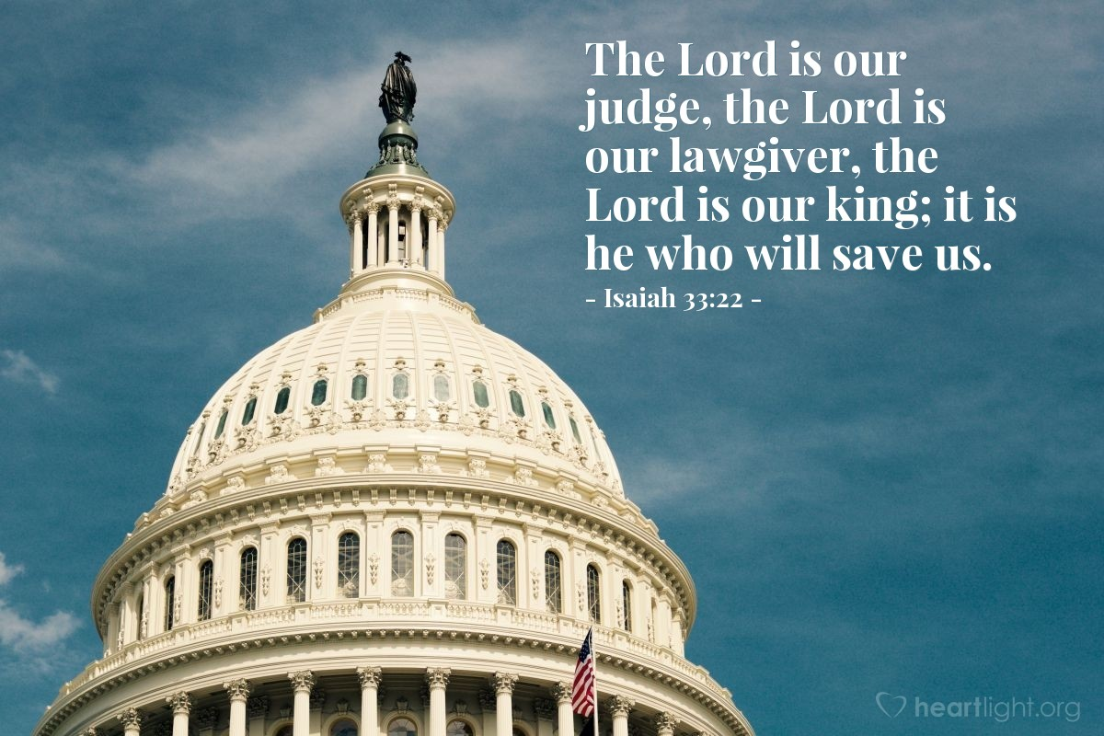
Isaiah 33:22
“For the LORD is our judge, The LORD is our lawgiver, The LORD is our king.”

Slide 12
Seven Words from Micah 5:2
Eternity
Ruler
Israel
Judah
Bethlehem
Ephrathah
Little

Slide 13
Micah 5:2
“But as for you, Bethlehem Ephrathah, Too little to be among the clans of Judah, From you One will go forth for Me to be ruler in Israel. His goings forth are from long ago, From the days of eternity.”

Slide 14

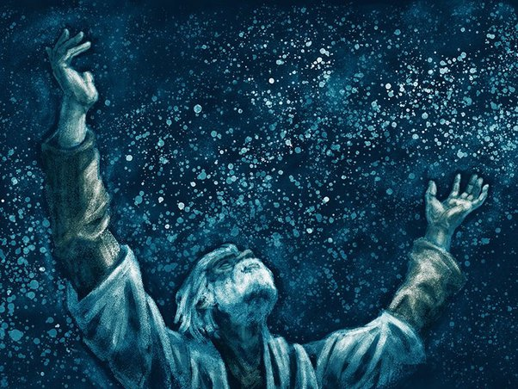
Genesis 12:3
“And I will bless those who bless you, And the one who curses you I will curse. And in you all the families of the earth will be blessed.”

Slide 15
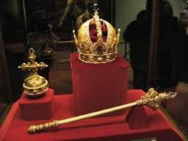
Numbers 24:17
“I see him, but not now; I behold him, but not near; A star shall come forth from Jacob, A scepter shall rise from Israel, And shall crush through the forehead of Moab, And tear down all the sons of Sheth.”

Slide 16
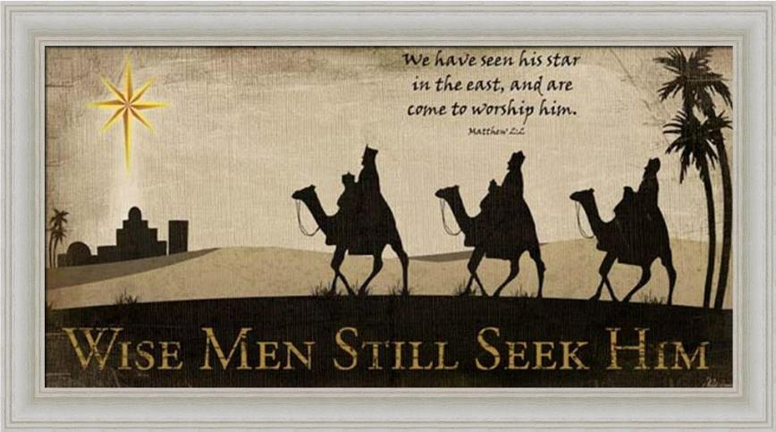

Slide 17
Seven Words from Micah 5:2
Eternity
Ruler
Israel
Judah
Bethlehem
Ephrathah
Little

Slide 18
Micah 5:2
“But as for you, Bethlehem Ephrathah, Too little to be among the clans of Judah, From you One will go forth for Me to be ruler in Israel. His goings forth are from long ago, From the days of eternity.”

Slide 19
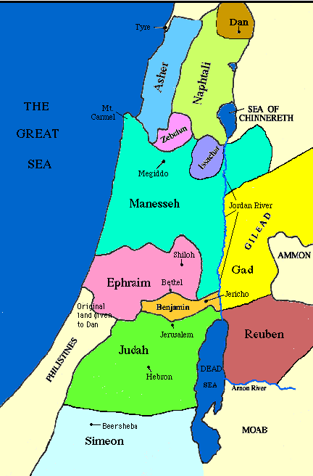

Slide 21
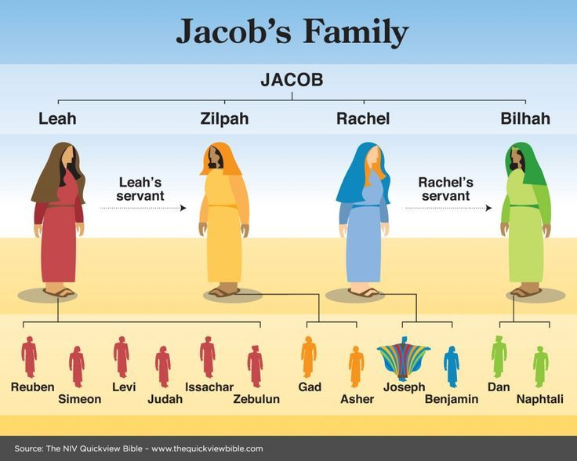

Slide 22
Messiah must be from the tribe of Judah
Genesis 49:10
Revelation 5:5

Slide 23
Genesis 49:10
“The scepter shall not depart from Judah, Nor the ruler’s staff from between his feet, Until Shiloh comes, And to him shall be the obedience of the peoples.”

Slide 24


Revelation 5:5
“and one of the elders said to me, “Stop weeping; behold, the Lion that is from the tribe of Judah, the Root of David, has overcome so as to open the book and its seven seals.”

Slide 25
Seven Words from Micah 5:2
Eternity
Ruler
Israel
Judah
Bethlehem
Ephrathah
Little

Slide 26
Micah 5:2
“But as for you, Bethlehem Ephrathah, Too little to be among the clans of Judah, From you One will go forth for Me to be ruler in Israel. His goings forth are from long ago, From the days of eternity.”

Slide 27
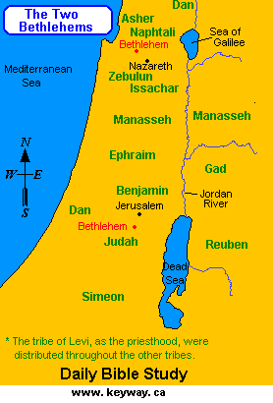

Slide 28
Seven Words from Micah 5:2
Eternity
Ruler
Israel
Judah
Bethlehem
Ephrathah
Little

Slide 29
Micah 5:2
“But as for you, Bethlehem Ephrathah, Too little to be among the clans of Judah, From you One will go forth for Me to be ruler in Israel. His goings forth are from long ago, From the days of eternity.”

Slide 30
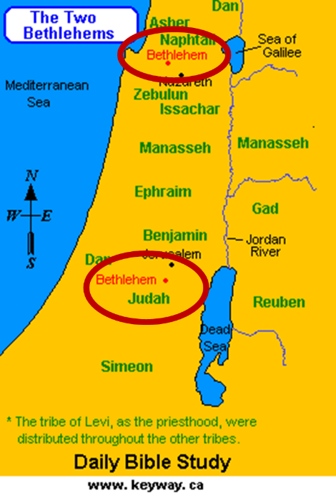

Slide 31
Seven Words from Micah 5:2
Eternity
Ruler
Israel
Judah
Bethlehem
Ephrathah
Little

Slide 32
Micah 5:2
“But as for you, Bethlehem Ephrathah, Too little to be among the clans of Judah, From you One will go forth for Me to be ruler in Israel. His goings forth are from long ago, From the days of eternity.”

Slide 33
Conclusion

Slide 34
Seven Words from Micah 5:2
Eternity
Ruler
Israel
Judah
Bethlehem
Ephrathah
Little

Slide 35
Matthew 2:4-6
“⁴ Gathering together all the chief priests and scribes of the people, he inquired of them where the Messiah was to be born. ⁵ They said to him, “In Bethlehem of Judea; for this is what has been written by the prophet: ⁶ ‘And you, Bethlehem, land of Judah, Are by no means least among the leaders of Judah; For out of you shall come forth a Ruler Who will shepherd My people Israel.’”

