Slide 1
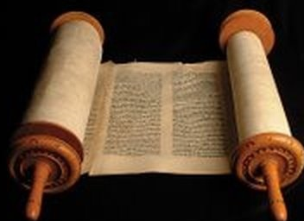
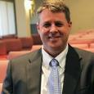
A Christmas Convergence*
Dr. Andrew M. Woods
Senior Pastor – Sugar Land Bible Church
President – Chafer Theological Seminary
*Adapted from David Hocking, Who Is The Messiah?; and C. I. Scofield, Addresses in Prophecy

Slide 2
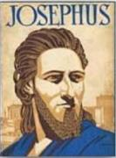
Josephus
Antiquities 18.3.3
“About this time there lived Jesus, a wise man, if indeed one ought to call him a man. For he was one who performed surprising deeds and was a teacher of such people as accept the truth gladly. He won over many Jews and many of the Greeks. He was the Christ. And when, upon the accusation of the principal men among us, Pilate had condemned him to a cross, those who had first come to love him did not cease. He appeared to them spending a third day restored to life, for the prophets of God had foretold these things and a thousand other marvels about him. And the tribe of the Christians, so called after him, has still to this day not disappeared.”

Slide 3
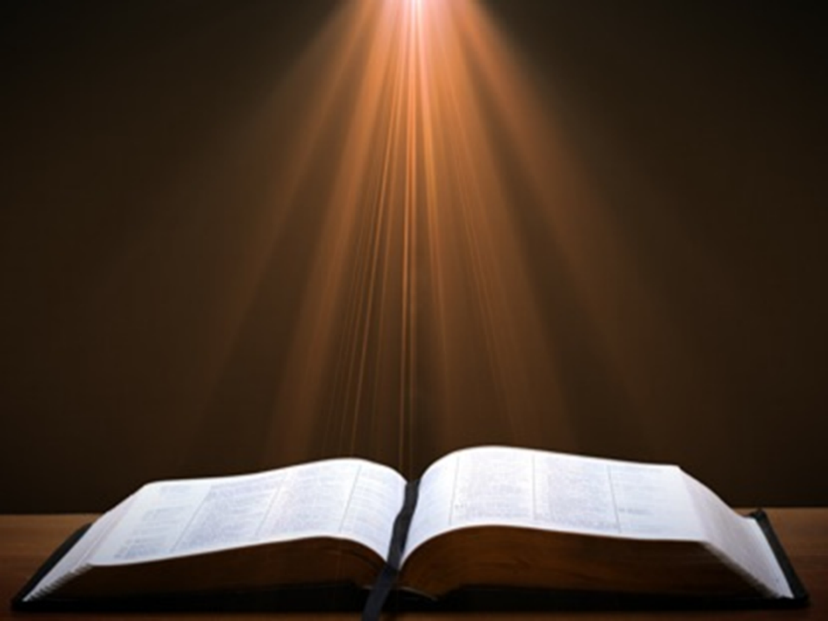
Luke 24:27, 44
“²⁷ Then beginning with Moses and with all the prophets, He explained to them the things concerning Himself in all the Scriptures…⁴⁴ Now He said to them, ‘These are My words which I spoke to you while I was still with you, that all things which are written about Me in the Law of Moses and the Prophets and the Psalms must be fulfilled.’”

Slide 4
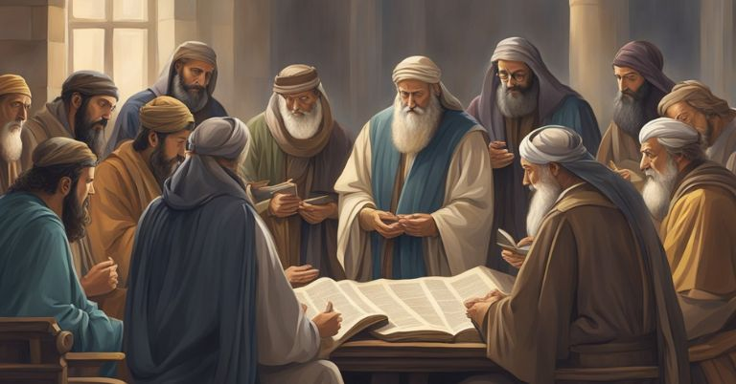
John 5:39, 46
“³⁹ You search the Scriptures because you think that in them you have eternal life; it is these that testify about Me…⁴⁶ For if you believed Moses, you would believe Me, for he wrote about Me.”

Slide 5
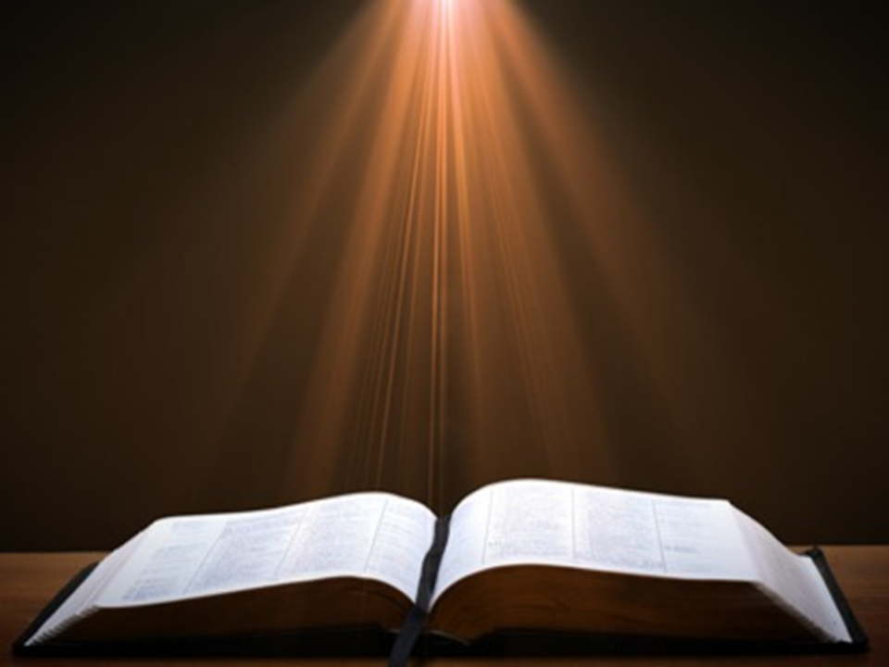
Acts 17:1-3
“¹ Now when they had traveled through Amphipolis and Apollonia, they came to Thessalonica, where there was a synagogue of the Jews. ² And according to Paul’s custom, he went to them, and for three Sabbaths reasoned with them from the Scriptures, ³ explaining and giving evidence that the Christ had to suffer and rise again from the dead, and saying, ‘This Jesus whom I am proclaiming to you is the Christ.’”

Slide 6
1 Corinthians 15:3-4
“³ For I handed down to you as of first importance what I also received, that Christ died for our sins according to the Scriptures, ⁴ and that He was buried, and that He was raised on the third day according to the Scriptures.”

Slide 7
Messiah Must Be:
  A man (Gen 3:15)
  Semitic (Gen 9:26)
  From Abraham’s line (Gen 12:3)
  From Isaac’s line (Gen 17:18-19)
  From Jacob’s line (Num 24:17)
  From the tribe of Judah (Gen 49:10)
  From the family of Jesse (Isa 11:1)

Slide 8
Messiah Must Be:
  From David’s line (2 Sam 7:16)
  Solomon’s line (1 Chron 28:4-7)
  Be born in Bethlehem (Micah 5:2)
  Be born of a virgin (Isa 7:14)
  Come before A.D. 70 (Mal 3:1)
  Present Himself to Israel on 3/30/33 (Dan 9:25)
  Die in a particular way (Zech 12:10)

Slide 9
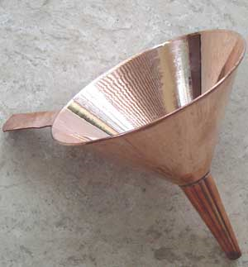

Slide 10
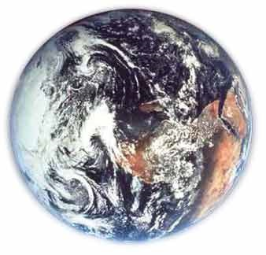
Modern Example
Hemisphere
Country
State
County
City
Zip code
Street name
Street address
Room
Person

Slide 11
1) Messiah must be a man
Genesis 3:15

Slide 12
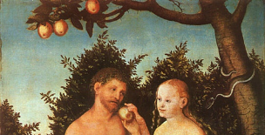
Genesis 3:15
“And I will put enmity between you and the woman, and between your seed and her seed; He shall bruise you on the head, and you shall bruise him on the heel.”

Slide 13
Genesis 3:15
“And I will put enmity between you and the woman, and between your seed and her seed; He shall bruise you on the head, and you shall bruise him on the heel.”

Slide 14
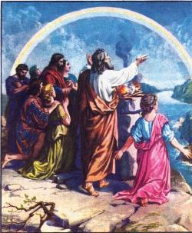
2) Messiah must be Semitic
Genesis 9:26

Slide 15
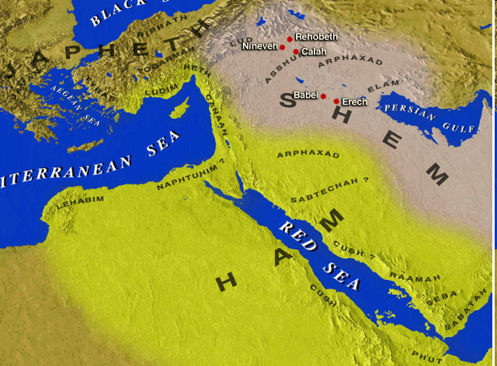

Slide 16
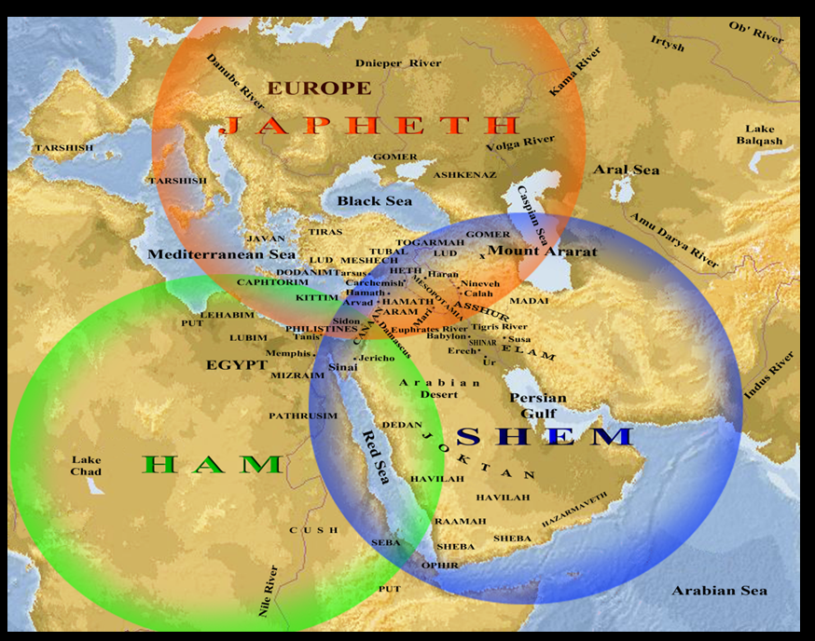

Slide 17
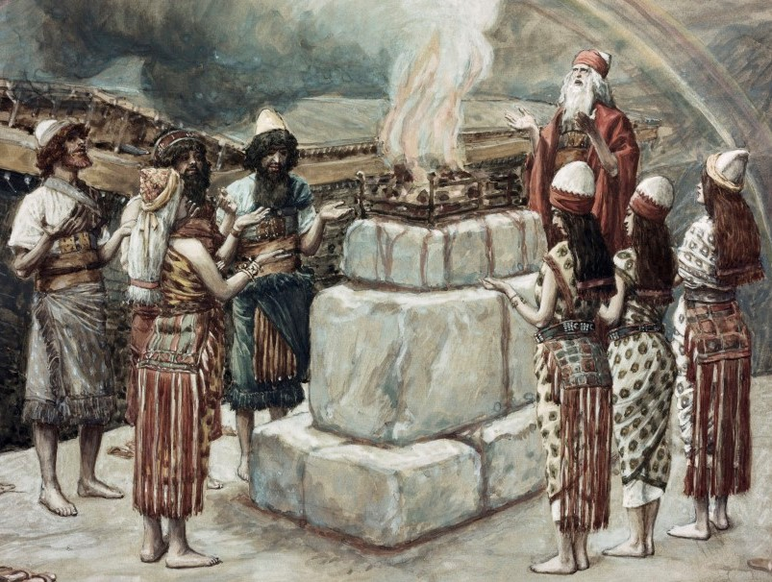
Genesis 9:26
“He also said, “Blessed be the Lord, The God of Shem; And let Canaan be his servant.”

Slide 18
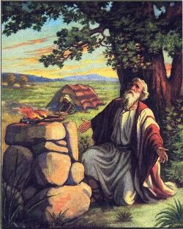
3) Must be from Abraham’s line
Genesis 12:3

Slide 19
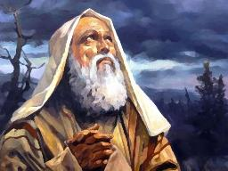
Genesis 12:3
“And I will bless those who bless you, And the one who curses you I will curse. And in you all the families of the earth will be blessed.”

Slide 20
4) Messiah must be from Isaac’s line
Genesis 17:18-19

Slide 21
Genesis 15:2-4
“² Abram said, ‘O Lord God, what will You give me, since I am childless, and the heir of my house is Eliezer of Damascus?’ ³ And Abram said, ‘Since You have given no offspring to me, one born in my house is my heir.’ ⁴ Then behold, the word of the Lord came to him, saying, ‘This man will not be your heir; but one who will come forth from your own body, he shall be your heir.’”

Slide 22
Genesis 17:18-19
“And Abraham said to God, ‘Oh that Ishmael might live before You!’ But God said, ‘No, but Sarah your wife will bear you a son, and you shall call his name Isaac; and I will establish My covenant with him for an everlasting covenant for his descendants after him.’”

Slide 23
5) Messiah must be Jewish or from the line of Jacob
Numbers 24:17

Slide 24
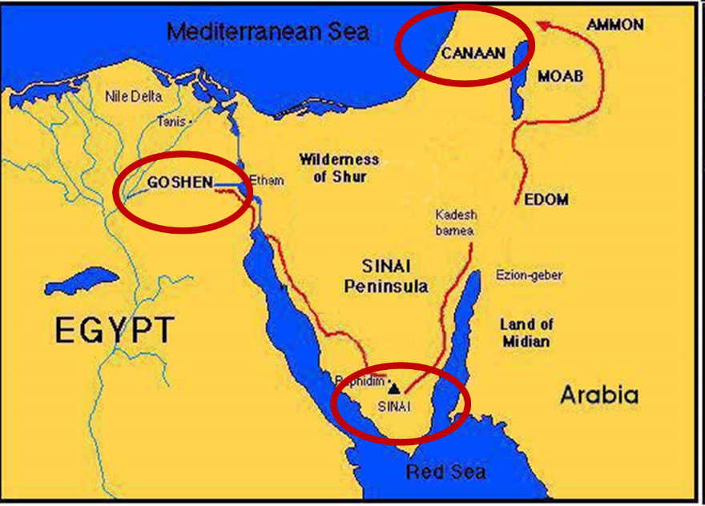

Slide 25
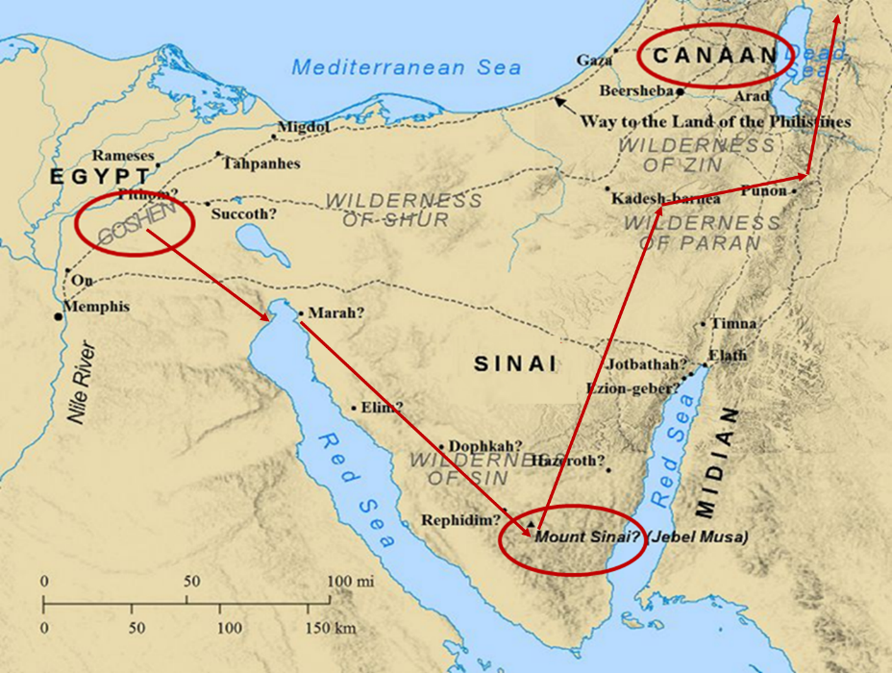

Slide 26
Balaam's 7 Oracles Blessing Israel (Num. 23-24)
First oracle (23:1-12), Balaam explained that God’s blessings upon Israel were irrevocable.
Second oracle (23:13-26), Balaam explained that the source of Israel’s blessing was her unique relationship to Yahweh
Third oracle (23:27–24:14), Balaam extolled Israel’s beauty.
Fourth oracle (24:15-19), Balaam explained that a future messianic deliverer (Gen 49:10) would spring forth and exercise dominion from Israel.

Slide 27
Balaam's 7 Oracles Blessing Israel (Num. 23-24)
Fifth oracle (24:20) predicts Amalek’s destruction. Amalek was the first foe that Israel had to fight against after leaving Egypt (Exod 17).
Sixth oracle (24:21-22) predicts the destruction of the Midianite group known as the Kenites as well as Assyria.
The nations of the seventh oracle are difficult to identify (24:23-24).

Slide 28
Balaam's 7 Oracles Blessing Israel (Num. 23-24)
First oracle (23:1-12), Balaam explained that God’s blessings upon Israel were irrevocable.
Second oracle (23:13-26), Balaam explained that the source of Israel’s blessing was her unique relationship to Yahweh
Third oracle (23:27–24:14), Balaam extolled Israel’s beauty.
Fourth oracle (24:15-19), Balaam explained that a future messianic deliverer (Gen 49:10) would spring forth and exercise dominion from Israel.

Slide 29
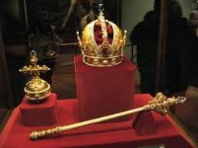
Numbers 24:17
“I see him, but not now; I behold him, but not near; A star shall come forth from Jacob, A scepter shall rise from Israel, And shall crush through the forehead of Moab, And tear down all the sons of Sheth.”

Slide 30
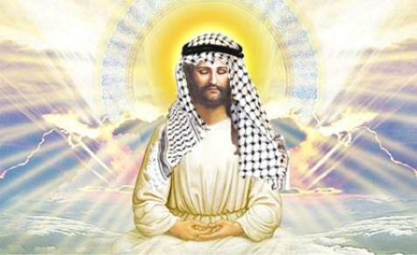

Slide 31
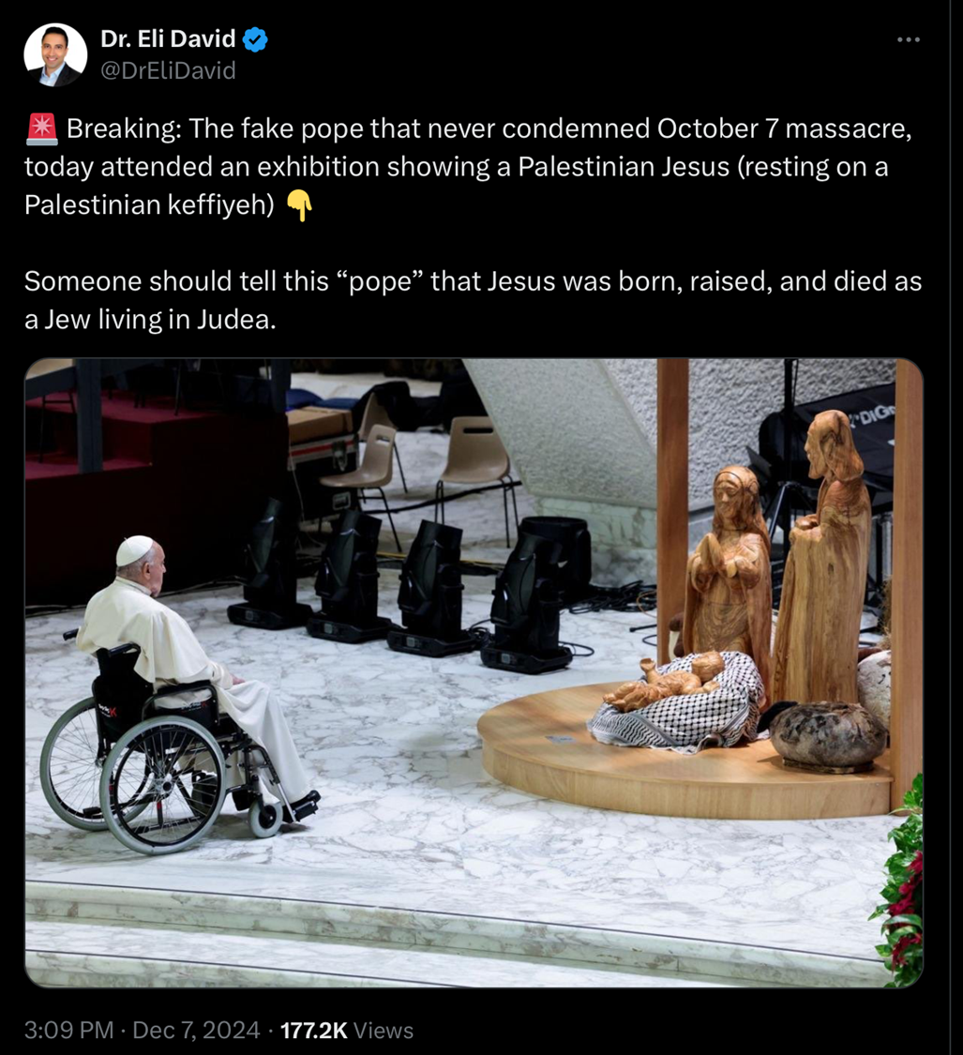

Slide 32
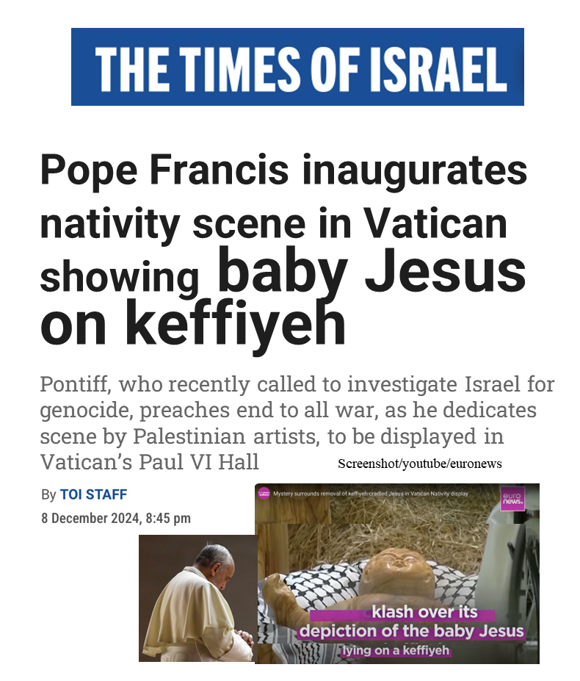

Slide 33
Numbers 24:17
“I see him, but not now; I behold him, but not near; A star shall come forth from Jacob, A scepter shall rise from Israel, And shall crush through the forehead of Moab, And tear down all the sons of Sheth.”

Slide 34
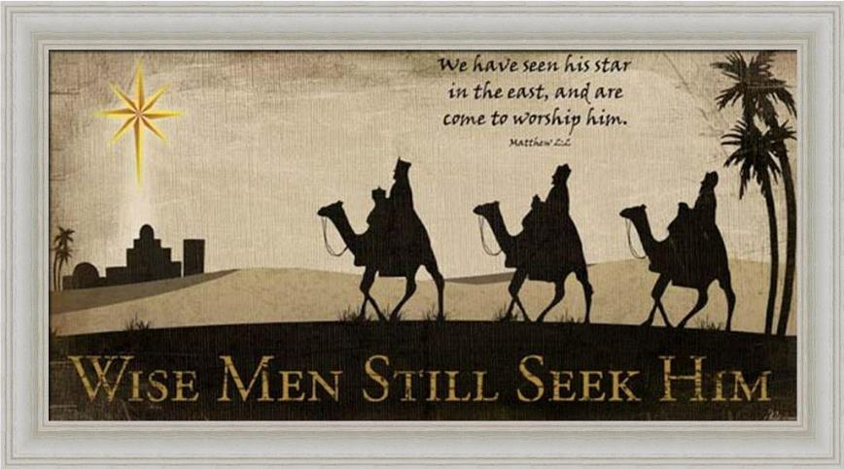

Slide 35

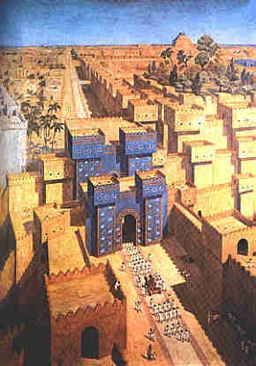
East = Babylon
Genesis 2:8
Genesis 11:2
Matthew 2:2

Slide 36
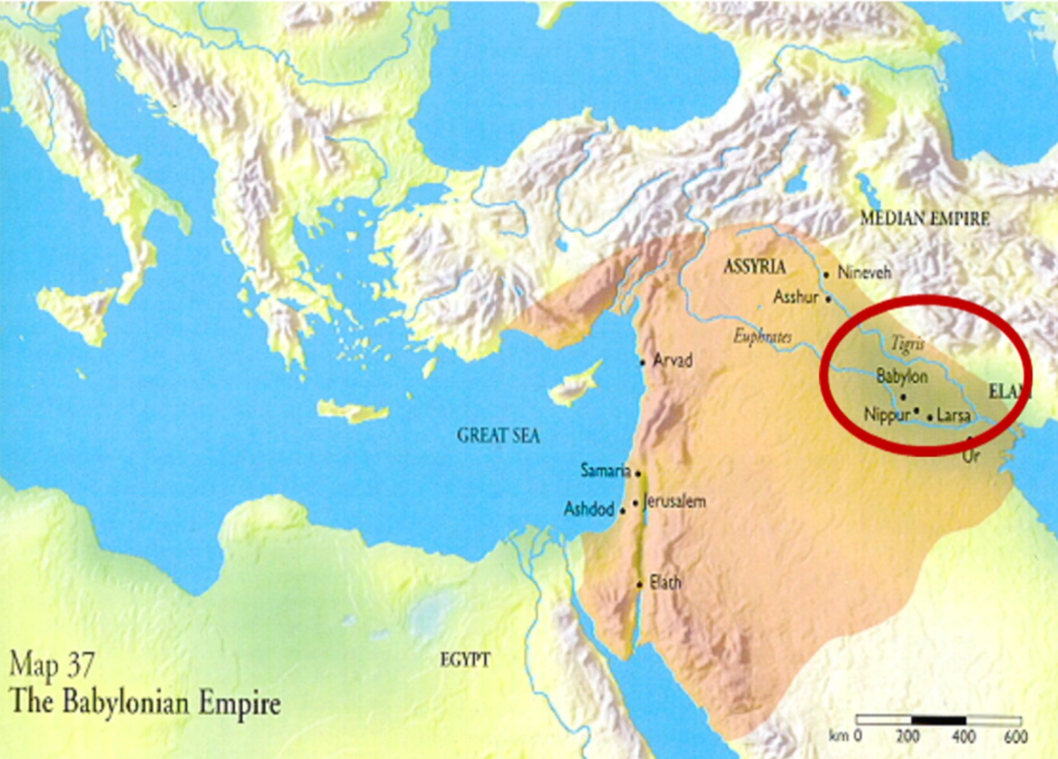

Slide 37
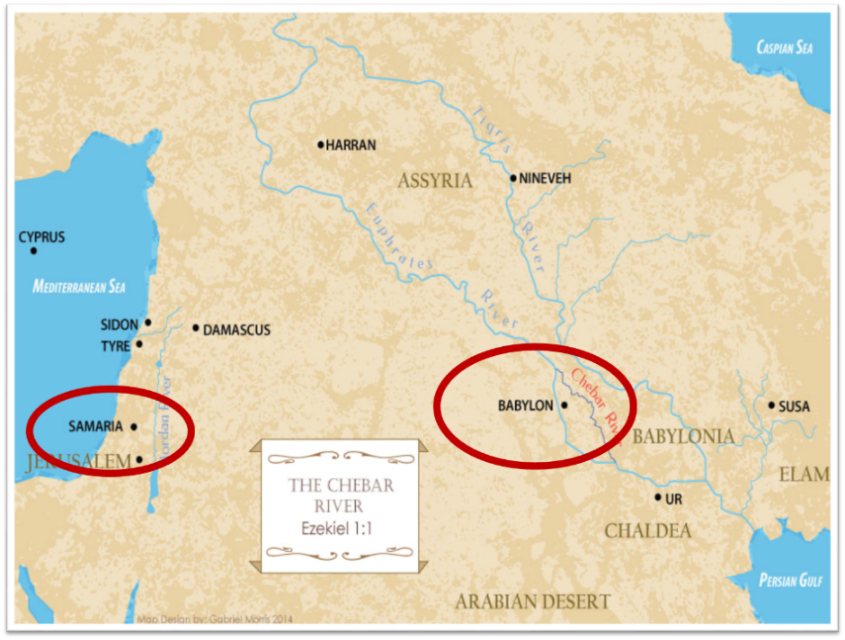

Slide 38
Deuteronomy 23:4
“because they did not meet you with food and water on the way when you came out of Egypt, and because they hired against you Balaam the son of Beor from Pethor of Mesopotamia, to curse you.”

Slide 39
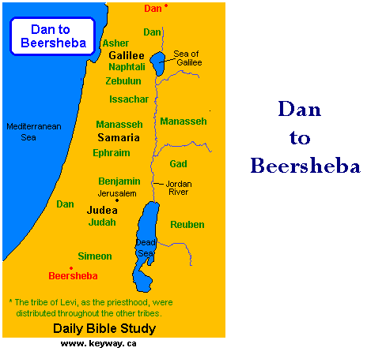

Slide 40
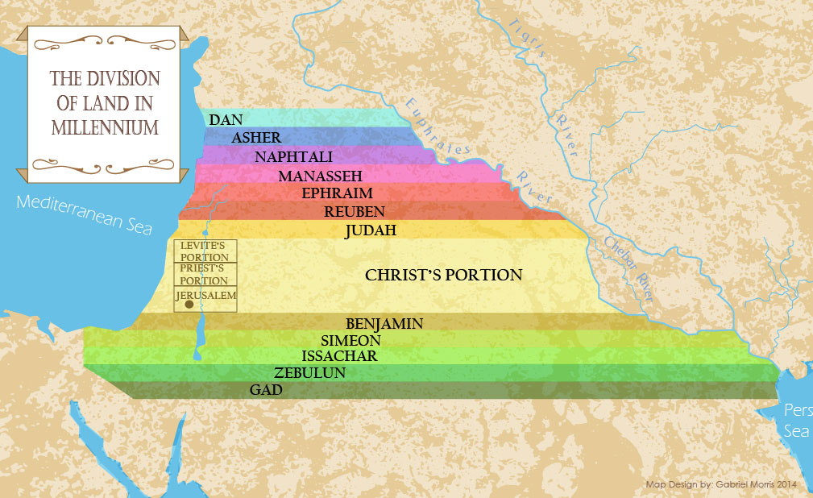

Slide 41
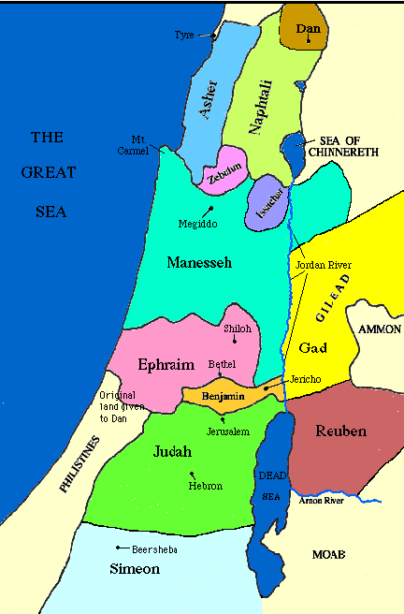

Slide 42
6) Messiah must be from the tribe of Judah
Genesis 49:10

Slide 43
Genesis 49:10
“The scepter shall not depart from Judah, Nor the ruler’s staff from between his feet, Until Shiloh comes, And to him shall be the obedience of the peoples.”

Slide 44
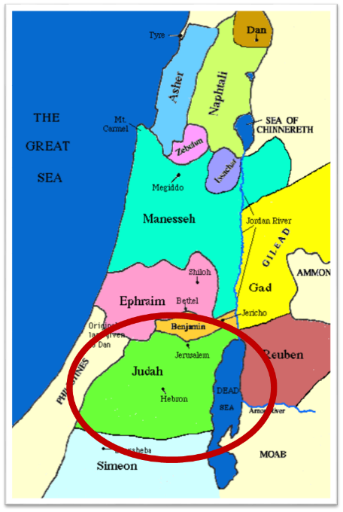

Slide 45
Genesis 49:10
“The scepter shall not depart from Judah, Nor the ruler’s staff from between his feet, Until Shiloh comes, And to him shall be the obedience of the peoples.”

Slide 46
Messiah must be from the tribe of Judah
Genesis 49:10
Revelation 5:5

Slide 47
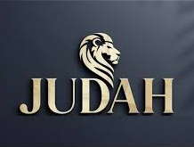
Revelation 5:5
“and one of the elders said to me, “Stop weeping; behold, the Lion that is from the tribe of Judah, the Root of David, has overcome so as to open the book and its seven seals.”

Slide 48
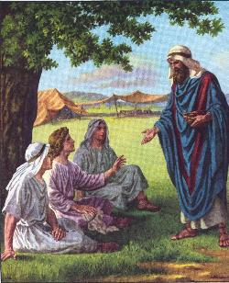
7) Messiah must be from the family of Jesse
Isaiah 11:1

Slide 49
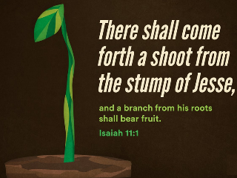
Isaiah 11:1
“Then a shoot will spring from the stem of Jesse, And a branch from his roots will bear fruit.”

Slide 50
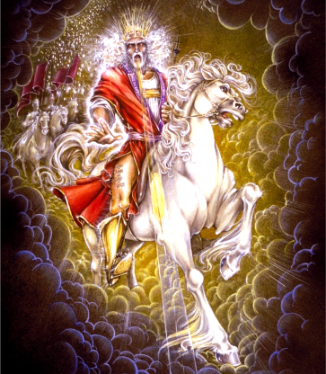
Isaiah 11:4
“But with righteousness He will judge the poor, And decide with fairness for the afflicted of the earth; And He will strike the earth with the rod of His mouth, And with the breath of His lips He will slay the wicked.”

Slide 51
1 Samuel 16:10-11
“¹⁰ Thus Jesse made seven of his sons pass before Samuel. But Samuel said to Jesse, ‘The Lord has not chosen these.’ ¹¹ And Samuel said to Jesse, ‘Are these all the children?’ And he said, ‘There remains yet the youngest, and behold, he is tending the sheep.’ Then Samuel said to Jesse, ‘Send and bring him; for we will not sit down until he comes here.’”

Slide 52
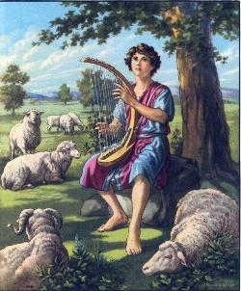
8) Messiah must be from the line of David
2 Samuel 7:16

Slide 53
2 Samuel 7:8, 16
“⁸ Now therefore, thus you shall say to My servant David, ‘Thus says the Lord of hosts, “I took you from the pasture, from following the sheep, to be ruler over My people Israel… ¹⁶ Your house and your kingdom shall endure before Me forever; your throne shall be established forever.”

Slide 54
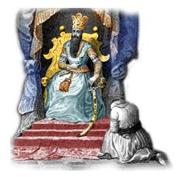
9) Messiah must be from the line of Solomon
1 Chronicles 28:4-7

Slide 55
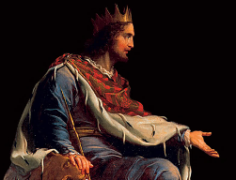
1 Chronicles 28:2, 5
“² Then King David rose to his feet and said, ‘… ⁵ Of all my sons (for the Lord has given me many sons), He has chosen my son Solomon to sit on the throne of the kingdom of the Lord over Israel.’”

Slide 56
Messiah Must Be:
  A man (Gen 3:15)
  Semitic (Gen 9:26)
  From Abraham’s line (Gen 12:3)
  From Isaac’s line (Gen 17:18-19)
  From Jacob’s line (Num 24:17)
  From the tribe of Judah (Gen 49:10)
  From the family of Jesse (Isa 11:1)
  From David’s line (2 Sam 7:16)
  From Solomon’s line (1 Chron 28:4-7)

Slide 57
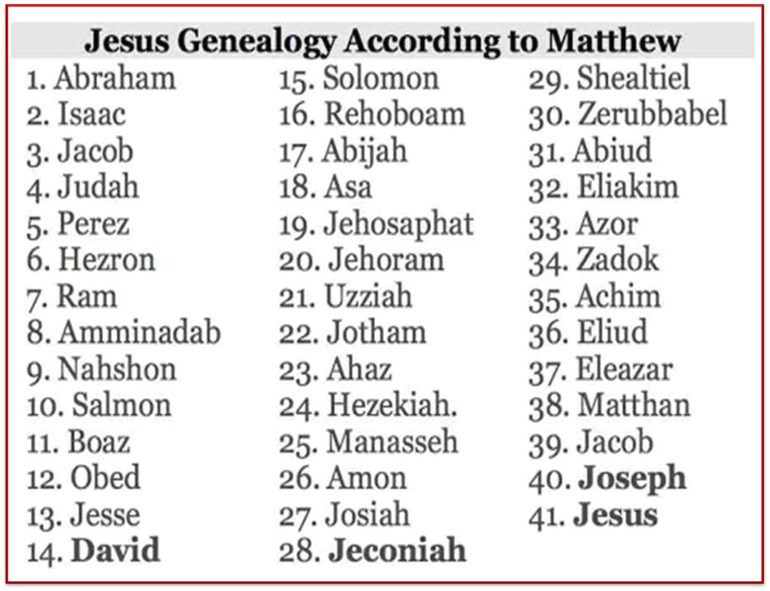

Slide 58
10) Messiah must be born in Bethlehem
Micah 5:2

Slide 59
Micah 5:2
“But as for you, Bethlehem Ephrathah, Too little to be among the clans of Judah, From you One will go forth for Me to be ruler in Israel. His goings forth are from long ago, From the days of eternity.”

Slide 60

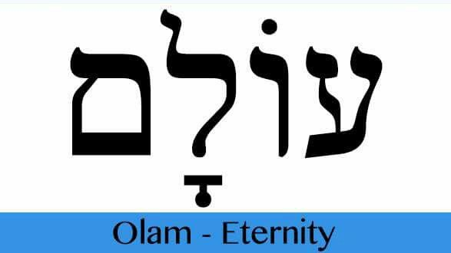
Psalm 90:2
“Before the mountains were born Or You gave birth to the earth and the world, Even from everlasting (olam) to everlasting (olam), You are God.”

Slide 61
Micah 5:2
“But as for you, Bethlehem Ephrathah, Too little to be among the clans of Judah, From you One will go forth for Me to be ruler in Israel. His goings forth are from long ago, From the days of eternity (olam) .”

Slide 62
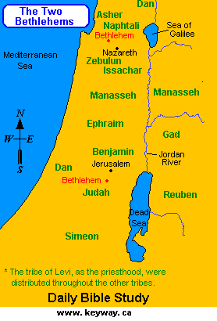

Slide 63
Micah 5:2
“But as for you, Bethlehem Ephrathah, Too little to be among the clans of Judah, From you One will go forth for Me to be ruler in Israel. His goings forth are from long ago, From the days of eternity.”

Slide 64
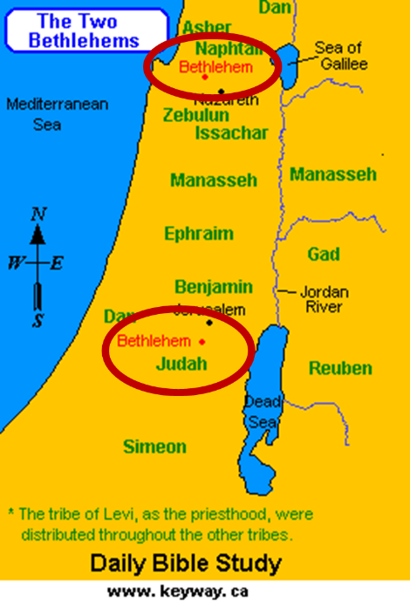

Slide 65
Matthew 2:4-6
“⁴ Gathering together all the chief priests and scribes of the people, he inquired of them where the Messiah was to be born. ⁵ They said to him, “In Bethlehem of Judea; for this is what has been written by the prophet: ⁶ ‘And you, Bethlehem, land of Judah, Are by no means least among the leaders of Judah; For out of you shall come forth a Ruler Who will shepherd My people Israel.’”

Slide 66
11) Messiah must be born of a virgin
Isaiah 7:13-14

Slide 67
Isaiah 7:13-14
“Then he said, “Listen now, O house of David! Is it too slight a thing for you to try the patience of men, that you will try the patience of my God as well? ¹⁴ Therefore the Lord Himself will give you a sign: Behold, a virgin will be with child and bear a son, and she will call His name Immanuel.”

Slide 68
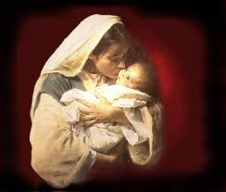
Almah Does Mean Virgin
  Almah
        OT uses (Gen 24:43; Exod 2:8; Ps 68:25; Song of Solomon 1:3; 6:8; Prov 30:18-19)
        LXX
        Matt 1:23

Slide 69
Isaiah 7:2, 13
“When it was reported to the House of David…Then he said, ‘Listen now, O house of David! Is it too slight a thing for you to try the patience of men, that you will try the patience of my God as well?’”

Slide 70
Isaiah 7:9–17
⁹ “… and the head of Ephraim is Samaria and the head of Samaria is the son of Remaliah. If you [s] will not believe, you [s] surely shall not last.”’” ¹⁰ Then the Lord spoke again to Ahaz, saying, ¹¹ “Ask a sign for yourself [s] from the Lord your God; make it deep as Sheol or high as heaven.” ¹² But Ahaz said, “I will not ask, nor will I test the Lord!” ¹³ Then he said, “Listen now, O house of David! Is it too slight a thing for you [pl] to try the patience of men, that you [pl] will try the patience of my God as well? . . .

Slide 71
Isaiah 7:9–17
…¹⁴ “Therefore the Lord Himself will give you [pl] a sign: Behold, a virgin will be with child and bear a son, and she will call His name Immanuel. ¹⁵ “He will eat curds and honey at the time He knows enough to refuse evil and choose good. ¹⁶ “For before the boy will know enough to refuse evil and choose good, the land whose two kings you [s] dread will be forsaken. ¹⁷ “The Lord will bring on you [s], on your people, and on your father’s house such days as have never come since the day that Ephraim separated from Judah, the king of Assyria.”

Slide 72
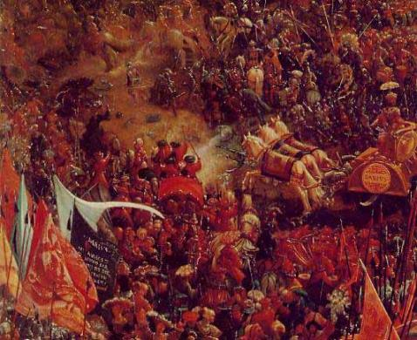
12) Messiah must come before A.D. 70
Malachi 3:1

Slide 73
Malachi 3:1
“‘Behold, I am going to send My messenger, and he will clear the way before Me. And the Lord, whom you seek, will suddenly come to His temple; and the messenger of the covenant, in whom you delight, behold, He is coming,’ says the Lord of hosts.”

Slide 74
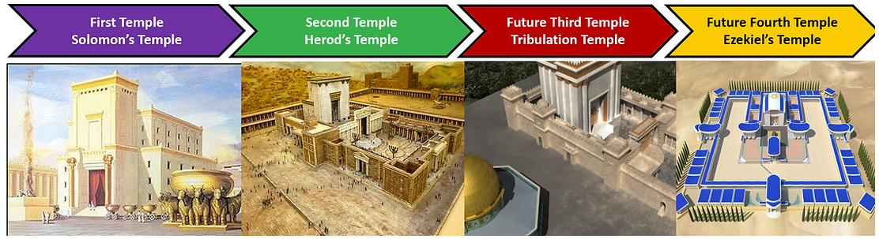
ISRAEL’S FOUR TEMPLES
Solomon’s pre exilic temple (Kings and Chronicles)
Zerubbabel’s post exilic temple (Ezra 1-6; John 2:20)
Antichrist's temple (Dan 9:27; Matt 24:15; 2 Thess 2:4; Rev 11:1-2)
Millennial temple (Ezek 40-48)

Slide 75
Luke 19:41-44
^{41 “}When He approached Jerusalem, He saw the city and wept over it, ⁴² saying, “If you had known in this day, even you, the things which make for peace! But now they have been hidden from your eyes. ⁴³ For the days will come upon you when your enemies will throw up a barricade against you, and surround you and hem you in on every side, ⁴⁴ and they will level you to the ground and your children within you, and they will not leave in you one stone upon another, because you did not recognize the time of your visitation.”

Slide 76

Matthew 24:1-2
“¹ Jesus came out from the temple and was going away when His disciples came up to point out the temple buildings to Him. ² And He said to them, “Do you not see all these things? Truly I say to you, not one stone here will be left upon another, which will not be torn down.”

Slide 77
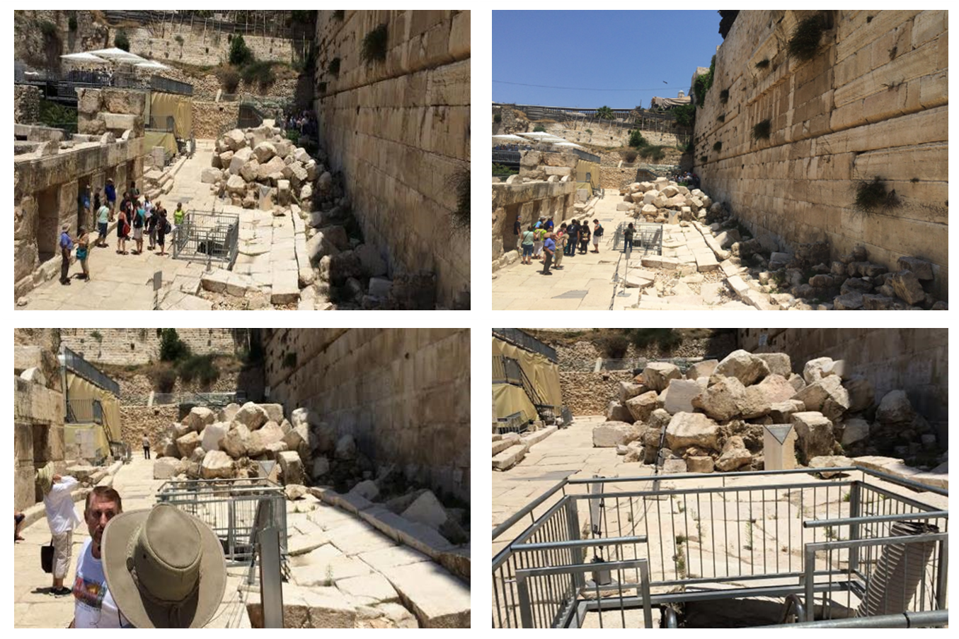

Slide 78

13) Messiah must present Himself to Israel on March 30, A.D. 33
Daniel 9:25

Slide 79
Daniel 9:25
“So you are to know and discern that from the issuing of a decree to restore and rebuild Jerusalem until Messiah the Prince there will be seven weeks and sixty-two weeks; it will be built again, with plaza and moat, even in times of distress.”

Slide 80
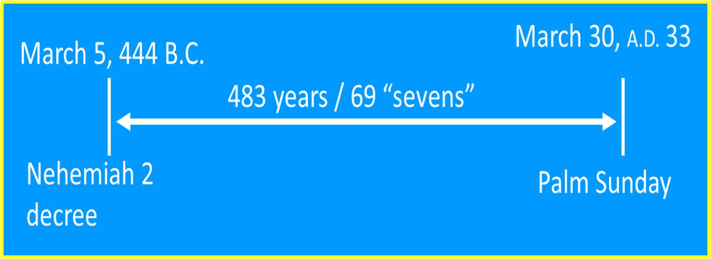

Slide 81
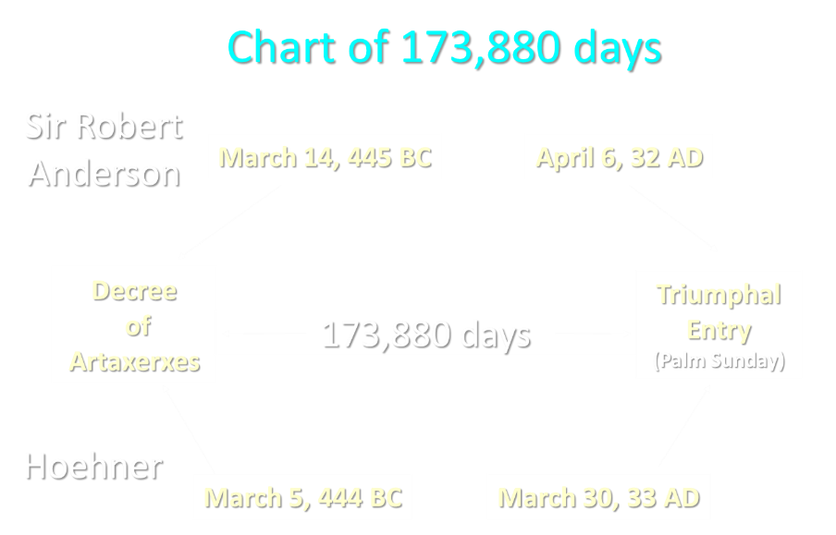
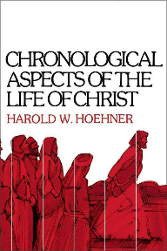

Slide 82
Luke 19:42-44
⁴² saying, “If you had known in this day, even you, the things which make for peace! But now they have been hidden from your eyes…⁴⁴ and they will level you to the ground and your children within you, and they will not leave in you one stone upon another, because you did not recognize the time of your visitation.”

Slide 83

Matthew 16:1-3
¹ The Pharisees and Sadducees came up, and testing Jesus, they asked Him to show them a sign from heaven. ² But He replied to them, “When it is evening, you say, ‘It will be fair weather, for the sky is red.’ ³ And in the morning, ‘There will be a storm today, for the sky is red and threatening.’ Do you know how to discern the appearance of the sky, but cannot discern the signs (sēmeion) of the times?”

Slide 84

Galatians 4:4
“But when the fullness of the time came, God sent forth His Son, born of a woman, born under the Law.”

Slide 86
East = Babylon
Genesis 2:8
Genesis 11:2
Matthew 2:2

Slide 89

Daniel 1:2
“The Lord gave Jehoiakim king of Judah into his hand, along with some of the vessels of the house of God; and he brought them to the land of Shinar, to the house of his god, and he brought the vessels into the treasury of his god.”

Slide 90
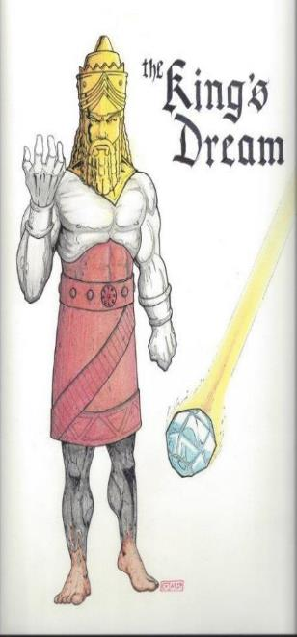
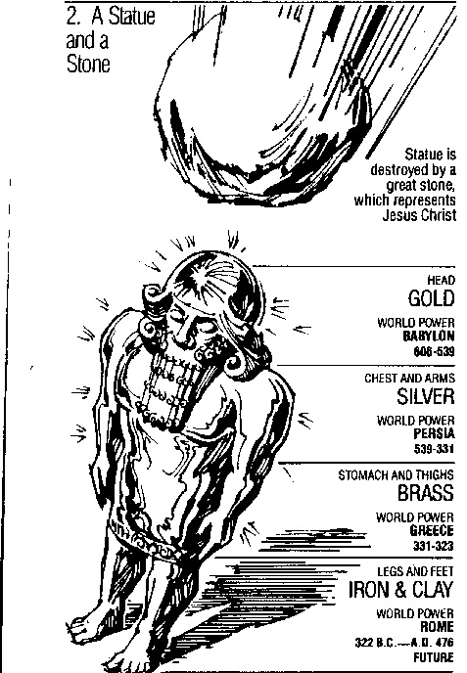
Statue
&
Stone

Slide 91
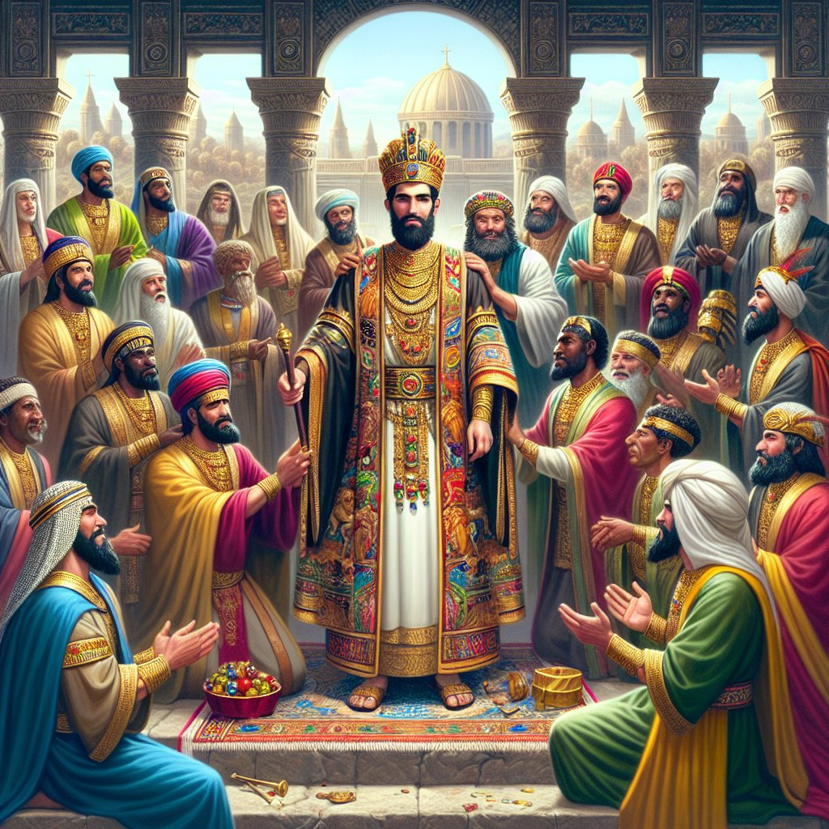
Daniel 2:48
“Then the king promoted Daniel and gave him many great gifts, and he made him ruler over the whole province of Babylon and chief prefect over all the wise men of Babylon.”

Slide 92
Numbers 24:17
“I see him, but not now; I behold him, but not near; A star shall come forth from Jacob, A scepter shall rise from Israel, And shall crush through the forehead of Moab, And tear down all the sons of Sheth.”

Slide 93

Deuteronomy 23:4
“because they did not meet you with food and water on the way when you came out of Egypt, and because they hired against you Balaam the son of Beor from Pethor of Mesopotamia, to curse you.”

Slide 94
15) Messiah must die in a particular way
Zechariah 12:10

Slide 95

Zechariah 12:10
“I will pour out on the house of David and on the inhabitants of Jerusalem, the Spirit of grace and of supplication, so that they will look on Me whom they have pierced; and they will mourn for Him, as one mourns for an only son, and they will weep bitterly over Him like the bitter weeping over a firstborn.”

Slide 96
Conclusion

Slide 97
Messiah Must Be:
  A man (Gen 3:15)
  Semitic (Gen 9:26)
  From Abraham’s line (Gen 12:3)
  From Isaac’s line (Gen 17:18-19)
  From Jacob’s line (Num 24:17)
  From the tribe of Judah (Gen 49:10)
  From the family of Jesse (Isa 11:1)
  From David’s line (2 Sam 7:16)

Slide 98
Messiah Must Be:
  From Solomon’s line (1 Chron 28:4-7)
  Be born in Bethlehem (Micah 5:2)
  Be born of a virgin (Isa 7:14)
  Come before A.D. 70 (Mal 3:1)
  Present Himself to Israel on 3/30/33 (Dan 9:25)
  Present Himself to Israel a particular way (Zech 9:9)
  Die in a particular way (Zech 12:10)

Slide 99
So What?
Do you understand what makes Christianity unique?
Are you allowing God to lead your life?
Have you considered Christ’s claims?

Slide 100

²⁴ The Lord bless you, and keep you; ²⁵ The Lord make His face shine on you, And be gracious to you; ²⁶ The Lord lift up His countenance on you, And give you peace.
Numbers 6:24–26 (NASB95)

