Slide 1
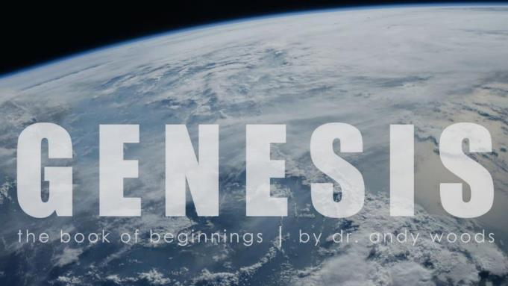
Genesis 12‒50
Israel’s Birth & Preservation

Slide 2
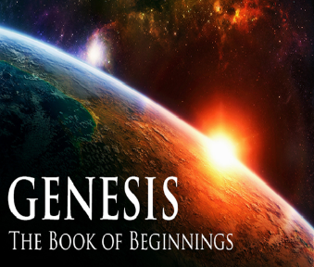
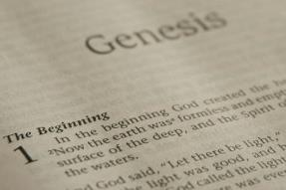
GENESIS STRUCTURE
Genesis 12-50 (four people)
Abraham (12:1–25:11)
Isaac (25:12–26:35)
Jacob (27–36)
Joseph (37–50)

Slide 3
Genesis 37‒50 Joseph
Joseph sold unto Egypt (37)
Canaan’s corruption (38)
Joseph falsely accused (39)
Joseph’s short-term predictions (40)
Joseph’s elevation (41)
Joseph’s first reunion with his brothers (42)
Joseph’s second reunion with his brothers (43‒45)
Joseph’s second reunion with his brothers (43‒45)
Sojourn to Egypt (46:1‒47:12)
Famine’s course (47:13-26)
Jacob in Egypt (47:27-31)
Jacob blesses Joseph’s sons (48)

Slide 4
Genesis 48:1-22 Jacob Blesses Joseph’s Sons
Adoption (48:1-7)
Blessing of Manasseh & Ephraim (48:8-20)
Exodus prophecy (48:21-22)

Slide 5
II. Genesis 48:8-20 Blessing
Jacob’s inquiry (8)
Joseph’s answer (9a)
Jacob’s command (9b)
Jacob’s eyesight (10a)
Joseph’s obedience (10b)
Jacob’s response (11)
Joseph’s presentation of 2 sons (12-13)
Opposite of Joseph’s expectation (14)
Blessing’s content (15-16)
Joseph’s reaction (17-18)
Jacob’s response (19)
Blessing (20)

Slide 6
II. Genesis 48:8-20 Blessing
Jacob’s inquiry (8)
Joseph’s answer (9a)
Jacob’s command (9b)
Jacob’s eyesight (10a)
Joseph’s obedience (10b)
Jacob’s response (11)
Joseph’s presentation of 2 sons (12-13)
Opposite of Joseph’s expectation (14)
Blessing’s content (15-16)
Joseph’s reaction (17-18)
Jacob’s response (19)
Blessing (20)

Slide 7
II. Genesis 48:8-20 Blessing
Jacob’s inquiry (8)
Joseph’s answer (9a)
Jacob’s command (9b)
Jacob’s eyesight (10a)
Joseph’s obedience (10b)
Jacob’s response (11)
Joseph’s presentation of 2 sons (12-13)
Opposite of Joseph’s expectation (14)
Blessing’s content (15-16)
Joseph’s reaction (17-18)
Jacob’s response (19)
Blessing (20)

Slide 8
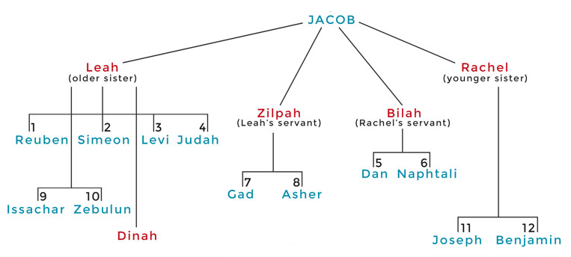

Slide 9
II. Genesis 48:8-20 Blessing
Jacob’s inquiry (8)
Joseph’s answer (9a)
Jacob’s command (9b)
Jacob’s eyesight (10a)
Joseph’s obedience (10b)
Jacob’s response (11)
Joseph’s presentation of 2 sons (12-13)
Opposite of Joseph’s expectation (14)
Blessing’s content (15-16)
Joseph’s reaction (17-18)
Jacob’s response (19)
Blessing (20)

Slide 10
II. Genesis 48:8-20 Blessing
Jacob’s inquiry (8)
Joseph’s answer (9a)
Jacob’s command (9b)
Jacob’s eyesight (10a)
Joseph’s obedience (10b)
Jacob’s response (11)
Joseph’s presentation of 2 sons (12-13)
Opposite of Joseph’s expectation (14)
Blessing’s content (15-16)
Joseph’s reaction (17-18)
Jacob’s response (19)
Blessing (20)

Slide 11
2 Corintians 4:16
“Therefore we do not lose heart, but though our outer man is decaying, yet our inner man is being renewed day by day.”

Slide 12
II. Genesis 48:8-20 Blessing
Jacob’s inquiry (8)
Joseph’s answer (9a)
Jacob’s command (9b)
Jacob’s eyesight (10a)
Joseph’s obedience (10b)
Jacob’s response (11)
Joseph’s presentation of 2 sons (12-13)
Opposite of Joseph’s expectation (14)
Blessing’s content (15-16)
Joseph’s reaction (17-18)
Jacob’s response (19)
Blessing (20)

Slide 13
II. Genesis 48:8-20 Blessing
Jacob’s inquiry (8)
Joseph’s answer (9a)
Jacob’s command (9b)
Jacob’s eyesight (10a)
Joseph’s obedience (10b)
Jacob’s response (11)
Joseph’s presentation of 2 sons (12-13)
Opposite of Joseph’s expectation (14)
Blessing’s content (15-16)
Joseph’s reaction (17-18)
Jacob’s response (19)
Blessing (20)

Slide 14
II. Genesis 48:8-20 Blessing
Jacob’s inquiry (8)
Joseph’s answer (9a)
Jacob’s command (9b)
Jacob’s eyesight (10a)
Joseph’s obedience (10b)
Jacob’s response (11)
Joseph’s presentation of 2 sons (12-13)
Opposite of Joseph’s expectation (14)
Blessing’s content (15-16)
Joseph’s reaction (17-18)
Jacob’s response (19)
Blessing (20)

Slide 15
Genesis 48:12-13 Joseph’s Presentation of 2 Sons
Submission (12)
Position (13)

Slide 16
Genesis 48:12-13 Joseph’s Presentation of 2 Sons
Submission (12)
Position (13)

Slide 17
Genesis 48:12-13 Joseph’s Presentation of 2 Sons
Submission (12)
Position (13)

Slide 18
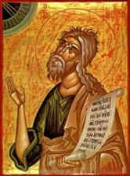
Jeremiah 30:7
“ Alas! for that day is great, There is none like it; And it is the time of Jacob’s distress, But he will be saved from it.”

Slide 19
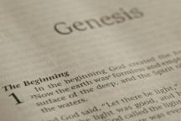
Beginning Themes
Universe Life Man Marriage Evil Clothing | Religion Salvation Language Government Nations Israel
Morris, Genesis Record, 18-20

Slide 20
II. Genesis 48:8-20 Blessing
Jacob’s inquiry (8)
Joseph’s answer (9a)
Jacob’s command (9b)
Jacob’s eyesight (10a)
Joseph’s obedience (10b)
Jacob’s response (11)
Joseph’s presentation of 2 sons (12-13)
Opposite of Joseph’s expectation (14)
Blessing’s content (15-16)
Joseph’s reaction (17-18)
Jacob’s response (19)
Blessing (20)

Slide 21
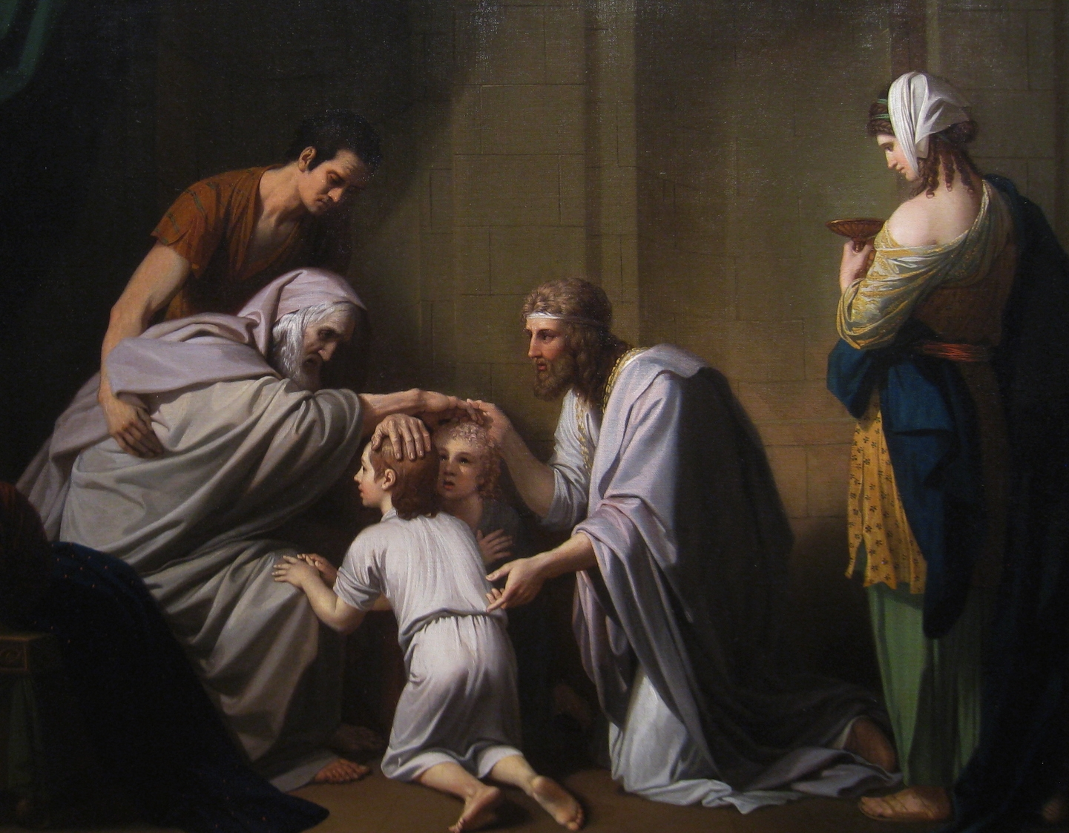

Slide 22
II. Genesis 48:8-20 Blessing
Jacob’s inquiry (8)
Joseph’s answer (9a)
Jacob’s command (9b)
Jacob’s eyesight (10a)
Joseph’s obedience (10b)
Jacob’s response (11)
Joseph’s presentation of 2 sons (12-13)
Opposite of Joseph’s expectation (14)
Blessing’s content (15-16)
Joseph’s reaction (17-18)
Jacob’s response (19)
Blessing (20)

Slide 23
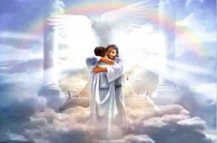
Ephesians 1:3
“Blessed be the God and Father of our Lord Jesus Christ, who has blessed us with every spiritual blessing in the heavenly places in Christ.”

Slide 24
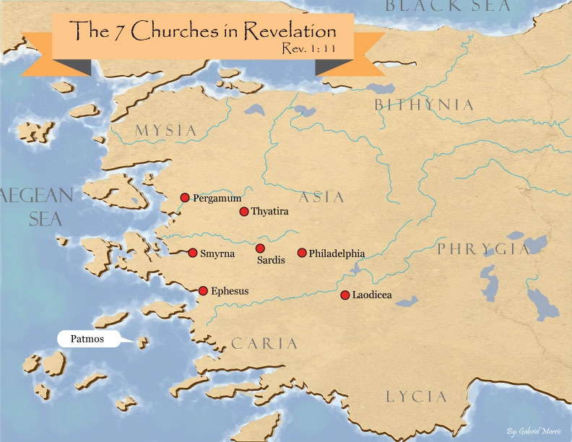

Slide 25
Revelation 2:9
“I know your tribulation and your poverty (but you are rich), and the blasphemy by those who say they are Jews and are not, but are a synagogue of Satan.”

Slide 26
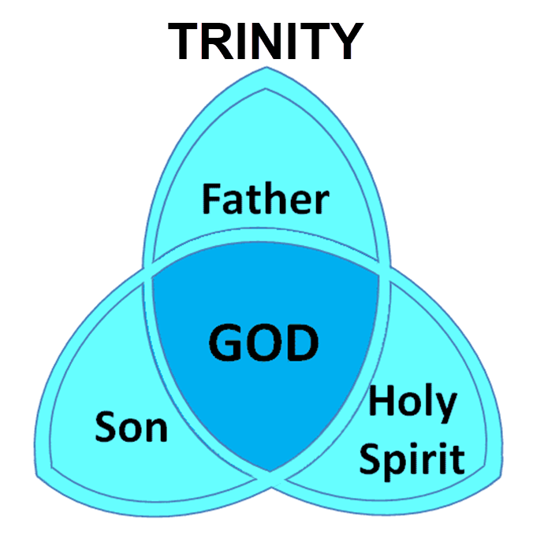

Slide 27
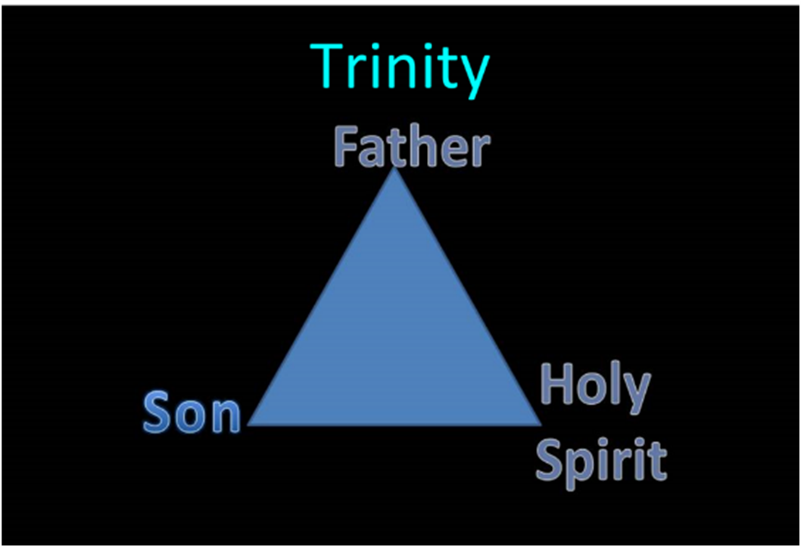

Slide 28
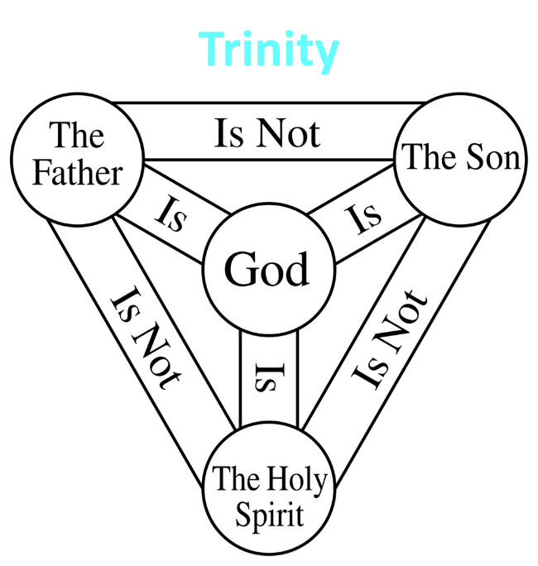

Slide 29
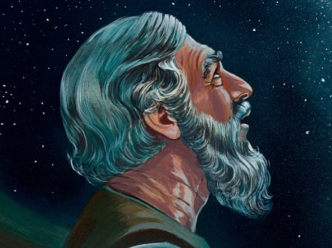
Genesis 15:4-5
⁴ Then behold, the word of the Lord came to him, saying, “This man will not be your heir; but one who will come forth from your own body, he shall be your heir.” ⁵ And He took him outside and said, “Now look toward the heavens, and count the stars, if you are able to count them.” And He said to him, “So shall your descendants be.”

Slide 30
II. Genesis 48:8-20 Blessing
Jacob’s inquiry (8)
Joseph’s answer (9a)
Jacob’s command (9b)
Jacob’s eyesight (10a)
Joseph’s obedience (10b)
Jacob’s response (11)
Joseph’s presentation of 2 sons (12-13)
Opposite of Joseph’s expectation (14)
Blessing’s content (15-16)
Joseph’s reaction (17-18)
Jacob’s response (19)
Blessing (20)

Slide 31
Genesis 48:17-18 Joseph’s Reaction
Reaction (17)
Protest (18)

Slide 32
Genesis 48:17-18 Joseph’s Reaction
Reaction (17)
Protest (18)

Slide 33
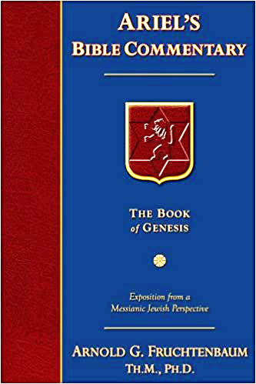
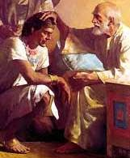
Dr. Arnold G. Fruchtenbaum
The Book of Genesis, 629
“According to the Nuzi Tablets, adoption in this manner was common, and such blessings were considered binding under Nuzi law.”

Slide 34
Genesis 48:17-18 Joseph’s Reaction
Reaction (17)
Protest (18)

Slide 35
II. Genesis 48:8-20 Blessing
Jacob’s inquiry (8)
Joseph’s answer (9a)
Jacob’s command (9b)
Jacob’s eyesight (10a)
Joseph’s obedience (10b)
Jacob’s response (11)
Joseph’s presentation of 2 sons (12-13)
Opposite of Joseph’s expectation (14)
Blessing’s content (15-16)
Joseph’s reaction (17-18)
Jacob’s response (19)
Blessing (20)

Slide 36
Dr. Arnold G. Fruchtenbaum
The Book of Genesis, 630
“Ephraim became a key tribe, and eventually the name Ephraim also became a synonym for all Israel. Sometimes in place of saying ‘Israel,’ the people would say Ephraim, not referring to only the Tribe of Ephraim but referring to the entire nation of Israel, especially the Northern Kingdom (Isa. 7:2, 7:5, 7:9, 7:17; Hos. 9:3–16).”

Slide 37
Beginning Themes
Universe Life Man Marriage Evil Clothing | Religion Salvation Language Government Nations Israel
Morris, Genesis Record, 18-20

Slide 39
Cain Murders Abel (Gen. 4:3-8)
4:3-5a
Messianic line through Abel (Gen 3:21; Heb 11:4) contrary to Eve’s false expectation (4:1)
Begins selection of younger over older pattern (Abel over Cain, Seth over Cain, Shem over Japheth, Isaac over Ishmael, Jacob over Esau, Judah and Joseph over their brothers, and Ephraim over Manasseh)

Slide 40
II. Genesis 48:8-20 Blessing
Jacob’s inquiry (8)
Joseph’s answer (9a)
Jacob’s command (9b)
Jacob’s eyesight (10a)
Joseph’s obedience (10b)
Jacob’s response (11)
Joseph’s presentation of 2 sons (12-13)
Opposite of Joseph’s expectation (14)
Blessing’s content (15-16)
Joseph’s reaction (17-18)
Jacob’s response (19)
Blessing (20)

Slide 41
Genesis 48:1-22 Jacob Blesses Joseph’s Sons
Adoption (48:1-7)
Blessing of Manasseh & Ephraim (48:8-20)
Exodus prophecy (48:21-22)

Slide 42
III. Genesis 48:21-22 Exodus Prophecy
Exodus prophecy (21)
Joseph’s additional inheritance (22)

Slide 43
III. Genesis 48:21-22 Exodus Prophecy
Exodus prophecy (21)
Joseph’s additional inheritance (22)

Slide 44
Genesis 48:21 Exodus Prophecy
Immediate future: Jacob’s death (21a)
Distant future: Exodus (21b)

Slide 45
Genesis 48:21 Exodus Prophecy
Immediate future: Jacob’s death (21a)
Distant future: Exodus (21b)

Slide 46
Genesis 48:21 Exodus Prophecy
Immediate future: Jacob’s death (21a)
Distant future: Exodus (21b)

Slide 47
Genesis 15:13-14, 16
“¹³ God said to Abram, “Know for certain that your descendants will be strangers in a land that is not theirs, where they will be enslaved and oppressed four hundred years. ¹⁴ But I will also judge the nation whom they will serve, and afterward they will come out with many possessions…¹⁶ Then in the fourth generation they will return here, for the wrongdoing of the Amorite is not yet complete.”

Slide 48
III. Genesis 48:21-22 Exodus Prophecy
Exodus prophecy (21)
Joseph’s additional inheritance (22)

Slide 49
Genesis 48:22 Joseph’s Additional Inheritance
Jacob’s gift to Joseph (22a)
Jacob’s original acquisition (22b)

Slide 50
Genesis 48:22 Joseph’s Additional Inheritance
Jacob’s gift to Joseph (22a)
Jacob’s original acquisition (22b)

Slide 51
Genesis 48:22 Joseph’s Additional Inheritance
Jacob’s gift to Joseph (22a)
Jacob’s original acquisition (22b)

Slide 52
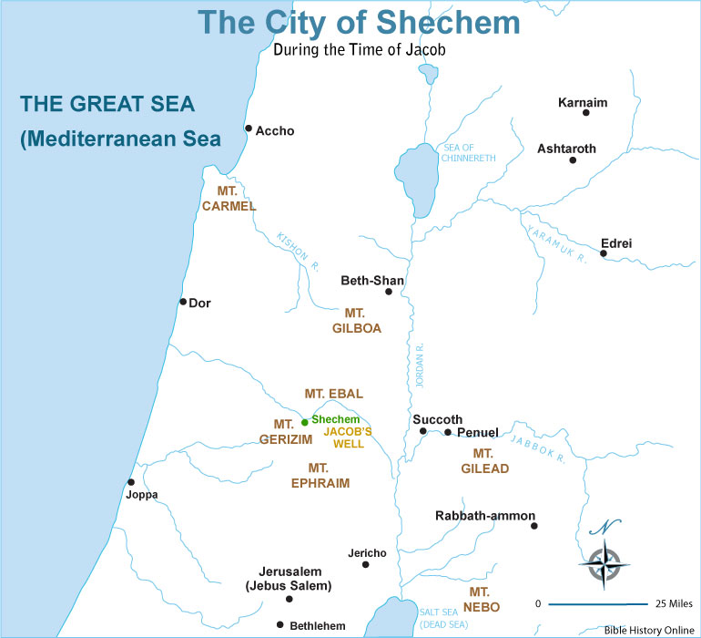

Slide 54
Conclusion

Slide 55
Genesis 48:1-22 Jacob Blesses Joseph’s Sons
Adoption (48:1-7)
Blessing of Manasseh & Ephraim (48:8-20)
Exodus prophecy (48:21-22)

Slide 56
²⁴ The Lord bless you, and keep you; ²⁵ The Lord make His face shine on you, And be gracious to you; ²⁶ The Lord lift up His countenance on you, And give you peace.
Numbers 6:24–26 (NASB95)

