Slide 1
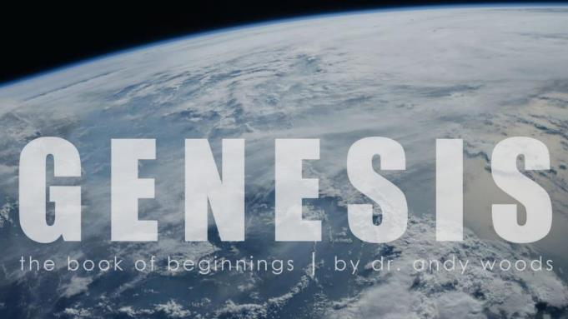
Genesis 12‒50
Israel’s Birth & Preservation

Slide 2
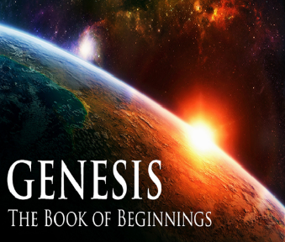
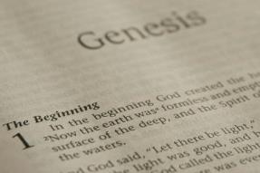
GENESIS STRUCTURE
Genesis 12-50 (four people)
Abraham (12:1–25:11)
Isaac (25:12–26:35)
Jacob (27–36)
Joseph (37–50)

Slide 3
Genesis 37‒50 Joseph
Joseph sold unto Egypt (37)
Canaan’s corruption (38)
Joseph falsely accused (39)
Joseph’s short-term predictions (40)
Joseph’s elevation (41)
Joseph’s first reunion with his brothers (42)
Joseph’s second reunion with his brothers (43‒45)
Joseph’s second reunion with his brothers (43‒45)
Sojourn to Egypt (46:1‒47:12)
Famine’s course (47:13-26)
Jacob in Egypt (47:27-31)
Jacob blesses Joseph’s sons (48)

Slide 4
Genesis 48:1-22 Jacob Blesses Joseph’s Sons
Occasion (48:1-7)
Blessing of Manasseh & Ephraim (48:8-20)
Exodus prophecy (48:21-22)

Slide 5
Genesis 48:1-22 Jacob Blesses Joseph’s Sons
Occasion (48:1-7)
Blessing of Manasseh & Ephraim (48:8-20)
Exodus prophecy (48:21-22)

Slide 6
I. Genesis 48:1-7 Occasion
Timing (1)
Report to Jacob (2)
Jacob’s testimony (3-7)

Slide 7
I. Genesis 48:1-7 Occasion
Timing (1)
Report to Jacob (2)
Jacob’s testimony (3-7)

Slide 8
Genesis 48:1 Timing
Jacob’s sickness (1a)
Joseph’s sons (1b)

Slide 9
Genesis 48:1 Timing
Jacob’s sickness (1a)
Joseph’s sons (1b)

Slide 10
Romans 8:19-22
¹⁹ For the anxious longing of the creation waits eagerly for the revealing of the sons of God. ²⁰ For the creation was subjected to futility, not willingly, but because of Him who subjected it, in hope ²¹ that the creation itself also will be set free from its slavery to corruption into the freedom of the glory of the children of God. ²² For we know that the whole creation groans and suffers the pains of childbirth together until now.

Slide 11
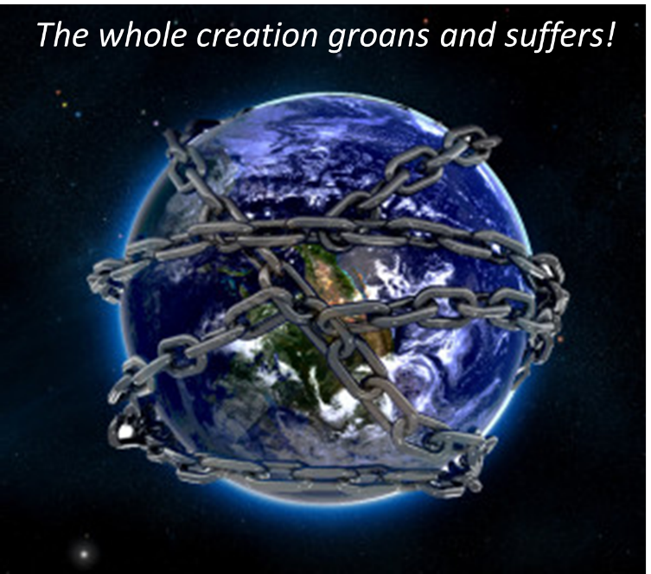

Slide 12
2 Corintians 4:16
“Therefore we do not lose heart, but though our outer man is decaying, yet our inner man is being renewed day by day.”

Slide 13
Genesis 48:1 Timing
Jacob’s sickness (1a)
Joseph’s sons (1b)

Slide 14
I. Genesis 48:1-7 Occasion
Timing (1)
Report to Jacob (2)
Jacob’s testimony (3-7)

Slide 15
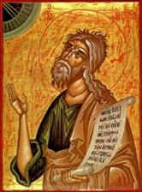
Jeremiah 30:7
“ Alas! for that day is great, There is none like it; And it is the time of Jacob’s distress, But he will be saved from it.”

Slide 16
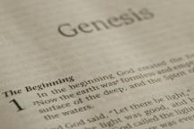
Beginning Themes
Universe Life Man Marriage Evil Clothing | Religion Salvation Language Government Nations Israel
Morris, Genesis Record, 18-20

Slide 17
I. Genesis 48:1-7 Occasion
Timing (1)
Report to Jacob (2)
Jacob’s testimony (3-7)

Slide 18
Genesis 48:3-7 Jacob’s Testimony
God’s appearance (3)
Abrahamic Covenant reaffirmed (4)
Jacob’s adoptions (5)
Joseph’s status (6)
Rachel’s death (7)

Slide 19
Genesis 48:3-7 Jacob’s Testimony
God’s appearance (3)
Abrahamic Covenant reaffirmed (4)
Jacob’s adoptions (5)
Joseph’s status (6)
Rachel’s death (7)

Slide 20
2 Peter 1:3-4
“³ Seeing that His divine power has granted to us everything pertaining to life and godliness, through the true knowledge of Him who called us by His own glory and excellence. ⁴For by these He has granted to us His precious and magnificent promises, so that by them you may become partakers of the divine nature, having escaped the corruption that is in the world by lust.”

Slide 21
2 Timothy 3:16-17
“¹⁶ All Scripture is inspired by God and profitable for teaching, for reproof, for correction, for training in righteousness; ¹⁷ so that the man of God may be adequate, equipped for every good work.”

Slide 22
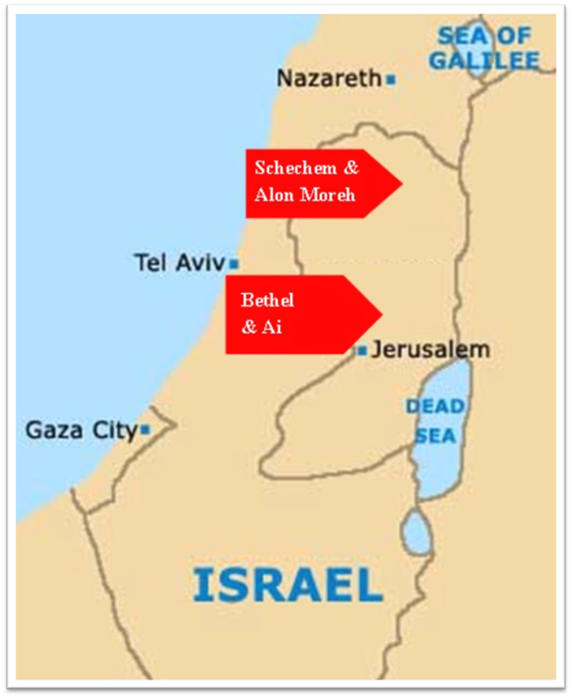

Slide 23
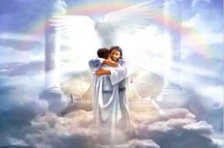
Ephesians 1:3
“Blessed be the God and Father of our Lord Jesus Christ, who has blessed us with every spiritual blessing in the heavenly places in Christ.”

Slide 24
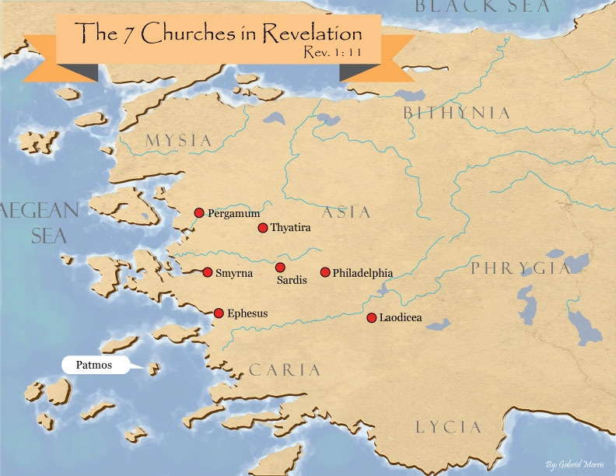

Slide 25
Revelation 2:9
“I know your tribulation and your poverty (but you are rich), and the blasphemy by those who say they are Jews and are not, but are a synagogue of Satan.”

Slide 26
Genesis 48:3-7 Jacob’s Testimony
God’s appearance (3)
Abrahamic Covenant reaffirmed (4)
Jacob’s adoptions (5)
Joseph’s status (6)
Rachel’s death (7)

Slide 27
Genesis 48:4 Abrahamic Covenant Reconfirmed
Fruitful (4a)
Numerous (4b)
Company of peoples (4c)
Land (4d)

Slide 28
Genesis 48:4 Abrahamic Covenant Reconfirmed
Fruitful (4a)
Numerous (4b)
Company of peoples (4c)
Land (4d)

Slide 29
Genesis 48:4 Abrahamic Covenant Reconfirmed
Fruitful (4a)
Numerous (4b)
Company of peoples (4c)
Land (4d)

Slide 30
Genesis 15:4-5
Then behold, the word of the Lord came to him, saying, “This man will not be your heir; but one who will come forth from your own body, he shall be your heir.” ⁵ And He took him outside and said, “Now look toward the heavens, and count the stars, if you are able to count them.” And He said to him, “So shall your descendants be.”

Slide 31
Genesis 48:4 Abrahamic Covenant Reconfirmed
Fruitful (4a)
Numerous (4b)
Company of peoples (4c)
Land (4d)

Slide 32
Good and Bad Kings
North – 19 kings (all bad)
South – 20 kings (8 good; significance of Gen 49:10)

Slide 33
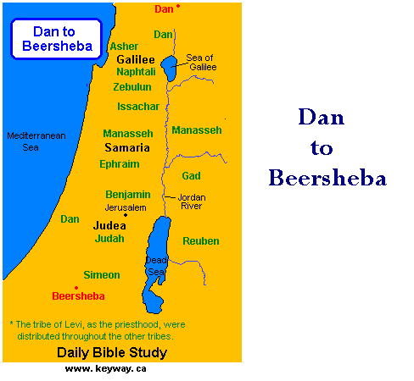

Slide 34
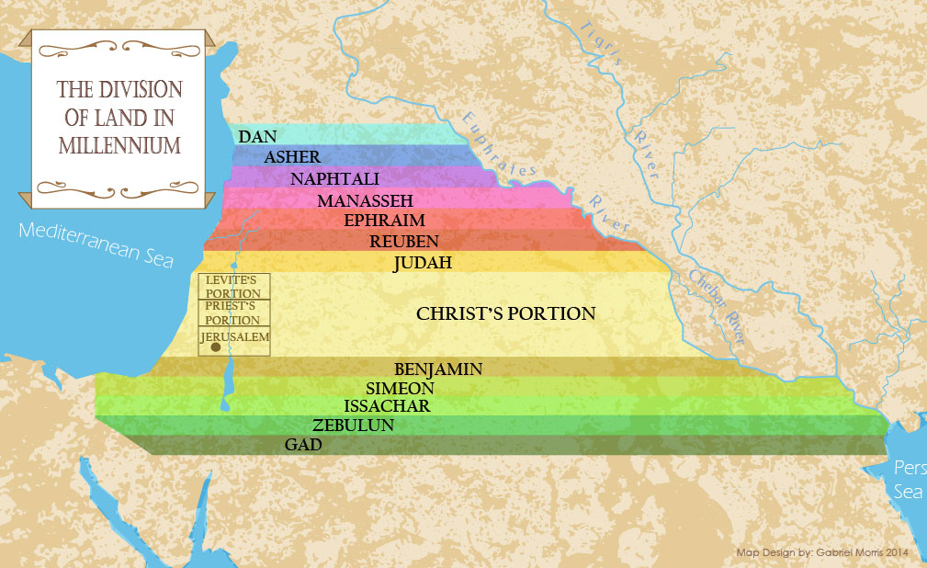

Slide 35
Genesis 48:4 Abrahamic Covenant Reconfirmed
Fruitful (4a)
Numerous (4b)
Company of peoples (4c)
Land (4d)

Slide 36
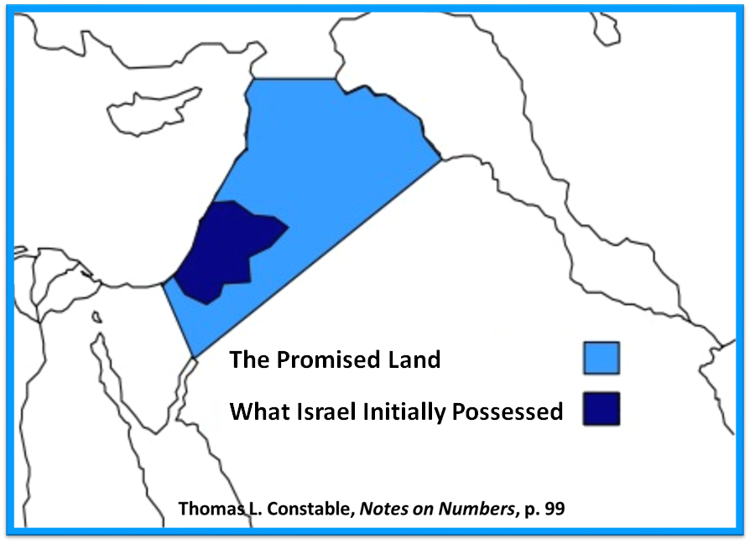

Slide 37
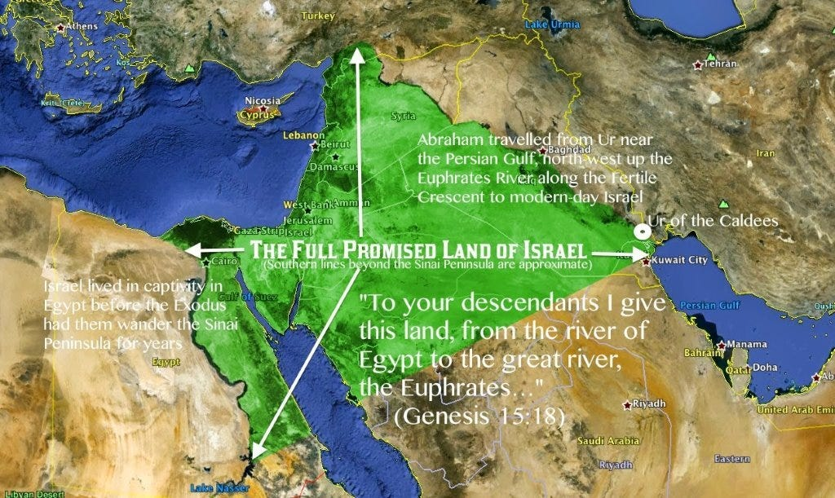

Slide 38
Evidence of Abrahamic Covenant’s Unconditional Nature
ANE covenant ratification ceremony (Gen 15)
Lack of stated conditions for Israel’s obedience (Gen 15)
Covenant's eternality (Gen 17:7, 13, 19; Ps. 90:2)
Covenant's immutability (Heb 6:13-18; Mal. 3:6)
Trans-generational reaffirmation despite perpetual national disobedience (Jer 31:35-37)
Walvoord, The Millennial Kingdom, 149-52

Slide 39
Land Promises Fulfilled in the Time of Joshua (Josh. 11:23; 21:43-45) or Solomon (1 Kgs. 4:21)?
Extended context (Josh 13:1-7; Judges 1:19, 21, 27, 29, 30-36)
Land gained in conquest was only a fraction of what was promised (1 Kgs. 4:25)
Jerusalem not conquered in Joshua’s day (Josh 15:63; 2 Sam 5)
Solomon’s reign extended to the border of Egypt (1 Kgs. 4:21) and not the River of Egypt (Gen. 15:18)
Solomon’s reign was tributary only (1 Kgs. 4:21)
Forever? (Gen 17:7-8, 13, 19)
Reaffirmation of land promises long after Joshua and Solomon’s time (Amos 9:11-15)
Fruchtenbaum, Israelology, 521-22, 631-32

Slide 41
Genesis 48:3-7 Jacob’s Testimony
God’s appearance (3)
Abrahamic Covenant reaffirmed (4)
Jacob’s adoptions (5)
Joseph’s status (6)
Rachel’s death (7)

Slide 42
Genesis 48:5 Jacob’s Adoption
Adoption (5a)
Analogy (5b)

Slide 43
Genesis 48:5 Jacob’s Adoption
Adoption (5a)
Analogy (5b)

Slide 44
Genesis 48:5 Jacob’s Adoption
Adoption (5a)
Analogy (5b)

Slide 46
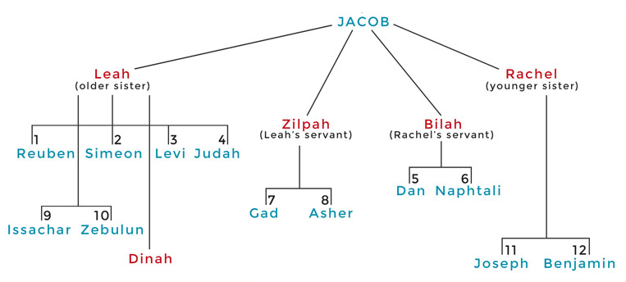

Slide 47
Genesis 48:3-7 Jacob’s Testimony
God’s appearance (3)
Abrahamic Covenant reaffirmed (4)
Jacob’s adoptions (5)
Joseph’s status (6)
Rachel’s death (7)

Slide 48
Genesis 48:3-7 Jacob’s Testimony
God’s appearance (3)
Abrahamic Covenant reaffirmed (4)
Jacob’s adoptions (5)
Joseph’s status (6)
Rachel’s death (7)

Slide 49
Genesis 48:7 Rachel’s Death
Death (7a)
Burial (7b)

Slide 50
Genesis 48:7 Rachel’s Death
Death (7a)
Burial (7b)

Slide 51
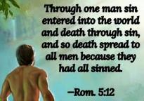
Genesis 2:16-17
“¹⁶ The Lord God commanded the man, saying, ‘From any tree of the garden you may eat freely; ¹⁷ but from the tree of the knowledge of good and evil you shall not eat, for in the day that you eat from it you will surely die (muwth).’”

Slide 52
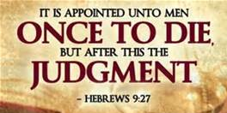
Hebrews 9:27
And inasmuch as it is appointed for men to die once and after this comes judgment.”

Slide 53
1 Thessalonians 4:13-18
¹³ "But we do not want you to be uninformed, brethren, about those who are asleep, so that you will not grieve as do the rest who have no hope. ¹⁴ For if we believe that Jesus died and rose again, even so God will bring with Him those who have fallen asleep in Jesus. ¹⁵ For this we say to you by the word of the Lord, that we who are alive and remain until the coming of the Lord, will not precede those who have fallen asleep. ¹⁶ For the Lord Himself will descend from . . .

Slide 54
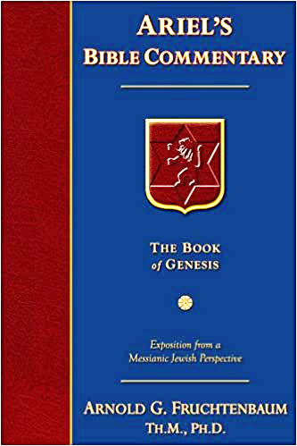
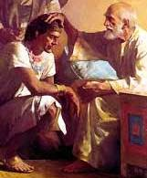
Dr. Arnold G. Fruchtenbaum
The Book of Genesis, 626
“The point Jacob was making is simply that Rachel died too soon, and there would therefore be no more sons by her. However, three tribes will end up descending from her two sons: the Tribe of Ephraim, the Tribe of Manasseh, and the Tribe Benjamin.”

Slide 57
Genesis 48:7 Rachel’s Death
Death (7a)
Burial (7b)

Slide 58
Conclusion

Slide 59
Genesis 48:1-22 Jacob Blesses Joseph’s Sons
Occasion (48:1-7)
Blessing of Manasseh & Ephraim (48:8-20)
Exodus prophecy (48:21-22)

Slide 60
²⁴ The Lord bless you, and keep you; ²⁵ The Lord make His face shine on you, And be gracious to you; ²⁶ The Lord lift up His countenance on you, And give you peace.
Numbers 6:24–26 (NASB95)

