Slide 2
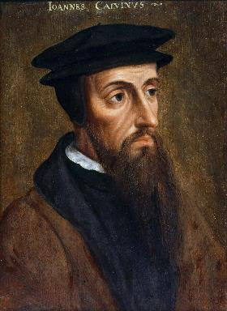
Neo-Calvinism vs. The Bible
Calvinism’s Mixed Blessing
Why Critique Calvinism?
The Source of Calvin’s Theology
Calvin’s Manner of Life
TULIP Through the Grid of Scripture
Conclusion

Slide 3
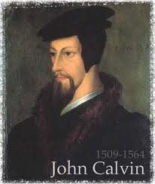
IV. Calvin’s Manner of Life
Bernard Cottret
Three infamous examples
General examples
The contrary example of Christ
The contrary example of Christ’s followers
Lack of love implications
Lack of love in Calvin’s writings
Conclusion

Slide 4
IV. Calvin’s Manner of Life
Bernard Cottret
Three infamous examples
General examples
The contrary example of Christ
The contrary example of Christ’s followers
Lack of love implications
Lack of love in Calvin’s writings
Conclusion

Slide 5
Bernard Cottret
France University professor
Calvin admirer
“Calvin: A Biography”
36 to 58 executions that Calvin involved in
Dates, executions, methods, torture
Heretic: for questioning or criticizing Calvin
Atmosphere in Geneva

Slide 6
IV. Calvin’s Manner of Life
Bernard Cottret
Three infamous examples
General examples
The contrary example of Christ
The contrary example of Christ’s followers
Lack of love implications
Lack of love in Calvin’s writings
Conclusion

Slide 7
Three Specific Infamous Examples
Jacques Gruet
Michael Servetus
Belot

Slide 8
IV. Calvin’s Manner of Life
Bernard Cottret
Three infamous examples
General examples
The contrary example of Christ
The contrary example of Christ’s followers
Lack of love implications
Lack of love in Calvin’s writings
Conclusion

Slide 9
John Calvin
Calvin stated, “I am persuaded that it is not without the special will of God that, apart from any verdict of the judges, the criminals have endured protracted torment at the hands of the executioner.”
Calvin's letter to Farel on 24 July, Selected Works of John Calvin. Cited in Paul Penley, “John Calvin Killed Rival Theologians: Bad Bible Interpretation Justified It,” online: http://www.reenactingtheway.com/blog/john-calvin-had-people-killed-and-bad-bible-interpretation-justified-it, 05 March 2015, accessed 13 November 2019.

Slide 10
John Calvin
Calvin stated, “Whoever shall now contend that it is unjust to put heretics and blasphemers to death, knowingly and willingly incur their guilt. It is not human authority that speaks, it is God who speaks and prescribes a perpetual rule for His Church.”
John Calvin. Cited in Paul Penley, “John Calvin Killed Rival Theologians: Bad Bible Interpretation Justified It,” online: http://www.reenactingtheway.com/blog/john-calvin-had-people-killed-and-bad-bible-interpretation-justified-it, 05 March 2015, accessed 13 November 2019.

Slide 11
John Calvin
“How could such torture be condoned? In November 1552 the Geneva Council declared Calvin's Institutes of the Christian Religion to be a ‘holy doctrine which no man might speak against.’ Disagreeing with Calvin’s view of God was a violation warranting the death penalty according to the way John Calvin interpreted Leviticus 24:16. The Geneva city council records describe one verdict where a man who publicly protested against John Calvin’s doctrine of predestination was flogged at all the city’s main intersections and then expelled…You did not get to disagree with Calvin in this town.”
“The Minutes Book of the Geneva City Council, 1541-59,” translated by Stefan Zweig, Erasmus: The Right to Heresy. Cited in Paul Penley, “John Calvin Killed Rival Theologians: Bad Bible Interpretation Justified It,” online: http://www.reenactingtheway.com/blog/john-calvin-had-people-killed-and-bad-bible-interpretation-justified-it, 05 March 2015, accessed 13 November 2019.

Slide 12
Dave Hunt
“In February of 1555, Calvin’s supporters gained the absolute majority on the council [in Geneva]. On May 16, there was an attempted uprising because Calvin had excluded certain libertarian civic officials from the Lord’s Supper. Leaders of the rebellion who fled to Bern were sentenced to death in abstentia. Four who failed to escape were beheaded, quartered, and their body parts hung in strategic locations as a warning. Evoking the phrase ‘henchmen of Satan,’ which he had used years earlier against the Anabaptists, Calvin justified this barbarity by saying, ‘Those who do not correct evil when they can do so and their office requires it are guilty of it.’ From 1554 until his death in 1564, ‘no one any longer dared oppose the Reformer openly.’”
Dave Hunt, “Calvinism Denied,” in Debating Calvinism: Five Points, Two Views, ed. Dave Hunt and James White (Sisters, OR: Multnomah, 2004), pp. 23-24.

Slide 13
Dave Hunt
“With dictatorial control over the populace (‘he ruled as few sovereigns have done’), Calvin imposed his brand of Christianity upon the citizenry with floggings, imprisonments, banishments, and burnings at the stake. Calvin has been called ‘the Protestant Pope’ and ‘the Genevese dictator’ who ‘would tolerate in Geneva the opinions of only one person, his own.’”
Dave Hunt, What Love Is This? Calvinism's Misrepresentation of God, 4th ed. (Bend, OR: Berean Call, 2013), 74; partly citing Williston Walker from John Calvin: The Organizer of Reformed Protestantism (New York, NY: Schocken Books, 1969), pp. 259 and 107.

Slide 14
Will Durant
“To regulate lay conduct a system of domiciliary visits was established … and questioned the occupants on all phases of their lives. … The allowable color and quantity of clothing, and the number of dishes permissible at a meal, were specified by law. Jewelry and lace were frowned upon. A woman was jailed for arranging her hair to an immoral height. … Censorship of the press was taken over from Catholic and secular precedents and enlarged: books … of immoral tendency were banned. … To speak disrespectfully of Calvin or the clergy was a crime. A first violation of these ordinances was punished with a reprimand, further violation with fines, persistent violation with imprisonment or banishment. Fornication was to be punished with exile or drowning; adultery, blasphemy, or idolatry, with death … a child was beheaded for striking its parents. In the years 1558–59 there were 414 prosecutions for moral offenses; between 1542 and 1564 there were seventy-six banishments and fifty-eight executions; the total population of Geneva was then about 20,000.”
Will Durant, “Caesar and Christ,” Pt. III of The Story of Civilization (New York: Simon and Schuster, 1950), 474.

Slide 15
John Calvin
James Edward McGoldrick, "Introducing John Calvin: The Reformer's Preparation," Reformation and Revival 10, no. 4 (2001): 21.
“A measure of legalism became apparent in Geneva, as the consistory put the lives of church members under continuous review and applied discipline to offenders. Church attendance was compulsory. Eating fish on Fridays was forbidden, as were attendance at theaters, dancing, cardplaying, and criticism of pastors. All heretical teaching was deemed subversive and subject to penalties under criminal law. Flagrant infractions could lead to banishment, imprisonment, and in extreme cases death. Judicial torture was common procedure.”

Slide 16
Philip Schaff
History of the Christian Church, vol. 8 , p. 700.
“The Reformers inherited the doctrine of persecution from their mother Church, and practiced it as far as they had the power. They fought intolerance with intolerance. They differed favorably from their opponents in the degree and extent, but not in the principle, of intolerance. They broke down the tyranny of popery, and thus opened the way for the development of religious freedom; but they denied to others the liberty which they exercised themselves. The Protestant governments in Germany and Switzerland excluded, within the limits of their jurisdiction, the Roman Catholics from all religious and civil rights, and took exclusive possession of their churches, convents, and other property. They banished, imprisoned, drowned, beheaded, hanged, and burned Anabaptists, Antitrinitarians, Schwenkfeldians, and other dissenters.”

Slide 17
Edward Gibbon
Decline and Fall, ch. LIV.
“The Reformers came out of Roman Catholicism which was known for its intolerance and persecution of anyone who differed from Catholic dogma, as anyone who has studied the Spanish Inquisition fully knows. The tragedy is that John Calvin and some of the other Reformers, became shamefully intolerant of those who differed from their doctrinal position, even to the point of executing the offender!” “The Reformers were ambitious of succeeding the tyrants whom they had dethroned. They imposed with equal rigor their creeds and confessions; they asserted the right of the magistrate to punish heretics with death. The nature of the tiger was the same...”
Initial quote by George Zeller, “Should We Go Back to the Reformation?” online: www.middletownbiblechurch.org/reformed/backto.htm, accessed 22 November 2019

Slide 18
IV. Calvin’s Manner of Life
Bernard Cottret
Three infamous examples
General examples
The contrary example of Christ
The contrary example of Christ’s followers
Lack of love implications
Lack of love in Calvin’s writings
Conclusion

Slide 19
The Contrary Example of Christ
Matthew 5:44
Luke 23:34
John 13:15

Slide 20
The Contrary Example of Christ
Matthew 5:44
Luke 23:34
John 13:15

Slide 21
Matthew 5:43-44
“⁴³ You have heard that it was said, ‘You shall love your neighbor and hate your enemy.’ ⁴⁴ But I say to you, love your enemies and pray for those who persecute you.”

Slide 22
The Contrary Example of Christ
Matthew 5:44
Luke 23:34
John 13:15

Slide 23
Dave Hunt
“Perhaps Calvin thought he was God’s instrument to force Irresistible Grace (a key doctrine in Calvinism) upon the citizens of Geneva, Switzerland—even upon those who proved their unworthiness by resisting to the death. He unquestionably did his best to be irresistible in imposing ‘righteousness,’ but what he imposed and the manner in which he imposed it was far from grace and the teachings and example of Christ.”
Dave Hunt, What Love Is This? Calvinism's Misrepresentation of God, 4th ed. (Bend, OR: Berean Call, 2013), 72.

Slide 24
IV. Calvin’s Manner of Life
Bernard Cottret
Three infamous examples
General examples
The contrary example of Christ
The contrary example of Christ’s followers
Lack of love implications
Lack of love in Calvin’s writings
Conclusion

Slide 25
The Contrary Example of Christ’s Followers
Acts 7:60
Galatians 5:22
1 Corinthians 11:1

Slide 26
The Contrary Example of Christ’s Followers
Acts 7:60
Galatians 5:22
1 Corinthians 11:1

Slide 27
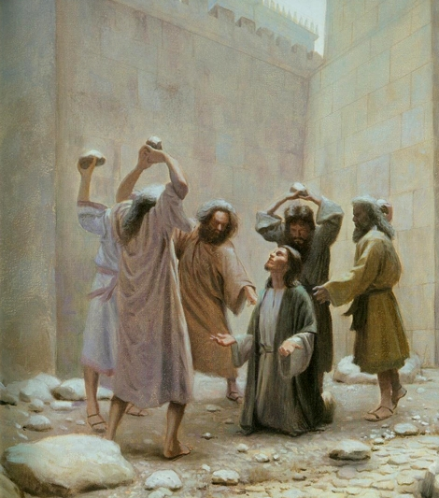
Acts 7:60
“Then falling on his knees, he cried out with a loud voice, “Lord, do not hold this sin against them!” Having said this, he fell asleep.”

Slide 28
The Contrary Example of Christ’s Followers
Acts 7:60
Galatians 5:22
1 Corinthians 11:1

Slide 29
PORTRAIT OF GROWTH 1:5-7

Slide 30
2 Peter 1:5-7
⁵ Now for this very reason also, applying all diligence, in your faith supply moral excellence, and in your moral excellence, knowledge, ⁶ and in your knowledge, self-control, and in your self-control, perseverance, and in your perseverance, godliness, ⁷ and in your godliness, brotherly kindness, and in your brotherly kindness, love.

Slide 31
The Contrary Example of Christ’s Followers
Acts 7:60
Galatians 5:22
1 Corinthians 11:1

Slide 32
IV. Calvin’s Manner of Life
Bernard Cottret
Three infamous examples
General examples
The contrary example of Christ
The contrary example of Christ’s followers
Lack of love implications
Lack of love in Calvin’s writings
Conclusion

Slide 33
Calvin said of God, “for, (as he hates sin) he can only love those whom he justifies [i.e., the elect].”
John Calvin
John Calvin, Institutes of the Christian Religion, Vol. 3, Chapter xi, section 11.

Slide 34
John 3:16
“For God so loved the world, that He gave His only begotten Son, that whoever believes in Him shall not perish, but have eternal life.”

Slide 35
Lack of Love Implications
“The primary teaching in Calvinism is the teaching on ‘election’ in that the majority of people God created, He did not elect to save nor did He love them. In fact, He hated them from before they were even born. Under the Calvinist view of election, wherein God does not love every human being or desires that each one come to faith and be saved, it makes sense that John Calvin did not have God’s love toward those he saw as his unsaved fellow man. After all, if God does not even love them, why should he? It is this reasoning that would have made it easy for Calvin to justify the torture and murder of people whom he believed, in his own estimation, to be heretics. But the Bible says that God is love. And He is righteous, true, faithful, and just. Such are fruits of the Spirit as described in Galatians 5:22, and love is the first one mentioned. It is hard not to believe that John Calvin was under the influence of some other spirit than the Holy Spirit.”
Bob Kirkland, Calvinism: None Dare Call It Heresy; Spotlight on the Life and Teachings of John Calvin (Eureka, MT: Lighthouse Trails, 2018), 23-24.

Slide 36
IV. Calvin’s Manner of Life
Bernard Cottret
Three infamous examples
General examples
The contrary example of Christ
The contrary example of Christ’s followers
Lack of love implications
Lack of love in Calvin’s writings
Conclusion

Slide 37
Lack of Love in Calvin’s Writings
“You will have to look long and hard to find anything in Calvin’s writings about love. It is certainly not obvious in his manner of life.”
Bob Kirkland, Calvinism: None Dare Call It Heresy; Spotlight on the Life and Teachings of John Calvin (Eureka, MT: Lighthouse Trails, 2018), 24.

Slide 38
1 John 4:8
“The one who does not love does not know God, for God is love.”

Slide 39
1 Timothy 1:5
“But the goal of our instruction is love from a pure heart and a good conscience and a sincere faith.”

Slide 40
Declaration of Independence
“the Laws of Nature and of Nature’s God,”
“we hold these truths to be self evident, that all men are created equal,”
“they are endowed by their Creator with certain unalienable Rights,”
“appealing to the Supreme Judge of the world for the rectitude of our intentions,”
“with firm reliance on the protection of Divine Providence.”
Church of the Holy Trinity v. U.S., 143 U.S. 457, 467-68 (1892)

Slide 41
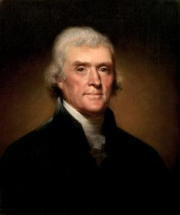
Thomas Jefferson
"I can never join Calvin in addressing his god. He was indeed an Atheist, which I can never be; or rather his religion was Daemonism. If ever man worshipped a false god, he did. The being described in his 5 points is not the god whom you and I acknowledge and adore, the Creator and benevolent and governor of the world, but a daemon of malignant spirit. It would be more pardonable to believe in no god at all, than to blaspheme him by the atrocious attributes of Calvin.”
Jefferson, Letter to John Adams, April 11, 1823

Slide 42
Thomas Jefferson
"The Presbyterian clergy are loudest, the most intolerant of all sects, the most tyrannical, and ambitious; ready at the word of the lawgiver, if such a word could be now obtained, to put the torch to the pile, and to rekindle in this virgin hemisphere, the flames in which their oracle Calvin consumed the poor Servetus, because he could not find in his Euclid the proposition which has demonstrated that three are one, and one is three, nor subscribe to that of Calvin that magistrates have a right to exterminate all heretics to Calvinistic creed.”
Jefferson, letter to William Short, April 13, 1820.

Slide 43
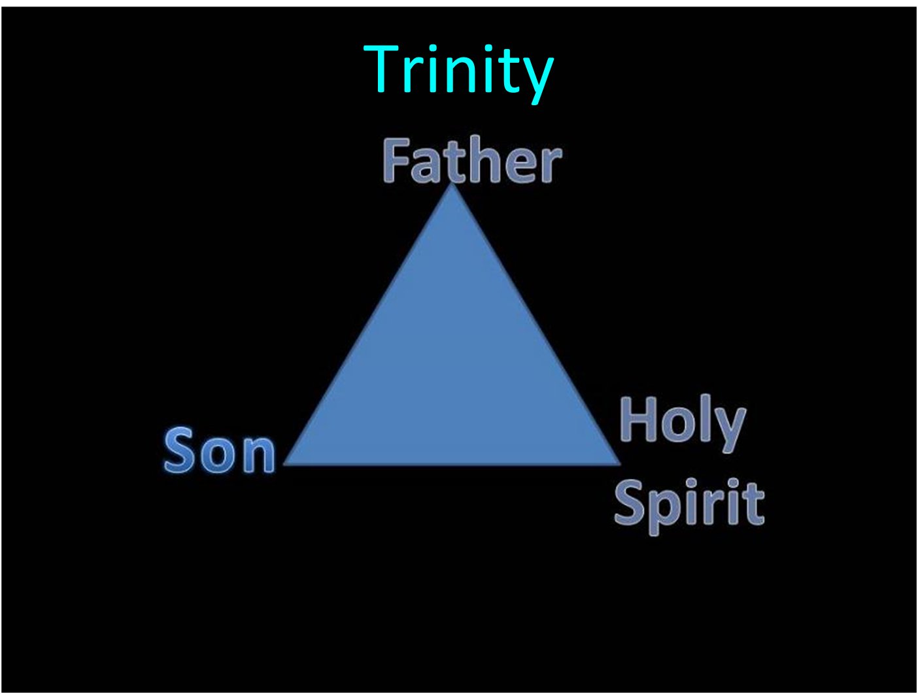

Slide 44
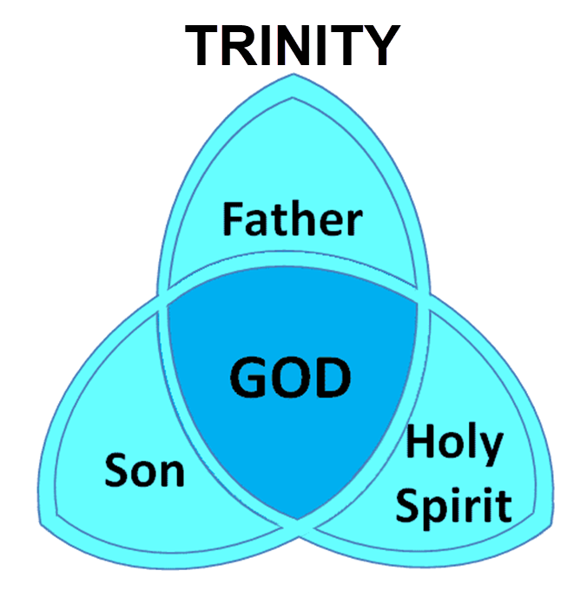

Slide 45
IV. Calvin’s Manner of Life
Bernard Cottret
Three infamous examples
General examples
The contrary example of Christ
The contrary example of Christ’s followers
Lack of love implications
Lack of love in Calvin’s writings
Conclusion

Slide 46
Conclusion
“Will you believe the godly men who wrote under the inspiration of the Holy Spirit, or will you believe a man who wrote under the inspiration of the Catholic Bishop Augustine and who was filled with hatred for those who disagreed with him?”
Bob Kirkland, Calvinism: None Dare Call It Heresy; Spotlight on the Life and Teachings of John Calvin (Eureka, MT: Lighthouse Trails, 2018), 41.

Slide 47
Neo-Calvinism vs. The Bible
Calvinism’s Mixed Blessing
Why Critique Calvinism?
The Source of Calvin’s Theology
Calvin’s Manner of Life
TULIP Through the Grid of Scripture
Conclusion

Slide 48
IV. Calvin’s Manner of Life
Bernard Cottret
Three infamous examples
General examples
The contrary example of Christ
The contrary example of Christ’s followers
Lack of love implications
Lack of love in Calvin’s writings
Conclusion

Slide 49
Neo-Calvinism vs. The Bible
Calvinism’s Mixed Blessing
Why Critique Calvinism?
The Source of Calvin’s Theology
Calvin’s Manner of Life
TULIP Through the Grid of Scripture
Conclusion

