Slide 1
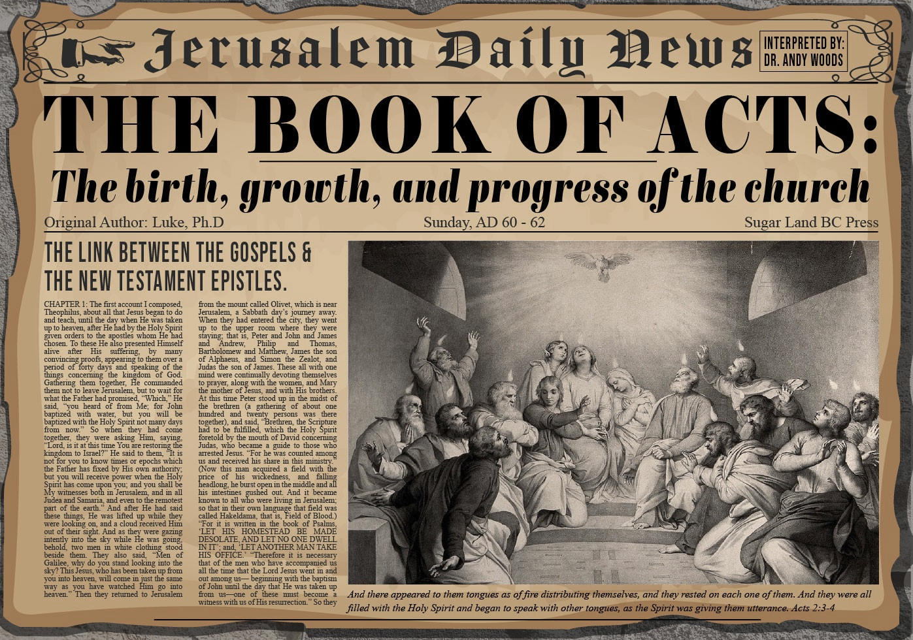


Slide 2
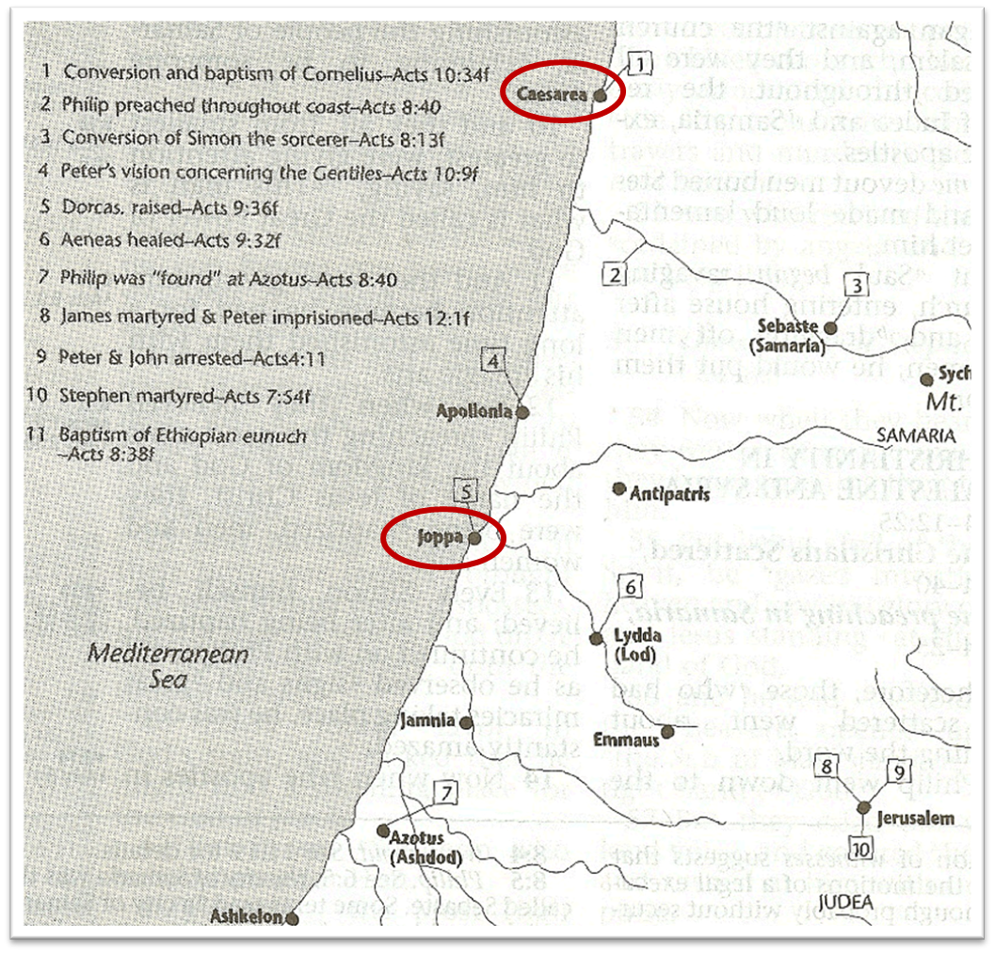

Slide 3
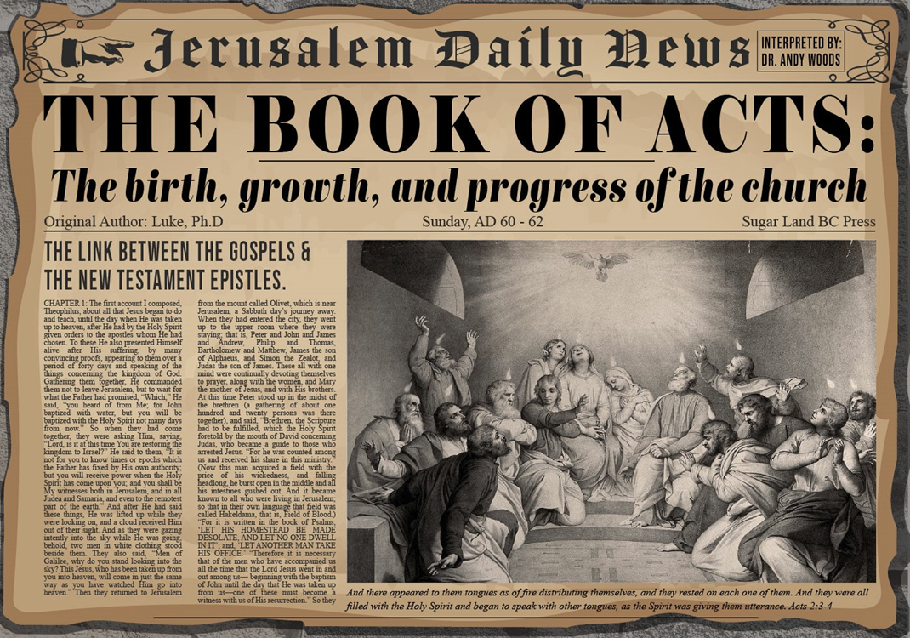
Acts 10:1‒11:18
Cornelius’ Salvation
  Cornelius’ Vision (10:1-8)
  Peter’s Vision (Acts 10:9-16)
  Vision’s Application (10:17-23a)
  Caesarean Ministry (10:23b-33)
  Peter & The Keys of the Kingdom (10:34-43)
  Gentiles’ Salvation (10:44-48)
  Peter’s Defense in Jerusalem (11:1-18)

Slide 4
VI. Gentiles’ Salvation
Acts 10:44-48
  Pentecost of the Gentiles (44)
  Jewish believers’ reaction (45-46a)
  Peters’ question: water baptism (46b-47)
  Water baptism (48a)
  Peter’s discipleship (48b)

Slide 5
VI. Gentiles’ Salvation
Acts 10:44-48
  Pentecost of the Gentiles (44)
  Jewish believers’ reaction (45-46a)
  Peters’ question: water baptism (46b-47)
  Water baptism (48a)
  Peter’s discipleship (48b)

Slide 6


Acts 11:15-16
¹⁵ And as I began to speak, the Holy Spirit fell upon them just as He did upon us at the beginning. ¹⁶ And I remembered the word of the Lord, how He used to say, ‘John baptized with water, but you will be baptized with the Holy Spirit.’

Slide 7

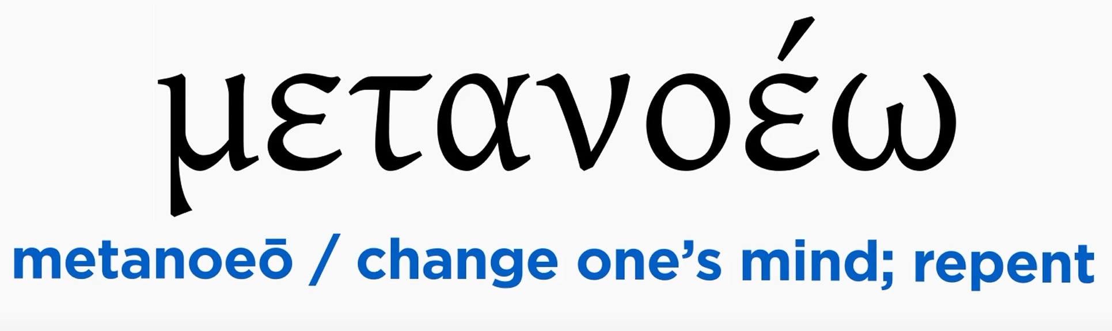
Acts 2:38
“Peter said to them, “Repent [metanoeō], and each of you be baptized in the name of Jesus Christ for (eis) the forgiveness of your sins; and you will receive the gift of the Holy Spirit.”

Slide 8
VI. Gentiles’ Salvation
Acts 10:44-48
  Pentecost of the Gentiles (44)
  Jewish believers’ reaction (45-46a)
  Peters’ question: water baptism (46b-47)
  Water baptism (48a)
  Peter’s discipleship (48b)

Slide 9
Acts 10:45-46a
Jewish Believers’ Reaction
      Amazement (45)
      Evidence of tongues (46a)

Slide 10
Acts 10:45-46a
Jewish Believers’ Reaction
      Amazement (45)
      Evidence of tongues (46a)

Slide 11
1 Corinthians 12:13
“For by one Spirit we were all baptized into one body, whether Jews or Greeks, whether slaves or free, and we were all made to drink of one Spirit.”

Slide 12
Acts 10:45-46a
Jewish Believers’ Reaction
      Amazement (45)
      Evidence of tongues (46a)

Slide 13
VI. Gentiles’ Salvation
Acts 10:44-48
  Pentecost of the Gentiles (44)
  Jewish believers’ reaction (45-46a)
  Peters’ question: water baptism (46b-47)
  Water baptism (48a)
  Peter’s discipleship (48b)

Slide 14
Acts 2:38
“Peter said to them, “Repent [metanoeō], and each of you be baptized in the name of Jesus Christ for (eis) the forgiveness of your sins; and you will receive the gift of the Holy Spirit.”

Slide 15

Matthew 12:41
“The men of Nineveh will stand up with this generation at the judgment and will condemn it because they repented at [in the face of/because of] (eis) the preaching of Jonah; and behold, something greater than Jonah is here.”

Slide 16
VI. Gentiles’ Salvation
Acts 10:44-48
  Pentecost of the Gentiles (44)
  Jewish believers’ reaction (45-46a)
  Peters’ question: water baptism (46b-47)
  Water baptism (48a)
  Peter’s discipleship (48b)

Slide 17

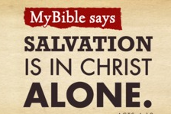
Acts 4:12
“And there is salvation in no one else; for there is no other name under heaven that has been given among men by which we must [dei] be saved.”

Slide 18
Acts 2:38
“Peter said to them, “Repent [metanoeō], and each of you be baptized in the name of Jesus Christ for (eis) the forgiveness of your sins; and you will receive the gift of the Holy Spirit.”

Slide 19
VI. Gentiles’ Salvation
Acts 10:44-48
  Pentecost of the Gentiles (44)
  Jewish believers’ reaction (45-46a)
  Peters’ question: water baptism (46b-47)
  Water baptism (48a)
  Peter’s discipleship (48b)

Slide 20
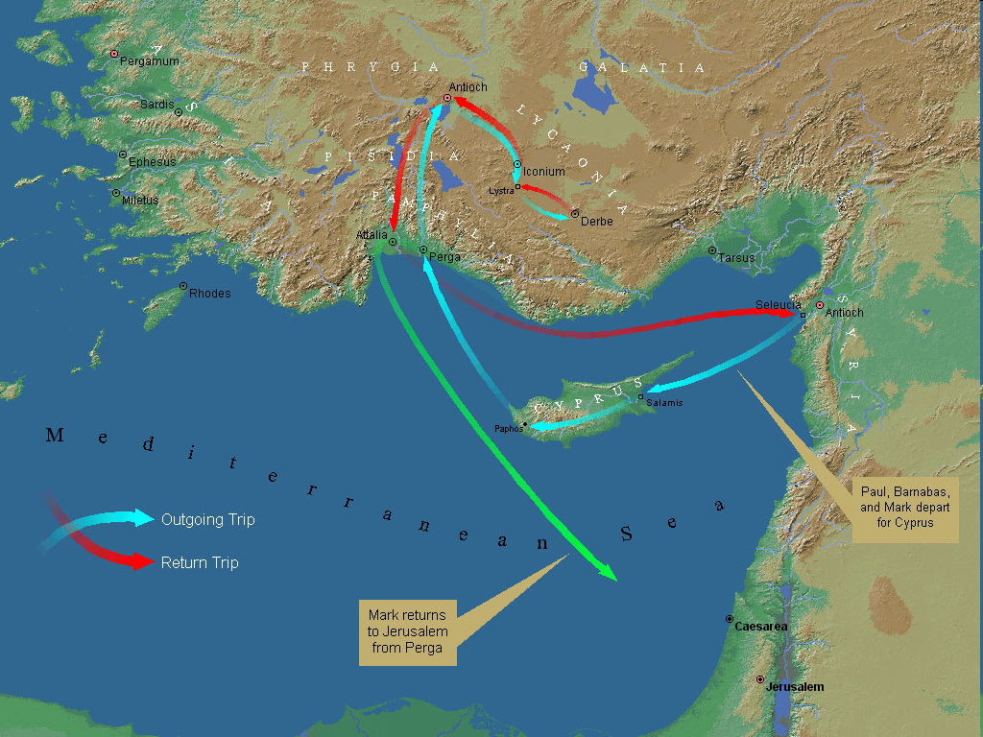
First Missionary Journey

Slide 21
Acts 10:1‒11:18
Cornelius’ Salvation
  Cornelius’ Vision (10:1-8)
  Peter’s Vision (Acts 10:9-16)
  Vision’s Application (10:17-23a)
  Caesarean Ministry (10:23b-33)
  Peter & The Keys of the Kingdom (10:34-43)
  Gentiles’ Salvation (10:44-48)
  Peter’s Defense in Jerusalem (11:1-18)

Slide 22
Conclusion

Slide 23
Acts 10:1‒11:18
Cornelius’ Salvation
  Cornelius’ Vision (10:1-8)
  Peter’s Vision (Acts 10:9-16)
  Vision’s Application (10:17-23a)
  Caesarean Ministry (10:23b-33)
  Peter & The Keys of the Kingdom (10:34-43)
  Gentiles’ Salvation (10:44-48)
  Peter’s Defense in Jerusalem (11:1-18)

