Slide 1
Genesis 12‒50
Israel’s Birth & Preservation

Slide 2
GENESIS STRUCTURE
Genesis 12-50 (four people)
Abraham (12:1–25:11)
Isaac (25:12–26:35)
Jacob (27–36)
Joseph (37–50)

Slide 3
Genesis 37‒50 Joseph
Joseph sold unto Egypt (37)
Canaan’s corruption (38)
Joseph falsely accused (39)
Joseph’s short-term predictions (40)
Joseph’s elevation (41)
Joseph’s first reunion with his brothers (42)
Joseph’s second reunion with his brothers (43‒45)
Joseph’s second reunion with his brothers (43‒45)
Sojourn to Egypt (46:1‒47:12)
Famine’s course (47:13-26)
Jacob in Egypt (47:27-31)

Slide 4
Genesis 47:27-31 Jacob in Egypt
Summary: Jacob’s family (47:27)
Jacob’s age (47:28)
Jacob’s charge (47:29-31)

Slide 5
Genesis 47:27-31 Jacob in Egypt
Summary: Jacob’s family (47:27)
Jacob’s age (47:28)
Jacob’s charge (47:29-31)

Slide 6
I. Genesis 47:27 Summary: Jacob’s Family in Goshen
Family in Goshen (27a)
God’s two-fold blessing (27b-c)

Slide 7
I. Genesis 47:27 Summary: Jacob’s Family in Goshen
Family in Goshen (27a)
God’s two-fold blessing (27b-c)

Slide 9
I. Genesis 47:27 Summary: Jacob’s Family in Goshen
Family in Goshen (27a)
God’s two-fold blessing (27b-c)

Slide 10
Genesis 47:27b-c God’s Two-Fold Blessing
Material prosperity (27b)
Numerical growth (27c)

Slide 11
Genesis 47:27b-c God’s Two-Fold Blessing
Material prosperity (27b)
Numerical growth (27c)

Slide 12
8 New Promises Genesis 12:1-3
Land (Gen. 12:1b)
Great nation (Gen. 12:2a)
Personal blessing (Gen. 12:2b)
Great name (Gen. 12:2c)
Blessing to others (Gen. 12:2d)
Blessing to blessers (Gen. 12:3a)
Cursing to cursers (Gen. 12:3b)
Blessing to the world (Gen. 12:3c)

Slide 13
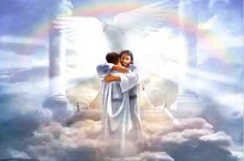
Ephesians 1:3
“Blessed be the God and Father of our Lord Jesus Christ, who has blessed us with every spiritual blessing in the heavenly places in Christ.”

Slide 15
Revelation 2:9
“I know your tribulation and your poverty (but you are rich), and the blasphemy by those who say they are Jews and are not, but are a synagogue of Satan.”

Slide 16
Genesis 47:27b-c God’s Two-Fold Blessing
Material prosperity (27b)
Numerical growth (27c)

Slide 17
2 Peter 3:9
“The Lord is not slow about His promise, as some count slowness, but is patient toward you, not wishing for any to perish but for all to come to repentance.”

Slide 18
Genesis 47:27-31 Jacob in Egypt
Summary: Jacob’s family (47:27)
Jacob’s age (47:28)
Jacob’s charge (47:29-31)

Slide 19
Genesis 47:27-31 Jacob in Egypt
Summary: Jacob’s family (47:27)
Jacob’s age (47:28)
Jacob’s charge (47:29-31)

Slide 20
III. Genesis 47:29-31 Jacob’s Charge to Joseph
Occasion (29a)
Charge (29b-30a)
Joseph’s agreement (30b)
Oath (31a)
Joseph’s agreement (31b)
Jacob’s worship (31c)

Slide 21
III. Genesis 47:29-31 Jacob’s Charge to Joseph
Occasion (29a)
Charge (29b-30a)
Joseph’s agreement (30b)
Oath (31a)
Joseph’s agreement (31b)
Jacob’s worship (31c)

Slide 22
III. Genesis 47:29-31 Jacob’s Charge to Joseph
Occasion (29a)
Charge (29b-30a)
Joseph’s agreement (30b)
Oath (31a)
Joseph’s agreement (31b)
Jacob’s worship (31c)

Slide 23
Genesis 47:29b-30a Charge
Basis (29b)
Ritual (29c)
Content (29d-30a)

Slide 24
Genesis 47:29b-30a Charge
Basis (29b)
Ritual (29c)
Content (29d-30a)

Slide 25
Genesis 47:29b-30a Charge
Basis (29b)
Ritual (29c)
Content (29d-30a)

Slide 26
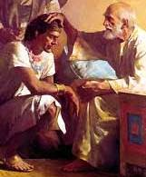
Dr. Arnold G. Fruchtenbaum
The Book of Genesis, 623
“Put, I pray you, your hand under my thigh. As in a previous passage (24:2), that idiom indicated the holding of the genitals, the source of vital power, which emphasized the solemnity of the oath.”

Slide 27
Genesis 47:29b-30a Charge
Basis (29b)
Ritual (29c)
Content (29d-30a)

Slide 28
Evidence of Abrahamic Covenant’s Unconditional Nature
ANE covenant ratification ceremony (Gen 15)
Lack of stated conditions for Israel’s obedience (Gen 15)
Covenant's eternality (Gen 17:7, 13, 19; Ps. 90:2)
Covenant's immutability (Heb 6:13-18; Mal. 3:6)
Trans-generational reaffirmation despite perpetual national disobedience (Jer 31:35-37)
Walvoord, The Millennial Kingdom, 149-52

Slide 29
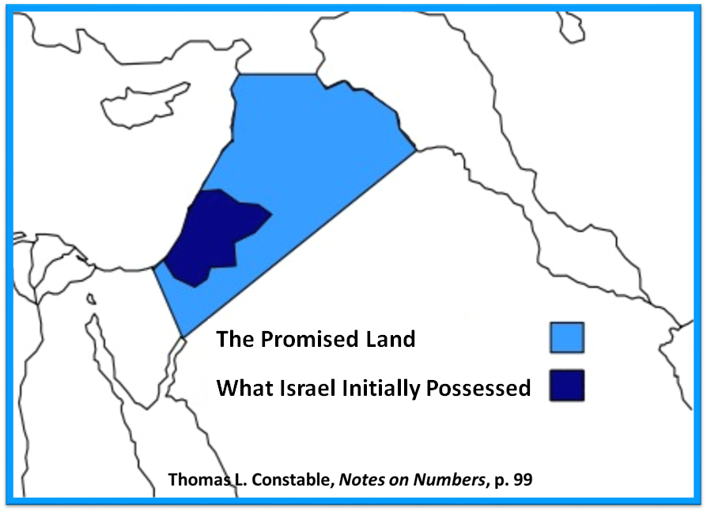

Slide 30
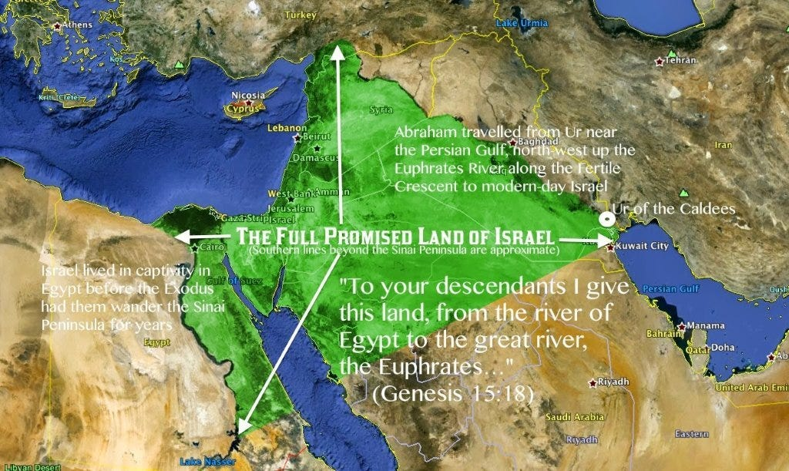

Slide 31
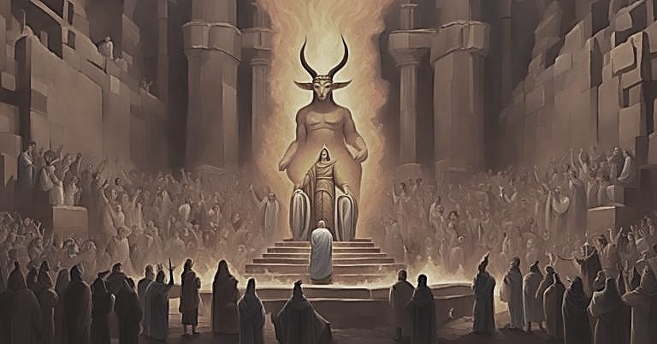
Genesis 15:16
“Then in the fourth generation they will return here, for the wrongdoing of the Amorite is not yet complete.”

Slide 32
2 Corintians 4:18
“…while we look not at the things which are seen, but at the things which are not seen; for the things which are seen are temporal, but the things which are not seen are eternal.”

Slide 33
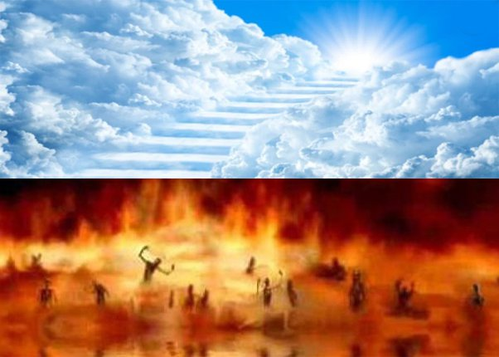
Daniel 12:2
“Many of those who sleep in the dust of the ground will awake, these to everlasting (olam) life, but the others to disgrace and everlasting (olam) contempt.”

Slide 34
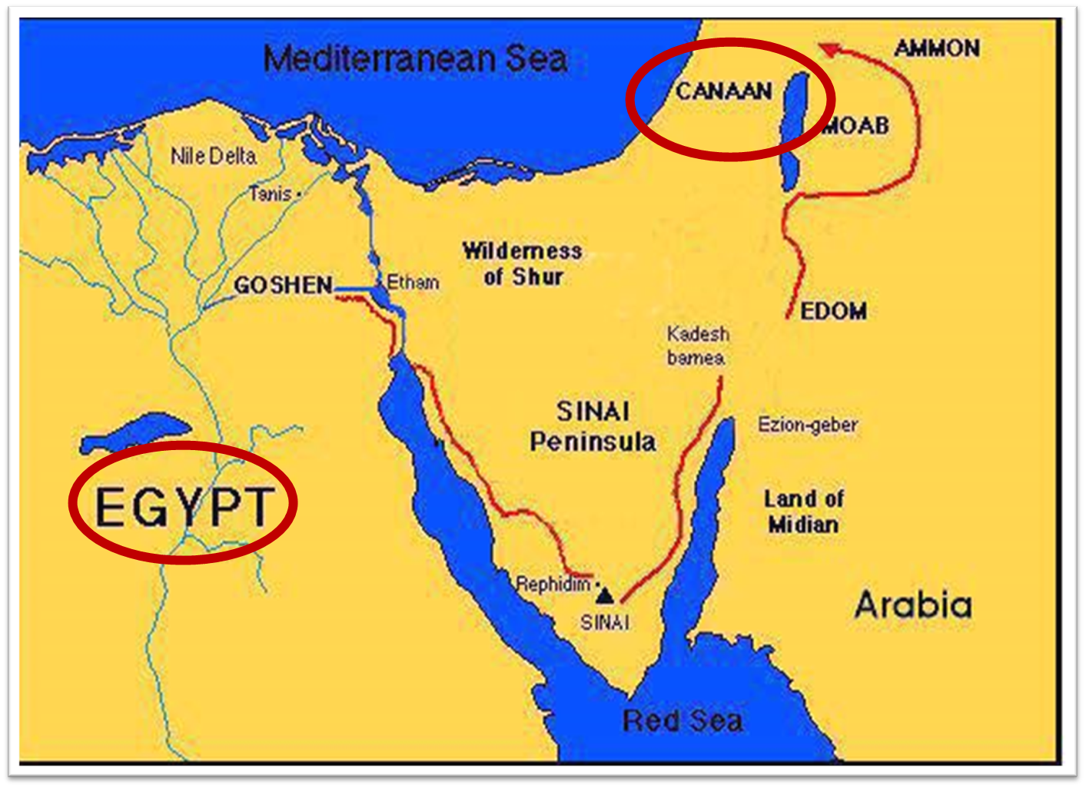

Slide 35
Dr. Arnold G. Fruchtenbaum
The Book of Genesis, 623
“First, the timing is: when I sleep with my fathers; Jacob expects to join them in the afterlife upon death. Second, he specifies: You shall carry me. The sequence here is: Jacob will go to be with his fathers, and after he has gone to be with his fathers, then Joseph is to carry his body to that cave. The order shows a clear belief in the afterlife; he asked Joseph to carry his body to Machpelah; however, prior to that he will be gathered to his fathers. This shows that being gathered to his fathers is not the same as being buried in the cave.”

Slide 36
Luke 16:24-26
“²⁴ And he cried out and said, ‘Father Abraham, have mercy on me, and send Lazarus so that he may dip the tip of his finger in water and cool off my tongue, for I am in agony in this flame.’ ²⁵ But Abraham said, ‘Child, remember that during your life you received your good things, and likewise Lazarus bad things; but now he is being comforted here, and you are in agony. ²⁶ And besides all this, between us and you there is a great chasm fixed, so that those who wish to come over from here to you will not be able, and that none may cross over from there to us.’”

Slide 37
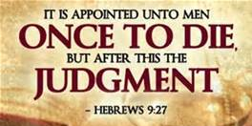
Hebrews 9:27
And inasmuch as it is appointed for men to die once and after this comes judgment.”

Slide 38
III. Genesis 47:29-31 Jacob’s Charge to Joseph
Occasion (29a)
Charge (29b-30a)
Joseph’s agreement (30b)
Oath (31a)
Joseph’s agreement (31b)
Jacob’s worship (31c)

Slide 39
III. Genesis 47:29-31 Jacob’s Charge to Joseph
Occasion (29a)
Charge (29b-30a)
Joseph’s agreement (30b)
Oath (31a)
Joseph’s agreement (31b)
Jacob’s worship (31c)

Slide 40
III. Genesis 47:29-31 Jacob’s Charge to Joseph
Occasion (29a)
Charge (29b-30a)
Joseph’s agreement (30b)
Oath (31a)
Joseph’s agreement (31b)
Jacob’s worship (31c)

Slide 41
III. Genesis 47:29-31 Jacob’s Charge to Joseph
Occasion (29a)
Charge (29b-30a)
Joseph’s agreement (30b)
Oath (31a)
Joseph’s agreement (31b)
Jacob’s worship (31c)

Slide 42
Dr. Arnold G. Fruchtenbaum
The Book of Genesis, 623-24
“Then in verse 31b, Jacob was now able to rest easy: And Israel bowed himself, meaning he turned over in bed to assume a bowed position. It was an act of worship; it was a position from which to worship God in adoration. It then states: upon the bed’s head. The Masoretic Text, which is the Hebrew Text upon which all translations are based, uses the word mittah, which means bed. However, the Septuagint used a Greek word meaning ‘staff’; and so it is obvious that the translators of the Septuagint, the Greek Old Testament, took the word mittah to be mattah, which means ‘staff.’”

Slide 43
Dr. Arnold G. Fruchtenbaum
The Book of Genesis, 623-24
“The three letters for both the word bed and the word “staff” are exactly the same; the only difference is in the vowel pointings, but these vowel pointings in the Hebrew Text were put in about a.d. 900–1000. So one is a mistranslation of the other. The question is: Which was the original reading? Hebrews 11:21 clearly sides with the Septuagint version, because Hebrews 11:21 describes Jacob as having worshipped, leaning up on the top of his staff. Therefore, in this section Jacob was leaning upon his staff, which he kept near to assist him in movement because apparently his old age had weakened him greatly.”

Slide 44
Conclusion

Slide 45
Genesis 37‒50 Joseph
Joseph sold unto Egypt (37)
Canaan’s corruption (38)
Joseph falsely accused (39)
Joseph’s short-term predictions (40)
Joseph’s elevation (41)
Joseph’s first reunion with his brothers (42)
Joseph’s second reunion with his brothers (43‒45)
Joseph’s second reunion with his brothers (43‒45)
Sojourn to Egypt (46:1‒47:12)
Famine’s course (47:13-26)
Jacob in Egypt (47:27-31)

Slide 46
Genesis 47:27-31 Jacob in Egypt
Summary: Jacob’s family (47:27)
Jacob’s age (47:28)
Jacob’s charge (47:29-31)

Slide 47
²⁴ The Lord bless you, and keep you; ²⁵ The Lord make His face shine on you, And be gracious to you; ²⁶ The Lord lift up His countenance on you, And give you peace.
Numbers 6:24–26 (NASB95)

