Slide 1
Genesis 12‒50
Israel’s Birth & Preservation

Slide 2
GENESIS STRUCTURE
Genesis 12-50 (four people)
Abraham (12:1–25:11)
Isaac (25:12–26:35)
Jacob (27–36)
Joseph (37–50)

Slide 3
Genesis 37‒50 Joseph
Joseph sold unto Egypt (37)
Canaan’s corruption (38)
Joseph falsely accused (39)
Joseph’s short-term predictions (40)
Joseph’s elevation (41)
Joseph’s first reunion with his brothers (42)
Joseph’s second reunion with his brothers (43‒45)
Sojourn to Egypt (46:1‒47:12)
Famine’s course (47:13-26)

Slide 4
Genesis 47:13-26 Famine’s Course
Cash (47:13-14)
Livestock (47:15-17)
Property (47:18-22)
Leasing of the land (47:23-26)

Slide 5
Genesis 47:13-26 Famine’s Course
Cash (47:13-14)
Livestock (47:15-17)
Property (47:18-22)
Leasing of the land (47:23-26)

Slide 6
I. Genesis 47:13-14 Cash
Famine described (13)
Money depleted (14)

Slide 7
I. Genesis 47:13-14 Cash
Famine described (13)
Money depleted (14)

Slide 8
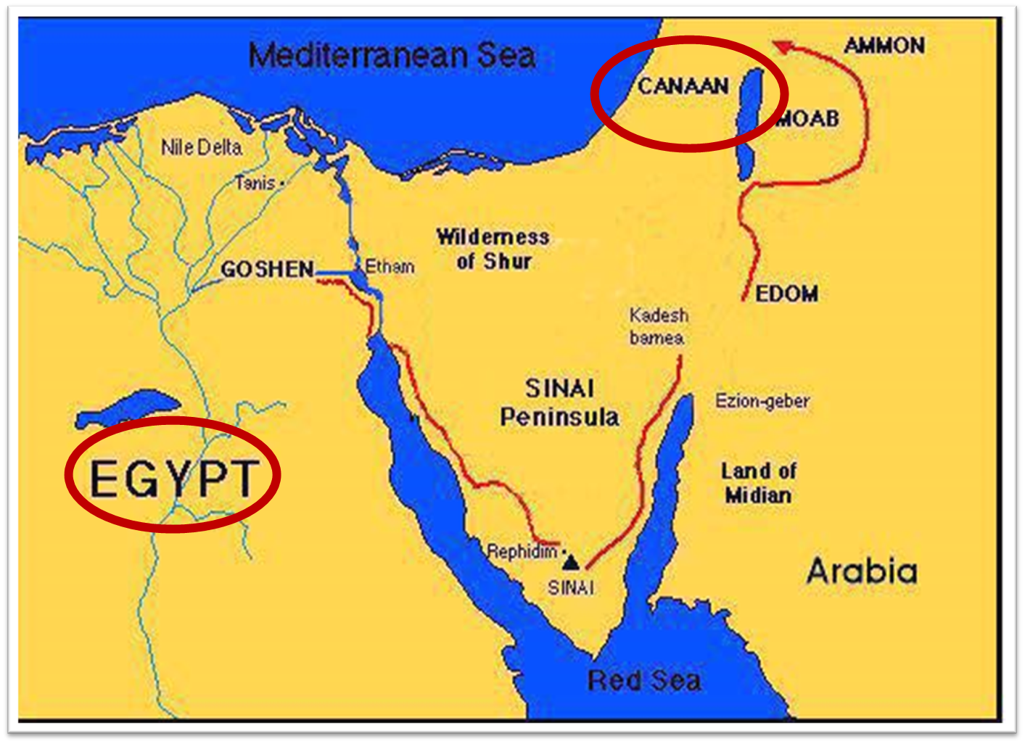

Slide 10
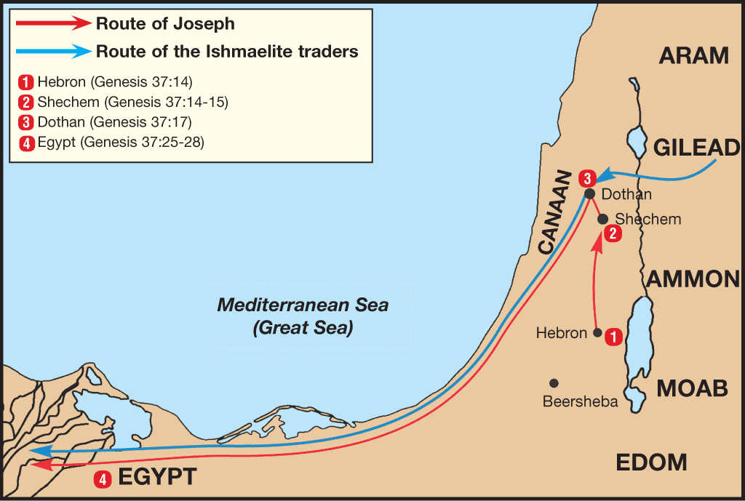

Slide 11
I. Genesis 47:13-14 Cash
Famine described (13)
Money depleted (14)

Slide 12
Genesis 47:13-26 Famine’s Course
Cash (47:13-14)
Livestock (47:15-17)
Property (47:18-22)
Leasing of the land (47:23-26)

Slide 13
II. Genesis 47:15-17 Livestock
Money’s failure (15)
Joseph’s offer (16)
Exchange summarized (17)

Slide 14
II. Genesis 47:15-17 Livestock
Money’s failure (15)
Joseph’s offer (16)
Exchange summarized (17)

Slide 15
II. Genesis 47:15-17 Livestock
Money’s failure (15)
Joseph’s offer (16)
Exchange summarized (17)

Slide 16
II. Genesis 47:15-17 Livestock
Money’s failure (15)
Joseph’s offer (16)
Exchange summarized (17)

Slide 17
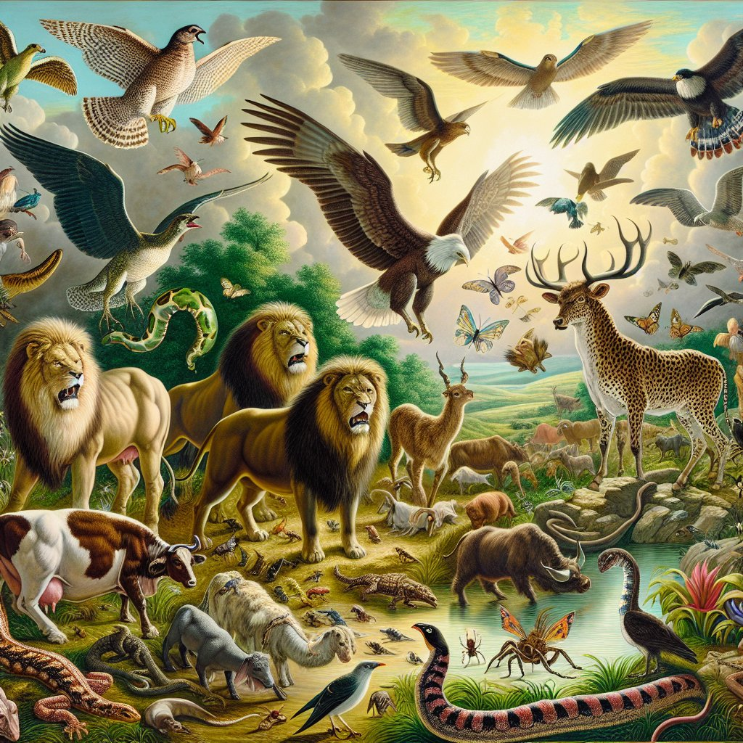
Psalm 50:10
“For every beast of the forest is Mine, The cattle on a thousand hills.”

Slide 18
Genesis 47:13-26 Famine’s Course
Cash (47:13-14)
Livestock (47:15-17)
Property (47:18-22)
Leasing of the land (47:23-26)

Slide 19
III. Genesis 47:18-22 Property
Need for bread (18-19)
Attaining of land (20-22)

Slide 20
III. Genesis 47:18-22 Property
Need for bread (18-19)
Attaining of land (20-22)

Slide 21
Genesis 47:18-19 Need for Bread
Timing (18a)
Desperation (18b-c)
Offer (19)

Slide 22
Genesis 47:18-19 Need for Bread
Timing (18a)
Desperation (18b-c)
Offer (19)

Slide 23
Genesis 47:18-19 Need for Bread
Timing (18a)
Desperation (18b-c)
Offer (19)

Slide 24
Genesis 47:18b-c Desperation
Things gone from first stage (18b)
Only bodies & lands left (18c)

Slide 25
Genesis 47:18b-c Desperation
Things gone from first stage (18b)
Only bodies & lands left (18c)

Slide 26
Genesis 47:18b-c Desperation
Things gone from first stage (18b)
Only bodies & lands left (18c)

Slide 27
2 Peter 1:19-21
“¹⁹ So we have the prophetic word made more sure, to which you do well to pay attention as to a lamp shining in a dark place, until the day dawns and the morning star arises in your hearts. ²⁰ But know this first of all, that no prophecy of Scripture is a matter of one’s own interpretation, ²¹ for no prophecy was ever made by an act of human will, but men moved by the Holy Spirit spoke from God.”

Slide 28
John 13:19; 14:29
“^{13:19} From now on I am telling you before it comes to pass, so that when it does occur, you may believe that I am He… ^{14:29} Now I have told you before it happens, so that when it happens, you may believe.”

Slide 29
What Happened to Christ’s Disciples?
Disciple | Place | Martyrdom
James the Son of Alpheus | Jerusalem | Clubbed to death
Simon the Zealot | Jerusalem | Martyred
James the Son of Zebedee | Judea (Acts 12:2) | Executed
Thaddeus | Mesopotamia | Beaten to death
Peter | Babylon, Rome | Crucified upside down
Matthew | Parthia (Tehran) | Beheaded
Notes:
109 prophecies…
Peter Stoner – SCIENCE SPEAKS, An Evaluation of Certain Christian Evidences
To fulfill just 8 prophecies =1 X 10 to the twenty-eighth power!
Can we visualize this with an illustration? Suppose we took an atheistic professor, blindfolded him and covered the state of Texas two feet deep with silver dollars. Then we put a check on one of those silver dollars and mixed them up. The odds of one person fulfilling just these eight prophecies would be the same as this atheistic professor selecting the silver dollar upon which we have placed a check, in his first try.
https://www.bereanpublishers.com/the-odds-of-eight-messianic-prophecies-coming-true/

Slide 30
What Happened to Christ’s Disciples?
Disciple | Place | Martyrdom
John | Asia Minor, Patmos, Ephesus | Fried in boiling oil
Philip | E. Turkey | Tortured & crucified
Thomas | India | Speared
Bartholomew | India | Flayed & crucified
Andrew | Ukraine, Russia, Greece | Hanged
Notes:
109 prophecies…
Peter Stoner – SCIENCE SPEAKS, An Evaluation of Certain Christian Evidences
To fulfill just 8 prophecies =1 X 10 to the twenty-eighth power!
Can we visualize this with an illustration? Suppose we took an atheistic professor, blindfolded him and covered the state of Texas two feet deep with silver dollars. Then we put a check on one of those silver dollars and mixed them up. The odds of one person fulfilling just these eight prophecies would be the same as this atheistic professor selecting the silver dollar upon which we have placed a check, in his first try.
https://www.bereanpublishers.com/the-odds-of-eight-messianic-prophecies-coming-true/

Slide 31
Luke 19:41-44
^{41 “}When He approached Jerusalem, He saw the city and wept over it, ⁴² saying, “If you had known in this day, even you, the things which make for peace! But now they have been hidden from your eyes. ⁴³ For the days will come upon you when your enemies will throw up a barricade against you, and surround you and hem you in on every side, ⁴⁴ and they will level you to the ground and your children within you, and they will not leave in you one stone upon another, because you did not recognize the time of your visitation.”

Slide 32
Matthew 24:1-2
“¹ Jesus came out from the temple and was going away when His disciples came up to point out the temple buildings to Him. ² And He said to them, “Do you not see all these things? Truly I say to you, not one stone here will be left upon another, which will not be torn down.”

Slide 33
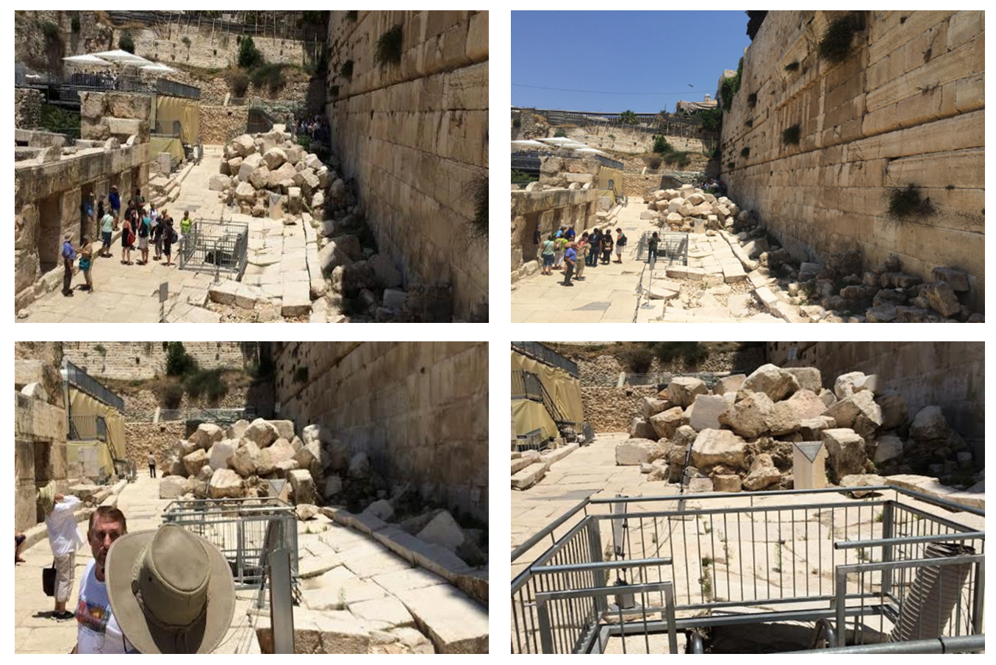

Slide 34
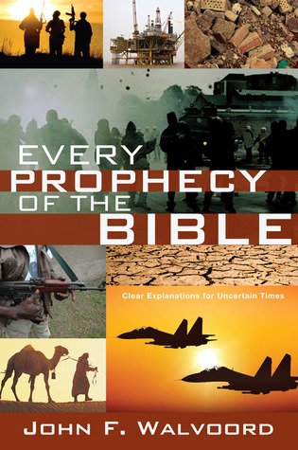

Slide 35
Genesis 47:18-19 Need for Bread
Timing (18a)
Desperation (18b-c)
Offer (19)

Slide 36
Genesis 47:19 Offer
Problem (19a)
Offer & solution (19b)

Slide 37
Genesis 47:19 Offer
Problem (19a)
Offer & solution (19b)

Slide 38
Genesis 47:19 Offer
Problem (19a)
Offer & solution (19b)

Slide 39
III. Genesis 47:18-22 Property
Need for bread (18-19)
Attaining of land (20-22)

Slide 40
Genesis 47:20-22 Attaining Land
Joseph purchases land (20)
Population transfer (21)
Exception for priesthood (22)

Slide 41
Genesis 47:20-22 Attaining Land
Joseph purchases land (20)
Population transfer (21)
Exception for priesthood (22)

Slide 42
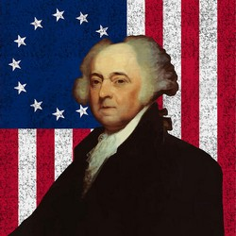
John Adams
“The moment the idea is admitted into society, that property is not as sacred as the laws of God, and that there is not a force of law and public justice to protect it, anarchy and tyranny commence. If ‘Thou Shalt Not Covet," and "Thou Shalt Not Steal’ were not commandments of Heaven, they must be made inviolable precepts in every society before it can be civilized or made free.”
John Adams, A Defence of the Constitutions of Government of the United States of America, 3 vols., American Constitutional and Legal History, ed. Leonard W. Levy (London: Dilly, 1787; reprint, NY: Da Capo, 1971), 3:217

Slide 43
Genesis 47:20-22 Attaining Land
Joseph purchases land (20)
Population transfer (21)
Exception for priesthood (22)

Slide 44
Genesis 47:20-22 Attaining Land
Joseph purchases land (20)
Population transfer (21)
Exception for priesthood (22)

Slide 45
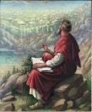
Revelation 17:9-10
“Here is the mind which has wisdom. The seven heads are seven mountains [oros] on which the woman sits, ¹⁰ and they are seven kings; five have fallen, one is, the other has not yet come; and when he comes, he must remain a little while.”

Slide 46
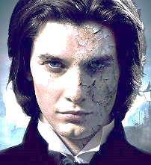
7 Kings or Kingdoms (Dan. 2:37-38) (Revelation 17:9-10)
Egypt
Assyria
Babylon
Persian
Greece
Rome I
Rome II

Slide 48
Revelation 1:6
“and He has made us to be a kingdom, priests to His God and Father—to Him be the glory and the dominion forever and ever. Amen.”

Slide 49
Revelation 5:10
“You have made them to be a kingdom and priests to our God; and they will reign [basileuō] upon the earth [gē].”

Slide 50
Genesis 47:13-26 Famine’s Course
Cash (47:13-14)
Livestock (47:15-17)
Property (47:18-22)
Leasing of the land (47:23-26)

Slide 51
IV. Genesis 47:23-26 Leasing of the Land
Joseph’s initiation (23-24)
People’s agreement (25)
New law (26)

Slide 52
IV. Genesis 47:23-26 Leasing of the Land
Joseph’s initiation (23-24)
People’s agreement (25)
New law (26)

Slide 53
Genesis 47:23-24 Joseph’s Initiation
Joseph’s offer (23)
Lease agreement (24)

Slide 54
Genesis 47:23-24 Joseph’s Initiation
Joseph’s offer (23)
Lease agreement (24)

Slide 55
Genesis 47:23-24 Joseph’s Initiation
Joseph’s offer (23)
Lease agreement (24)

Slide 56
IV. Genesis 47:23-26 Leasing of the Land
Joseph’s initiation (23-24)
People’s agreement (25)
New law (26)

Slide 57
Genesis 47:25 People’s Agreement
Basis (25a)
Agreement (25b)

Slide 58
Genesis 47:25 People’s Agreement
Basis (25a)
Agreement (25b)

Slide 59
Genesis 47:25 People’s Agreement
Basis (25a)
Agreement (25b)

Slide 60
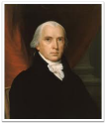
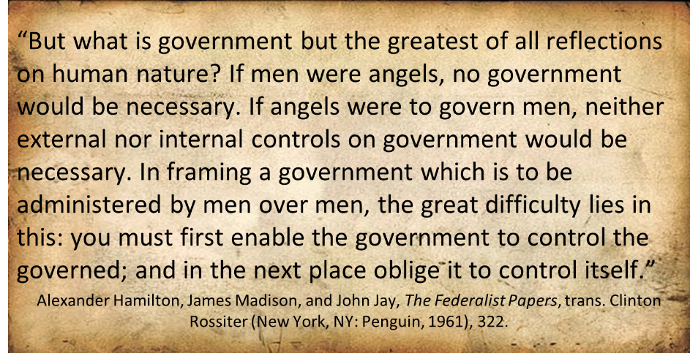
Federalist # 51

Slide 61
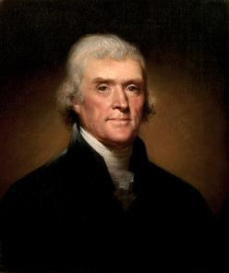
Thomas Jefferson
Kentucky Resolutions of 1798: "...in questions of power then, let no more be heard of confidence in man, but bind him down from mischief by the chains of the constitution..." (from draft)
Papers of Thomas Jefferson 30:529-556

Slide 62
IV. Genesis 47:23-26 Leasing of the Land
Joseph’s initiation (23-24)
People’s agreement (25)
New law (26)

Slide 63
Genesis 47:26 New Law
Content (26a)
Exception: priests (26b)

Slide 64
Genesis 47:26 New Law
Content (26a)
Exception: priests (26b)

Slide 65
Dr. Arnold G. Fruchtenbaum
The Book of Genesis, 621
“Genesis 47:26 records the new law: And Joseph made a statute concerning the land of Egypt unto this day, meaning unto the day that Moses wrote up the account of Genesis. This means that the law that Joseph put into effect a long time earlier was still in effect in the days of Moses. It also means that the Pharaoh of the Oppression, the Pharaoh in the Book of Exodus, was still benefiting from the policy of Joseph, although he knew not Joseph, meaning he did not recognize or appreciate what Joseph had done.”

Slide 66
Genesis 47:26 New Law
Content (26a)
Exception: priests (26b)

Slide 68
Revelation 1:6
“and He has made us to be a kingdom, priests to His God and Father—to Him be the glory and the dominion forever and ever. Amen.”

Slide 69
Revelation 5:10
“You have made them to be a kingdom and priests to our God; and they will reign [basileuō] upon the earth [gē].”

Slide 70
Genesis 37‒50 Joseph
Joseph sold unto Egypt (37)
Canaan’s corruption (38)
Joseph falsely accused (39)
Joseph’s short-term predictions (40)
Joseph’s elevation (41)
Joseph’s first reunion with his brothers (42)
Joseph’s second reunion with his brothers (43‒45)
Joseph’s second reunion with his brothers (43‒45)
Sojourn to Egypt (46:1‒47:12)
Famine’s course (47:13-26)
Jacob in Egypt (47:27-31)

Slide 71
Genesis 47:27-31 Jacob in Egypt
Summary: Jacob’s family (47:27)
Jacob’s age (47:28)
Jacob’s charge (47:29-31)

Slide 72
Genesis 47:27-31 Jacob in Egypt
Summary: Jacob’s family (47:27)
Jacob’s age (47:28)
Jacob’s charge (47:29-31)

Slide 73
I. Genesis 47:27 Summary: Jacob’s Family in Goshen
Family in Goshen (27a)
God’s two-fold blessing (27b-c)

Slide 74
I. Genesis 47:27 Summary: Jacob’s Family in Goshen
Family in Goshen (27a)
God’s two-fold blessing (27b-c)

Slide 75
I. Genesis 47:27 Summary: Jacob’s Family in Goshen
Family in Goshen (27a)
God’s two-fold blessing (27b-c)

Slide 76
Genesis 47:27b-c God’s Two-Fold Blessing
Material prosperity (27b)
Numerical growth (27c)

Slide 77
Genesis 47:27b-c God’s Two-Fold Blessing
Material prosperity (27b)
Numerical growth (27c)

Slide 78
8 New Promises Genesis 12:1-3
Land (Gen. 12:1b)
Great nation (Gen. 12:2a)
Personal blessing (Gen. 12:2b)
Great name (Gen. 12:2c)
Blessing to others (Gen. 12:2d)
Blessing to blessers (Gen. 12:3a)
Cursing to cursers (Gen. 12:3b)
Blessing to the world (Gen. 12:3c)

Slide 79
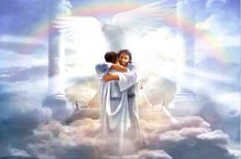
Ephesians 1:3
“Blessed be the God and Father of our Lord Jesus Christ, who has blessed us with every spiritual blessing in the heavenly places in Christ.”

Slide 80
Genesis 47:27b-c God’s Two-Fold Blessing
Material prosperity (27b)
Numerical growth (27c)

Slide 81
Genesis 47:27-31 Jacob in Egypt
Summary: Jacob’s family (47:27)
Jacob’s age (47:28)
Jacob’s charge (47:29-31)

Slide 82
Genesis 47:27-31 Jacob in Egypt
Summary: Jacob’s family (47:27)
Jacob’s age (47:28)
Jacob’s charge (47:29-31)

Slide 83
III. Genesis 47:29-31 Jacob’s Charge to Joseph
Occasion (29a)
Charge (29b-30a)
Joseph’s agreement (30b)
Oath (31a)
Joseph’s agreement (31b)
Jacob’s worship (31c)

Slide 84
III. Genesis 47:29-31 Jacob’s Charge to Joseph
Occasion (29a)
Charge (29b-30a)
Joseph’s agreement (30b)
Oath (31a)
Joseph’s agreement (31b)
Jacob’s worship (31c)

Slide 85
III. Genesis 47:29-31 Jacob’s Charge to Joseph
Occasion (29a)
Charge (29b-30a)
Joseph’s agreement (30b)
Oath (31a)
Joseph’s agreement (31b)
Jacob’s worship (31c)

Slide 86
Genesis 47:29b-30a Charge
Basis (29b)
Ritual (29c)
Content (29d-30a)

Slide 87
Genesis 47:29b-30a Charge
Basis (29b)
Ritual (29c)
Content (29d-30a)

Slide 88
Genesis 47:29b-30a Charge
Basis (29b)
Ritual (29c)
Content (29d-30a)

Slide 89
Dr. Arnold G. Fruchtenbaum
The Book of Genesis, 623
“Put, I pray you, your hand under my thigh. As in a previous passage (24:2), that idiom indicated the holding of the genitals, the source of vital power, which emphasized the solemnity of the oath.”

Slide 90
Genesis 47:29b-30a Charge
Basis (29b)
Ritual (29c)
Content (29d-30a)

Slide 91
Evidence of Abrahamic Covenant’s Unconditional Nature
ANE covenant ratification ceremony (Gen 15)
Lack of stated conditions for Israel’s obedience (Gen 15)
Covenant's eternality (Gen 17:7, 13, 19; Ps. 90:2)
Covenant's immutability (Heb 6:13-18; Mal. 3:6)
Trans-generational reaffirmation despite perpetual national disobedience (Jer 31:35-37)
Walvoord, The Millennial Kingdom, 149-52

Slide 92
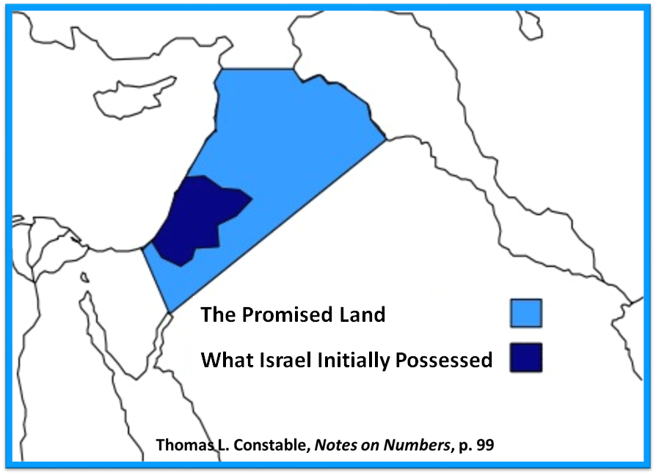

Slide 93
Dr. Arnold G. Fruchtenbaum
The Book of Genesis, 623
“First, the timing is: when I sleep with my fathers; Jacob expects to join them in the afterlife upon death. Second, he specifies: You shall carry me. The sequence here is: Jacob will go to be with his fathers, and after he has gone to be with his fathers, then Joseph is to carry his body to that cave. The order shows a clear belief in the afterlife; he asked Joseph to carry his body to Machpelah; however, prior to that he will be gathered to his fathers. This shows that being gathered to his fathers is not the same as being buried in the cave.”

Slide 94
III. Genesis 47:29-31 Jacob’s Charge to Joseph
Occasion (29a)
Charge (29b-30a)
Joseph’s agreement (30b)
Oath (31a)
Joseph’s agreement (31b)
Jacob’s worship (31c)

Slide 95
III. Genesis 47:29-31 Jacob’s Charge to Joseph
Occasion (29a)
Charge (29b-30a)
Joseph’s agreement (30b)
Oath (31a)
Joseph’s agreement (31b)
Jacob’s worship (31c)

Slide 96
III. Genesis 47:29-31 Jacob’s Charge to Joseph
Occasion (29a)
Charge (29b-30a)
Joseph’s agreement (30b)
Oath (31a)
Joseph’s agreement (31b)
Jacob’s worship (31c)

Slide 97
III. Genesis 47:29-31 Jacob’s Charge to Joseph
Occasion (29a)
Charge (29b-30a)
Joseph’s agreement (30b)
Oath (31a)
Joseph’s agreement (31b)
Jacob’s worship (31c)

Slide 98
Dr. Arnold G. Fruchtenbaum
The Book of Genesis, 623-24
“Then in verse 31b, Jacob was now able to rest easy: And Israel bowed himself, meaning he turned over in bed to assume a bowed position. It was an act of worship; it was a position from which to worship God in adoration. It then states: upon the bed’s head. The Masoretic Text, which is the Hebrew Text upon which all translations are based, uses the word mittah, which means bed. However, the Septuagint used a Greek word meaning ‘staff’; and so it is obvious that the translators of the Septuagint, the Greek Old Testament, took the word mittah to be mattah, which means ‘staff.’”

Slide 99
Dr. Arnold G. Fruchtenbaum
The Book of Genesis, 623-24
“The three letters for both the word bed and the word “staff” are exactly the same; the only difference is in the vowel pointings, but these vowel pointings in the Hebrew Text were put in about a.d. 900–1000. So one is a mistranslation of the other. The question is: Which was the original reading? Hebrews 11:21 clearly sides with the Septuagint version, because Hebrews 11:21 describes Jacob as having worshipped, leaning up on the top of his staff. Therefore, in this section Jacob was leaning upon his staff, which he kept near to assist him in movement because apparently his old age had weakened him greatly.”

Slide 100
Conclusion

Slide 101
Genesis 37‒50 Joseph
Joseph sold unto Egypt (37)
Canaan’s corruption (38)
Joseph falsely accused (39)
Joseph’s short-term predictions (40)
Joseph’s elevation (41)
Joseph’s first reunion with his brothers (42)
Joseph’s second reunion with his brothers (43‒45)
Joseph’s second reunion with his brothers (43‒45)
Sojourn to Egypt (46:1‒47:12)
Famine’s course (47:13-26)
Jacob in Egypt (47:27-31)

Slide 102
²⁴ The Lord bless you, and keep you; ²⁵ The Lord make His face shine on you, And be gracious to you; ²⁶ The Lord lift up His countenance on you, And give you peace.
Numbers 6:24–26 (NASB95)

