Slide 2
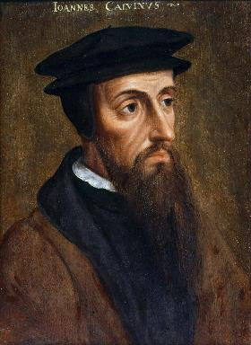
Neo-Calvinism vs. The Bible
Calvinism’s Mixed Blessing
Why Critique Calvinism?
The Source of Calvin’s Theology
Calvin’s Manner of Life
TULIP Through the Grid of Scripture
Conclusion

Slide 3
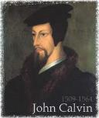
II. The Source of Calvin’s Theology
Augustine (A.D. 343‒430)
Calvin’s literary dependence upon Augustine
Who was Augustine?
The Institutes of the Christian Religion (A.D. 1536)

Slide 4
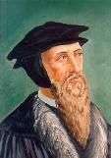
“Augustine is so wholly with me, that if I wished to write a confession of my faith, I could do so with all fullness and satisfaction to myself out of his writings.”
John Calvin
John Calvin, “A Treatise on the Eternal Predestination of God,” in John Calvin, Calvin’s Calvinism, trans. Henry Cole (Grandville, MI: Reformed Free Publishing Association, 1987), 38

Slide 5
Matt 7:16-18
The Root Determines the Fruit
“You will know them by their fruits. Grapes are not gathered from thorn bushes nor figs from thistles, are they? So every good tree bears good fruit, but the bad tree bears bad fruit. A good tree cannot produce bad fruit, nor can a bad tree produce good fruit.”

Slide 6
II. The Source of Calvin’s Theology
Augustine (A.D. 343‒430)
Calvin’s literary dependence upon Augustine
Who was Augustine?
The Institutes of the Christian Religion (A.D. 1536)

Slide 7
Who Was Augustine?
A.D. 343‒430
Father of Determinism
Father of Amillennialism
Father of the Inquisition
Limited Facility with Scripture’s Original Languages
Embraced Roman Catholic Doctrines:
Infant Baptism
Mary’s Sinlessness
Purgatory
The Roman Catholic Church as the Only True Church

Slide 8
“This passage is explained in various ways. I pass by the dreams of the Jews, who apply all passages of this kind to the temporal reign of the Messiah, which they have contrived by their own imagination.... I willingly view this passage as referring to Judea, and afterwards to other parts of the world.... Let us now see when this prophecy was fulfilled, or shall be fulfilled. The Lord began some kind of restoration when he brought his people out of Babylon: but that was only a foretaste, and, therefore, I have no hesitation in saying that this passage, as well as others of a similar kind, must refer to the kingdom of Christ; and in no other light could it be viewed, if we compare it with other prophecies.”
John Calvin
Commentary on Isaiah 35:1
Isaiah 35:1— “The wilderness and the solitary place shall be glad.”

Slide 9
“Here the Prophet describes the felicity which shall be under the reign of Christ: and we know that whenever the Prophets set forth promises of a happy and prosperous state to God’s people, they adopt metaphorical expressions, and say, that abundance of all good things shall flow, that there shall be the most fruitful produce, that provisions shall be bountifully supplied; for they accommodated their mode of speaking to the notions of that ancient people; it is therefore no wonder if they sometimes speak to them as to children. At the same time, the Spirit under these figurative expressions declares, that the kingdom of Christ shall in every way be happy and blessed, or that the Church of God, which means the same thing, shall be blessed, when Christ shall begin to reign.”
John Calvin
Commentary on Amos 9:13
Amos 9:13—“Behold the days come, saith the LORD, that the plowman shall overtake the reaper, and the treader of grapes him that soweth seed: and the mountains shall drop sweet wine, and all the hills shall melt.”

Slide 10
“For as we are dull and entangled in earthly thoughts, our minds can hardly rise up to heaven, though the Lord with a clear voice invites us to himself. The Prophet then, in order to aid our weakness, adds a vivid representation, as though God stood before their eyes. Stand, he says, shall his feet on the mount of Olives. He does not here promise a miracle, such as even the ignorant might conceive to be literal; nor does he do this in what follows, when he says, The mount shall be rent…half…to the east and half to the west. This has never happened, that mount has never been rent: but as the Prophet could not, under those grievous trials, which might have overwhelmed the minds of the godly a hundred times, have extolled the power of God…without employing a highly figurative language, he therefore accommodates himself, as I have said, to the capacity of our flesh.”
John Calvin
Commentary on Zechariah 14:4
Zechariah 14:4—“And his feet shall stand in that day upon the mount of Olives…and the mount of Olives shall cleave in the midst thereof toward the east and toward the west….”

Slide 11
Who Was Augustine?
A.D. 343‒430
Father of Determinism
Father of Amillennialism
Father of the Inquisition
Limited Facility with Scripture’s Original Languages
Embraced Roman Catholic Doctrines:
Infant Baptism
Mary’s Sinlessness
Purgatory
The Roman Catholic Church as the Only True Church

Slide 12
Who Was Augustine?
A.D. 343‒430
Father of Determinism
Father of Amillennialism
Father of the Inquisition
Limited Facility with Scripture’s Original Languages
Embraced Roman Catholic Doctrines:
Infant Baptism
Mary’s Sinlessness
Purgatory
The Roman Catholic Church as the Only True Church

Slide 13
Augustine
Augustine, Edited by Philip Schaff, A Treatise on the Merits and Forgiveness of Sins, and on the Baptism of Infants (Aeterna Press, 2014 edition), p. 29, 30, 112.
“Let there be then no eternal salvation promised to infants out of our own opinion, without Christ’s baptism…So that infants, unless they pass into the number of believers through the sacrament [baptism] which was divinely instituted for this purpose, will undoubtedly remain in this darkness...unless this benefit [baptism] has been bestowed upon them [infants], they are manifestly in danger of damnation.”

Slide 14
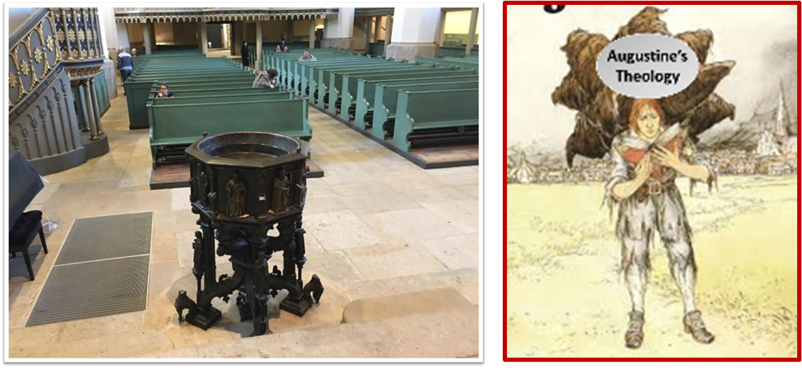
Augustine
Augustine, Edited by Philip Schaff, A Treatise on the Merits and Forgiveness of Sins, and on the Baptism of Infants (Kindle edition, published by Amazon Digital Services), Chapter 8, Kindle location 3350.
“[U]nbaptized infants not only cannot enter into the kingdom of God, but cannot have everlasting life.”

Slide 15
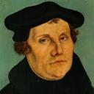
Martin Luther
Alister E. McGrath, Reformation Thought: An Introduction (Grand Rapids: Baker, 1995), 179.
He believed that “such sacraments could generate faith; and hence baptism could generate faith of an infant.”
Notes:
Outline

Slide 16
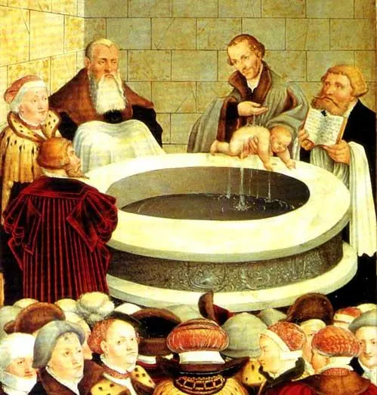

Slide 17
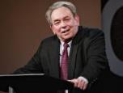
R.C. Sproul
https://www.ligonier.org/learn/devotionals/the-infant-baptism-question/
“The Eastern Orthodox, Roman Catholic, Lutheran, Anglican, and Reformed churches all practice infant baptism. Today we want to look at four lines of evidence that show the validity of this practice. First, just as baptism is the sign of entrance into the community of the new covenant, so circumcision was the sign of entrance into the core community of the old covenant (the people of Israel; God-fearing Gentiles did not have to be circumcised).…The absence of controversy anywhere in the early church indicates that the church was comfortable with infant baptism, and was carrying on the apostolic tradition of the New Testament.”

Slide 18
Who Was Augustine?
A.D. 343‒430
Father of Determinism
Father of Amillennialism
Father of the Inquisition
Limited Facility with Scripture’s Original Languages
Embraced Roman Catholic Doctrines:
Infant Baptism
Mary’s Sinlessness
Purgatory
The Roman Catholic Church as the Only True Church

Slide 19
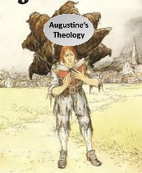
Augustine
Augustine, On Nature and Grace (Pickerington, OH: Beloved Publishing, 2014), pp. 35-36.
Augustine also said things to suggest he believed Mary was sinless as can be seen in his book On Nature and Grace in chapter 42 titled “The Blessed Virgin Mary May Have Lived Without Sin.”

Slide 20
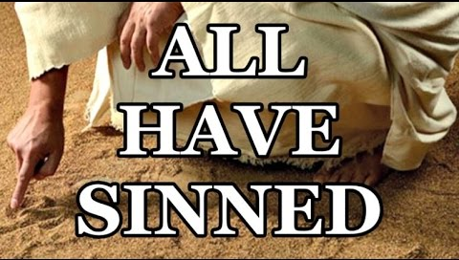
Romans 3:23
“ for all have sinned and fall short of the glory of God.”

Slide 21
Luke 1:46-47
“⁴⁶ And Mary said: “My soul exalts the Lord, ⁴⁷ And my spirit has rejoiced in God my Savior.”

Slide 22
Who Was Augustine?
A.D. 343‒430
Father of Determinism
Father of Amillennialism
Father of the Inquisition
Limited Facility with Scripture’s Original Languages
Embraced Roman Catholic Doctrines:
Infant Baptism
Mary’s Sinlessness
Purgatory
The Roman Catholic Church as the Only True Church

Slide 23
Augustine
The City of God, trans., Marcus Dods (NY: Random House, 1950), Book XX, chap. 25
Augustine wrote, “From these words it more evidently appears that some shall in the last judgment suffer some kind of purgatorial punishments...”

Slide 24
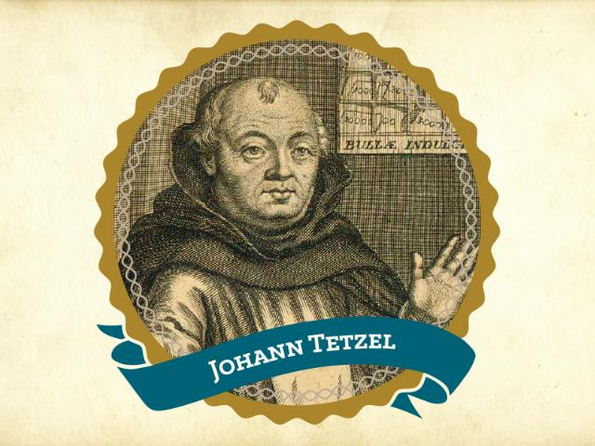
“As soon as the gold in the casket rings; the rescued soul to heaven springs.”

Slide 25
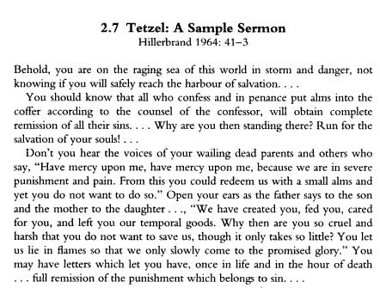

Slide 26
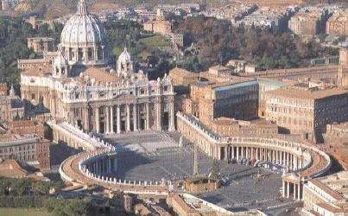
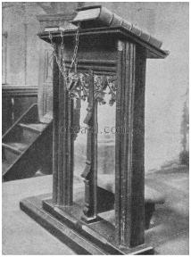

Slide 27
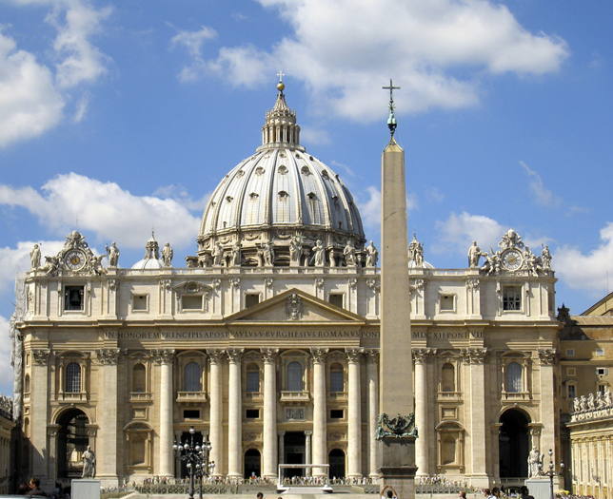

Slide 28
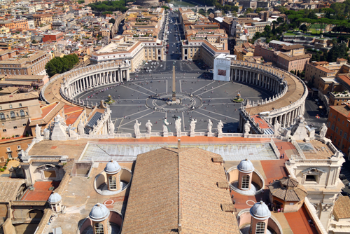

Slide 29
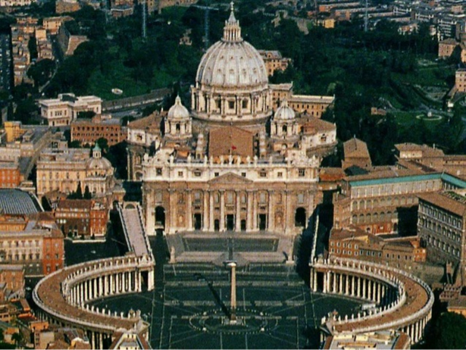

Slide 30
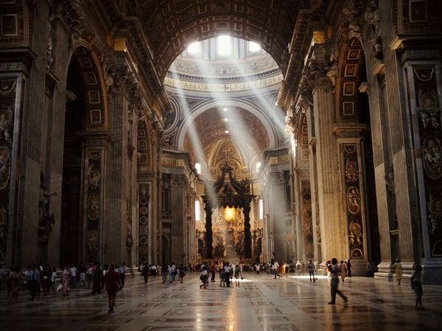

Slide 31
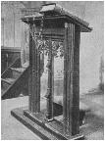
Acts 17:10-11
¹⁰ The brethren immediately sent Paul and Silas away by night to Berea, and when they arrived, they went into the synagogue of the Jews. ¹¹ Now these were more noble-minded than those in Thessalonica, for they received the word with great eagerness, examining the Scriptures daily to see whether these things were so.

Slide 32
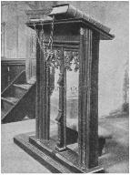
1 Thessalonians 5:20-21
²⁰ do not despise prophetic utterances. ²¹ But examine everything carefully; hold fast to that which is good;

Slide 33
1 Corinthians 14:29 (NASB)
²⁹ Let two or three prophets speak, and let the others pass judgment.…³² and the spirits of prophets are subject to prophets.

Slide 34
Revelation 2:2
“I know your deeds and your toil and perseverance, and that you cannot tolerate evil men, and you put to the test those who call themselves apostles, and they are not, and you found them to be false.”

Slide 35
Luke 16:24-26
“²⁴ And he cried out and said, ‘Father Abraham, have mercy on me, and send Lazarus so that he may dip the tip of his finger in water and cool off my tongue, for I am in agony in this flame.’ ²⁵ But Abraham said, ‘Child, remember that during your life you received your good things, and likewise Lazarus bad things; but now he is being comforted here, and you are in agony. ²⁶ And besides all this, between us and you there is a great chasm fixed, so that those who wish to come over from here to you will not be able, and that none may cross over from there to us.’”

Slide 36
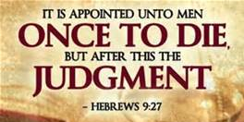
Hebrews 9:27
And inasmuch as it is appointed for men to die once and after this comes judgment.”

Slide 37
Who Was Augustine?
A.D. 343‒430
Father of Determinism
Father of Amillennialism
Father of the Inquisition
Limited Facility with Scripture’s Original Languages
Embraced Roman Catholic Doctrines:
Infant Baptism
Mary’s Sinlessness
Purgatory
The Roman Catholic Church as the Only True Church

Slide 38
Augustine
Aug. Cont. Epist. Fundament c.5. Augustine, Against the Fundamental Epistle of Manichaeus, (JehuBooks. A.D. 397, Kindle edition), Kindle location 89, Chapter 5. Also in the print edition of Against the Epistle of Manichaeus Called Fundamental by CreateSpace Independent Publishing Platform, June 7, 2015, p. 13. Also cited in Calvin, Institutes, I, vii, 3.
Augustine said, “I should not believe the gospel unless I were moved to do so by the authority of the [Catholic ] Church.”

Slide 39
Augustine
Augustine and Chrysostom, Edited by Philip Schaff, Nicene and Post-Nicene Fathers, Volume 1-14 (Ephesians Four Group, 2015 edition, Kindle edition), Kindle location, 106761.
Augustine said, “The Catholic Church alone is the body of Christ. . . . Outside this body, the Holy Spirit giveth life to no one.”

Slide 40
II. The Source of Calvin’s Theology
Augustine (A.D. 343‒430)
Calvin’s literary dependence upon Augustine
Who was Augustine?
The Institutes of the Christian Religion (A.D. 1536)

Slide 41
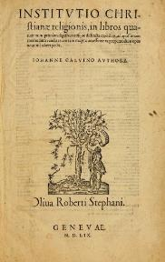
Calvin’s “Institutes of the Christian Religion”
A.D. 1536 (1st edition)
Foundational
Written by Calvin:
at age 25
2 years after declaring himself a Protestant
While still on the Roman Catholic Church payroll
Contain (along with Calvin’s other writings) no clear salvation experience

Slide 42
Calvin’s “Institutes of the Christian Religion”
A.D. 1536 (1st edition)
Foundational
Written by Calvin:
at age 25
2 years after declaring himself a Protestant
While still on the Roman Catholic Church payroll
Contain (along with Calvin’s other writings) no clear salvation experience

Slide 43
Calvin’s “Institutes of the Christian Religion”
A.D. 1536 (1st edition)
Foundational
Written by Calvin:
at age 25
2 years after declaring himself a Protestant
While still on the Roman Catholic Church payroll
Contain (along with Calvin’s other writings) no clear salvation experience

Slide 44
Calvin’s “Institutes of the Christian Religion”
A.D. 1536 (1st edition)
Foundational
Written by Calvin:
at age 25
2 years after declaring himself a Protestant
While still on the Roman Catholic Church payroll
Contain (along with Calvin’s other writings) no clear salvation experience

Slide 45
Calvin’s “Institutes of the Christian Religion”
A.D. 1536 (1st edition)
Foundational
Written by Calvin:
at age 25
2 years after declaring himself a Protestant
While still on the Roman Catholic Church payroll
Contain (along with Calvin’s other writings) no clear salvation experience

Slide 46
Calvin’s “Institutes of the Christian Religion”
A.D. 1536 (1st edition)
Foundational
Written by Calvin:
at age 25
2 years after declaring himself a Protestant
While still on the Roman Catholic Church payroll
Contain (along with Calvin’s other writings) no clear salvation experience

Slide 47
Calvin’s Salvation?
“Within only two years after Calvin declared himself a Protestant, he published his famous Institutes of the Christian Religion. In all of Calvin’s writing, one will not find a clear testimony of his salvation experience. A statement of his ‘conversion’ can only be found in his book Commentary on the Psalms…If we assume his vague intellectual testimony of salvation was a genuine salvation experience, he had been a Christian for just about two years when he wrote his Institutes, which is a foundational resource for today’s Calvinism.”
Bob Kirkland, Calvinism: None Dare Call It Heresy; Spotlight on the Life and Teachings of John Calvin (Eureka, MT: Lighthouse Trails, 2018), 16.

Slide 48
Romans 12:2
“And do not be conformed to this world, but be transformed by the renewing of your mind, so that you may prove what the will of God is, that which is good and acceptable and perfect.”

Slide 49
Calvin’s “Institutes of the Christian Religion”
A.D. 1536 (1st edition)
Foundational
Written by Calvin:
at age 25
2 years after declaring himself a Protestant
While still on the Roman Catholic Church payroll
Contain (along with Calvin’s other writings) no clear salvation experience

Slide 50
Dave Hunt
“Most of those today, including evangelical leaders who hold Calvin in great esteem, are not aware that they have been captivated by the writings of a devout Roman Catholic, newly converted to Luther’s Protestantism, who had broken with Rome only a year before. Oddly, Calvin kept himself on the payroll of the Roman Catholic Church for nearly a year after he claimed to have been miraculously delivered from the ‘deep slough’ of ‘obstinate addiction to the superstitions of the papacy.’”
Dave Hunt, What Love Is This? Calvinism's Misrepresentation of God, 4th ed. (Bend, OR: Berean Call, 2013), 42.

Slide 51
Calvin’s “Institutes of the Christian Religion”
A.D. 1536 (1st edition)
Foundational
Written by Calvin:
at age 25
2 years after declaring himself a Protestant
While still on the Roman Catholic Church payroll
Contain (along with Calvin’s other writings) no clear salvation experience

Slide 52
Calvin’s Salvation?
“Within only two years after Calvin declared himself a Protestant, he published his famous Institutes of the Christian Religion. In all of Calvin’s writing, one will not find a clear testimony of his salvation experience. A statement of his ‘conversion’ can only be found in his book Commentary on the Psalms…If we assume his vague intellectual testimony of salvation was a genuine salvation experience, he had been a Christian for just about two years when he wrote his Institutes, which is a foundational resource for today’s Calvinism.”
Bob Kirkland, Calvinism: None Dare Call It Heresy; Spotlight on the Life and Teachings of John Calvin (Eureka, MT: Lighthouse Trails, 2018), 16.

Slide 53
Calvin’s Salvation?
“God by a sudden conversion [referring to his sudden move away from the Catholic Church at the age of 23] subdued and brought my mind to a teachable frame, which was more hardened in such matters than might have been expected from one at my early period of life. Having thus received some taste and knowledge of true godliness I was immediately inflamed with so intense a desire to make progress therein, that although I did not altogether leave off other studies, I yet pursued them with less ardor.”
John Calvin, Commentary on the Book of Psalms, vol. I, p. xl (Amazon Digital Services LLC, 2011 edition, Kindle Edition), Kindle locations 939-943.

Slide 54
Conclusion

Slide 55
Neo-Calvinism vs. The Bible
Calvinism’s Mixed Blessing
Why Critique Calvinism?
The Source of Calvin’s Theology
Calvin’s Manner of Life
TULIP Through the Grid of Scripture
Conclusion

Slide 56
II. The Source of Calvin’s Theology
Augustine (A.D. 343‒430)
Calvin’s literary dependence upon Augustine
Who was Augustine?
The Institutes of the Christian Religion (A.D. 1536)

Slide 57
Neo-Calvinism vs. The Bible
Calvinism’s Mixed Blessing
Why Critique Calvinism?
The Source of Calvin’s Theology
Calvin’s Manner of Life
TULIP Through the Grid of Scripture
Conclusion

