Slide 2
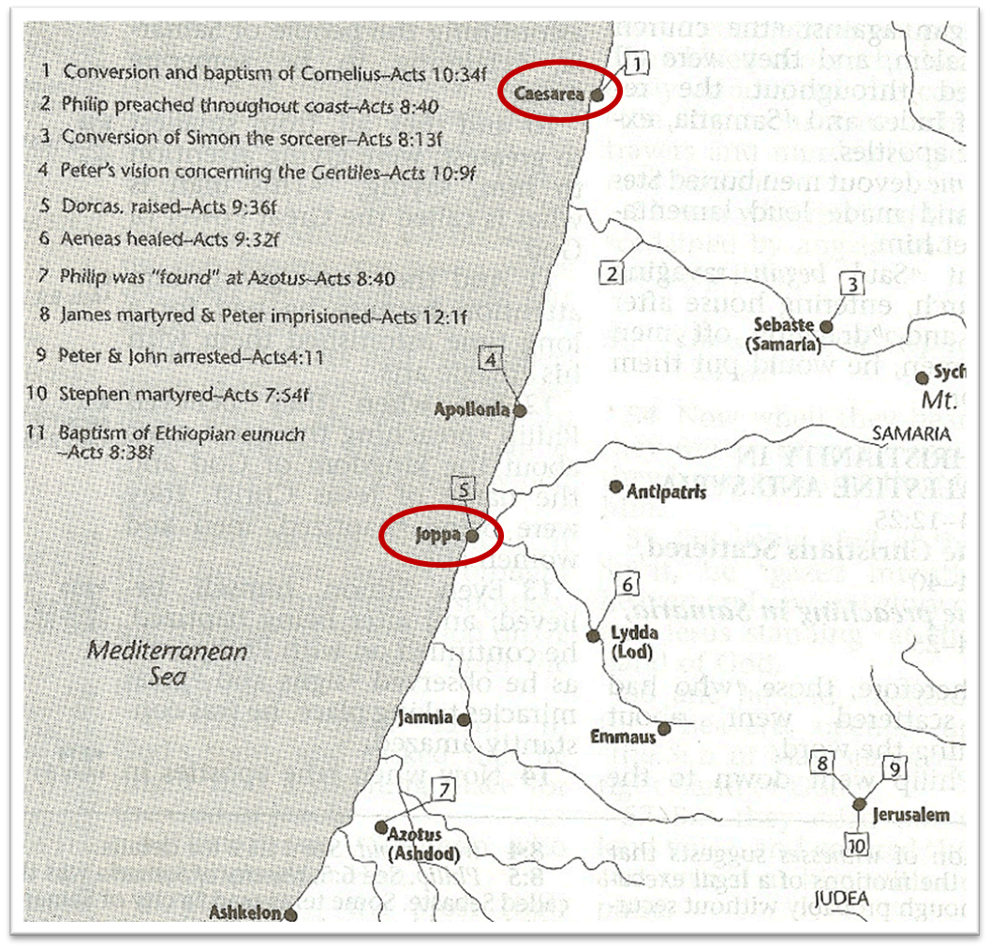

Slide 3
Acts 10:1‒11:18 Cornelius’ Salvation
Cornelius’ Vision (10:1-8)
Peter’s Vision (Acts 10:9-16)
Vision’s Application (10:17-23a)
Caesarean Ministry (10:23b-33)
Peter & The Keys of the Kingdom (10:34-43)
Gentiles’ Salvation (10:44-48)
Peter’s Defense in Jerusalem (11:1-18)

Slide 4
V. Peter & The Keys of the Kingdom Acts 10:34-43
Introduction (34-35)
Yeshua’s work (36-38)
Apostolic witnesses (39-41)
Apostolic commission (42-43)

Slide 5
V. Peter & The Keys of the Kingdom Acts 10:34-43
Introduction (34-35)
Yeshua’s work (36-38)
Apostolic witnesses (39-41)
Apostolic commission (42-43)

Slide 6
Acts 10:34-35 Introduction
God is no respecter of persons (34)
Righteousness is available in any nation (35)

Slide 7
Acts 10:34-35 Introduction
God is no respecter of persons (34)
Righteousness is available in any nation (35)

Slide 8
8 New Promises Genesis 12:1-3
Land (Gen. 12:1b)
Great nation (Gen. 12:2a)
Personal blessing (Gen. 12:2b)
Great name (Gen. 12:2c)
Blessing to others (Gen. 12:2d)
Blessing to blessers (Gen. 12:3a)
Cursing to cursers (Gen. 12:3b)
Blessing to the world (Gen. 12:3c)

Slide 9
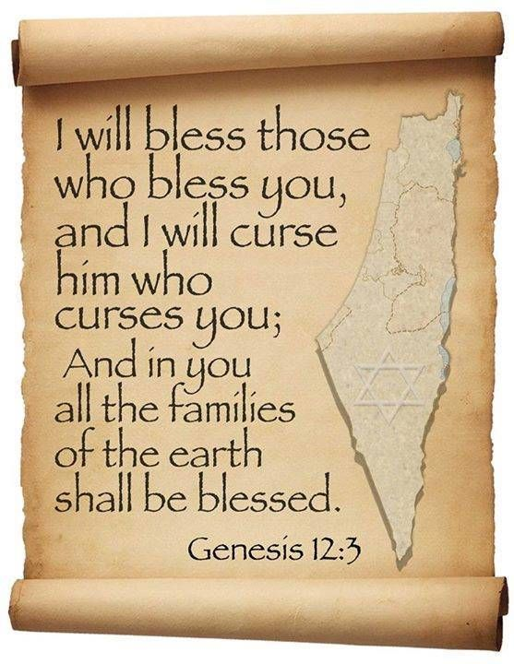
Genesis 12:3
“And I will bless those who bless you, And the one who curses you I will curse. And in you all the families of the earth will be blessed.”

Slide 10
Acts 10:34-35 Introduction
God is no respecter of persons (34)
Righteousness is available in any nation (35)

Slide 11
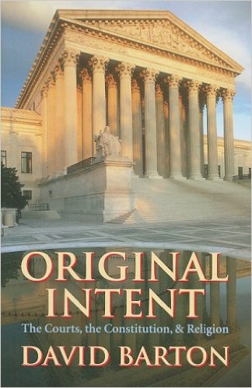
David Barton, Original Intent, p. 245

Slide 12
Dr. Arnold G. Fruchtenbaum
The Book of Acts, 241
“In verse 35, Peter recognized the fact of Gentile acceptance: but in every nation he that fears him, and works righteousness is acceptable to him. The one who fears God obviously has faith. The one who has faith will work righteousness as the evidence of that faith. Such a person is acceptable to God.”

Slide 13
V. Peter & The Keys of the Kingdom Acts 10:34-43
Introduction (34-35)
Yeshua’s work (36-38)
Apostolic witnesses (39-41)
Apostolic commission (42-43)

Slide 14
Acts 10:36-38 Yeshua’s Work
Preparation (36)
First coming (37)
Life and work (38)

Slide 15
Acts 10:36-38 Yeshua’s Work
Preparation (36)
First coming (37)
Life and work (38)

Slide 16
Isaiah 9:6-7
⁶ For a child will be born to us, a son will be given to us; And the government will rest on His shoulders; And His name will be called Wonderful Counselor, Mighty God, Eternal Father, Prince of Peace.⁷ There will be no end to the increase of His government or of peace, On the throne of David and over his kingdom, To establish it and to uphold it with justice and righteousness From then on and forevermore. The zeal of the Lord of hosts will accomplish this.

Slide 17
Acts 10:36-38 Yeshua’s Work
Preparation (36)
First coming (37)
Life and work (38)

Slide 18
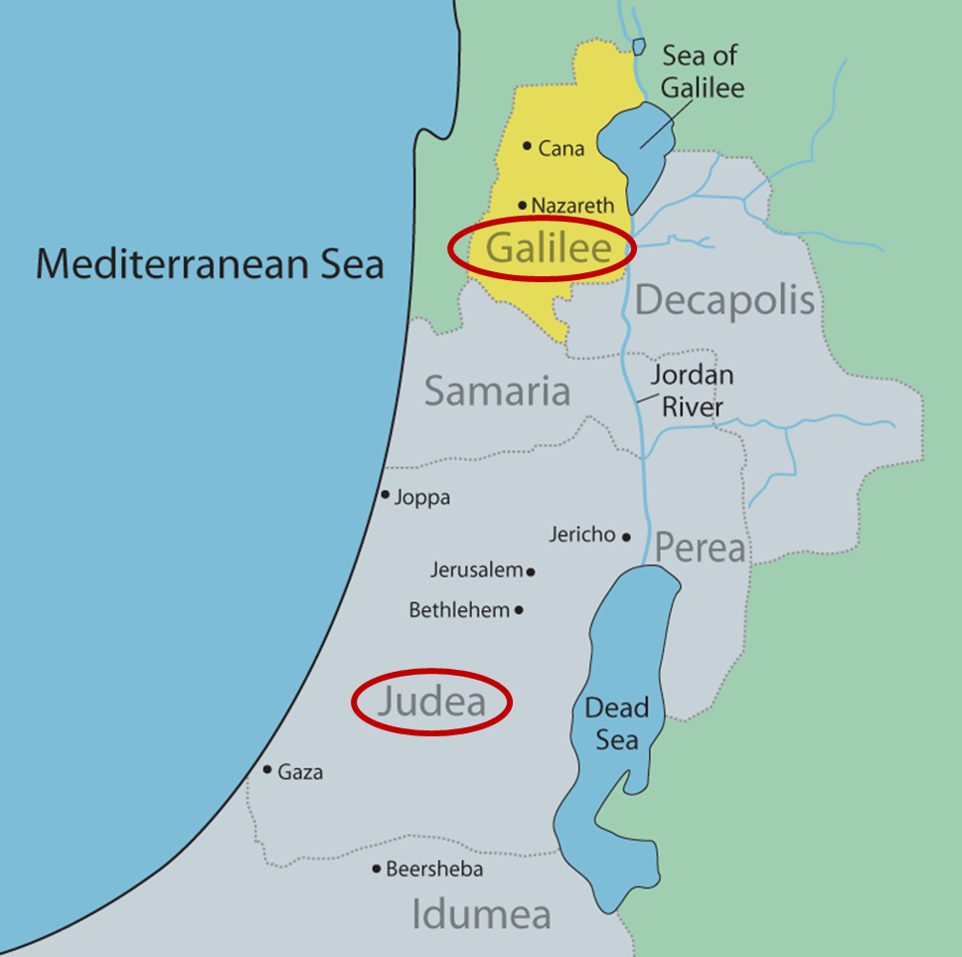

Slide 19
Acts 10:36-38 Yeshua’s Work
Preparation (36)
First coming (37)
Life and work (38)

Slide 20
Isaiah 61:1-2
¹ The Spirit of the Lord God is upon me, Because the Lord has anointed me To bring good news to the afflicted; He has sent me to bind up the brokenhearted, To proclaim liberty to captives And freedom to prisoners;² To proclaim the favorable year of the Lord And the day of vengeance of our God; To comfort all who mourn.

Slide 21
Luke 4:16-21
¹⁶ And He came to Nazareth, where He had been brought up; and as was His custom, He entered the synagogue on the Sabbath, and stood up to read. ¹⁷ And the book of the prophet Isaiah was handed to Him. And He opened the book and found the place where it was written,¹⁸ “The Spirit of the Lord is upon Me, Because He anointed Me to preach the gospel to the poor. He has sent Me to proclaim release to the captives, And recovery of sight to the blind, To set free those who are oppressed,¹⁹ To free . . .

Slide 22
Luke 4:16-21
. . . those who are oppressed,¹⁹ To proclaim the favorable year of the Lord.” ²⁰ And He closed the book, gave it back to the attendant and sat down; and the eyes of all in the synagogue were fixed on Him. ²¹ And He began to say to them, “Today this Scripture has been fulfilled in your hearing.”

Slide 23
Isaiah 61:1-2
¹ The Spirit of the Lord God is upon me, Because the Lord has anointed me To bring good news to the afflicted; He has sent me to bind up the brokenhearted, To proclaim liberty to captives And freedom to prisoners;² To proclaim the favorable year of the Lord And the day of vengeance of our God; To comfort all who mourn..

Slide 24
V. Peter & The Keys of the Kingdom Acts 10:34-43
Introduction (34-35)
Yeshua’s work (36-38)
Apostolic witnesses (39-41)
Apostolic commission (42-43)

Slide 25
Acts 10:39-41 Apostolic Witnesses
Declaration (39a)
Death (39b)
Resurrection (40)
Post-resurrection (41)

Slide 26
Acts 10:39-41 Apostolic Witnesses
Declaration (39a)
Death (39b)
Resurrection (40)
Post-resurrection (41)

Slide 27
Acts 10:39-41 Apostolic Witnesses
Declaration (39a)
Death (39b)
Resurrection (40)
Post-resurrection (41)

Slide 28
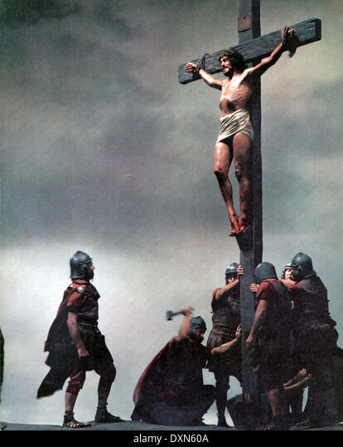
Acts 2:23
“this Man, delivered over by the predetermined plan and foreknowledge of God, you nailed to a cross by the hands of godless men and put Him to death.”

Slide 29
Acts 10:39-41 Apostolic Witnesses
Declaration (39a)
Death (39b)
Resurrection (40)
Post-resurrection (41)

Slide 30
Acts 10:39-41 Apostolic Witnesses
Declaration (39a)
Death (39b)
Resurrection (40)
Post-resurrection (41)

Slide 31
V. Peter & The Keys of the Kingdom Acts 10:34-43
Introduction (34-35)
Yeshua’s work (36-38)
Apostolic witnesses (39-41)
Apostolic commission (42-43)

Slide 32
Acts 10:42-43 Apostolic Commission
Apostles’ testimony (42)
Prophets’ testimony (43)

Slide 33
Acts 10:42-43 Apostolic Commission
Apostles’ testimony (42)
Prophets’ testimony (43)

Slide 34
Acts 10:42-43 Apostolic Commission
Apostles’ testimony (42)
Prophets’ testimony (43)

Slide 35
Luke 24:27, 44
“²⁷ Then beginning with Moses and with all the prophets, He explained to them the things concerning Himself in all the Scriptures…⁴⁴ Now He said to them, ‘These are My words which I spoke to you while I was still with you, that all things which are written about Me in the Law of Moses and the Prophets and the Psalms must be fulfilled.’”

Slide 36
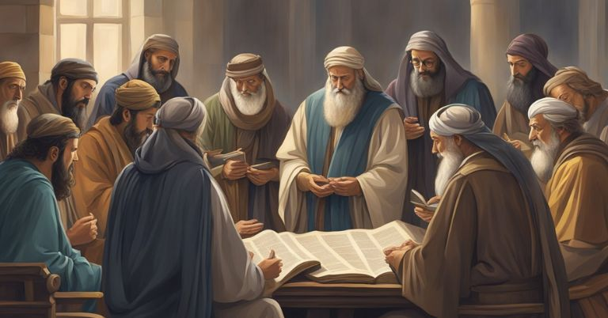
John 5:39, 46
“³⁹ You search the Scriptures because you think that in them you have eternal life; it is these that testify about Me…⁴⁶ For if you believed Moses, you would believe Me, for he wrote about Me.”

Slide 37
Passage Conditioning Salvation on Faith Alone (Sola Fide)
Genesis 15:6
John 3:16; 5:24; 6:28-29, 47; 16:8-9; 20:30-31
Acts 16:30-31
Romans 1:16; Ephesians 2:8-9
Hebrews 11:6

Slide 38
Belief – God’s One Condition for Justification
Gen 15:6
Then he believed in the LORD; and He reckoned it to him as righteousness.
John 3:16
For God so loved the world, that He gave His only begotten Son, that whoever believes in Him shall not perish, but have eternal life.
Acts 16:30-31
"Sirs, what must I do to be saved?" They said, "Believe in the Lord Jesus, and you will be saved..."

Slide 39
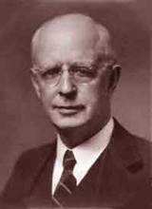
Lewis Sperry Chafer, vol. 7, Systematic Theology (Grand Rapids, MI: Kregel Publications, 1993), 265-66.
Belief-God’s One Condition for Justification
“…because upwards of 150 passages of Scripture condition salvation upon believing only (cf. John 3:16; Acts 16:31).”

Slide 40
Acts 11:15-16
¹⁵ And as I began to speak, the Holy Spirit fell upon them just as He did upon us at the beginning. ¹⁶ And I remembered the word of the Lord, how He used to say, ‘John baptized with water, but you will be baptized with the Holy Spirit.’

Slide 41
Acts 2:38
“Peter said to them, “Repent [metanoeō], and each of you be baptized in the name of Jesus Christ for (eis) the forgiveness of your sins; and you will receive the gift of the Holy Spirit.”

Slide 42
Acts 10:1‒11:18 Cornelius’ Salvation
Cornelius’ Vision (10:1-8)
Peter’s Vision (Acts 10:9-16)
Vision’s Application (10:17-23a)
Caesarean Ministry (10:23b-33)
Peter & The Keys of the Kingdom (10:34-43)
Gentiles’ Salvation (10:44-48)
Peter’s Defense in Jerusalem (11:1-18)

Slide 43
VI. Gentiles’ Salvation Acts 10:44-48
Pentecost of the Gentiles (44)
Jewish believers’ reaction (45-46a)
Peters’ question: water baptism (46b-47)
Water baptism (48a)
Peter’s discipleship (48b)

Slide 44
VI. Gentiles’ Salvation Acts 10:44-48
Pentecost of the Gentiles (44)
Jewish believers’ reaction (45-46a)
Peters’ question: water baptism (46b-47)
Water baptism (48a)
Peter’s discipleship (48b)

Slide 45
Acts 11:15-16
¹⁵ And as I began to speak, the Holy Spirit fell upon them just as He did upon us at the beginning. ¹⁶ And I remembered the word of the Lord, how He used to say, ‘John baptized with water, but you will be baptized with the Holy Spirit.’

Slide 46
VI. Gentiles’ Salvation Acts 10:44-48
Pentecost of the Gentiles (44)
Jewish believers’ reaction (45-46a)
Peters’ question: water baptism (46b-47)
Water baptism (48a)
Peter’s discipleship (48b)

Slide 47
Acts 10:45-46a Jewish Believers’ Reaction
Amazement (45)
Evidence of tongues (46a)

Slide 48
Acts 10:45-46a Jewish Believers’ Reaction
Amazement (45)
Evidence of tongues (46a)

Slide 49
1 Corinthians 12:13
“For by one Spirit we were all baptized into one body, whether Jews or Greeks, whether slaves or free, and we were all made to drink of one Spirit.”

Slide 50
Acts 10:45-46a Jewish Believers’ Reaction
Amazement (45)
Evidence of tongues (46a)

Slide 51
VI. Gentiles’ Salvation Acts 10:44-48
Pentecost of the Gentiles (44)
Jewish believers’ reaction (45-46a)
Peters’ question: water baptism (46b-47)
Water baptism (48a)
Peter’s discipleship (48b)

Slide 52
Acts 2:38
“Peter said to them, “Repent [metanoeō], and each of you be baptized in the name of Jesus Christ for (eis) the forgiveness of your sins; and you will receive the gift of the Holy Spirit.”

Slide 53
VI. Gentiles’ Salvation Acts 10:44-48
Pentecost of the Gentiles (44)
Jewish believers’ reaction (45-46a)
Peters’ question: water baptism (46b-47)
Water baptism (48a)
Peter’s discipleship (48b)

Slide 54
Acts 2:38
“Peter said to them, “Repent [metanoeō], and each of you be baptized in the name of Jesus Christ for (eis) the forgiveness of your sins; and you will receive the gift of the Holy Spirit.”

Slide 55
VI. Gentiles’ Salvation Acts 10:44-48
Pentecost of the Gentiles (44)
Jewish believers’ reaction (45-46a)
Peters’ question: water baptism (46b-47)
Water baptism (48a)
Peter’s discipleship (48b)

Slide 56
Acts 10:1‒11:18 Cornelius’ Salvation
Cornelius’ Vision (10:1-8)
Peter’s Vision (Acts 10:9-16)
Vision’s Application (10:17-23a)
Caesarean Ministry (10:23b-33)
Peter & The Keys of the Kingdom (10:34-43)
Gentiles’ Salvation (10:44-48)
Peter’s Defense in Jerusalem (11:1-18)

Slide 57
Conclusion

Slide 58
Acts 10:1‒11:18 Cornelius’ Salvation
Cornelius’ Vision (10:1-8)
Peter’s Vision (Acts 10:9-16)
Vision’s Application (10:17-23a)
Caesarean Ministry (10:23b-33)
Peter & The Keys of the Kingdom (10:34-43)
Gentiles’ Salvation (10:44-48)
Peter’s Defense in Jerusalem (11:1-18)

