Slide 1
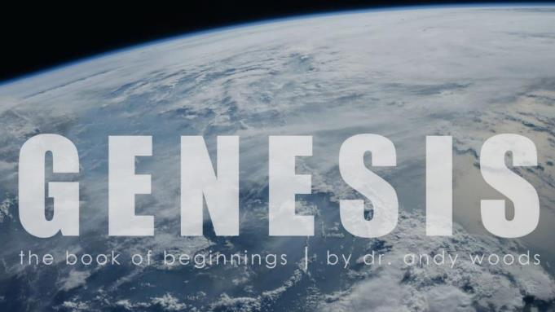
Genesis 12‒50
Israel’s Birth & Preservation

Slide 2
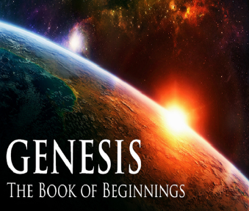
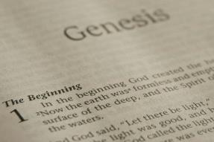
GENESIS STRUCTURE
Genesis 12-50 (four people)
Abraham (12:1–25:11)
Isaac (25:12–26:35)
Jacob (27–36)
Joseph (37–50)

Slide 3
Genesis 37‒50 Joseph
Joseph sold unto Egypt (37)
Canaan’s corruption (38)
Joseph falsely accused (39)
Joseph’s short-term predictions (40)
Joseph’s elevation (41)
Joseph’s first reunion with his brothers (42)
Joseph’s second reunion with his brothers (43‒45)
Sojourn to Egypt (46:1‒47:12)

Slide 4
Genesis 46:1‒47:12 Sojourn to Egypt
Divine Sanction (46:1-7)
House of Jacob (46:8-27)
Jacob Arrives in Egypt (46:28-34)
Jacob’s Family Before Pharaoh (47:1-10)
Settlement in Goshen (47:11-12)

Slide 5
IV. Genesis 47:1-10 Jacob’s Family Before Pharaoh
Joseph’s report to pharaoh (1)
Brothers before Pharaoh (2-6)
Jacob before Pharaoh (7-10)

Slide 6
Genesis 47:7-10 Jacob Before Pharaoh
Joseph presents Jacob (7a)
Jacob blessed Pharaoh (7b)
Pharaoh’s inquiry (8)
Jacob’s answer (9)
Jacob blesses Pharaoh (10a)
Jacob’s exit (10b)

Slide 7
Genesis 47:7-10 Jacob Before Pharaoh
Joseph presents Jacob (7a)
Jacob blessed Pharaoh (7b)
Pharaoh’s inquiry (8)
Jacob’s answer (9)
Jacob blesses Pharaoh (10a)
Jacob’s exit (10b)

Slide 8
Genesis 47:7-10 Jacob Before Pharaoh
Joseph presents Jacob (7a)
Jacob blessed Pharaoh (7b)
Pharaoh’s inquiry (8)
Jacob’s answer (9)
Jacob blesses Pharaoh (10a)
Jacob’s exit (10b)

Slide 9
2 Cor. 4:18 (NASB)
¹⁸ while we look not at the things which are seen, but at the things which are not seen; for the things which are seen are temporal, but the things which are not seen are eternal.

Slide 10
Genesis 47:7-10 Jacob Before Pharaoh
Joseph presents Jacob (7a)
Jacob blessed Pharaoh (7b)
Pharaoh’s inquiry (8)
Jacob’s answer (9)
Jacob blesses Pharaoh (10a)
Jacob’s exit (10b)

Slide 11
Genesis 46:1‒47:12 Sojourn to Egypt
Divine Sanction (46:1-7)
House of Jacob (46:8-27)
Jacob Arrives in Egypt (46:28-34)
Jacob’s Family Before Pharaoh (47:1-10)
Settlement in Goshen (47:11-12)

Slide 12
V. Genesis 47:11-12 Settlement in Goshen
Joseph’s settlement (11)
Joseph’s nourishment (12)

Slide 13
V. Genesis 47:11-12 Settlement in Goshen
Joseph’s settlement (11)
Joseph’s nourishment (12)

Slide 14
Genesis 47:11 Joseph’s Settlement
Joseph’s placement (11a)
Location (11b)
Pharaoh’s command (11c)

Slide 15
Genesis 47:11 Joseph’s Settlement
Joseph’s placement (11a)
Location (11b)
Pharaoh’s command (11c)

Slide 16
Ephesians 2:8-10
“⁸ For by grace you have been saved through faith; and that not of yourselves, it is the gift of God; ⁹ not as a result of works, so that no one may boast. ¹⁰ For we are His workmanship, created in Christ Jesus for good works, which God prepared beforehand so that we would walk [peripateō, subjunctive mood] in them.”

Slide 17
Genesis 47:11 Joseph’s Settlement
Joseph’s placement (11a)
Location (11b)
Pharaoh’s command (11c)

Slide 18
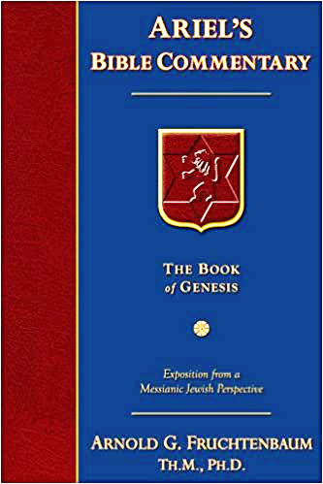
Dr. Arnold G. Fruchtenbaum
The Book of Genesis, 616-17
“Furthermore, it was: in the best of the land, the land of Goshen. Here it is called: in the land of Rameses, which was a section of the land of Goshen. It was, in fact, the better part of Goshen, which today is known as Wadi Tumilat, a valley that is thirty miles long, extending from the Eastern Nile to Lake Timsah. The Rameses of the Nineteenth Dynasty, who came after this time, may very well have been named after this particular land. The City of Rameses was earlier known as Tanis, and before that, it was known as Avaris.”

Slide 19
Dr. Arnold G. Fruchtenbaum
The Book of Genesis, 616-17
“In the course of time, these names changed. According to Numbers 11:5, Goshen was a place where the fish were in abundance. Psalm 78:12 states that this was called the field of Zoan and it was one of the outlet channels of the Nile leading to the sea. It was a very fertile area and a very good area. Indeed, Goshen was the prime land of Egypt, and the area of Rameses was Wadi Tumilat, which was the prime area of Goshen.”

Slide 20
Genesis 47:11 Joseph’s Settlement
Joseph’s placement (11a)
Location (11b)
Pharaoh’s command (11c)

Slide 22
V. Genesis 47:11-12 Settlement in Goshen
Joseph’s settlement (11)
Joseph’s nourishment (12)

Slide 23
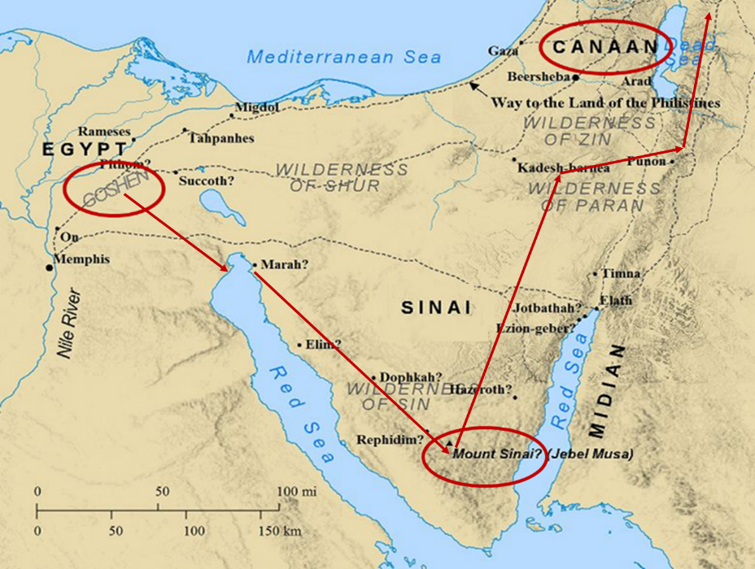

Slide 24
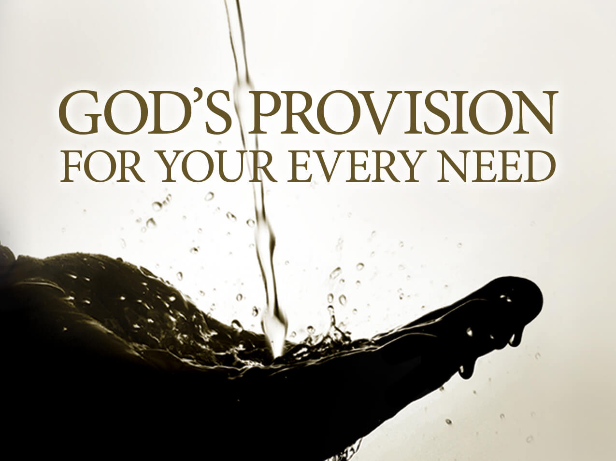
God’s Provision (Phil. 4:19)
Exodus 16
1 Kings 17:2-6
Psalm 37:25
Matthew 6:25-34

Slide 25
Conclusion

Slide 26
Genesis 46:1‒47:12 Sojourn to Egypt
Divine Sanction (46:1-7)
House of Jacob (46:8-27)
Jacob Arrives in Egypt (46:28-34)
Jacob’s Family Before Pharaoh (47:1-10)
Settlement in Goshen (47:11-12)

Slide 27
²⁴ The Lord bless you, and keep you; ²⁵ The Lord make His face shine on you, And be gracious to you; ²⁶ The Lord lift up His countenance on you, And give you peace.
Numbers 6:24–26 (NASB95)

