Slide 2
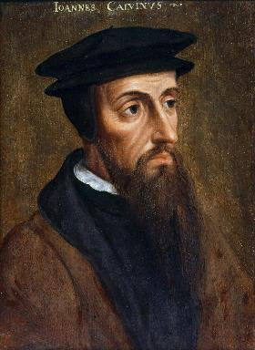
Neo-Calvinism vs. The Bible
Calvinism’s Mixed Blessing
Why Critique Calvinism?
The Source of Calvin’s Theology
Calvin’s Manner of Life
TULIP Through the Grid of Scripture
Conclusion

Slide 3
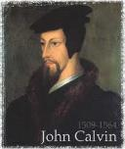
II. The Source of Calvin’s Theology
Augustine (A.D. 343‒430)
Calvin’s literary dependence upon Augustine
Who was Augustine?
The Institutes of the Christian Religion (A.D. 1536)

Slide 4
II. The Source of Calvin’s Theology
Augustine (A.D. 343‒430)
Calvin’s literary dependence upon Augustine
Who was Augustine?
The Institutes of the Christian Religion (A.D. 1536)

Slide 5
II. The Source of Calvin’s Theology
Augustine (A.D. 343‒430)
Calvin’s literary dependence upon Augustine
Who was Augustine?
The Institutes of the Christian Religion (A.D. 1536)

Slide 6
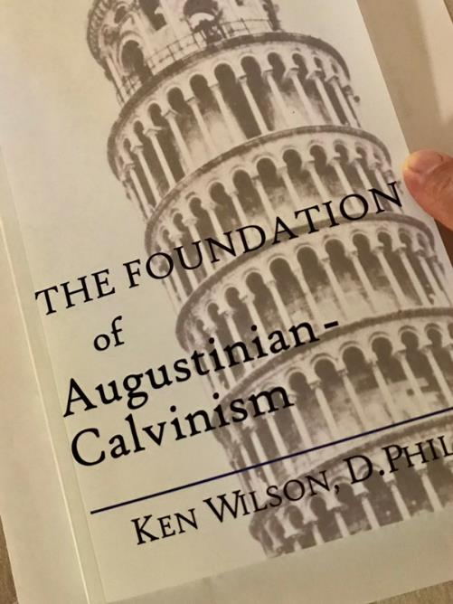

Slide 7
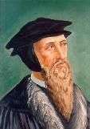
“Augustine is so wholly with me, that if I wished to write a confession of my faith, I could do so with all fullness and satisfaction to myself out of his writings.”
John Calvin
John Calvin, “A Treatise on the Eternal Predestination of God,” in John Calvin, Calvin’s Calvinism, trans. Henry Cole (Grandville, MI: Reformed Free Publishing Association, 1987), 38

Slide 8
﻿“‘We have come into the way of faith,’ says Augustine: ‘Let us constantly adhere to it…’”
“The truth of God is too powerful, both here and everywhere, to dread the slanders of the ungodly, as Augustine powerfully maintains. … Augustine disguises not that … he was often charged with preaching the doctrine of predestination too freely, but … he abundantly refutes the charge. … For it has been shrewdly observed by Augustine (De Genesi ad litteram, Lib V) that we can safely follow Scripture. …”
“For Augustine, rightly expounding this passage, says…”
“I say with Augustine, that the Lord has created those who, as he certainly foreknew, were to go to destruction, and he did so because he so willed.”
“If your mind is troubled, decline not to embrace the counsel of Augustine…”
Calvin, Institutes, III: xxi, 2, 4; xxiii, 1, 5, 8; IV: xiii, 9; III: xxiii, 11, 13, 14.

Slide 9
“I will not hesitate, therefore, simply to confess with Augustine that … those things will certainly happen which he [God] has foreseen [and] that the destruction [of the non-elect] consequent upon predestination is also most just.”
“Augustine, in two passages in particular, gives a portraiture of the form of ancient monasticism.”
“Here the words of Augustine most admirably apply.”
“This is a faithful saying from Augustine; but because his words will perhaps have more authority than mine, let us adduce the following passage from his treatise.”
“Wherefore, Augustine not undeservedly orders such, as senseless teachers or sinister and ill-omened prophets, to retire from the Church.”
Calvin, Institutes, III: xxi, 2, 4; xxiii, 1, 5, 8; IV: xiii, 9; III: xxiii, 11, 13, 14.

Slide 10
Laurence M. Vance
“Howbeit, to prove conclusively that Calvin was a disciple of Augustine, we need look no further than Calvin himself. One can’t read five pages in Calvin’s Institutes without seeing the name of Augustine. Calvin quotes Augustine over four hundred times in the Institutes alone. He called Augustine by such titles as ‘holy man’ and ‘holy father.’”
Laurence M. Vance, The Other Side of Calvinism, rev. ed. (Pensacola, FL: Vance Publications, 1999); citing Calvin, Institutes, 139, 146, 148–49..

Slide 11
Calvin said: “I say with Augustine, that the Lord has created those who, as he certainly foreknow, were to go to destruction, and he did so because he so willed. Why he willed it is not ours to ask, as we cannot comprehend, nor can it become us even to raise a controversy as to the justice of the divine will. Whenever we speak of it, we are speaking of the supreme standard of justice.”
John Calvin
John Calvin, Institutes of the Christian Religion, Vol. 3, Chapter 23, section 5.

Slide 12
Matt 7:16-18
The Root Determines the Fruit
“You will know them by their fruits. Grapes are not gathered from thorn bushes nor figs from thistles, are they? So every good tree bears good fruit, but the bad tree bears bad fruit. A good tree cannot produce bad fruit, nor can a bad tree produce good fruit.”

Slide 13
II. The Source of Calvin’s Theology
Augustine (A.D. 343‒430)
Calvin’s literary dependence upon Augustine
Who was Augustine?
The Institutes of the Christian Religion (A.D. 1536)

Slide 14
Who Was Augustine?
A.D. 343‒430
Father of Determinism
Father of Amillennialism
Father of the Inquisition
Limited Facility with Scripture’s Original Languages
Embraced Roman Catholic Doctrines:
Infant Baptism
Mary’s Sinlessness
Purgatory
The Roman Catholic Church as the Only True Church

Slide 15
Who Was Augustine?
A.D. 343‒430
Father of Determinism
Father of Amillennialism
Father of the Inquisition
Limited Facility with Scripture’s Original Languages
Embraced Roman Catholic Doctrines:
Infant Baptism
Mary’s Sinlessness
Purgatory
The Roman Catholic Church as the Only True Church

Slide 16
Who Was Augustine?
A.D. 343‒430
Father of Determinism
Father of Amillennialism
Father of the Inquisition
Limited Facility with Scripture’s Original Languages
Embraced Roman Catholic Doctrines:
Infant Baptism
Mary’s Sinlessness
Purgatory
The Roman Catholic Church as the Only True Church

Slide 17
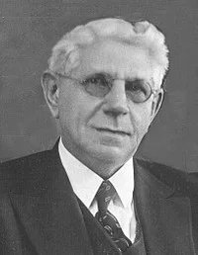
The Father of Determinism
"Predestination does not form an important subject of discussion in history until the time of Augustine. Earlier Church Fathers allude to it, but do not as yet seem to have a very clear conception of it. On the whole they regard it as the prescience of God with reference to human deeds, on the basis of which He determines their future destiny.”
Louis Berkhof, Systematic Theology: With a Complete Textual Index, 4th and rev. ed. (Grand Rapids: Eerdman's, 1932; reprint, Grand Rapids: Baker, 1996), 109.

Slide 18
Who Was Augustine?
A.D. 343‒430
Father of Determinism
Father of Amillennialism
Father of the Inquisition
Limited Facility with Scripture’s Original Languages
Embraced Roman Catholic Doctrines:
Infant Baptism
Mary’s Sinlessness
Purgatory
The Roman Catholic Church as the Only True Church

Slide 19
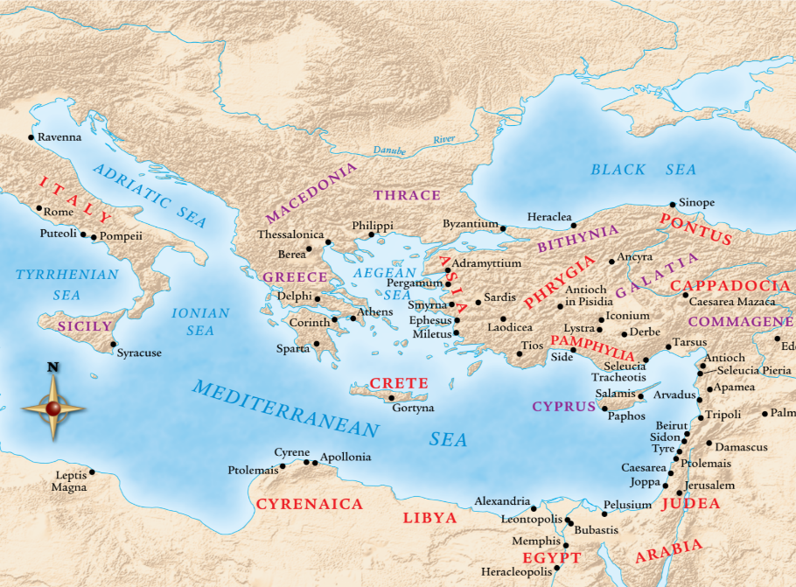

Slide 21
Augustine
The City of God, trans., Marcus Dods (NY: Random House, 1950), Book XX, chap. 7, p. 719.
“And this opinion would not be objectionable…for I myself, too, once held this opinion. But, as they assert that those who then rise again shall enjoy the leisure of immoderate carnal banquets, furnished with an amount of meat and drink such as not only to shock the feeling of the temperate, but even to surpass the measure of credulity itself, such assertions can be believed only by the carnal. They who do believe them are called by the spiritual Chiliasts, which we may literally reproduce by the name Millenarians.”

Slide 22
Augustine
The City of God, trans., Marcus Dods (NY: Random House, 1950), Book XX, chap. 9, p. 725-26.
Augustine wrote, “the saints reign with Christ during the same thousand years, understood in the same way, that is, of the time of His first coming” and “Therefore the Church even now is the kingdom of Christ, and the kingdom of heaven. Accordingly, even now His saints reign with Him.”

Slide 23
John Calvin
Institutes of the Christian Religion, III, xxv, 5.
“But Satan has not only befuddled men’s senses to make them bury with the corpses the memory of resurrection; he has also attempted to corrupt this part of the doctrine with various falsifications…Now their fiction is too childish either to need or to be worth a refutation. And the Apocalypse, from which they undoubtedly drew a pretext for their error, does not support them. For the number ‘one thousand’ [Rev. 20:4] does not apply to the eternal blessedness of the church but only to the various disturbances that awaited the church, while still toiling on earth…Those who assign the children of God a thousand years in which to enjoy the inheritance of the life to come do not realize how much reproach they are casting upon Christ and his Kingdom.”

Slide 24
Who Was Augustine?
A.D. 343‒430
Father of Determinism
Father of Amillennialism
Father of the Inquisition
Limited Facility with Scripture’s Original Languages
Embraced Roman Catholic Doctrines:
Infant Baptism
Mary’s Sinlessness
Purgatory
The Roman Catholic Church as the Only True Church

Slide 25
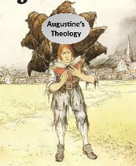
Augustine
Augustine, “Advice to Marcellinus on the Punishment of Donatists,” AD 412; Tr. J. G. Cunningham, Letters of Augustine, II, 169ff. In Stevenson, Creeds, Councils, and Controversies, 213.
In matters of church discipline Calvin imitated Augustine’s totalitarian style of government. Augustine, it will be remembered, advised Marcellinus, an African governor, to punish the Donatists (a Christian sect who objected to certain Church practices), “not by stretching them on the rack, nor by furrowing their flesh with iron claws, nor by scorching them with flames, but by beating them with rods.”

Slide 26
Augustine
Augustine, The Writings Against the Manichaeans and Against the Donatists, Part II—The Donatists (Devoted Publishing edition, 2017), p. 333; also available at Christian Classics Ethereal Library (https:// www.ccel.org/ ccel/ schaff/ npnf104. v.vi.viii.html).
“Why...should not the Church use force in compelling her lost sons to return, if the lost sons compelled others to their destruction?”

Slide 27
Augustine, Calvin, and Luke 14:23
Stewart Sutherland, Leslie Houlden, Peter Clarke, and Friedhelm Hardy, The World’s Religions (England, Routledge Companion Encyclopedias, 1988), p. 162.
“The emperor, he [Augustine] argued, had the duty of suppressing schism and heresy, and indeed of putting pressure on heretics to oblige them to convert. ‘Compel them to come in’ (Luke 14: 23) was given a new and unsuspected meaning. Augustine had become the father of the Inquisition.”

Slide 28
Luke 14:23
“And the master said to the slave, ‘Go out into the highways and along the hedges, and compel them to come in, so that my house may be filled.”

Slide 29
Augustine, Calvin, and Luke 14:23
Paul Penley, “John Calvin Killed Rival Theologians: Bad Bible Interpretation Justified It,” online: http://www.reenactingtheway.com/blog/john-calvin-had-people-killed-and-bad-bible-interpretation-justified-it, 05 March 2015, accessed 13 November 2019.
“John Calvin followed Augustine’s biblical justification for burning heretics. Augustine excused extreme measures through his interpretation of Jesus’ Great Banquet parable in Luke 14:16-24. When the master could not fill up his banquet in the parable, he commanded his servants in Luke 14:23 ‘to compel people to come so that my house will be filled.’ Augustine and Calvin believed burning heretics would ‘compel’ more people to enter their house of God. Interpreting ‘compulsion’ as a license to kill without consideration for Jesus’ other teaching to ‘love your enemies’ is a major hermeneutical error. Any part of Jesus’ teaching should be interpreted in light of the whole.”

Slide 30
Philip Schaff
History of the Christian Church, vol. 8 , p. 700.
“The Reformers inherited the doctrine of persecution from their mother Church, and practiced it as far as they had the power. They fought intolerance with intolerance. They differed favorably from their opponents in the degree and extent, but not in the principle, of intolerance. They broke down the tyranny of popery, and thus opened the way for the development of religious freedom; but they denied to others the liberty which they exercised themselves. The Protestant governments in Germany and Switzerland excluded, within the limits of their jurisdiction, the Roman Catholics from all religious and civil rights, and took exclusive possession of their churches, convents, and other property. They banished, imprisoned, drowned, beheaded, hanged, and burned Anabaptists, Antitrinitarians, Schwenkfeldians, and other dissenters.”

Slide 31
Edward Gibbon
Decline and Fall, ch. LIV.
“The Reformers came out of Roman Catholicism which was known for its intolerance and persecution of anyone who differed from Catholic dogma, as anyone who has studied the Spanish Inquisition fully knows. The tragedy is that John Calvin and some of the other Reformers, became shamefully intolerant of those who differed from their doctrinal position, even to the point of executing the offender!” “The Reformers were ambitious of succeeding the tyrants whom they had dethroned. They imposed with equal rigor their creeds and confessions; they asserted the right of the magistrate to punish heretics with death. The nature of the tiger was the same...”
Initial quote by George Zeller, “Should We Go Back to the Reformation?” online: www.middletownbiblechurch.org/reformed/backto.htm, accessed 22 November 2019

Slide 32
Dave Hunt
“Calvinism Denied,” in Debating Calvinism: Five Points, Two Views, ed. Dave Hunt and James White (Sisters, OR: Multnomah, 2004), pp. 23-24.
“In February of 1555, Calvin’s supporters gained the absolute majority on the council [in Geneva]. On May 16, there was an attempted uprising because Calvin had excluded certain libertarian civic officials from the Lord’s Supper. Leaders of the rebellion who fled to Bern were sentenced to death in abstentia. Four who failed to escape were beheaded, quartered, and their body parts hung in strategic locations as a warning. Evoking the phrase ‘henchmen of Satan,’ which he had used years earlier against the Anabaptists, Calvin justified this barbarity by saying, ‘Those who do not correct evil when they can do so and their office requires it are guilty of it.’ From 1554 until his death in 1564, ‘no one any longer dared oppose the Reformer [Calvin] openly.’”

Slide 33
Who Was Augustine?
A.D. 343‒430
Father of Determinism
Father of Amillennialism
Father of the Inquisition
Limited Facility with Scripture’s Original Languages
Embraced Roman Catholic Doctrines:
Infant Baptism
Mary’s Sinlessness
Purgatory
The Roman Catholic Church as the Only True Church

Slide 34
Who Was Augustine?
A.D. 343‒430
Father of Determinism
Father of Amillennialism
Father of the Inquisition
Limited Facility with Scripture’s Original Languages
Embraced Roman Catholic Doctrines:
Infant Baptism
Mary’s Sinlessness
Purgatory
The Roman Catholic Church as the Only True Church

Slide 35
Who Was Augustine?
A.D. 343‒430
Father of Determinism
Father of Amillennialism
Father of the Inquisition
Limited Facility with Scripture’s Original Languages
Embraced Roman Catholic Doctrines:
Infant Baptism
Mary’s Sinlessness
Purgatory
The Roman Catholic Church as the Only True Church

Slide 36
Augustine
Augustine, Edited by Philip Schaff, A Treatise on the Merits and Forgiveness of Sins, and on the Baptism of Infants (Aeterna Press, 2014 edition), p. 29, 30, 112.
“Let there be then no eternal salvation promised to infants out of our own opinion, without Christ’s baptism…So that infants, unless they pass into the number of believers through the sacrament [baptism] which was divinely instituted for this purpose, will undoubtedly remain in this darkness...unless this benefit [baptism] has been bestowed upon them [infants], they are manifestly in danger of damnation.”

Slide 37
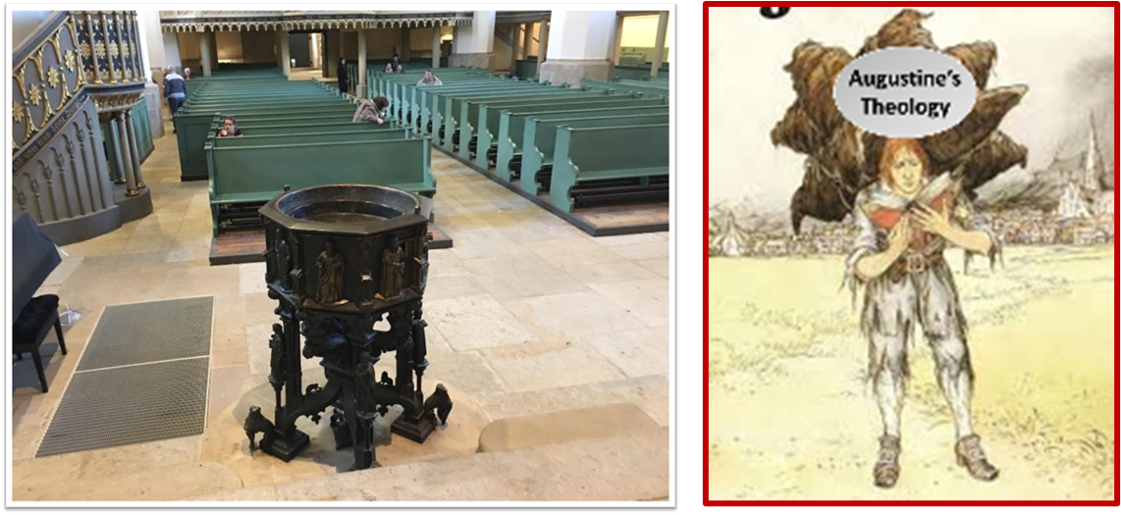
Augustine
Augustine, Edited by Philip Schaff, A Treatise on the Merits and Forgiveness of Sins, and on the Baptism of Infants (Kindle edition, published by Amazon Digital Services), Chapter 8, Kindle location 3350.
“[U]nbaptized infants not only cannot enter into the kingdom of God, but cannot have everlasting life.”

Slide 38
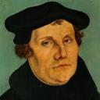
Martin Luther
Alister E. McGrath, Reformation Thought: An Introduction (Grand Rapids: Baker, 1995), 179.
He believed that “such sacraments could generate faith; and hence baptism could generate faith of an infant.”
Notes:
Outline

Slide 39
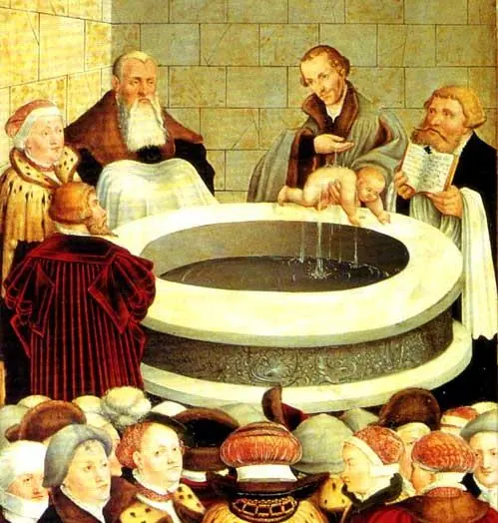

Slide 40
R.C. Sproul
https://www.ligonier.org/learn/devotionals/the-infant-baptism-question/
“The Eastern Orthodox, Roman Catholic, Lutheran, Anglican, and Reformed churches all practice infant baptism. Today we want to look at four lines of evidence that show the validity of this practice. First, just as baptism is the sign of entrance into the community of the new covenant, so circumcision was the sign of entrance into the core community of the old covenant (the people of Israel; God-fearing Gentiles did not have to be circumcised).…The absence of controversy anywhere in the early church indicates that the church was comfortable with infant baptism, and was carrying on the apostolic tradition of the New Testament.”

Slide 41
Who Was Augustine?
A.D. 343‒430
Father of Determinism
Father of Amillennialism
Father of the Inquisition
Limited Facility with Scripture’s Original Languages
Embraced Roman Catholic Doctrines:
Infant Baptism
Mary’s Sinlessness
Purgatory
The Roman Catholic Church as the Only True Church

Slide 42
Augustine
Augustine, On Nature and Grace (Pickerington, OH: Beloved Publishing, 2014), pp. 35-36.
Augustine also said things to suggest he believed Mary was sinless as can be seen in his book On Nature and Grace in chapter 42 titled “The Blessed Virgin Mary May Have Lived Without Sin.”

Slide 43
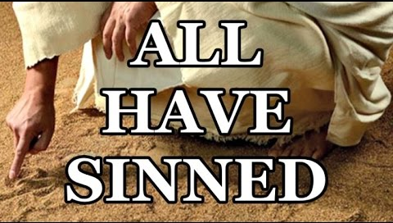
Romans 3:23
“ for all have sinned and fall short of the glory of God.”

Slide 44
Luke 1:46-47
“⁴⁶ And Mary said: “My soul exalts the Lord, ⁴⁷ And my spirit has rejoiced in God my Savior.”

Slide 45
Who Was Augustine?
A.D. 343‒430
Father of Determinism
Father of Amillennialism
Father of the Inquisition
Limited Facility with Scripture’s Original Languages
Embraced Roman Catholic Doctrines:
Infant Baptism
Mary’s Sinlessness
Purgatory
The Roman Catholic Church as the Only True Church

Slide 46
Augustine
The City of God, trans., Marcus Dods (NY: Random House, 1950), Book XX, chap. 25
Augustine wrote, “From these words it more evidently appears that some shall in the last judgment suffer some kind of purgatorial punishments...”

Slide 47
Luke 16:24-26
“²⁴ And he cried out and said, ‘Father Abraham, have mercy on me, and send Lazarus so that he may dip the tip of his finger in water and cool off my tongue, for I am in agony in this flame.’ ²⁵ But Abraham said, ‘Child, remember that during your life you received your good things, and likewise Lazarus bad things; but now he is being comforted here, and you are in agony. ²⁶ And besides all this, between us and you there is a great chasm fixed, so that those who wish to come over from here to you will not be able, and that none may cross over from there to us.’”

Slide 48
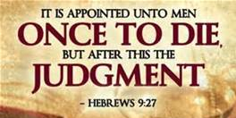
Hebrews 9:27
And inasmuch as it is appointed for men to die once and after this comes judgment.”

Slide 49
Who Was Augustine?
A.D. 343‒430
Father of Determinism
Father of Amillennialism
Father of the Inquisition
Limited Facility with Scripture’s Original Languages
Embraced Roman Catholic Doctrines:
Infant Baptism
Mary’s Sinlessness
Purgatory
The Roman Catholic Church as the Only True Church

Slide 50
Augustine
Aug. Cont. Epist. Fundament c.5. Augustine, Against the Fundamental Epistle of Manichaeus, (JehuBooks. A.D. 397, Kindle edition), Kindle location 89, Chapter 5. Also in the print edition of Against the Epistle of Manichaeus Called Fundamental by CreateSpace Independent Publishing Platform, June 7, 2015, p. 13. Also cited in Calvin, Institutes, I, vii, 3.
Augustine said, “I should not believe the gospel unless I were moved to do so by the authority of the [Catholic ] Church.”

Slide 51
Augustine
Augustine and Chrysostom, Edited by Philip Schaff, Nicene and Post-Nicene Fathers, Volume 1-14 (Ephesians Four Group, 2015 edition, Kindle edition), Kindle location, 106761.
Augustine said, “The Catholic Church alone is the body of Christ. . . . Outside this body, the Holy Spirit giveth life to no one.”

Slide 52
II. The Source of Calvin’s Theology
Augustine (A.D. 343‒430)
Calvin’s literary dependence upon Augustine
Who was Augustine?
The Institutes of the Christian Religion (A.D. 1536)

Slide 53
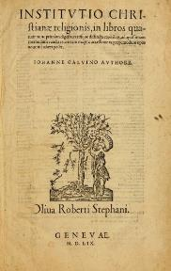
Calvin’s “Institutes of the Christian Religion”
A.D. 1536 (1st edition)
Foundational
Written by Calvin:
at age 25
2 years after declaring himself a Protestant
While still on the Roman Catholic Church payroll
Contain (along with Calvin’s other writings) no clear salvation experience

Slide 54
Calvin’s “Institutes of the Christian Religion”
A.D. 1536 (1st edition)
Foundational
Written by Calvin:
at age 25
2 years after declaring himself a Protestant
While still on the Roman Catholic Church payroll
Contain (along with Calvin’s other writings) no clear salvation experience

Slide 55
Calvin’s “Institutes of the Christian Religion”
A.D. 1536 (1st edition)
Foundational
Written by Calvin:
at age 25
2 years after declaring himself a Protestant
While still on the Roman Catholic Church payroll
Contain (along with Calvin’s other writings) no clear salvation experience

Slide 56
Calvin’s “Institutes of the Christian Religion”
A.D. 1536 (1st edition)
Foundational
Written by Calvin:
at age 25
2 years after declaring himself a Protestant
While still on the Roman Catholic Church payroll
Contain (along with Calvin’s other writings) no clear salvation experience

Slide 57
Calvin’s “Institutes of the Christian Religion”
A.D. 1536 (1st edition)
Foundational
Written by Calvin:
at age 25
2 years after declaring himself a Protestant
While still on the Roman Catholic Church payroll
Contain (along with Calvin’s other writings) no clear salvation experience

Slide 58
Calvin’s “Institutes of the Christian Religion”
A.D. 1536 (1st edition)
Foundational
Written by Calvin:
at age 25
2 years after declaring himself a Protestant
While still on the Roman Catholic Church payroll
Contain (along with Calvin’s other writings) no clear salvation experience

Slide 59
Calvin’s Salvation?
“Within only two years after Calvin declared himself a Protestant, he published his famous Institutes of the Christian Religion. In all of Calvin’s writing, one will not find a clear testimony of his salvation experience. A statement of his ‘conversion’ can only be found in his book Commentary on the Psalms…If we assume his vague intellectual testimony of salvation was a genuine salvation experience, he had been a Christian for just about two years when he wrote his Institutes, which is a foundational resource for today’s Calvinism.”
Bob Kirkland, Calvinism: None Dare Call It Heresy; Spotlight on the Life and Teachings of John Calvin (Eureka, MT: Lighthouse Trails, 2018), 16.

Slide 60
Romans 12:2
“And do not be conformed to this world, but be transformed by the renewing of your mind, so that you may prove what the will of God is, that which is good and acceptable and perfect.”

Slide 61
Calvin’s “Institutes of the Christian Religion”
A.D. 1536 (1st edition)
Foundational
Written by Calvin:
at age 25
2 years after declaring himself a Protestant
While still on the Roman Catholic Church payroll
Contain (along with Calvin’s other writings) no clear salvation experience

Slide 62
Dave Hunt
“Most of those today, including evangelical leaders who hold Calvin in great esteem, are not aware that they have been captivated by the writings of a devout Roman Catholic, newly converted to Luther’s Protestantism, who had broken with Rome only a year before. Oddly, Calvin kept himself on the payroll of the Roman Catholic Church for nearly a year after he claimed to have been miraculously delivered from the ‘deep slough’ of ‘obstinate addiction to the superstitions of the papacy.’”
Dave Hunt, What Love Is This? Calvinism's Misrepresentation of God, 4th ed. (Bend, OR: Berean Call, 2013), 42.

Slide 63
Calvin’s “Institutes of the Christian Religion”
A.D. 1536 (1st edition)
Foundational
Written by Calvin:
at age 25
2 years after declaring himself a Protestant
While still on the Roman Catholic Church payroll
Contain (along with Calvin’s other writings) no clear salvation experience

Slide 64
Calvin’s Salvation?
“Within only two years after Calvin declared himself a Protestant, he published his famous Institutes of the Christian Religion. In all of Calvin’s writing, one will not find a clear testimony of his salvation experience. A statement of his ‘conversion’ can only be found in his book Commentary on the Psalms…If we assume his vague intellectual testimony of salvation was a genuine salvation experience, he had been a Christian for just about two years when he wrote his Institutes, which is a foundational resource for today’s Calvinism.”
Bob Kirkland, Calvinism: None Dare Call It Heresy; Spotlight on the Life and Teachings of John Calvin (Eureka, MT: Lighthouse Trails, 2018), 16.

Slide 65
Calvin’s Salvation?
“God by a sudden conversion [referring to his sudden move away from the Catholic Church at the age of 23] subdued and brought my mind to a teachable frame, which was more hardened in such matters than might have been expected from one at my early period of life. Having thus received some taste and knowledge of true godliness I was immediately inflamed with so intense a desire to make progress therein, that although I did not altogether leave off other studies, I yet pursued them with less ardor.”
John Calvin, Commentary on the Book of Psalms, vol. I, p. xl (Amazon Digital Services LLC, 2011 edition, Kindle Edition), Kindle locations 939-943.

Slide 66
Conclusion

Slide 67
Neo-Calvinism vs. The Bible
Calvinism’s Mixed Blessing
Why Critique Calvinism?
The Source of Calvin’s Theology
Calvin’s Manner of Life
TULIP Through the Grid of Scripture
Conclusion

Slide 68
II. The Source of Calvin’s Theology
Augustine (A.D. 343‒430)
Calvin’s literary dependence upon Augustine
Who was Augustine?
The Institutes of the Christian Religion (A.D. 1536)

Slide 69
Neo-Calvinism vs. The Bible
Calvinism’s Mixed Blessing
Why Critique Calvinism?
The Source of Calvin’s Theology
Calvin’s Manner of Life
TULIP Through the Grid of Scripture
Conclusion

